Slide 1
Compiler Design

Slide 2
Course Outline
Introduction to Compiling
Lexical Analysis
Syntax Analysis
Context Free Grammars
Top-Down Parsing, LL Parsing
Bottom-Up Parsing, LR Parsing
Syntax-Directed Translation
Attribute Definitions
Evaluation of Attribute Definitions
Semantic Analysis, Type Checking
Run-Time Organization
Intermediate Code Generation
Code Optimization
Code Generation

Slide 3
Preliminaries Required
Basic knowledge of programming languages.
Basic knowledge of FSA and CFG.
Knowledge of a high programming language for the programming assignments.
Textbook:
Alfred V. Aho, Ravi Sethi, and Jeffrey D. Ullman,
“Compilers: Principles, Techniques, and Tools”
Addison-Wesley, 1986.

Slide 4
Compiler - Introduction
A compiler is a program that can read a program in one language - the source language - and translate it into an equivalent program in another language - the target language.
A compiler acts as a translator, transforming human-oriented programming languages into computer-oriented machine languages.
Ignore machine-dependent details for programmer

Slide 5
COMPILERS
A compiler is a program takes a program written in a source language and translates it into an equivalent program in a target language.
source program COMPILER target program
error messages
( Normally a program written in
a high-level programming language)
( Normally the equivalent program in
machine code – relocatable object file)

Slide 6

Compiler vs Interpreter
An interpreter is another common kind of language processor. Instead of producing a target program as a translation, an interpreter appears to directly execute the operations specified in the source program on inputs supplied by the user
The machine-language target program produced by a compiler is usually much faster than an interpreter at mapping inputs to outputs .
An interpreter, however, can usually give better error diagnostics than a compiler, because it executes the source program statement by statement

Slide 7
Compiler Applications
• Machine Code Generation
– Convert source language program to machine understandable one
– Takes care of semantics of varied constructs of source language
– Considers limitations and specific features of target machine
– Automata theory helps in syntactic checks
– valid and invalid programs
– Compilation also generate code for syntactically correct programs

Slide 8
Other Applications
In addition to the development of a compiler, the techniques used in compiler design can be applicable to many problems in computer science.
Techniques used in a lexical analyzer can be used in text editors, information retrieval system, and pattern recognition programs.
Techniques used in a parser can be used in a query processing system such as SQL.
Many software having a complex front-end may need techniques used in compiler design.
A symbolic equation solver which takes an equation as input. That program should parse the given input equation.
Most of the techniques used in compiler design can be used in Natural Language Processing (NLP) systems.

Slide 9
Major Parts of Compilers
There are two major parts of a compiler: Analysis and Synthesis
In analysis phase, an intermediate representation is created from the given source program.
Lexical Analyzer, Syntax Analyzer and Semantic Analyzer are the parts of this phase.
In synthesis phase, the equivalent target program is created from this intermediate representation.
Intermediate Code Generator, Code Generator, and Code Optimizer are the parts of this phase.

Slide 10
Structure of a Compiler
Breaks the source program into pieces and fit into a
grammatical structure
If this part detect any syntactically ill formed or semantically unsound error it is report to the user
It collect the information about the source program and stored in a data structure – Symbol Table
Analysis
Synthesis
Construct the target program from the available symbol table and intermediate representation

Slide 11
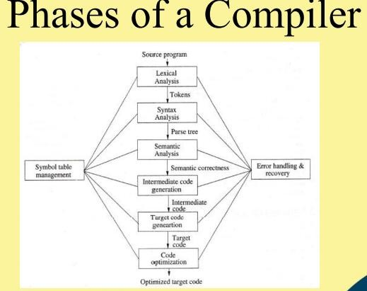

Slide 12
Phases of A Compiler
Source
Program
Lexical
Analyzer
Syntax
Analyzer
Semantic
Analyzer
Intermediate
Code Generator
Code
Optimizer
Code
Generator
Target
Program
Each phase transforms the source program from one representation
into another representation.
They communicate with error handlers.
They communicate with the symbol table.b

Slide 13
Lexical Analyzer
Lexical Analyzer reads the source program character by character and returns the tokens of the source program.
A token describes a pattern of characters having same meaning in the source program. (such as identifiers, operators, keywords, numbers, delimeters and so on)
Ex: newval := oldval + 12 => tokens: newval identifier
:= assignment operator
oldval identifier
+ add operator
12 a number
Puts information about identifiers into the symbol table.
Regular expressions are used to describe tokens (lexical constructs).
A (Deterministic) Finite State Automaton can be used in the implementation of a lexical analyzer.

Slide 14
Phases of Compiler-Lexical Analysis
It is also called as scanning
This phase scans the source code as a stream of characters and converts it into meaningful lexemes.
For each lexeme, the lexical analyzer produces as output a token of the form
It passes on to the subsequent phase, syntax analysis.
This points to an entry in the symbol table for this token.
Information from the symbol-table
entry 'is needed for semantic analysis and code generation
It is an abstract
symbol that is used during syntax analysis
<token-name, attribute-value>

Slide 15
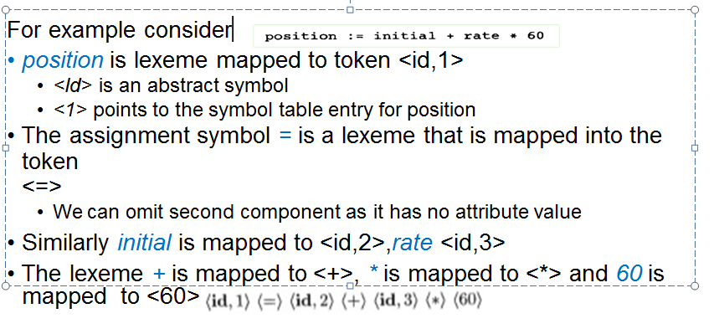
Lexical Analysis

Slide 16
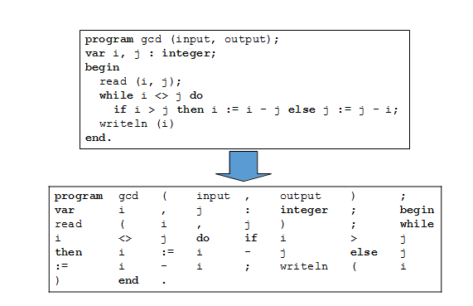
Lexical Analysis
Lexical analysis breaks up a program into tokens
Grouping characters into non-separatable units (tokens)
Changing a stream to characters to a stream of tokens

Slide 17
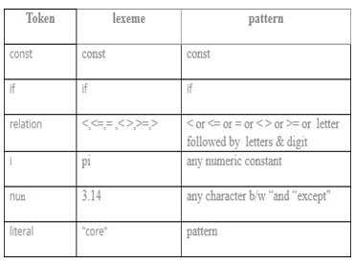
Token , Pattern and Lexeme
Token: Token is a sequence of characters that can be treated as a single logical entity. Typical tokens are, 1) Identifiers 2) keywords 3) operators 4) special symbols 5)constants
Pattern: A set of strings in the input for which the same token is produced as output. This set of strings is described by a rule called a pattern associated with the token.
Lexeme: A lexeme is a sequence of characters in the source program that is matched by the pattern for a token.

Slide 18
Token , Pattern and Lexeme
Example 1
int a = 10; //Input Source code
Tokens int (keyword), a(identifier), =(operator), 10(constant) and ;(punctuation-semicolon)
Total number of tokens: ??

Slide 19
Token , Pattern and Lexeme
Example 2
int main() {
// printf() sends the string inside quotation to // the standard output (the display)
printf("Welcome to Compiler Design!");
return 0;
}
Tokens 'int', 'main', '(', ')', '{', 'printf', '(', ' "Welcome to Compiler Design!" ', ')', ';', 'return', '0', ';', '}'
Total number of tokens: ??

Slide 20
Phases of Compiler-Symbol Table Management
Symbol table is a data structure holding information about all symbols defined in the source program
Not part of the final code, however used as reference by all phases of a compiler
Typical information stored there include name, type, size, relative offset of variables
Generally created by lexical analyzer and syntax analyzer
Good data structures needed to minimize searching time
The data structure may be flat or hierarchical

Slide 21
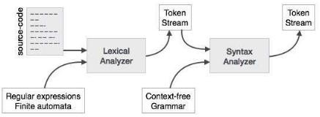
A Syntax Analyzer creates the syntactic structure (generally a parse tree) of the given program.
A syntax analyzer is also called as a parser.
A parse tree describes a syntactic structure
In a parse tree, all terminals are at leaves.
All inner nodes are non-terminals in
a context free grammar
Syntax Analysis

Slide 22

Phases of Compiler-Syntax Analysis
This is the second phase, it is also called as parsing
It takes the token produced by lexical analysis as input and generates a parse tree (or syntax tree).
In this phase, token arrangements are checked against the source code grammar, i.e. the parser checks if the expression made by the tokens is syntactically correct.

Slide 23
Syntax Analyzer (CFG)
The syntax of a language is specified by a context free grammar (CFG).
The rules in a CFG are mostly recursive.
A syntax analyzer checks whether a given program satisfies the rules implied by a CFG or not.
If it satisfies, the syntax analyzer creates a parse tree for the given program.
Ex: We use BNF (Backus Naur Form) to specify a CFG
assgstmt -> identifier := expression
expression -> identifier
expression -> number
expression -> expression + expression

Slide 24
Parsing Techniques
Depending on how the parse tree is created, there are different parsing techniques.
These parsing techniques are categorized into two groups:
Top-Down Parsing,
Bottom-Up Parsing
Top-Down Parsing:
Construction of the parse tree starts at the root, and proceeds towards the leaves.
Efficient top-down parsers can be easily constructed by hand.
Recursive Predictive Parsing, Non-Recursive Predictive Parsing (LL Parsing).
Bottom-Up Parsing:
Construction of the parse tree starts at the leaves, and proceeds towards the root.
Normally efficient bottom-up parsers are created with the help of some software tools.
Bottom-up parsing is also known as shift-reduce parsing.
Operator-Precedence Parsing – simple, restrictive, easy to implement
LR Parsing – much general form of shift-reduce parsing, LR, SLR, LALR

Slide 25
Syntax Analyzer versus Lexical Analyzer
Which constructs of a program should be recognized by the lexical analyzer, and which ones by the syntax analyzer?
Both of them do similar things; But the lexical analyzer deals with simple non-recursive constructs of the language.
The syntax analyzer deals with recursive constructs of the language.
The lexical analyzer simplifies the job of the syntax analyzer.
The lexical analyzer recognizes the smallest meaningful units (tokens) in a source program.
The syntax analyzer works on the smallest meaningful units (tokens) in a source program to recognize meaningful structures in our programming language.

Slide 26
Semantic Analysis

Slide 27
Phases of Compiler-Semantic Analysis
Semantic analysis checks whether the parse tree constructed follows the rules of language.
The semantic analyzer uses the syntax tree and the information in the symbol table to check the source program for semantic consistency with the language definition.
It also gathers type information and saves it in either the syntax tree or the symbol table, for subsequent use during intermediate-code generation.
An important part of semantic analysis is type checking

Slide 28

Phases of Compiler-Semantic Analysis
Suppose that position, initial, and rate have been declared to be floating-point numbers and that the lexeme 60 by itself forms an integer.
The type checker in the semantic analyzer discovers that the operator
* is applied to a floating-point number rate and an integer 60.
In this case, the integer may be converted into a floating-point number.

Slide 29
Intermediate Code Generation

Slide 30
Phases of Compiler-Intermediate Code Generation
After semantic analysis the compiler generates an intermediate code of the source code for the target machine.
It represents a program for some abstract machine.
It is in between the high-level language and the machine language.
This intermediate code should be generated in such a way that it makes it easier to be translated into the target machine code.
A compiler may produce an explicit intermediate codes representing the source program.
These intermediate codes are generally machine (architecture independent). But the level of intermediate codes is close to the level of machine codes

Slide 31

Phases of Compiler-Intermediate Code Generation
An intermediate form called three-address code were used
It consists of a sequence of assembly-like instructions with three operands per instruction. Each operand can act like a register.

Slide 32
Code Optimization

Slide 33
Phases of Compiler-Code Optimization
The next phase does code optimization of the intermediate code.
Optimization can be assumed as something that removes unnecessary code lines, and arranges the sequence of statements in order to speed up the program execution without wasting resources (CPU, memory).

Slide 34
Code Generation

Slide 35
Phases of Compiler-Code Generation
In this phase, the code generator takes the optimized representation of the intermediate code and maps it to the target machine language.
If the target language is machine code, registers or memory locations are selected for each of the variables used by the program.
Then, the intermediate instructions are translated into sequences of machine instructions that perform the same task.
Produces the target language in a specific architecture.
The target program is normally is a relocatable object file containing the machine codes

Slide 36

Phases of Compiler-Code Generation
For example, using registers R1 and R2, the intermediate code might get translated into the machine code
The first operand of each instruction specifies a destination. The F in each instruction tells us that it deals with floating-point numbers.

Slide 37
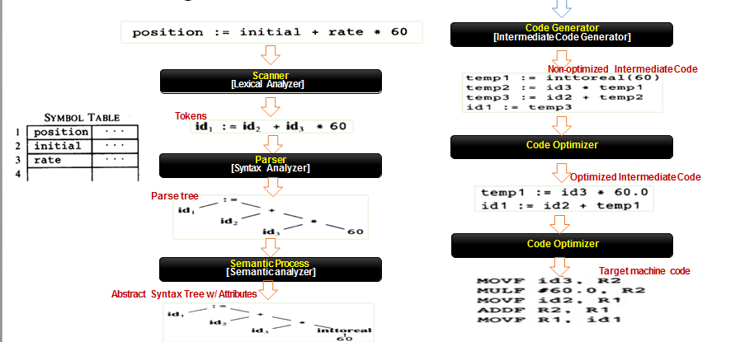
Phases of Compiler-Translation of assignment statement

Slide 38
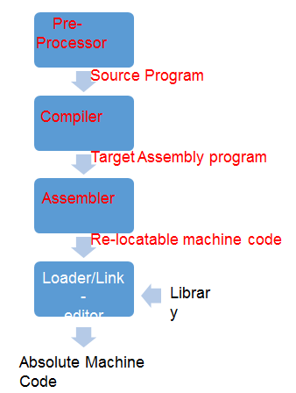
Cousins of Compiler- Language Processing System

Slide 39
Preprocessor
Pre-processors produce input to compilers
The functions performed are:
Macro processing - allows user to define macros
File inclusion - include header files into the program
Rational pre-processors - It augment older languages with more modern flow-of-control and data structuring facilities
Language extension - It attempt to add capabilities to the language by what
amounts to built-in macros. (embed query in C)

Slide 40
Assembler
Assembly code is a mnemonic version of machine code, in which names are used instead of binary codes for operation
MOV a,R1
ADD #2,R1 MOV R1,b
Some compiler produce assembly code , which will be passed to an assembler for further processing
Some other compiler perform the job of assembler, producing relocatable machine code which will be passed directly to the loader/link editor

Slide 41
Two-Pass Assembler
This is the simplest form of assembler
In First pass, all the identifiers that denote storage location are found and stored in a symbol table.
Let consider b=a+2
Identifier | Address
a | 0
b | 4

Slide 42
Loader/Link editor
Loading – It Loads the relocatable machine code to the proper location
Link editor allows us to make a single program from several files of relocatable machine code

Slide 43
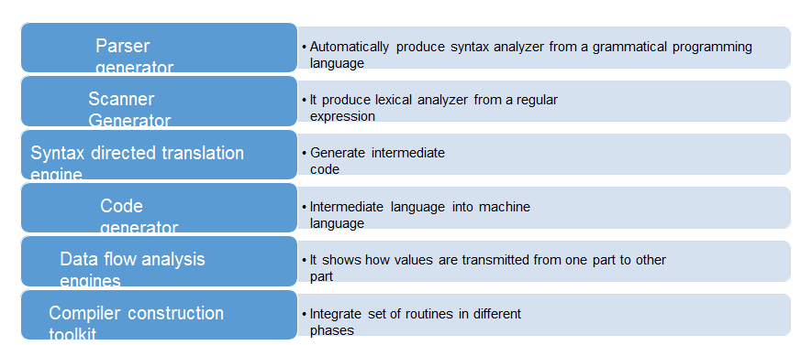
Compiler Construction Tool

Slide 44
Role of a Lexical Analyzer
Role of lexical analyzer
Specification of tokens
Recognition of tokens
Lexical analyzer generator
Finite automata
Design of lexical analyzer generator

Slide 45
Why to separate Lexical analysis and parsing
Simplicity of design
Improving compiler efficiency
Enhancing compiler portability

Slide 46
The role of lexical analyzer
token
Source
program
Lexical Analyzer
Parser
To semantic
analysis
getNextToken
Symbol
table

Slide 47
Lexical Analyzer
Lexical Analyzer reads the source program character by character to produce tokens.
Normally a lexical analyzer doesn’t return a list of tokens at one shot, it returns a token when the parser asks a token from it.
source
program
Lexical Analyzer
token
Parser
get next token

Slide 48
Lexical errors
Some errors are out of power of lexical analyzer to recognize:
fi (a == f(x)) …
However it may be able to recognize errors like:
d = 2r
Such errors are recognized when no pattern for tokens matches a character sequence

Slide 49
Error recovery
Panic mode: successive characters are ignored until we reach to a well formed token
Delete one character from the remaining input
Insert a missing character into the remaining input
Replace a character by another character
Transpose two adjacent characters

Slide 50
Token
Token represents a set of strings described by a pattern.
Identifier represents a set of strings which start with a letter continues with letters and digits
The actual string (newval) is called as lexeme.
Tokens: identifier, number, addop, delimeter, …
Since a token can represent more than one lexeme, additional information should be held for that specific lexeme. This additional information is called as the attribute of the token.
For simplicity, a token may have a single attribute which holds the required information for that token.
For identifiers, this attribute a pointer to the symbol table, and the symbol table holds the actual attributes for that token.

Slide 51
Token
Some attributes:
<id,attr> where attr is pointer to the symbol table
<assgop,_> no attribute is needed (if there is only one assignment operator)
<num,val> where val is the actual value of the number.
Token type and its attribute uniquely identifies a lexeme.
Regular expressions are widely used to specify patterns.

Slide 52
Tokens, Patterns and Lexemes
A token is a pair a token name and an optional token value
A pattern is a description of the form that the lexemes of a token may take
A lexeme is a sequence of characters in the source program that matches the pattern for a token

Slide 53
Example
Token
Informal description
Sample lexemes
if
Characters i, f
if
else
Characters e, l, s, e
else
comparison
< or > or <= or >= or == or !=
<=, !=
id
Letter followed by letter and digits
pi, score, D2
number
Any numeric constant
3.14159, 0, 6.02e23
literal
Anything but “ sorrounded by “
“core dumped”
printf(“total = %d\n”, score);

Slide 54
Terminology of Languages
Alphabet : a finite set of symbols (ASCII characters)
String :
Finite sequence of symbols on an alphabet
Sentence and word are also used in terms of string
ε is the empty string
|s| is the length of string s.
Language: sets of strings over some fixed alphabet
∅ the empty set is a language.
{ε} the set containing empty string is a language
The set of well-formed C programs is a language
The set of all possible identifiers is a language.

Slide 55
Terminology of Languages
Operators on Strings:
Concatenation: xy represents the concatenation of strings x and y. s ε = s ε s = s
s^{n} ₌ s s s .. s ( n times) s⁰ ₌ ε

Slide 56

Input buffering
Sometimes lexical analyzer needs to look ahead some symbols to decide about the token to return
In C language: we need to look after -, = or < to decide what token to return
In Fortran: DO 5 I = 1.25
We need to introduce a two buffer scheme to handle large look-aheads safely
E = M * C * * 2 eof

Slide 57
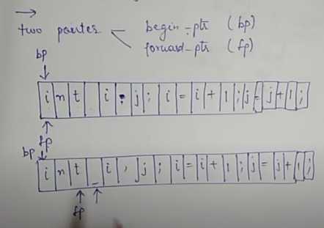
Cont..,

Slide 58
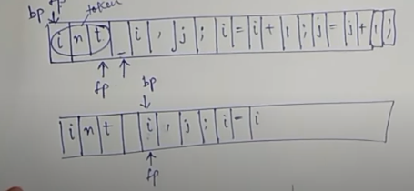
Cont..,

Slide 59
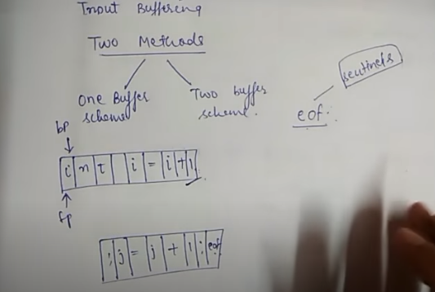
Cont..,

Slide 60
Sentinels
E = M eof * C * * 2 eof
eof
Switch (*forward++) {
case eof:
if (forward is at end of first buffer) {
reload second buffer;
forward = beginning of second buffer;
}
else if {forward is at end of second buffer) {
reload first buffer;\
forward = beginning of first buffer;
}
else /* eof within a buffer marks the end of input */
terminate lexical analysis;
break;
cases for the other characters;
}

Slide 61
Specification of tokens
In theory of compilation regular expressions are used to formalize the specification of tokens
Regular expressions are means for specifying regular languages
Example:
Letter_(letter_ | digit)*
Each regular expression is a pattern specifying the form of strings

Slide 62
Regular expressions
Ɛ is a regular expression, L(Ɛ) = {Ɛ}
If a is a symbol in ∑then a is a regular expression, L(a) = {a}
(r) | (s) is a regular expression denoting the language L(r) ∪ L(s)
(r)(s) is a regular expression denoting the language L(r)L(s)
(r)* is a regular expression denoting (L(r))*
(r) is a regular expression denting L(r)

Slide 63
Regular definitions
d1 -> r1
d2 -> r2
…
dn -> rn
Example:
letter_ -> A | B | … | Z | a | b | … | Z | _
digit -> 0 | 1 | … | 9
id -> letter_ (letter_ | digit)*

Slide 64
Extensions
One or more instances: (r)+
Zero or one instances: r?
Character classes: [abc]
Example:
letter_ -> [A-Za-z_]
digit -> [0-9]
id -> letter_(letter|digit)*

Slide 65
Recognition of tokens
Starting point is the language grammar to understand the tokens:
stmt -> if expr then stmt
| if expr then stmt else stmt
| Ɛ
expr -> term relop term
| term
term -> id
| number

Slide 66
Recognition of tokens (cont.)
The next step is to formalize the patterns:
digit -> [0-9]
Digits -> digit+
number -> digit(.digits)? (E[+-]? Digit)?
letter -> [A-Za-z_]
id -> letter (letter|digit)*
If -> if
Then -> then
Else -> else
Relop -> < | > | <= | >= | = | <>
We also need to handle whitespaces:
ws -> (blank | tab | newline)+

Slide 67
Operations on Languages
Concatenation:
L₁L₂ = { s₁s₂ | s₁ ∈ L₁ and s₂ ∈ L₂ }
Union
L₁ ∪ L₂ = { s | s ∈ L₁ or s ∈ L₂ }
Exponentiation:
L⁰ = {ε} L¹ = L L² = LL
Kleene Closure
L* =
Positive Closure
L⁺ =

Slide 68
Example
L₁ = {a,b,c,d} L₂ = {1,2}
L₁L₂ = {a1,a2,b1,b2,c1,c2,d1,d2}
L₁ ∪ L₂ = {a,b,c,d,1,2}
L₁³ = all strings with length three (using a,b,c,d}
L₁* = all strings using letters a,b,c,d and empty string
L₁⁺ = doesn’t include the empty string

Slide 69
Regular Expressions
We use regular expressions to describe tokens of a programming language.
A regular expression is built up of simpler regular expressions (using defining rules)
Each regular expression denotes a language.
A language denoted by a regular expression is called as a regular set.

Slide 70
Regular Expressions (Rules)
Regular expressions over alphabet Σ
Reg. Expr Language it denotes
ε {ε}
a∈ Σ {a}
(r₁) | (r₂) L(r₁) ∪ L(r₂)
(r₁) (r₂) L(r₁) L(r₂)
(r)* (L(r))*
(r) L(r)
(r)⁺ = (r)(r)*
(r)? = (r) | ε

Slide 71
Regular Expressions (cont.)
We may remove parentheses by using precedence rules.
* highest
concatenation next
| lowest
ab*|c means (a(b)*)|(c)
Ex:
Σ = {0,1}
0|1 => {0,1}
(0|1)(0|1) => {00,01,10,11}
0* => {ε ,0,00,000,0000,....}
(0|1)* => all strings with 0 and 1, including the empty string

Slide 72
Regular Definitions
To write regular expression for some languages can be difficult, because their regular expressions can be quite complex. In those cases, we may use regular definitions.
We can give names to regular expressions, and we can use these names as symbols to define other regular expressions.
A regular definition is a sequence of the definitions of the form:
d₁ → r₁ where d_{i} is a distinct name and
d₂ → r₂ r_{i} is a regular expression over symbols in
. Σ∪{d₁,d₂,...,d_{i-1}}
d_{n} → r_{n}
basic symbols previously defined names

Slide 73
Regular Definitions (cont.)
Ex: Identifiers in Pascal
letter → A | B | ... | Z | a | b | ... | z
digit → 0 | 1 | ... | 9
id → letter (letter | digit ) *
If we try to write the regular expression representing identifiers without using regular definitions, that regular expression will be complex.
(A|...|Z|a|...|z) ( (A|...|Z|a|...|z) | (0|...|9) ) *
Ex: Unsigned numbers in Pascal
digit → 0 | 1 | ... | 9
digits → digit ⁺
opt-fraction → ( . digits ) ?
opt-exponent → ( E (+|-)? digits ) ?
unsigned-num → digits opt-fraction opt-exponent

Slide 74
Regular expressions
Ɛ is a regular expression, L(Ɛ) = {Ɛ}
If a is a symbol in ∑then a is a regular expression, L(a) = {a}
(r) | (s) is a regular expression denoting the language L(r) ∪ L(s)
(r)(s) is a regular expression denoting the language L(r)L(s)
(r)* is a regular expression denoting (L(r))*
(r) is a regular expression denting L(r)

Slide 75
Regular definitions
d1 -> r1
d2 -> r2
…
dn -> rn
Example:
letter_ -> A | B | … | Z | a | b | … | Z | _
digit -> 0 | 1 | … | 9
id -> letter_ (letter_ | digit)*

Slide 76
Extensions
One or more instances: (r)+
Zero or one instances: r?
Character classes: [abc]
Example:
letter_ -> [A-Za-z_]
digit -> [0-9]
id -> letter_(letter|digit)*

Slide 77
Recognition of tokens
Starting point is the language grammar to understand the tokens:
stmt -> if expr then stmt
| if expr then stmt else stmt
| Ɛ
expr -> term relop term
| term
term -> id
| number

Slide 78
Recognition of tokens (cont.)
The next step is to formalize the patterns:
digit -> [0-9]
Digits -> digit+
number -> digit(.digits)? (E[+-]? Digit)?
letter -> [A-Za-z_]
id -> letter (letter|digit)*
If -> if
Then -> then
Else -> else
Relop -> < | > | <= | >= | = | <>
We also need to handle whitespaces:
ws -> (blank | tab | newline)+

Slide 79
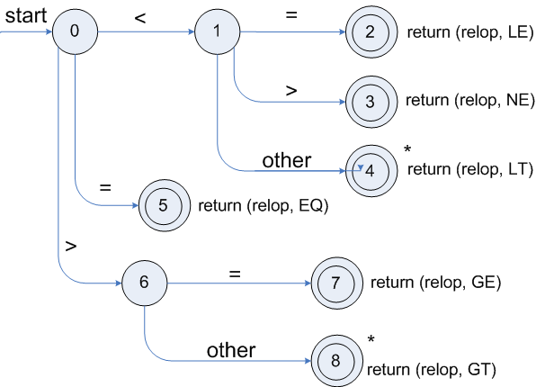
Transition diagrams
Transition diagram for relop

Slide 80
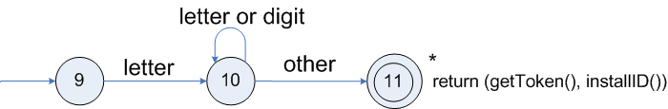
Transition diagrams (cont.)
Transition diagram for reserved words and identifiers

Slide 81
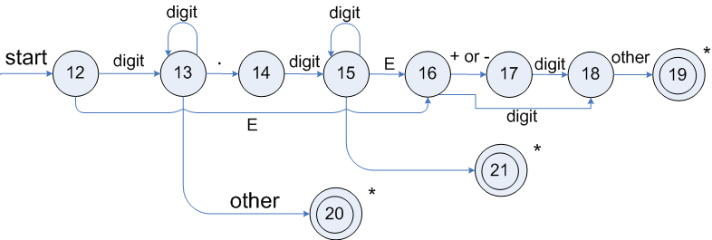
Transition diagrams (cont.)
Transition diagram for unsigned numbers

Slide 82
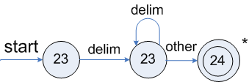
Transition diagrams (cont.)
Transition diagram for whitespace

Slide 83
Design of a Lexical Analyzer (LEX)

Slide 84
Design of a Lexical Analyzer
LEX is a software tool that automatically construct a lexical analyzer from a program
The Lexical analyzer will be of the form
P1 {action 1}
P2 {action 2}
--
--
Each pattern pi is a regular expression and action i is a program fragment that is to be executed whenever a lexeme matched by pi is found in the input
If two or more patterns that match the longest lexeme, the first listed matching pattern is chosen

Slide 85
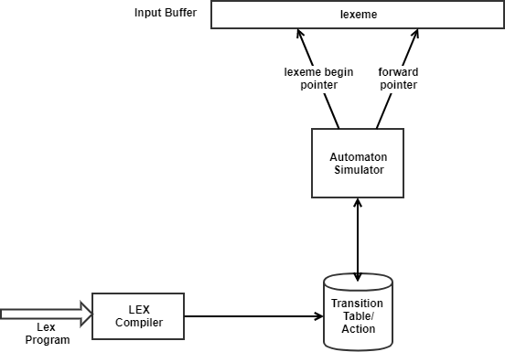
Design of a Lexical Analyzer
Here the Lex compiler constructs a transition table for a finite automaton from the regular expression pattern in the Lex specification
The lexical analyzer itself consists of a finite automaton simulator that uses this transition table to look for the regular expression patterns in the input buffer

Slide 86
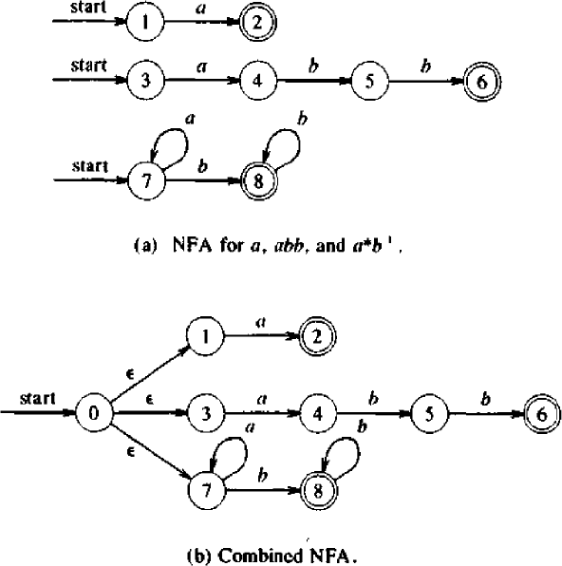
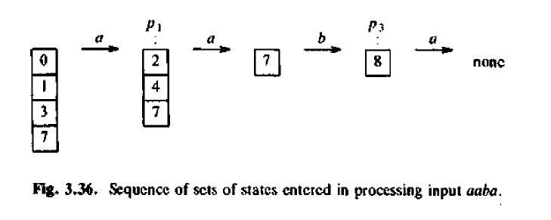
Example
Consider Lexeme
a {action A1 for pattern p1}
abb{action A2 for pattern p2}
a*b* {action A3 for pattern p3}

Slide 87
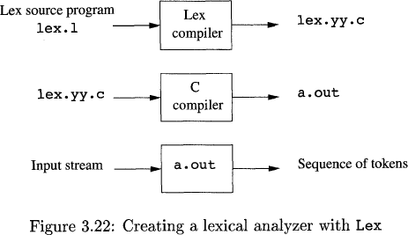
LEX in use
An input file, which we call lex.1, is
written in the Lex language and
describes the lexical analyzer to be generated.
The Lex compiler transforms lex. 1
to a C program, in a file that is always named lex. yy . c.
The latter file is compiled by the C compiler into a file called a. out.
The C-compiler output is a working
lexical analyzer that can take a
stream of input characters and produce a stream of tokens.

Slide 88
Structure of LEX Program
%{ Definition section %} %% Rules section %% User Subroutine section

Slide 89
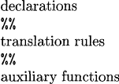
General format
The declarations section includes declarations of variables, manifest constants (identifiers declared to stand for a constant, e.g., the name of a token)
The translation rules each have the form
Pattern { Action )
Each pattern is a regular expression, which may use the regular definitions of the declaration section.
The actions are fragments of code, typically written in C, although many variants of Lex using other languages have been created.
The third section holds whatever additional functions are used in the actions.

Slide 90
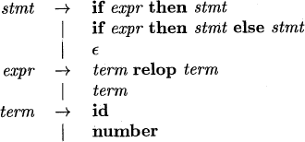
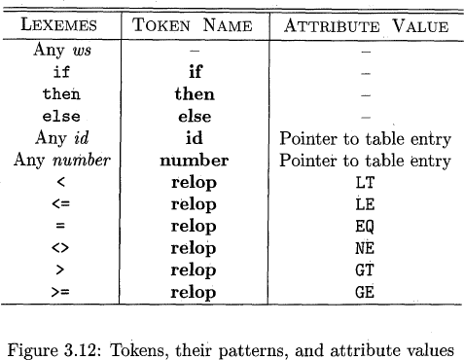
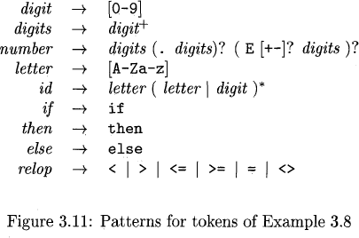
Consider the following statement

Slide 91
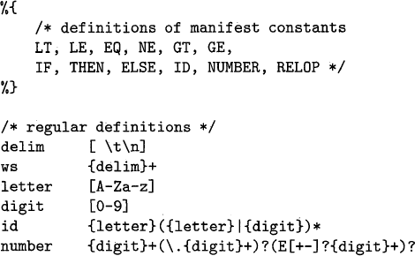
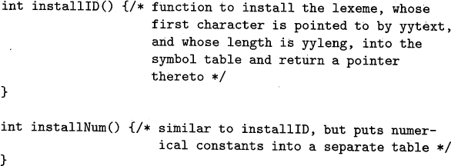
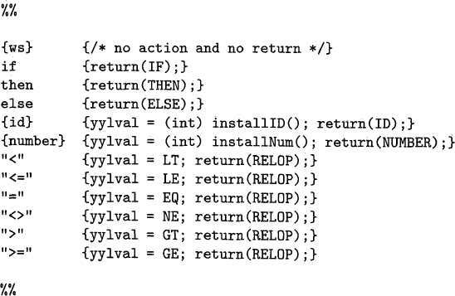

Slide 92
/*
Lex program to count the number of vowels & consonants from the given input string.*/
%{
#include<stdio.h> int vow=0, con=0;
%}
%%
[ \t\n]+ ;
[aeiouAEIOU]+ {vow++;}
[^aeiouAEIOU] {con++;}
%%
int main( )
{
printf("Enter some input string:\n");
yylex();
printf("Number of vowels=%d\n",vow);
printf("Number of consonants=%d\n",con);
}

Slide 93
Lexical Analyzer Generator - Lex
Lex Source program
lex.l
Lexical Compiler
lex.yy.c
C
compiler
lex.yy.c
a.out
a.out
Sequence of tokens
Input stream

Slide 94
Finite Automata
Regular expressions = specification
Finite automata = implementation
Recognizer ---A recognizer for a language is a program that takes as input a string x answers ‘yes’ if x is a sentence of the language and ‘no’ otherwise.
A better way to convert a regular expression to a recognizer is to construct a generalized transition diagram from the expression. This diagram is called a finite automaton.
Finite Automaton can be
Deterministic
Non-deterministic

Slide 95
Finite Automata
A finite automaton consists of
An input alphabet Σ
A set of states S
A start state n
A set of accepting states F ⊆ S
A set of transitions state →^{input} state

Slide 96
Finite Automata
Transition
s₁ →ª s₂
Is read
In state s₁ on input “a” go to state s₂
If end of input
If in accepting state => accept, otherwise => reject
If no transition possible => reject

Slide 97
Finite Automata State Graphs
A state
The start state
An accepting state
a
A transition

Slide 98
Finite Automata
A recognizer for a language is a program that takes a string x, and answers “yes” if x is a sentence of that language, and “no” otherwise.
We call the recognizer of the tokens as a finite automaton.
A finite automaton can be: deterministic(DFA) or non-deterministic (NFA)
This means that we may use a deterministic or non-deterministic automaton as a lexical analyzer.
Both deterministic and non-deterministic finite automaton recognize regular sets.
Which one?
deterministic – faster recognizer, but it may take more space
non-deterministic – slower, but it may take less space
Deterministic automatons are widely used lexical analyzers.
First, we define regular expressions for tokens; Then we convert them into a DFA to get a lexical analyzer for our tokens.
Algorithm1: Regular Expression ➔ NFA ➔ DFA (two steps: first to NFA, then to DFA)
Algorithm2: Regular Expression ➔ DFA (directly convert a regular expression into a DFA)

Slide 99
Non-Deterministic Finite Automaton (NFA)
A non-deterministic finite automaton (NFA) is a mathematical model that consists of:
S - a set of states
Σ - a set of input symbols (alphabet)
move – a transition function move to map state-symbol pairs to sets of states.
s₀ - a start (initial) state
F – a set of accepting states (final states)
ε- transitions are allowed in NFAs. In other words, we can move from one state to another one without consuming any symbol.
A NFA accepts a string x, if and only if there is a path from the starting state to one of accepting states such that edge labels along this path spell out x.

Slide 100
Deterministic and Nondeterministic Automata
Deterministic Finite Automata (DFA)
One transition per input per state
No ε-moves
Nondeterministic Finite Automata (NFA)
Can have multiple transitions for one input in a given state
Can have ε-moves
Finite automata have finite memory
Need only to encode the current state

Slide 101
A Simple Example
A finite automaton that accepts only “1”
A finite automaton accepts a string if we can follow transitions labeled with the characters in the string from the start to some accepting state
1

Slide 102
Another Simple Example
A finite automaton accepting any number of 1’s followed by a single 0
Alphabet: {0,1}
Check that “1110” is accepted.
1
0

Slide 103

NFA

Slide 104
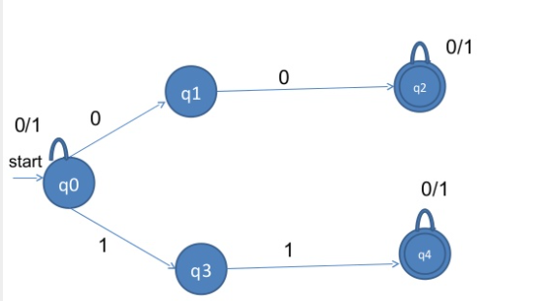
NFA

Slide 105
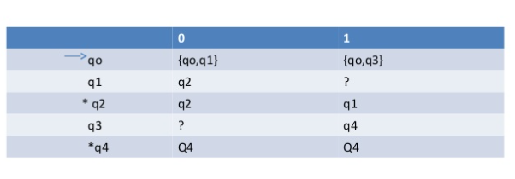
Transition Table

Slide 106
Converting A Regular Expression into A NFA (Thomson’s Construction)
This is one way to convert a regular expression into a NFA.
There can be other ways (much efficient) for the conversion.
Thomson’s Construction is simple and systematic method. It guarantees that the resulting NFA will have exactly one final state, and one start state.
Construction starts from simplest parts (alphabet symbols).
To create a NFA for a complex regular expression, NFAs of its sub-expressions are combined to create its NFA,

Slide 107
Thomson’s Construction (cont.)
ε
To recognize an empty string ε
To recognize a symbol a in the alphabet Σ
i
f
a
i
f
If N(r₁) and N(r₂) are NFAs for regular expressions r₁ and r₂
For regular expression r₁ | r₂
ε
N(r₁)
ε
NFA for r₁ | r₂
i
ε
f
ε
N(r₂)

Slide 108
Thomson’s Construction (cont.)
For regular expression r₁ r₂
Final state of N(r₂) become final state of N(r₁r₂)
i
N(r₁)
N(r₂)
f
NFA for r₁ r₂
For regular expression r*
ε
ε
ε
i
N(r)
f
ε
NFA for r*

Slide 109
Thomson’s Construction (Example - (a|b) * a )
a:
a
a
ε
ε
(a | b)
ε
ε
b:
b
b
ε
a
ε
ε
(a|b) *
ε
ε
ε
ε
b
ε
ε
a
ε
ε
(a|b) * a
ε
ε
a
ε
ε
b
ε

Slide 110
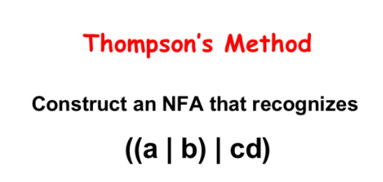
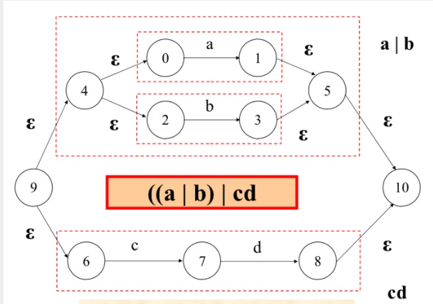

Slide 111
Converting a NFA into a DFA (subset construction)
put ε-closure({s₀}) as an unmarked state into the set of DFA (DS)
while (there is one unmarked S₁ in DS) do
begin
mark S₁
for each input symbol a do
begin
S₂ ⬅ ε-closure(move(S₁,a))
if (S₂ is not in DS) then
add S₂ into DS as an unmarked state
transfunc[S₁,a] ⬅ S₂
end
end
a state S in DS is an accepting state of DFA if a state in S is an accepting state of NFA
the start state of DFA is ε-closure({s₀})
ε-closure({s₀}) is the set of all states can be accessible
from s₀ by ε-transition.
set of states to which there is a transition on
a from a state s in S₁

Slide 112
Converting a NFA into a DFA (Example)
2
a
3
ε
ε
0
ε
1
ε
a
ε
6
7
8
ε
4
b
5
ε
S₀ = ε-closure({0}) = {0,1,2,4,7} S₀ into DS as an unmarked state
⇓ mark S₀
ε-closure(move(S₀,a)) = ε-closure({3,8}) = {1,2,3,4,6,7,8} = S₁ S₁ into DS
ε-closure(move(S₀,b)) = ε-closure({5}) = {1,2,4,5,6,7} = S₂ S₂ into DS
transfunc[S₀,a] ⬅ S₁ transfunc[S₀,b] ⬅ S₂
⇓ mark S₁
ε-closure(move(S₁,a)) = ε-closure({3,8}) = {1,2,3,4,6,7,8} = S₁
ε-closure(move(S₁,b)) = ε-closure({5}) = {1,2,4,5,6,7} = S₂
transfunc[S₁,a] ⬅ S₁ transfunc[S₁,b] ⬅ S₂
⇓ mark S₂
ε-closure(move(S₂,a)) = ε-closure({3,8}) = {1,2,3,4,6,7,8} = S₁
ε-closure(move(S₂,b)) = ε-closure({5}) = {1,2,4,5,6,7} = S₂
transfunc[S₂,a] ⬅ S₁ transfunc[S₂,b] ⬅ S₂

Slide 113
Converting a NFA into a DFA (Example – cont.)
S₀ is the start state of DFA since 0 is a member of S₀={0,1,2,4,7}
S₁ is an accepting state of DFA since 8 is a member of S₁ = {1,2,3,4,6,7,8}
a
S₁
a
S₀
b
a
b
S₂
b

Slide 114
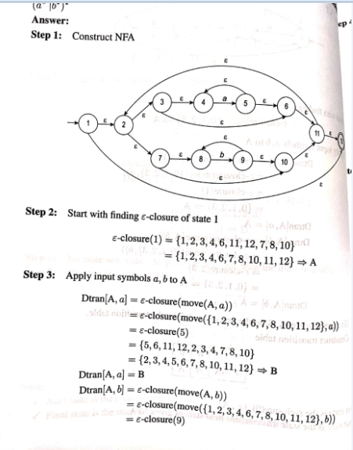

Slide 115
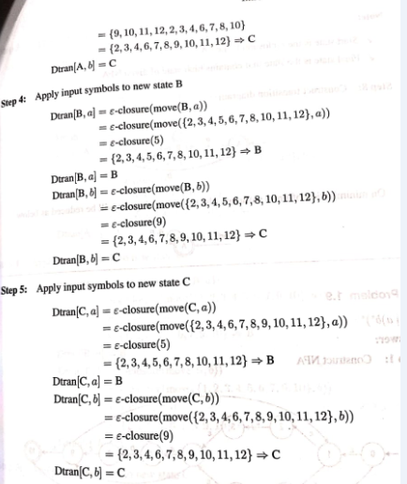

Slide 116
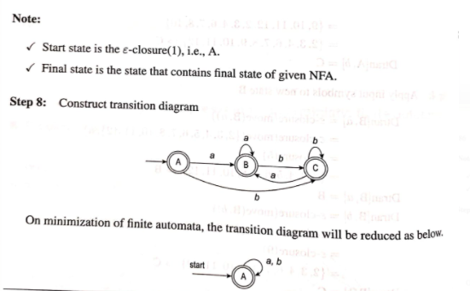

Slide 117
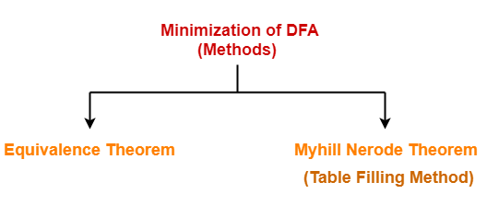
Minimization of DFA

Slide 118
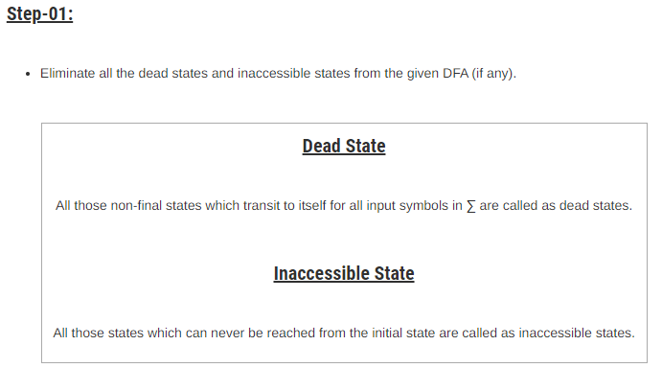
Minimization of DFA

Slide 119
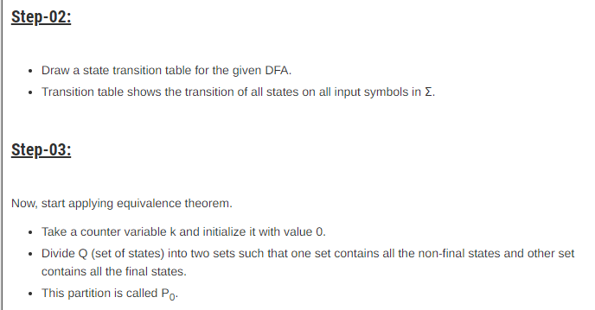
Minimization of DFA

Slide 120
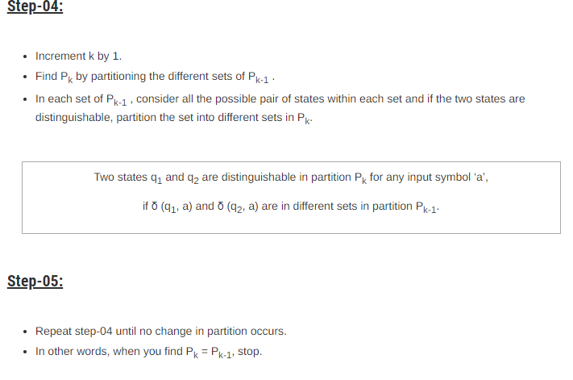
Minimization of DFA

Slide 121
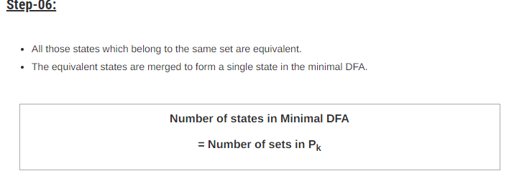
Minimization of DFA

Slide 122
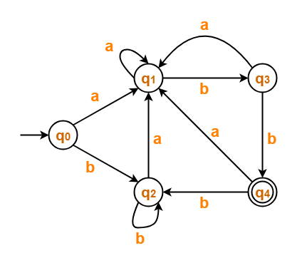
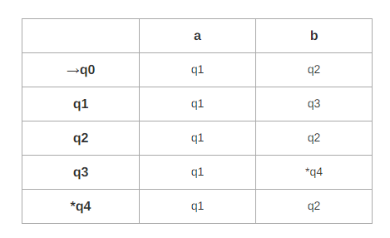
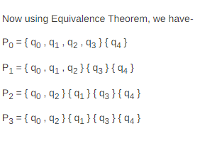
Example-Minimization of DFA

Slide 123
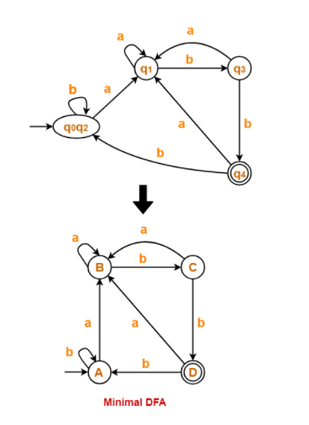
Example-Minimization of DFA

Slide 124
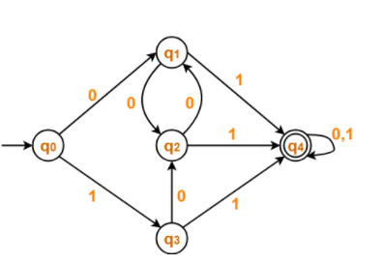
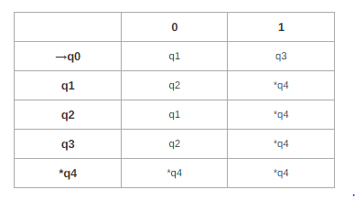
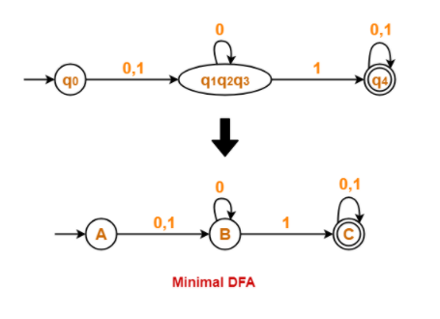
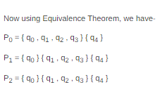
Example-Minimization of DFA

Slide 125
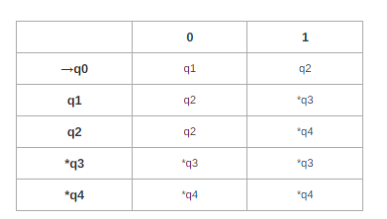
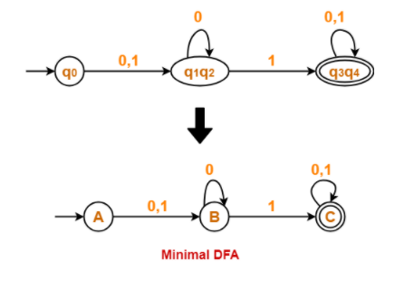
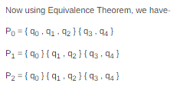
Example-Minimization of DFA

Slide 126
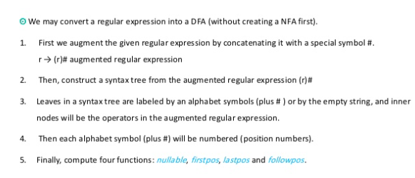
Regular Expression to DFA (Direct Method)

Slide 127

Regular Expression to DFA (Direct Method)- Example
Regular Expression: (a/b)*abb
Augmented Grammar : (a/b)*abb# =➔ (a/b)*.a.b.b.#

Slide 128

Regular Expression to DFA (Direct Method)- Example

Slide 129

Computation of Nullable, Firstpos, LastPos:

Slide 130

Example:

Slide 131

Direct Method

Slide 132

Direct Method

Slide 133

Direct Method

Slide 134

Direct Method

Slide 135

Direct Method

Slide 136

Direct Method

