Slide 1
LR Parsers

Slide 2
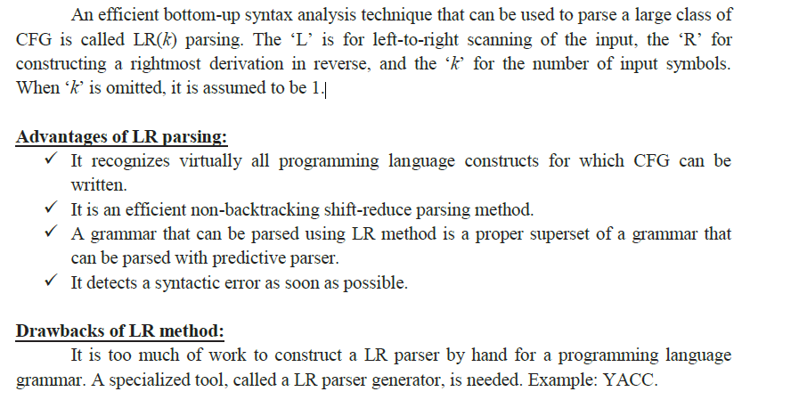
Introduction to LR Parsing

Slide 3
Why LR Parsers?
LR parsing is attractive for a variety of reasons:
LR parsers can be constructed to recognize all programming language constructs.
The LR-parsing method is the most general non backtracking shift-reduce parsing method it can be implemented efficiently.
An LR parser can detect a syntactic error as soon as it is possible to do so on a left-to-right scan of the input.
The class of grammars that can be parsed using LR methods is a proper superset of the class of grammars that can be parsed with predictive or LL methods. LR grammars can describe more languages than LL grammars.
The principal drawback of the LR method is that it is too much work to construct an LR parser for a typical programming-language grammar.

Slide 4
LR Parsers
The most powerful shift-reduce parsing (yet efficient) is:
LR(k) parsing.
left to right right-most k lookhead
scanning derivation (k is omitted ➔ it is 1)
LR parsing is attractive because:
LR parsing is most general non-backtracking shift-reduce parsing, yet it is still efficient.
The class of grammars that can be parsed using LR methods is a proper superset of the class of grammars that can be parsed with predictive parsers. LL(1)-Grammars ⊂ LR(1)-Grammars
An LR-parser can detect a syntactic error as soon as it is possible to do so a left-to-right scan of the input.

Slide 5
LR Parsers
LR-Parsers
covers wide range of grammars.
SLR – simple LR parser
LR – most general LR parser
LALR – intermediate LR parser (look-head LR parser)
SLR, LR and LALR work same (they used the same algorithm), only their parsing tables are different.

Slide 6
LR Parsing Algorithm
input
a₁ | ... | a_{i} | ... | a_{n} | $
stack
S_{m}
X_{m}
S_{m-1}
X_{m-1}
.
.
S₁
X₁
S₀
LR Parsing Algorithm
output
Action Table terminals and $ s t four different a actions t e s | Goto Table non-terminal s t each item is a a state number t e s

Slide 7
A Configuration of LR Parsing Algorithm
A configuration of a LR parsing is:
( S_{o} X₁ S₁ ... X_{m} S_{m}, a_{i} a_{i+1} ... a_{n} $ )
Stack Rest of Input
S_{m} and a_{i} decides the parser action by consulting the parsing action table. (Initial Stack contains just S_{o} )
A configuration of a LR parsing represents the right sentential form:
X₁ ... X_{m} a_{i} a_{i+1} ... a_{n} $

Slide 8
Actions of A LR-Parser
shift s -- shifts the next input symbol and the state s onto the stack
( S_{o} X₁ S₁ ... X_{m} S_{m}, a_{i} a_{i+1} ... a_{n} $ ) ➔ ( S_{o} X₁ S₁ ... X_{m} S_{m} a_{i} s, a_{i+1} ... a_{n} $ )
reduce A→β (or rn where n is a production number)
pop 2|β| (=r) items from the stack;
then push A and s where s=goto[s_{m-r},A]
( S_{o} X₁ S₁ ... X_{m} S_{m}, a_{i} a_{i+1} ... a_{n} $ ) ➔ ( S_{o} X₁ S₁ ... X_{m-r} S_{m-r} A s, a_{i} ... a_{n} $ )
Output is the reducing production reduce A→β
Accept – Parsing successfully completed
Error -- Parser detected an error (an empty entry in the action table)

Slide 9
Reduce Action
pop 2|β| (=r) items from the stack; let us assume that β = Y₁Y₂...Y_{r}
then push A and s where s=goto[s_{m-r},A]
( S_{o} X₁ S₁ ... X_{m-r} S_{m-r} Y₁ S_{m-r} ...Y_{r} S_{m}, a_{i} a_{i+1} ... a_{n} $ )
➔ ( S_{o} X₁ S₁ ... X_{m-r} S_{m-r} A s, a_{i} ... a_{n} $ )
In fact, Y₁Y₂...Y_{r} is a handle.
X₁ ... X_{m-r} A a_{i} ... a_{n} $ ⇒ X₁ ... X_{m} Y₁...Y_{r} a_{i} a_{i+1} ... a_{n} $

Slide 10
(SLR) Parsing Tables for Expression Grammar
Action Table
Goto Table
1) E → E+T
2) E → T
3) T → T*F
4) T → F
5) F → (E)
6) F → id
state | id | + | * | ( | ) | $ |  | E | T | F
0 | s5 |  |  | s4 |  |  |  | 1 | 2 | 3
1 |  | s6 |  |  |  | acc
2 |  | r2 | s7 |  | r2 | r2
3 |  | r4 | r4 |  | r4 | r4
4 | s5 |  |  | s4 |  |  |  | 8 | 2 | 3
5 |  | r6 | r6 |  | r6 | r6
6 | s5 |  |  | s4 |  |  |  |  | 9 | 3
7 | s5 |  |  | s4 |  |  |  |  |  | 10
8 |  | s6 |  |  | s11
9 |  | r1 | s7 |  | r1 | r1
10 |  | r3 | r3 |  | r3 | r3
11 |  | r5 | r5 |  | r5 | r5

Slide 11
Actions of A (S)LR-Parser -- Example
stack input action output
0 id*id+id$ shift 5
0id5 *id+id$ reduce by F→id F→id
0F3 *id+id$ reduce by T→F T→F
0T2 *id+id$ shift 7
0T2*7 id+id$ shift 5
0T2*7id5 +id$ reduce by F→id F→id
0T2*7F10 +id$ reduce by T→T*F T→T*F
0T2 +id$ reduce by E→T E→T
0E1 +id$ shift 6
0E1+6 id$ shift 5
0E1+6id5 $ reduce by F→id F→id
0E1+6F3 $ reduce by T→F T→F
0E1+6T9 $ reduce by E→E+T E→E+T
0E1 $ accept

Slide 12
Constructing SLR Parsing Tables – LR(0) Item
An LR(0) item of a grammar G is a production of G a dot at the some position of the right side.
Ex: A → aBb Possible LR(0) Items: A → .aBb
(four different possibility) A → a.Bb
A → aB.b
A → aBb.
Sets of LR(0) items will be the states of action and goto table of the SLR parser.
A collection of sets of LR(0) items (the canonical LR(0) collection) is the basis for constructing SLR parsers.
Augmented Grammar:
G’ is G with a new production rule S’→S where S’ is the new starting symbol.

Slide 13
The Closure Operation
If I is a set of LR(0) items for a grammar G, then closure(I) is the set of LR(0) items constructed from I by the two rules:
Initially, every LR(0) item in I is added to closure(I).
If A → α.Bβ is in closure(I) and B→γ is a production rule of G; then B→.γ will be in the closure(I). We will apply this rule until no more new LR(0) items can be added to closure(I).

Slide 14
The Closure Operation -- Example
E’ → E closure({E’ → .E}) =
E → E+T { E’ → .E kernel items
E → T E → .E+T
T → T*F E → .T
T → F T → .T*F
F → (E) T → .F
F → id F → .(E)
F → .id }

Slide 15
Goto Operation
If I is a set of LR(0) items and X is a grammar symbol (terminal or non-terminal), then goto(I,X) is defined as follows:
If A → α.Xβ in I then every item in closure({A → αX.β}) will be in goto(I,X).
Example:
I ={ E’ → .E, E → .E+T, E → .T,
T → .T*F, T → .F,
F → .(E), F → .id }
goto(I,E) = { E’ → E., E → E.+T }
goto(I,T) = { E → T., T → T.*F }
goto(I,F) = {T → F. }
goto(I,() = { F → (.E), E → .E+T, E → .T, T → .T*F, T → .F,
F → .(E), F → .id }
goto(I,id) = { F → id. }

Slide 16
Construction of The Canonical LR(0) Collection
To create the SLR parsing tables for a grammar G, we will create the canonical LR(0) collection of the grammar G’.
Algorithm:
C is { closure({S’→.S}) }
repeat the followings until no more set of LR(0) items can be added to C.
for each I in C and each grammar symbol X
if goto(I,X) is not empty and not in C
add goto(I,X) to C
goto function is a DFA on the sets in C.

Slide 17
The Canonical LR(0) Collection -- Example
I₀: E’ → .E I₁: E’ → E. I₆: E → E+.T I₉: E → E+T.
E → .E+T E → E.+T T → .T*F T → T.*F
E → .T T → .F
T → .T*F I₂: E → T. F → .(E) I₁₀: T → T*F.
T → .F T → T.*F F → .id
F → .(E)
F → .id I₃: T → F. I₇: T → T*.F I₁₁: F → (E).
F → .(E)
I₄: F → (.E) F → .id
E → .E+T
E → .T I₈: F → (E.)
T → .T*F E → E.+T
T → .F
F → .(E)
F → .id
I₅: F → id.

Slide 18
Transition Diagram (DFA) of Goto Function
I₀
E
I₁
I₂
I₃
I₄
I₅
I₆
I₇
I₈
to I₂
to I₃
to I₄
T
I₉
to I₃
to I₄
to I₅
I₁₀
to I₄
to I₅
I₁₁
to I₆
*
to I₇
F
(
T
id
F
*
F
(
id
(
E
)
id
id
T
F
+
(

Slide 19
Constructing SLR Parsing Table (of an augumented grammar G’)
Construct the canonical collection of sets of LR(0) items for G’. C←{I₀,...,I_{n}}
Create the parsing action table as follows
If a is a terminal, A→α.aβ in I_{i} and goto(I_{i},a)=I_{j} then action[i,a] is shift j.
If A→α. is in I_{i} , then action[i,a] is reduce A→α for all a in FOLLOW(A) where A≠S’.
If S’→S. is in I_{i} , then action[i,$] is accept.
If any conflicting actions generated by these rules, the grammar is not SLR(1).
Create the parsing goto table
for all non-terminals A, if goto(I_{i},A)=I_{j} then goto[i,A]=j
All entries not defined by (2) and (3) are errors.
Initial state of the parser contains S’→.S

Slide 20
Parsing Tables of Expression Grammar
Action Table
Goto Table
state | id | + | * | ( | ) | $ |  | E | T | F
0 | s5 |  |  | s4 |  |  |  | 1 | 2 | 3
1 |  | s6 |  |  |  | acc
2 |  | r2 | s7 |  | r2 | r2
3 |  | r4 | r4 |  | r4 | r4
4 | s5 |  |  | s4 |  |  |  | 8 | 2 | 3
5 |  | r6 | r6 |  | r6 | r6
6 | s5 |  |  | s4 |  |  |  |  | 9 | 3
7 | s5 |  |  | s4 |  |  |  |  |  | 10
8 |  | s6 |  |  | s11
9 |  | r1 | s7 |  | r1 | r1
10 |  | r3 | r3 |  | r3 | r3
11 |  | r5 | r5 |  | r5 | r5

Slide 21
Another Example
GivenGrammar - G
S → AA
A → aA | b
Step 1:
Add Augment Production and insert '•' symbol at the first position for every production in G
S` → •S
S → •AA
A → •aA
A → •b
Step 2:
Add Augment production to the I0 State and Compute the Closure
I0 = Closure (S` → •S)

Slide 22
Contd…
Add all productions starting with "A" in modified I0 State because "•" is followed by the non-terminal. So, the I0 State becomes.
I0= S` → •S S → •AA A → •aA A → •b
I1= Go to (I0, S) = closure (S` → S•) = S` → S•
Here, the Production is reduced so close the State.
I1= S` → S•
I2= Go to (I0, A) = closure (S → A•A)
Add all productions starting with A in to I2 State because "•" is followed by the non-terminal. So, the I2 State becomes
I2 =S→A•A A → •aA A → •b

Slide 23
Contd…
I3= Go to (I0,a) = Closure (A → a•A)
Add productions starting with A in I3.
A → a•A A → •aA A → •b
I4= Go to (I0, b) = closure (A → b•) = A → b•
I5= Go to (I2, A) = Closure (S → A • A) = S → AA•
Go to (I2,a) = Closure (A → a•A) = (same as I3)
Go to (I2, b) = Closure (A → b•) = (same as I4)
Go to (I3, a) = Closure (A → a•A) = (same as I3) Go to (I3, b) = Closure (A → b•) = (same as I4)
I6= Go to (I3, A) = Closure (A → aA•) = A → aA•

Slide 24
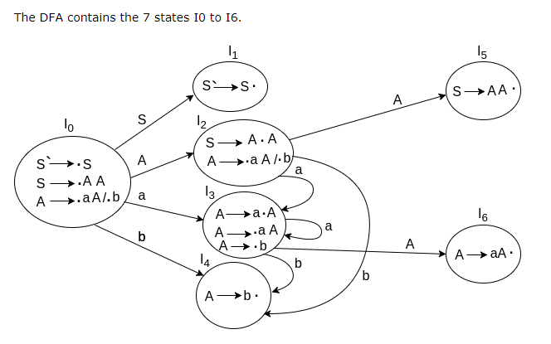
Contd…

Slide 25
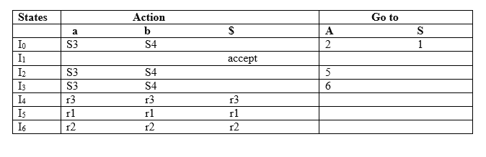
LR(0) Table
If a state is going to some other state on a terminal then it correspond to a Shift move.
If a state is going to some other state on a variable then it correspond to Go to move.
If a state contain the final item in the particular row then write the Reduce move completely.

Slide 26
LR(0) Table Entry Explanation
Productions are numbered as follows:
S → AA ... (1)
A → aA ... (2)
A → b ... (3)
I0 on S is going to I1 so write it as 1.
I0 on A is going to I2 so write it as 2.
I2 on A is going to I5 so write it as 5.
I3 on A is going to I6 so write it as 6.
I0, I2and I3on a are going to I3 so write it as S3 which means that shift 3.
I0, I2 and I3 on b are going to I4 so write it as S4 which means that shift 4.
I4, I5 and I6 all states contains the final item because they contain • in the right most end. So rate the production as production number.

Slide 27
Contd…
I1 contains the final item which drives(S` → S•), so action {I1, $} = Accept.
I4 contains the final item which drives A → b• and that production corresponds to the production number 3 so write it as r3 in the entire row.
I5 contains the final item which drives S → AA• and that production corresponds to the production number 1 so write it as r1 in the entire row.
I6 contains the final item which drives A → aA• and that production corresponds to the production number 2 so write it as r2 in the entire row.

Slide 28
SLR(1) Grammar
An LR parser using SLR(1) parsing tables for a grammar G is called as the SLR(1) parser for G.
If a grammar G has an SLR(1) parsing table, it is called SLR(1) grammar (or SLR grammar in short).
Every SLR grammar is unambiguous, but every unambiguous grammar is not a SLR grammar.

Slide 29
shift/reduce and reduce/reduce conflicts
If a state does not know whether it will make a shift operation or reduction for a terminal, we say that there is a shift/reduce conflict.
If a state does not know whether it will make a reduction operation using the production rule i or j for a terminal, we say that there is a reduce/reduce conflict.
If the SLR parsing table of a grammar G has a conflict, we say that that grammar is not SLR grammar.

Slide 30
Conflict Example
S → L=R I₀: S’ → .S I₁: S’ → S. I₆: S → L=.R I₉: S → L=R.
S → R S → .L=R R → .L
L→ *R S → .R I₂: S → L.=R L→ .*R
L → id L → .*R R → L. L → .id
R → L L → .id
R → .L I₃: S → R.
I₄: L → *.R I₇: L → *R.
Problem R → .L
FOLLOW(R)={=,$} L→ .*R I₈: R → L.
= shift 6 L → .id
reduce by R → L
shift/reduce conflict I₅: L → id.

Slide 31
Conflict Example2
S → AaAb I₀: S’ → .S
S → BbBa S → .AaAb
A → ε S → .BbBa
B → ε A → .
B → .
Problem
FOLLOW(A)={a,b}
FOLLOW(B)={a,b}
a reduce by A → ε b reduce by A → ε
reduce by B → ε reduce by B → ε
reduce/reduce conflict reduce/reduce conflict

Slide 32
Constructing Canonical LR(1) Parsing Tables
In SLR method, the state i makes a reduction by A→α when the current token is a:
if the A→α. in the I_{i} and a is FOLLOW(A)
In some situations, βA cannot be followed by the terminal a in a right-sentential form when βα and the state i are on the top stack. This means that making reduction in this case is not correct.
S → AaAb S⇒AaAb⇒Aab⇒ab S⇒BbBa⇒Bba⇒ba
S → BbBa
A → ε Aab ⇒ ε ab Bba ⇒ ε ba
B → ε AaAb ⇒ Aa ε b BbBa ⇒ Bb ε a

Slide 33
LR(1) Item
To avoid some of invalid reductions, the states need to carry more information.
Extra information is put into a state by including a terminal symbol as a second component in an item.
A LR(1) item is:
A → α.β,a where a is the look-head of the LR(1) item
(a is a terminal or end-marker.)

Slide 34
LR(1) Item (cont.)
When β ( in the LR(1) item A → α.β,a ) is not empty, the look-head does not have any affect.
When β is empty (A → α.,a ), we do the reduction by A→α only if the next input symbol is a (not for any terminal in FOLLOW(A)).
A state will contain A → α.,a₁ where {a₁,...,a_{n}} ⊆ FOLLOW(A)
...
A → α.,a_{n}

Slide 35
Canonical Collection of Sets of LR(1) Items
The construction of the canonical collection of the sets of LR(1) items are similar to the construction of the canonical collection of the sets of LR(0) items, except that closure and goto operations work a little bit different.
closure(I) is: ( where I is a set of LR(1) items)
every LR(1) item in I is in closure(I)
if A→α.Bβ,a in closure(I) and B→γ is a production rule of G; then B→.γ,b will be in the closure(I) for each terminal b in FIRST(βa) .

Slide 36
goto operation
If I is a set of LR(1) items and X is a grammar symbol (terminal or non-terminal), then goto(I,X) is defined as follows:
If A → α.Xβ,a in I then every item in closure({A → αX.β,a}) will be in goto(I,X).

Slide 37
Construction of The Canonical LR(1) Collection
Algorithm:
C is { closure({S’→.S,$}) }
repeat the followings until no more set of LR(1) items can be added to C.
for each I in C and each grammar symbol X
if goto(I,X) is not empty and not in C
add goto(I,X) to C
goto function is a DFA on the sets in C.

Slide 38
A Short Notation for The Sets of LR(1) Items
A set of LR(1) items containing the following items
A → α.β,a₁
...
A → α.β,a_{n}
can be written as
A → α.β,a₁/a₂/.../a_{n}

Slide 39
Canonical LR(1) Collection -- Example
S
A
a
S → AaAb I₀: S’ → .S ,$ I₁: S’ → S. ,$
S → BbBa S → .AaAb ,$
A → ε S → .BbBa ,$ I₂: S → A.aAb ,$
B → ε A → . ,a
B → . ,b I₃: S → B.bBa ,$
I₄: S → Aa.Ab ,$ I₆: S → AaA.b ,$ I₈: S → AaAb. ,$
A → . ,b
I₅: S → Bb.Ba ,$ I₇: S → BbB.a ,$ I₉: S → BbBa. ,$
B → . ,a
to I₄
B
b
to I₅
A
a
B
b

Slide 40
Canonical LR(1) Collection – Example2
S’ → S
1) S → L=R
2) S → R
3) L→ *R
4) L → id
5) R → L
I₀:S’ → .S,$
S → .L=R,$
S → .R,$
L → .*R,$/=
L → .id,$/=
R → .L,$
I₁:S’ → S.,$
I₄:L → *.R,$/=
R → .L,$/=
L→ .*R,$/=
L → .id,$/=
R
to I₇
S
*
L
I₂:S → L.=R,$
R → L.,$
to I₆
to I₈
L
*
to I₄
id
R
to I₅
I₃:S → R.,$
id
I₅:L → id.,$/=
I₉:S → L=R.,$
I₁₀:R → L.,$
I₁₁:L → *.R,$
R → .L,$
L→ .*R,$
L → .id,$
I₁₂:L → id.,$
R
I₁₃:L → *R.,$
I₆:S → L=.R,$
R → .L,$
L → .*R,$
L → .id,$
to I₉
L
to I₁₀
*
I₄ and I₁₁
I₅ and I₁₂
I₇ and I₁₃
I₈ and I₁₀
to I₁₁
R
to I₁₃
id
L
to I₁₂
to I₁₀
I₇:L → *R.,$/=
*
to I₁₁
id
I₈: R → L.,$/=
to I₁₂

Slide 41
Construction of LR(1) Parsing Tables
Construct the canonical collection of sets of LR(1) items for G’. C←{I₀,...,I_{n}}
Create the parsing action table as follows
If a is a terminal, A→α.aβ,b in I_{i} and goto(I_{i},a)=I_{j} then action[i,a] is shift j.
If A→α.,a is in I_{i} , then action[i,a] is reduce A→α where A≠S’.
If S’→S.,$ is in I_{i} , then action[i,$] is accept.
If any conflicting actions generated by these rules, the grammar is not LR(1).
Create the parsing goto table
for all non-terminals A, if goto(I_{i},A)=I_{j} then goto[i,A]=j
All entries not defined by (2) and (3) are errors.
Initial state of the parser contains S’→.S,$

Slide 42
LR(1) Parsing Tables – (for Example2)
 | id | * | = | $ | S | L | R
0 | s5 | s4 |  |  | 1 | 2 | 3
1 |  |  |  | acc
2 |  |  | s6 | r5
3 |  |  |  | r2
4 | s5 | s4 |  |  |  | 8 | 7
5 |  |  | r4 | r4
6 | s12 | s11 |  |  |  | 10 | 9
7 |  |  | r3 | r3
8 |  |  | r5 | r5
9 |  |  |  | r1
10 |  |  |  | r5
11 | s12 | s11 |  |  |  | 10 | 13
12 |  |  |  | r4
13 |  |  |  | r3
no shift/reduce or
no reduce/reduce conflict
⇓
so, it is a LR(1) grammar

Slide 43
LALR Parsing Tables
LALR stands for LookAhead LR.
LALR parsers are often used in practice because LALR parsing tables are smaller than LR(1) parsing tables.
The number of states in SLR and LALR parsing tables for a grammar G are equal.
But LALR parsers recognize more grammars than SLR parsers.
yacc creates a LALR parser for the given grammar.
A state of LALR parser will be again a set of LR(1) items.

Slide 44
Creating LALR Parsing Tables
Canonical LR(1) Parser ➔ LALR Parser
shrink # of states
This shrink process may introduce a reduce/reduce conflict in the resulting LALR parser (so the grammar is NOT LALR)
But, this shrik process does not produce a shift/reduce conflict.

Slide 45
The Core of A Set of LR(1) Items
The core of a set of LR(1) items is the set of its first component.
Ex: S → L.=R,$ ➔ S → L.=R Core
R → L.,$ R → L.
We will find the states (sets of LR(1) items) in a canonical LR(1) parser with same cores. Then we will merge them as a single state.
I₁:L → id.,= A new state: I₁₂: L → id.,=
➔ L → id.,$
I₂:L → id.,$ have same core, merge them
We will do this for all states of a canonical LR(1) parser to get the states of the LALR parser.
In fact, the number of the states of the LALR parser for a grammar will be equal to the number of states of the SLR parser for that grammar.

Slide 46
Creation of LALR Parsing Tables
Create the canonical LR(1) collection of the sets of LR(1) items for the given grammar.
Find each core; find all sets having that same core; replace those sets having same cores with a single set which is their union.
C={I₀,...,I_{n}} ➔ C’={J₁,...,J_{m}} where m ≤ n
Create the parsing tables (action and goto tables) same as the construction of the parsing tables of LR(1) parser.
Note that: If J=I₁ ∪ ... ∪ I_{k} since I₁,...,I_{k} have same cores
➔ cores of goto(I₁,X),...,goto(I₂,X) must be same.
So, goto(J,X)=K where K is the union of all sets of items having same cores as goto(I₁,X).
If no conflict is introduced, the grammar is LALR(1) grammar. (We may only introduce reduce/reduce conflicts; we cannot introduce a shift/reduce conflict)

Slide 47
Shift/Reduce Conflict
We say that we cannot introduce a shift/reduce conflict during the shrink process for the creation of the states of a LALR parser.
Assume that we can introduce a shift/reduce conflict. In this case, a state of LALR parser must have:
A → α.,a and B → β.aγ,b
This means that a state of the canonical LR(1) parser must have:
A → α.,a and B → β.aγ,c
But, this state has also a shift/reduce conflict. i.e. The original canonical LR(1) parser has a conflict.
(Reason for this, the shift operation does not depend on lookaheads)

Slide 48
Reduce/Reduce Conflict
But, we may introduce a reduce/reduce conflict during the shrink process for the creation of the states of a LALR parser.
I₁ : A → α.,a I₂: A → α.,b
B → β.,b B → β.,c
⇓
I₁₂: A → α.,a/b ➔ reduce/reduce conflict
B → β.,b/c

Slide 49
Canonical LALR(1) Collection – Example2
S’ → S
1) S → L=R
2) S → R
3) L→ *R
4) L → id
5) R → L
I₀:S’ → .S,$
S → .L=R,$
S → .R,$
L → .*R,$/=
L → .id,$/=
R → .L,$
I₁:S’ → S.,$
I₄₁₁:L → *.R,$/=
R → .L,$/=
L→ .*R,$/=
L → .id,$/=
R
to I₇₁₃
S
*
L
I₂:S → L.=R,$
R → L.,$
to I₆
to I₈₁₀
L
*
to I₄₁₁
id
R
to I₅₁₂
I₃:S → R.,$
id
I₅₁₂:L → id.,$/=
R
I₉:S → L=R.,$
I₆:S → L=.R,$
R → .L,$
L → .*R,$
L → .id,$
to I₉
Same Cores
I₄ and I₁₁
I₅ and I₁₂
I₇ and I₁₃
I₈ and I₁₀
L
to I₈₁₀
*
to I₄₁₁
id
to I₅₁₂
I₇₁₃:L → *R.,$/=
I₈₁₀: R → L.,$/=

Slide 50
LALR(1) Parsing Tables – (for Example2)
 | id | * | = | $ | S | L | R
0 | s5 | s4 |  |  | 1 | 2 | 3
1 |  |  |  | acc
2 |  |  | s6 | r5
3 |  |  |  | r2
4 | s5 | s4 |  |  |  | 8 | 7
5 |  |  | r4 | r4
6 | s12 | s11 |  |  |  | 10 | 9
7 |  |  | r3 | r3
8 |  |  | r5 | r5
9 |  |  |  | r1
no shift/reduce or
no reduce/reduce conflict
⇓
so, it is a LALR(1) grammar

Slide 51
Using Ambiguous Grammars
All grammars used in the construction of LR-parsing tables must be un-ambiguous.
Can we create LR-parsing tables for ambiguous grammars ?
Yes, but they will have conflicts.
We can resolve these conflicts in favor of one of them to disambiguate the grammar.
At the end, we will have again an unambiguous grammar.
Why we want to use an ambiguous grammar?
Some of the ambiguous grammars are much natural, and a corresponding unambiguous grammar can be very complex.
Usage of an ambiguous grammar may eliminate unnecessary reductions.
Ex.
E → E+T | T
E → E+E | E*E | (E) | id ➔ T → T*F | F
F → (E) | id

Slide 52
Sets of LR(0) Items for Ambiguous Grammar
I₀: E’ → .E
E → .E+E
E → .E*E
E → .(E)
E → .id
E
I₁: E’ → E.
E → E .+E
E → E .*E
+
I₄: E → E +.E
E → .E+E
E → .E*E
E → .(E)
E → .id
E
+
I₇: E → E+E.
E → E.+E
E → E.*E
I₄
(
*
I₅
I₂
*
id
I₃
(
(
I₅: E → E *.E
E → .E+E
E → .E*E
E → .(E)
E → .id
E
+
(
I₈: E → E*E.
E → E.+E
E → E.*E
I₄
I₂: E → (.E)
E → .E+E
E → .E*E
E → .(E)
E → .id
I₂
*
id
I₅
I₃
E
id
id
)
I₆: E → (E.)
E → E.+E
E → E.*E
I₉: E → (E).
+
I₃: E → id.
*
I₄
I₅

Slide 53
SLR-Parsing Tables for Ambiguous Grammar
FOLLOW(E) = { $,+,*,) }
State I₇ has shift/reduce conflicts for symbols + and *.
I₀
E
I₁
+
I₄
E
I₇
when current token is +
shift ➔ + is right-associative
reduce ➔ + is left-associative
when current token is *
shift ➔ * has higher precedence than +
reduce ➔ + has higher precedence than *

Slide 54
SLR-Parsing Tables for Ambiguous Grammar
FOLLOW(E) = { $,+,*,) }
State I₈ has shift/reduce conflicts for symbols + and *.
I₀
E
I₁
*
I₅
E
I₇
when current token is *
shift ➔ * is right-associative
reduce ➔ * is left-associative
when current token is +
shift ➔ + has higher precedence than *
reduce ➔ * has higher precedence than +

Slide 55
SLR-Parsing Tables for Ambiguous Grammar
Action
Goto
 | id | + | * | ( | ) | $ |  | E
0 | s3 |  |  | s2 |  |  |  | 1
1 |  | s4 | s5 |  |  | acc
2 | s3 |  |  | s2 |  |  |  | 6
3 |  | r4 | r4 |  | r4 | r4
4 | s3 |  |  | s2 |  |  |  | 7
5 | s3 |  |  | s2 |  |  |  | 8
6 |  | s4 | s5 |  | s9
7 |  | r1 | s5 |  | r1 | r1
8 |  | r2 | r2 |  | r2 | r2
9 |  | r3 | r3 |  | r3 | r3

Slide 56
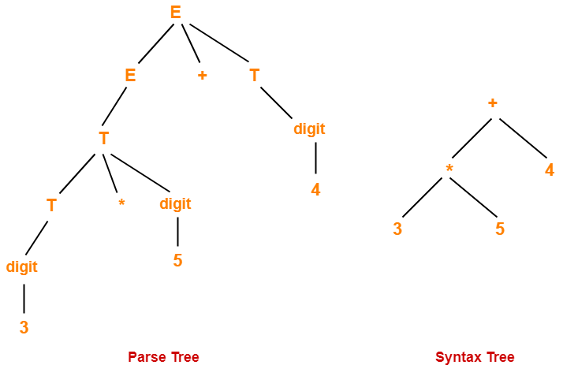

Slide 57
Parse Tree | Syntax Tree
Parse tree is a graphical representation of the replacement process in a derivation. | Syntax tree is the compact form of a parse tree.
Each interior node represents a grammar rule. Each leaf node represents a terminal. | Each interior node represents an operator. Each leaf node represents an operand.
Parse trees provide every characteristic information from the real syntax. | Syntax trees do not provide every characteristic information from the real syntax.
Parse trees are comparatively less dense than syntax trees. | Syntax trees are comparatively more dense than parse trees.

