Slide 1
Syntax Directed Translation
COMPILER DESIGN

Slide 2
Outline
Syntax Directed Definitions
Evaluation Orders of SDD’s
Applications of Syntax Directed Translation
Syntax Directed Translation Schemes
Implementing L-Attribute SDD

Slide 3
Introduction
We can associate information with a language construct by attaching attributes to the grammar symbols.
A syntax directed definition specifies the values of attributes by associating semantic rules with the grammar productions.
Production
Semantic Rule
E->E1+T
E.code=E1.code||T.code||’+’
We may alternatively insert the semantic actions inside the grammar
E -> E1+T {print ‘+’}

Slide 4
Syntax Directed Definitions
A SDD is a context free grammar with attributes and rules
Attributes are associated with grammar symbols and rules with productions
Attributes may be of many kinds: numbers, types, table references, strings, etc.
Synthesized attributes
  A synthesized attribute at node N is defined only in terms of attribute values of children of N
Inherited attributes
  An inherited attribute at node N is defined only in terms of attribute values at N’s parent, N itself and N’s siblings

Slide 5
Example of S-attributed SDD
Production
Semantic Rules
L -> E n
E -> E1 + T
E -> T
T -> T1 * F
T -> F
F -> (E)
F -> digit
L.val = E.val
E.val = E1.val + T.val
E.val = T.val
T.val = T1.val * F.val
T.val = F.val
F.val = E.val
F.val = digit.lexval

Slide 6
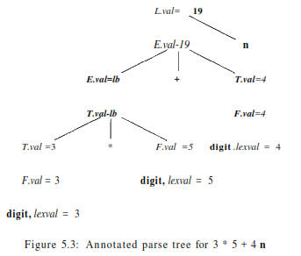

Slide 7
Example of mixed attributes
Production
Semantic Rules
T -> FT’
T’ -> *FT’1
3) T’ -> ε
4) F -> digit
T’.inh = F.val
T.val = T’.syn
T’1.inh = T’.inh*F.val
T’.syn = T’1.syn
T’.syn = T’.inh
F.val = F.val = digit.lexval

Slide 8
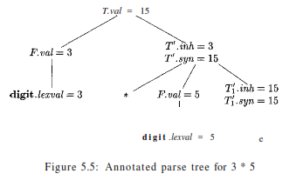

Slide 9
Evaluation orders for SDD’s
A dependency graph is used to determine the order of computation of attributes
Dependency graph
  For each parse tree node, the parse tree has a node for each attribute associated with that node
  If a semantic rule defines the value of synthesized attribute A.b in terms of the value of X.c then the dependency graph has an edge from X.c to A.b
  If a semantic rule defines the value of inherited attribute B.c in terms of the value of X.c then the dependency graph has an edge from X.c to B.c

Slide 10
Ordering the evaluation of attributes
If dependency graph has an edge from M to N then M must be evaluated before the attribute of N
Thus the only allowable orders of evaluation are those sequence of nodes N1,N2,…,Nk such that if there is an edge from Ni to Nj then i<j
Such an ordering is called a topological sort of a graph

Slide 11
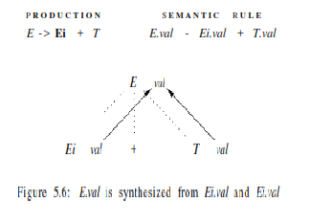

Slide 12
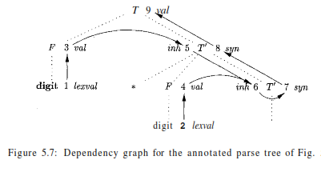

Slide 13
S-Attributed definitions
An SDD is S-attributed if every attribute is synthesized
We can have a post-order traversal of parse-tree to evaluate attributes in S-attributed definitions
postorder(N) {
for (each child C of N, from the left) postorder(C);
evaluate the attributes associated with node N;
}
S-Attributed definitions can be implemented during bottom-up parsing without the need to explicitly create parse trees

Slide 14
L-Attributed definitions
A SDD is L-Attributed if the edges in dependency graph goes from Left to Right but not from Right to Left.
More precisely, each attribute must be either
  Synthesized
  Inherited, but if there is a production A->X1X2…Xn and there is an inherited attribute Xi.a computed by a rule associated with this production, then the rule may only use:
    Inherited attributes associated with the head A
    Either inherited or synthesized attributes associated with the occurrences of symbols X1,X2,…,Xi-1 located to the left of Xi
    Inherited or synthesized attributes associated with this occurrence of Xi itself, but in such a way that there is no cycle in the graph

Slide 15
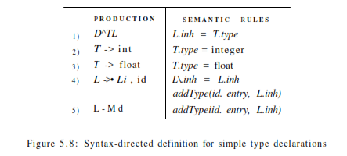
Example for Syntax Directed Definition

Slide 16
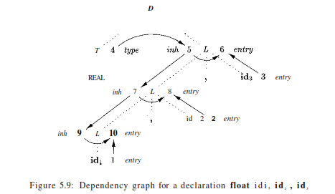
Dependancy Graph

Slide 17
Application of Syntax Directed Translation
Construction of syntax trees
  Leaf nodes: Leaf(op,val)
  Interior node: Node(op,c1,c2,…,ck)
Example:
Production
Semantic Rules
E.node=new node(‘+’, E1.node,T.node)
E.node=new node(‘-’, E1.node,T.node)
E.node = T.node
T.node = E.node
T.node = new Leaf(id,id.entry)
T.node = new Leaf(num,num.val)
E -> E1 + T
E -> E1 - T
E -> T
T -> (E)
T -> id
T -> num

Slide 18
Syntax Tree
Steps in the construction of the syntax tree for a - 4 + c
1) p1 = new Leaf(id, entry-a);
2) P2 = new Leaf (num, 4);
3) P3 = new Node('-',p1,p2);
4) P4 = new Leaf'(id, entry-c);
5) p5 = new Node('+',p3,p4);

Slide 19
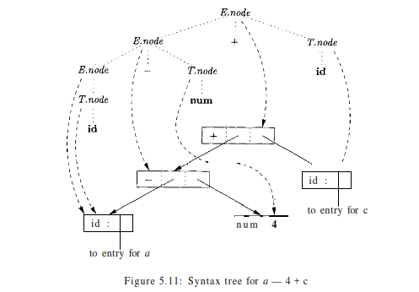

Slide 20
Syntax tree for L-attributed definition
Production
Semantic Rules
E.node=E’.syn
E’.inh=T.node
E1’.inh=new node(‘+’, E’.inh,T.node)
E’.syn=E1’.syn
E1’.inh=new node(‘-’, E’.inh,T.node)
E’.syn=E1’.syn
E’.syn = E’.inh
T.node = E.node
T.node=new Leaf(id,id.entry)
T.node = new Leaf(num,num.val)
E -> TE’
E’ -> + TE1’
E’ -> -TE1’
E’ -> ∈
T -> (E)
T -> id
T -> num

Slide 21
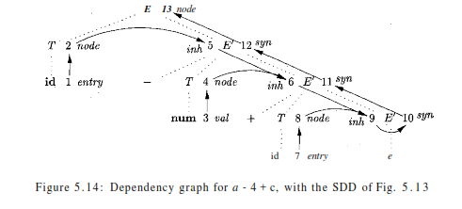
Dependancy Graph

Slide 22
Syntax Directed Translation Schemes
An SDT is a CFG with program fragments embedded within production bodies
Those program fragments are called semantic actions
They can appear at any position within production body
Any SDT can be implemented by first building a parse tree and then performing the actions in a left-to-right depth first order
Typically SDT’s are implemented during parsing without building a parse tree

Slide 23
Postfix Translation Schemes
Simplest SDDs are those that we can parse the grammar bottom-up and the SDD is s-attributed
For such cases we can construct SDT where each action is placed at the end of the production and is executed along with the reduction of the body to the head of that production
SDT’s with all actions at the right ends of the production bodies are called postfix SDT’s

Slide 24
Example of postfix SDT
L -> E n {print(E.val);}
E -> E1 + T {E.val=E1.val+T.val;}
E -> T {E.val = T.val;}
T -> T1 * F {T.val=T1.val*F.val;}
T -> F {T.val=F.val;}
F -> (E) {F.val=E.val;}
F -> digit {F.val=digit.lexval;}

Slide 25
Parse-Stack implementation of postfix SDT’s
In a shift-reduce parser we can easily implement semantic action using the parser stack
For each nonterminal (or state) on the stack we can associate a record holding its attributes
Then in a reduction step we can execute the semantic action at the end of a production to evaluate the attribute(s) of the non-terminal at the left side of the production
And put the value on the stack in replace of the right side of production

Slide 26
Example
L -> E n {print(stack[top-1].val);
top=top-1;}
E -> E1 + T {stack[top-2].val=stack[top-2].val+stack.val;
top=top-2;}
E -> T
T -> T1 * F {stack[top-2].val=stack[top-2].val+stack.val;
top=top-2;}
T -> F
F -> (E) {stack[top-2].val=stack[top-1].val
top=top-2;}
F -> digit

Slide 27
SDT’s with actions inside productions
For a production B->X {a} Y
  If the parse is bottom-up then we perform action “a” as soon as this occurrence of X appears on the top of the parser stack
  If the parser is top down we perform “a” just before we expand Y
Sometimes we can’t do things as easily as explained above
One example is when we are parsing this SDT with a bottom-up parser
L -> E n
E -> {print(‘+’);} E1 + T
E -> T
T -> {print(‘*’);} T1 * F
T -> F
F -> (E)
F -> digit {print(digit.lexval);}

Slide 28
SDT’s with actions inside productions (cont)
L
Any SDT can be implemented as follows
  Ignore the actions and produce a parse tree
  Examine each interior node N and add actions as new children at the correct position
  Perform a postorder traversal and execute actions when their nodes are visited
E
{print(‘+’);}
E
+
T
T
F
{print(‘*’);}
{print(4);}
T
*
F
digit
{print(5);}
F
digit
{print(3);}
digit

Slide 29
SDT’s for L-Attributed definitions
We can convert an L-attributed SDD into an SDT using following two rules:
  Embed the action that computes the inherited attributes for a nonterminal A immediately before that occurrence of A. if several inherited attributes of A are dependent on one another in an acyclic fashion, order them so that those needed first are computed first
  Place the action of a synthesized attribute for the head of a production at the end of the body of the production

Slide 30
Implementing L-Attributed SDD
A recursive-descent parser has a function A for each non-terminal A we can extend the parser into a translator as follows:
  a) The arguments of function A are the inherited attributes of nonterminal A.
  b) The return-value of function A is the collection of synthesized attributes of nonterminal A.

Slide 31
In the body of function A, we need to both parse and handle attributes:
  1. Decide upon the production used to expand A.
  2. Check that each terminal appears on the input when it is required. We shall assume that no backtracking is needed, but the extension to recursive-descent parsing with backtracking can be done by restoring the input position upon failure
  3. Preserve, in local variables, the values of all attributes needed to compute inherited attributes for non-terminals in the body or synthesized attributes for the head non-terminal.
  4. Call functions corresponding to non-terminals in the body of the selected production, providing them with the proper arguments. Since the underlying SDD is L-attributed, we have already computed these attributes and stored them in local variables.

Slide 32
Example
S -> while (C) S1 L1=new();
L2=new();
S1.next=L1;
C.false=S.next;
C.true=L2;
S.code=label||L1||C.code||label||L2||S1.code
S -> while ( {L1=new();L2=new();C.false=S1.next;C.true=L2;}
C) {S1.next=L1;}
S1{S.code=label||L1||C.code||label||L2||S1.code;}

