Slide 1
Semantic Analysis -SDD

Slide 2
(3)
Semantic Analysis
•
Semantic Analysis computes additional information related to the
of the program once the syntactic structure is known.
meaning
•
In typed languages as C, semantic analysis involves adding information to
the symbol table and performing type checking.
•
The information to be computed is beyond the capabilities of standard
parsing techniques, therefore it is not regarded as syntax.
•
As for Lexical and Syntax analysis, also for Semantic Analysis we need both
a Representation Formalism and an Implementation Mechanism.
•
As representation formalism this lecture illustrates what are called Syntax
Directed Translations.

Slide 3
(4)
Syntax Directed Translation: Intro
• The Principle of Syntax Directed Translation states that the meaning
input sentence is related to its syntactic structure, i.e., to its Parse-Tree.
of an
• By Syntax Directed Translations we indicate those formalisms for specify-
ing translations for programming language constructs guided by context-free
grammars.
– We associate Attributes to the grammar symbols representing the
language constructs.
– Values for attributes are computed by Semantic Rules associated with grammar productions.

Slide 4
(5)
Syntax Directed Translation:
Intro
(Cont.)
• Evaluation of Semantic Rules may:
– Generate Code;
– Insert information into the Symbol Table;
– Perform Semantic Check;
– Issue error messages;
– etc.
• There are two notations for attaching semantic
1. Syntax Directed Definitions. High-level
rules:
specification hiding
many
implementation details (also called Attribute Grammars).
2. Translation Schemes. More implementation oriented: Indicate in which semantic rules are to be evaluated.
the order

Slide 5
(6)
Summary
• Syntax Directed Translations
• Syntax Directed Definitions
• Implementing Syntax Directed Definitions
– Dependency Graphs
– S-Attributed Definitions
– L-Attributed Definitions
• Translation Schemes

Slide 6
(7)
Syntax Directed Definitions
• Syntax Directed Definitions are a generalization of context-free grammars
in which:
1. Grammar symbols have an associated set of Attributes;
2. Productions are associated with Semantic Rules for computing the values of attributes.
• Such formalism generates Annotated Parse-Trees where each node of the
tree is a record with a field for each attribute (e.g., X.a indicates the attribute
a of the grammar symbol X ).

Slide 7
(8)
Syntax Directed Definitions (Cont.)
• The value of an attribute of a grammar symbol at a given parse-tree
node is
defined by a semantic rule associated with the production used at that node.
• We distinguish between two kinds of attributes:
1. Synthesized Attributes. They are computed from the values of the
attributes of the children nodes.
2. Inherited Attributes. They are computed from the values of the attributes of both the siblings and the parent nodes.

Slide 8
(9)
Form of Syntax Directed Definitions
• Each production, A → α, is associated with a set of semantic rules:
b := f (c₁ , c₂ , . . . , c_{k} ), where f is a function and either
1. b is a synthesized attribute of A, and c₁ , c₂ , . . . , c_{k} are attributes of the
grammar symbols of the production, or
2. b is an inherited attribute of a grammar symbol in α,
and c1 , c2 , . . . , ck
are attributes of grammar symbols in α or attributes of A.
• Note. Terminal symbols are assumed to have synthesized attributes supplied
by the lexical analyzer.
• Procedure calls (e.g. print in the next slide) define values of Dummy
synthesized attributes of the non terminal on the left-hand side of the production.

Slide 9

(10)
Syntax Directed Definitions: An Example
• Example. Let us consider the Grammar for arithmetic expressions.
The
Syntax Directed Definition associates to each non terminal a synthesized
attribute
called val.
PRO D U C T ION
SE M A N T I C RU L E
print(E.val)
L
E
E
T
T
F
F
→ En
→
→
→
→
→
→
E1
T
T₁
F
+ T
E.val
E.val
T .val
T .val
F.val
F.val
:= E1.val
:= T .val
+ T .val
∗
F
:= T1 .val ∗ F.val
:= F.val
:= E.val
:=digit.lexval
(E)
digit

Slide 10
S-Attributed Definitions
Definition. An S-Attributed Definition is a Syntax Directed Definition that uses
only synthesized attributes.
• Evaluation Order. Semantic rules in a S-Attributed Definition can be
evaluated by a bottom-up, or PostOrder, traversal of the parse-tree.
• Example. The above arithmetic grammar is an example of an S-Attributed
(11)
Definition.
The
annotated parse-tree for the
L
input 3*5+4n is:
E.val =
+
19
n
E.val
=
15
T .val = 4
T .val
=
15
F.val = 4
digit.lexval= 4
T .val
= 3
*
F.val
= 5
F.val
= 3
digit.lexval= 5
digit.lexval= 3

Slide 11
(12)
Inherited Attributes
• Inherited Attributes are useful for expressing the dependence of a
on the context in which it appears.
construct
• It is always possible to rewrite a syntax directed definition to use only
synthesized attributes, but it is often more natural to use both synthesized and inherited attributes.
• Evaluation Order. Inherited attributes cannot be evaluated by a simple
PreOrder traversal of the parse-tree:
– Unlike synthesized attributes, the order in which the inherited attributes
of the children are computed is important!!! Indeed:
∗ Inherited attributes of the children can depend from both left and right
siblings!

Slide 12

Inherited Attributes: An Example
(13)
• Example. Let us consider the syntax directed definition with both inherited
and
synthesized attributes for the grammar for
“type
declarations”:
PRO D U C T I ON
D → T L
SE M A N T I C RU L E
L.in := T .type
T .type :=integer
T .type :=real
L₁ .in := L.in; addtype(id.entry, L.in)
addtype(id.entry, L.in)
a synthesized attribute, type, determined by the
T
T
L
L
→int
→real
→ L₁ , id
→ id
• The
non terminal T has
keyword in the declaration.
• The production D → T L is associated with the semantic rule L.in :=
T .type which set the inherited attribute L.in.
• Note: The production L → L1 , id distinguishes the two occurrences of L.

Slide 13
Inherited Attributes: An Example (Cont.)
(14)
• Synthesized attributes can be evaluated by a PostOrder traversal.
• Inherited attributes that do not depend from right children can be evaluated by a classical PreOrder traversal.
• The annotated parse-tree for the input real id1 , id2,
D
T .type = real
id3
is:
L.in
real
L.in
,
id3
L.in
,
id2
id1

Slide 14
Inherited Attributes: An Example (Cont.)
(14)
• Synthesized attributes can be evaluated by a PostOrder traversal.
• Inherited attributes that do not depend from right children can be evaluated
by a classical PreOrder traversal.
• The annotated parse-tree for the input real id₁ , id₂, id₃ is:
D
T .type = real
L.in= real
,
real
L.in
id3
L.in
,
id2
id1

Slide 15
Inherited Attributes: An Example (Cont.)
(14)
• Synthesized attributes can be evaluated by a PostOrder traversal.
• Inherited attributes that do not depend from right children can be evaluated
by a classical PreOrder traversal.
• The annotated parse-tree for the input real id₁ , id₂, id₃ is:
D
T .type = real
L.in= real
,
real
L.in=
,
real
id3
L.in
id2
id1

Slide 16
Inherited Attributes: An Example (Cont.)
(14)
• Synthesized attributes can be evaluated by a PostOrder traversal.
• Inherited attributes that do not depend from right children can be evaluated
by a classical PreOrder traversal.
• The annotated parse-tree for the input real id₁ , id₂, id₃ is:
D
T .type = real
L.in= real
,
real
L.in=
real
id3
L.in= real
id1
,
id2
• L.in is then inherited top-down the tree
by the other L-nodes.
• At each L-node the procedure addtype inserts into the symbol table the type
of the identifier.

Slide 17
(15)
Summary
• Syntax Directed Translations
• Syntax Directed Definitions
• Implementing Syntax Directed Definitions
– Dependency Graphs
– S-Attributed Definitions
– L-Attributed Definitions
• Translation Schemes

Slide 18
(16)
Dependency Graphs
• Implementing a Syntax Directed Definition consists primarily in finding an
order for the evaluation of attributes
– Each attribute value must be available when a computation is performed.
• Dependency Graphs are the most general technique used to evaluate syntax
directed definitions with both synthesized and inherited attributes.
• A Dependency Graph shows the interdependencies among the attributes of
the various nodes of a parse-tree.
– There is a node for each attribute;
– If attribute b depends on an attribute c there is a link from the node for c
to the node for b (b ← c).
• Dependency Rule: If an attribute b depends from an attribute c, then we need to fire the semantic rule for c first and then the semantic rule for b.

Slide 19
(17)
Evaluation Order
• The evaluation order of semantic rules depends from a Topological
derived from the dependency graph.
Sort
• Topological Sort: Any ordering m1, m2, . . . , mk such that if mi → mj
is a link in the dependency graph then m_{i} < m_{j} .
• Any topological sort of a dependency graph gives a valid order to evaluate the semantic rules.

Slide 20

(18)
Dependency Graphs: An Example
• Example. Build the dependency graph for the parse-tree of real id1, id2 ,
id3 .

Slide 21
(19)
Implementing Attribute Evaluation: General Remarks
• Attributes can be evaluated by building a dependency graph at compile-time
and then finding a topological sort.
• Disavantages
1. This method fails if the dependency graph has a cycle: We need a test for
non-circularity;
2. This method is time consuming due to the construction of the dependency graph.
• Alternative Approach. Design the syntax directed definition in such a
way that attributes can be evaluated with a fixed order avoiding to build the dependency graph (method followed by many compilers).

Slide 22
(20)
Strongly Non-Circular Syntax Directed Definitions
• Strongly Non-Circular Syntax Directed Definitions. Formalisms
for
which an attribute evaluation order can be fixed at compiler construction
time.
– They form a class that is less general than the class of non-circular
definitions.
– In the following we illustrate two kinds of strictly non-circular definitions:
S-Attributed and L-Attributed Definitions.

Slide 23
(21)
Summary
• Syntax Directed Translations
• Syntax Directed Definitions
• Implementing Syntax Directed Definitions
– Dependency Graphs
– S-Attributed Definitions
– L-Attributed Definitions
• Translation Schemes

Slide 24
(22)
Evaluation of S-Attributed Definitions
• Synthesized Attributes can be evaluated by a bottom-up parser
as the
input is being analyzed avoiding the construction of a dependency graph.
• The parser keeps the values of the synthesized attributes in its stack.
• Whenever a reduction A → α is made, the attribute for A is computed from
the attributes of α which appear on the stack.
• Thus, a translator for an S-Attributed Definition can be simply implemented
by extending the stack of an LR-Parser.

Slide 25


Extending a Parser Stack
(23)
• Extra fields are added to the stack to hold the values of synthesized attributes.
• In the simple case of just one attribute per grammar symbol the stack has two fields: state and val
state
val
Z
Y
X
. . .
Z.x
Y .x
X.x
. . .
• The current top of the stack is indicated by the pointer top.
• Synthesized attributes are computed just before each reduction:
– Before the reduction A → X Y Z is made, the attribute for A is computed: A.a := f (val[top], val[top − 1], val[top − 2]).

Slide 26

Extending a Parser Stack: An Example
• Example. Consider the S-attributed definitions for the arithmetic
(24)
expres-
sions.
To evaluate attributes the parser executes the
following code
PRO D U C T I ON
CO D E
print(val[top − 1])
L
E
E
T
T
F
F
→ En
→
→
→
→
→
→
E1
T
+ T
val[ntop]
:=
val[top]
+ val[top − 2]
T1 ∗ F
F
(E)
digit
val[ntop]
:=
val[top]
∗ val[top − 2]
val[ntop]
:=
val[top − 1]
• The variable ntop is set
top is set to ntop: When
ntop = top − r + 1.
to the new top of the stack. After a reduction is done
a reduction A → α is done with |α| = r, then
• During a shift action both the token and its value are pushed into the stack.

Slide 27
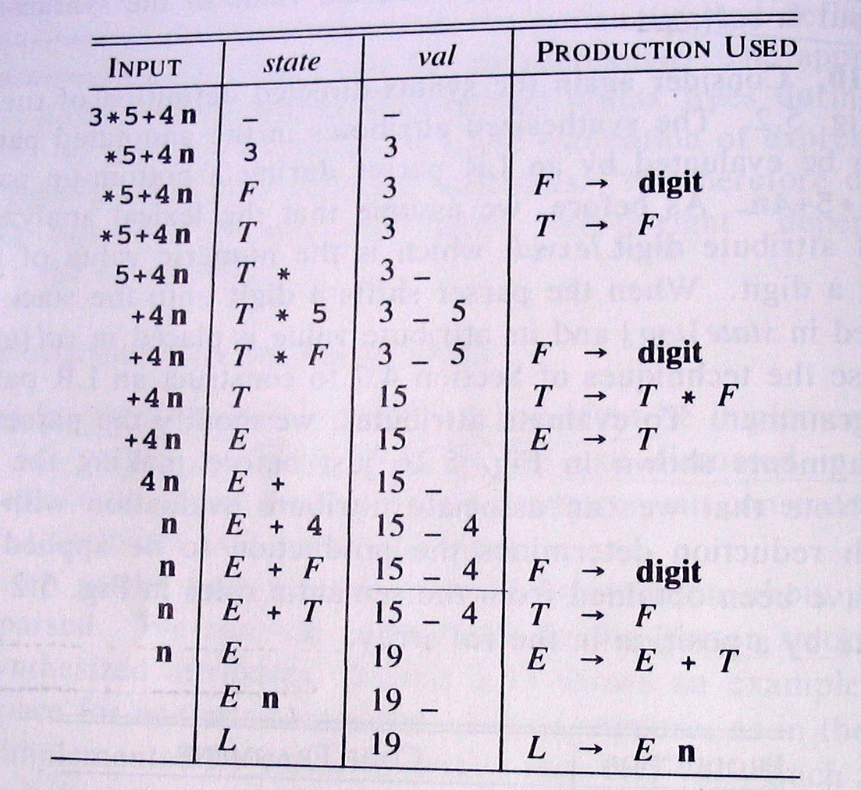
Extending a Parser Stack: An Example (Cont.)
(25)
• The following Figure shows the moves made by the parser on input 3*5+4n.
– Stack states are replaced by their corresponding grammar symbol;
– Instead of the token digit the actual value is shown.

Slide 28
(26)
Summary
• Syntax Directed Translations
• Syntax Directed Definitions
• Implementing Syntax Directed Definitions
– Dependency Graphs
– S-Attributed Definitions
– L-Attributed Definitions
• Translation Schemes

Slide 29
(27)
L-Attributed Definitions
• L-Attributed Definitions contain both synthesized and inherited attributes
but do not need to build a dependency graph to evaluate them.
• Definition. A syntax directed definition is L-Attributed if each inherited
attribute of X_{j} in a production A → X₁ . . . X_{j} . . . X_{n}, depends only on:
1. The attributes of the symbols to the left (this is what L in L-Attributed
stands for) of Xj , i.e., X1X2 . . .
2. The inherited attributes of A.
Xj −1,
and
• Theorem. Inherited attributes in L-Attributed Definitions can be computed
by a PreOrder traversal of the parse-tree.

Slide 30
Evaluating L-Attributed Definitions
(28)
• L-Attributed Definitions are a class of syntax directed definitions whose
attributes can always be evaluated by single traversal of the parse-tree.
• The following procedure evaluate L-Attributed Definitions by mixing
PostOrder (synthesized) and PreOrder (inherited) traversal.
Algorithm: L-Eval(n: Node)
Input: Node of an annotated parse-tree.
Output: Attribute evaluation.
Begin
For each child m of n, from left-to-right
Begin
Evaluate inherited attributes of m;
L-Eval(m)
End;
Evaluate synthesized attributes of n
Do
End.

Slide 31
(29)
Summary
• Syntax Directed Translations
• Syntax Directed Definitions
• Implementing Syntax Directed Definitions
– Dependency Graphs
– S-Attributed Definitions
– L-Attributed Definitions
• Translation Schemes

Slide 32
(30)
Translation Schemes
• Translation Schemes are more implementation oriented than syntax directed
definitions since they indicate the order in which semantic rules and attributes are to be evaluated.
• Definition. A Translation Scheme is a context-free grammar in which
1. Attributes are associated with grammar symbols;
2. Semantic Actions are enclosed between braces {} and are inserted within the right-hand side of productions.
• Yacc uses Translation Schemes.

Slide 33
(31)
Translation Schemes (Cont.)
• Translation Schemes deal with both synthesized and inherited attributes.
• Semantic Actions are treated as terminal symbols: Annotated parse-trees
contain semantic actions as children of the node standing for the correspond- ing production.
• Translation Schemes are useful to evaluate L-Attributed definitions at parsing
time (even if they are a general mechanism).
– An L-Attributed Syntax-Directed Definition can be turned into a
Translation Scheme.

Slide 34
(32)
Translation Schemes: An Example
• Consider the Translation Scheme for the L-Attributed Definition for
declarations”:
“type
D →
T {L.in := T .type} L
int {T .type :=integer}
real {T .type :=real}
{L₁ .in := L.in} L₁ , id {addtype(id.entry, L.in)}
id {addtype(id.entry, L.in)}
T
T
L
L
→
→
→
→

Slide 35
(33)
Translation Schemes: An Example (Cont.)
• Example (Cont). The parse-tree with semantic actions for the input
real id₁, id₂, id₃ is:
D
T
{L.in := T .type}
L
real
{T.type
:= real} {L1 .in := L.in}
L1
,
id3
{addtype(id3 .entry,
L.in)}
{L2 .in := L1 .in} L2
,
id2 {addtype(id2 .entry,
L1 .in)}
id1
{addtype(id1 .entry, L2 .in)}
• Traversing the Parse-Tree in depth-first order (PostOrder) we can
evaluate the attributes.

Slide 36
(34)
Design of Translation Schemes
• When designing a Translation Scheme we must be sure that an attribute
is available when a semantic action is executed.
value
• When the semantic action involves only synthesized attributes: The
action can be put at the end of the production.
– Example. The following Production and Semantic Rule:
T → T1 ∗ F
T .val
:= T1 .val
∗ F.val
yield the translation scheme:
T → T1 ∗ F
{T .val := T1 .val ∗ F.val}

Slide 37
(35)
Design of Translation Schemes (Cont.)
• Rules for Implementing L-Attributed SDD’s. If we have an L-Attibuted
Syntax-Directed Definition we must enforce the following restrictions:
1. An inherited attribute for a symbol in the right-hand side of a production
must be computed in an action before the symbol;
2. A synthesized attribute for the non terminal on the left-hand side can only be computed when all the attributes it references have been computed: The action is usually put at the end of the production.

Slide 38
(36)
Compile-Time Evaluation of Translation Schemes
• Attributes in a Translation Scheme following the above rules can be computed
at compile time similarly to the evaluation of S-Attributed Definitions.
• Main Idea. Starting from a Translation Scheme (with embedded actions) we
introduce a transformation that makes all the actions occur at the right ends
of their productions.
– For each embedded semantic action we introduce a new Marker (i.e., a
non terminal, say M ) with an empty production (M → ǫ);
– The semantic action is attached at the end of the production M → ǫ.

Slide 39
(37)
Compile-Time Evaluation of Translation Schemes
(Cont.)
• Example. Consider the following translation scheme:
S
S C
→ aA{C.i = f (A.s)}C
→ bAB{C.i = f (A.s)}C
→ c{C.s = g(C.i)}
Then, we add new markers M1 , M2
with:
S
S
→ aAM1 C
→ bABM2 C
M1
M2
→ ǫ
→ ǫ
{M1 .s
{M2 .s
:= f (val[top])}
:= f (val[top − 1])}
C → c
The inherited
{C.s := g(val[top − 1])}
attribute of C is the synthesized attribute of either M1 or M2 :
The value of C.i is always in val[top -1] when C → c is applied.

Slide 40
Compile-Time Evaluation of Translation Schemes (Cont.)
(38)
General rules to compute translations schemes during bottom-up parsing assum-
ing
•
an L-attributed grammar.
For every production A
→ X1 . . . Xn introduce n new markers
M1 , . . . , Mn and replace the production by A → M1 X1 . . . Mn Xn.
Thus, we know the position of every synthesized and inherited attribute of
X_{j} and A:
1. X_{j} .s is stored in the val entry in the parser stack associated with X_{j} ;
2. X_{j} .i is stored in the val entry in the parser stack associated with M_{j} ;
3. A.i is stored in the val entry in the parser stack immediately before the
position storing M₁ .
Remark 1. Since there is only one production for each marker a grammar
remains LL(1) with addition of markers.
Remark 2. Adding markers to an LR(1) Grammar can introduce conflicts for not L-Attributed SDD’s!!!
•
•
•

Slide 41
Compile-Time Evaluation of Translation Schemes (Cont.)
(39)
Example. Computing the inherited attribute Xj .i after reducing with Mj →
ǫ.
M_{j}
X_{j} .i
top→ Xj −1
Xj −1
Xj −1.s
X_{j −1}.i
•
•
•
•
•
A.i is in val[top − 2j + 2];
X1.i is in val[top − 2j + 3];
Mj −1
. . .
. . .
X₁
X₁ .s
X1.s is in val[top
X₂.i is in val[top
and so on.
− 2j + 4];
− 2j + 5];
M₁
X₁ .i
(top-2j+2)→
M_{A}
A.i
(top-2j)→

Slide 42
(40)
Summary
• Syntax Directed Translations
• Syntax Directed Definitions
• Implementing Syntax Directed Definitions
– Dependency Graphs
– S-Attributed Definitions
– L-Attributed Definitions
• Translation Schemes

