Slide 1
MODULE-IV
Intermediate Code Generation

Slide 2
Contents
Intermediate Code Generation
Intermediate Languages - prefix - postfix
Quadruple - triple - indirect triples Representation
Syntax tree- Evaluation of expression - three-address code
Synthesized attributes – Inherited attributes
Intermediate languages – Declarations
Assignment Statements
Boolean Expressions, Case Statements
Back patching

Slide 3
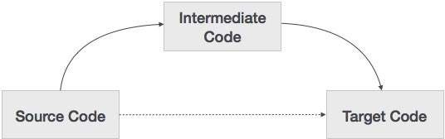
What is intermediate code?
During the translation of a source program into the object code for a target machine, a compiler may generate a middle-level language code, which is known as intermediate code

Slide 4
Three-address instruction forms
1. Assignment instructions of the form x = y op z,
where op is a binary arithmetic or logical operation, and x, y, and z are addresses.
2. Assignments of the form x = op y,
where op is a unary operation.
unary operations include unary minus, logical negation, and
Conversion operators that, for example, convert an integer to a floating-point number.
3. Copy instructions of the form x = y, where x is assigned the value of y.
4. An unconditional jump goto L.
The three-address instruction with label L is the next to be executed.
5. Conditional jumps of the form if x goto L and if False x goto L.
Execute the instruction with label L next if x is true and false, respectively.
Otherwise, the following three-address instruction in sequence is executed next, as usual.

Slide 5
Three-address instruction forms
Conditional jumps such as if x relop y goto L,
which apply a relational operator (<, ==, >=, etc.) to x and y, and execute the instruction with label L next if x stands in relation relop to y.
If not, the three-address instruction following if x relop y goto L is executed next, in sequence.
Procedure calls and returns are implemented using the following instructions:
param x for parameters;
call p, n and y = call p, n for procedure and function calls, respectively; and
return y, where y, representing a returned value, is optional.
Their typical use is as the sequence of three-address instructions
param x1
param x2
------
param xn
call p, n

Slide 6
Three-address instruction forms
generated as part of a call of the procedure p(x1; x2; : : : ; xn).
The integer n, indicating the number of actual parameters in
\call p, n," is not redundant because calls can be nested

Slide 7
Three-address instruction forms
Indexed copy instructions of the form x = y[i] and x[i]=y.
The instruction x = y[i] sets x to the value in the location i memory units beyond
location y.
The instruction x[i]=y sets the contents of the location I units beyond x to the value of y.
Address and pointer assignments of the form x = &y, x = *y, and * x = y.
The instruction x = &y sets the r-value of x to be the location (l-value) of y.
Presumably y is a name, perhaps a temporary, that denotes an expression with an l-value such as A[i][j], and x is a pointer name or temporary.
In the instruction x = * y, presumably y is a pointer or a temporary whose r-value is a location.
The r-value of x is made equal to the contents of that location.
Finally, * x = y sets the r-value of the object pointed to by x to the r-value of y.

Slide 8
Example -3 address code
do i = i+1; while (a[i] < v);
Two possible translations of this statement
Symbolic Labels
L: t1=i+1
i=t1
t2=i*8
t3=a[t2]
If t3<v goto L
Position Numbers
100: t1=i+1
101: i=t1
102:t2=i*8
103: t3=a[t2]
104: If t3<v goto 100

Slide 9
Intermediate code
The following are commonly used intermediate code representation :
Syntax tree
Postfix Notation
Three-Address Code

Slide 10
Syntax tree
Syntax tree is more than condensed form of a parse tree.
The operator and keyword nodes of the parse tree are moved to their parents and a chain of single productions is replaced by single link in syntax tree.
The internal nodes are operators and child nodes are operands.
To form syntax tree put parentheses in the expression, this way it's easy to recognize which operand should come first.

Slide 11
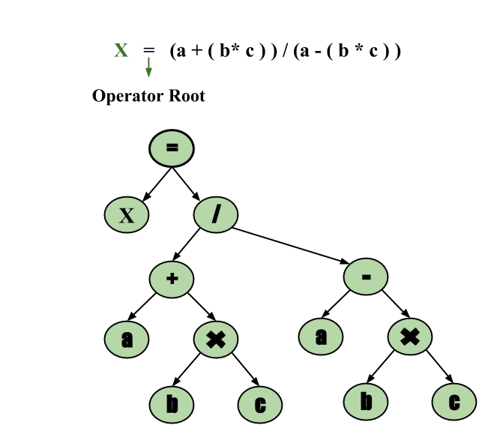
Syntax tree
Example –
x = (a + b * c) / (a – b * c)

Slide 12
Postfix Notation
The ordinary (infix) way of writing the sum of a and b is with operator in the middle : a + b
The postfix notation for the same expression places the operator at the right end as ab +.
In general, if e1 and e2 are any postfix expressions, and + is any binary operator, the result of applying + to the values denoted by e1 and e2 is postfix notation by e1e2 +.
No parentheses are needed in postfix notation because the position and arity (number of arguments) of the operators permit only one way to decode a postfix expression.
In postfix notation the operator follows the operand.

Slide 13
Postfix Notation
Example – The postfix representation of the expression
(a – b) * (c + d) + (a – b) is
ab – cd + ab -+*.

Slide 14
Three-Address Code
A statement involving no more than three references(two for operands and one for result) is known as three address statement.
A sequence of three address statements is known as three address code. Three address statement is of the form x = y op z , here x, y, z will have address (memory location).
Sometimes a statement might contain less than three references but it is still called three address statement.
For Example :a = b + c * d;
The intermediate code generator will try to divide this expression into sub-expressions and then generate the corresponding code.
r1 = c * d;
r2 = b + r1;
a = r2

Slide 15
Three-Address Code
A three-address code has at most three address locations to calculate the expression. A three- address code can be represented in three forms :
Quadruples
Triples
Indirect Triples

Slide 16

Quadruples
Each instruction in quadruples presentation is divided into four fields: operator, arg1, arg2, and result. The example is represented below in quadruples format:
OP | arg1 | arg2 | result
* | c | d | r1
+ | b | r1 | r2
= | r2 |  | a

Slide 17
Triples
Each instruction in triples presentation has three fields : op, arg1, and arg2.The results of respective sub-expressions are denoted by the position of expression.
 | OP | arg1 | arg2
(0) | * | c | d
(1) | + | b | (0)
(2) | = | (1)

Slide 18
Indirect Triples
This representation is an enhancement over triples representation.
It uses pointers instead of position to store results.
This enables the optimizers to freely re-position the sub-expression to produce an optimized code.
 |  | OP | arg1 | arg2
35 | (0) | * | c | d
36 | (1) | + | b | (0)
37 | (2) | = | (1)

Slide 19
Type Expressions
Example: int[2][3]
array(2,array(3,integer))
A basic type is a type expression
A type name is a type expression
A type expression can be formed by applying the array type constructor to a number and a type expression.
A record is a data structure with named field
A type expression can be formed by using the type constructor g for function types
If s and t are type expressions, then their Cartesian product s*t is a type expression
Type expressions may contain variables whose values are type expressions

Slide 20
Type Equivalence
They are the same basic type.
They are formed by applying the same constructor to structurally equivalent types.
One is a type name that denotes the other.

Slide 21

Declarations

Slide 22
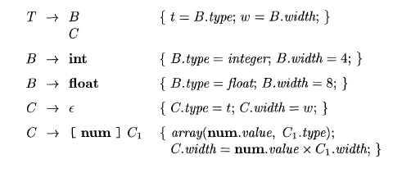
Storage Layout for Local Names
Computing types and their widths

Slide 23
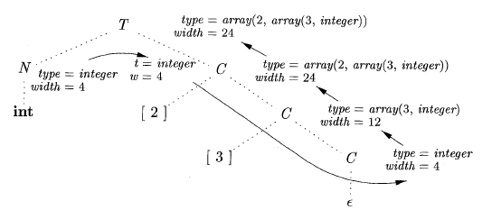
Storage Layout for Local Names
Syntax-directed translation of array types

Slide 24

Sequences of Declarations
Actions at the end:

Slide 25
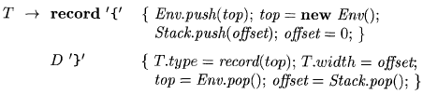
Fields in Records and Classes

Slide 26
Translation of Expressions and Statements
We discussed how to find the types and offset of variables
We have therefore necessary preparations to discuss about translation to intermediate code
We also discuss the type checking

Slide 27
Three-address code for expressions

Slide 28
Incremental Translation

Slide 29
Addressing Array Elements
Layouts for a two-dimensional array:

Slide 30
Semantic actions for array reference

Slide 31
Translation of Array References
Nonterminal L has three synthesized attributes:
L.addr
L.array
L.type

Slide 32
Conversions between primitive types in Java

Slide 33
Introducing type conversions into expression evaluation

Slide 34
Boolean Expression
The translation of if-else-statements and while-statements is tied to the translation of boolean expressions.
In programming languages, boolean expressions are used to
1. Alter the flow of control.
2. Compute logical values.

Slide 35
Boolean Expression
1. Alter the flow of control.
Boolean expressions are used as conditional expressions in statements that alter the flow of control.
The value of such boolean expressions is implicit in a position reached in a program.
For example, in if (E) S, the expression E must be true if statement S is reached.
2. Compute logical values.
A boolean expression can represent true or false as values.
Boolean expressions can be evaluated in analogy to arithmetic expressions using three-address instructions with logical operators.

Slide 36
Boolean Expression
The intended use of boolean expressions is determined by its syntactic context.
For example, an expression following the keyword if is used to alter the flow of control, while an expression on the right side of an assignment is used to denote a logical value.
Such syntactic contexts can be specified in a number of ways:
we may use two different nonterminals, use inherited attributes, or set a flag during parsing.
Alternatively we may build a syntax tree and invoke different procedures for the two different uses of boolean expressions.

Slide 37
Boolean expressions
Focus on the use of boolean expressions to alter the flow
of control
Boolean expressions are composed of the boolean operators
&& - AND, I I - OR, and ! - NOT
applied to elements that are boolean variables or relational expressions.
Relational expressions are of the form El re1 E2, where El and E2 are arithmetic expressions
Grammar to generate Boolean expression:
B → B1 or B2 | B → B1 and B2 | B → not B1 | B → (B1)|B → E1 relop E2 |
B → false| B → true

Slide 38
Boolean expressions
Semantic definition of the programming language determines
whether all parts of a boolean expression must be evaluated.
If the language definition permits (or requires) portions of a boolean expression to go unevaluated
the compiler can optimize the evaluation of boolean expressions by computing only enough of an expression to determine its value.
In an expression such as B1 I I B2, neither B1 nor B2 is necessarily evaluated fully.
If we determine that B1 is true, then we can conclude that the entire expression is true without having to evaluate B2.
Similarly, given B1&&B2, if B1 is false, then the entire expression is false.

Slide 39
Short-Circuit Code
In short-circuit (or jumping) code, the boolean operators &&, I I , and ! translate into jumps.
The operators themselves do not appear in the code
Instead, the value of a boolean expression is represented by a position in the code sequence.

Slide 40
Short-Circuit Code
The statement
might be translated into the code
In this translation, the Boolean expression is true if control reaches label L2.
If the expression is false, control goes immediately to L1, skipping L2 and the assignment x = 0.

Slide 41
Flow-of-Control Statements
Translation of boolean expressions into three-address code in the context of statements generated using the following grammar
S -> if (B) S1
S -> if ( B ) S1 else S2
S -> while ( B ) S1
Non terminal B represents a boolean expression and nonterminal S represents a statement

Slide 42
Boolean Expression
Synthesized attributes associated with Boolean expression and Statement
B.code ,S.code- gives the translation into three-address instructions
Inherited attributes associated with Boolean expression and Statement
B.true - label to which control flows if B is true
B.false - label to which control flows if B is false
S.next - label attached to the first 3-address statement to be executed immediately after the code for S.
Functions used in Syntax directed definitions
newlabel() creates a new label each time it is called
label(L) attaches label L to the next three-address instruction to be generated

Slide 43
Syntax directed definition for P → S
P-> S : Program P consist of statement S
S.next is initialized to to a new label
P.code consists of S.code followed by the new label S.next
assign is a placeholder for assignment statements

Slide 44
Syntax directed definition for S → S₁S₂
S1 followed by the code for S2
The first instruction after the code for S1 is the beginning of the code for S2
The instruction after the code for S2 is also the instruction after the code for S.

Slide 45
Syntax directed definition for Boolean Expression S -> if (B) S1
Syntax-directed definition
Create a new label B.true and attach it to the first three-address instruction generated for the statement S1
Within B. code are jumps based on the value of B.
If B is true, control flows to the first instruction of S1 .code, and
If B is false, control flows to the instruction immediately following S1.code.
By setting B.false to S.next, we ensure that control will skip the code for S1 if B evaluates to false.

Slide 46
Syntax directed definition for Boolean Expression S -> if ( B ) S1 else S2
Syntax-directed definition
Create two labels B.true and B.false
If B is true, B jumps to the first instruction of the code for S1
If B is false, jumps to the first instruction of the code for S2
Control flows from both S1 and S2 to the three-address instruction immediately following the code for S - its label is given by the inherited attribute S.next.
An explicit goto S.next appears after the code for S1 to skip over the code for S2.
No goto is needed after S2, since S2. next is the same as S. next.

Slide 47
Boolean Expression S → while (B) S1
Syntax-directed definition
begin – local variable that holds a new label attached to the first instruction for the while-statement, also the first instruction for B.
begin- is a variable rather than an attribute, because begin is local to the semantic rules for this production.
S.next - marks the instruction that control must flow to if B is false; hence, B. false is set to be S.next
B. true - Code for B generates a jump to this label if B is true and attached to the first instruction for S1
goto begin - causes a jump back to the beginning of the code for the boolean expression.
S1 .next is set to this label begin, so jumps from within S1. code can go directly to begin

Slide 48
Control-Flow Translation of Boolean Expressions
Boolean expression B is translated into three-address instructions
B is evaluated using conditional and unconditional jumps to one of two labels:
B.true - if B is true
B.fa1se - if B is false

Slide 49
Control-Flow Translation of Boolean Expressions
If B1 is true, then B itself is true, so B1.true is the same as B.true.
If B1 is false, then B2 must be evaluated, so make B1.false be the label of the first instruction in the code for B2.
The true and false exits of B2 are the same as the true and false exits of B, respectively.

Slide 50
Control-Flow Translation of Boolean Expressions
If B1 is true, then B2 must be evaluated so make B1.true is assigned as the label of the first instruction in the code for B2
If B1 is false, then B itself is false, so B1.false is the same as B.false
If B2 is true, then B itself is true, so B2.true is the same as B.true
If B2 is false, then B itself is false, so B2.false is the same as B.false

Slide 51
Control-Flow Translation of Boolean Expressions
No code is needed for an expression B of the form ! B1
Interchange the true and false exits of B to get the true and false exits of B1.

Slide 52
Control-Flow Translation of Boolean Expressions
Translated directly into a comparison three-address instruction with jumps to the appropriate places
For instance, B of the form a < b translates into

Slide 53
Control-Flow Translation of Boolean Expressions
The constants true and false translate into jumps to B.true and B.false, respectively

Slide 54
S
Control-Flow Translation of Boolean Expressions -Example
Consider the expression
S
S.next
L1:

Slide 55
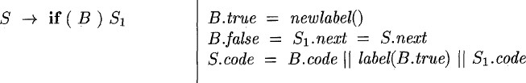
B
S₁
if B.condition goto B.true
goto B.false
L2: x = 0 S₁.code
L1:

Slide 56

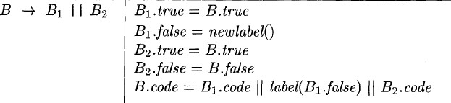
B₁
B₂
If B1.condition goto L2
goto L3
L3:If B2.condition goto L2
goto L1
L2: x = 0
L1:
B₁.true = B.true = L2 B₁.false = L3
B₂.true = B.true = L2 B₂.false = B.false = L1
B.true
B.false

Slide 57
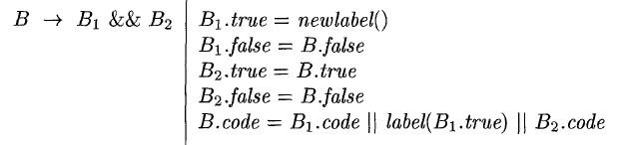
B₁
B₂
If x< 100 goto L2
goto L3
L3: If B2.condition goto L2
goto L1
L2: x = 0
L1:

Slide 58
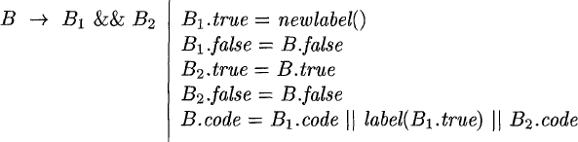
B₁
B₂
If X < 100 goto L2
goto L3
L3: If B2.condition goto L2 goto L1
L2: x = 0
L1:
B₁.true = L4
B₁.false = B.false = L1 B₂.true = B.true = L2 B₂.false = B.false = L1

Slide 59
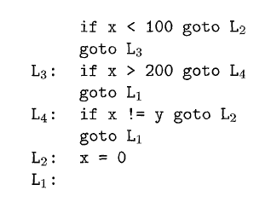
B₁
B₂
Control-Flow Translation of the above statement is
B₁.true = L4
B₁.false = B.false = L1 B₂.true = B.true = L2 B₂.false = B.false = L1
If B1.condition goto L4 goto L1
L4: If B2.condition goto L2
goto L1

Slide 60
Avoiding Redundant Gotos
if x > 200 goto L4 goto L1
L4: …
➔
ifFalse x > 200 goto L1 L4: …
(fall through)
Translated code of Boolean expressions are not optimized ones
Redundant gotos are noticed
Can be avoided using fallthrough

Slide 61
Using Fall Through
We now adapt the semantic rules for boolean expressions to allow control to fall through whenever possible.
S → if (E) S₁
{E.true = fall; // not newlabel; E.false = S.next;
S₁.next = S.next;
S.code = E.code || S₁.code }
Similarly, the rules for if-else- and while- statements also set E.true to fall.

Slide 62
Using Fall Through Cont’d
E → E₁ || E₂
{E₁.true = if (E.true = fall) then newlabel() else E.true; E₁.false = fall;
E₂.true = E.true; E₂.false = E.false;
E.code = if (E.true = fall) then E₁.code || E₂.code ||
label(E₁.true)
else E₁.code || E₂.code }
E → E₁ && E₂
{E₁.true = fall;
E₁.false = if (E.false = fall) then newlabel() else E.false;
E₂.true = E.true; E₂.false = E.false;
E.code = if (E.false = fall) then E₁.code || E₂.code ||
label(E₁.false)
else E₁.code || E₂.code }

Slide 63
Using Fall Through Cont’d
E → E₁ relop E₂
{test = E₁.addr relop E₂.addr
s = if E.true != fall and E.false != fall then
gen(‘if’ test ‘goto’, E.true) || gen(‘goto’, E.false) else if (E.true != fall) then gen(‘if’ test ‘goto’, E.true)
else if (E.false != fall) then gen(‘ifFalse’ test ‘goto’, E.false)
else ‘’
E.code := E₁.code || E₂ .code || s
}

Slide 64
Using Fall Through Example
if (X < 100 || x > 200 && x != y) x = 0;
=>
if x < 100 goto L2 ifFalse x > 200 goto L1 ifFalse x!=y goto L1
L2: x = 0 L1:

Slide 65
Problems to be solved
Translate the following expressions with and without fall through
If (a==b && c==d || e==f) x==1;
If (a==b || c==d || e==f) x==1;
If (a==b && c==d && e==f) x==1;
If a < b or c < d and e < f
while a < b do
if c<d then
x=y+z
else
x=y-z

Slide 66
Backpatching
A key problem when generating code for boolean expressions and flow-of-control statements is that of matching a jump instruction with the target of the jump.
For example, the translation of the boolean expression B in if ( B ) S contains a jump, for when B is false, to the instruction following the code for S.
In a one-pass translation, B must be translated before S is examined.
What then is the target of the goto that jumps over the code for S?

Slide 67
Backpatching
For the examples of the previous lectures for implementing syntax-directed definitions, the easiest way is to use two passes.
First syntax tree is constructed
Then traversed in depth-first order to compute the translations given in the definition.
Problem in generating three address codes in a single pass for Boolean expressions and flow of control statements is :
We may not know the labels that control must go to at the time jump statements are generated.

Slide 68
Backpatching
This problem is solved by generating a series of branch statements with the targets of the jumps temporarily left unspecified.
Each such statement will be put on a list of goto statements whose labels will be filled in when the proper label can be determined.
This subsequent filling of addresses for the determined labels is called BACKPATCHING.

Slide 69
Backpatching
For implementing Backpatching
Instructions are generated into an instruction array
Labels act as indices to this array.
To manipulate list of labels , three functions are used:
makelist(i)
merge(p1,p2) and
backpatch(p,i)

Slide 70
Backpatching
makelist(i) : creates a new list containing only i, an index into the array of instructions and returns pointer to the list it has made.
merge(i,j) – concatenates the lists pointed to by i and j ,and returns a pointer to the concatenated list.
backpatch(p,i) – inserts i as the target label for each of the statements on the list pointed to by p.

Slide 71
Backpatching
Let’s now try to construct the translation scheme for Boolean expression.
Let the grammar be:
B → B1 or MB2
B → B1 and MB2
B → not B1
B → (B1)
B → id1 relop id2
B → false
B → true
M → ε

Slide 72
Backpatching
What we have done is inserting a marker non-terminal M into the grammar to cause a semantic action to pick up, at appropriate times the index of the next instructionto be generated.
This is done by the semantic action:
{ M.instr = nextinstr; } for the rule M → ε

Slide 73
Backpatching
Two synthesized attributes truelist and falselist of non-terminal B are used to generate jumping code for Boolean expressions.
B.truelist : Contains the list of all the jump statements left incomplete to be filled by the label for the start of the code for B=true.
B.falselist : Contains the list of all the jump statements left incomplete to be filled by the label for the start of the code for B=false.

Slide 74
Backpatching
The variable nextinstr holds the index of the next instruction to follow.
This value will be backpatched onto B₁.truelist in case of B → B1 and MB2 where it contains the address of the first statement of B₂.code.
This value will be backpatched onto B₁.falselist in case of B → B1 or MB2 where it contains the address of the first statement of B₂.code.

Slide 75
Backpatching-Boolean expressions
We use the following semantic actions for the above grammar :
1) B → B₁ or M B₂
backpatch(B₁.falselist, M.instr)
B.truelist = merge(B₁.truelist, B₂.truelist)
B.falselist = B₂.falselist
If B1 is true, then B is also true, so the jumps on B1. truelist become part of B.truelist.
If B1 is false, we must next test B2, so the target for the jumps B1.falselist must be the beginning of the code generated for B2.
This target is obtained using the marker nonterminal M.
M produces, as a synthesized attribute M.instr, the index of the next instruction, just before B2 code starts being generated
The value M.instr will be backpatched onto the B1 .falselist (i.e., each instruction on the list B1. falselist will receive M.instr as its target label) when we have seen the remainder of the production B -> B1 or M B2.

Slide 76
Backpatching -Boolean expressions
2)B → B₁ and M B₂
backpatch(B₁.truelist, M.instr)
B.truelist = B₂.truelist
B.falselist = merge(B₁.falselist, B₂.falselist)
If B1 is true, we must next test B2, so the target for the jumps B1. truelist must be the beginning of the code generated for B2.
This target is obtained using the marker nonterminal M.instr , the index of the next instruction, just before B2 code starts being generated
The value M.instr will be backpatched onto the B1.truelist.
If B1 is false, then B is also false, so the jumps on B1. falselist become part of B.falselist.

Slide 77
Backpatching -Boolean expressions
Swaps the true and false lists
3) B → not B₁
B.truelist = B₁.falselist
B.falselist = B₁.truelist
4) B → (B₁)
B.truelist = B₁.truelist
B.falselist = B₁.falselist
5) B → id₁ relop id₂
B.truelist = makelist(nextinstr)
B.falselist = makelist(nextinstr+1 )
emit(if id₁.place relop id₂.place goto __ )
emit(goto ___)
Ignores parenthesis
generates two instructions, a conditional goto and an unconditional one.
Both gotos have unfilled targets
These instructions are put on B.truelist and B.falselist, respectively

Slide 78
Backpatching-Boolean expressions
6) B → true
B.truelist = makelist(nextinstr)
emit(goto ___)
7) B → false
E.falselist = makelist(nextinstr)
emit(goto ___)
8) M → ε
M.instr = nextinstr;

Slide 79
Backpatching-Boolean expressions Example
Expression of of the form B → B₁ or M B₂
Consider the expression
B
B1
B2
B → B₁ or M B₂
backpatch(B₁.falselist, M.instr)
B.truelist = merge(B₁.truelist, B₂.truelist)
B.falselist = B₂.falselist

Slide 80
Backpatching-Boolean expressions Example
B
B1
B2
B → id₁ relop id₂
B.truelist = makelist(nextinstr)
B.falselist = makelist(nextinstr+1 )
emit(if id₁.place relop id₂.place goto __ )
emit(goto ___)

Slide 81
Backpatching-Boolean expressions Example
Expression of of the form B → B₁ or M B₂
B
B1
B2
The marker nonterminal M in the production records the value of nextinstr, which at this time is 102
B → B₁ or M B₂
backpatch(B₁.falselist, M.instr)
B.truelist = merge(B₁.truelist, B₂.truelist)
B.falselist = B₂.falselist

Slide 82
Backpatching-Boolean expressions Example
B
B1
B2
B → id₁ relop id₂
B.truelist = makelist(nextinstr)
B.falselist = makelist(nextinstr+1 )
emit(if id₁.place relop id₂.place goto __ )
emit(goto ___)

Slide 83
Backpatching-Boolean expressions Example
B
B1
B2
The marker nonterminal M in the production records the value of nextinstr, which at this time is 104
2)B → B₁ and M B₂
backpatch(B₁.truelist, M.instr)
B.truelist = B₂.truelist
B.falselist = merge(B₁.falselist, B₂.falselist)

Slide 84
Backpatching-Boolean expressions Example
B
B1
B2
B → id₁ relop id₂
B.truelist = makelist(nextinstr)
B.falselist = makelist(nextinstr+1 )
emit(if id₁.place relop id₂.place goto __ )
emit(goto ___)

Slide 85
Backpatching -Boolean expressions Example
B
B1
B2
B₁.truelist =102
M.instr=104
backpatch(102,104) – instruction in 102 is filled with 104
2)B → B₁ and M B₂
backpatch(B₁.truelist, M.instr)
B.truelist = B₂.truelist
B.falselist = merge(B₁.falselist, B₂.falselist)

Slide 86
Backpatching-Boolean expressions Example
Expression of of the form B → B₁ or M B₂
B
B2
B1
B₁.falselist =101
M.instr=102
backpatch(101,102) – instruction in 101 is filled with 102
B → B₁ or M B₂
backpatch(B₁.falselist, M.instr)
B.truelist = merge(B₁.truelist, B₂.truelist)
B.falselist = B₂.falselist

Slide 87
Backpatching-Boolean expressions Example
B
The entire expression is true if and only if the gotos of instructions 100
or 104 are reached
Expression is false if and only if the gotos of instructions 103 or 105 are reached.

Slide 88
Backpatching-Boolean expressions Example
Annotated parse tree for

Slide 89
Backpatching-Flow of control
Backpatching can be used to translate flow-of-control statements in one pass.
Consider statements generated by the following grammar:
S denotes a statement
L denotes statement list
B denotes boolean expression

Slide 90
Backpatching-Flow of control
Boolean expressions generated by nonterminal B have two lists of jumps
B. truelist -Contains the list of all the jump statements left incomplete to be filled by the label for the start of the code for B=true.
B.falselist-Contains the list of all the jump statements left incomplete to be filled by the label for the start of the code for B=false.
Statements generated by nonterminals S and L have a list of unfilled jumps
Eventually filled by backpatching.
S.nextlist - list of all conditional and unconditional jumps to the instruction following the code for statement S in execution order.
L.nextlist - list of all conditional and unconditional jumps to the instruction following the code for statement L in execution order

Slide 91
Backpatching-Translation of Flow of control statements

Slide 92
Backpatching-Flow of control
In the above production
Two occurrences of the marker nonterminal M
Used to record the instruction numbers of the beginning of the code for B and the beginning of the code for S1
For the rule M → ε , semantic action is { M.instr = nextinstr; }
After the body S1 of the while-statement is executed, control flows to the beginning.
When the entire production is reduced to S, S1.nextlist is backpatched to make all targets on that list be M1.instr.
An explicit jump to the beginning of the code for B is appended after the code for S1 because control may also "fall out the bottom."
B.truelist is backpatched to go to the beginning of S1 by making jumps on B. truelist go to M2 . instr.

Slide 93
Backpatching-Flow of control
If control "falls out the bottom" of S1, as when S1 is an assignment
code has to be included at the end of S1 to jump to S2
A new nonterminal N with production N → ε is introduced for this purpose
N has attribute N.nextlist, which will be a list consisting of the instruction number of the jump goto - that is generated by the semantic action (7) for N.
When B is true, jumps are backpatched to the instruction M1.instr;
Similarly, when B is false jumps are backpatched to the beginning of the code for S2.
S.nextlist includes all jumps out of S1 and S2, as well as the jump generated by N.
temp is a temporary variable that is used only for merging lists.

Slide 94
Backpatching-Flow of control
Above two productions handle sequences of statements.
In L -> L₁ M S
Instruction following the code for L1 in order of execution is the beginning of S.
Thus the L1 .nextlist list is backpatched to the beginning of the code for S, which is given by M. instr.
In L -> S , L. nextlist is the same as S.nextlist

Slide 95
Backpatching-Flow of control
No new instructions are generated anywhere in these semantic
rules, except for rules (3) and (7).
All other code is generated by the semantic actions associated with assignment-statements and expressions.
The flow of control causes the proper backpatching so that the assignments and Boolean expression evaluations will connect properly.

Slide 96
Labels and Goto Statements
Labels are stored in the symbol table (and associated with intermediate language labels).
Generated as soon as a jump or a declaration is met (to avoid one additional pass)
For “goto L”, we have to change L into the address of the three-address code for the statement where L is attached.
When L’s address has been found, we can do this easily with the information in the symbol table.
Otherwise, we have to use backpatching. We keep the list of address to be filled in the symbol table

Slide 97
Break and Continue Statements
Break/exit: pass an additional (inherited) attribute to the translation function of loops with the label a break/exit should jump to.
A new label is passed when entering a new loop
A break-statement is a jump to the first instruction after the code for the enclosing statement S.
keep track of the enclosing statement S
generate an unfilled jump for the break- statement
put the unfilled jump on S.nextlist
backpatch when the exit place is known

Slide 98
Break and Continue Statements
Continue statements :
can be handled in a manner analogous to the break statement.
The main difference between the two is that the target of the generated jump is different

Slide 99
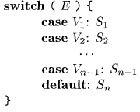
Translation of a switch-statement
The "switch" or "case" statement is available in a variety of languages.
switch-statement syntax is shown below .
There is a selector expression E, which is to be evaluated
Followed by n constant values Vl , V2, . . - , Vn that the expression might take
Has a default "value," which always matches the expression if no other value does.

Slide 100
Translation of a switch-statement
The intended translation of a switch is code to:
1. Evaluate the expression E.
2. Find the value V, in the list of cases that is the same as the value of the expression. Recall that the default value matches the expression if none of the values explicitly mentioned in cases does.
3. Execute the statement Sj associated with the value found.

Slide 101
Translation of a switch-statement
Step (2) is an n-way branch, which can be implemented in one of several ways.
If the number of cases is small (say 10 at most)
use a sequence of conditional jumps
each jump tests for an individual value and transfers to the code for the corresponding statement.
Way to implement this sequence of conditional jumps is to create a table of pairs
each pair consisting of a value and a label for the corresponding statement's code.
The value of the expression itself, paired with the label for the default statement is placed at the end of the table at run time.
A simple loop generated by the compiler compares the value of the expression with each value in the table
if no other match is found, the last (default) entry is sure to match

Slide 102
Translation of a switch-statement
If the number of values exceeds 10
Create hash table for the values, with the labels of the various statements as entries.
If no entry for the value possessed by the switch expression is found, a jump to the default statement is generated
Special case that can be implemented even more efficiently than by an n-way branch.
If the values all lie in range, say min to max
number of different values is a reasonable fraction of max - min
then we can construct an array of max-- min "buckets," where bucket j - min contains the label of the statement with value j
any bucket that would otherwise remain unfilled contains the default label.

Slide 103
Translation of a switch-statement
To perform the switch, evaluate the expression to obtain the value j;
Check that it is in the range min to max
transfer indirectly to the table entry at offset j - min.
For example, if the expression is of type character, a table of, say, 128 entries (depending on the character set) may be created and transferred through with no range testing

Slide 104
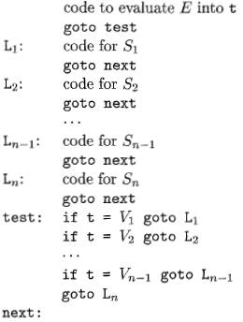
Syntax-Directed Translation of Switch-Statements
A convenient translation of the switch statement is
All tests appear at the end
A simple code generator can recognize the multiway branch and generate efficient code for it

Slide 105
Syntax-Directed Translation of Switch-Statements
When the keyword switch is noticed
generate two new labels test and next, and a new temporary t.
parse the expression E and generate code to evaluate E into t.
After processing E, generate the jump goto test .
When the keyword case is noticed
create a new label L_{i} and enter it into the symbol table.
Each value-label pair consisting of the value V, of the case constant and L_{i} (or a pointer to the symbol-table entry for L_{i}) is placed in a queue
We process each statement case V, : S_{i} by emitting the label L_{i} attached to the code for S_{i} followed by the jump goto next.

Slide 106
Syntax-Directed Translation of Switch-Statements
When the end of the switch is found
generate the code for the n-way branch.
Read the queue of value-label pairs
generate a sequence of three-address statements of the form shown below.
t is the temporary holding the value of the selector expression E
L_{n}, is the label for the default statement

Slide 107
Syntax-Directed Translation of Switch-Statements
Another form of translation of switch case
Compiler should emit code for each of the statements S_{i} as it notices.
Hence it is tedious for one-pass compiler to place the branching statements at the beginning
This form of translation is not effective

