Slide 1
Switched Communication Networks
Module 2

Slide 2
Overview
LAN topologies
Switching - Circuit Switching
X.25 Network and Frame Relay
Packet Switching-Virtual and Datagram switching
Cell switching
ATM architecture, ATM layers, ATM cell format
Multiple access

Slide 3
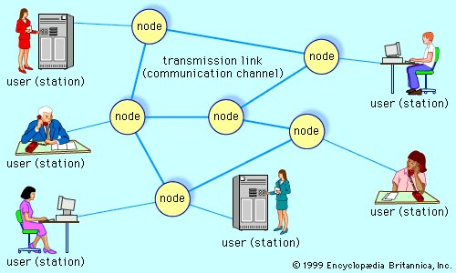
Telecommunications network, electronic system of links and switches, and the controls that govern their operation, that allows for data transfer and exchange among multiple users

Slide 4
When several users of telecommunications media wish to communicate with one another, they must be organized into some form of network.
In theory, each user can be given a direct point-to-point link to all the other users in what is known as a fully connected topology (telephone), but in practice this technique is impractical and expensive—especially for a large and dispersed network.
This method is inefficient, since most of the links will be idle at any given time.
Modern telecommunications networks avoid these issues by establishing a linked network of switches, or nodes, such that each user is connected to one of the nodes. Each link in such a network is called a communications channel. Wire, fiber-optic cable, and radio waves may be used for different communications channels.

Slide 5
Types of networks
Switched communications network
Broadcast network
Network access
Scheduled access
Random access
Carrier sense multiple access

Slide 6
Switched communications network
A switched communications network transfers data from source to destination through a series of network nodes.
Switching can be done in one of two ways. In a circuit-switched network, and a packet-switched network

Slide 7
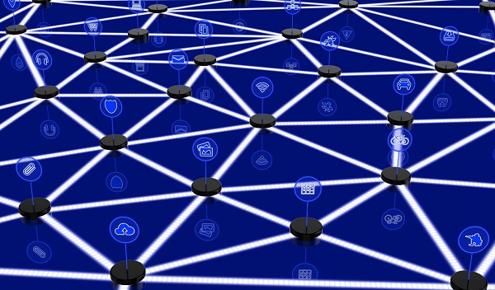
In large networks, there may be more than one paths for transmitting data from sender to receiver. Selecting a path that data must take out of the available options is called switching.

Slide 8
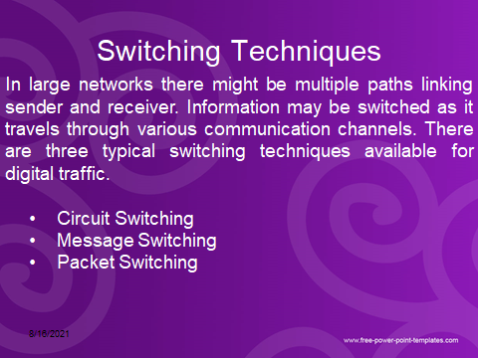
Switched Communications Networks

Slide 9
Circuit Switching
Circuit switching is a technique that directly connects the sender and the receiver in an unbroken path.
Telephone switching equipment, for example, establishes a path that connects the caller's telephone to the receiver's telephone by making a physical connection.
With this type of switching technique, once a connection is established, a dedicated path exists between both ends until the connection is terminated.
Routing decisions must be made when the circuit is first established, but there are no decisions made after that time.

Slide 10
Circuit switching
Advantages:
The communication channel (once established) is dedicated.
Once path is set up, the only delay is in data transmission speed
No problem of congestion or garbled message

Slide 11
Circuit switching
Disadvantages:
Long set up time is required.
Possible long wait to establish a connection, (10 sec, more on long distance or international calls.) during which no data can be transmitted.
A request token must travel to the receiver and then acknowledged before any transmission can happen
More expensive than any other switching techniques, because a dedicated path is required for each connection. Inefficient use of the communication channel, because the channel is not used when the connected systems are not using it.

Slide 12
Message Switching
There is no need to establish a dedicated path between two stations.
When a station sends a message, the destination address is appended to the message.
The message is then transmitted through the network, in its entirety, from node to node.
Each node receives the entire message, stores it in its entirety on disk, and then transmits the message to the next node.
This type of network is called a store-and-forward network.

Slide 13
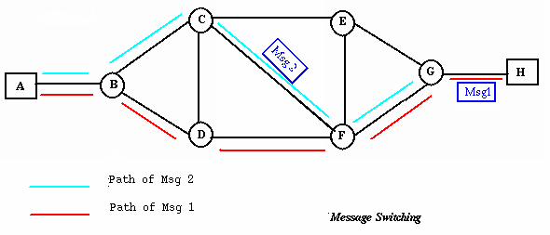
Message Switching
A message-switching node is typically a general-purpose computer.
The device needs sufficient secondary-storage capacity to store the incoming messages, which could be long.
A time delay is introduced using this type of scheme due to store- and-forward time, plus the time required to find the next node in the transmission path.

Slide 14
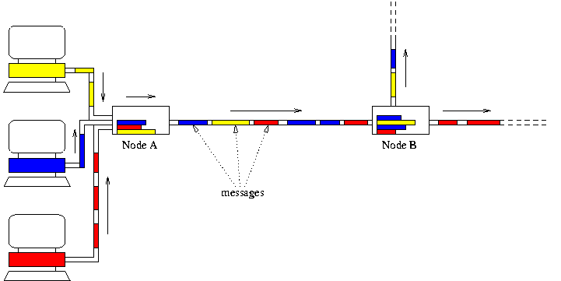
Message Switching

Slide 15
Message Switching
Advantages:
Channel efficiency can be greater compared to circuit- switched systems, because more devices are sharing the channel.
Traffic congestion can be reduced, because messages may be temporarily stored in route.
Message priorities can be established due to store-and-forward technique.
Message broadcasting can be achieved with the use of broadcast address appended in the message.

Slide 16
Message Switching
Disadvantages:
Message switching is not compatible with interactive applications.
Store-and-forward devices are expensive, because they must have large disks to hold potentially long messages.

Slide 17
Packet Switching
When the message block size is large, message switching suffers with long transmission delays.
To overcome this problem, packet switching technique is used.
Packet switching limits the length of the message to a fixed size.

Slide 18
Packet Switching
Packet switching method, a message is broken into small parts, called packets.
Each packet is tagged with appropriate source and destination addresses. Apart from the data field, a packet also contains a header and a trailer field.
Header field consists of the source and destination addresses, and sequence number of the packet. The trailer field consists of checksum that is used for error control.

Slide 19
Packet Switching
Since packets have a strictly defined maximum length, they can be stored in main memory instead of disk, therefore access delay and cost are minimized.
Also the transmission speeds, between nodes, are optimized.
With current technology, packets are generally accepted onto the network on a first-come, first-served FIFO basis. If the network becomes overloaded, packets are delayed or discarded (``dropped'').

Slide 20
Packet size
The size of the packet can vary from 180 bits, the size for the Data kit® virtual circuit switch designed by Bell Labs for communications and business applications.
To 1,024 or 2,048 bits for the 1PSS® switch, also designed by Bell Labs for public data networking; to 53 bytes for ATM switching, such as Lucent Technologies' packet switches.

Slide 21
Packet switching
The analog signal from your phone is converted into a digital data stream. That series of digital bits is then divided into relatively tiny clusters of bits, called packets. Each packet has at its beginning the digital address -- a long number -- to which it is being sent. The system blasts out all those tiny packets, as fast as it can, and they travel across the nation's digital backbone systems to their destination: the telephone, or rather the telephone system, of the person you're calling.
They do not necessarily travel together; they do not travel sequentially. They don't even all travel via the same route. But eventually they arrive at the right point -- that digital address added to the front of each string of digital data -- and at their destination are reassembled into the correct order, then converted to analog form, so your friend can understand what you're saying.

Slide 22
Advantages of packet Switching
Efficiency.
More faults tolerant.
Bill users only on the basis of duration of connectivity. improved delay
It uses a digital network.
High data transmission quality
Packet switching is cost effective
Rerouted
share the same channel at the same time

Slide 23
Disadvantages of Packet Switching
Packets may be lost on their route, so sequence numbers are required to identify missing packets.
Switching nodes requires more processing power as the packet switching protocols are more complex.
Switching nodes for packet switching require large amount of RAM to handle large quantities of packets.
A significant data transmission delay occurs – Use of store and forward method causes a significant data transmission.

Slide 24
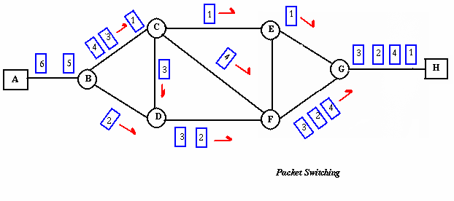
Packet Switching
Packet switching can be seen as a solution that tries to combine the advantages of message and circuit switching and to minimize the disadvantages of both.
The methods of packet switching: Datagram and virtual circuit.

Slide 25
Packet Switching: Virtual Circuit
Preplanned route is established before any data packets are sent.
A logical connection is established when a sender send a "call request packet" to the receiver and the receiver send back an acknowledge packet "call accepted packet" to the sender if the receiver agrees on conversational parameters.
The conversational parameters can be maximum packet sizes, path to be taken, and other variables necessary to establish and maintain the conversation.
Virtual circuits imply acknowledgements, flow control, and error control, so virtual circuits are reliable.
That is, they have the capability to inform upper-protocol layers if a transmission problem occurs.

Slide 26
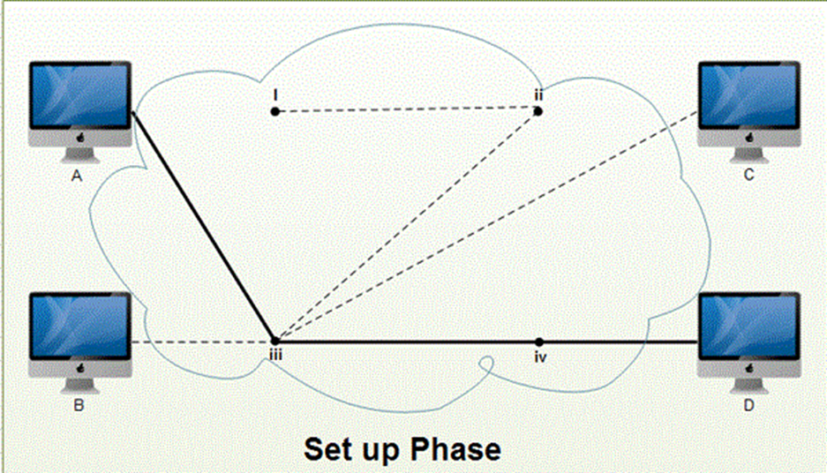
Virtual Circuit Packet Switching

Slide 27
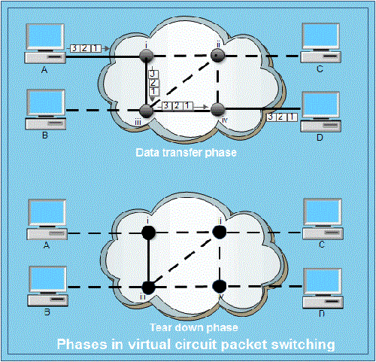
Virtual Circuit Packet Switching

Slide 28
Packet Switching:Virtual Circuit
In virtual circuit, the route between stations does not mean that this is a dedicated path, as in circuit switching.
A packet is still buffered at each node and queued for output over a line.
The difference between virtual circuit and datagram approaches:
With virtual circuit, the node does not need to make a routing decision for each packet.
It is made only once for all packets using that virtual circuit.

Slide 29
Packet Switching: Virtual Circuit
VC's offer guarantees that
the packets sent arrive in the order sent
with no duplicates or omissions
with no errors (with high probability) regardless of how they are implemented internally.

Slide 30
Packet Switching: Datagram
Datagram packet switching is similar to message switching in that each packet is a self-contained unit with complete addressing information attached.
This fact allows packets to take a variety of possible paths through the network.
So the packets, each with the same destination address, do not follow the same route, and they may arrive out of sequence at the exit point node (or the destination).
Reordering is done at the destination point based on the sequence number of the packets.
It is possible for a packet to be destroyed if one of the nodes on its way is crashed momentarily. Thus all its queued packets may be lost.

Slide 31
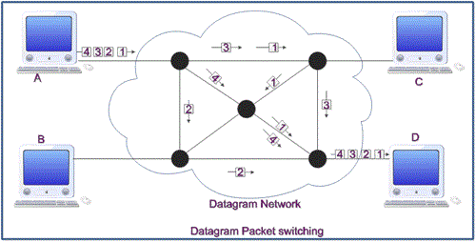
Packet Switching: Datagram
.

Slide 32
X.25ing
X.25 is a protocol suite defined by ITU-T for packet switched communications over WAN (Wide Area Network).
It was originally designed for use in the 1970s and became very popular in 1980s.
Presently, it is used for networks for ATMs and credit card verification. It allows multiple logical channels to use the same physical line. It also permits data exchange between terminals with different communication speeds.

Slide 33
X.25: three protocol layers
Physical Layer: It lays out the physical, electrical and functional characteristics that interface between the computer terminal and the link to the packet switched node. X.21 physical implementer is commonly used for the linking.
Data Link Layer: It comprises the link access procedures for exchanging data over the link. Here, control information for transmission over the link is attached to the packets from the packet layer to form the LAPB frame (Link Access Procedure Balanced). This service ensures a bit-oriented, error-free, and ordered delivery of frames.
Packet Layer: This layer defines the format of data packets and the procedures for control and transmission of the data packets. It provides external virtual circuit service. Virtual circuits may be of two types: virtual call and permanent virtual circuit. The virtual call is established dynamically when needed through call set up procedure, and the circuit is relinquished through call clearing procedure. Permanent virtual circuit, on the other hand, is fixed and network assigned.

Slide 34
Circuit switching
Advantages:
The communication channel (once established) is dedicated.
Disadvantages:
Possible long wait to establish a connection, (10 sec, more on long- distance or international calls.) during which no data can be transmitted.
More expensive than any other switching techniques, because a dedicated path is required for each connection. Inefficient use of the communication channel, because the channel is not used when the connected systems are not using it.

Slide 35
Message Switching
There is no need to establish a dedicated path between two stations.
When a station sends a message, the destination address is appended to the message.
The message is then transmitted through the network, in its entirety, from node to node.
Each node receives the entire message, stores it in its entirety on disk, and then transmits the message to the next node.
This type of network is called a store-and-forward network.

Slide 36
Message Switching
A message-switching node is typically a general-purpose computer.
The device needs sufficient secondary-storage capacity to store the incoming messages, which could be long.
A time delay is introduced using this type of scheme due to store- and-forward time, plus the time required to find the next node in the transmission path.

Slide 37
Message Switching

Slide 38
Message Switching
Advantages:
Channel efficiency can be greater compared to circuit- switched systems, because more devices are sharing the channel.
Traffic congestion can be reduced, because messages may be temporarily stored in route.
Message priorities can be established due to store-and-forward technique.
Message broadcasting can be achieved with the use of broadcast address appended in the message.

Slide 39
Message Switching
Disadvantages:
Message switching is not compatible with interactive applications.
Store-and-forward devices are expensive, because they must have large disks to hold potentially long messages.

Slide 40
Packet Switching
Packet switching can be seen as a solution that tries to combine the advantages of message and circuit switching and to minimize the disadvantages of both.
The methods of packet switching: Datagram and virtual circuit.

Slide 41
Packet Switching
In both packet switching methods, a message is broken into small parts, called packets.
Each packet is tagged with appropriate source and destination addresses.
Since packets have a strictly defined maximum length, they can be stored in main memory instead of disk, therefore access delay and cost are minimized.
Also the transmission speeds, between nodes, are optimized.
With current technology, packets are generally accepted onto the network on a first-come, first-served FIFO basis. If the network becomes overloaded, packets are delayed or discarded (``dropped'').

Slide 42
Packet size
The size of the packet can vary from 180 bits, the size for the Data kit® virtual circuit switch designed by Bell Labs for communications and business applications.
To 1,024 or 2,048 bits for the 1PSS® switch, also designed by Bell Labs for public data networking; to 53 bytes for ATM switching, such as Lucent Technologies' packet switches.

Slide 43
Packet switching
The analog signal from your phone is converted into a digital data stream. That series of digital bits is then divided into relatively tiny clusters of bits, called packets. Each packet has at its beginning the digital address -- a long number -- to which it is being sent. The system blasts out all those tiny packets, as fast as it can, and they travel across the nation's digital backbone systems to their destination: the telephone, or rather the telephone system, of the person you're calling.
They do not necessarily travel together; they do not travel sequentially. They don't even all travel via the same route. But eventually they arrive at the right point -- that digital address added to the front of each string of digital data -- and at their destination are reassembled into the correct order, then converted to analog form, so your friend can understand what you're saying.

Slide 44
Packet Switching: Datagram
Datagram packet switching is similar to message switching in that each packet is a self-contained unit with complete addressing information attached.
This fact allows packets to take a variety of possible paths through the network.
So the packets, each with the same destination address, do not follow the same route, and they may arrive out of sequence at the exit point node (or the destination).
Reordering is done at the destination point based on the sequence number of the packets.
It is possible for a packet to be destroyed if one of the nodes on its way is crashed momentarily. Thus all its queued packets may be lost.

Slide 45
Packet Switching: Virtual Circuit
In the virtual circuit approach, a preplanned route is established
before any data packets are sent.
A logical connection is established when
a sender send a "call request packet" to the receiver and the receiver send back an acknowledge packet "call accepted packet" to the sender if the receiver agrees on conversational parameters.
The conversational parameters can be maximum packet sizes, path to be taken, and other variables necessary to establish and maintain the conversation.
Virtual circuits imply acknowledgements, flow control, and error control, so virtual circuits are reliable.
That is, they have the capability to inform upper-protocol layers if a transmission problem occurs.

Slide 46
Packet Switching:Virtual Circuit
In virtual circuit, the route between stations does not mean that this is a dedicated path, as in circuit switching.
A packet is still buffered at each node and queued for output over a line.
The difference between virtual circuit and datagram approaches:
With virtual circuit, the node does not need to make a routing decision for each packet.
It is made only once for all packets using that virtual circuit.

Slide 47
Packet Switching: Virtual Circuit
VC's offer guarantees that
the packets sent arrive in the order sent
with no duplicates or omissions
with no errors (with high probability)
regardless of how they are implemented internally.

Slide 48
Advantages of packet switching
Advantages:
Packet switching is cost effective, because switching devices do not need massive amount of secondary storage.
Packet switching offers improved delay characteristics, because there are no long messages in the queue(max packet size is fixed).
Packet can be rerouted if there is any problem, such as, busy or disabled links.
The advantage of packet switching is that many network users can share the same channel at the same time. Packet switching can maximize link efficiency by making optimal use of link bandwidth.

Slide 49
Disadvantages of packet switching
Disadvantages:
Protocols for packet switching are typically more complex.
It can add some initial costs in implementation.
If packet is lost, sender needs to retransmit the data.
Another disadvantage is that packet-switched systems still
can’t deliver the same quality as dedicated circuits in applications requiring very little delay - like voice
conversations or moving images.

Slide 50
Circuit Switching
Circuit switching is a technique that directly connects the sender and the receiver in an unbroken path.
Telephone switching equipment, for example, establishes a path that connects the caller's telephone to the receiver's telephone by making a physical connection.
With this type of switching technique, once a connection is established, a dedicated path exists between both ends until the connection is terminated.
Routing decisions must be made when the circuit is first established, but there are no decisions made after that time.

Slide 51
Circuit switching
Advantages:
The communication channel (once established) is dedicated.
Disadvantages:
Possible long wait to establish a connection, (10 sec, more on long- distance or international calls.) during which no data can be transmitted.
More expensive than any other switching techniques, because a dedicated path is required for each connection. Inefficient use of the communication channel, because the channel is not used when the connected systems are not using it.

Slide 52
Message Switching
There is no need to establish a dedicated path between two stations.
When a station sends a message, the destination address is appended to the message.
The message is then transmitted through the network, in its entirety, from node to node.
Each node receives the entire message, stores it in its entirety on disk, and then transmits the message to the next node.
This type of network is called a store-and-forward network.

Slide 53
Message Switching
A message-switching node is typically a general-purpose computer.
The device needs sufficient secondary-storage capacity to store the incoming messages, which could be long.
A time delay is introduced using this type of scheme due to store- and-forward time, plus the time required to find the next node in the transmission path.

Slide 54
Message Switching

Slide 55
Message Switching
Advantages:
Channel efficiency can be greater compared to circuit- switched systems, because more devices are sharing the channel.
Traffic congestion can be reduced, because messages may be temporarily stored in route.
Message priorities can be established due to store-and-forward technique.
Message broadcasting can be achieved with the use of broadcast address appended in the message.

Slide 56
Message Switching
Disadvantages:
Message switching is not compatible with interactive applications.
Store-and-forward devices are expensive, because they must have large disks to hold potentially long messages.

Slide 57
Packet Switching
Packet switching can be seen as a solution that tries to combine the advantages of message and circuit switching and to minimize the disadvantages of both.
The methods of packet switching: Datagram and virtual circuit.

Slide 58
Packet Switching
In both packet switching methods, a message is broken into small parts, called packets.
Each packet is tagged with appropriate source and destination addresses.
Since packets have a strictly defined maximum length, they can be stored in main memory instead of disk, therefore access delay and cost are minimized.
Also the transmission speeds, between nodes, are optimized.
With current technology, packets are generally accepted onto the network on a first-come, first-served FIFO basis. If the network becomes overloaded, packets are delayed or discarded (``dropped'').

Slide 59
Packet size
The size of the packet can vary from 180 bits, the size for the Data kit® virtual circuit switch designed by Bell Labs for communications and business applications.
To 1,024 or 2,048 bits for the 1PSS® switch, also designed by Bell Labs for public data networking; to 53 bytes for ATM switching, such as Lucent Technologies' packet switches.

Slide 60
Packet switching
The analog signal from your phone is converted into a digital data stream. That series of digital bits is then divided into relatively tiny clusters of bits, called packets. Each packet has at its beginning the digital address -- a long number -- to which it is being sent. The system blasts out all those tiny packets, as fast as it can, and they travel across the nation's digital backbone systems to their destination: the telephone, or rather the telephone system, of the person you're calling.
They do not necessarily travel together; they do not travel sequentially. They don't even all travel via the same route. But eventually they arrive at the right point -- that digital address added to the front of each string of digital data -- and at their destination are reassembled into the correct order, then converted to analog form, so your friend can understand what you're saying.

Slide 61
Packet Switching: Datagram
Datagram packet switching is similar to message switching in that each packet is a self-contained unit with complete addressing information attached.
This fact allows packets to take a variety of possible paths through the network.
So the packets, each with the same destination address, do not follow the same route, and they may arrive out of sequence at the exit point node (or the destination).
Reordering is done at the destination point based on the sequence number of the packets.
It is possible for a packet to be destroyed if one of the nodes on its way is crashed momentarily. Thus all its queued packets may be lost.

Slide 62
Packet Switching: Virtual Circuit
In the virtual circuit approach, a preplanned route is established
before any data packets are sent.
A logical connection is established when
a sender send a "call request packet" to the receiver and the receiver send back an acknowledge packet "call accepted packet" to the sender if the receiver agrees on conversational parameters.
The conversational parameters can be maximum packet sizes, path to be taken, and other variables necessary to establish and maintain the conversation.
Virtual circuits imply acknowledgements, flow control, and error control, so virtual circuits are reliable.
That is, they have the capability to inform upper-protocol layers if a transmission problem occurs.

Slide 63
Packet Switching:Virtual Circuit
In virtual circuit, the route between stations does not mean that this is a dedicated path, as in circuit switching.
A packet is still buffered at each node and queued for output over a line.
The difference between virtual circuit and datagram approaches:
With virtual circuit, the node does not need to make a routing decision for each packet.
It is made only once for all packets using that virtual circuit.

Slide 64
Packet Switching: Virtual Circuit
VC's offer guarantees that
the packets sent arrive in the order sent
with no duplicates or omissions
with no errors (with high probability)
regardless of how they are implemented internally.

Slide 65
Advantages of packet switching
Advantages:
Packet switching is cost effective, because switching devices do not need massive amount of secondary storage.
Packet switching offers improved delay characteristics, because there are no long messages in the queue(max packet size is fixed).
Packet can be rerouted if there is any problem, such as, busy or disabled links.
The advantage of packet switching is that many network users can share the same channel at the same time. Packet switching can maximize link efficiency by making optimal use of link bandwidth.

Slide 66
Disadvantages of packet switching
Disadvantages:
Protocols for packet switching are typically more complex.
It can add some initial costs in implementation.
If packet is lost, sender needs to retransmit the data.
Another disadvantage is that packet-switched systems still
can’t deliver the same quality as dedicated circuits in applications requiring very little delay - like voice
conversations or moving images.

Slide 67
Circuit switching
Advantages:
The communication channel (once established) is dedicated.
Disadvantages:
Possible long wait to establish a connection, (10 sec, more on long- distance or international calls.) during which no data can be transmitted.
More expensive than any other switching techniques, because a dedicated path is required for each connection. Inefficient use of the communication channel, because the channel is not used when the connected systems are not using it.

Slide 68
Message Switching
There is no need to establish a dedicated path between two stations.
When a station sends a message, the destination address is appended to the message.
The message is then transmitted through the network, in its entirety, from node to node.
Each node receives the entire message, stores it in its entirety on disk, and then transmits the message to the next node.
This type of network is called a store-and-forward network.

Slide 69
Message Switching
A message-switching node is typically a general-purpose computer.
The device needs sufficient secondary-storage capacity to store the incoming messages, which could be long.
A time delay is introduced using this type of scheme due to store- and-forward time, plus the time required to find the next node in the transmission path.

Slide 70
Message Switching

Slide 71
Message Switching
Advantages:
Channel efficiency can be greater compared to circuit- switched systems, because more devices are sharing the channel.
Traffic congestion can be reduced, because messages may be temporarily stored in route.
Message priorities can be established due to store-and-forward technique.
Message broadcasting can be achieved with the use of broadcast address appended in the message.

Slide 72
Message Switching
Disadvantages:
Message switching is not compatible with interactive applications.
Store-and-forward devices are expensive, because they must have large disks to hold potentially long messages.

Slide 73
Packet Switching
Packet switching can be seen as a solution that tries to combine the advantages of message and circuit switching and to minimize the disadvantages of both.
The methods of packet switching: Datagram and virtual circuit.

Slide 74
Packet Switching
In both packet switching methods, a message is broken into small parts, called packets.
Each packet is tagged with appropriate source and destination addresses.
Since packets have a strictly defined maximum length, they can be stored in main memory instead of disk, therefore access delay and cost are minimized.
Also the transmission speeds, between nodes, are optimized.
With current technology, packets are generally accepted onto the network on a first-come, first-served FIFO basis. If the network becomes overloaded, packets are delayed or discarded (``dropped'').

Slide 75
Packet size
The size of the packet can vary from 180 bits, the size for the Data kit® virtual circuit switch designed by Bell Labs for communications and business applications.
To 1,024 or 2,048 bits for the 1PSS® switch, also designed by Bell Labs for public data networking; to 53 bytes for ATM switching, such as Lucent Technologies' packet switches.

Slide 76
Packet switching
The analog signal from your phone is converted into a digital data stream. That series of digital bits is then divided into relatively tiny clusters of bits, called packets. Each packet has at its beginning the digital address -- a long number -- to which it is being sent. The system blasts out all those tiny packets, as fast as it can, and they travel across the nation's digital backbone systems to their destination: the telephone, or rather the telephone system, of the person you're calling.
They do not necessarily travel together; they do not travel sequentially. They don't even all travel via the same route. But eventually they arrive at the right point -- that digital address added to the front of each string of digital data -- and at their destination are reassembled into the correct order, then converted to analog form, so your friend can understand what you're saying.

Slide 77
Packet Switching: Datagram
Datagram packet switching is similar to message switching in that each packet is a self-contained unit with complete addressing information attached.
This fact allows packets to take a variety of possible paths through the network.
So the packets, each with the same destination address, do not follow the same route, and they may arrive out of sequence at the exit point node (or the destination).
Reordering is done at the destination point based on the sequence number of the packets.
It is possible for a packet to be destroyed if one of the nodes on its way is crashed momentarily. Thus all its queued packets may be lost.

Slide 78
Packet Switching: Virtual Circuit
In the virtual circuit approach, a preplanned route is established
before any data packets are sent.
A logical connection is established when
a sender send a "call request packet" to the receiver and the receiver send back an acknowledge packet "call accepted packet" to the sender if the receiver agrees on conversational parameters.
The conversational parameters can be maximum packet sizes, path to be taken, and other variables necessary to establish and maintain the conversation.
Virtual circuits imply acknowledgements, flow control, and error control, so virtual circuits are reliable.
That is, they have the capability to inform upper-protocol layers if a transmission problem occurs.

Slide 79
Packet Switching:Virtual Circuit
In virtual circuit, the route between stations does not mean that this is a dedicated path, as in circuit switching.
A packet is still buffered at each node and queued for output over a line.
The difference between virtual circuit and datagram approaches:
With virtual circuit, the node does not need to make a routing decision for each packet.
It is made only once for all packets using that virtual circuit.

Slide 80
Packet Switching: Virtual Circuit
VC's offer guarantees that
the packets sent arrive in the order sent
with no duplicates or omissions
with no errors (with high probability)
regardless of how they are implemented internally.

Slide 81
Advantages of packet switching
Advantages:
Packet switching is cost effective, because switching devices do not need massive amount of secondary storage.
Packet switching offers improved delay characteristics, because there are no long messages in the queue(max packet size is fixed).
Packet can be rerouted if there is any problem, such as, busy or disabled links.
The advantage of packet switching is that many network users can share the same channel at the same time. Packet switching can maximize link efficiency by making optimal use of link bandwidth.

Slide 82
Disadvantages of packet switching
Disadvantages:
Protocols for packet switching are typically more complex.
It can add some initial costs in implementation.
If packet is lost, sender needs to retransmit the data.
Another disadvantage is that packet-switched systems still
can’t deliver the same quality as dedicated circuits in applications requiring very little delay - like voice
conversations or moving images.

Slide 83
Switching Techniques
In large networks there might be multiple paths linking sender and receiver. Information may be switched as it travels through various communication channels. There are three typical switching techniques available for digital traffic.
Circuit Switching
Message Switching
Packet Switching

