Slide 1
Error Detection
and
Correction

Slide 2

Note
Data can be corrupted
during transmission.
Some applications require that
errors be detected and corrected.

Slide 3
INTRODUCTION
Let us first discuss some issues related, directly or indirectly, to error detection and correction.
Topics discussed in this section:
Types of Errors
Redundancy
Detection Versus Correction
Forward Error Correction Versus Retransmission
Coding
Modular Arithmetic

Slide 4
Note
In a single-bit error, only 1 bit in the data unit has changed.

Slide 5

Figure 10.1 Single-bit error

Slide 6
Note
A burst error means that 2 or more bits in the data unit have changed.

Slide 7

Figure 10.2 Burst error of length 8

Slide 8
Note
To detect or correct errors, we need to send extra (redundant) bits with data.

Slide 9

Figure 10.3 The structure of encoder and decoder

Slide 10
Note
In this book, we concentrate on block codes; we leave convolution codes
to advanced texts.

Slide 11
Note
In modulo-N arithmetic, we use only the integers in the range 0 to N −1, inclusive.

Slide 12

Figure 10.4 XORing of two single bits or two words

Slide 13
10-2 BLOCK CODING
In block coding, we divide our message into blocks, each of k bits, called datawords. We add r redundant bits to each block to make the length n = k + r. The resulting n-bit blocks are called codewords.
Topics discussed in this section:
Error Detection
Error Correction
Hamming Distance
Minimum Hamming Distance

Slide 14

Figure 10.5 Datawords and codewords in block coding

Slide 15
Example 10.1
The 4B/5B block coding discussed in Chapter 4 is a good example of this type of coding. In this coding scheme,
k = 4 and n = 5. As we saw, we have 2^{k} = 16 datawords and 2^{n} = 32 codewords. We saw that 16 out of 32 codewords are used for message transfer and the rest are either used for other purposes or unused.

Slide 16
Error Detection
Enough redundancy is added to detect an error.
The receiver knows an error occurred but does not know which bit(s) is(are) in error.
Has less overhead than error correction.

Slide 17

Figure 10.6 Process of error detection in block coding

Slide 18
Example 10.2
Let us assume that k = 2 and n = 3. Table 10.1 shows the list of datawords and codewords. Later, we will see how to derive a codeword from a dataword.
Assume the sender encodes the dataword 01 as 011 and
sends it to the receiver. Consider the following cases:
1. The receiver receives 011. It is a valid codeword. The
receiver extracts the dataword 01 from it.

Slide 19
Example 10.2 (continued)
2. The codeword is corrupted during transmission, and
111 is received. This is not a valid codeword and is
discarded.
3. The codeword is corrupted during transmission, and
000 is received. This is a valid codeword. The receiver
incorrectly extracts the dataword 00. Two corrupted
bits have made the error undetectable.

Slide 20

Table 10.1 A code for error detection (Example 10.2)

Slide 21
Note
An error-detecting code can detect
only the types of errors for which it is designed; other types of errors may remain undetected.

Slide 22

Figure 10.7 Structure of encoder and decoder in error correction

Slide 23
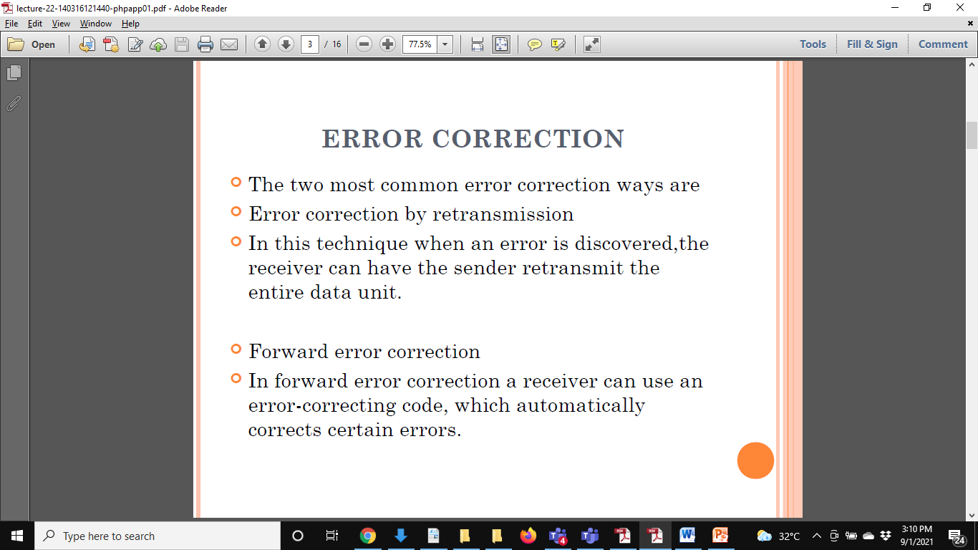
ERROR CORRECTION

Slide 24
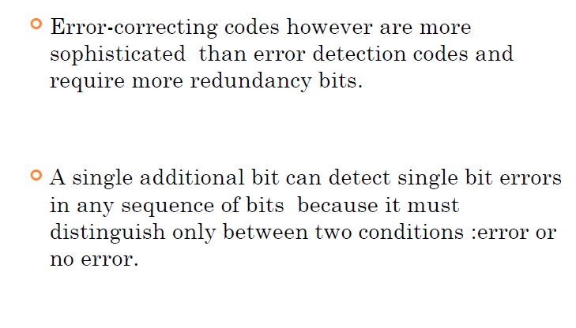
ERROR CORRECTION

Slide 25
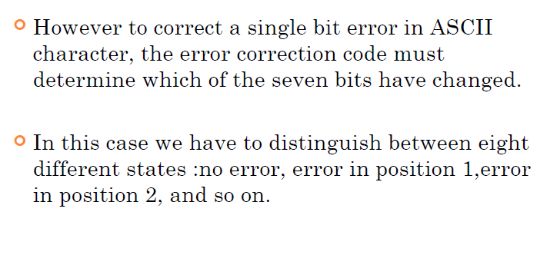
ERROR CORRECTION

Slide 26
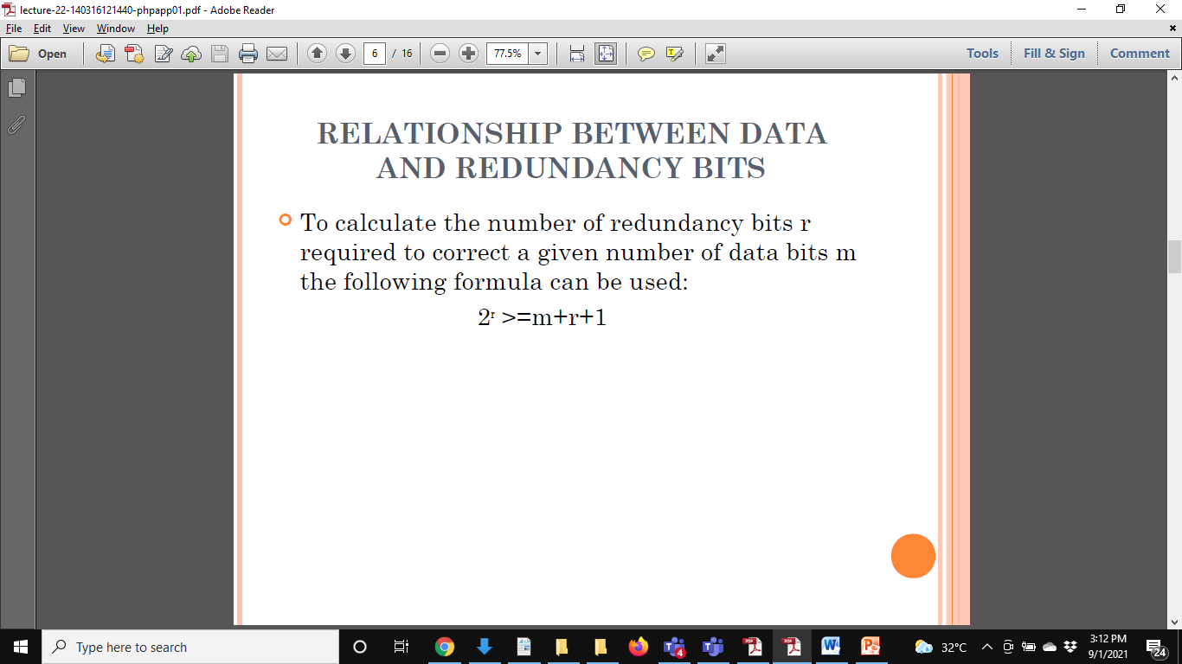

Slide 27
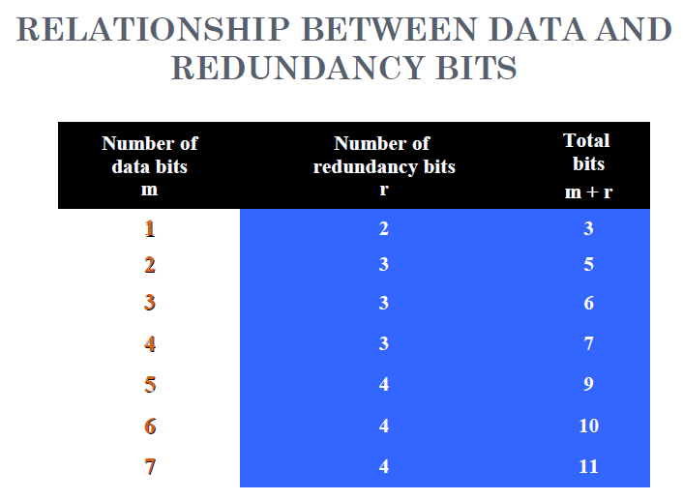

Slide 28
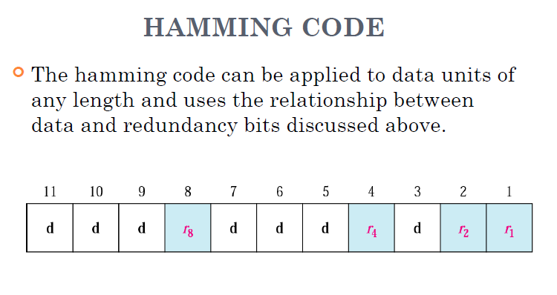

Slide 29
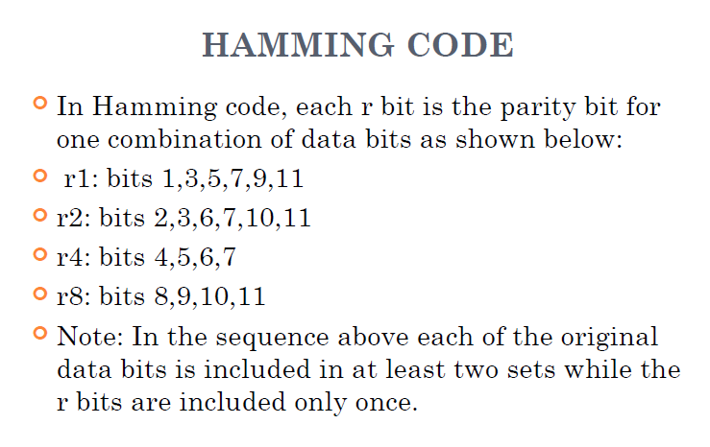

Slide 30
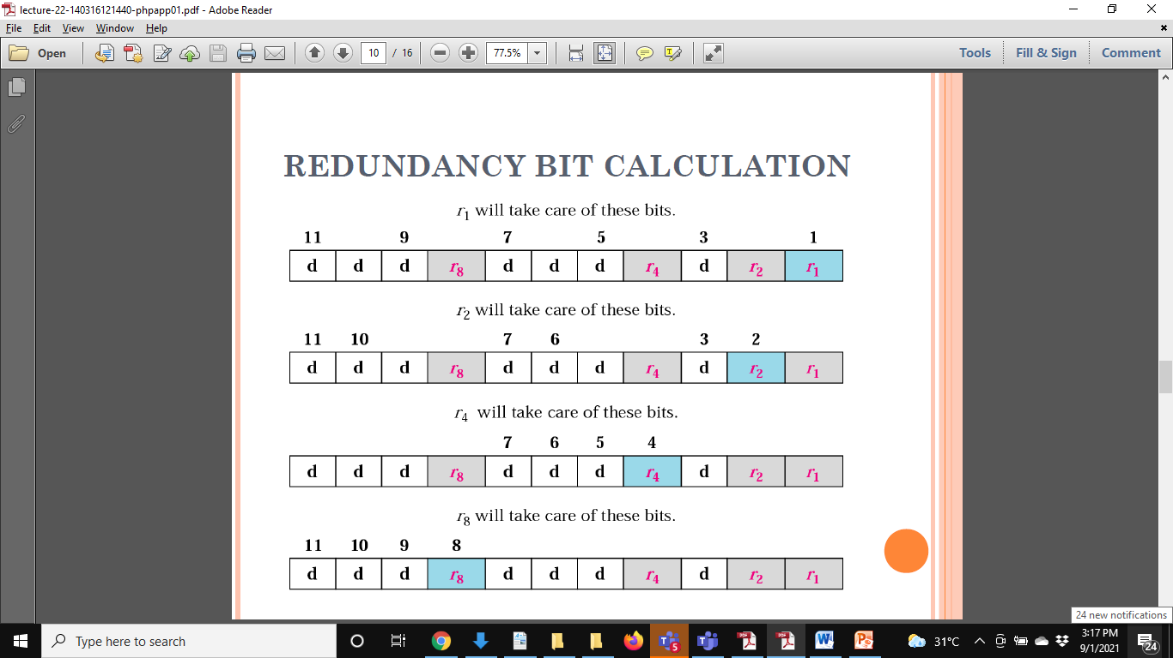

Slide 31
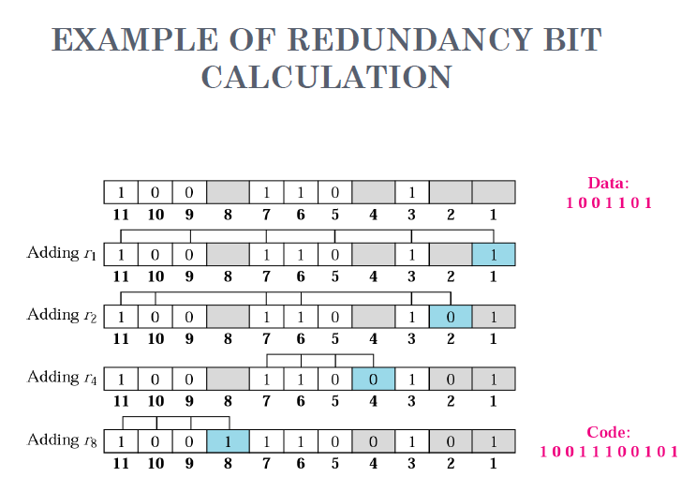

Slide 32
