Slide 1
Module:6
Transport Layer

Slide 2
Overview
TCP and UDP
Congestion Control
Effects of Congestion
Traffic Management
TCP Congestion Control
Congestion Avoidance Mechanisms
Queuing Mechanisms - QoS Parameter

Slide 3
PROCESS-TO-PROCESS DELIVERY
The transport layer is responsible for process-to-process delivery—the delivery of a packet, part of a message, from one process to another. Two processes communicate in a client/server relationship, as we will see later.
Topics discussed in this section:
Client/Server Paradigm
Multiplexing and Demultiplexing
Connectionless Versus Connection-Oriented Service
Reliable Versus Unreliable
Three Protocols

Slide 4

Note
The transport layer is responsible for process-to-process delivery.

Slide 5

Types of data deliveries

Slide 6

Port numbers

Slide 7

IP addresses versus port numbers

Slide 8

IANA Port number ranges(Internet Assigned Number Authority)

Slide 9

Socket address

Slide 10

Multiplexing and demultiplexing

Slide 11

Error control

Slide 12

Position of UDP, TCP, and SCTP in TCP/IP suite

Slide 13
USER DATAGRAM PROTOCOL (UDP)
The User Datagram Protocol (UDP) is called a connectionless, unreliable transport protocol. It does not add anything to the services of IP except to provide process-to-process communication instead of host-to-host communication.
Topics discussed in this section:
Well-Known Ports for UDP
User Datagram
Checksum
UDP Operation
Use of UDP

Slide 14
UDP is a very simple protocol using a minimum of overhead. If a process wants to send a small message and does not care much about reliability, it can use UDP. Sending a small message by using UDP takes much less interaction between the sender and receiver than using TCP or SCTP.
User Datagram: UDP packets, called user datagrams, have a fixed-size header of 8 bytes.

Slide 15
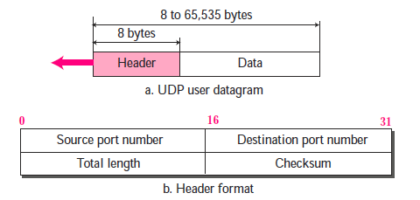
User datagram

Slide 16


Well-known ports used with UDP

Slide 17

Example.1
In UNIX, the well-known ports are stored in a file called /etc/services. Each line in this file gives the name of the server and the well-known port number. We can use the
grep utility to extract the line corresponding to the desired application. The following shows the port for FTP. Note that FTP can use port 21 with either UDP or TCP.

Slide 18

Example.1 (continued)
SNMP uses two port numbers (161 and 162), each for a different purpose, as we will see in Chapter 28.
Notes:
SNMP SCTP

Slide 19

User datagram format

Slide 20
UDP length
= IP length – IP header’s length
A field that specifies the length in bytes of the UDP header and UDP data. The minimum length is 8 bytes because that is the length of the header. The field size sets a theoretical limit of 65,535 bytes (8 byte header + 65,527 bytes of data) for a UDP datagram.

Slide 21
Pseudo Header
to do a proper checksum, a "pseudo header" is included. It's "pseudo", because it is not actually part of the UDP datagram. It contains the most important parts of the IP header, that is, source and destination address, protocol number and data length

Slide 22

Pseudoheader for checksum calculation

Slide 23
Example .2
Figure 23.11 shows the checksum calculation for a very small user datagram with only 7 bytes of data. Because the number of bytes of data is odd, padding is added for checksum calculation. The pseudoheader as well as the padding will be dropped when the user datagram is delivered to IP.

Slide 24


Slide 25
Checksum calculation of a simple UDP user datagram

Slide 26

Queues in UDP

Slide 27
TCP
TCP is a connection-oriented protocol; it creates a virtual connection between two TCPs to send data. In addition, TCP uses flow and error control mechanisms at the transport level.
Topics discussed in this section:
TCP Services
TCP Features
Segment
A TCP Connection
Flow Control
Error Control

Slide 28

Well-known ports used by TCP

Slide 29

Stream delivery

Slide 30

Sending and receiving buffers

Slide 31

TCP segments

Slide 32
Note
The bytes of data being transferred in each connection are numbered by TCP.
The numbering starts with a randomly generated number.

Slide 33

TCP segment format

Slide 34

Figure 23.17 Control field

Slide 35

Table Description of flags in the control field

Slide 36

Connection establishment using three-way handshaking

Slide 37

Data transfer

Slide 38

Connection termination using three-way handshaking

Slide 39
Note
The FIN segment consumes one sequence number if it does
not carry data.

Slide 40
Note
The FIN + ACK segment consumes
one sequence number if it
does not carry data.

Slide 41

Half-close

Slide 42

Sliding window

Slide 43
Note
A sliding window is used to make transmission more efficient as well as
to control the flow of data so that the destination does not become
overwhelmed with data.
TCP sliding windows are byte-oriented.

Slide 44
Example .4
What is the value of the receiver window (rwnd) for host A if the receiver, host B, has a buffer size of 5000 bytes and 1000 bytes of received and unprocessed data?
Solution
The value of rwnd = 5000 − 1000 = 4000. Host B can receive only 4000 bytes of data before overflowing its buffer. Host B advertises this value in its next segment to A.

Slide 45
Example 5
What is the size of the window for host A if the value of rwnd is 3000 bytes and the value of cwnd is 3500 bytes?
Solution
The size of the window is the smaller of rwnd and cwnd, which is 3000 bytes.

Slide 46
Example 6
Figure 23.23 shows an unrealistic example of a sliding window. The sender has sent bytes up to 202. We assume that cwnd is 20 (in reality this value is thousands of bytes). The receiver has sent an acknowledgment number of 200 with an rwnd of 9 bytes (in reality this value is thousands of bytes). The size of the sender window is the minimum of rwnd and cwnd, or 9 bytes. Bytes 200 to 202 are sent, but not acknowledged. Bytes 203 to 208 can be sent without worrying about acknowledgment. Bytes 209 and above cannot be sent.

Slide 47

Figure 23.23 Example 23.6

Slide 48
Note
Some points about TCP sliding windows:
❏ The size of the window is the lesser of rwnd and
cwnd.
❏ The source does not have to send a full window’s
worth of data.
❏ The window can be opened or closed by the
receiver, but should not be shrunk.
❏ The destination can send an acknowledgment at
any time as long as it does not result in a shrinking
window.
❏ The receiver can temporarily shut down the
window; the sender, however, can always send a
segment of 1 byte after the window is shut down.

Slide 49
Note
ACK segments do not consume sequence numbers and are not acknowledged.

Slide 50
Note
In modern implementations, a retransmission occurs if the retransmission timer expires or three duplicate ACK segments have arrived.

Slide 51
Note
No retransmission timer is set for an ACK segment.

Slide 52
Note
Data may arrive out of order and be temporarily stored by the receiving TCP,
but TCP guarantees that no out-of-order segment is delivered to the process.

Slide 53

Normal operation

Slide 54

Lost segment

Slide 55
Note
The receiver TCP delivers only ordered data to the process.

Slide 56
Congestion Control
DATA TRAFFIC:
The main focus of congestion control and quality of service is data traffic. In congestion control we try to avoid traffic congestion. In quality of service, we try to create an appropriate environment for the traffic. So, before talking about congestion control and quality of service, we discuss the data traffic itself.

Slide 57

Traffic descriptors: data flow value
Effective bandwidth is a function of these 3 values

Slide 58

Three traffic profiles

Slide 59
CONGESTION
Congestion in a network may occur if the load on the network—the number of packets sent to the network—is greater than the capacity of the network—the number of packets a network can handle. Congestion control refers to the mechanisms and techniques to control the congestion and keep the load below the capacity.

Slide 60

Queues in a router

Slide 61

Packet delay and throughput as functions of load

Slide 62
CONGESTION CONTROL
Congestion control refers to techniques and mechanisms that can either prevent congestion, before it happens, or remove congestion, after it has happened. In general, we can divide congestion control mechanisms into two broad categories: open-loop congestion control (prevention) and closed-loop congestion control (removal).
Topics discussed in this section:
Open-Loop Congestion Control
Closed-Loop Congestion Control

Slide 63

Congestion control categories

Slide 64
Closed Loop Congestion Control

Slide 65
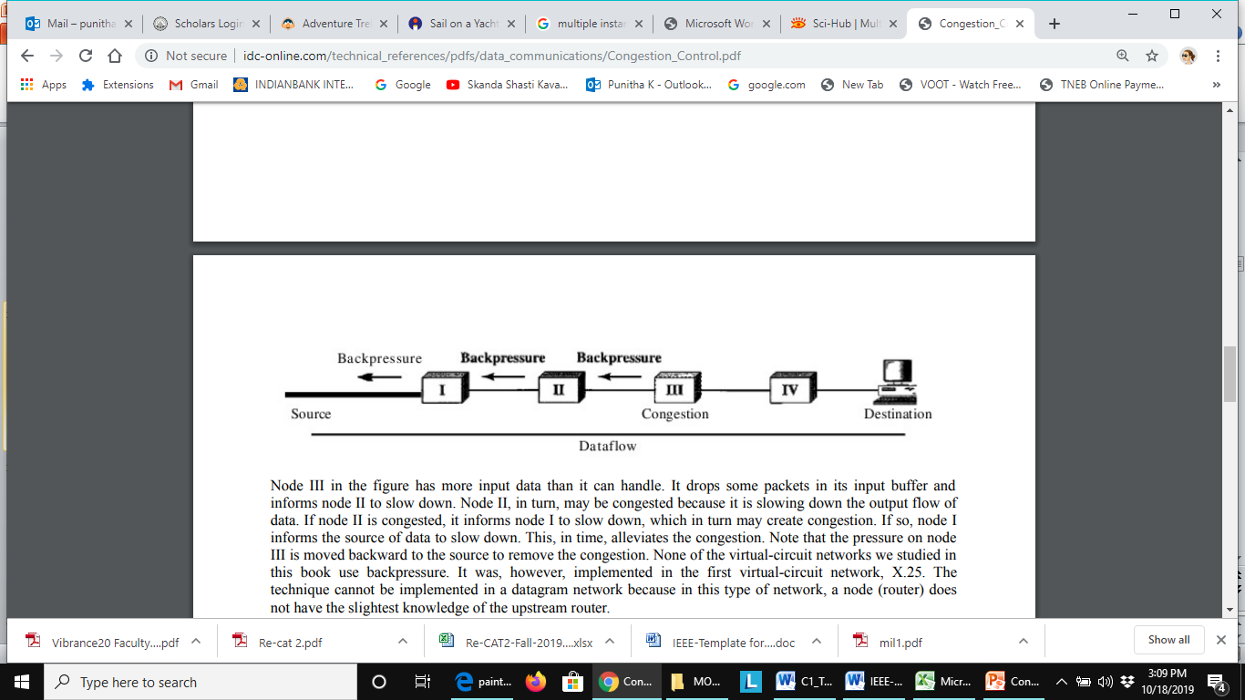
Backpressure method for alleviating congestion
Backpressure mechanism stops receiving data from the immediate upstream node or nodes. This may cause the upstream node or nodes to become congested, and they, in turn, reject data from their upstream nodes or nodes. And so on.
Backpressure is a node-to-node congestion control that starts with a node and propagates, in the opposite direction of data flow, to the source. The backpressure technique can be applied only to virtual circuit networks, in which each node knows the upstream node from which a flow of data is corning.

Slide 66

Choke packet
A choke packet is a packet sent by a node to the source to inform it of congestion. difference between the backpressure and choke packet methods:
  In backpresure, the warning is from one node to its upstream node, although the warning may eventually reach the source station.
  In the choke packet method, the warning is from the router, which has encountered congestion, to the source station directly. The intermediate nodes through which the packet has traveled are not warned.

Slide 67
Implicit Signaling
No communication between the congested node or nodes and the source.
Source guesses that there is congestion somewhere in the network when it does not receive any acknowledgment. Therefore the delay in receiving an acknowledgment is interpreted as congestion in the network.
On sensing this congestion, the source slows down.
This type of congestion control policy is used by TCP.

Slide 68
Explicit Signaling
Different from the choke packet method:
In the choke packet method, a separate packet is used for this purpose; in the explicit signaling method, the signal is included in the packets that carry data.
Explicit signaling, congestion control can occur in either the forward or the backward direction.
  Backward Signaling A bit can be set in a packet moving in the direction opposite to the congestion. This bit can warn the source that there is congestion and that it needs to slow down to avoid the discarding of packets.
  Forward Signaling A bit can be set in a packet moving in the direction of the congestion. This bit can warn the destination that there is congestion. The receiver in this case can use policies, such as slowing down the acknowledgments, to alleviate the congestion.

Slide 69
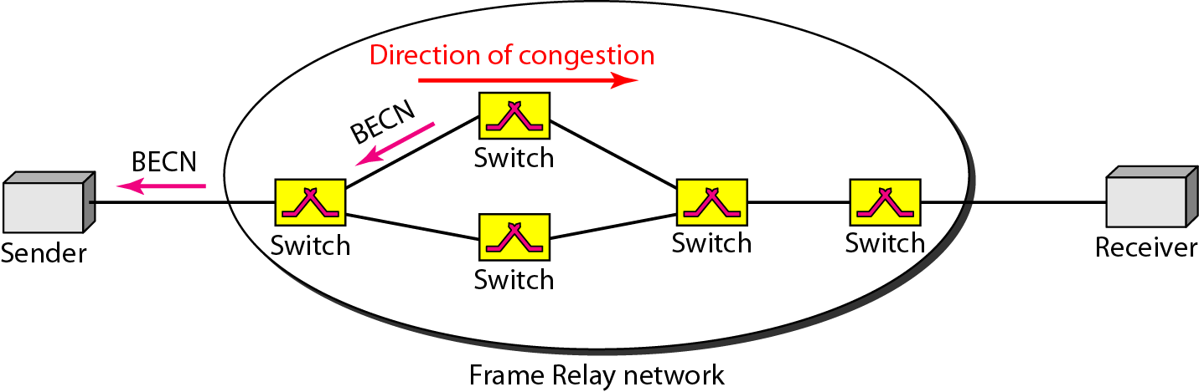
BECN

Slide 70
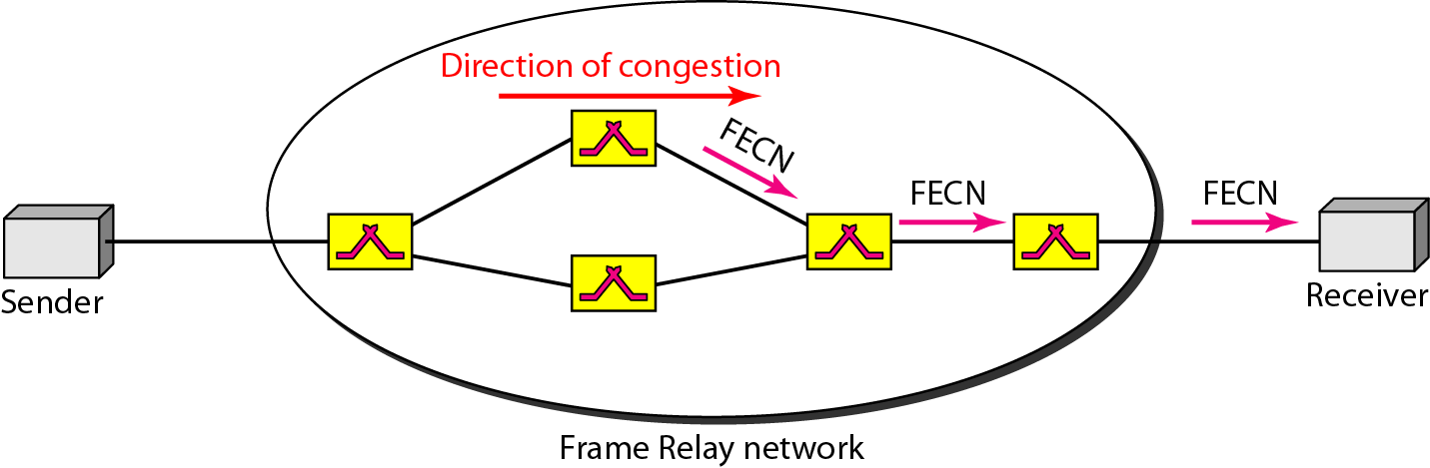
FECN

Slide 71
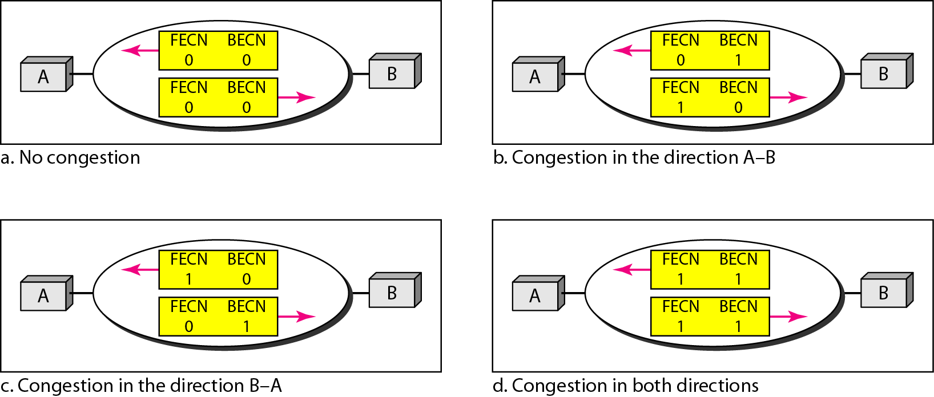
Four cases of congestion

Slide 72
Congestion Control
DATA TRAFFIC:
The main focus of congestion control and quality of service is data traffic. In congestion control we try to avoid traffic congestion. In quality of service, we try to create an appropriate environment for the traffic. So, before talking about congestion control and quality of service, we discuss the data traffic itself.

Slide 73
Network Congestion
Over-subscription
Poor network design/mis-configuration
Over-utilized devices
Faulty devices
Security attack

Slide 74
Effects of Network Congestion
Delay
Packet Loss
Timeouts
Jitter
Buffer Memory is Full
Severe Performance Degradation
Loss of Customers

Slide 75
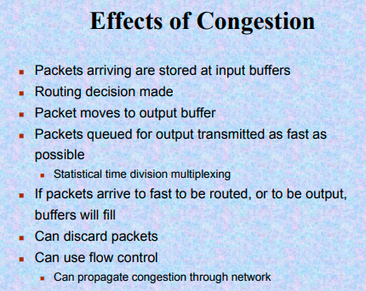

Slide 76
Troubleshooting Network Congestion
Ping
LAN Performance Tests
Bandwidth Monitoring

Slide 77
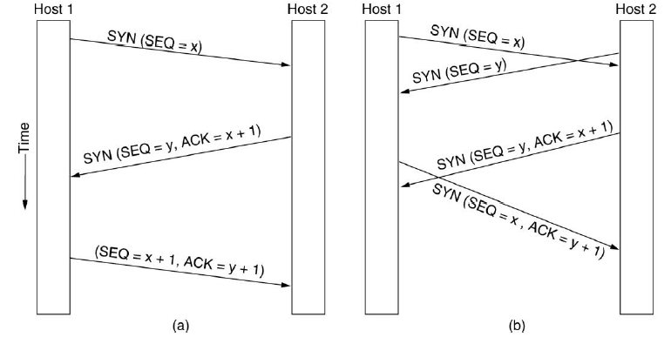
TCP Connection Management
TCP Connection Establishment

Slide 78
TCP Connection Management
TCP Connection Release

Slide 79
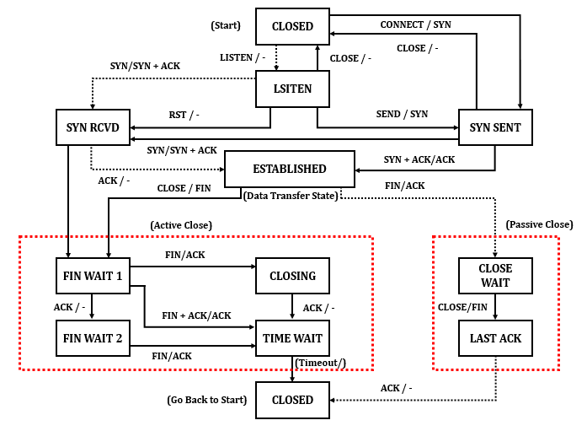
TCP Connection Management

Slide 80
TWO EXAMPLES
To better understand the concept of congestion control, let us give two examples: one in TCP and the other in Frame Relay.
Topics discussed in this section:
Congestion Control in TCP
Congestion Control in Frame Relay

Slide 81
TCP Congestion Control
Congestion policy in TCP:
Slow Start Phase: starts slowly increment is exponential to threshold
Congestion Avoidance Phase: After reaching the threshold increment is by 1
Congestion Detection Phase: Sender goes back to Slow start phase or Congestion avoidance phase.

Slide 82
TCP Congestion Control: Slow Start Phase : exponential increment
In this phase after every RTT the congestion window size increments exponentially. RTT means a round-trip delay that includes queueing delays at the routers preceding the congested links.
Initially cwnd = 1
After 1 RTT, cwnd = 2^(1) = 2
2 RTT, cwnd = 2^(2) = 4
3 RTT, cwnd = 2^(3) = 8

Slide 83

Slow start, exponential increase

Slide 84
Note
In the slow-start algorithm, the size of the congestion window increases exponentially until it reaches a threshold.

Slide 85
Congestion Avoidance Mechanisms in TCP
additive increment – This phase starts after the threshold value also denoted as ssthresh.
The size of cwnd(congestion window) increases additive. After each RTT cwnd = cwnd + 1.
Initially cwnd = i
After 1 RTT, cwnd = i+1
2 RTT, cwnd = i+2
3 RTT, cwnd = i+3

Slide 86

Figure Congestion avoidance, additive increase

Slide 87
Note
In the congestion avoidance algorithm, the size of the congestion window increases additively until
congestion is detected.

Slide 88
Note
An implementation reacts to congestion detection in one of the following ways:
❏ If detection is by time-out, a new slow
start phase starts.
❏ If detection is by three ACKs, a new
congestion avoidance phase starts.

Slide 89

TCP congestion policy summary

Slide 90
Congestion Detection Phase
Multiplicative decrement – If congestion occurs, the congestion window size is decreased. The only way a sender can guess that congestion has occurred is the need to retransmit a segment.
Retransmission can occur in one of two cases: when the RTO timer times out or when three duplicate ACKs are received.

Slide 91
Congestion Detection Phase
Case 1 : Retransmission due to Timeout
In this case congestion possibility is high.
(a) ssthresh is reduced to half of the current window size.
(b) set cwnd = 1
(c) start with slow start phase again.

Slide 92
Congestion Detection Phase
Case 2 : Retransmission due to 3 Acknowledgement Duplicates
In this case congestion possibility is less.
(a) ssthresh value reduces to half of the current window size.
(b) set cwnd= ssthresh
(c) start with congestion avoidance phase

Slide 93
Congestion control algorithms
Leaky Bucket
Token Bucket Algorithm

Slide 94
Traffic Shaping
Traffic shaping is a mechanism to control the amount and the rate of the traffic sent to the network.
Two techniques can shape traffic:
  Leaky bucket
  Token bucket.

Slide 95
Leaky Bucket
If a bucket has a small hole at the bottom, the water leaks from the bucket at a constant rate as long as there is water in the bucket.
The rate at which the water leaks does not depend on the rate at which the water is input to the bucket unless the bucket is empty.
The input rate can vary, but the output rate remains constant. Similarly, in networking, a technique called leaky bucket can smooth out bursty traffic.
Bursty chunks are stored in the bucket and sent out at an average rate. Figure shows a leaky bucket and its effects.

Slide 96

Leaky bucket

Slide 97
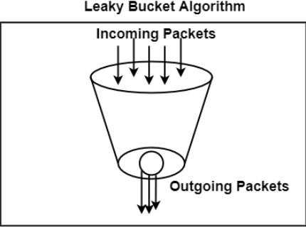

Slide 98

Leaky bucket implementation

Slide 99
Note
A leaky bucket algorithm shapes bursty traffic into fixed-rate traffic by averaging the data rate. It may drop the packets if the bucket is full.

Slide 100
Note
The token bucket allows bursty traffic at a regulated maximum rate.

Slide 101

Token bucket

Slide 102
Combining Token bucket and Leaky bucket

Slide 103
QUALITY OF SERVICE
Quality of service (QoS) is an internetworking issue that has been discussed more than defined. We can informally define quality of service as something a flow seeks to attain.
Topics discussed in this section:
Flow Characteristics
Flow Classes

Slide 104

Flow characteristics

Slide 105
Delay: Is the amount of time data(signal) takes to reach the destination. Now a higher delay generally means congestion of some sort of breaking of the communication link.
Jitter: Is the variation of delay time. This caused by network congestion, timing drift, or route changes.

Slide 106
TECHNIQUES TO IMPROVE QoS
Some techniques can be used to improve the quality of service. The four common methods: scheduling, traffic shaping, admission control, and resource reservation.
Topics discussed in this section:
Scheduling
Traffic Shaping
Resource Reservation
Admission Control

Slide 107
Scheduling
Packets from different flows arrive at a switch or router for processing.
A good scheduling technique treats the different flows in a fair and appropriate manner.
Several scheduling techniques are designed to improve the quality of service.
  FIFO queuing
  Priority queuing
  Weighted fair queuing.

Slide 108

FIFO queue

Slide 109

Priority queuing

Slide 110
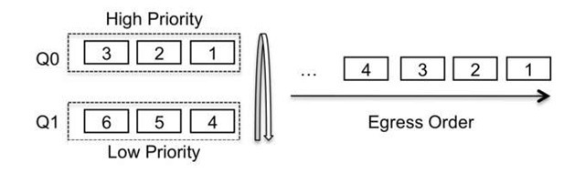
Priority queuing

Slide 111
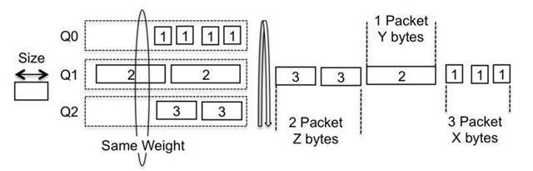
Weighted fair queuing

Slide 112

Weighted fair queuing

Slide 113
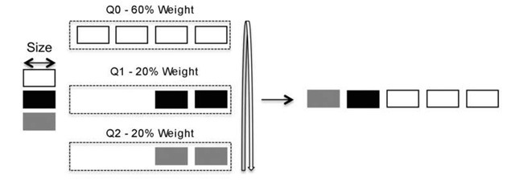
Weighted Round Robin

Slide 114
Deficit Weighted Round Robin
Key elements and parameters in implementing DWRR
Weight
The quantum translates the weight value into bytes
The value of credits can be positive or negative
The deficit counter, which provides bandwidth fairness, is the sum of the quantum and the credits

Slide 115
Resource Reservation
Buffer
Bandwidth
CPU time

Slide 116
Admission control
Router / switch
  Accept or reject flow based on flow specification.

