Slide 1
Module 7
Application layer
2: Application Layer

Slide 2
Application layer
Is the top most layer in OSI and TCP/IP layered model. This layer exists in both layered Models because of its significance, of interacting with user and user applications.
This layer is for applications which are involved in communication system. A user may or may not directly interacts with the applications.
2: Application Layer

Slide 3
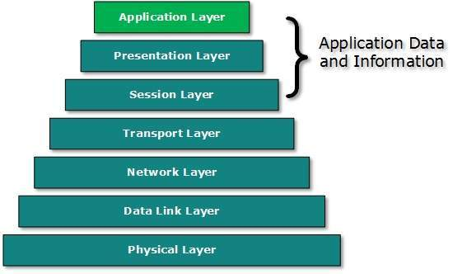
Application layer
2: Application Layer

Slide 4
Two remote application
Peer-to-peer: Both remote processes are executing at same level and they exchange data using some shared resource.
Client-Server: One remote process acts as a Client and requests some resource from another application process acting as Server.
2: Application Layer

Slide 5
Communication
Two processes in client-server model can interact in various ways:
Sockets
Remote Procedure Calls (RPC)
2: Application Layer

Slide 6
Domain Name System (DNS)
DNS is a host name to IP address translation service. DNS is a distributed database implemented in a hierarchy of name servers. It is an application layer protocol for message exchange between clients and servers.
DNS Basics
Requirement
Domain:
  Generic domain
  Country domain
  Inverse domain
2: Application Layer

Slide 7
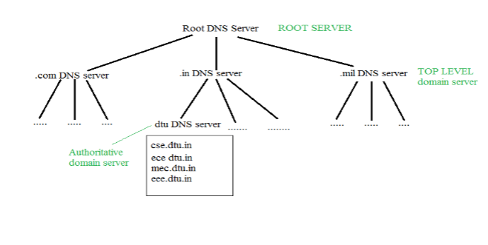
Organization of Domain
DNS record
Namespace
Name server
2: Application Layer

Slide 8
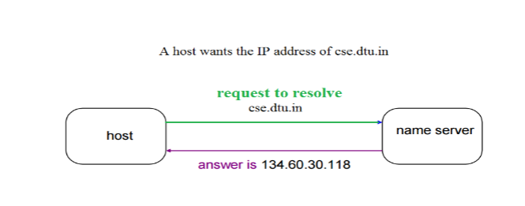
Name to Address Resolution
2: Application Layer

Slide 9
Hierarchy of Name Servers
Root name servers
Top level server
Authoritative name servers
2: Application Layer

Slide 10
How DNS Servers Work
DNS servers and IP addresses
The DNS Lookup Process
2: Application Layer

Slide 11
Steps in a DNS lookup:
A user enters a domain name
DNS recursive resolver, sends a query to the root DNS nameserver (.)
Root server returns to the resolver the address of the top-level domain
Resolver then sends the information request to the Top-Level Domain server
TLD name server responds to the resolver with the targeted IP address of the domain’s nameserver.
NS recursive resolver sends the query to the domain’s DNS server.
Domain’s DNS server then returns the IP address to the DNS resolver for the requested domain
Finally, the DNS resolver returns the IP address of the requested domain to the requesting web browser. The browser sends the HTTPS request to the targeted IP address, and the server with that address returns the webpage, which renders in the user’s browser.
2: Application Layer

Slide 12
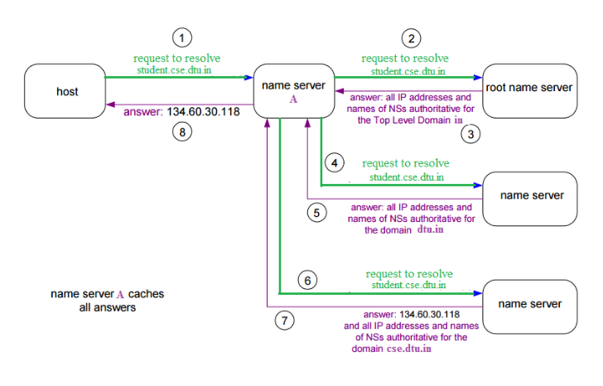
Domain Name Server
2: Application Layer

Slide 13
Types of DNS Services
Recursive DNS Server
Authoritative DNS Server
2: Application Layer

Slide 14

Application Layer - Processes Communicating
host or
server
host or
server
Process:
program running within a host
Client process:
initiates communication
Server process:
waits to be contacted
process sends/receives messages to/from its socket
identifier includes both IP address and port numbers associated with process on host.
controlled by
app developer
process
process
socket
socket
TCP with
buffers,
variables
TCP with
buffers,
variables
Internet
Controlled by OS

Slide 15
App-layer protocol defines
Types of messages exchanged,
  e.g., request, response
Message syntax:
  what fields in messages & how fields are delineated
Message semantics
  meaning of information in fields
Rules for when and how processes send & respond to messages
Public-domain protocols: Proprietary protocols:
  ♦ defined in RFCs ♦ e.g., Skype
  ♦ allows for interoperability
  ♦ e.g., HTTP, SMTP
2: Application Layer

Slide 16
2: Application Layer

Slide 17
2: Application Layer

Slide 18
2: Application Layer

Slide 19
2: Application Layer

Slide 20
2: Application Layer

Slide 21
2: Application Layer

Slide 22
2: Application Layer

Slide 23
2: Application Layer

Slide 24
HTTP (Hypertext Transfer Protocol)
Web page consists of base HTML-file which includes several referenced objects
Each object is addressable by a Uniform Resource Locator (URL)
HTTP is used as the webpage application layer protocol
client/server model
  client: browser that requests, receives, “displays” Web objects
  server: Web server sends objects in response to requests
uses TCP
assures inter-operatability
HTTP request
PC running
Explorer
HTTP response
HTTP request
Server
running
Apache Web
server
HTTP response
Mac running
Navigator
2: Application Layer

Slide 25
HTTP connections
Nonpersistent HTTP
At most one object is sent over a TCP connection.
Persistent HTTP
Multiple objects can be sent over single TCP connection between client and server.
2: Application Layer

Slide 26
Non-Persistent HTTP: Response time
Definition of Round Trip Time: time for a small packet to travel from client to server and back.
Response time:
one RTT to initiate TCP connection
one RTT for HTTP request and first few bytes of HTTP response to return
file transmission time
total = 2RTT+transmit time
initiate TCP
connection
RTT
request
file
RTT
time to
transmit
file
file
received
time
time
2: Application Layer

Slide 27
Persistent HTTP
Nonpersistent HTTP issues:
requires 2 RTTs per object
OS overhead for each TCP connection
browsers often open parallel TCP connections to fetch referenced objects
Persistent HTTP
server leaves connection open after sending response
subsequent HTTP messages between same client/server sent over open connection
client sends requests as soon as it encounters a referenced object
as little as one RTT for all the referenced objects
2: Application Layer

Slide 28
Cookies: Keeping state
What cookies can bring:
shopping carts
recommendations
user session state (Web e-mail)
aside
Cookies and privacy:
cookies permit sites to learn a lot about you
you may supply name and e-mail to sites
How to keep “state”:
protocol endpoints: maintain state at sender/receiver over multiple transactions
cookies: http messages carry state
2: Application Layer

Slide 29

Web caches (proxy server)
Goal: satisfy client request without involving origin server
user sets browser: Web accesses via cache
browser sends all HTTP requests to cache
Why Web caching?
  reduce response time for client request
  reduce traffic on an institution’s access link.
  enables “poor” content providers to effectively deliver content
origin
server
Proxy
server
HTTP request
HTTP request
client
HTTP response
HTTP response
HTTP request
HTTP response
client
origin
server
2: Application Layer

Slide 30
Conditional GET
cache
server
Goal: don’t send object if cache has up-to-date cached version
cache: specify date of cached copy in HTTP request
If-modified-since: <date>
server: response contains no object if cached copy is up-to-date:
HTTP/1.0 304 Not Modified
HTTP request msg
If-modified-since: <date>
object
not
modified
HTTP response
HTTP/1.0
304 Not Modified
HTTP request msg
If-modified-since: <date>
object
modified
HTTP response
HTTP/1.0 200 OK
<data>
2: Application Layer

Slide 31

FTP: the file transfer protocol
FTP
user
interface
FTP
client
file transfer
FTP
server
user
at host
remote file
system
local file
system
transfer file to/from remote host
client/server model
  client: side that initiates transfer (either to/from remote)
  server: remote host
2: Application Layer

Slide 32
FTP: separate control, data connections
TCP control connection
port 21
FTP client contacts FTP server at port 21
client authorized over control connection
client browses remote directory by sending commands over control connection.
when server receives file transfer command, server opens 2nd TCP connection (for file) to client
after transferring one file, server closes data connection.
server opens another TCP data connection to transfer another file.
FTP server maintains “state”: current directory, earlier authentication
FTP
client
TCP data connection
port 20
FTP
server
2: Application Layer

Slide 33
FTP issues
Multiple connections are used
  for each directory listing and file transmission
No integrity check at receiver
Messages are sent in clear text
  including Passwords and file contents
  can be sniffed by eavesdroppers
Solution
  Secure FTP (SSH FTP)
    allows a range of operations on remote files
  FTPS ( FTP over Secure Sockets Layer (SSL) )
  Transport Layer Security (TLS) encryption
2: Application Layer

Slide 34
Electronic Mail
outgoing
message queue
user mailbox
Three major components:
user agents
mail servers
simple mail transfer protocol: SMTP
User Agent
“mail reader”
composing, editing, reading mail messages
e.g., Eudora, Outlook, elm, Mozilla Thunderbird
outgoing, incoming messages stored on server
user
agent
mail
server
user
agent
SMTP
mail
server
user
agent
SMTP
SMTP
mail
server
user
agent
user
agent
user
agent
2: Application Layer

Slide 35
Electronic Mail: mail servers
Mail Servers
mailbox contains incoming messages for user
message queue of outgoing (to be sent) mail messages
SMTP protocol between mail servers to send email messages
  client: sending mail server
  “server”: receiving mail server
user
agent
mail
server
user
agent
SMTP
mail
server
user
agent
SMTP
SMTP
mail
server
user
agent
user
agent
user
agent
2: Application Layer

Slide 36
Electronic Mail: SMTP [RFC 2821]
uses TCP to reliably transfer email message from client to server (port 25)
direct transfer: sending server to receiving server
three phases of transfer
  handshaking (greeting)
  transfer of messages
  closure
command/response interaction
  commands: ASCII text
  response: status code and phrase
messages must be in 7-bit ASCII
2: Application Layer

Slide 37

Scenario: Alice sends message to Bob
1) Alice uses User Agent (UA) to compose message and send to bob@someschool.edu
2) Alice’s UA sends message to her mail server; message placed in message queue
3) Client side of SMTP opens TCP connection with Bob’s mail server
4) SMTP client sends Alice’s message over the TCP connection
5) Bob’s mail server places the message in Bob’s mailbox
6) Bob invokes his user agent to read message
1
mail
server
mail
server
user
agent
user
agent
2
3
6
4
5
2: Application Layer

Slide 38
SMTP
SMTP uses persistent connections
SMTP requires message (header & body) to be in 7-bit ASCII
SMTP server uses CRLF.CRLF to determine end of message
2: Application Layer

Slide 39
Mail message format
SMTP: protocol for exchanging email msgs
RFC 822: standard for text message format:
header lines, e.g.,
  To:
  From:
  Subject:
  different from SMTP commands!
body
  the “message”,
  ASCII characters only
header
blank
line
body
2: Application Layer

Slide 40
Message format: multimedia extensions
MIME: multimedia mail extension, RFC 2045, 2056
additional lines in msg header declare MIME content type
From: alice@crepes.fr
To: bob@hamburger.edu
Subject: Picture of yummy crepe.
MIME-Version: 1.0
Content-Transfer-Encoding: base64
Content-Type: image/jpeg
base64 encoded data .....
.........................
......base64 encoded data
MIME version
method used
to encode data
multimedia data
type, subtype,
parameter declaration
encoded data
2: Application Layer

Slide 41
Mail access protocols
SMTP
access
protocol
user
agent
user
agent
sender’s mail
server
receiver’s mail
server
SMTP: delivery/storage to receiver’s server
Mail access protocol: retrieval from server
  POP: Post Office Protocol [RFC 1939]
    authorization (agent <-->server) and download
  IMAP: Internet Mail Access Protocol [RFC 1730]
    more features (more complex)
    manipulation of stored msgs on server
  HTTP: gmail, Hotmail, Yahoo! Mail, etc.
2: Application Layer

Slide 42
DNS: Domain Name System
People: many identifiers:
  name, passport #
Internet hosts, routers:
  IP address (32 bit) - used for addressing datagrams
  “name”, e.g., ww.yahoo.com - used by humans
Domain Name System:
distributed database implemented in hierarchy of many name servers
application-layer protocol host, routers, name servers to communicate to resolve names (address/name translation)
  note: core Internet function, implemented as application-layer protocol
  complexity at network’s “edge”
2: Application Layer

Slide 43
DNS services
hostname to IP address translation
host aliasing
  Canonical, alias names
load distribution
  replicated Web servers: set of IP addresses for one canonical name
Why not centralize DNS?
single point of failure
traffic volume
distant centralized database
maintenance issues
2: Application Layer

Slide 44
Distributed, Hierarchical Database
Root DNS Servers
com DNS servers
org DNS servers
edu DNS servers
yahoo.com
DNS servers
pbs.org
DNS servers
poly.edu
DNS servers
umass.edu
DNS servers
amazon.com
DNS servers
Client wants IP for www.amazon.com; 1st approx:
client queries a root server to find com DNS server
client queries com DNS server to get amazon.com DNS server
client queries amazon.com DNS server to get IP address for www.amazon.com
2: Application Layer

