Slide 2
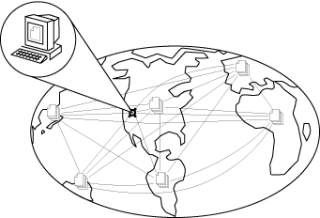
What Is the Internet?
A network of networks, joining many government, university and private computers together and providing an infrastructure for the use of E-mail, bulletin boards, file archives, hypertext documents, databases and other computational resources
The vast collection of computer networks which form and act as a single huge network for transport of data and messages across distances which can be anywhere from the same office to anywhere in the world.
Notes:
5

Slide 3

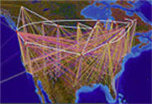
What is the Internet?
The largest network of networks in the world.
Uses TCP/IP protocols and packet switching .
Runs on any communications substrate.
From Dr. Vinton Cerf,
Co-Creator of TCP/IP

Slide 4

Brief History of the Internet
1968 - DARPA (Defense Advanced Research Projects Agency) contracts with BBN (Bolt, Beranek & Newman) to create ARPAnet
1970 - First five nodes:
UCLA
Stanford
UC Santa Barbara
U of Utah, and
BBN
1974 - TCP specification by Vint Cerf
1984 – On January 1, the Internet with its 1000 hosts converts en masse to using TCP/IP for its messaging

Slide 5
Network Address Example
Host address: 192.252.12.14
Subnet mask: 255.255.255.0
To obtain the network address, AND the host IP with its subnet mask:
Host IP:
Mask:
Net addr:
which is:
11000000.11111100.00001100.00001110
11111111.11111111.11111111.00000000
11000000.11111100.00001100.00000000
192.152.12.0

Slide 6
TCP/IP Addresses
Every host on the Internet must have a unique IP address
The IP address is a 32-bit number which we write in dotted decimal notation
The first part of the IP address is the network address – the remainder is the host ID
A subnet mask is used to determine the network address from a IP host address
All hosts on the same network are configured with the same subnet mask

Slide 7
Obtaining an Internet Network Address
IP network addresses must be unique, or the Internet will not be stable
The Internet Network Information Centre (InterNIC) was originally responsible for issuing Internet network addresses
Today, the Internet Assigned Number Authority (IANA) issues network addresses to Information Service Providers (ISPs)
ISPs split networks up into subnets and sell them on to their customers

Slide 8
Domain Name System (DNS)
IP addresses are used to identify hosts on a TCP/IP network
Example: 134.220.1.9
Numbers are not ‘friendly’ – people prefer names
DNS is a protocol used to map IP addresses to textual names
E.g. www.wlv.ac.uk maps to 134.220.1.9

Slide 9
DNS on the Internet
DNS names have a hierarchical structure
Example: www.wlv.ac.uk
Root Level
com
net
fr
uk
us
Top-level domain
ac
co
Second-level
domain
aston
staffs
wlv
clun
www
ftp
Server name

Slide 10
Internet Email Addresses
mel.ralph@wlv.ac.uk
Local part
@
Domain name of mail server
The Local part is the name of a special file stored on the mail server called the user’s mailbox
The Domain name is resolved using DNS
The mail server is also known as a mail exchanger

Slide 11
Hypertext Transfer Protocol (HTTP)
The Internet
(TCP/IP)
Request
Web page
WWW server
Browser app
HTTP is the protocol used to access resources on the World Wide Web
A browser application is used to send a request to the WWW server for a resource, e.g. a web page, graphics file, audio file, etc.
The server responds by sending the resource (a file) to the client and closing the connection

Slide 12
Uniform Resource Locator (URL)
URL is the standard for specifying the whereabouts of a resource (such as a web page) on the Internet
A URL has four parts:
The protocol used to retrieve the resource
The host where the resource is held
The port number of the server process on the host
The name of the resource file
http://www.wlv.ac.uk:80/index.html
Protocol
Port number
Name of web page
Host

Slide 13
URL Defaults
A server will normally be setup to use standard defaults
This enables the URL to be simplified
In the case of a Web server for example
Default port will be 80
Default name for home page will be index.html
Hence the previous URL can be shortened to
http://www.wlv.ac.uk/

Slide 14
File Transfer Protocol (FTP)
ftp://ftp.demon.co.uk/pub/
Protocol for copying files between client and an FTP server
Uses a TCP connection for reliable transfer of files with error-checking
Most browsers support FTP, or you can use a dedicated FTP client program, e.g WS_FTP
Trivial File Transfer Protocol (TFTP) is a lightweight version for small memory devices

Slide 15
Telnet
Telnet allows a user to run commands and programs remotely on another computer across the Internet
The user runs a Telnet client program on the local host
A Telnet server process must be running on the remote host
The user must have the necessary permissions and password to access the remote host

Slide 16
Some Port Assignments
21 FTP
23 Telnet
25 smtp (mail)
70 gopher
79 finger
80 HTTP

Slide 17
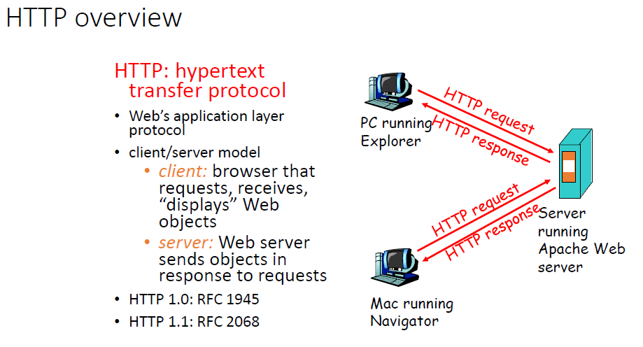

Slide 18
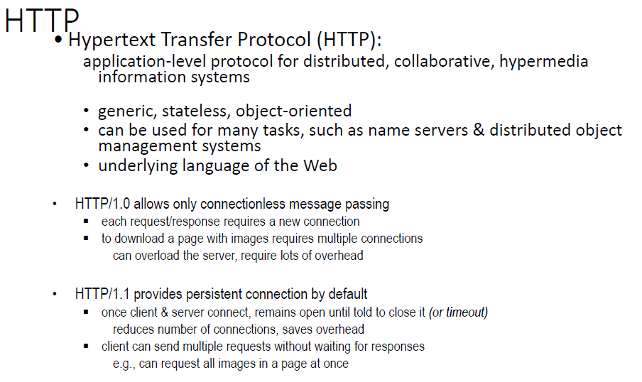

Slide 19
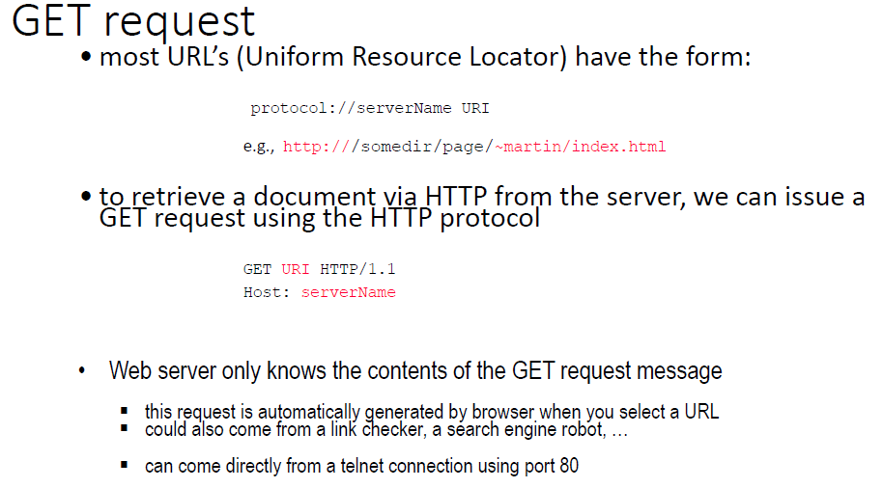

Slide 20
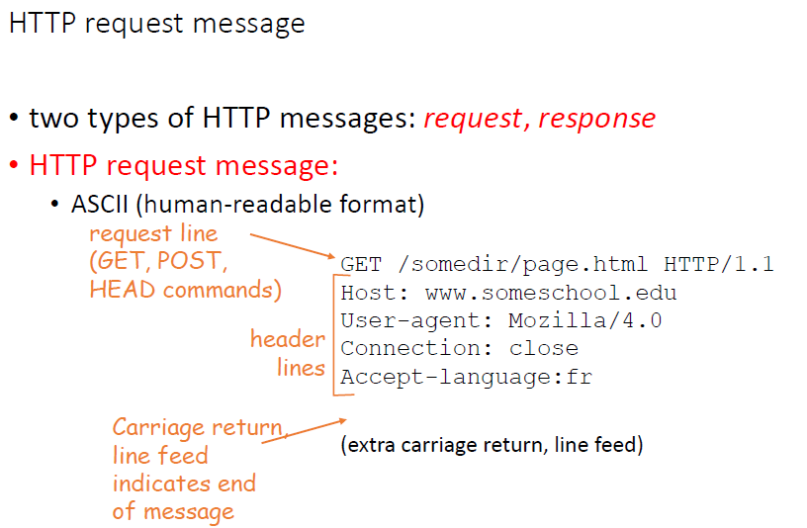

Slide 21
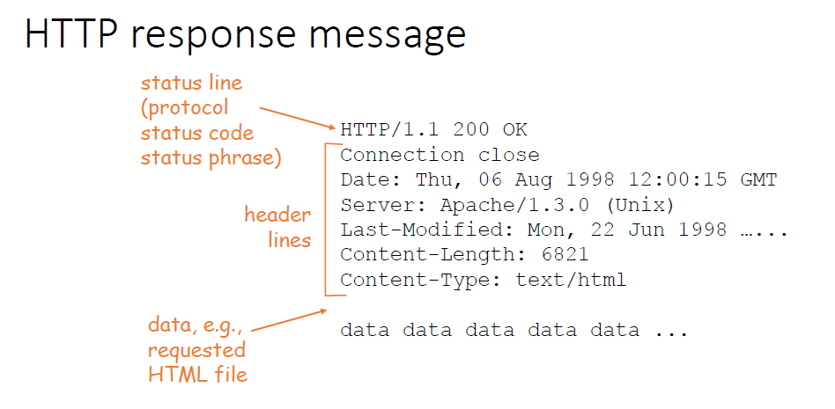

Slide 22
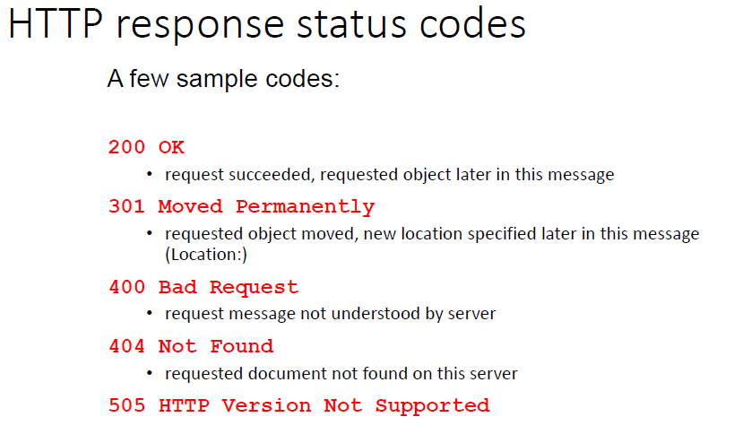

Slide 23
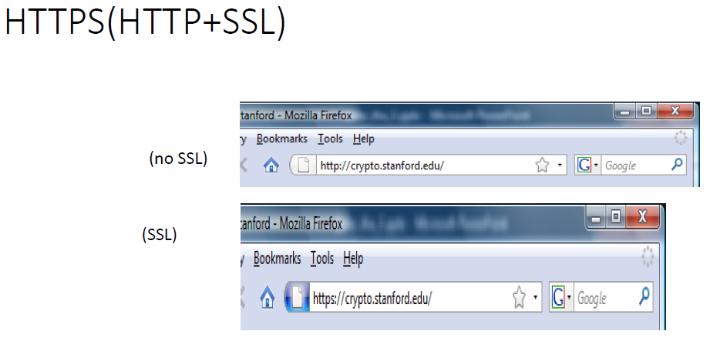

Slide 24
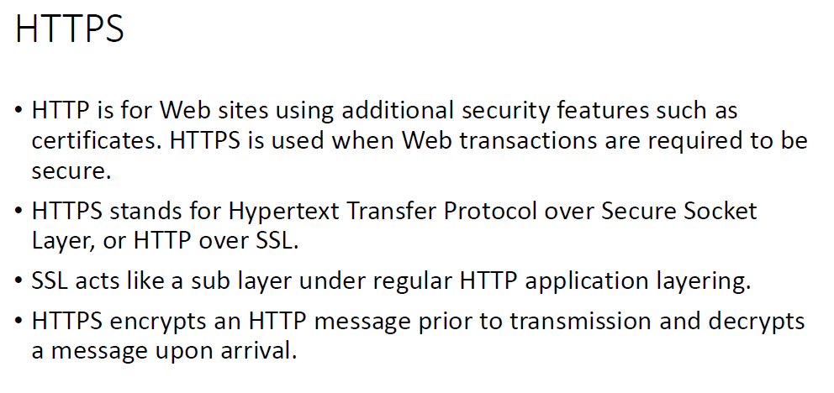

Slide 25
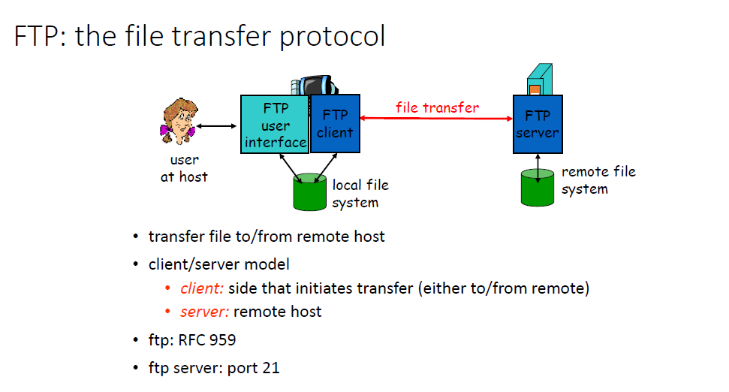

Slide 26
