Slide 1

Logic Families
How the Logic gates are implemented using electronic circuits?
A logic family of monolithic digital integrated circuit devices is a group of electronic logic gates constructed using one of several designs, usually with compatible logic levels and power supply characteristics within a family.
Many No. of Logic families are available. They are classified as
Based on the Transistor technology.
Based on Operating Point.
Based on Logic.

Slide 2
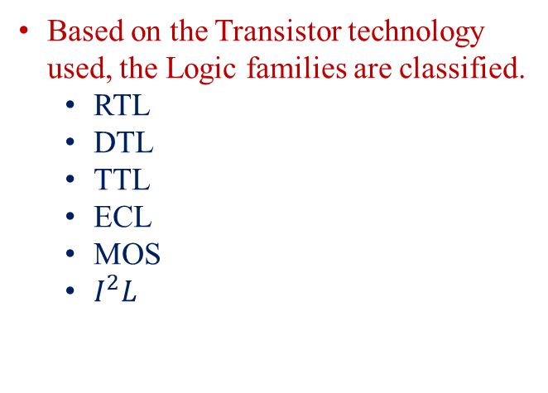
Logic Families
Logic families
Bipolar Junction Transistor
RTL
DTL
TTL
ECL
MOS Field Effect Transistor
PMOS
NMOS
CMOS
Based on the Transistor technology used, the Logic families are classified.
RTL
DTL
TTL
ECL
MOS
$I^{2}L$

Slide 3
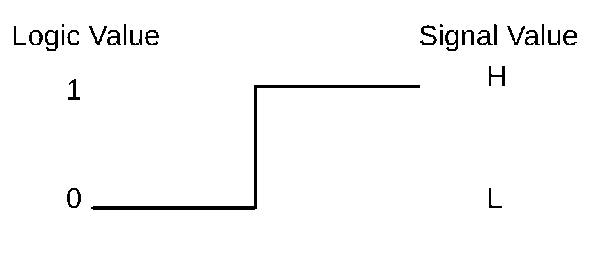

Positive and Negative Logic
Voltage Levels are the values associated with the operation of Logic Gates.
Based on the assignment of voltage levels to 0 and 1.
Two types
Positive Logic
Logic 1 is assigned to High level Voltage (1 to H).
Logic 0 is assigned to Low level Voltage (0 to L).
Negative Logic
Logic 0 is assigned to High level Voltage (0 to H).
Logic 1 is assigned to Low level Voltage (1 to L).

Slide 4

Positive and Negative Logic
Truth Table
x | y | z
L | L | L
L | H | L
H | L | L
H | H | H
Positive Logic AND gate

Slide 5
Characteristics of Logic Families
Useful to compare logic families and their performances.
Some important parameters are
Fan-out.
Fan-in.
Power Dissipation.
Propagation Delay.
Noise Margin.
Operating Temperature.

Slide 6
FAN-OUT
The No. of standard loads that can be connected to the output of the gate without degrading its normal operation.
A standard load is usually defined as the amount of current needed by an input of another gate in the same logic family.
Maximum No. of inputs that can be connected to the output of a gate.
Also called as Loading.
Exceeding the maximum limit of Fan-out leads to malfunctioning.
Crossing the limit is overloading.

Slide 7
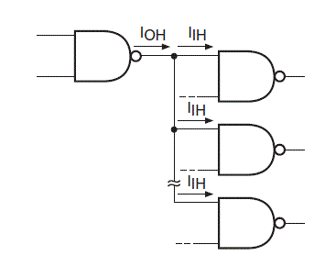

FAN-OUT
Calculated from the amount of current available in the output of a gate and the amount of current needed in each input of a gate.
Current Source.
High level output drives other gates.
In TTL IOH= 400µA and IIH= 40µA , then the Fan-out is 10.
Loading gates
Fan out =$\frac{I_{OH}}{I_{IH}}$
Driving gate

Slide 8
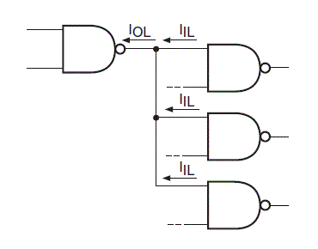

FAN-OUT
Calculated from the amount of current available in the output of a gate and the amount of current needed in each input of a gate.
Current Sink.
Low level output drives other gates.
In TTL IOL= 16mA and IIL= 1.6A , then the Fan-out is 10.
Loading gates
Fan out =$\frac{I_{OL}}{I_{IL}}$
Driving gate

Slide 9
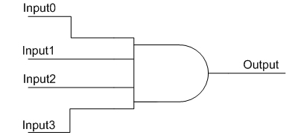
FAN-IN
Fan-in is the number of inputs a logic gate can handle.
Physical logic gates with a large fan-in tend to be slower than those with a small fan-in.
Large Fan-in→ Slower the Gate.
Gates with More No. of inputs requires More complex input circuit.
The complexity of the input circuitry increases the input capacitance of the device.

Slide 10
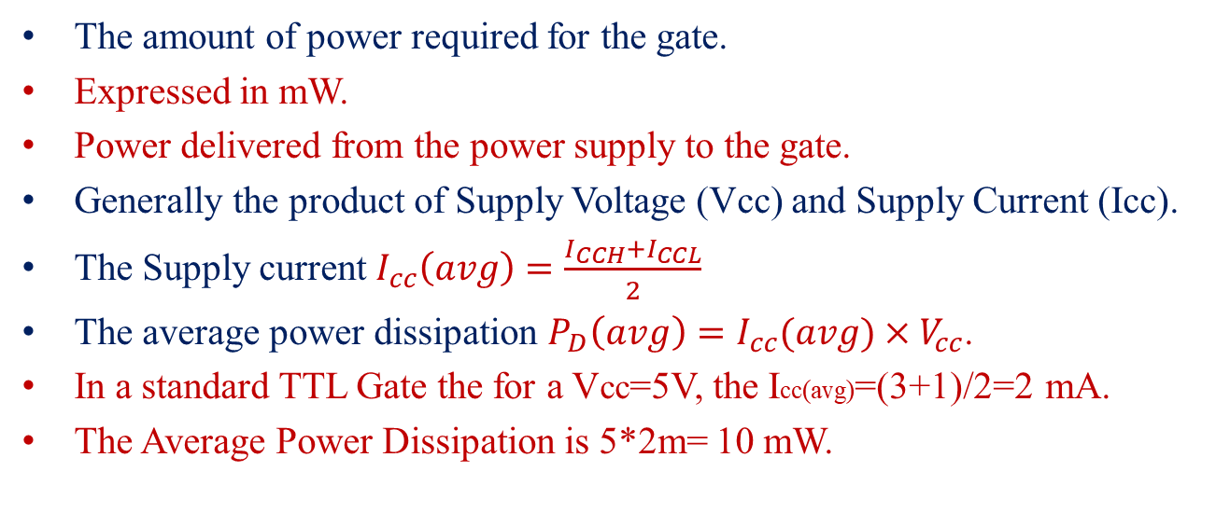
POWER DISSIPATION
The amount of power required for the gate.
Expressed in mW.
Power delivered from the power supply to the gate.
Generally the product of Supply Voltage (Vcc) and Supply Current (Icc).
The Supply current $I_{cc}\left(avg\right)=\frac{I_{CCH}+I_{CCL}}{2}$
The average power dissipation $P_{D}\left(avg\right)=I_{cc}(avg)×V_{cc}$.
In a standard TTL Gate the for a Vcc=5V, the Icc(avg)=(3+1)/2=2 mA.
The Average Power Dissipation is 5*2m= 10 mW.

Slide 11
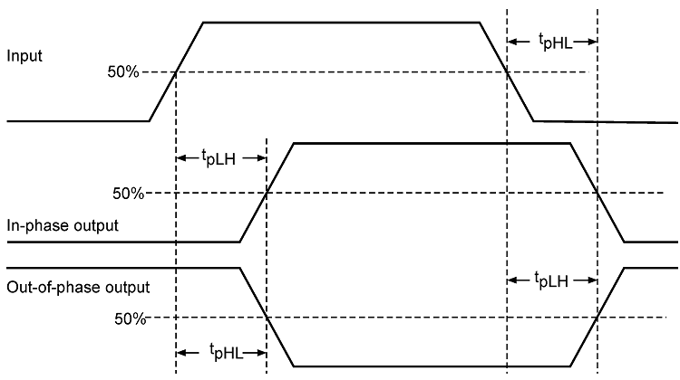
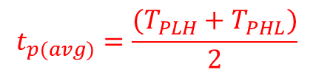
PROPAGATION DELAY
The average transition delay time for the signal to propagate from input to output when the binary signal changes its value (0 to 1 or 1 to 0).
Measured in ns.
It is customary to measure the time from 50% point.
Average propagation delay is
In a standard TTL gate TPLH=11 ns and TPHL= 7ns so the average delay is 9 ns.
$$t_{p(avg)}=\frac{(T_{PLH}+T_{PHL})}{2}$$

Slide 12
NOISE MARGIN
The unwanted signals are referred as Noise.
Spurious electrical signals from industrial and other sources.
Two types
DC noise due to the drift in the voltage levels of signals.
AC noise due to random pulse (switching signals).
Noise Margin is the maximum noise voltage added to an input signal of a digital circuit that does not cause an undesirable change in the circuit’s output.
Noise Margin is the ability of circuits to operate reliably in an environment with noise.
Expressed in Volts.

Slide 13
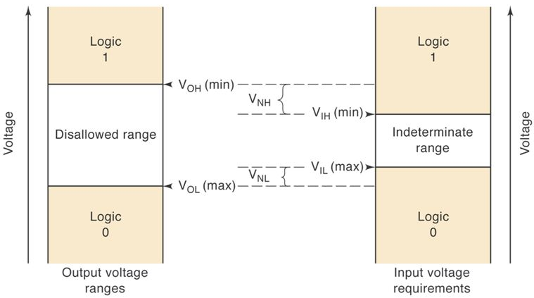
NOISE MARGIN
Range of input and output voltages available to a circuit.
In output voltage range
Between Vcc and VOH →Logic 1.
Between 0v to VOL→ Logic 0.
In input voltage range
Between 0v to VIL→ Logic 0.
Between VIH to Vcc→ Logic 1.
Noise Margin:
VNH=VOH-VIH
VNL=VIL-VOL
Vcc
Vcc
0 v
0 v
Smaller One
In TTL, VOH=2.4 v, VOL=0.4 v, VIH=2 v, VIL=0.8 v
VNH=0.4 v and VNL=0.4 v

Slide 14
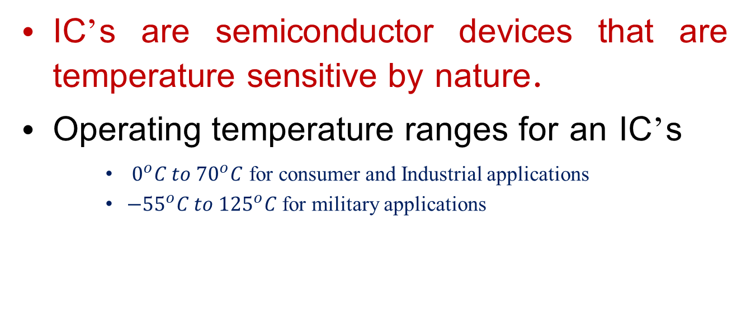
OPERATING TEMPERATURE
IC’s are semiconductor devices that are temperature sensitive by nature.
Operating temperature ranges for an IC’s
$0^{o}C to {70}^{o}C$ for consumer and Industrial applications
$−{55}^{o}C to {125}^{o}C$ for military applications

Slide 15
Transistor Transistor Logic (TTL)
The full form of TTL is Transistor Transistor Logic
This is a logic family which is mainly build up of NPN transistors, PN junction diodes and diffused resistors
The basic building block of this logic family is NAND gate
Subfamilies of this logic are
Standard TTL, advanced Schottky TTL, schottky TTL, low power TTL, high power TTL, fast TTL

Slide 16
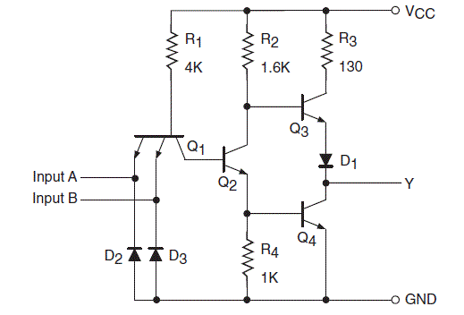
Transistor Transistor Logic (TTL)
TTL NAND

Slide 17
Transistor Transistor Logic (TTL)
When both inputs A and B are low, both the diodes are forward biased. So the current due to the supply voltage +V_{CC} = 5 V will go to the ground through R₁ and the two diodes D_{A} and D_{B}
The supply voltage gets dropped in the resistor R₁ and it will not be sufficient to turn ON the transistor Q₂. With Q₂ open, the transistor Q₄ will also cut off. But the transistor Q₃ is pulled high. Since Q₃ is an emitter follower, the output at the terminal will also be HIGH, which is at logic 1
When any one input, either A or B is low, the diode with low input will be forward biased. The same operation will take place as explained above. In this case, the output will be HIGH
When both the inputs A and B are high, both the diodes at the emitter-base junction will be reverse biased. The diode D_{C} at the collector-base junction is forward biased. It will turn on the transistor Q₂. With Q₂ turned ON, transistor Q₄ will also be turned ON
Both the transistors at the output side will conduct and so the output at terminal will have LOW value, which is considered as logic 0.

Slide 18
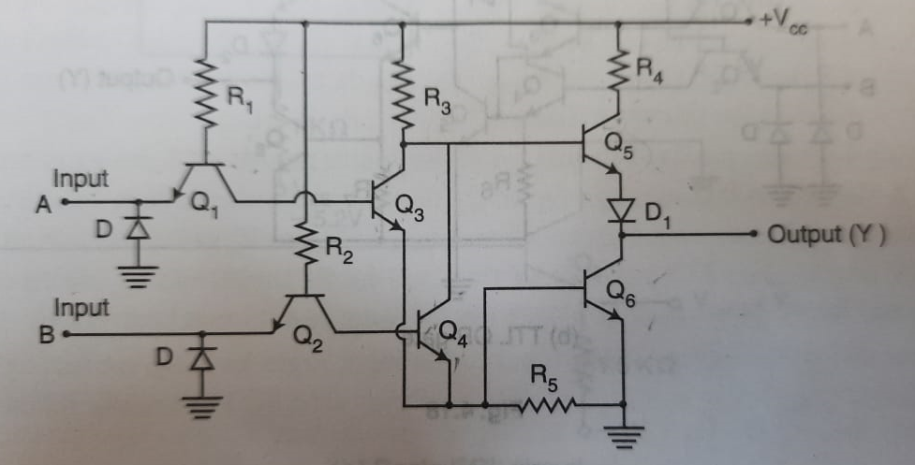
Transistor Transistor Logic (TTL)
NOR Gate

Slide 19
When the inputs are low, the base emitter junctions of Q1 and Q2 are forward bias and pull current away from transistors Q3 and Q4 keeping them OFF. As a result Q5 is ON and Q6 is OFF, producing a high output.
When input A is low and input B is high,Q3 is OFF and Q4 is ON. The transistor Q4 turns ON Q6 and turns OFF Q5,producing a LOW output.
When both inputs A and B are HIGH, transistors Q3 and Q4 are ON. This has the same effect as either one being ON, turning Q6 ON and Q5 OFF. The result is a LOW output.
The combination of Q5 and Q6 forms a totem pole output in the circuit

Slide 20
CMOS Logic Family
CMOS(Complementary MOS) logic family uses both N-channel and P-channel MOSFET devices
Speed of operation is high and power dissipation is less in CMOS
CMOS also has more fan-out and better noise margin

Slide 21
Complementary MOS
Complementary MOS (CMOS) circuits take advantage of the fact that both n ‐channel and p ‐channel devices can be fabricated on the same substrate.
CMOS circuits consist of both types of MOS devices, interconnected to form logic functions.
The basic circuit is the inverter, which consists of one p ‐channel transistor and one n ‐channel transistor.
The source terminal of the p ‐channel device is at VDD,(5 to 15V) and the source terminal of the n ‐channel device is at ground.
The two voltage levels are 0 V for the low level and VDD for the high level (typically, 5 V).

Slide 22
Complementary MOS-NOT Gate
Three rules to understand CMOS are
The n ‐channel MOS conducts when its gate‐to‐source voltage is positive.
The p ‐channel MOS conducts when its gate‐to‐source voltage is negative.
Either type of device is turned off if its gate‐to‐source voltage is zero.

Slide 23
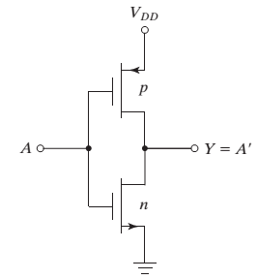
Complementary MOS-NOT Gate
When the input is low, both gates are at zero potential. The input is at-VDD relative to the source of the p ‐channel device and at 0 V relative to the source of the n ‐channel device.
The result is that the p‐channel device is turned on and the n‐channel device is turned off.
Under these conditions, there is a low‐impedance path from VDD to the output and a very high impedance path from output to ground. Therefore, the output voltage approaches the high level VDD under normal loading conditions.
When the input is high, both gates are at VDD and the situation is reversed: The p ‐channel device is off and the n ‐channel device is on. The result is that the output approaches the low level of 0 V

Slide 24
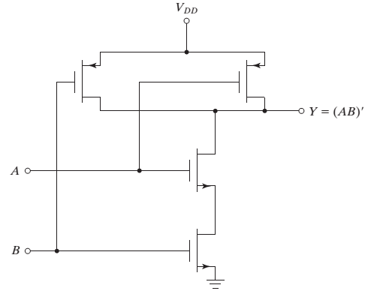
Complementary MOS-NAND Gate

Slide 25
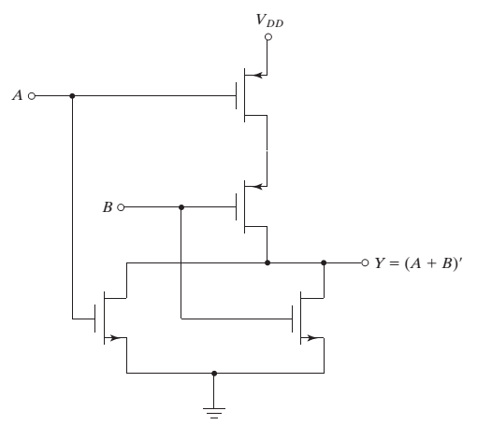
Complementary MOS-NOR Gate

Slide 26
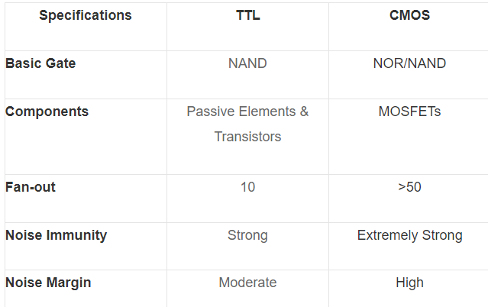
CMOS Logic Family
Comparison of TTL with CMOS

