Slide 1
Module 5-Design of Sequential Logic Circuits
Topics covered:Latches, Flip-Flops - SR, D, JK & T
Dr.N.Subhashini

Slide 2

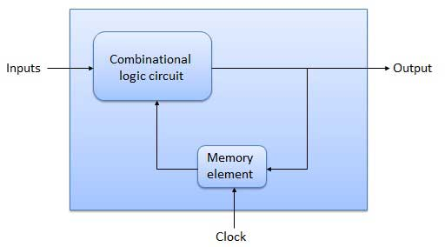
INTRODUCTION TO SEQUENTIAL LOGIC
The present state and the external circuit determine the output and the next state of sequential circuits.
Thus in sequential circuits, the output variables depend not only on the present input variables but also on the past history of input variables.
Sequential Circuit- Block Diagram

Slide 3
INTRODUCTION TO SEQUENTIAL LOGIC
Combinational vs Sequential Circuit
S.No | Combinational logic | Sequential logic
1 | The output variable, at all times depends on the combination of input variables. | The output variable depends not only on the present input but also depend upon the past history of inputs.
2 | Memory unit is not required | Memory unit is required to store the past history of input variables.
3 | Faster in speed | Slower than combinational circuits.
4 | Easy to design | Comparatively difficult to design.
5 | Eg. MUX, Decoder, Parallel adder | Eg. Counter, Shift Register, Serial adder

Slide 4
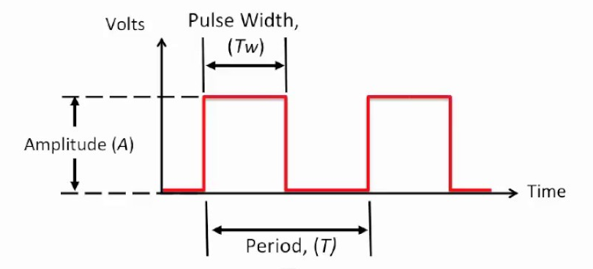
What is clock?
Clk signal is a square wave used in digital circuits
Duty cycle Tw/T= Ton/ (Ton +Toff)=T/2/T= 0.5
Frequency -1/T
Operational speed and transition of state is defined by the clock signal in sequential circuit

Slide 5
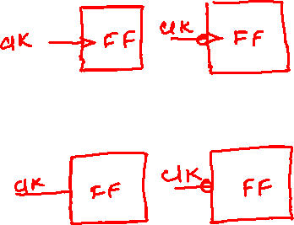
Clock Triggering
There are two types of clock triggering
Edge triggering
Positive edge trigger
Negative edge trigger
Level Triggering
Positive level trigger
Negative level trigger

Slide 6
Storage elements-Latches and Flip flops
LATCHES
Made up of logic gates
It does not have a clock in its circuitry
Continuously monitor the input but change its output wrt input
Sensitive to input signal only
It is level triggered
No sync signal- asynchronous circuit
Power requirement-low
Operational speed is more
Less complex in design
FLIP FLOPS
Made up of logic gates and latches
It has a clock in its circuitry
Continuously monitor the input but change its output wrt clock
Sensitive to both input signal and clock signal
It is edge triggered
Sync signal- synchronous circuit
More power requirement
Response happens wrt clock. So operational speed is less
More complex in design

Slide 7
FLIP-FLOPS
Triggering of Flip flops
Edge Triggering: In the edge triggering the output responds to the changes in the input only at the positive or negative edges of the clock pulse at the clock input.
(i). Positive edge triggering: Here the output responds to the changes in the input only at the positive edge of the clock pulse at the clock input.
(ii). Negative edge triggering: Here the output responds to the changes in the input only at the negative edge of the clock pulse at the clock input.

Slide 8
FLIP-FLOPS
Triggering of Flip flops
There are two types of level triggered latches:
(i). Positive level triggered: The output of the latch responds to the input changes only when the enable input is 1(HIGH).
(ii). Negative level triggered: The output of the latch responds to the input changes only when the enable input is 0 (LOW).

Slide 9
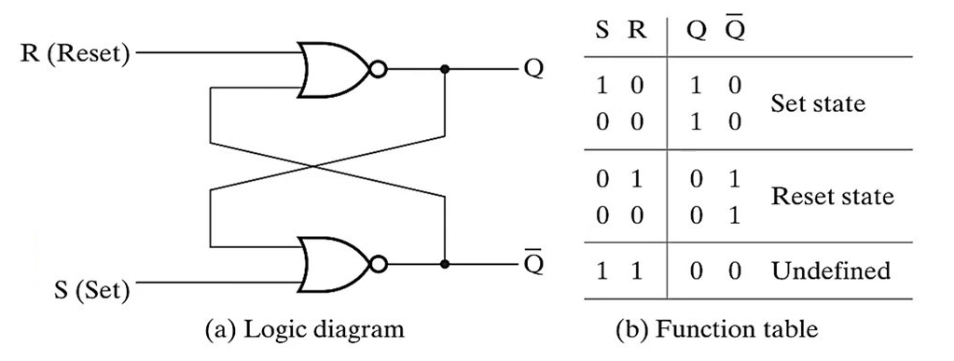
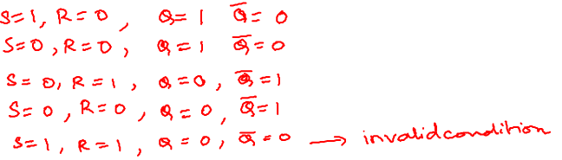
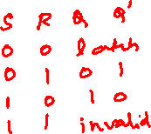
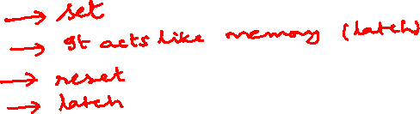
SR Latch- 1 bit memory storage device

Slide 10
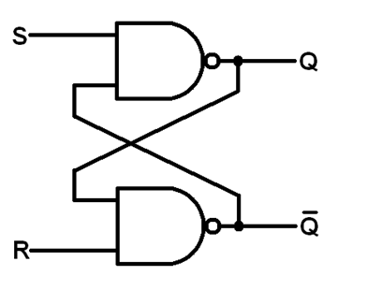
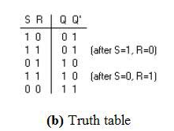
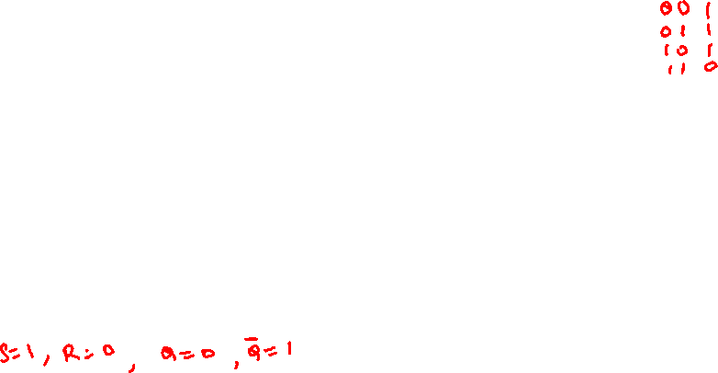
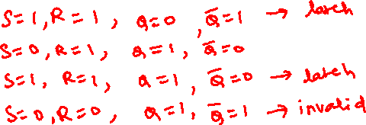
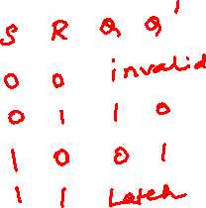
SR latch- using NAND gate

Slide 11
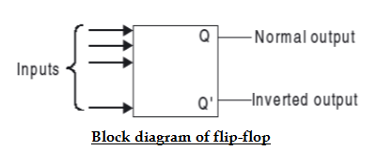
FLIP-FLOPS
Flip flops
The basic 1-bit digital memory circuit is known as a flip-flop. Flip-Flops are synchronous bistable devices (has two outputs Q and Q’).
In this case, the term synchronous means that the output changes state only at a specified point on the triggering input called the clock (CLK), i.e., changes in the output occur in synchronization with the clock. It can have only two states, either the 1 state or the 0 state.

Slide 12
FLIP-FLOPS
Flip flops
Flip-flops can be obtained by using NAND or NOR gates.
If Q is 1 i.e., Set, then Q' is 0; if Q is 0 i.e., Reset, then Q' is 1. That means Q and Q' cannot be at the same state simultaneously.
There are different types of flip-flops depending on how their inputs and clock pulses cause transition between two states.
We will discuss four different types of flip-flops SR, D, JK, and T.
Basically D, J-K, and T are three different modifications of the S-R flip-flop.

Slide 13
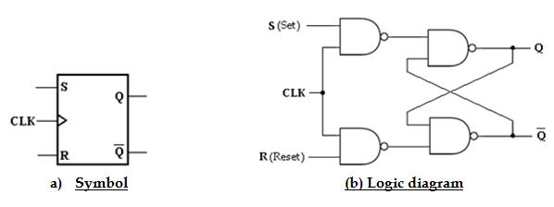
S-R FLIP-FLOP
When S is HIGH and R is LOW, the Q output goes HIGH on the triggering edge of the clock pulse, and the Flip-Flop is SET.
When S is LOW and R is HIGH, the Q output goes LOW on the triggering edge of the clock pulse, and the Flip-Flop is RESET.
When both S and R are LOW, the output does not change from its prior state.
An invalid condition exists when both S and R are HIGH.

Slide 14
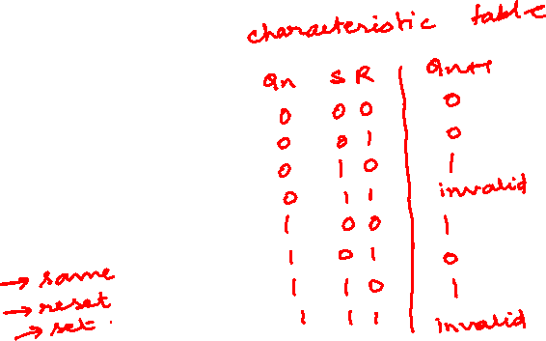
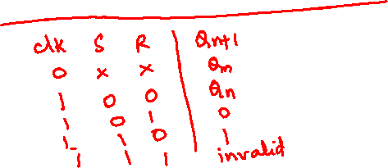
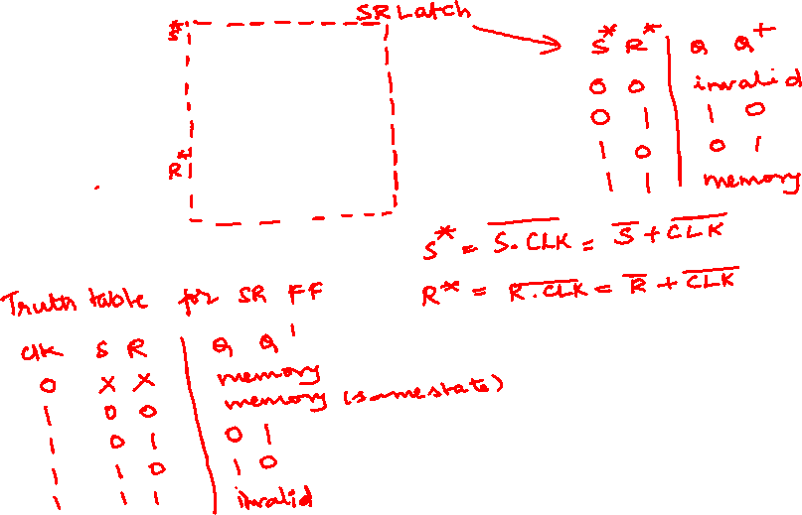

Slide 15
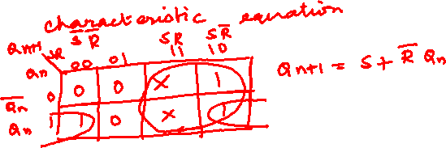
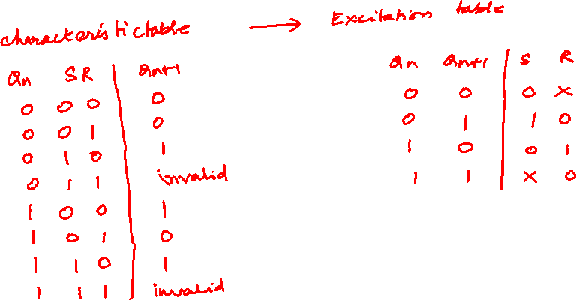

Slide 16
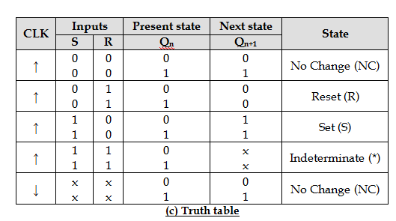
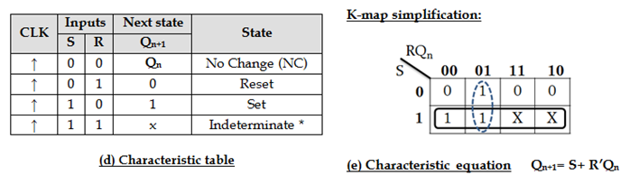
S-R FLIP-FLOP

Slide 17
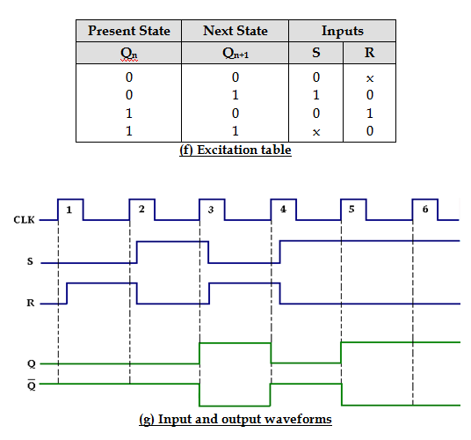
FLIP-FLOPS
SR Flip flops

Slide 18
FLIP-FLOPS
SR Flip flops
module SR_FF(Q,QB,S,R,CLK);
module srflip(Q,QB,S,R,CLK);
input S,R,CLK;
output Q,QB;
reg Q,QB;
always @(posedge CLK)
begin
case({S,R})
2'b00:Q=Q;
2'b01:Q=0;
2'b10:Q=1;
2'b11:Q=1'bx;
endcase
QB=~Q;
end
endmodule

Slide 19
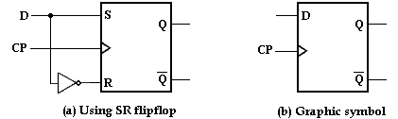
D FLIP-FLOP
In D Flip-Flop, the basic SR Flip-Flop is used with complemented inputs.
To eliminate the undesirable condition of the indeterminate state in the RS Flip-Flop is to ensure that inputs S and R are never equal to 1 at the same time. This is done by D Flip-Flop.
The D (delay or data) Flip-Flop has one input called delay input and clock pulse input.

Slide 20
FLIP-FLOPS
TEST BENCH
module
module srfliptb;
reg S,R,CLK;
wire Q,QB;
srflip uut(.Q(Q), .QB(QB), .S(S), .R(R), .CLK(CLK) );
always #100 CLK=~CLK;
initial begin
CLK=1;
S=1; R=0;
#100;
S=0; R=0;
#100;
S=0; R=1;
#100;
S=0; R=0;
#100;
S=1; R=1;
end
endmodule

Slide 21
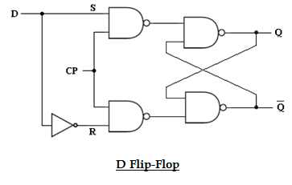
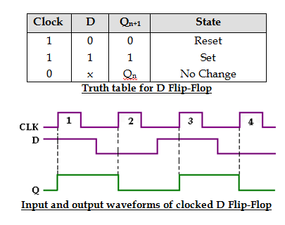
D FLIP-FLOP

Slide 22
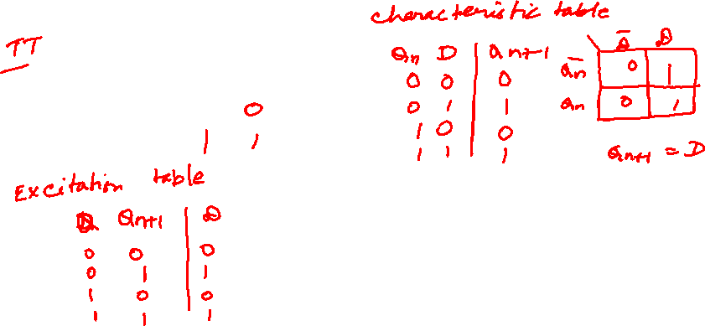
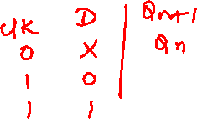
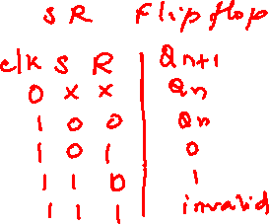

Slide 23
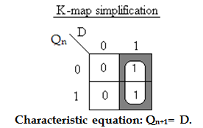
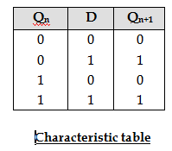
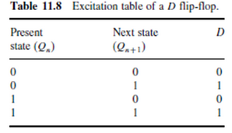
D FLIP-FLOP

Slide 24
D FLIP-FLOP
odule d_ff1(Q,QB,D,CLK);
input D,CLK;
output Q,QB;
reg Q,QB;
always @(posedge CLK)
begin
Q=D;
QB=~Q;
end
endmodule
module d_ff_tb1;
reg D;
reg CLK;
wire Q;
wire QB;
d_ff1 uut(.Q(Q), .QB(QB), .D(D), .CLK(CLK));
always #100 CLK=~CLK;
initial begin
CLK=1;
D=1;
#200;
D=0;
end
endmodule

Slide 25
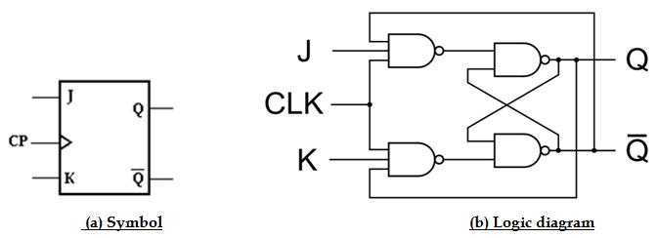
J-K FLIP-FLOP
JK means Jack Kilby, Texas Instrument (TI) Engineer, who invented IC in 1958.
JK flip-flop is built using only NAND gates.
JK Flip-Flop has two inputs J(set) and K(reset).

Slide 26
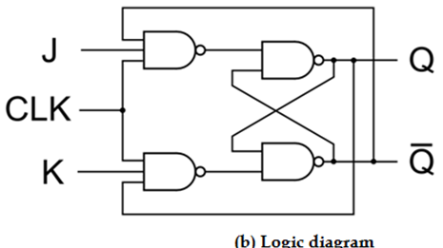
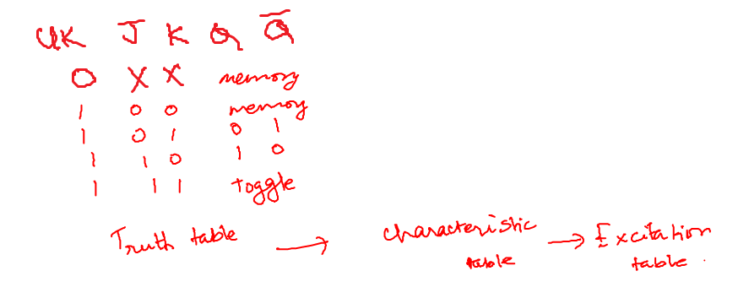
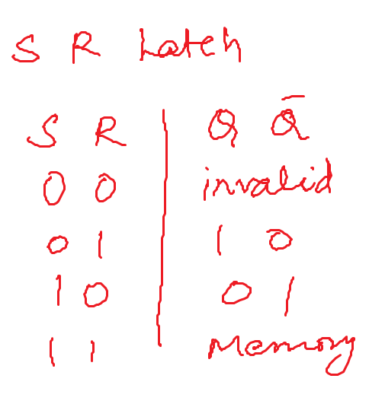
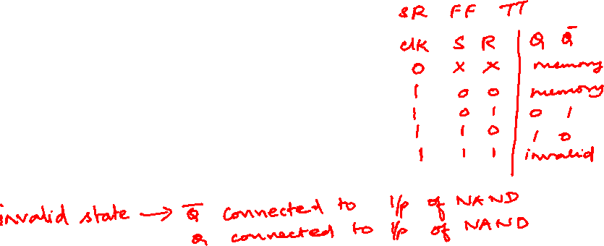

Slide 27
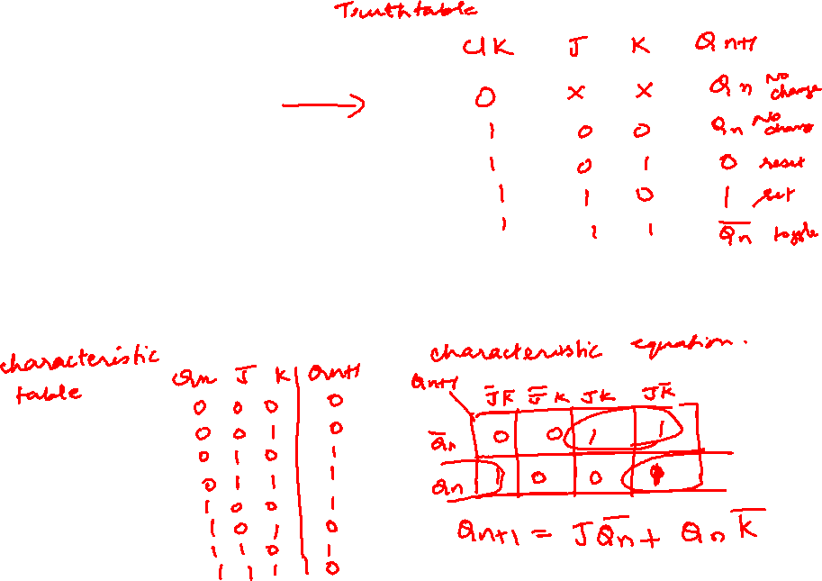

Slide 28
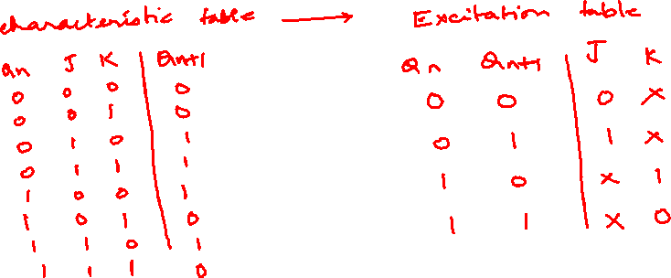

Slide 29
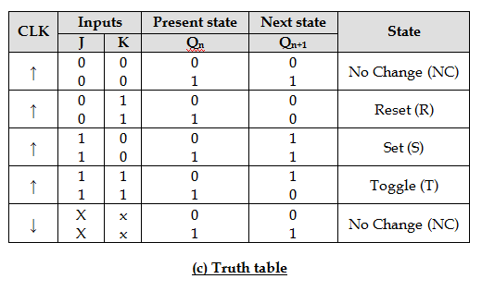
J-K FLIP-FLOP

Slide 30
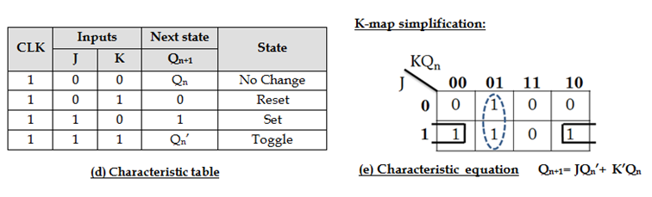
J-K FLIP-FLOP

Slide 31
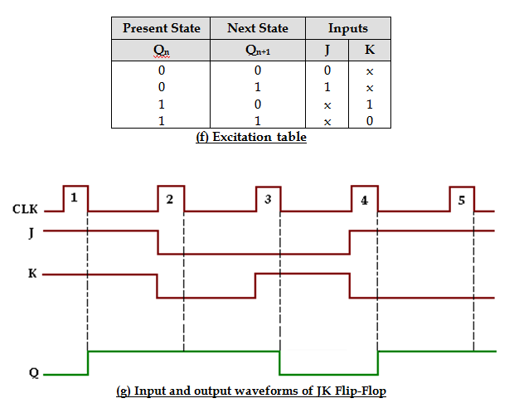
J-K FLIP-FLOP

Slide 32
J-K FLIP-FLOP
module jk_ff_tb;
reg J;
reg K;
reg CLK;
wire Q;
wire QB;
jk_ff uut(.Q(Q), .QB(QB), .J(J), .K(K), .CLK(CLK));
always #100 CLK=~CLK;
initial begin
CLK=1;
J=1;K=0;
#100;
J=0; K=0;
#100;
J=0; K=1;
#100;
J=1; K=1;
end
endmodule
module jk_ff(Q,QB,J,K,CLK);
input J,K,CLK;
output Q,QB;
reg Q,QB;
always @(posedge CLK)
begin
case({J,K})
2'b00:Q=Q;
2'b01:Q=0;
2'b10:Q=1;
2'b11:Q=~Q;
endcase
QB=~Q;
end
endmodule

Slide 33
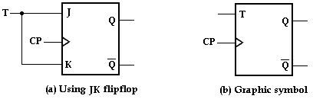
T FLIP-FLOP
The T (Toggle) Flip-Flop is a modification of the JK Flip-Flop. It is obtained from JK Flip-Flop by connecting both inputs J and K together, i.e., single input.
Regardless of the present state, the Flip-Flop complements its output when the clock pulse occurs while input T= 1.

Slide 34
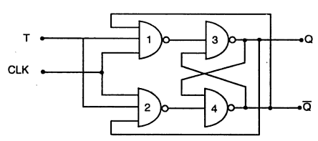
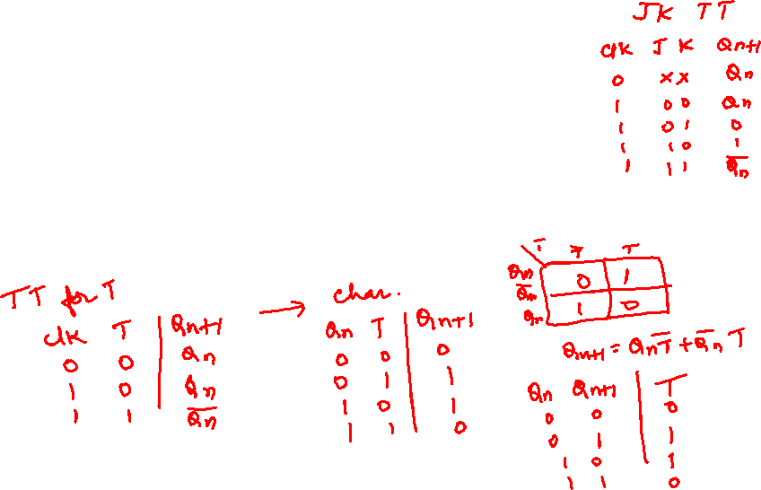
T FLIP-FLOP

Slide 35
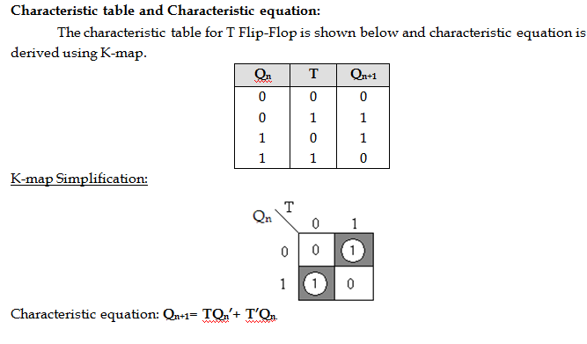
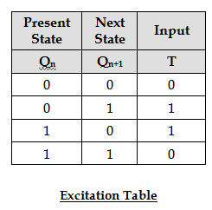
T FLIP-FLOP

Slide 36
T FLIP-FLOP
module t_ff(Q,QB,T,CLK);
input T,CLK;
output Q,QB;
reg Q=0,QB;
always @(posedge CLK)
begin
case(T)
1'b0:Q=Q;
1'b1:Q=~Q;
endcase
QB=~Q;
end
endmodule
module t_ff_tb;
reg T;
reg CLK;
wire Q;
wire QB;
t_ff uut (.Q(Q), .QB(QB), .T(T),.CLK(CLK));
always #100 CLK=~CLK;
initial begin
CLK=1;
T=0;
#200 T=1;
#200 T=0;
#200 T=1;
end
endmodule

Slide 37
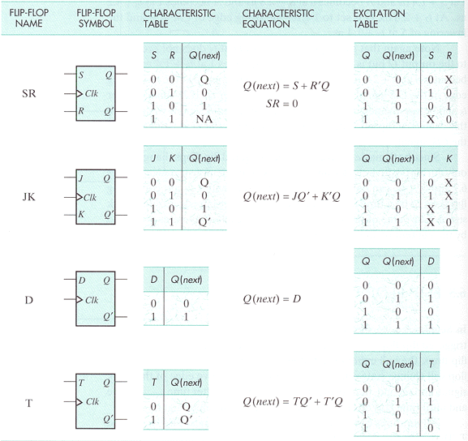
Summary of FLIP-FLOPS

