Slide 1
Module 3
CARRIER TRANSPORT MECHANISM
Charge Carriers in semi-conductors
Drift and Diffusion of carriers
Mobility
Generation
Recombination and Injection of Carriers
Carrier Transport Equations
Excess Carrier Lifetime

Slide 2
Mobile Charge Carriers in Semiconductors
Three primary types of carrier action occur inside a semiconductor:
Drift: charged particle motion under the influence of an electric field.
Diffusion: particle motion due to concentration gradient or temperature gradient.
Recombination-generation (R-G)

Slide 3
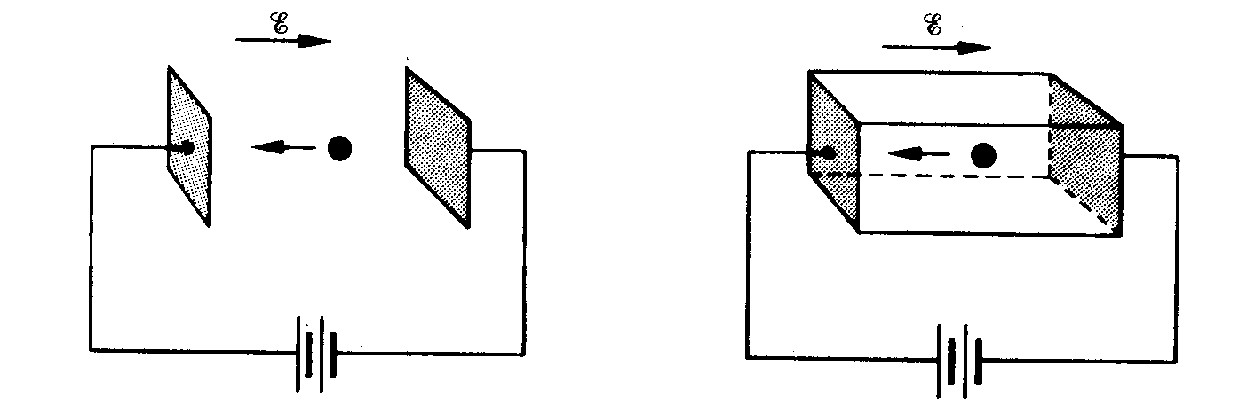
Electrons as Moving Particles
In vacuum
In semiconductor
F = (-q)E = m_{o}a
F = (-q)E = m_{n}*a
where m_{n}* is the
conductivity effective mass

Slide 4
Conductivity Effective Mass, m*
Under the influence of an electric field (E-field), an electron or a hole is accelerated:
electrons
holes
Electron and hole conductivity effective masses
 | Si | Ge | GaAs
m_{n}*/m_{o} | 0.26 | 0.12 | 0.068
m_{p}*/m_{o} | 0.39 | 0.30 | 0.50
m_{o} = 9.1×10⁻³¹ kg

Slide 5
Carrier Scattering
Mobile electrons and atoms in the Si lattice are always in random thermal motion.
Electrons make frequent collisions with the vibrating atoms
“lattice scattering” or “phonon scattering” – increases with increasing T
Other scattering mechanisms:
deflection by ionized impurity atoms
deflection due to Coulombic force between carriers
“carrier-carrier scattering” – only significant at high carrier concentrations
The net current in any direction is zero,
if no E-field is applied.
3
2
1
electron
4
5

Slide 6
Thermal Velocity, v_{th}
Average electron kinetic energy

Slide 7
Carrier Drift
When an electric field (e.g. due to an externally applied voltage) exists within a semiconductor, mobile charge carriers will be accelerated by the electrostatic force:
2
3
1
4
electron
5
E
Electrons drift in the direction opposite to the E-field → net current
Because of scattering, electrons in a semiconductor do not undergo constant acceleration. However, they can be viewed as quasi-classical particles moving at a constant average drift velocity v_{dn}

Slide 8
Carrier Drift (Band Model)
E_{c}
E_{v}

Slide 9
Electron Momentum
With every collision, the electron loses momentum
Between collisions, the electron gains momentum
–q E t_{mn}
t_{mn} ≡ average time between electron scattering events
Conservation of momentum →
|m_{n}*v_{dn} | = | q E τ_{mn}|

Slide 10
Carrier Mobility μ
For electrons:
|v_{dn}| = qEτ_{mn} / m_{n}* ≡ μ_{n}E
μ_{n} ≡ [qτ_{mn} / m_{n}*] is the electron mobility
Similarly, for holes:
|v_{dp}|= qEτ_{mp} / m_{p}* ≡ μ_{p}E
μ_{p} ≡ [qτ_{mp} / m_{p}*] is the hole mobility
Electron and hole mobilities for intrinsic semiconductors @ 300K
 | Si | Ge | GaAs | InAs
μ_{n} (cm²/Vs) | 1400 | 3900 | 8500 | 30,000
μ_{p} (cm²/Vs) | 470 | 1900 | 400 | 500

Slide 11
Example: Drift Velocity Calculation
a) Find the hole drift velocity in an intrinsic Si sample for E = 10³ V/cm.
b) What is the average hole scattering time?
Solution:
a)
b)
v_{dp} = μ_{p}E

Slide 12
Mean Free Path
Average distance traveled between collisions

Slide 13
Mechanisms of Carrier Scattering
Dominant scattering mechanisms:
1. Phonon scattering (lattice scattering)
2. Impurity (dopant) ion scattering
Phonon scattering limited mobility decreases with increasing T:
μ = qτ / m

Slide 14
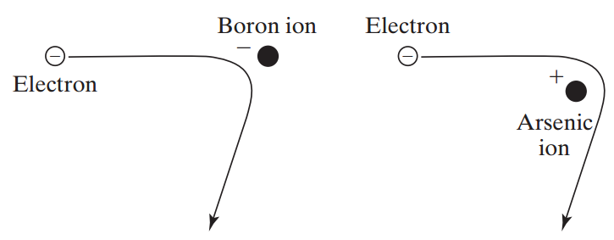
Impurity Ion Scattering
There is less change in the electron’s direction if the electron travels by the ion at a higher speed.
Ion scattering limited mobility increases with increasing T:

Slide 15
Matthiessen's Rule
The probability that a carrier will be scattered by mechanism i within a time period dt is
τ_{i} ≡ mean time between scattering events due to mechanism i
→ Probability that a carrier will be scattered by any mechanism within a time period dt is

Slide 16
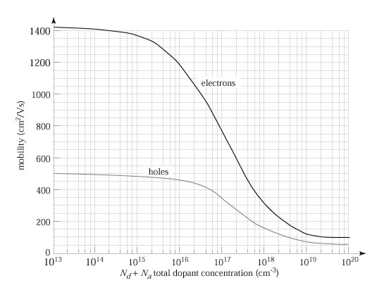
Mobility Dependence on Doping
Carrier mobilities in Si at 300K

Slide 17
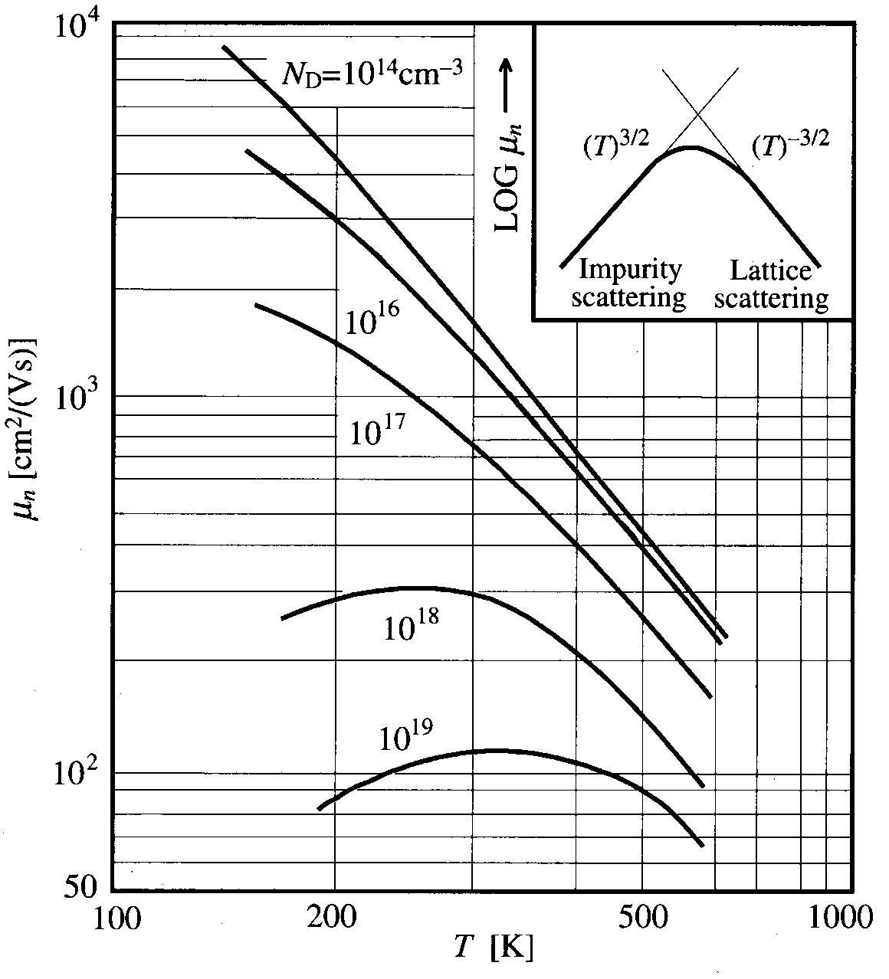
Mobility Dependence on Temperature

Slide 18
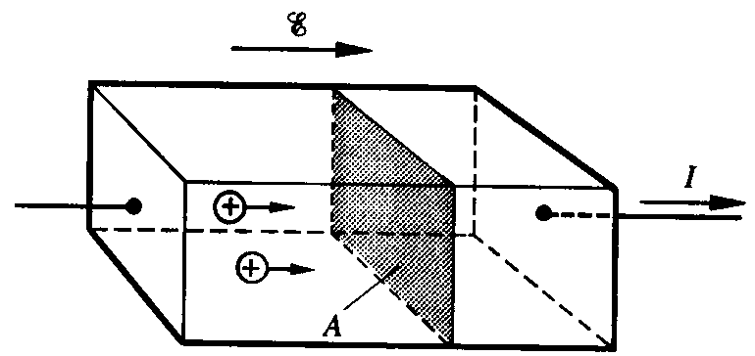
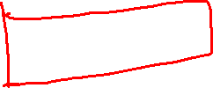
Hole Drift Current Density J_{p,drift}
v_{dp} Δt A = volume from which all holes cross plane in time Δt
p v_{dp} Δt A = number of holes crossing plane in time Δt
q p v_{dp} Δt A = hole charge crossing plane in time Δt
q p v_{dp} A = hole charge crossing plane per unit time = hole current
→ Hole drift current per unit area J_{p,drift} = q p v_{dp}

Slide 19
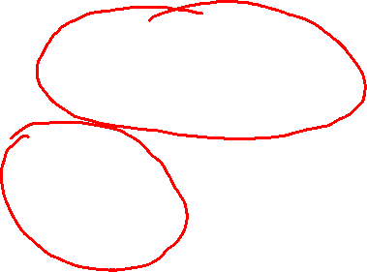
Conductivity and Resistivity
In a semiconductor, both electrons and holes conduct current:
The conductivity of a semiconductor is
Unit: mho/cm
The resistivity of a semiconductor is
Unit: ohm-cm

Slide 20
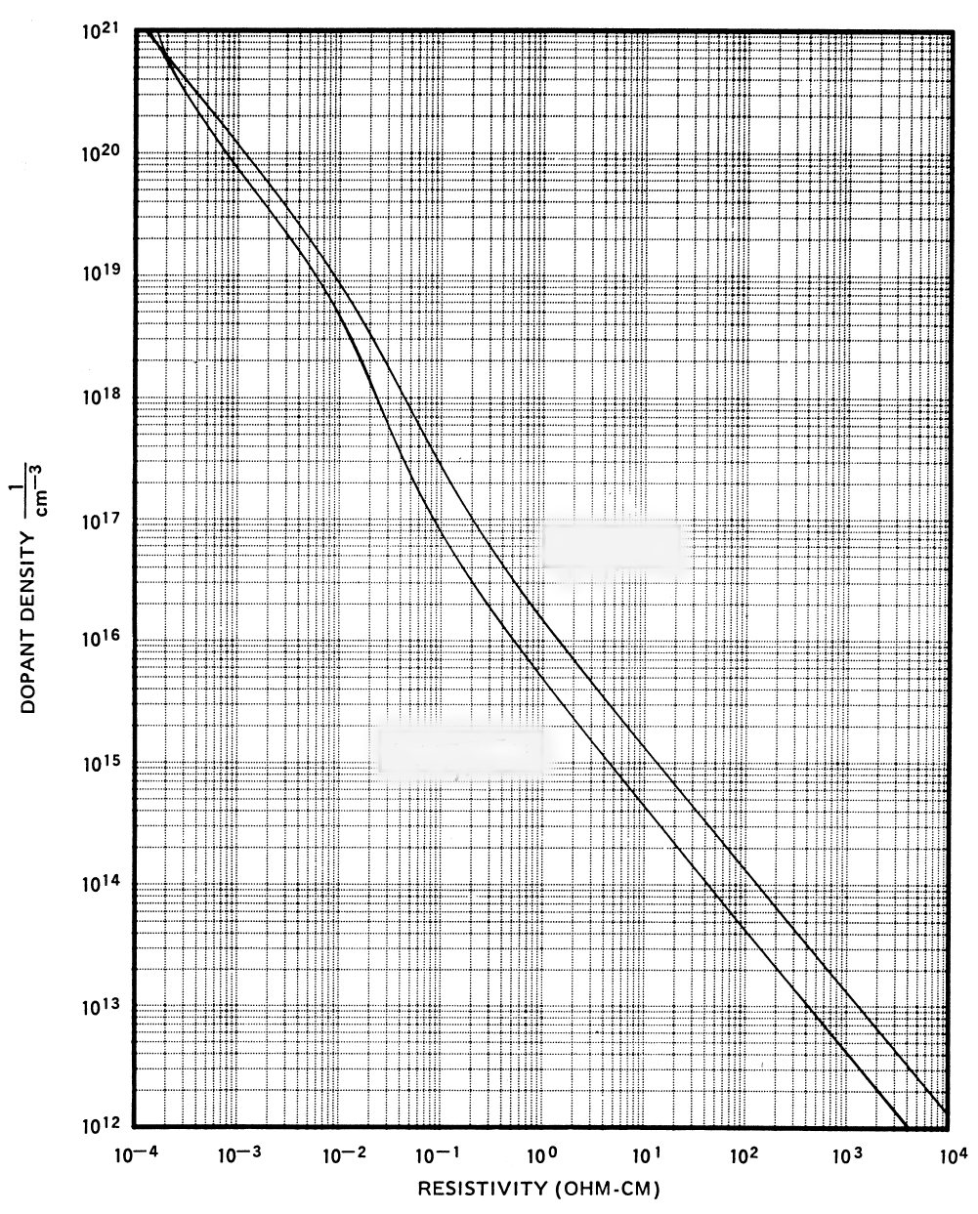


Resistivity Dependence on Doping
For n-type material:
For p-type material:
p-type
n-type
Note: This plot (for Si) does not apply to compensated material (doped with both acceptors and donors).
Lecture 4, Slide 20

Slide 21
Electrical Resistance
I
V
_
+
W
t
uniformly doped semiconductor
L
Resistance
[Unit: ohms]
where ρ is the resistivity

Slide 22
Example: Resistance Calculation
What is the resistivity of a Si sample doped with 10¹⁶/cm³ Boron?
Answer:

Slide 23
Example: Dopant Compensation
Consider the same Si sample doped with 10¹⁶/cm³ Boron, and additionally doped with 10¹⁷/cm³ Arsenic. What is its resistivity?
Answer:
(10¹⁷-10¹⁶)

Slide 24
Example: T Dependence of ρ
Consider a Si sample doped with 10¹⁷cm⁻³ As. How will its resistivity change when the temperature is increased from T=300K to T=400K?
Answer:
The temperature dependent factor in σ (and therefore ρ) is μ_{n}.
From the mobility vs. temperature curve for 10¹⁷ cm⁻³, we find that μ_{n} decreases from 770 at 300K to 400 at 400K.
Thus, ρ increases by

Slide 25
Summary of Charge carriers in Semiconductors
Electrons and holes can be considered as quasi-classical particles with effective mass m*
In the presence of an electric field E, carriers move with average drift velocity v_{d} = μE , μ is the carrier mobility
Mobility decreases with the increasing total concentration of ionized dopants
Mobility is dependent on temperature
decreases with increasing T if lattice scattering is dominant
decreases with decreasing T if impurity scattering is dominant
The conductivity and the resistivity of a semiconductor is dependent on its mobile charge carrier concentrations and mobilities

Slide 26
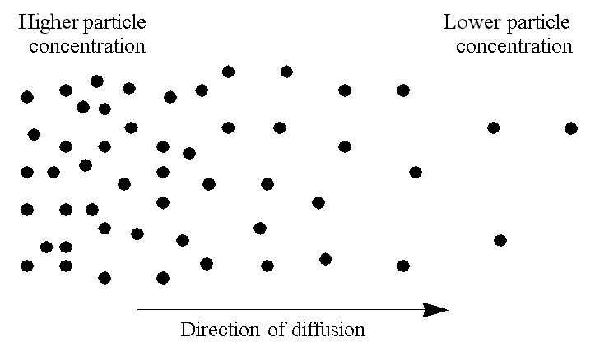
Diffusion
Particles diffuse from regions of higher concentration to regions of lower concentration region, due to random thermal motion.
26

Slide 27
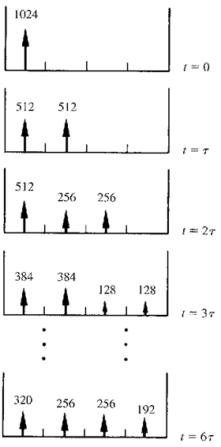
1-D Diffusion Example
Thermal motion causes particles to move into an adjacent compartment every t seconds
Each particle has an equal probability of jumping to the left or jumping to the right.
27

Slide 28
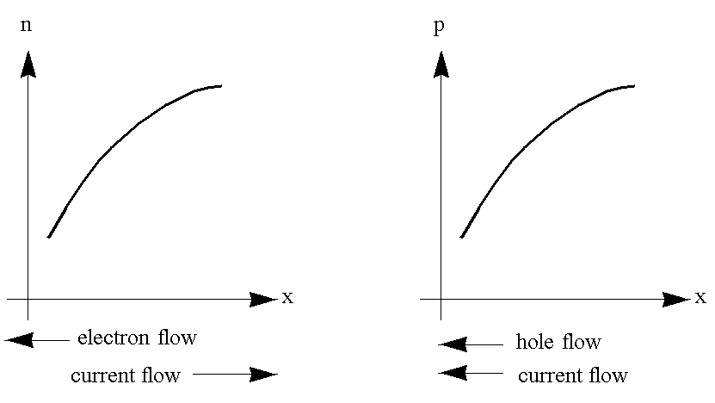
Diffusion Current
D is the diffusion constant, or diffusivity.
28

Slide 29
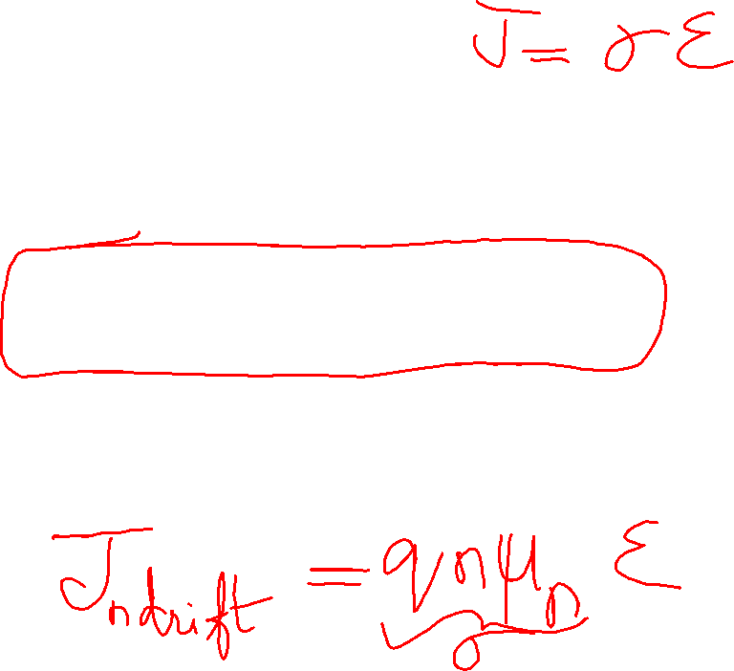
Total Current
29

Slide 30
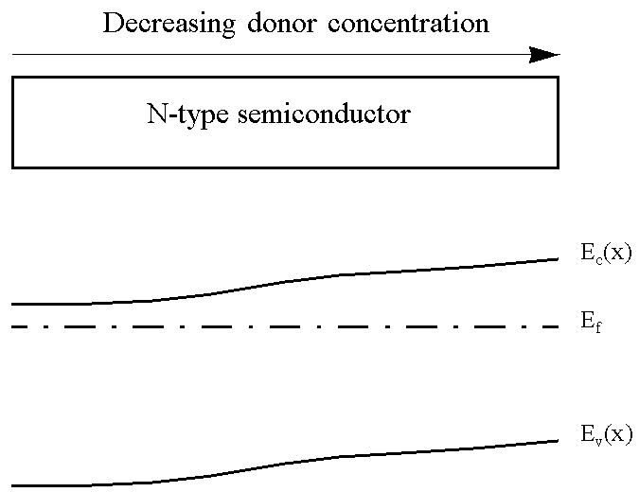
Non-Uniformly-Doped Semiconductor
The position of E_{F} relative to the band edges is determined by the carrier concentrations, which is determined by the net dopant concentration.
In equilibrium E_{F} is constant; therefore, the band-edge energies vary with position in a non-uniformly doped semiconductor:
E_{c}(x)
E_{F}
E_{v}(x)
30

Slide 31
Potential Difference due to n(x), p(x)
The ratio of carrier densities at two points depends exponentially on the potential difference between these points:
31

Slide 32
Built-In Electric Field due to n(x), p(x)
Consider a piece of a non-uniformly doped semiconductor:
E_{c}(x)
E_{F}
E_{v}(x)
32

Slide 33
Einstein Relationship between D, μ
In equilibrium there is no net flow of electrons or holes
➔ The drift and diffusion current components must balance each other exactly. (A built-in electric field exists, such that the drift current exactly cancels out the diffusion current due to the concentration gradient.)
J_{n} = 0 and J_{p} = 0
The Einstein relationship is valid for a non-degenerate semiconductor, even under non-equilibrium conditions.
33

Slide 34
Example: Diffusion Constant
What is the hole diffusion constant in a sample of silicon with μ_{p} = 410 cm² / V s ?
Answer:
Remember: kT/q = 26 mV at room temperature.
34

Slide 35
Quasi-Neutrality Approximation
If the dopant concentration profile varies gradually with position, then the majority-carrier concentration distribution does not differ much from the dopant concentration distribution.
n-type material:
p-type material:
in n-type material
35

Slide 36
Generation and Recombination
Generation:
Recombination:
Generation and recombination processes act to change the carrier concentrations, and thereby indirectly affect current flow
36

Slide 37
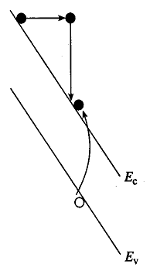
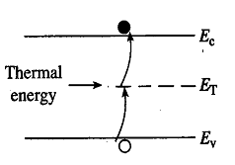
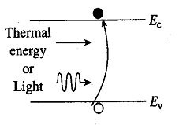
Generation Processes
Band-to-Band
R-G Center
Impact Ionization
37

Slide 38
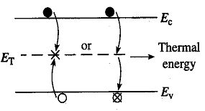
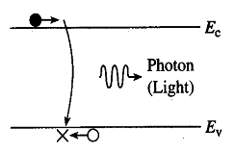
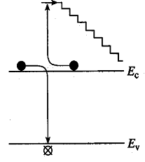
Recombination Processes
Direct
R-G Center
Auger
Recombination in Si is primarily via R-G centers
38

Slide 39
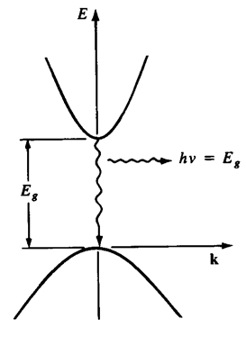
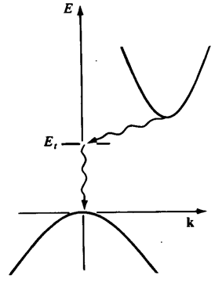
Direct vs. Indirect Band Gap Materials
Energy (E) vs. momentum (k) Diagrams
Direct:
Indirect:
Little change in momentum
is required for recombination
momentum is conserved by
photon emission
Large change in momentum
is required for recombination
momentum is conserved by
phonon + photon emission
39

Slide 40
Excess Carrier Concentrations
equilibrium values
Charge neutrality condition:
40

Slide 41
Low-Level Injection
Often the disturbance from equilibrium is small, such that the majority-carrier concentration is not affected significantly:
For an n-type material:
For a p-type material:
However, the minority carrier concentration can be significantly affected.
41

Slide 42
Indirect Recombination Rate
Suppose excess carriers are introduced into an n-type Si sample (e.g. by temporarily shining light onto it) at time t = 0.
How does p vary with time t > 0?
Consider the rate of hole recombination via traps:
Under low-level injection conditions, the hole generation rate is not significantly affected:
42

Slide 43
The net rate of change in p is therefore
43

Slide 44
Minority Carrier (Recombination) Lifetime
The minority carrier lifetime τ is the average time an excess minority carrier “survives” in a sea of majority carriers
τ ranges from 1 ns to 1 ms in Si and depends on the density of metallic impurities (contaminants) such as Au and Pt, and the density of crystalline defects. These impurities/defects give rise to localized energy states deep within the band gap. Such deep traps capture electrons or holes to facilitate recombination and are called recombination-generation centers.
44

Slide 45
Relaxation to Equilibrium State
Consider a semiconductor with no current flow in which thermal equilibrium is disturbed by the sudden creation of excess holes and electrons. The system will relax back to the equilibrium state via the R-G mechanism:
for electrons in p-type material
for holes in n-type material
45

Slide 46
Example: Photoconductor
Consider a sample of Si doped with 10¹⁶ cm⁻³ boron,
with recombination lifetime 1 μs. It is exposed continuously to light, such that electron-hole pairs are generated throughout the sample at the rate of 10²⁰ per cm³ per second, i.e. the generation rate G_{L} = 10²⁰/cm³/s
What are p₀ and n₀ ?
What are Δn and Δp ?
(Hint: In steady-state, generation rate equals recombination rate.)
46

Slide 47
What are p and n ?
What is the np product ?
Note: The np product can be very different from n_{i}².
47

Slide 48
Net Recombination Rate (General Case)
For arbitrary injection levels, the net rate of carrier recombination is:
48

Slide 49
Summary
Electron/hole concentration gradient → diffusion
Current flowing in a semiconductor is comprised of drift and diffusion components for electrons and holes
In equilibrium J_{n} = J_{n,drift} + J_{n,diff} = 0 and J_{p} = J_{p,drift} + J_{p,diff} = 0
The characteristic constants of drift and diffusion are related:
J = J_{n,drift} + J_{n,diff} + J_{p,drift} + J_{p,diff}
49

Slide 50
Summary (cont’d)
Generation and recombination (R-G) processes affect carrier concentrations as a function of time, and thereby current flow
Generation rate is enhanced by deep (near midgap) states due to defects or impurities, and also by high electric field
Recombination in Si is primarily via R-G centers
The characteristic constant for (indirect) R-G is the minority carrier lifetime:
Generally, the net recombination rate is proportional to
p
n
50

Slide 51
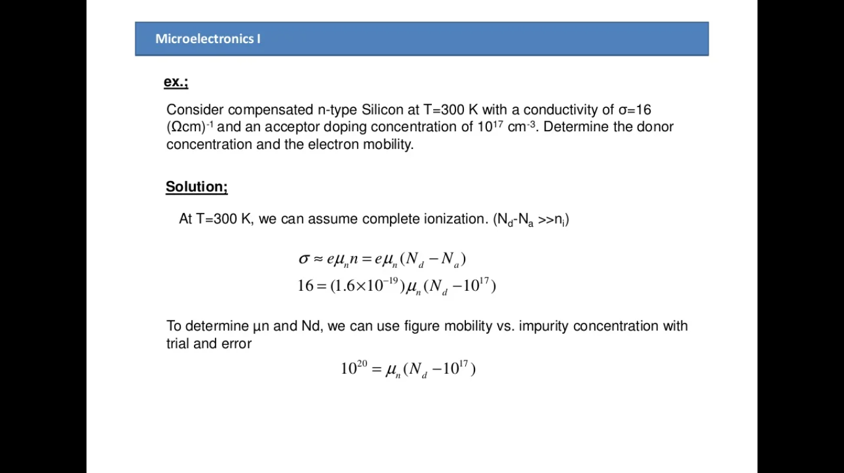
Problem on Electron Mobility

Slide 52
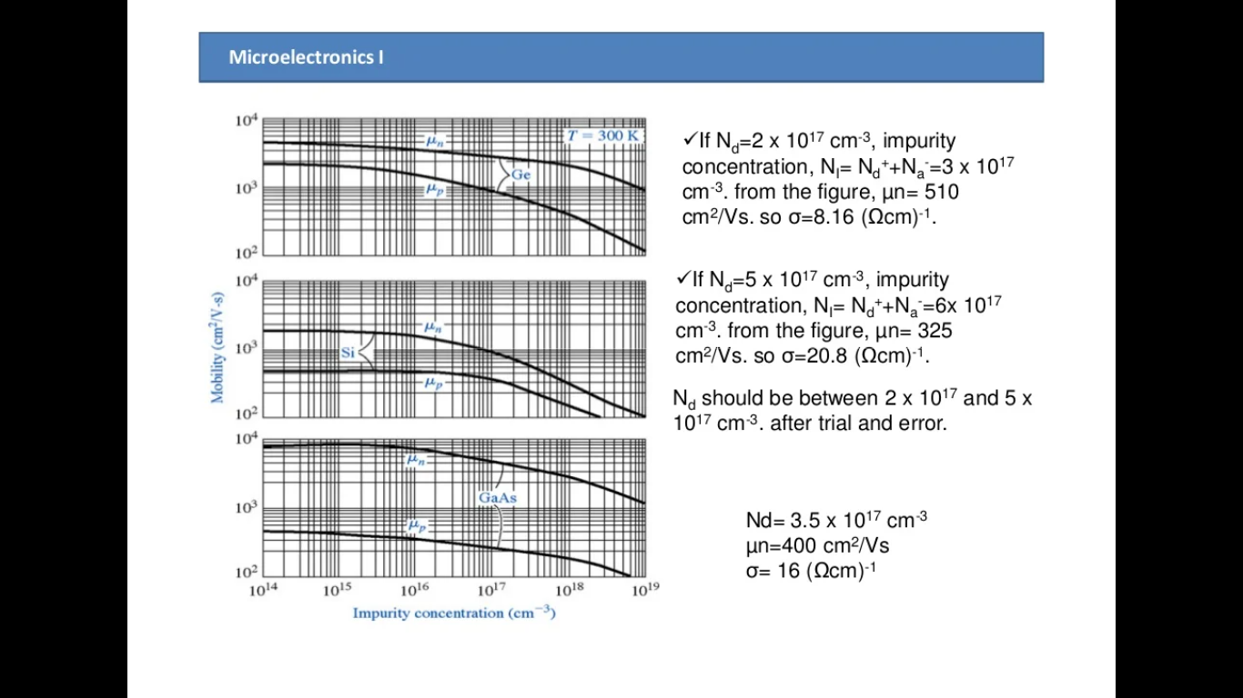

Slide 53
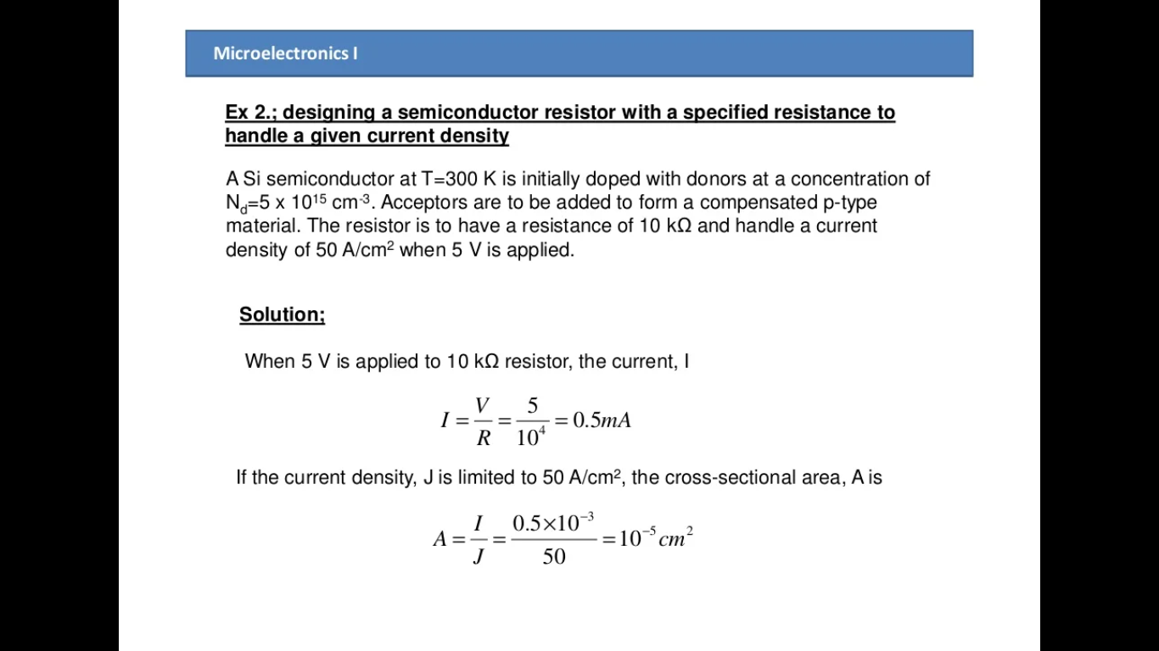

Slide 54
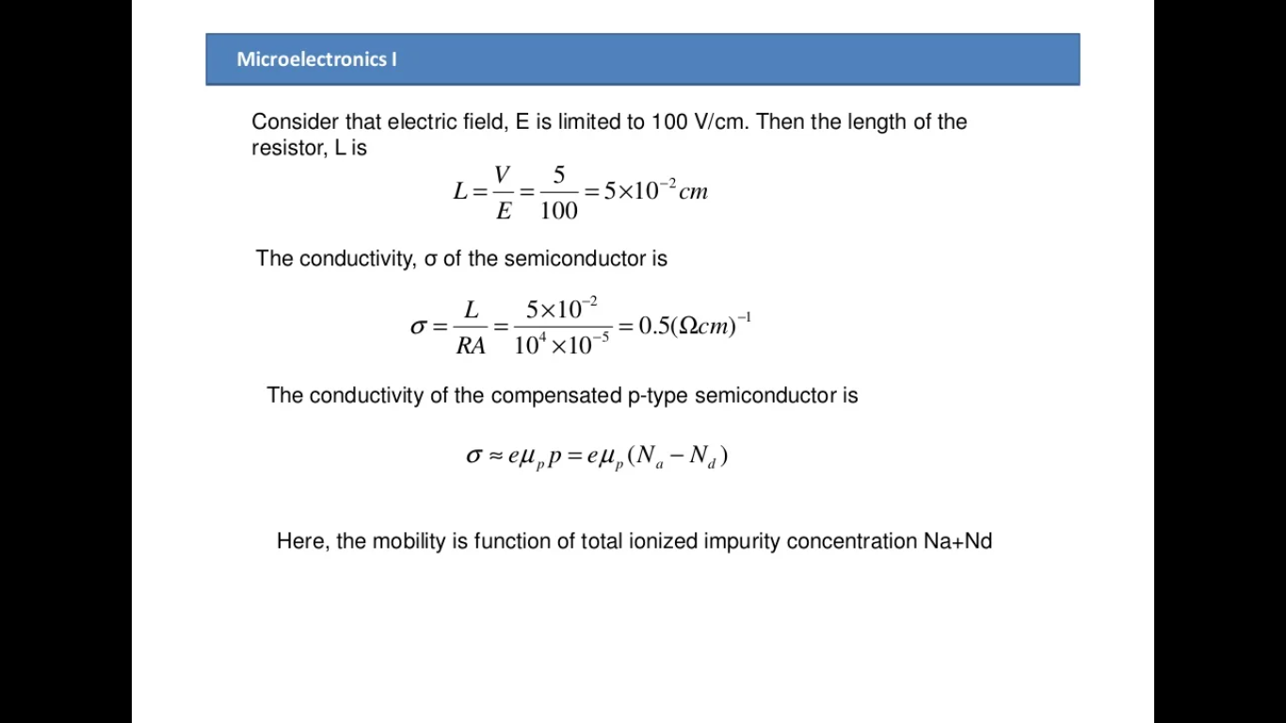

Slide 55
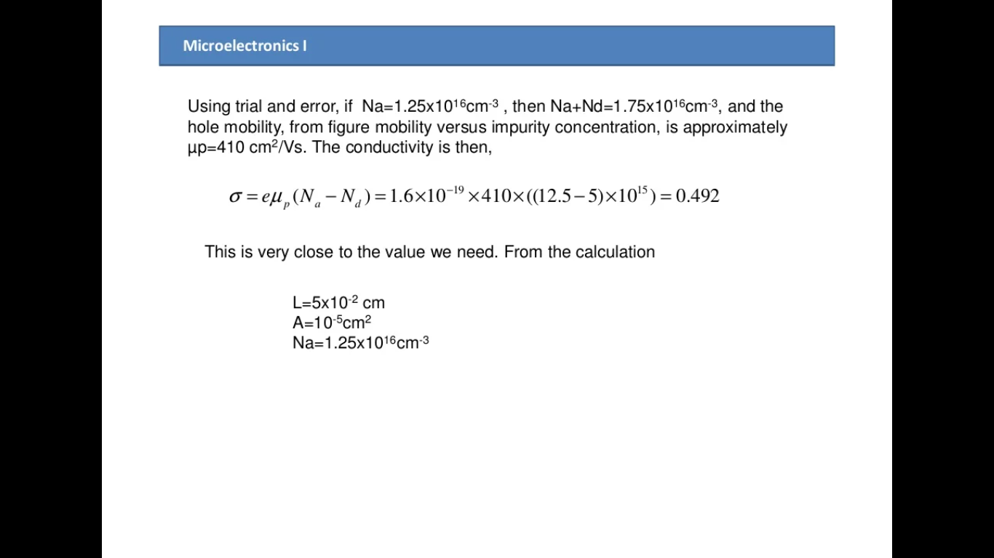

Slide 56
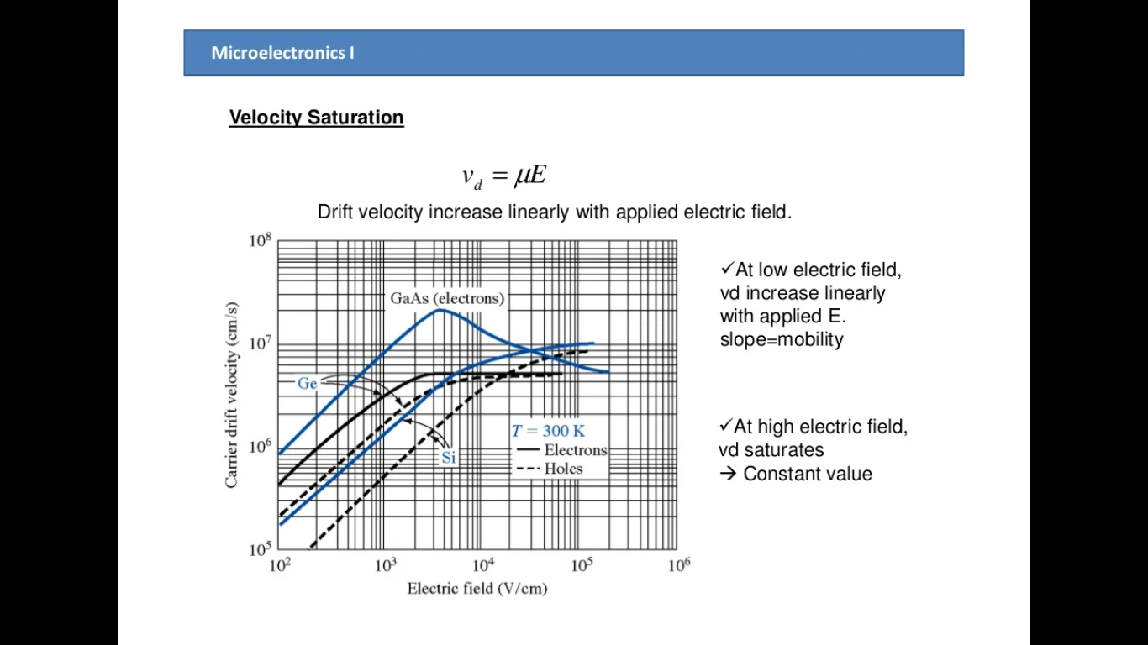

Slide 57
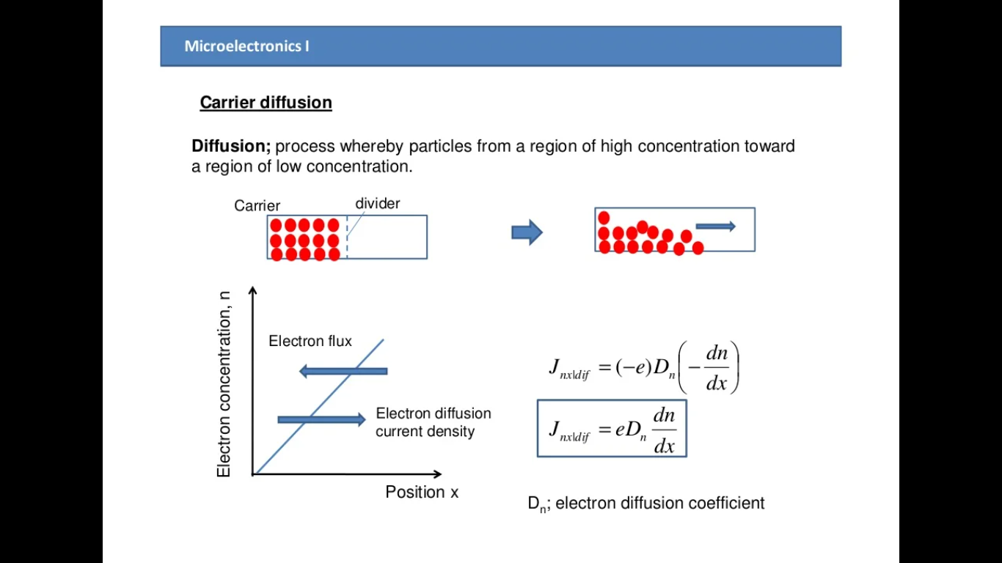

Slide 58
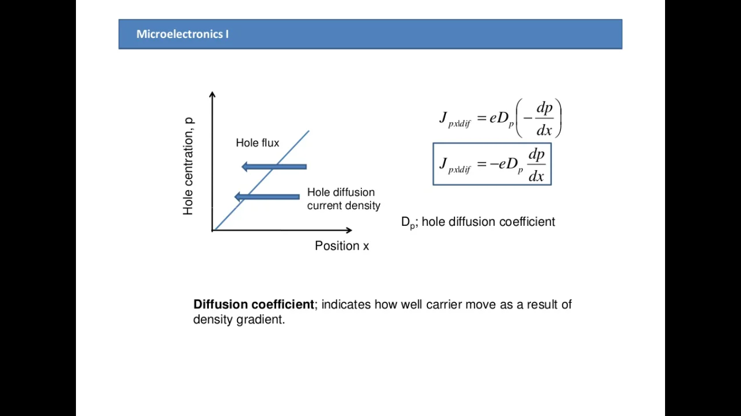

Slide 59
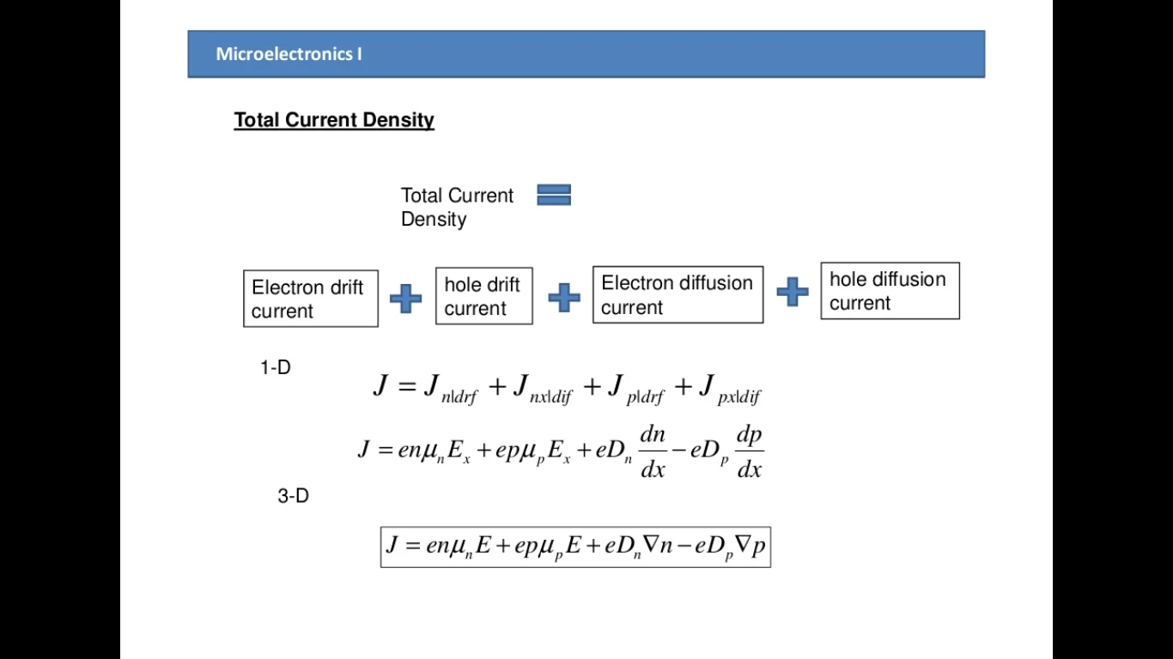

Slide 60
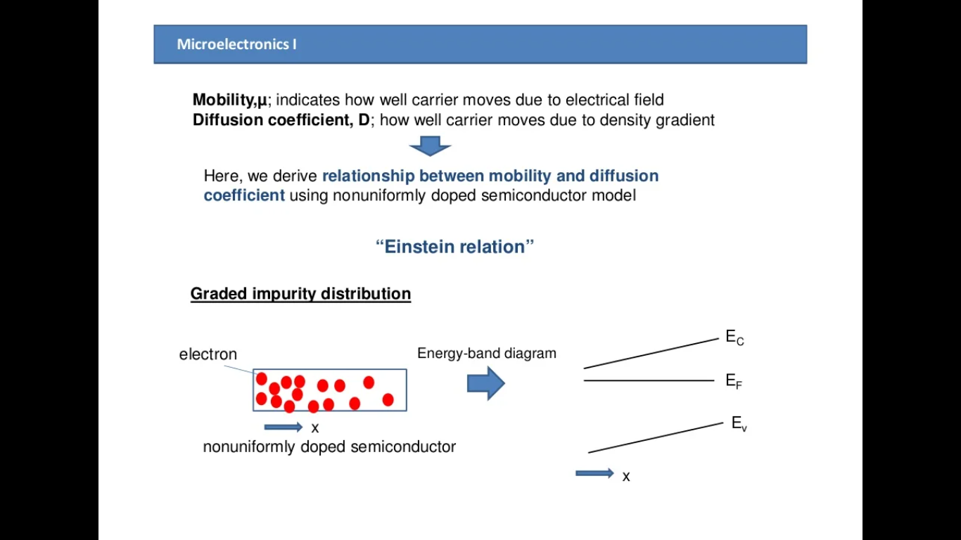

Slide 61
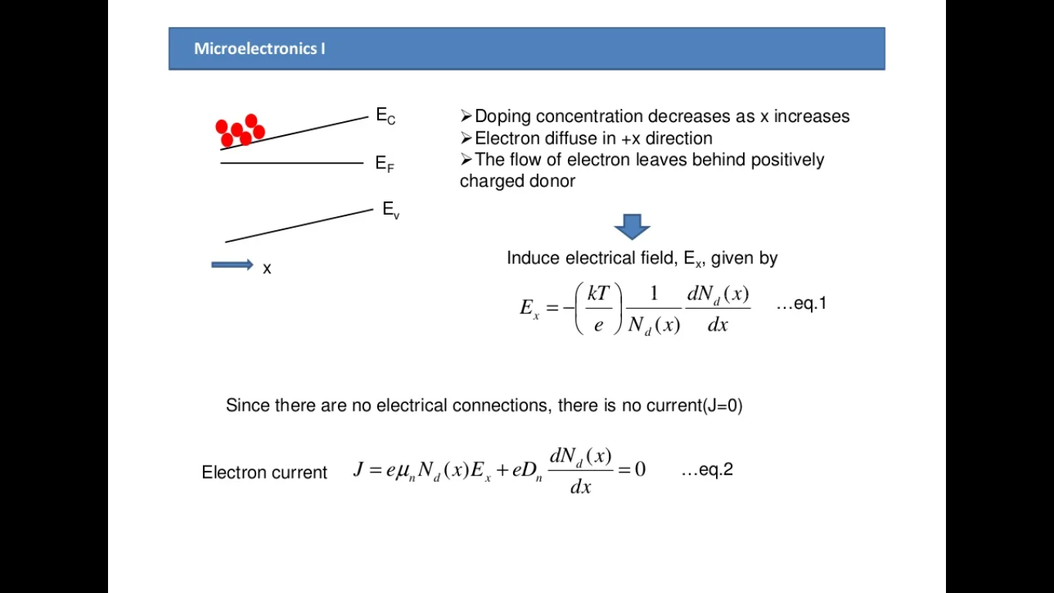

Slide 62
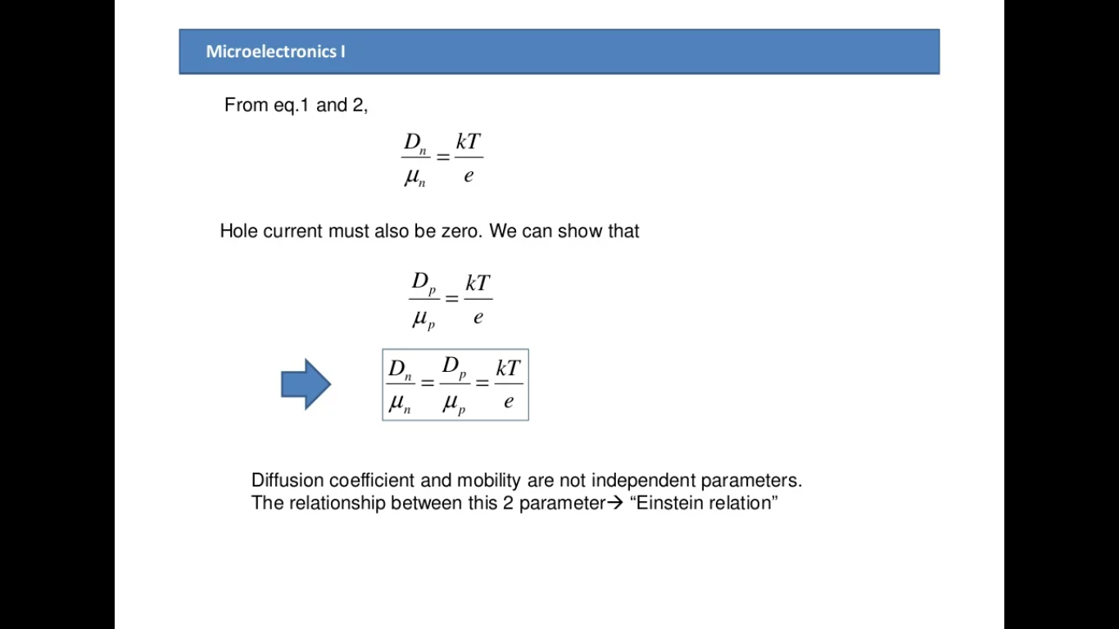

Slide 63
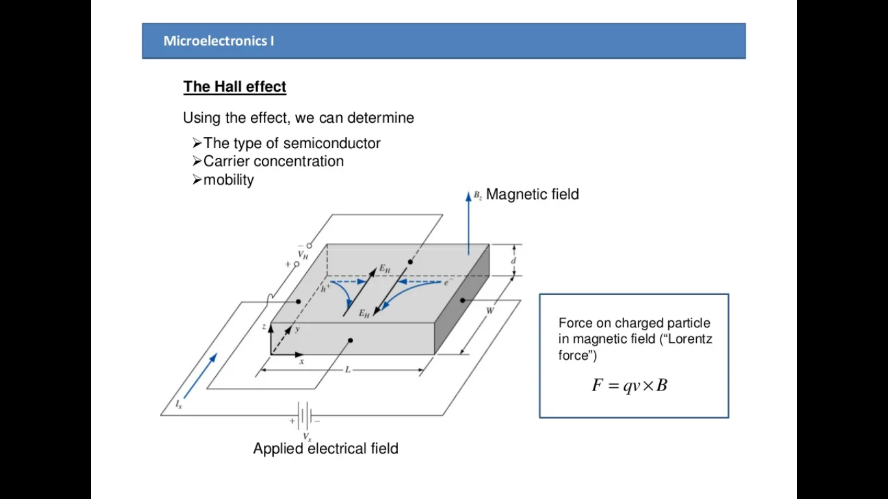

Slide 64
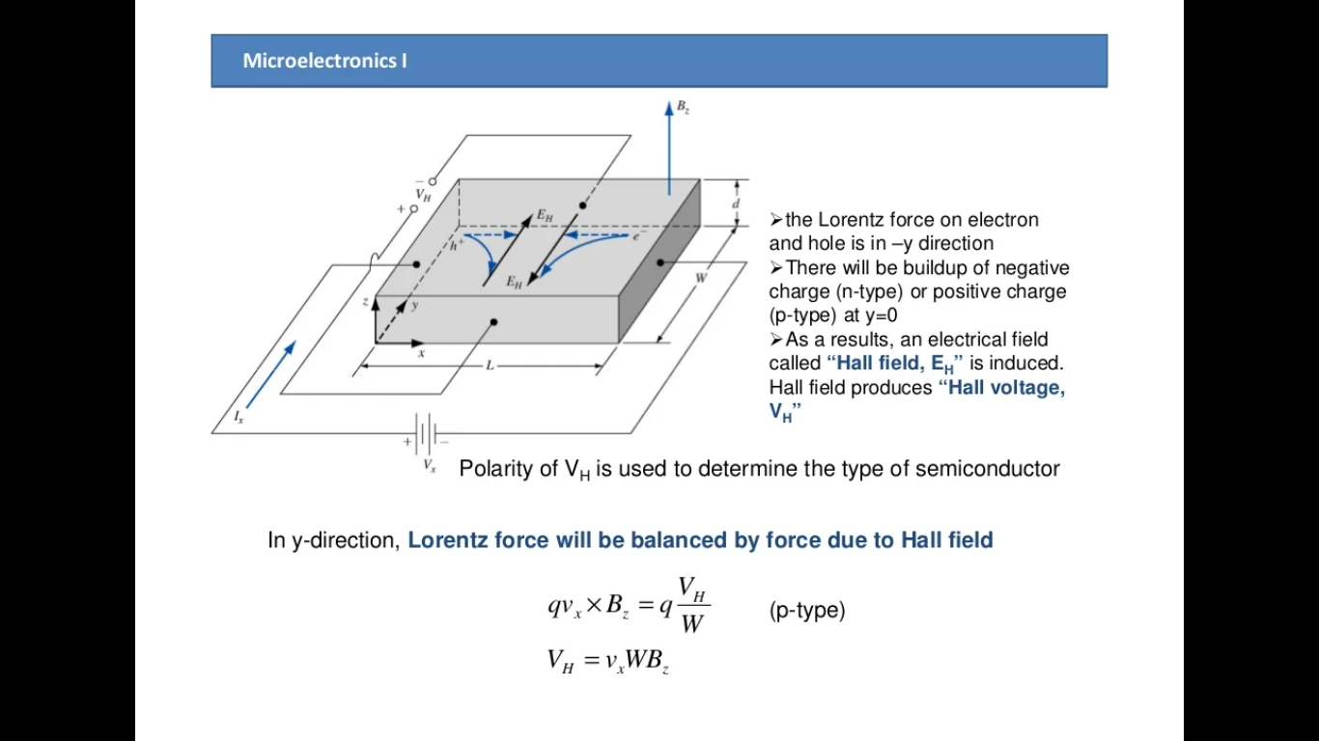

Slide 65
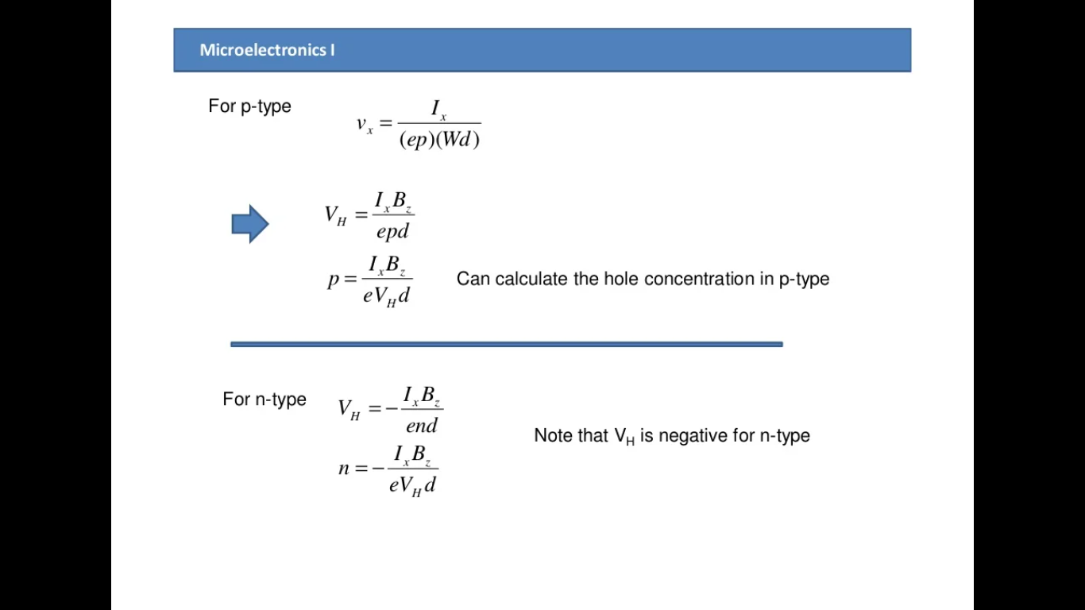

Slide 66
