Slide 1
ECE1004 – Signals and Systems
Dr. Florence Gnana Poovathy J
Assistant Professor (Senior)
School of Electronics Engineering (SENSE)
VIT-Chennai
Fall 2022-2023 Semester
VIT-Chennai - SENSE

Slide 2
Suggested Readings
Alan. V. Oppenheim, Alan. S. Willsk, S. Hamid Nawab, “Signals and Systems”, 2013, second edition, Pearson Education Limited, Noida, India.
VIT-Chennai - SENSE

Slide 3
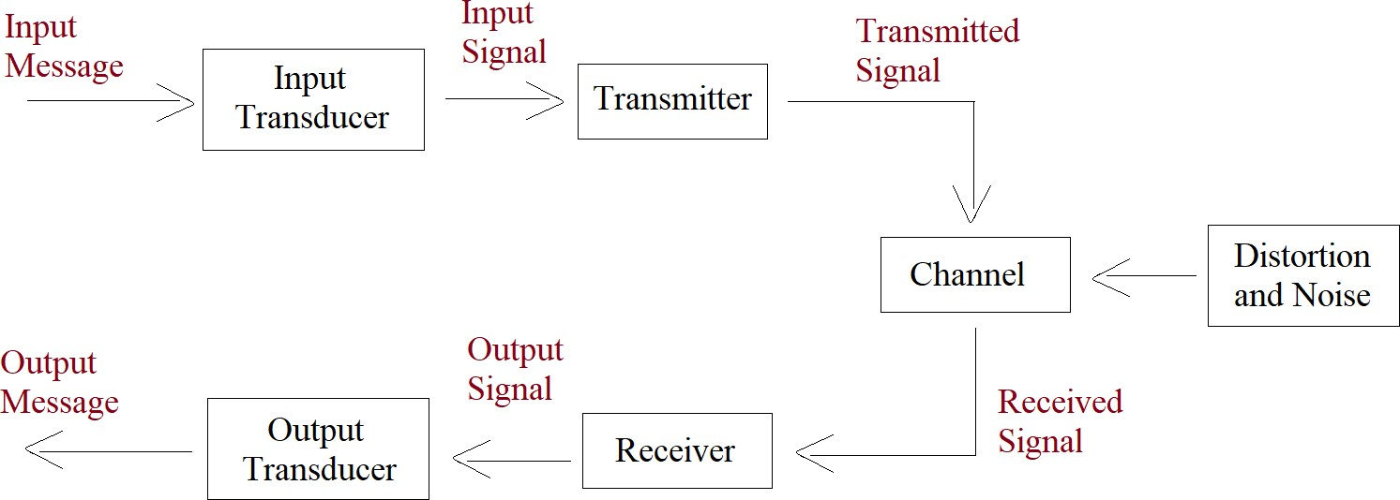
An Overview of ‘Signals and Systems’
Figure 1:A typical example
VIT-Chennai - SENSE

Slide 4

Contents
1
Module 1: Introduction to Continuous Time and Discrete Time Signals
VIT-Chennai - SENSE

Slide 5
Module 1: Introduction to Signals
Topics to be covered in Module 1
Representation of Signals
Classification of Signals/Types of signals Operations on Signals
VIT-Chennai - SENSE

Slide 6
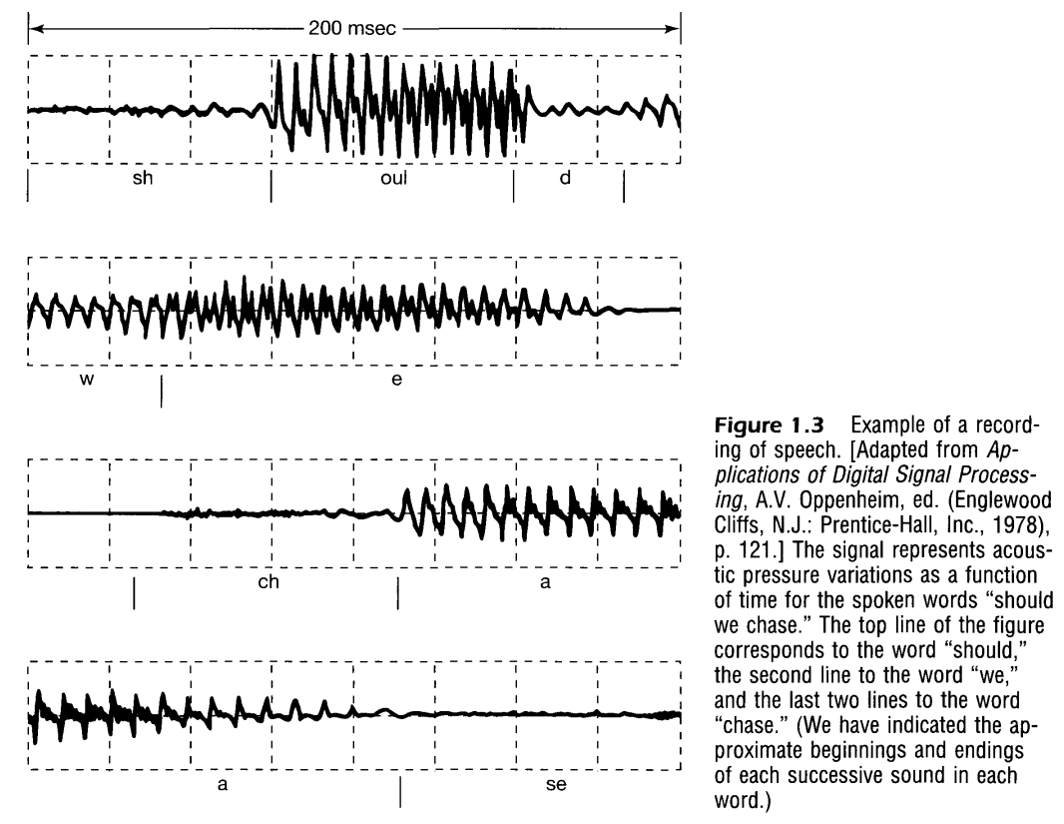

Slide 7
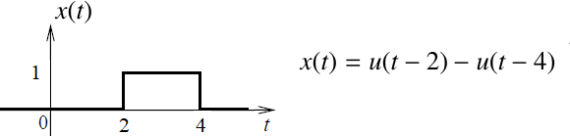
Module 1: Introduction to Signals
Signal Representation
A continuous-time signal x (t) can be represented in functional and graphical forms.
A discrete-time signal x [n] can be represented in tabular, functional, graphical and sequential forms.
A deterministic x (t) or x [n] can be expressed/represented in terms of step and ramp functions (as shown in Figure 23).
Figure 23:Signal representation - example
VIT-Chennai - SENSE

Slide 8
Module 1: Introduction to Signals
Classification of Signals
Continuous-time signal versus discrete-time signal Continuous-value signal versus discrete-valuesignal
Deterministic signal versus random signal
Even signal versus odd signal Periodic signal versus aperiodic signal Energy signal versus power signal
VIT-Chennai - SENSE

Slide 9
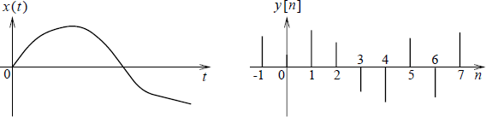
Module 1: Introduction to Signals
Continuous-time signal versus discrete-time signal
Continuous Time (CT) Signal: A signal x (t) that is specified for all value of time t
Discrete Time (DT) Signal: A signal y [n] that is specified only for integer value of n
Figure 2:Continuous-time versus discrete-time signal
VIT-Chennai - SENSE

Slide 10
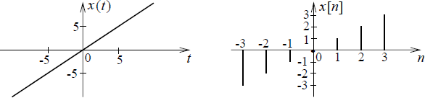
Module 1: Introduction to Signals
Example 1.1: Sketch the waveforms of the CT signal x (t) = t and DT signal x [n] = n
Figure 3:Waveforms of CT and DT signals
VIT-Chennai - SENSE

Slide 11
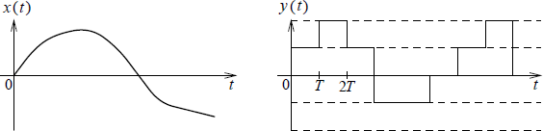
Module 1: Introduction to Signals
Continuous-value signal versus discrete-value signal
Continuous-Value Signal: A signal x (t) whose amplitude can take on any value
Discrete-Value Signal: A signal y (t) whose amplitude can take on only a finite number of values
Figure 4:Continuous-value versus discrete-value signal
VIT-Chennai - SENSE

Slide 12
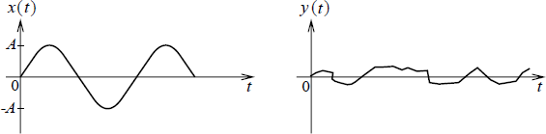
Module 1: Introduction to Signals
Deterministic signal versus randon signal
Deterministic Signal: A signal x (t) that can be mathematically modeled explicitly as a function of time, i.e., x (t) = A sin(2πf₀t)
Random Signal: A signal y (t) that is known only in terms of probabilistic description, i.e., noise
Figure 5:Deterministic versus random signal
VIT-Chennai - SENSE

Slide 13
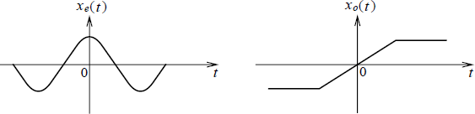
Module 1: Introduction to Signals
Even signal versus odd signal
Even Signal: A signal x_{e} (t) that satisfies the condition x_{e} (t) = x_{e} (−t)
Odd Signal: A signal x_{o} (t) that satisfies the condition
x_{o} (t) = −x_{o} (−t)
Figure 6:Even versus odd signal
VIT-Chennai - SENSE

Slide 14
Module 1: Introduction to Signals
Any deterministic signal x (t) can be expressed as a sum of an even signal and an odd signal: x (t) = x_{e} (t) + x_{o} (t) where
1
, ,
1
, ,
x (t) = x (t) + x (−t)
and x (t) = x (t) −
x (−t) (1)
e
2
o
2
Example 1.2: Show that x (t) = A sin(2πf₀t) is an odd signal
Given x (t) = A sin(2πf₀t) Therefore, x (−t) = A sin(2πf₀ × (−t))
= A × , − sin(2πf₀t), since sin(−θ) = − sin(θ)
= −A sin(2πf₀t)
x (−t) = −x (t)
Hence, x (t) is an odd signal
VIT-Chennai - SENSE

Slide 15
Module 1: Introduction to Signals
Example 1.3: Find the even and odd components of the signal
x (t) = cos(t) + sin(t) cos(t)
The even component,
1
,
,
x (t) = x (t) + x (−t)
e
2
1
,
,
= cos(t) + sin(t) cos(t) + cos(
−t) + sin(−t) cos(−t)
2
1
,
,
= cos(t) + sin(t) cos(t) + cos(t) − sin(t) cos(t)
2
= cos(t)
Note:sin( −θ) = − sin(θ) and cos(−θ) = cos(θ)
VIT-Chennai - SENSE

Slide 16
Module 1: Introduction to Signals
The odd component,
1
,
,
x (t) = x (t) − x (−t)
o
2
1
,
,
= cos(t) + sin(t) cos(t) − cos(−t) − sin(−t) cos(
−t)
2
1
, ,
= cos(t) + sin(t) cos(t)− cos(t) + sin(t) cos(t)
2
= sin(t) cos(t)
VIT-Chennai - SENSE

Slide 17
Module 1: Introduction to Signals
Characteristics/properties of Even and Odd Signals
For an even signal,
T
0
T
0
∫
∫
x_{e} (t)dt = 2 x_{e} (t)dt
−T0
0
For an odd signal,
T
0
x_{o} (t)dt = 0
−T0
The product of two even signals is an even signal The product of two odd signals is an even signal
The product of an even signal and an odd signal is an odd signal
∫
VIT-Chennai - SENSE

Slide 18
Module 1: Introduction to Signals
Periodic signal versus aperiodic signal
Periodic Signal: A continuous-time signal x (t) with a constant period 0 < T₀ < ∞ such that
x (t) = x (t + T₀) (2)
(or) a discrete-time signal x [n] with a constant integer period 0 < K₀ < ∞ such that
x [n] = x [n + K₀]
(3)
Aperiodic Signal: A signal y (t) or y [n] that does not satisfy the above property
VIT-Chennai - SENSE

Slide 19
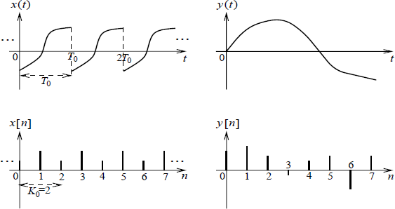
Module 1: Introduction to Signals
Figure 7:Periodic versus aperiodic signals
VIT-Chennai - SENSE

Slide 20
Module 1: Introduction to Signals
Energy-type signal versus power-type signal
Energy-type signal: A signal x (t) or x [n] that has a finite energy E_{x}
such that 0 < E_{x} < ∞ where
∞
2
in the case of CT signal (4)
E = |x (t)| dt
x
∫
−∞
or
∞
2
E_{x} = |x [n]| dt in the case of DT signal
(5)
Σ
n=−∞
Note that the power of an energy-type signal will be zero.
VIT-Chennai - SENSE

Slide 21

Module 1: Introduction to Signals
Power-type signal: A signal x (t) or x [n] that has a finite power P_{x}
such that 0 < P_{x} < ∞ where
1
$$\frac{T}{2}$$
₂
|x (t)| dt in the case of CT signal (6)
P = lim
∫ T
x
T→∞ T
−
T
2
or
1
K
P = lim
Σ
|x [n]|
2
in the case of DT signal (7)
x
K→∞ 2K + 1 _{n=−K}
Note that the energy of a power-type signal will be infinity.
VIT-Chennai - SENSE
Winter 2021-2022 Semester 19 / 50

Slide 22
Module 1: Introduction to Signals
In the case of a periodic signal, i.e. x (t) with a period T₀ or x [n] with a period K₀
1
t +T
1 0
2
P_{x} = _{T}
∫
|x (t)| dt in the case of CT signal (8)
0 t1
or
1
P =
K₀
k+K0−1
Σ
|x [n]|
2
in the case of DT signal.
(9)
x
n=k
In general, power-type signals are periodic but NOT all periodic signals are of power-type.
VIT-Chennai - SENSE

Slide 23
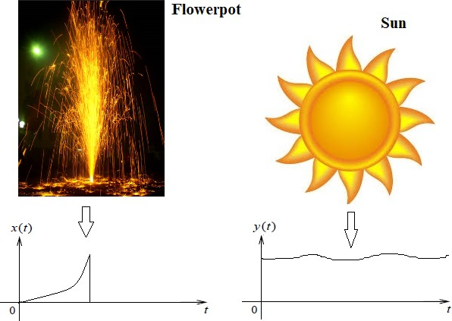
Figure 8:Energy signal versus power signal
VIT-Chennai - SENSE

Slide 24


Module 1: Introduction to Signals
Example 1.4: Determine the energy and power of the signal
x (t) = A cos(2πf₀t).
∞
Energy of x(t): E =
2
x
∫
∫
|x (t)| dt
−∞
∞
=
2
|A cos(2πf t)| dt = ∞
.
0
−∞
1
$$\frac{T}{2}$$
₂
|x (t)| dt
Power of x(t):
P = lim
∫ T
x
T→∞ T
−
T
2
1
$$\frac{T}{2}$$
_{A}2
= lim
2
∫ T
|A cos(2πf t)| dt = .
T→∞ T
0
2
−
T
2
Hence, x (t) is a power-type signal.
VIT-Chennai - SENSE

Slide 25

Module 1: Introduction to Signals
Example 1.5: Determine the energy and power of y (t) = exp(−|t|).
∞
∫
2
Energy of y(t): E = |y (t)| dt
y
−∞
∞
∫
2
= | exp(−|
t|)| dt
−∞
∞
∫
2
= 2 | exp(−t)| dt
modulus removal
0
∞
1
∫
= 2 exp(−2t)dt = 2 × = 1.
0
2
$$\frac{T}{2}$$
1
₂
|y (t)| dt
Power of y(t):
P = lim
∫
y
T→∞ T
−
T
2
1
T→∞ T
Hence, x (t) is an energy-type signal.
= lim × {a finite value} = 0.
VIT-Chennai - SENSE

Slide 26
Module 1: Introduction to Signals
Elementary signals Exponential signal Sinusoidal signal
Complex-exponential signal
Singularity functions/signals
Impulse function Step function Ramp function Signum function
Rectangular function Sinc function
VIT-Chennai - SENSE

Slide 27
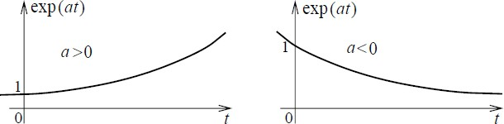
Module 1: Introduction to Signals
Exponential signal: x (t) = A exp(at) where 0 < |a| < ∞ is a non-zero parameter/constant.
For a > 0, x (t) is growing For a < 0, x (t) is decaying
Figure 9:Exponential signals
VIT-Chennai - SENSE

Slide 28
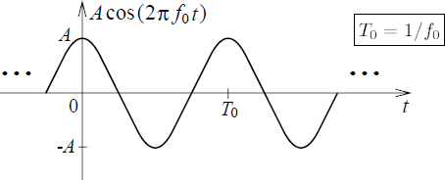
Module 1: Introduction to Signals
Sinusoidal signal: x (t) = A cos(2πf₀t + θ) or x (t) = A sin(2πf₀t + θ) where A is the amplitude, f₀ is the frequency (in Hertz) and θ is the phase angle (in radian).
Figure 10:A CT sinusoidal signal with period T₀ = ¹
f0
VIT-Chennai - SENSE

Slide 29
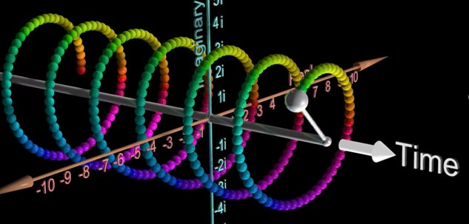
Module 1: Introduction to Signals
Complex exponential signal:
x (t) = A exp(j 2πf₀t) = A cos(2πf₀t) + j A sin(2πf₀t) where A is the magnitude and f₀ is the frequency. Note that the power of x (t) is A².
Figure 11:A complex exponential signal x (t) = A exp(j 2πf₀t) where A = 3 and
f₀ = 1/π (source video:Click here and watch from 7:10 to 7:30 sec)
VIT-Chennai - SENSE

Slide 30
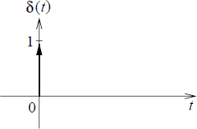
Module 1: Introduction to Signals
Unit impulse function in CT (dirac delta): A function δ(t) defined as
.
1, t = 0
0, elsewhere
δ(t) =
Figure 12:CT impulse functions
VIT-Chennai - SENSE

Slide 31
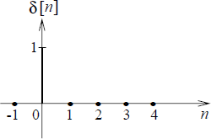
Module 1: Introduction to Signals
Unit impulse function in DT (dirac delta): A function δ[n] defined as
.
1, n = 0
0, n ̸= 0
δ[n] =
Figure 13:DT impulse functions
VIT-Chennai - SENSE

Slide 32
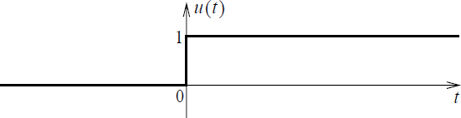
Module 1: Introduction to Signals
Unit step function in CT: A function u(t) defined as
.
1, t ≥ 0
0, t < 0
u(t) =
Figure 14:CT unit step function
VIT-Chennai - SENSE

Slide 33
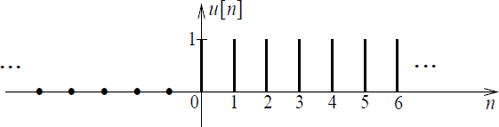
Module 1: Introduction to Signals
Unit step function in DT: A function u[n] defined as
.
1, n ≥ 0
u[n] =
0, n < 0
Figure 15:DT unit step function
VIT-Chennai - SENSE

Slide 34
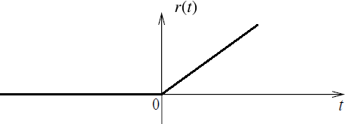
Module 1: Introduction to Signals
Unit ramp function in CT: A function r (t) defined as
.
t, t ≥ 0
0, t < 0
r (t) =
Figure 16:CT unit ramp function
VIT-Chennai - SENSE
Winter 2021-2022 Semester 32 / 50

Slide 35
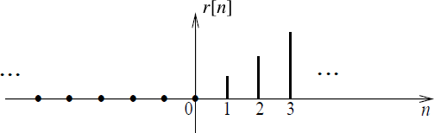
Module 1: Introduction to Signals
Unit ramp function in DT: A function r [n] defined as
.
n, n ≥ 0
0, n < 0
r [n] =
Figure 17:DT unit ramp function
VIT-Chennai - SENSE

Slide 36
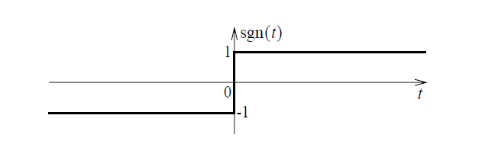
Module 1: Introduction to Signals
Signum function in CT: A function sgn(t) defined as

1, t > 0

sgn(t) =
0, t = 0
−1, t < 0
Figure 18:CT signum function
VIT-Chennai - SENSE

Slide 37
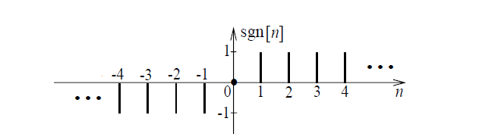
Module 1: Introduction to Signals
Signum function in DT (dirac delta): A function sgn[n] defined as

1, n > 0

sgn[n] =
0, n = 0
−1, n < 0
Figure 19:DT unit step function
VIT-Chennai - SENSE

Slide 38
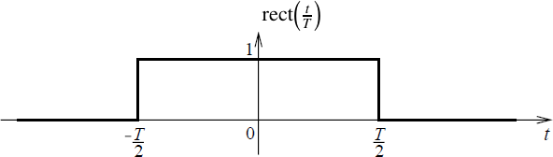
Module 1: Introduction to Signals
Unit rectangular function in CT: A function rect
t
defined as
T
.
t
1, |t| ≤ T/2 0, otherwise
rect
=
T
Figure 20:CT unit rectangular function
VIT-Chennai - SENSE

Slide 39
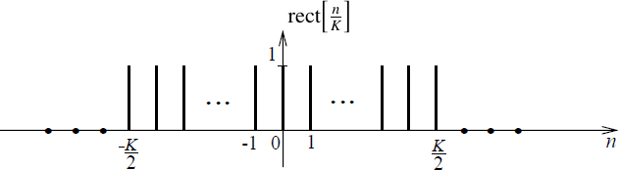
Module 1: Introduction to Signals
n
Unit rectangular function in DT: A function rect ( ) defined as
K
.
n
1, |n| ≤ ⌊K/2⌋
0, otherwise
Rect( ) =
K
Figure 21:DT unit rectangular function
VIT-Chennai - SENSE

Slide 40
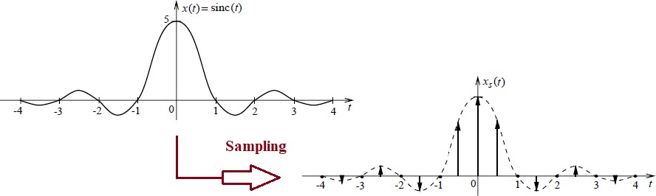
Module 1: Introduction to Signals
Sinc function: The sinc function is defined as sinc(t) = ^{sin(πt)}
πt
Figure 22:Sinc functions
Note that x (t) =
∞
1
s
Σ
x (nT ) × δ(t − nT ) where T = (T is the
n=−∞
s s s
Fs
s
sampling interval and F_{s} is the sampling frequency).
VIT-Chennai - SENSE
Winter 2021-2022 Semester 38 / 50

Slide 41
Module 1: Introduction to Signals
Operations on Signals Amplitude scaling Time shifting
Time scaling
VIT-Chennai - SENSE

Slide 42
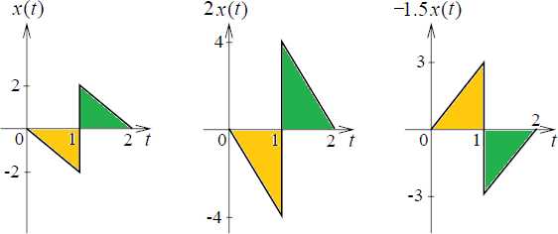
Module 1: Introduction to Signals
Amplitude scaling: The operation Ax (t) or Ax [n] is to multiply the amplitude of x (t) (or x[n]) by an amount A
Figure 24:Amplitude scaling
VIT-Chennai - SENSE

Slide 43
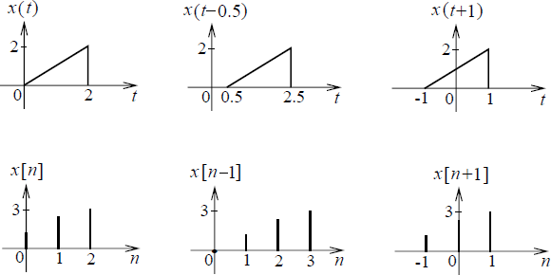
Module 1: Introduction to Signals
Time shifting: The operation x (t − T ) or x [n − K ] is to shift x (t) (or x[n]) by an amount T (or K )
Figure 25:Time shifting
VIT-Chennai - SENSE

Slide 44
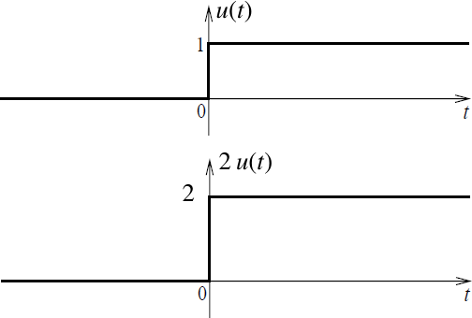
Module 1: Introduction to Signals
Example 1.6: Sketch the waveform x (t) = 2u(t) − u(t − 2)
Figure 26:Answer to example 1.6
VIT-Chennai - SENSE

Slide 45
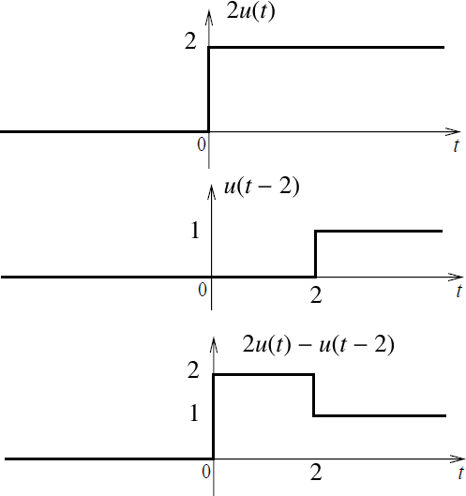
Module 1: Introduction to Signals
Figure 27:Answer to example 1.6 - continued
VIT-Chennai - SENSE

Slide 46
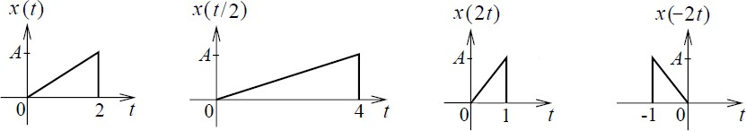
Module 1: Introduction to Signals
Time scaling in CT: The operation x (at) is to scale the time-axis of x (t) by a constant a
a > 1 contracts/shrinks the function horizontally
A proper fraction 0 < a < 1 (for example: ¹ and ¹ ) expands the
function horizontally
a < 0 leads to time inversion or time reversal
2 3
Figure 28:CT Time Scaling
VIT-Chennai - SENSE

Slide 47
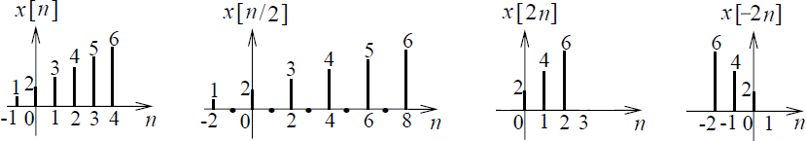
Module 1: Introduction to Signals
Time scaling in DT: The operation x [Kn] is to scale the discrete time-axis of x [n] by a integer K
K > 1 contracts/shrinks the function horizontally
A proper fraction 0 < K < 1 (for example: ¹ and ¹ ) expands the
function horizontally
K < 0 leads to time inversion or time reversal
2 3
Figure 29:DT Time Scaling
VIT-Chennai - SENSE
Winter 2021-2022 Semester 46 / 50

Slide 48
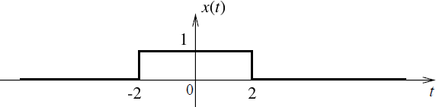
Module 1: Introduction to Signals
Example 1.7: If the waveform x (t) is as shown in Figure 30, sketch the waveform
y (t) = −2 x ((t-3)/2)
(Hint: Time scaling → time shifting → amplitude scaling)
Figure 30:The waveform x (t) for example 1.7
VIT-Chennai - SENSE

Slide 49
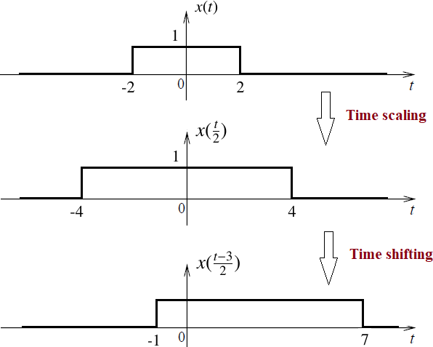
Module 1: Introduction to Signals
Figure 31:Answer to example 1.7
VIT-Chennai - SENSE

Slide 50
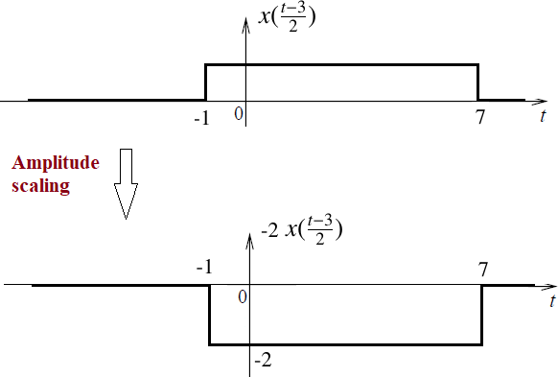
Module 1: Introduction to Signals
Figure 32:Answer to example 1.7 - continued
VIT-Chennai - SENSE

Slide 51
Module 1: Introduction to Signals
Module 1 - Summary
Classification of signals: continuous-time or discrete-time,
continuous-valued or discrete-valued, random or deterministic, even or odd, periodic or aperiodic and energy or power
Elementary signals (sinusoidal, exponential, complex-exponential, etc.) and singularity signals (unit impulse, unit step, unit ramp, etc.)
Signal representation: tabular, functional, graphical and sequential forms
Operations on signals: amplitude scaling, time shifting and time scaling
VIT-Chennai - SENSE

