Slide 1
BECE206L - Analog Circuits
Dr. Sangeetha R.G
Professor
School of Electronics Engineering (SENSE)

Slide 2
Module 4 | Operational Amplifier Characteristics and Applications (7)
Operational amplifier, Ideal and Nonideal characteristics of OP-AMP, DC and AC characteristics-Operational amplifier with negative feedback: Voltage Series, Voltage Shunt feedback amplifier - Applications of OP-AMP - summing, scaling, and averaging amplifiers, I/V and V/I converter, Integrator, Differentiator, Instrumentation amplifiers and Precision Rectifiers.

Slide 3
Module-4
OP-AMP CHARACTERISTICS
Op-Amp equivalent circuits, ideal Op-Amp, Op-Amp DC characteristics & AC characteristics, non-ideal Op-Amp characteristics.
Op-Amp DC characteristics: Model of Op-Amp, Non inverting Amplifier, Inverting mode, offset, thermal drift.
AC characteristics: Closed-Loop Frequency Response, Slew Rate, Combination of Linear Noise in Operational Amplifier, Common Mode Rejection

Slide 4
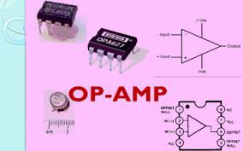
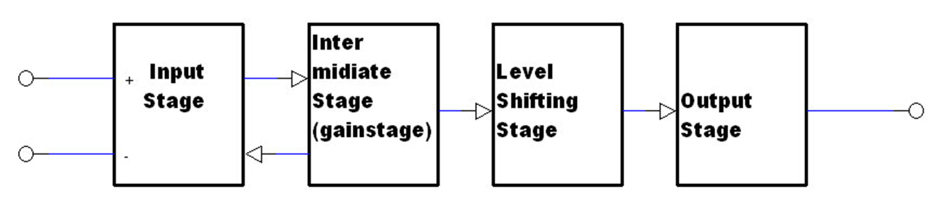
INTRODUCTION

Slide 5
INTRODUCTION
Op-Amp is a direct coupled high gain amplifier usually consist of one or more differential amplifier and usually followed by a level translator and output stage
Op-amp is versatile device that can be used to amplify AC as well as DC signals.
It was originally designed for performing mathematical operation such as addition, subtraction, multiplication, and integration (that is why it is called as operational amplifier)

Slide 6
INTRODUCTION
Operational amplifier is available as a single integrated circuit package
In addition with suitable feedback components, the op amp can be used for variety of applications comparators, filters, oscillators, regulators and so on
Op amp are classified as :
(i). General purpose (IC741 & IC 351)
(ii). Special purpose (LM380)

Slide 7
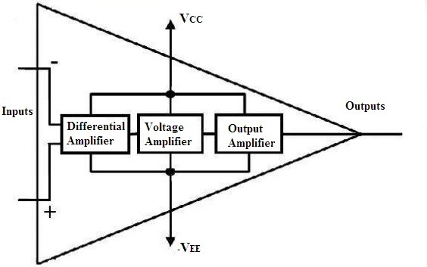
INTRODUCTION
Block diagram of a typical op-amp

Slide 8
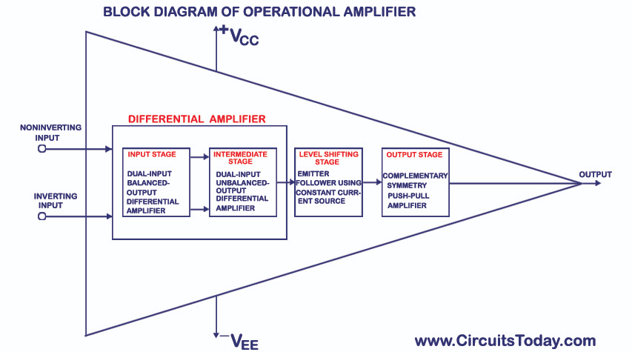
INTRODUCTION

Slide 9
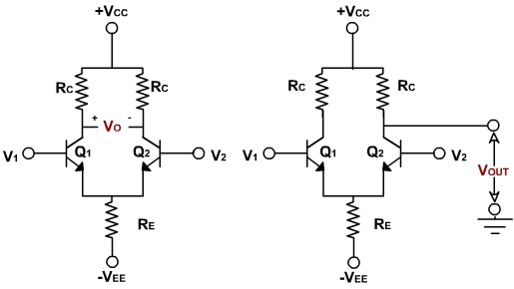
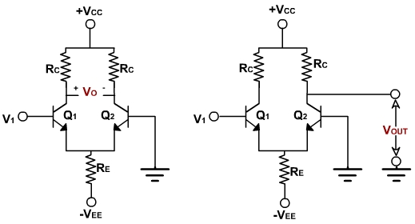
The differential amplifiers are of different configurations.
The four differential amplifier configurations are following:
Dual input, balanced output differential amplifier.
Dual input, unbalanced output differential amplifier.
Single input balanced output differential amplifier.
Single input unbalanced output differential amplifier.

Slide 10
INTRODUCTION
A differential amplifier that provides high voltage gain and high input impedance
Another differential amplifier used for providing additional voltage gain
A emitter follower circuit used to bring the DC level to the ground potential when no input signal is applied
A push pull complementary amplifier used to provides low output impedance, large AC output swings and high current sourcing and sinking capability

Slide 11
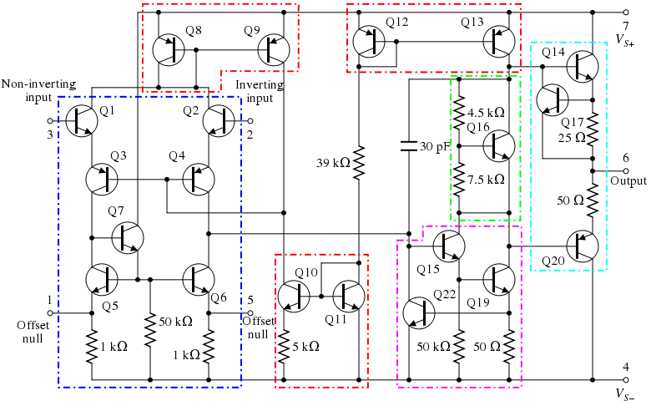

Slide 12
OP-AMP EQUIVALENT CIRCUIT

Slide 13
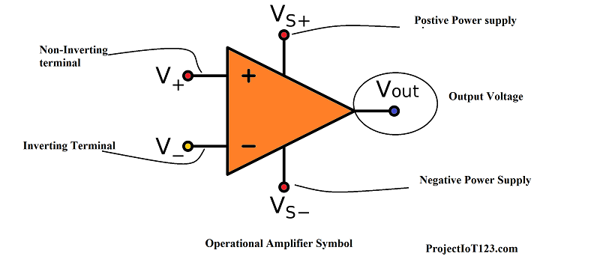
OP-AMP EQUIVALENT CIRCUIT
Symbol of Op-Amp

Slide 14
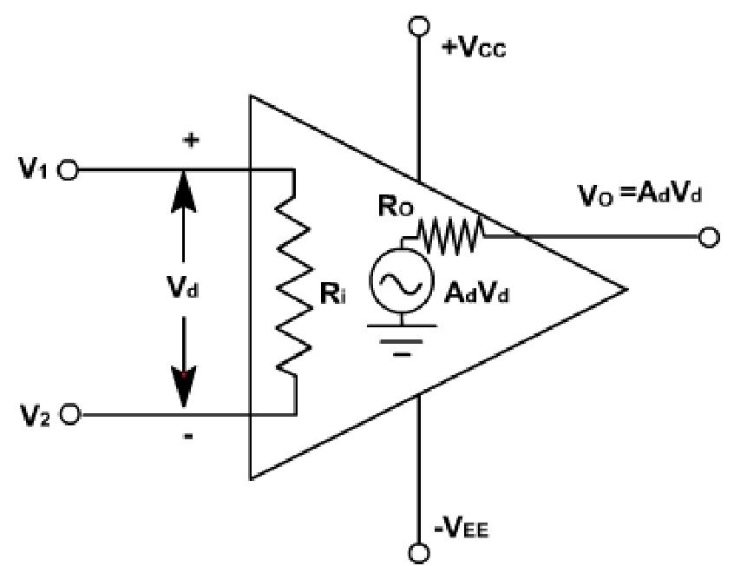
OP-AMP EQUIVALENT CIRCUIT

Slide 15
OP-AMP
TERMINALS

Slide 16
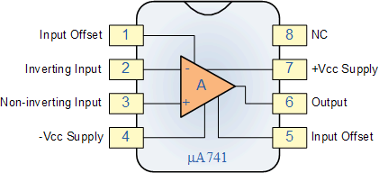
OP-AMP TERMINALS
Pin Diagram of Op-Amp

Slide 17
OP-AMP TERMINALS
Op-amp Manufacturers

Slide 18


OP-AMP TERMINALS

Slide 19
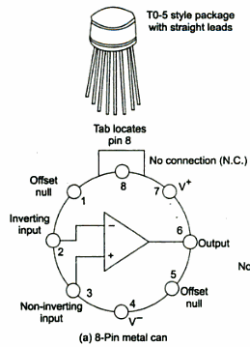
OP-AMP TERMINALS
Metal Can

Slide 20
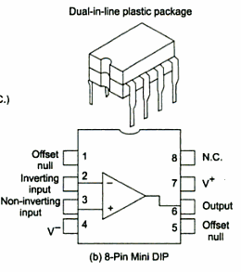
OP-AMP TERMINALS
Symbol of Op-Amp

Slide 21
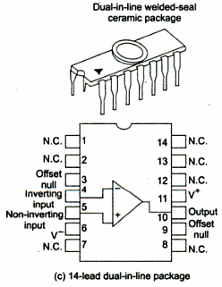
OP-AMP TERMINALS
Symbol of Op-Amp

Slide 22
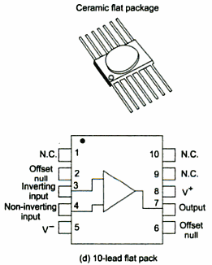
OP-AMP TERMINALS
Symbol of Op-Amp

Slide 23
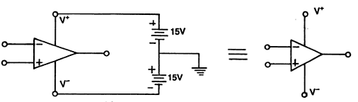
OP-AMP TERMINALS

Slide 24
IDEAL OP-AMP

Slide 25


IDEAL OP-AMP
Characteristics | Symbol | Ideal Values | Practical values
Open loop voltage gain | A_{OL} | ∞ | 200000
Input resistance | R_{in} | ∞ | 2 MΩ
Output resistance | R₀ | 0 | 75 Ω
Offset voltage | V₀ | 0 | 6 mV
Bandwidth | BW | ∞ | 1 MHz
CMRR | ρ | ∞ | 90 dB
Slew rate | S | ∞ | 0.5 V/µs
Power supply rejection ratio | PSRR | 0 | 150 µV/V

Slide 26

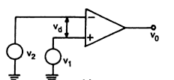
IDEAL OP-AMP

Slide 27
IDEAL OP-AMP CHARACTERISTICS
INPUT OFFSET VOLTAGE (6mV)
INPUT CAPACITANCE (1.4 pF)
INPUT RESISTANCE (2M ohm)
INPUT BIAS CURRENT (500nA)
INPUT OFFSET CURRENT (200mA)

Slide 28
IDEAL OP-AMP CHARACTERISTICS
OFFSET VOLTAGE ADJUSTMENT RANGE (15mV)
POWER SUPPLY REJECTION RATIO (150µV/V)
VOLTAGE GAIN (200000 Under test condition)
OUTPUT VOLTAGE SWING (13V)
OUTPUT RESISTANCE (75 Ohm)
POWER CONSUMPTION (85 mW)
SLEW RATE (0.5V/µs)

Slide 29
IDEAL INVERTING AMPLIFIER

Slide 30
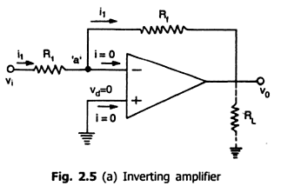
IDEAL INVERTING AMPLIFIER

Slide 31
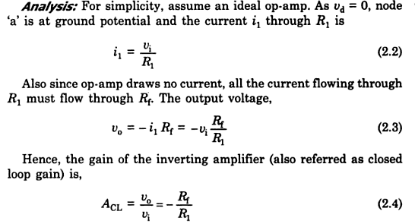
IDEAL INVERTING AMPLIFIER

Slide 32
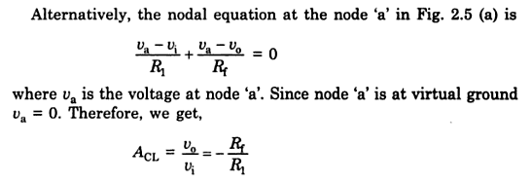

IDEAL INVERTING AMPLIFIER

Slide 33
PRACTICAL INVERTING AMPLIFIER

Slide 34
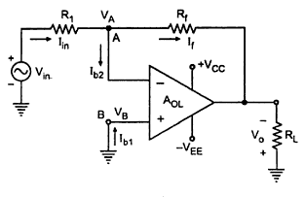
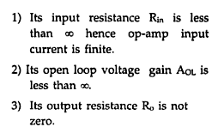
PRACTICAL INVERTING AMPLIFIER

Slide 35
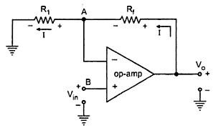
IDEAL NON-INVERTING AMPLIFIER

Slide 36
Refer class notes

Slide 37
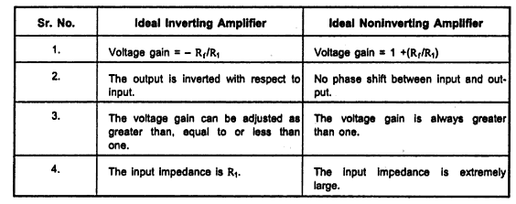
IDEAL NON-INVERTING AMPLIFIER

Slide 38
DC CHARACTERISTICS OF OP-AMP

Slide 39
DC CHARACTERISTICS OF OP-AMP
INPUT OFFSET CURRENT
Bias compensation will work only if both IB values are equal, but practically they are not equal
There will be always a small difference between IB values, this difference is called input offset current
Even after bias compensation, offset current will produce output voltage when no input voltage is applied

Slide 40
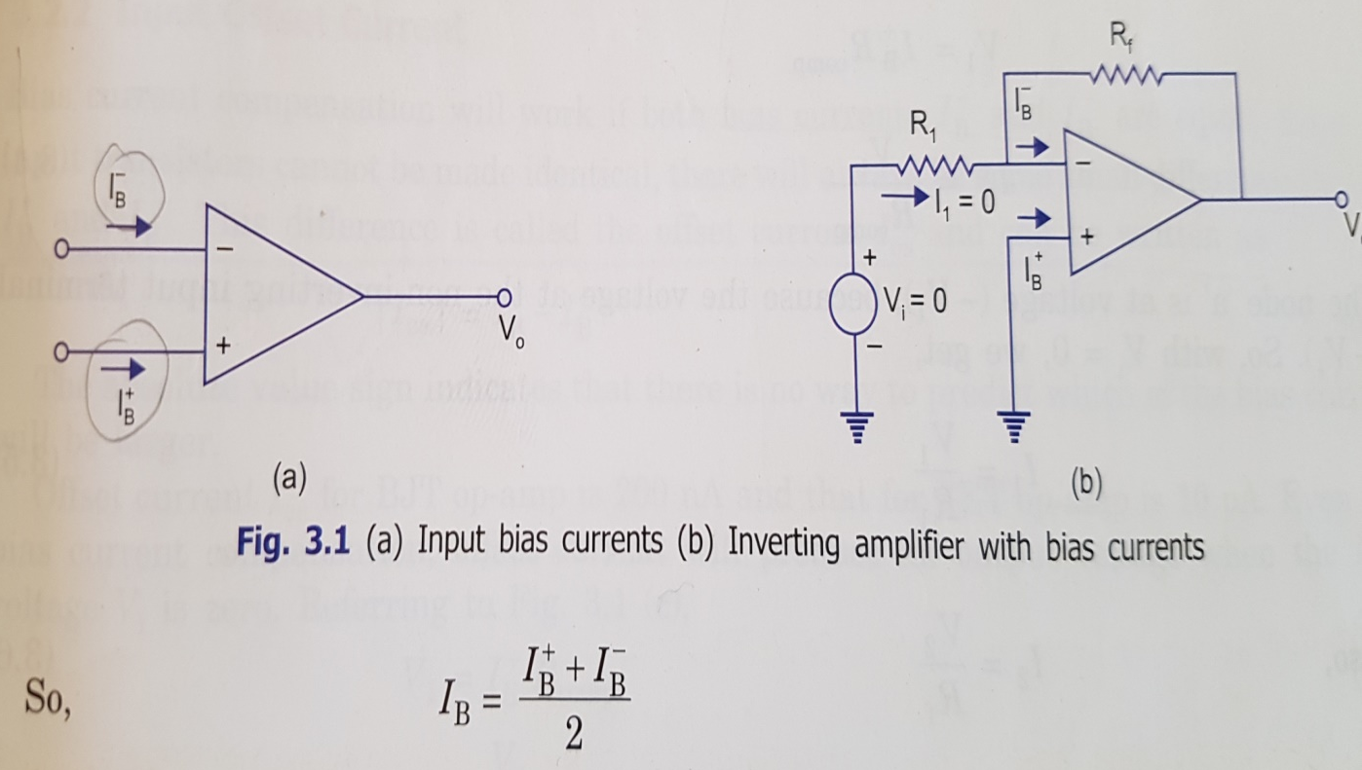
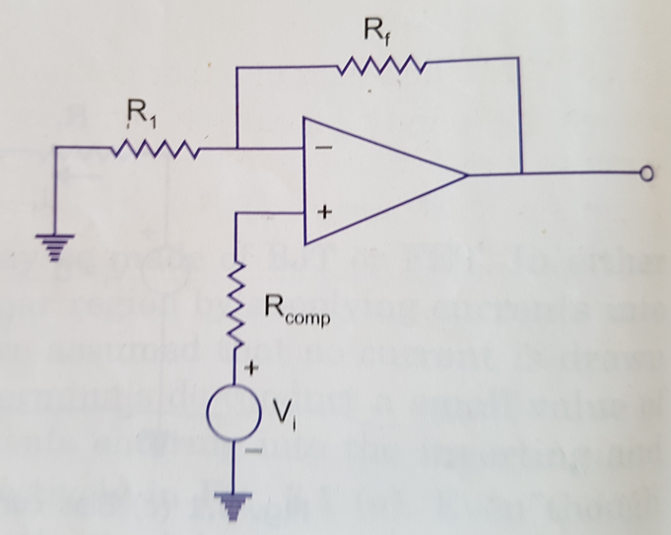

Slide 41
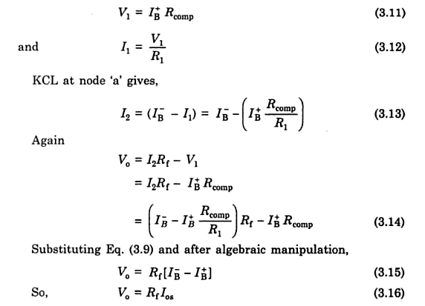
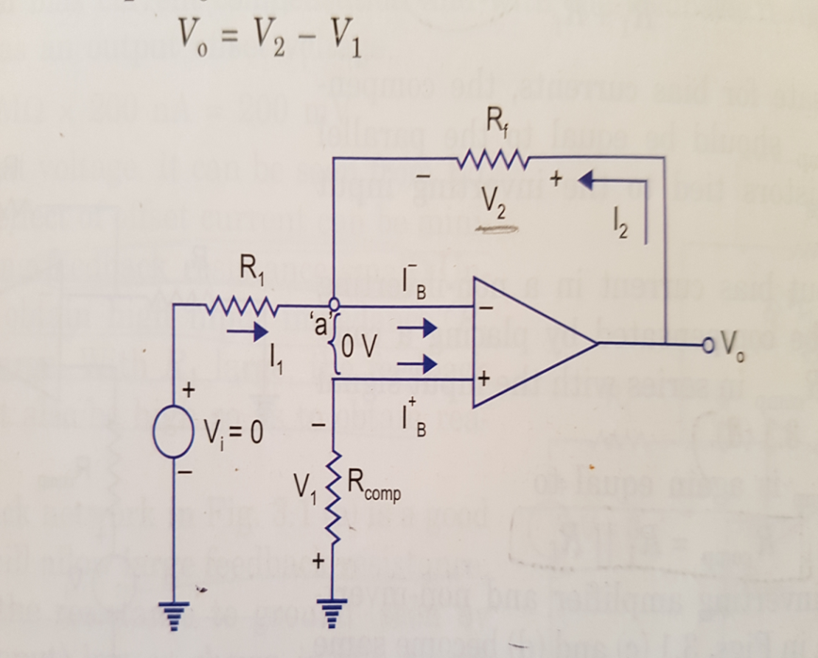

DC CHARACTERISTICS OF OP-AMP
INPUT OFFSET CURRENT

Slide 42

DC CHARACTERISTICS OF OP-AMP
INPUT OFFSET CURRENT
The effect of offset current can be minimized by keeping feedback resistance small.
But to obtain a high input impedance, R1 must be kept large, so Rf also should be high to get reasonable gain
T-Feedback is the good solution to solve this problem

Slide 43
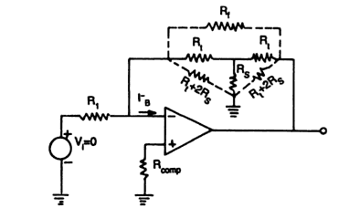
DC CHARACTERISTICS OF OP-AMP
INPUT OFFSET CURRENT

Slide 44
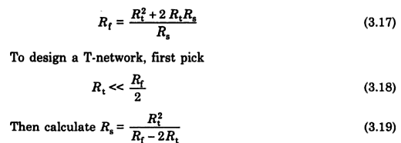
DC CHARACTERISTICS OF OP-AMP
INPUT OFFSET CURRENT
The T-Feedback allow large feedback resistance while keeping the resistance to ground low
The T-feedback network provides a feedback signal as if the network were a single feedback resistor

Slide 45
DC CHARACTERISTICS OF OP-AMP
VOLTAGE
Still the output voltage will not be zero with zero input voltage, this is due to the unavoidable imbalance inside the op-amp
To avoid this, we may apply small voltage at the input terminals to make the output as zero. This voltage is called input offset voltage VOS.
This voltage is applied at the input for making output voltage to zero volts

Slide 46
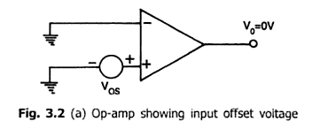
DC CHARACTERISTICS OF OP-AMP
INPUT OFFSET VOLTAGE

Slide 47
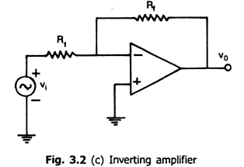
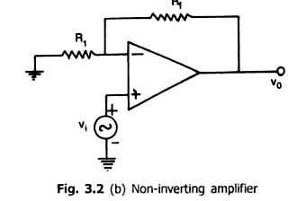
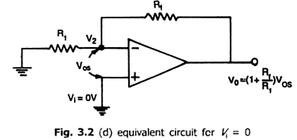
DC CHARACTERISTICS OF OP-AMP

Slide 48

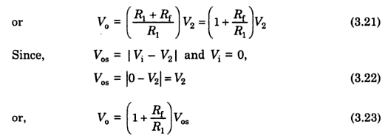
DC CHARACTERISTICS OF OP-AMP
INPUT OFFSET VOLTAGE

Slide 49
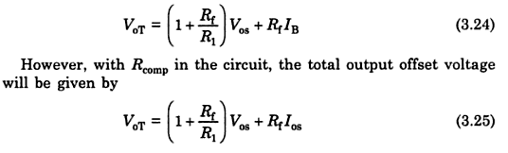
DC CHARACTERISTICS OF OP-AMP
TOTAL OUTPUT OFFSET VOLTAGE

Slide 50
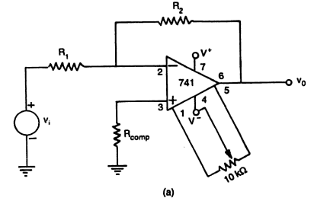
DC CHARACTERISTICS OF OP-AMP
TOTAL OUTPUT OFFSET VOLTAGE

Slide 51
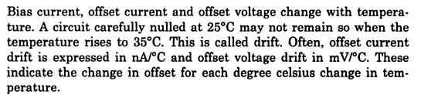
DC CHARACTERISTICS OF OP-AMP
THERMAL DRIFT

Slide 52
AC CHARACTERISTICS OF OP-AMP

Slide 53
AC CHARACTERISTICS OF OP-AMP
Ideally op-amp should have a infinite bandwidth
But the practical op-amp gain decreases (roll-off) at higher frequencies
Reason: capacitance due to physical characteristics of the device (BJT or FET) and internal construction of op-amp
For op-amp with one break (corner) frequency, all the capacitance effect can be represented by a single capacitor C (figure)
There is only one pole due to R₀C and one -20dB/decade roll-off comes into effect.

Slide 54
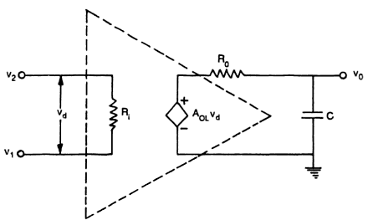
AC CHARACTERISTICS OF OP-AMP
FREQUENCY RESPONSE

Slide 55
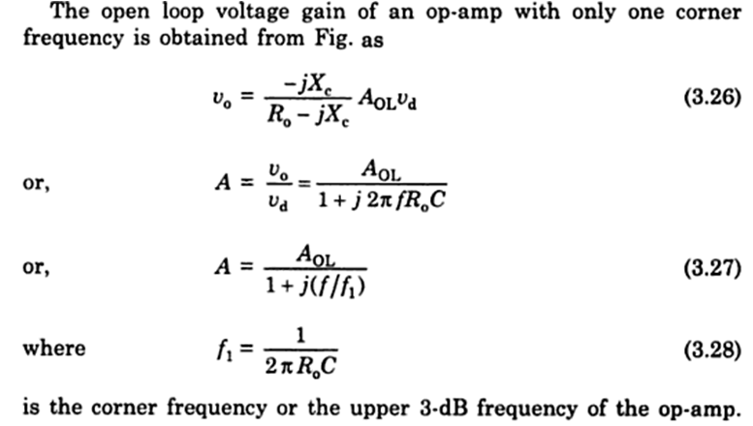
AC CHARACTERISTICS OF OP-AMP
FREQUENCY RESPONSE

Slide 56
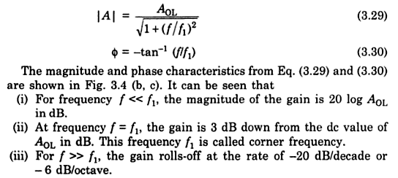
AC CHARACTERISTICS OF OP-AMP
FREQUENCY RESPONSE
46

Slide 57
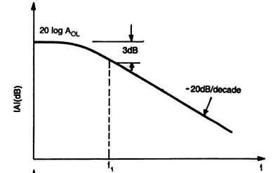
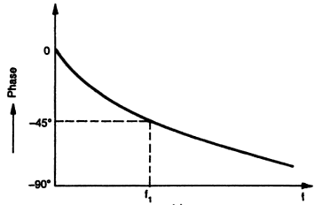
AC CHARACTERISTICS OF OP-AMP
FREQUENCY RESPONSE

Slide 58
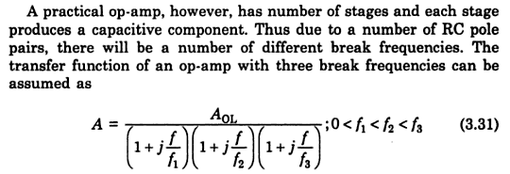
AC CHARACTERISTICS OF OP-AMP
FREQUENCY RESPONSE

Slide 59
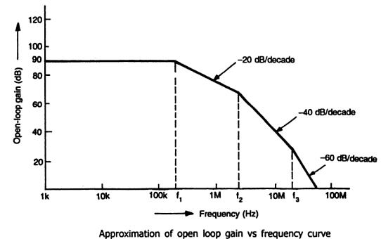
AC CHARACTERISTICS OF OP-AMP
FREQUENCY RESPONSE

Slide 60
AC CHARACTERISTICS OF OP-AMP
REQUEONSE
The open loop frequency response is flat 90dB from low frequencies (DC Signals) to 200kHz for the first break frequency
From 200kHz to 2MHz gain drops from 90dB to 70dB which is -20dB/decade.
At frequency from 2MHz to 20MHz the roll-off rate is -40 dB/decade
As frequency is increasing, cascading effect of RC poles comes into effect and roll-off rate increasing successively by -20dB/decade

Slide 61
SLEW RATE
The Slew Rate of an op amp describes how fast the output voltage can change in response to an immediate change in voltage at the input.
The higher the value (in V/µs) of slew rate, the faster the output can change and the more easily it can reproduce high frequency signals.
If a square wave is applied to the input of the op amp, the output should also be a square wave.
However the fast rising and falling edges of the square wave can tend to cause the amplifier to oscillate for a short time after the rise or fall.

Slide 62
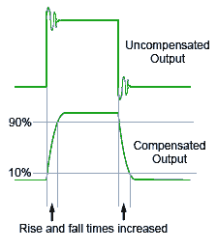
SLEW RATE
To prevent this effect, the op amp’s internal circuitry contains a small amount of compensation capacitance that slows down the rate of change by acting as a RC time constant so that very fast transient voltages do not trigger oscillation, but this compensation also limits the slew rate of the op amp as shown in Figure.

Slide 63

SLEW RATE
If the largest possible voltage swing and the highest frequency of the signal are known, the minimum required slew rate for the op amp can be calculated using the formula:
Where f = the highest signal frequency (Hz) and V_{pk} = the maximum peak voltage of the signal.
For example if an op amp is to amplify a signal with a peak amplitude of 6 volts at a frequency of 40kHz, an op amp with a slew rate of at least 2π x 40 exp3 x 6 = 1.5V/µs would be required.

Slide 64
Applications
of OP-AMP

Slide 65
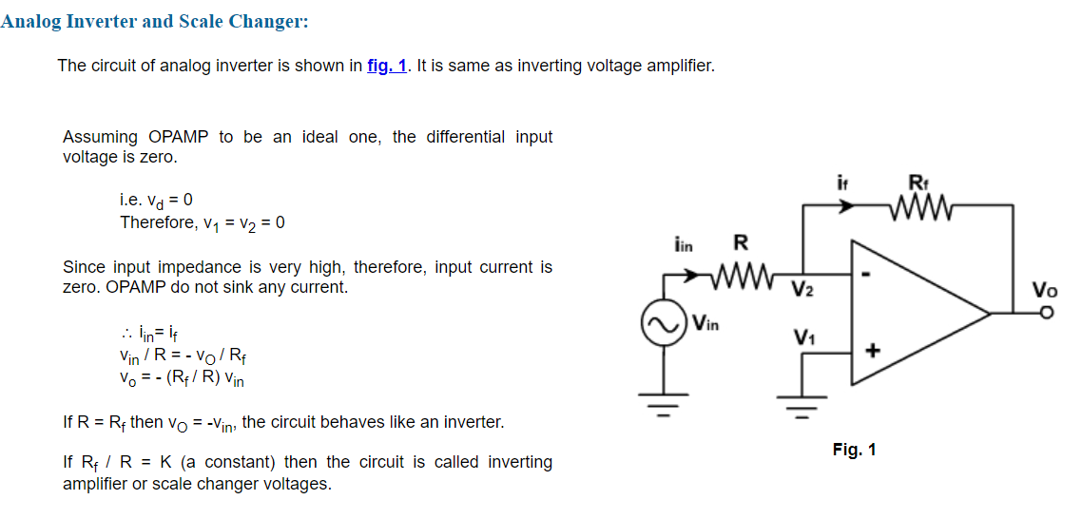
Applications of Operational Amplifiers

Slide 66
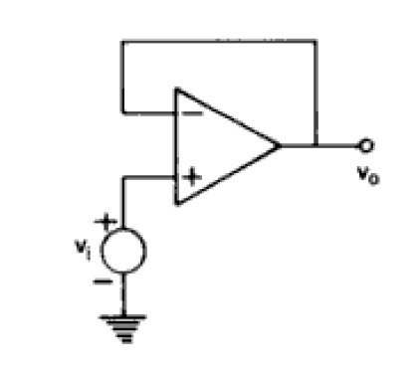
Voltage follower
Output voltage = Input voltage

Slide 67
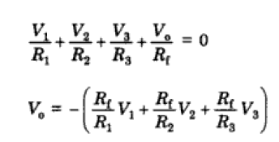
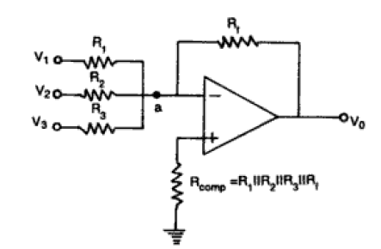

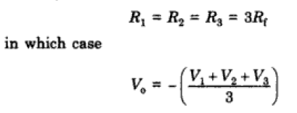
Inverting Summer

Slide 68




Non inverting summer

Slide 69

Differential Amplifier:
The basic differential amplifier is shown in fig.

Slide 70

Since there are two inputs superposition theorem can be used to find the output voltage. When V_{b}= 0, then the circuit becomes inverting amplifier, hence the output due to V_{a} only is
V_{o(a)} = -(R_{f} / R₁) V_{a}
Similarly when, V_{a} = 0, the configuration is a inverting amplifier having a voltage divided network at the non-inverting input

Slide 71

Integrator:
A circuit in which the output voltage waveform is the integral of the input voltage waveform is called integrator. Fig., shows an integrator circuit using OPAMP.

Slide 72
Here, the feedback element is a capacitor. The current drawn by OPAMP is zero and also the V₂ is virtually grounded.
Therefore, i₁ = i_{f} and v₂ = v₁ = 0
Integrating both sides with respect to time from 0 to t, we get
The output voltage is directly proportional to the negative integral of the input voltage and inversely proportional to the time constant RC.
If the input is a sine wave the output will be cosine wave. If the input is a square wave, the output will be a triangu­lar wave. For accurate integration, the time period of the input signal T must be longer than or equal to RC.

Slide 73

Fig., shows the output of integrator for square and sinusoidal inputs.

Slide 74


Differentiator
A circuit in which the output voltage waveform is the diffe­rentiation of input voltage is called differentiator.

Slide 75

The expression for the output voltage can be obtained from the Kirchoff's current equation written at node v₂.
Thus the output v_{o} is equal to the RC times the negative instantaneous rate of change of the input voltage v_{in} with time. A cosine wave input produces sine output.
The input signal will be differentiated properly if the time period T of the input signal is larger than or equal to R_{f} C.
T ≥ R_{f} C

Slide 76

As the frequency changes, the gain changes. Also at higher frequen­cies the circuit is highly susceptible at high frequency noise and noise gets amplified. Both the high frequency noise and problem can be corrected by adding, few components.

Slide 77

Find Vo and verify that if R₃ / R₄ = R₁ / R₂, the circuit is an instrumentation amplifier with gain A = 1 + R₂ / R₁.

Slide 78
VOLTAGE TO CURRENT CONVERTER
In a voltage to current converter, the output load current is proportional to the input voltage
According to the load, V to I converter can be classified into:
(i). Floating load
(ii). Grounded load
In floating type V to I converter R_{L} is not connected to the ground where as in grounded type on end of RL is connected to the ground
54

Slide 79


VOLTAGE TO CURRENT CONVERTER
V to I converter with floating load

Slide 80
VOLTAGE TO CURRENT CONVERTER
V to I converter with floating load
The input voltage Vi is converted into the output current of Vi/R1
This current flows through the signal source and load, therefore signal source should be capable of providing this load current
The proportional constant is generally 1/R1 hence this circuit is also called transconductance amplifier or it is also called as voltage controlled current source (VCCS)
This current maintained properly for all the load like (R,C,LED)

Slide 81
VOLTAGE TO CURRENT CONVERTER
V to I converter with grounded load
When one end of the load is grounded, it is no longer possible to place the load within feedback loop of the op-amp
In this circuit the load resistance RL is connected to ground and it is also known as Howland current converter
The analysis of the circuit is accomplished by determining the voltage v1 at the non-inverting input terminal and then establishing the relationship between v1 and the load current

Slide 82



VOLTAGE TO CURRENT CONVERTER
V to I converter with grounded load

Slide 83
CURRENT TO VOLTAGE CONVERTER
In I to V converter, the inverting terminal of the op-amp is at virtual ground, no current flow through Rs and current i_{S} flow through feed back resistor Rf
Thus the output voltage V₀=-i_{s}R_{f} is capable of measuring lowest current which depends on bias current IB of the op-amp
Sometimes the resistor R_{f} is shunted with the capacitor C_{f} to reduce high frequency noise and the possibility of oscillations
This circuit also known as transresistance amplifier

Slide 84

CURRENT TO VOLTAGE CONVERTER

Slide 85
Instrumentation Amplifier
Instrumentation amplifier is a kind of differential amplifier with additional input buffer stages. The addition of input buffer stages makes it easy to match (impedance matching) the amplifier with the preceding stage. ... In the circuit diagram, opamps labelled A1 and A2 are the input buffers.
An instrumentation amplifier is a special kind of differential amplifier. In general, it is a differential amplifier, but the input impedances on the two inputs are very high (meaning very small input currents), and the same for each input. There is usually a way to change the gain with one resistor.
An instrumentation amplifier is used to amplify very low-level signals, rejecting noise and interference signals. Examples can be heartbeats, blood pressure, temperature, earthquakes and so on.

Slide 86
Features
Instrumentation amplifiers are precision, integrated operational amplifiers that have differential input and single-ended or differential output.
Some of their key features include
very high common mode rejection ratio (CMRR),
high open loop gain,
low DC offset,
low drift,
low input impedance,
and low noise.

Slide 87

Instrumentation Amplifier

Slide 88




Since the differential input voltage of OPAMP is negligible, therefore,
v₁= v_{x}
and v₂ = v_{y}
The input impedance of OPAMP is very large and, therefore, the input current of OPAMP is negligible.
Thus
And
From equation (E-1)
or

Slide 89



From equation (E-2)
Or
The OPAMP3 is working as differential amplifier, therefore,

Slide 90

Find v_{out} and i_{out} for the circuit shown in fig. The input voltage is sinusoidal with amplitude of 0.5 V.

