Slide 1
Design Of FIR Filter Design
Module :5 Week 9

Slide 2


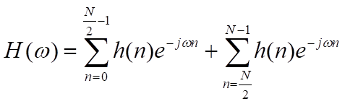
Case 2: Frequency response of linear phase FIR filter when impulse response is symmetrical and N is EVEN
We know that,
In FIR filter only N samples so
Since N is Even

Slide 3
Case II ( continued)
Let m = N-1-n , so n=N-1-m
When n = N/2, m = N/2 – 1
When N = N-1, m = 0
h(N-1-m) = h(m)

Slide 4
Case II ( continued)

Slide 5
Case II ( continued)
Let k = N/2 – n, so n = N/2-k
When n = 0, k = N/2
When n = N/2 - 1, k = 1

Slide 6
Case II ( continued)
Magnitude response
Phase response

Slide 7
Case 3: Frequency response of linear phase FIR filter when impulse response is Anti-symmetrical and N is ODD
Fourier transform of h(n):
In FIR filter only N samples so
Symmetry is at
Since N is odd

Slide 8
Case III (Continued)
Due to anti symmetry, h(N-1-m) = -h(m)

Slide 9
Case III (Continued)

Slide 10
Case III (Continued)
If there is no middle term, (i.e.) h((N-1)/2) = 0 then j = e^{j(π/2)} ,

Slide 11
Case III (Continued)
This can be rearranged

Slide 12
Case III (Continued)
Magnitude response
Phase response

Slide 13
Case 4: Frequency response of linear phase FIR filter when impulse response is Anti-symmetrical and N is EVEN
Magnitude response
Phase response

Slide 14
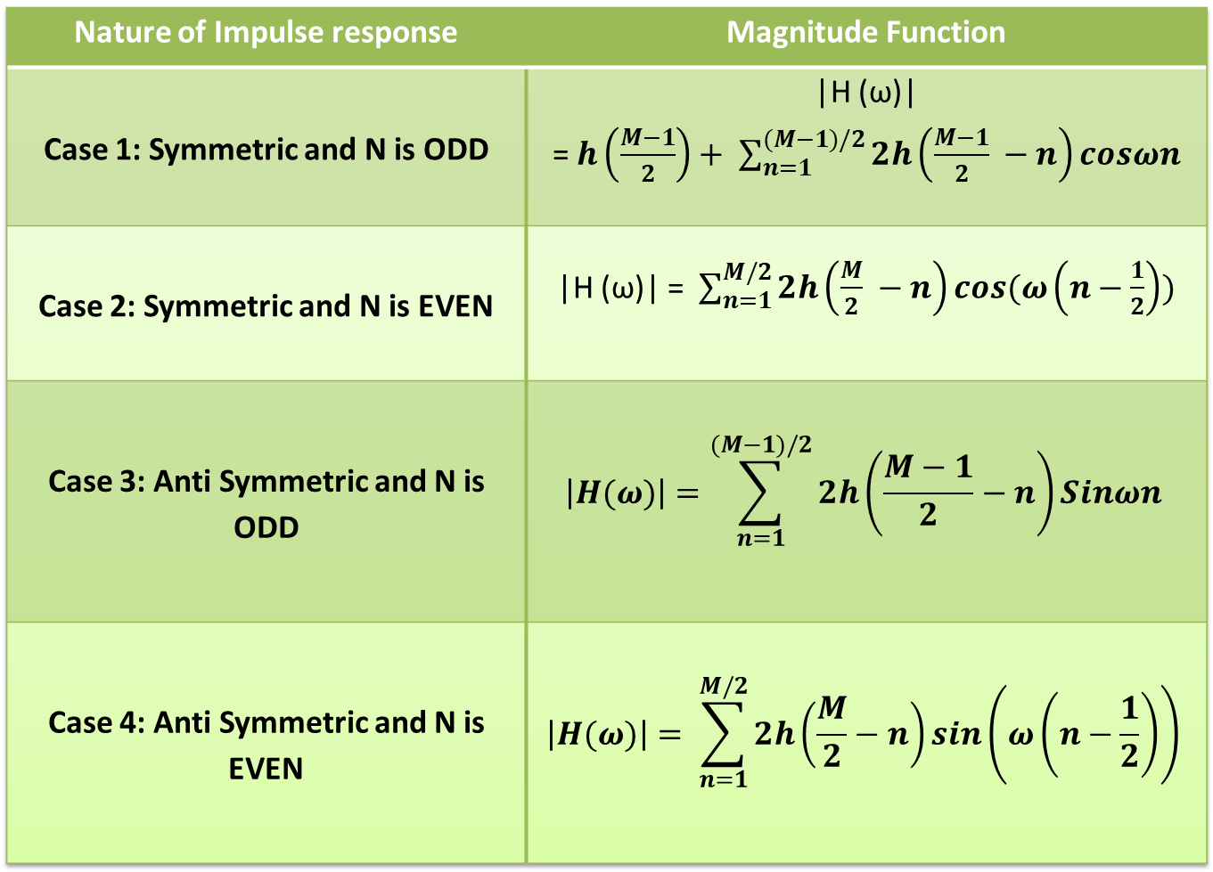
Nature of Impulse response | Magnitude Function
Case 1: Symmetric and N is ODD | |H (ω)| =$h\left(\frac{M−1}{2}\right)+ \sum_{n=1}^{(M−1)/2}{2h\left(\frac{M−1}{2} −n\right)cosωn}$
Case 2: Symmetric and N is EVEN | |H (ω)| =$\sum_{n=1}^{M/2}{2h\left(\frac{M}{2} −n\right)cos(ω\left(n−\frac{1}{2}\right))}$
Case 3: Anti Symmetric and N is ODD | $$\left|H(ω)\right|=\sum_{n=1}^{(M−1)/2}{2h\left(\frac{M−1}{2}−n\right)Sinωn}$$
Case 4: Anti Symmetric and N is EVEN | $$\left|H(ω)\right|= \sum_{n=1}^{M/2}{2h\left(\frac{M}{2}−n\right)sin\left(ω\left(n−\frac{1}{2}\right)\right)}$$

