Slide 1
Design Of FIR Filter Design
Module :5 Week 10

Slide 2
FIR Filter design
FIR filter design is simply to determine the M coefficients of h(n) , n = 0,1, … M-1. from the specification of the desired frequency response H(ω)

Slide 3
FIR filters using Windows
Let desired frequency response H_{d}(ω)
The corresponding impulse response h_{d}(n)
H_{d}(ω) is nothing but Fourier transform of h_{d}(n)
Fourier transform
Inverse Fourier transform

Slide 4
FIR filters using Windows (contd)
In general, the obtained impulse response is infinite in duration, it must be truncated at some point
That point is n = M-1 to yield an FIR filter length M
This is equivalent to multiplying h_{d}(n) by a “rectangular window” which is

Slide 5
FIR filters using Windows (contd)
The unit impulse response of the FIR filter becomes

Slide 6
FIR filters using Windows (contd)
Multiplication in time domain result in convolution of H(ω) with W(ω) in frequency domain
Rectangular window frequency response W(ω)

Slide 7
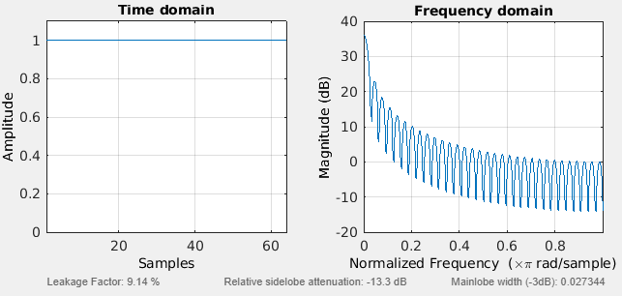
Response of Rectangular window
Width of the main lobe is 4π/M
As M increases, main lobe width decreases
Even though the width of the side lobe decreases, the height of the side lobe increase while M increasing
Not visible, because w(ω) has been normalized by M

Slide 8
Observation from Windows
FIR filter response obtained by truncating hd(n) to length M, plays significant role
Convolution of Hd(ω) with W(ω) has effect if smoothing Hd(ω)
As M increases, W(ω) becomes narrower and smoothing provided by W(ω) is reduced
On the other hand, the large side lobes [w(ω)] result in undesirable ringing effects in the FIR filter frequency response H(ω) and also relatively larger side lobes in H(ω)
FIR filter response obtained by truncating hd(n) to length M, plays significant role
Convolution of Hd(ω) with W(ω) has effect if smoothing Hd(ω)
As M increases, W(ω) becomes narrower and smoothing provided by W(ω) is reduced
On the other hand, the large side lobes [w(ω)] result in undesirable ringing effects in the FIR filter frequency response H(ω) and also relatively larger side lobes in H(ω)

Slide 9
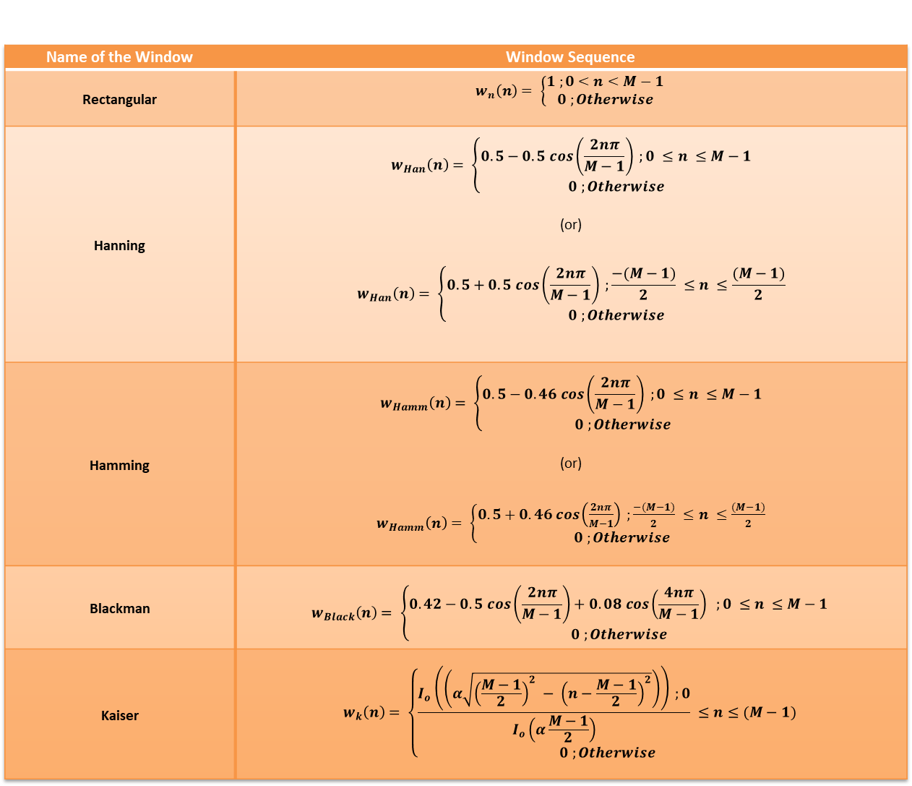
Window sequences for FIR filter design
Name of the Window | Window Sequence
Rectangular | $$w_{n}\left(n\right)= \left\{\begin{aligned}1 ;0<n<M−1 \\ 0 ;Otherwise\end{aligned}\right.$$
Hanning | $$w_{Han}\left(n\right)= \left\{\begin{aligned}0.5−0.5 cos\left(\frac{2nπ}{M−1}\right) ;0 ≤n ≤M−1 \\ 0 ;Otherwise\end{aligned}\right.$$ (or) $$w_{Han}\left(n\right)= \left\{\begin{aligned}0.5+0.5 cos\left(\frac{2nπ}{M−1}\right) ;\frac{−(M−1)}{2} ≤n ≤\frac{(M−1)}{2} \\ 0 ;Otherwise\end{aligned}\right.$$
Hamming | $$w_{Hamm}\left(n\right)= \left\{\begin{aligned}0.5−0.46 cos\left(\frac{2nπ}{M−1}\right) ;0 ≤n ≤M−1 \\ 0 ;Otherwise\end{aligned}\right.$$ (or) $w_{Hamm}\left(n\right)= \left\{\begin{aligned}0.5+0.46 cos\left(\frac{2nπ}{M−1}\right) ;\frac{−(M−1)}{2} ≤n ≤\frac{(M−1)}{2} \\ 0 ;Otherwise\end{aligned}\right.$
Blackman | $$w_{Black}\left(n\right)= \left\{\begin{aligned}0.42−0.5 cos\left(\frac{2nπ}{M−1}\right)+0.08 cos\left(\frac{4nπ}{M−1}\right) ;0 ≤n ≤M−1 \\ 0 ;Otherwise\end{aligned}\right.$$
Kaiser | $$w_{k}\left(n\right)= \left\{\begin{aligned}\frac{I_{o}\left(\left(α\sqrt{{\left(\frac{M−1}{2}\right)}^{2} − {\left(n−\frac{M−1}{2}\right)}^{2}}\right)\right) ;0}{I_{o}\left(α\frac{M−1}{2}\right)} ≤n≤(M−1) \\ 0 ;Otherwise\end{aligned}\right.$$

Slide 10
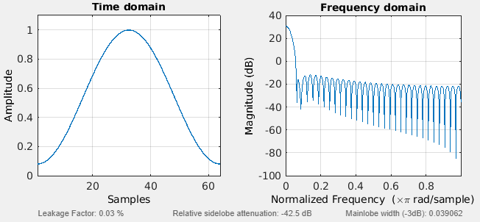
Time domain and frequency domain characteristics of windows
Hamming window

Slide 11
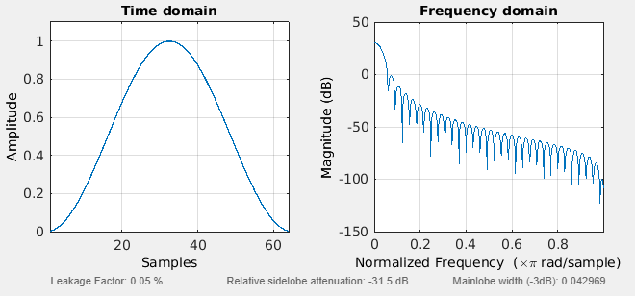
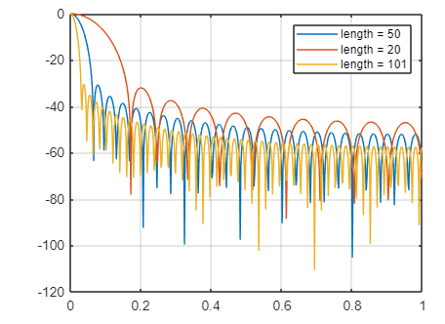
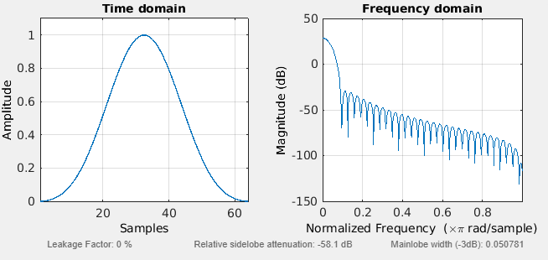
Hanning window
Kaiser window
Blackman window

Slide 12
Windows Observation
All these windows have significantly lower side lobes than rectangular window
Also for the same value of M, the width of the main lobe is wider for other windows compared to rectangular window
The transition in FIR filter response is wider
To reduce the width of the transition region we can increase the length of the window

Slide 13
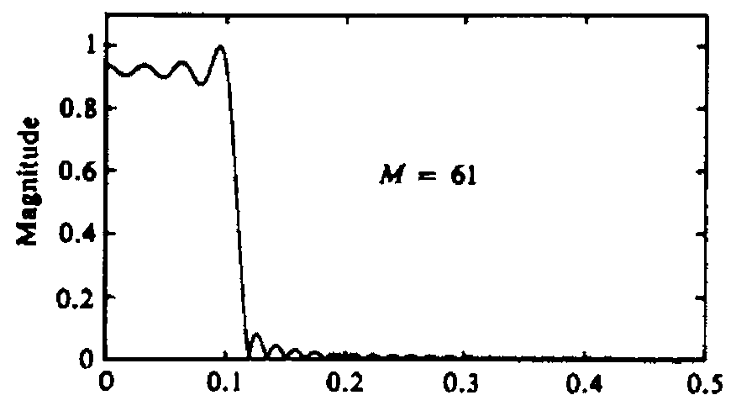
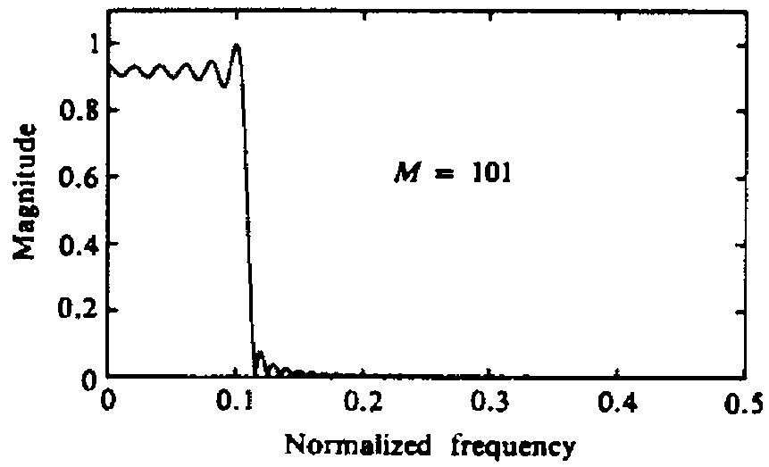
Filter Observation
Magnitude response H(ω) of the LPF for M= 61 and M=101 are given below

Slide 14
Filter Observation
Large oscillations or ripples occur in the pass band of the filter as M increases
Large oscillations are due to large side lobes in frequency characteristic W(ω) of rectangular window
Due to convolution of W(ω) and H_{d}(ω), the oscillations occur as side lobes of W(ω) move across the discontinuity exists in H_{d}(ω)
The multiplication of h_{d}(n) with W(n) is identical to truncating the desired filter characteristic H_{d}(ω)

Slide 15
Filter Observation
The truncation introduce ripples in frequency response characteristic of H (ω) due to non uniform convergence
The oscillatory behavior near the band edge of the filter is called Gibbs phenomenon
To avoid this use other windows which has taper and decays towards zero gradually instead of abruptly

Slide 16
Frequency domain Characteristics of some window function
Type of Window | Width of Mainlobe | Peak Sidelobe magnitude (dB)
Rectangular | 4π/M | -13
Hanning | 8π/M | -31
Hamming | 8π/M | -41
Blackman | 12π/M | -58
Kaiser | 4.25π/M | -13.32

Slide 17
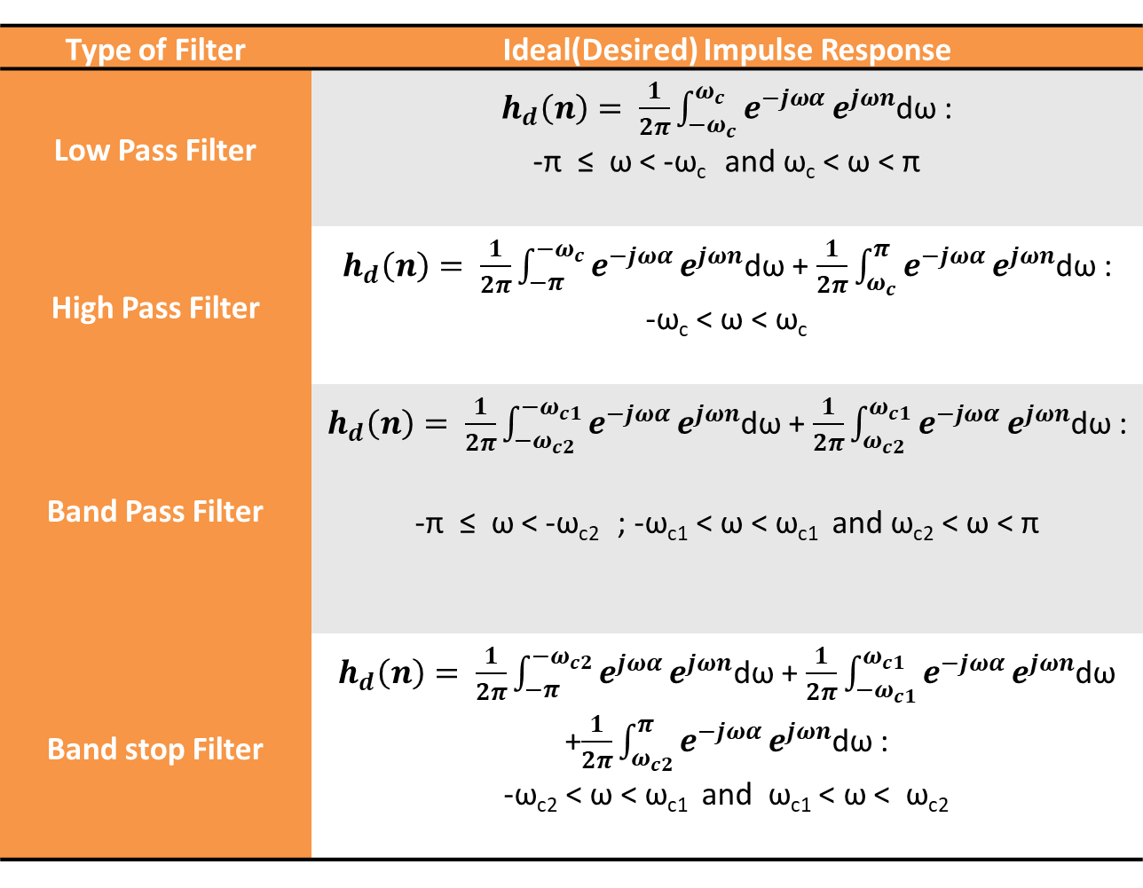
Desired impulse response for FIR filter design using windows
Type of Filter | Ideal(Desired) Impulse Response
Low Pass Filter | $h_{d}\left(n\right)= \frac{1}{2π}\int_{−ω_{c}}^{ω_{c}}{e^{−jωα}}e^{jωn}$dω : -π ≤ ω < -ω_{c} and ω_{c} < ω < π
High Pass Filter | $h_{d}\left(n\right)= \frac{1}{2π}\int_{−π}^{{−ω}_{c}}{e^{−jωα}}e^{jωn}$dω + $\frac{1}{2π}\int_{ω_{c}}^{π}{e^{−jωα}}e^{jωn}$dω : -ω_{c} < ω < ω_{c}
Band Pass Filter | $h_{d}\left(n\right)= \frac{1}{2π}\int_{{−ω}_{c2}}^{{−ω}_{c1}}{e^{−jωα}}e^{jωn}$dω + $\frac{1}{2π}\int_{ω_{c2}}^{ω_{c1}}{e^{−jωα}}e^{jωn}$dω : -π ≤ ω < -ω_{c2} ; -ω_{c1} < ω < ω_{c1} and ω_{c2} < ω < π
Band stop Filter | $h_{d}\left(n\right)= \frac{1}{2π}\int_{−π}^{{−ω}_{c2}}{e^{jωα}}e^{jωn}$dω + $\frac{1}{2π}\int_{{−ω}_{c1}}^{ω_{c1}}{e^{−jωα}}e^{jωn}$dω +$\frac{1}{2π}\int_{ω_{c2}}^{π}{e^{−jωα}}e^{jωn}$dω : -ω_{c2} < ω < ω_{c1} and ω_{c1} < ω < ω_{c2}

Slide 18
Band Pass Filter
Low pass Filter
Band Stop Filter
High pass Filter

