Slide 1
Module -VII
Multirate Digital Signal Processing

Slide 2
What does multirate mean?
Multirate simply means “multiple sampling rates”.
A multirate DSP system uses multiple sampling rates within the system.
Whenever a signal at one rate has to be used by a system that expects a different rate, the rate has to be increased or decreased, and some processing is required to do so.
Therefore “Multirate DSP” really refers to the art or science of changing sampling rates.
The process of converting a signal from a given rate to a different rate is called sampling rate conversion.
System that employ multiple sampling rates in the processing of digital signals are called multirate digital signal processing systems.

Slide 3
Why should I do multirate DSP?
The most immediate reason is when you need to pass data between two systems which use incompatible sampling rates.
For example,
Professional audio systems use 48 kHz rate, but consumer CD players use 44.1 kHz , for broadcasting 32 KHz; when audio professionals transfer their recorded music to CDs, they need to do a rate conversion.
But the most common reason is that multirate DSP can greatly increase processing efficiency which reduces DSP system cost.
Examples of multirate DSP
Signal Compression ,Image coding , Speech coding, A/D and D/A Converter , Communication Systems

Slide 4
Various advantages of Multirate DSP
Computational requirements are less
Storage for filter coefficents are less
Finite arithmetic effects are less
Filter order required in multirate application are low
Sensitivity to filter coefficient lengths are less
While designing multirate systems, effect of aliasing for decimation and pseudoimages for interpolation should be avoided.

Slide 5
What are the categories of multirate?
Multirate consists of:
Decimation: To decrease the sampling rate.
2) Interpolation: To increase the sampling rate.
3) Resampling:To combine decimation and interpolation in
order to change the sampling rate by a fractional
value that can be expressed as a ratio.
For example, to resample by a factor of 1.5, just interpolate by a factor of 3 then decimate by a factor of 2 (to change the sampling rate by a factor of 3/2=1.5.)

Slide 6
Multirate Digital Signal Processing
Basic Sampling Rate Alteration Devices
Up-sampler - Used to increase the sampling
rate by an integer factor
Down-sampler - Used to decrease the sampling
rate by an integer factor

Slide 7
Up-Sampler
Time-Domain Characterization
An up-sampler with an up-sampling factor L, where L is a positive integer, develops an output sequence with a sampling rate that is L times larger than that of the input sequence x[n] , digital anti-aliasing filter h₁(k)
Block-diagram representation
x[n]
L
h₁(k)

Slide 8
Up-Sampler
Up-sampling operation is implemented by inserting equidistant zero-valued samples between two consecutive samples of x[n]
Input-output relation

Slide 9
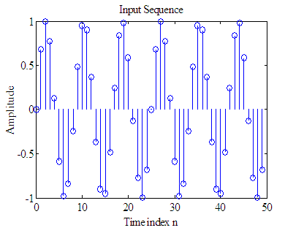
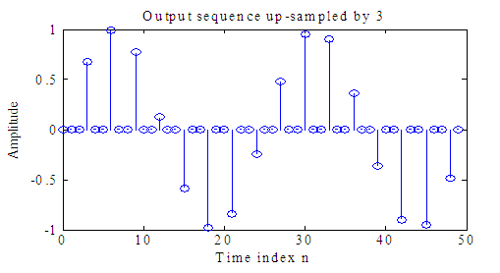
Up-Sampler
Figure below shows the up-sampling by a factor of 3 of a sinusoidal sequence with a frequency of 0.12 Hz obtained.

Slide 10
Up-Sampler
In practice, the zero-valued samples inserted by the up-sampler are replaced with appropriate nonzero values using some type of filtering process
Process is called interpolation and will be discussed later

Slide 11
Down-Sampler
Time-Domain Characterization
An down-sampler with a down-sampling factor M, where M is a positive integer, develops an output sequence y[n] with a sampling rate that is (1/M)-th of that of the input sequence x[n]
Block-diagram representation
x[n]
M
y[n]

Slide 12
Down-Sampler
Down-sampling operation is implemented by keeping every M-th sample of x[n] and removing in-between samples to generate y[n]
Input-output relation
y[n] = x[nM]

Slide 13
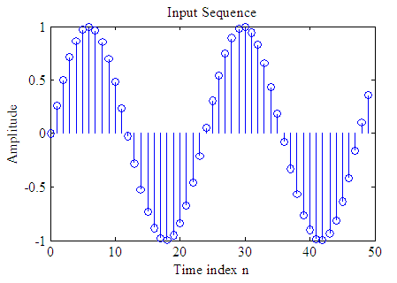
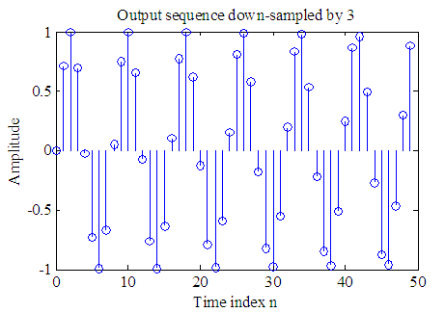
Down-Sampler
Figure below shows the down-sampling by a factor of 3 of a sinusoidal sequence of frequency 0.042 Hz.

Slide 14
Basic Sampling Rate Alteration Devices
Sampling periods have not been explicitly shown in the block-diagram representations of the up-sampler and the down-sampler
This is for simplicity and the fact that the mathematical theory of multirate systems can be understood without bringing the sampling period T or the sampling frequency into the picture

Slide 15
Down-Sampler
Figure below shows explicitly the time-dimensions for the down-sampler
M
Input sampling frequency
Output sampling frequency

Slide 16
Up-Sampler
Figure below shows explicitly the time-dimensions for the up-sampler
L
y[n]
Input sampling frequency
Output sampling frequency

Slide 17
Basic Sampling Rate Alteration Devices
The up-sampler and the down-sampler are linear but time-varying discrete-time systems
We illustrate the time-varying property of a down-sampler
The time-varying property of an up-sampler can be proved in a similar manner

Slide 18
Basic Sampling Rate Alteration Devices
Consider a factor-of-M down-sampler defined by
Its output for an input is then given by
From the input-output relation of the down-sampler we obtain
y[n] = x[nM]

Slide 19
Up-Sampler
Frequency-Domain Characterization
Consider first a factor-of-2 up-sampler whose input-output relation in the time-domain is given by

Slide 20
Spectrum of the Up-Sampler
In terms of the z-transform, the input-output relation is then given by

Slide 21
Cont…
In a similar manner, we can show that for a factor-of-L up-sampler
On the unit circle, for , the input-output relation is given by

Slide 22
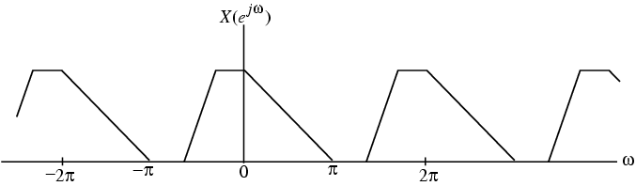
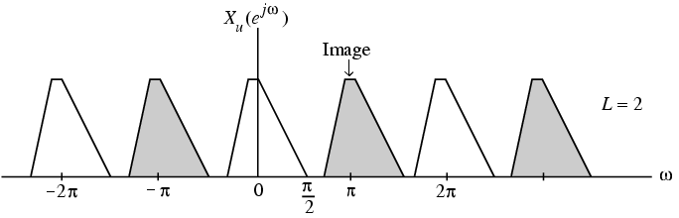
Cont…
Figure below shows the relation between and for L = 2 in the case of a typical sequence x[n]

Slide 23
Up-Sampler
As can be seen, a factor-of-2 sampling rate expansion leads to a compression of by a factor of 2 and a 2-fold repetition in the baseband [0, 2π]
This process is called imaging as we get an additional “image” of the input spectrum

Slide 24
Up-Sampler
Similarly in the case of a factor-of-L sampling rate expansion, there will be additional images of the input spectrum in the baseband
Lowpass filtering of removes the images and in effect “fills in” the zero-valued samples in with interpolated sample values

Slide 25
Up-Sampler
Illustrate the frequency-domain properties of the up-sampler shown below for L = 4

Slide 26
Spectrum of the Down-Sampler
Frequency-Domain Characterization
Applying the z-transform to the input-output relation of a factor-of-M down-sampler
we get
The expression on the right-hand side cannot be directly expressed in terms of X(z)

Slide 27
Cont…
To get around this problem, define a new sequence :
Then

Slide 28
Cont…
Now, can be formally related to x[n] through
where
A convenient representation of c[n] is given by
where

Slide 29
Cont…
Taking the z-transform of and making use of
we arrive at

Slide 30
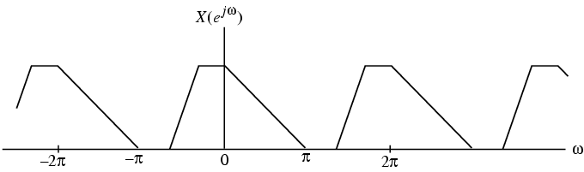
Spectrum of the Down-Sampler
Consider a factor-of-2 down-sampler with an input x[n] whose spectrum is as shown below
The DTFTs of the output and the input sequences of this down-sampler are then related as

Slide 31
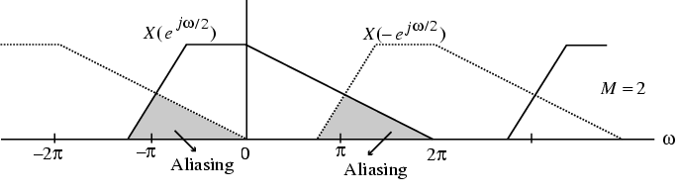
Aliasing Effect in Down-Sampler
Now implying that the second term in the previous equation is simply obtained by shifting the first term to the right by an amount 2π as shown below

Slide 32
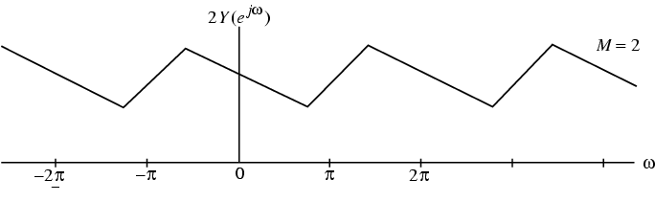
Cont…
x[n]
h(n)
M
y[n]
The plots of the two terms have an overlap, and hence, in general, the original “shape” of is lost when x[n] is down-sampled as indicated below

Slide 33
Cont…
This overlap causes the aliasing that takes place due to under-sampling
There is no overlap, i.e., no aliasing, only if
Note: is indeed periodic with a period 2π, even though the stretched version of is periodic with a period 4π

Slide 34
Down-Sampler
For the general case, the relation between the DTFTs of the output and the input of a factor-of-M down-sampler is given by
is a sum of M uniformly shifted and stretched versions of and scaled by a factor of 1/M

Slide 35
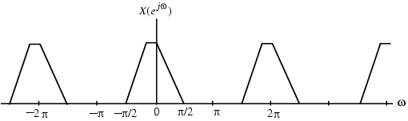
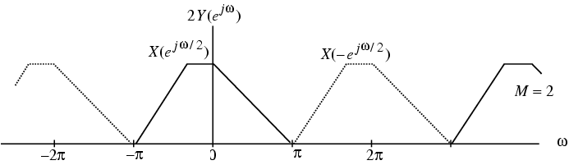
Original and Downsampled Spectrum
Aliasing is absent if and only if
as shown below for M = 2

Slide 36
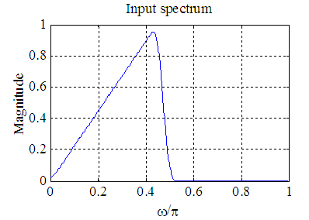
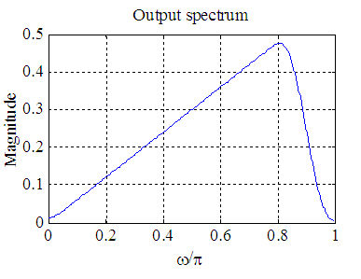
Down-Sampler
Illustrate the frequency-domain properties of the up-sampler shown below for M = 2

Slide 37
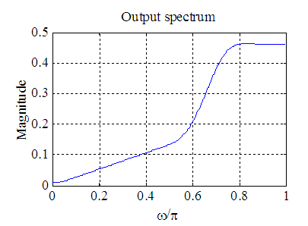
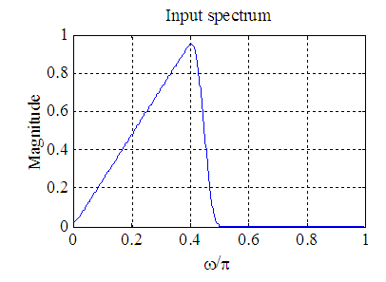
Down-Sampler
The input and output spectra of a down-sampler with M = 3 are shown below
Effect of aliasing can be clearly seen

Slide 38
Cascade Equivalences
Fractional Sampling Rate Alteration
A complex multirate system is formed by an interconnection of the up-sampler, the down-sampler, and the components of an LTI digital filter
In many applications these devices appear in a cascade form
An interchange of the positions of the branches in a cascade often can lead to a computationally efficient realization

Slide 39
Cascade Equivalences
To implement a fractional change in the sampling rate we need to employ a cascade of an up-sampler and a down-sampler
Consider the two cascade connections shown below
M
L
L
M

Slide 40
Cascade Equivalences
A cascade of a factor-of-M down-sampler and a factor-of-L up-sampler is interchangeable with no change in the input-output relation:
if and only if M and L are relatively prime, i.e., M and L do not have any common factor that is an integer k > 1

Slide 41
Cascade Equivalences
Two other cascade equivalences are shown below
Cascade equivalence #1
M
M
Cascade equivalence #2
L
L

Slide 42
Filters in Sampling Rate Alteration Systems
From the sampling theorem it is known that a the sampling rate of a critically sampled discrete-time signal with a spectrum occupying the full Nyquist range cannot be reduced any further since such a reduction will introduce aliasing
Hence, the bandwidth of a critically sampled signal must be reduced by lowpass filtering before its sampling rate is reduced by a down-sampler

Slide 43
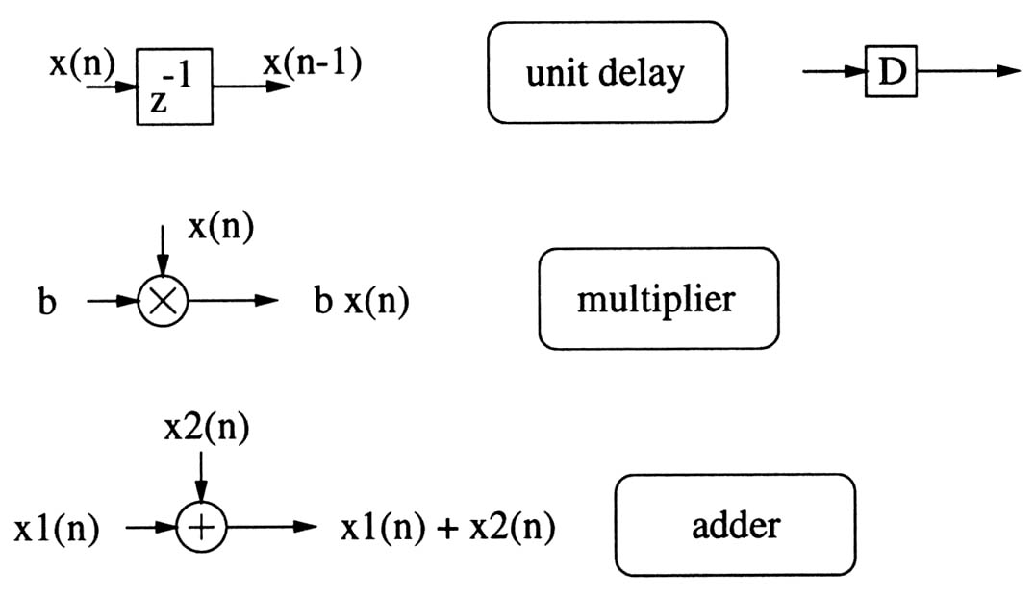
Signal Flow Graph
A collection of nodes and directed edges
Node: computation or task
Directed edge (j,k)
a linear transformation from node j to node k
Usually as constant gain multiplier or delay elements
Widely used in digital filter structures
Basic blocks :

Slide 44
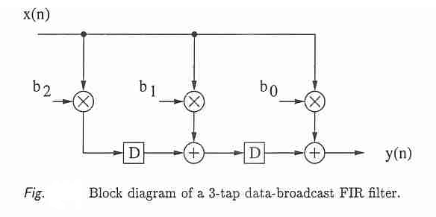
Block Diagram

Slide 45
Filters in Sampling Rate Alteration Systems
Likewise, the zero-valued samples introduced by an up-sampler must be interpolated to more appropriate values for an effective sampling rate increase
We shall show next that this interpolation can be achieved simply by digital lowpass filtering
We now develop the frequency response specifications of these lowpass filters

Slide 46
Filter Specifications
Since up-sampling causes periodic repetition of the basic spectrum, the unwanted images in the spectra of the up-sampled signal must be removed by using a lowpass filter H(z), called the interpolation filter, as indicated below
The above system is called an interpolator
L

Slide 47
Filter Specifications
On the other hand, prior to down-sampling, the signal v[n] should be bandlimited to by means of a lowpass filter, called the decimation filter, as indicated below to avoid aliasing caused by down-sampling
The above system is called a decimator
M

Slide 48
Interpolation Filter Specifications
Assume x[n] has been obtained by sampling a continuous-time signal at the Nyquist rate
If and denote the Fourier transforms of and x[n], respectively, then it can be shown
where is the sampling period

Slide 49
Interpolation Filter Specifications
Since the sampling is being performed at the Nyquist rate, there is no overlap between the shifted spectras of
If we instead sample at a much higher rate yielding y[n], its Fourier transform is related to through

Slide 50
Interpolation Filter Specifications
On the other hand, if we pass x[n] through a factor-of-L up-sampler generating , the relation between the Fourier transforms of x[n] and are given by
It therefore follows that if is passed through an ideal lowpass filter H(z) with a cutoff at π/L and a gain of L, the output of the filter will be precisely y[n]

Slide 51
Interpolation Filter Specifications
In practice, a transition band is provided to ensure the realizability and stability of the lowpass interpolation filter H(z)
Hence, the desired lowpass filter should have a stopband edge at and a passband edge close to to reduce the distortion of the spectrum of x[n]

Slide 52
Interpolation Filter Specifications
If is the highest frequency that needs to be preserved in x[n], then
Summarizing the specifications of the lowpass interpolation filter are thus given by

Slide 53
Decimation Filter Specifications
In a similar manner, we can develop the specifications for the lowpass decimation filter that are given by

Slide 54
Filter Design Methods
The design of the filter H(z) is a standard IIR or FIR lowpass filter design problem

Slide 55
Filters for Fractional Sampling Rate Alteration
A fractional change in the sampling rate can be achieved by cascading a factor-of-M decimator with a factor-of-L interpolator, where M and L are positive integers
Such a cascade is equivalent to a decimator with a decimation factor of M/L or an interpolator with an interpolation factor of L/M

Slide 56
Filters for Fractional Sampling Rate Alteration
There are two possible such cascade connections as indicated below
The second scheme is more computationally efficient since only one of the filters, or , is adequate to serve as both the interpolation and the decimation filter
M
L
L
M

Slide 57
Filters for Fractional Sampling Rate Alteration
Hence, the desired configuration for the fractional sampling rate alteration is as indicated below where the lowpass filter H(z) has a stopband edge frequency given by
L
M

Slide 58
Computational Requirements
The lowpass decimation or interpolation filter can be designed either as an FIR or an IIR digital filter
In the case of single-rate digital signal processing, IIR digital filters are, in general, computationally more efficient than equivalent FIR digital filters, and are therefore preferred where computational cost needs to be minimized

Slide 59
Computational Requirements
This issue is not quite the same in the case of multirate digital signal processing
To illustrate this point further, consider the factor-of-M decimator shown below
If the decimation filter H(z) is an FIR filter of length N implemented in a direct form, then
M

Slide 60
Computational Requirements
Now, the down-sampler keeps only every M-th sample of v[n] at its output
Hence, it is sufficient to compute v[n] only for values of n that are multiples of M and skip the computations of in-between samples
This leads to a factor of M savings in the computational complexity

Slide 61
Computational Requirements
Now assume H(z) to be an IIR filter of order K with a transfer function
where

Slide 62
Computational Requirements
Its direct form implementation is given by
Since v[n] is being down-sampled, it is sufficient to compute v[n] only for values of n that are integer multiples of M

Slide 63
Computational Requirements
However, the intermediate signal w[n] must be computed for all values of n
For example, in the computation of
K+1 successive values of w[n] are still required
As a result, the savings in the computation in this case is going to be less than a factor of M

Slide 64
Computational Requirements
For the case of interpolator design, very similar arguments hold
If H(z) is an FIR interpolation filter, then the computational savings is by a factor of L (since v[n] has zeros between its consecutive nonzero samples)
On the other hand, computational savings is significantly less with IIR filters

Slide 65
Filter Bank
For multirate processing it is required to separate
a signal into a set of sub- bands signals.
In some application where these kind of sub-band have to be combined .
For this Filter Banks are used.
Analysis Filter Bank
Synthesis Filter Bank
Sub-Band Coding Filter Bank
Quadrature-Mirror Filter Bank

Slide 66
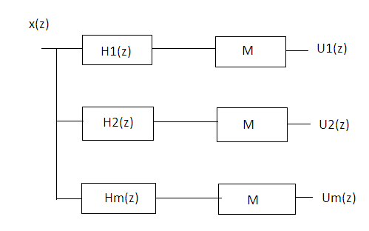
1) Analysis Filter Bank
It consist of M-sub filter.
The individual H_{k}(z) is known as analysis filter.
All the sub filter are equally spaced in frequancy
and each have the same frequancy.

Slide 67
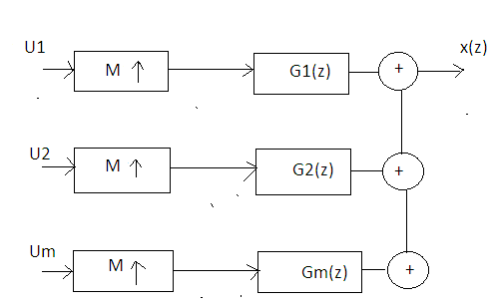
2) Synthesis Filter Bank
It is dual of M-channel analysis bank K.
Each Um(z) is fed to upsampler.
The upsampling process produced the signal U_{m}(z^{m})

Slide 68
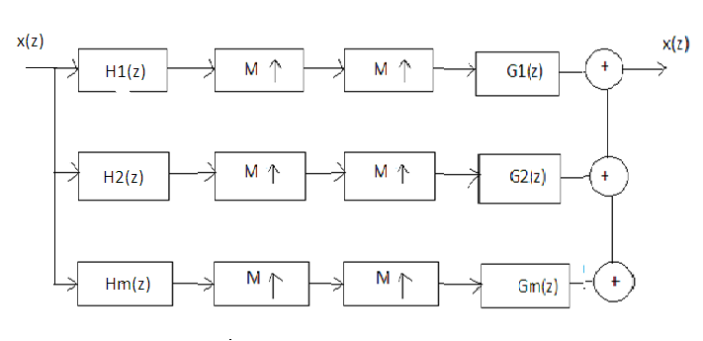
3) Sub-Band Coding Filter Bank
It is obtained by combining analysis and synthesis filter bank.
Analysis filter bank splits the broadband input signal x(n).
Synthesis filter bank is used to reconstruct output signal x(n)

Slide 69
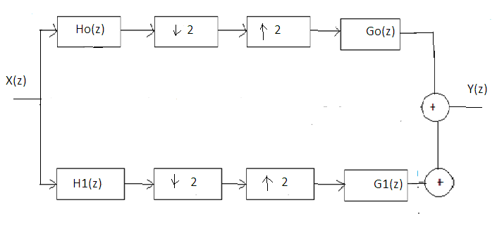
4) Quadrature Mirror Filter Bank
It is a two channel sub-band coding filter bank with complementary frequency response.
It consist of two sections
1) Analysis section ,
Ho(z) –lowpass filter , H1(z) –highpass filter
2) Synthesis Section
Go(z) –lowpass filter , G1(z) –highpass filter

Slide 70
Application of Multirate DSP
High Quality Analog to Digital Conversion for Digital Audio.
Efficient Digital to Analog Conversion in Compact Hi-Fi Systems.
Applicationin the Acquisition of High Quality Data.
Multirate Narrowband Filtering.
(Sharp transition between passband and stopbands)

Slide 71
Thank You

