Slide 1

Digital Signal Processing
Dr.
K. Mohanaprasad
1 / 13

Slide 2



Contents
1
Filter Realizations
Cascaded Form
Parallel Form
2 / 13

Slide 3








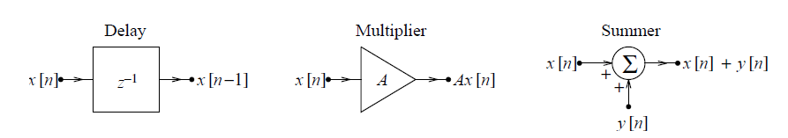
Filter Realizations
Realization of Filters
Digital filters can be represented by constant coefficient difference
equations
Basic elements or operations to relaize a filter are
Gain or sacling
Delay
Summer or adder
Following figure shows the above elements
Delay elements in cascade results in an output delayed by the sum of
the individual delays
The operational notation for the delay of k unit is z ^{−k}
3 / 13

Slide 4


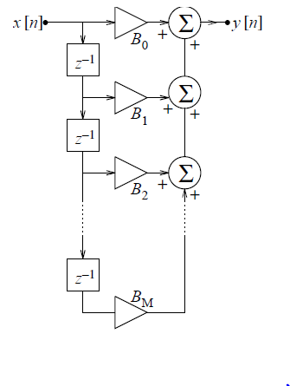
Filter Realizations
A non recursive filter decribed by
y [n] = B₀ x [n] + B₁x [n − 1] + ... + B_{M} x [n − M]
(1)
can be realized using a feed-forward structure with M delay elements
Realization of a non-recursive digital filter
4 / 13

Slide 5


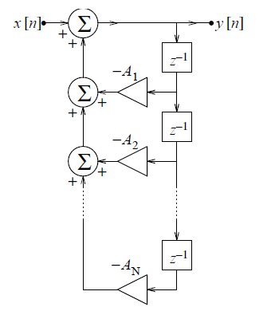
Filter Realizations
A recursive filter decribed by
y [n] = −A₁y [n − 1] − A₂y [n − 2]... − A_{N} y [n − N ]
+ x [n]
can be realized using a feedback structure as shown below, which requires N delay elements
Realization of a non-recursive digital filter
(2)
5 / 13

Slide 6

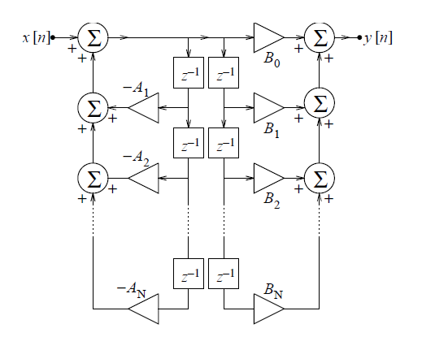
Filter Realizations
The general form of difference equation of a digital filter is
y [n] = −A1y [n−1]−A2y [n−2]−...−AN y [n−N ]+B0x [n]+B1x [n−1]+...+
(3)
This requires both feed-forward and feed-back structure and the
number of delay elements required is 2N
This representation is known as diret form-1
6 / 13

Slide 7



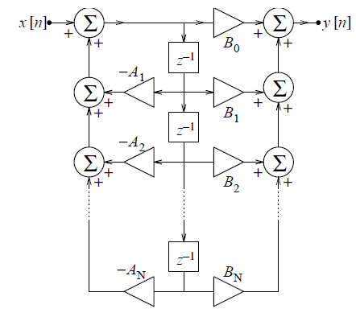
Filter Realizations
The LTI system can be cascaded in any order, we can switch the
feed-back and feed-forward path to obtain the canonical realization with only N delay elements
Canonical realization:- An implementation with minimum number of delay elements
This realization is known as direct form-II
7 / 13

Slide 8



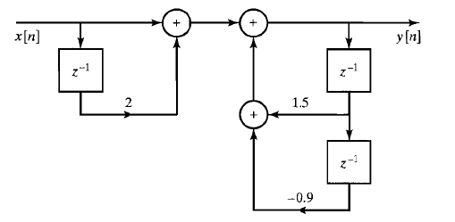
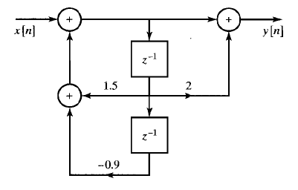
Filter Realizations
More examples on Direct form I and Direct form II
1 + 2z ⁻¹
H (z ) =
Y (z )
1 − 1.5z ⁻¹ + 0.9z ⁻²
1 + 2z ⁻¹
⇒
=
X (z ) 1 − 1.5z ⁻¹ + 0.9z ⁻²
(4)
⇒ Y (z )[1 − 1.5z ⁻¹ + 0.9z ⁻²] = X (z )[1 + 2z ⁻¹]
⇒ y (n) − 1.5y (n − 1) + 0.9y (n − 2) = x (n) + 2x (n − 1)
⇒ y (n) = 1.5y (n − 1) − 0.9y (n − 2) + x (n) + 2x (n − 1)
Direct Form I
Direct Form II
8 / 13

Slide 9


Filter Realizations Cascaded Form
Cascaded form implementation of a filter is obtained by factorizing
the transfer function
General form of a transfer function afetr factorization is given below
(5)
The first order factors represents the real poles and zeros and the
second order terms represents the comples poles and zeros
Cascaded direct form I and direct form II are possible
9 / 13

Slide 10
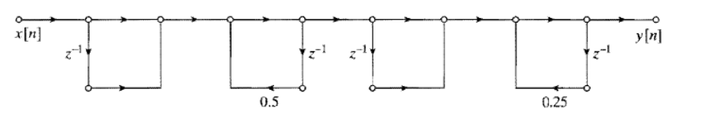
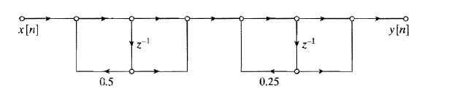
Filter Realizations Cascaded Form
Example
1 + 2z ⁻¹ + z ⁻²
H (z ) =
1 - 0.75z ⁻¹ + 0.125z ⁻²
(1 + z ⁻¹)(1 + z ⁻¹)
(6)
=
(1 - 0.5z ⁻¹)(1 - 0.25z ⁻¹ )
10 / 13

Slide 11

Filter Realizations Parallel Form
Transfer function H (z ) can be factorized in the form of a partial
fraction expansion as shown below
(7)
Here also we can have direct form I and direct form II realizations
11 / 13

Slide 12
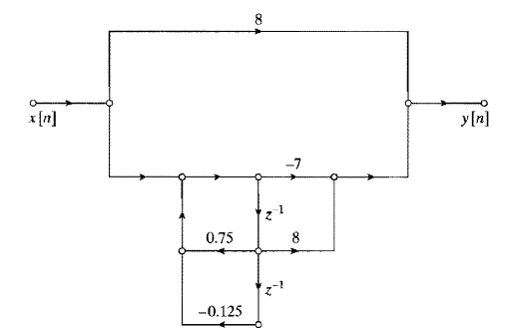
Filter Realizations Parallel Form
Example
1 + 2z ⁻¹ + z ⁻²
H (z ) =
1 - 0.75z ⁻¹ + 0.125z ⁻²
(8)
1
= 8 + ^{-7 + 8z -}
1 - 0.75z ⁻¹ + 0.125z ⁻²
12 / 13

Slide 13
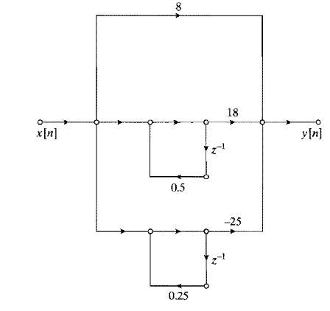
Filter Realizations Parallel Form
Example
1 + 2z ⁻¹ + z ⁻²
H (z ) =
1 - 0.75z ⁻¹ + 0.125z ⁻²
1
= 8 + ^{-7 + 8z -}
(9)
1 - 0.75z ⁻¹ + 0.125z ⁻²
18
25
= 8 +
-
1 - 0.5z ⁻¹ 1 - 0.25z ⁻¹
13 / 13

