Slide 1

Lecture 1
Introduction to Digital Signal Processing
Dr K. Mohanaprasad
Associate Professor
School of Electronics Engineering (SENSE)
VIT Chennai

Slide 2
Analog Vs Digital
i) Signal
Analog : voice, audio, video, ….
Digital : digitized analog signal, data
ii) Processing
Analog : passive/active filtering
AM, FM, PM modulation
Fourier, Lap lace transform
Digital : FIR/IIR filtering
AM, windowing
Discrete Fourier transform, z-transform

Slide 3
Analog vs. Digital (cont’d)
iii) System
Analog : R, L, C, Op-amp, switch, …
differential equation
Digital : adder, multiplier, memory, …
difference equation
iv) Theory
Circuit theory
DSP theory

Slide 4
What is Signal Processing?
Signal in
Processing
Signal out
(Analog or Digital)
(Analog or Digital)
Operation, Transformation
Example of Signals:
Analog: Speech, Music, Photos, Video, radar, sonar, …
Discrete-domain/Digital:
digitized speech, digitized music, digitized images, digitized video, digitized radar and sonar signals,…
stock market data, daily max temperature data, ...

Slide 5
Limitations of Analog Signal Processing
Accuracy limitations due to
Component tolerances
Undesired nonlinearities
Limited repeatability due to
Tolerances
Changes in environmental conditions
Temperature
Vibration
Sensitivity to electrical noise
Limited dynamic range for voltage and currents
Inflexibility to changes
Difficulty of implementing certain operations
Nonlinear operations
Time-varying operations
Difficulty of storing information

Slide 6
Why Go Digital?
Programmability
One hardware can perform several tasks.
Upgradeability and flexibility.
Repeatability
Identical performance from unit to unit.
No drift in performance due to temperature or aging.
Immune to noise
Offers higher performance.

Slide 7
Digital Signal Processing
Represent signals by a sequence of numbers
Sampling or analog-to-digital conversions
Perform processing on these numbers with a digital processor
Digital signal processing
Reconstruct analog signal from processed numbers
Reconstruction or digital-to-analog conversion
digital signal
digital signal
analog
signal
A/D
DSP
D/A
analog
signal
Analog input – analog output
Digital recording of music
Analog input – digital output
Touch tone phone dialing
Digital input – analog output
Text to speech
Digital input – digital output
Compression of a file on computer

Slide 8
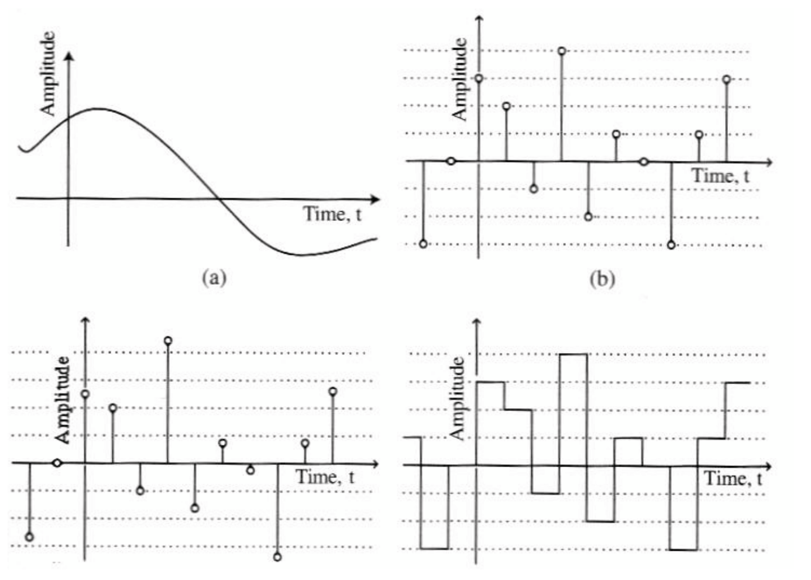
Signals

Slide 9
Advantages
Accuracy can be controlled by choosing word length
Repeatable
Sensitivity to electrical noise is minimal
Dynamic range can be controlled using floating point numbers
Flexibility can be achieved with software implementations
Non-linear and time-varying operations are easier to implement
Digital storage is cheap
Digital information can be encrypted for security
Price/performance and reduced time-to-market
Limitations
Sampling causes loss of information
A/D and D/A requires mixed-signal hardware
Limited speed of processors
Quantization and round-off errors

Slide 10
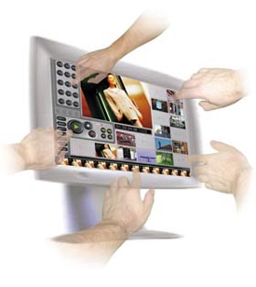



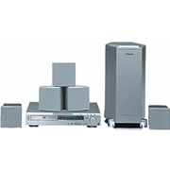
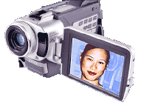
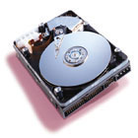

What is DSP Used For?
…And much more!

Slide 11
DSP is Everywhere
Sound applications
Compression, enhancement, special effects, synthesis, recognition, echo cancellation,…
Cell Phones, MP3 Players, Movies, Dictation, Text-to-speech,…
Communication
Modulation, coding, detection, equalization, echo cancellation,…
Cell Phones, dial-up modem, DSL modem, Satellite Receiver,…
Automotive
ABS, GPS, Active Noise Cancellation, Cruise Control, Parking,…
Medical
Magnetic Resonance, Tomography, Electrocardiogram,…
Military
Radar, Sonar, Space photographs, remote sensing,…
Image and Video Applications
DVD, JPEG, Movie special effects, video conferencing,…
Mechanical
Motor control, process control, oil and mineral prospecting,…

Slide 12
Signal Processing Applications
Speech processing
Speech compression
Speech recognition
Speaker Identification, Verification
Speech synthesis
Speech enhancement, Echo cancellation

Slide 13

DSP Applications – Image Processing
Image Processing
Image compression
Pattern recognition
Ghost cancellation
Noise reduction
Deblurring
Object tracking
Image fusion
Video Processing/compression, tracking...

