Slide 1

Lecture -2 Review of Discrete-time signals
Dr K. Mohanaprasad
Associate Professor
School of Electronics Engineering (SENSE)
VIT Chennai

Slide 2
Some Practical Signals:
Audio Signals
Video Signals
Seismic Signals
Biomedical Signals
Time Series

Slide 3
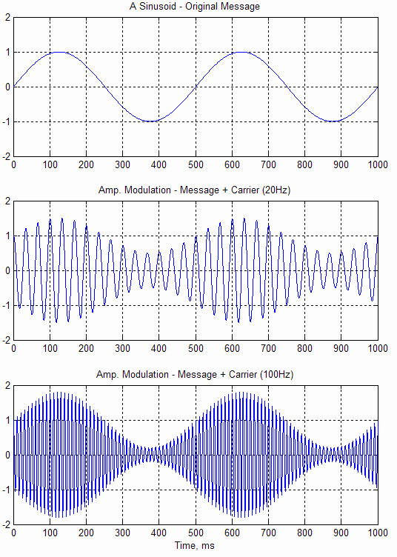
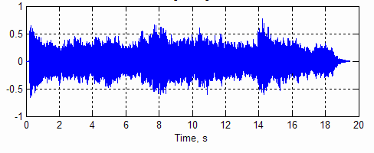
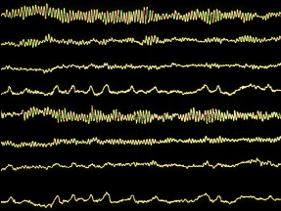



Slide 4
Â Discrete Time Signals
Sampling
Unit impulse sequence
Unit step sequence
Complex Exponential sequence
Periodicity

Slide 5
Discrete-Time Signals
Â A discrete-time signal, commonly referred to as a sequence, is only
defined at discrete time instances, where t is defined to take integer values only.
Â Discrete-time signals may also be written as a sequence of numbers inside braces:
{x[n]} = {K, − 0.2, 2.2,1.1, 0.2, − 3.7, 2.9,K}
↑
ª n indicates discrete time, in integer intervals, the bold-face denotes time t=0.
Â Discrete time signals are often generated from continuous time signals
by sampling which can roughly
independent variable (time)
be
interpreted as quantizing the
{x(n)} = x(nT ) = x(t )
n = L,−2,−1,0,1,2,L
Sampling interval / period
s
t =nT_{s}

Slide 6
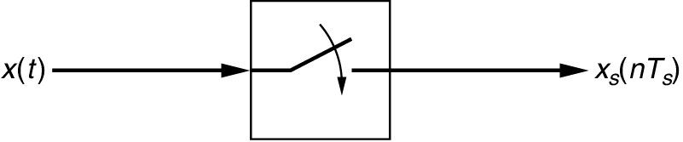
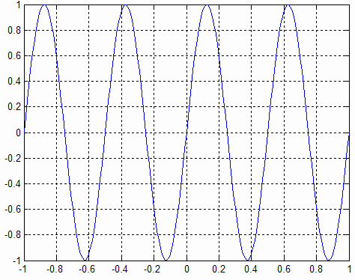
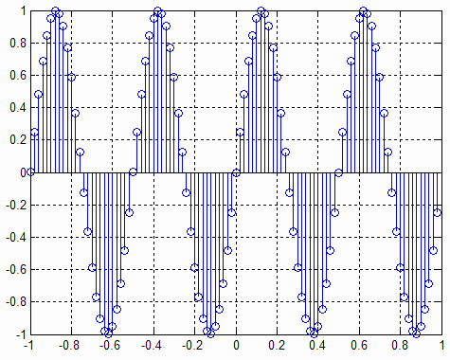
Sampling
Â Think of sampling as a switch, that stays closed for an infinitesimally small amount of signal time. It takes samples from the continuous time.
It
Ts

Slide 7


Discrete Signals
Â A length-N sequence is often referred to as an N-point sequence
Â The length of a finite-length sequence can be increased by zero-padding, i.e., by
appending it with zeros
Â A right-sided sequence x[n] has zero-valued samples for n<N_{1.} If N₁>0, a right- sided sequence is called a causal sequence
^{N}1
n
Â A left sequence x[n] has zero-valued samples for n>N_{2.} If N₂<0, a left-sided sequence is called an anti-causal sequence
^{N} 2
n

Slide 8
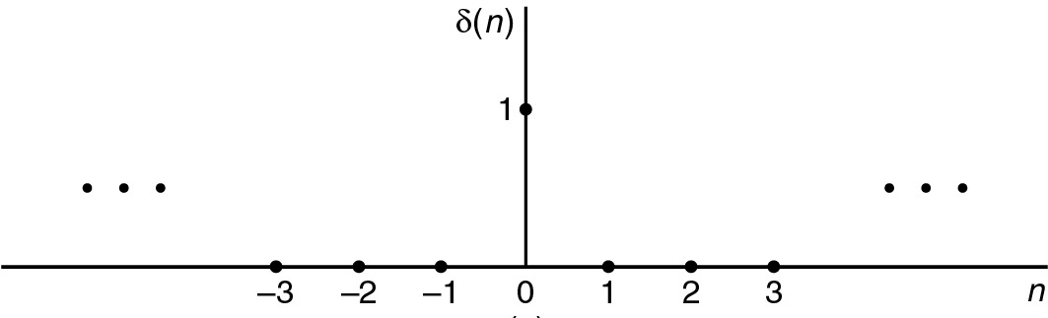
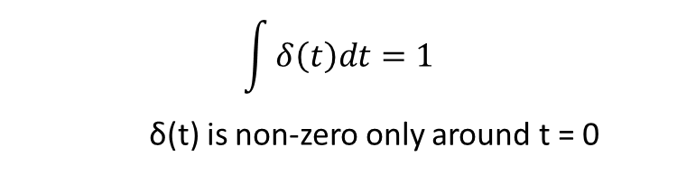

Discrete Time Signals
Unit
Impulse
(sequence)
$$δ\left(n\right)=\left\{\begin{aligned}1, n=0 \\ 0, otherewise\end{aligned}\right.$$
⎨
The sifting property carries into discrete time
domain
⎧ f [n₀ ], n = n₀
⎩0, n ≠ n₀
b b
n=a n=a
f [n]δ [n − n0 ] = f [n0 ]δ [n − n0 ] =
⎨
a<n0, b>n0
∑
f [n]δ [n − n0 ] = ∑ f [n0 ]δ [n − n0 ] =
f [n0 ]
$$\int{δ\left(t\right)dt=1}$$
δ(t) is non-zero only around t = 0

Slide 9
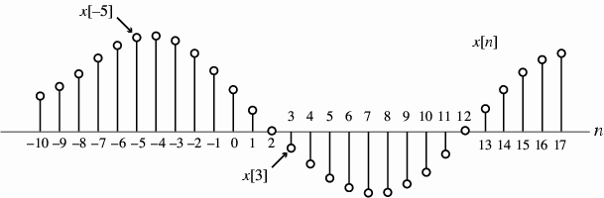
Discrete Time Signals
Unit Impulse (sequence)
Â The sifting property has one very important consequence:
A sequence can be generated in terms of impulses
x[n] = ... + x[−1]δ [n + 1] +
∞
x[0]δ [n] +
x[1]δ [n − 1] + ...
=
∑
x[m]δ [n − m]
m=−∞
=x[-5]δ[n+5]
We will use this property in the future to define any system in terms of its “impulse response”

Slide 10

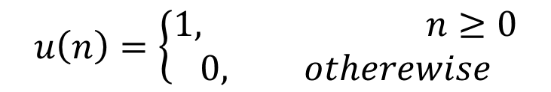
Discrete Time Signals
Unit
Step
(sequence)
1
n
–4
–3 –2 –1
0
1
2
3
4
5
6
⎨
$$u\left(n\right)=\left\{\begin{aligned}1, n≥0 \\ 0, otherewise\end{aligned}\right.$$

Slide 11
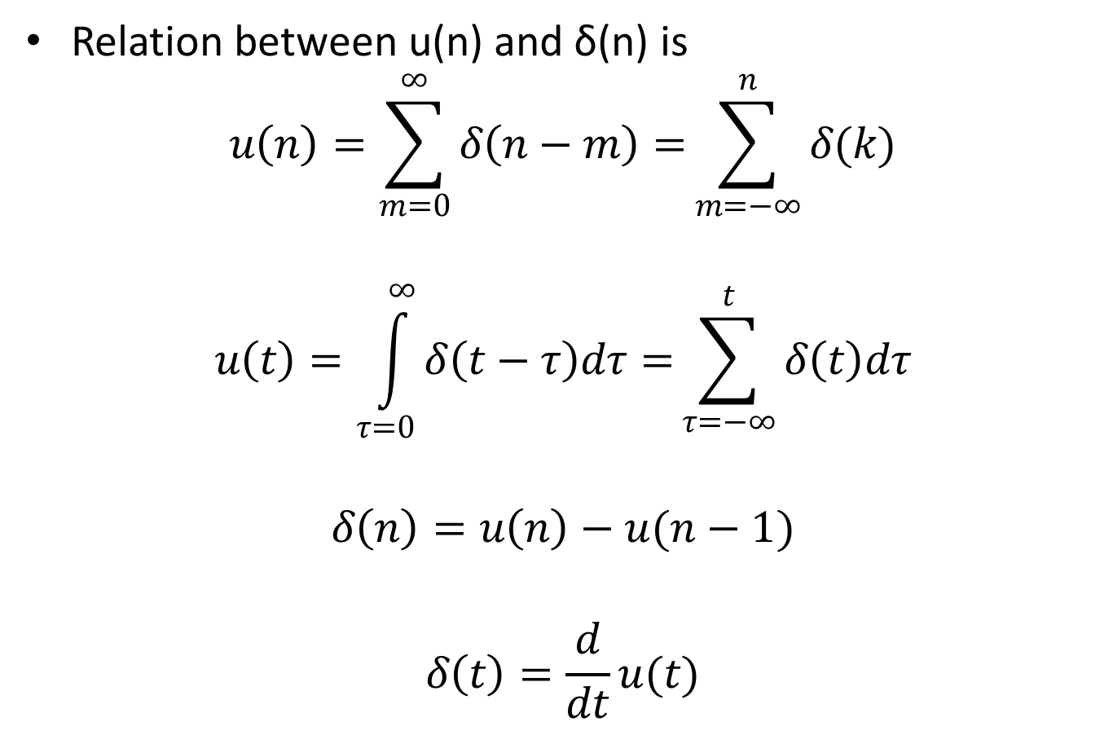
Continued………
Relation between u(n) and δ(n) is
$$u\left(n\right)=\sum_{m=0}^{∞}{δ\left(n−m\right)=}\sum_{m=−∞}^{n}{δ(k)}$$
$$u\left(t\right)=\int_{τ=0}^{∞}{δ\left(t−τ\right)dτ=}\sum_{τ=−∞}^{t}{δ\left(t\right)dτ}$$
$$δ\left(n\right)=u\left(n\right)−u(n−1)$$
$$δ\left(t\right)=\frac{d}{dt}u(t)$$

Slide 12
Discrete Time Signals
Exponential Sequence
Â Exponential sequence -
x[n] = A α ^{n} ,
− ∞ < n < ∞
ª where A and α are real or complex numbers. If |α|<1, this is decaying exponential
ª What about for 0 < α <1, or what about
-1 < α <
0, and |α|>1???
e^{(σo + jωo )} ,
A =
A
e
^{jφ} ,
Â If we write
α =
Angular (discrete) frequency
of the sequence
ª then we can
express
x[n]
ª where
=
A
e
^{jφ}e^{(σo +}
jωo ) n
= xre [n] +
j xim [n],
xre [n] =
x_{im} [n] =
A e^{σo n} cos( ω_{o} n + φ),
A e^{σo n}
sin( ωo n + φ)

Slide 13
Discrete Time Signals
Exponential Sequence
Â x_{re}[n] and x_{im}[n] of a complex exponential sequence are real
sinusoidal sequences with constant (σ₀=0), growing (σ₀>0), or
attenuating (σ₀<0) amplitudes for n > 0
Real part
Imaginary part
1
1
0.5
0.5
0
Amplitude
0
Amplitude
-0.5
-0.5
-1
0
10
20
Time index n
30
40
-1
0
10
20
Time index n
30
40
x[n]
= exp(−
1
+ j
π
6
)n ⋅ u[n]
12

Slide 14
Discrete Time Signals
Exponential Sequence
Â A special case of the exponential signal is very commonly used in
DSP: A=real constant, and α=jω_{o} is purely imaginary, i.e.,
x[n] = Ae
jωo n
= A(cos [ω ₀ n]+ j sin [ω ₀ n])
Â If both A and α are purely real, then we have a real exponential
sequence
x[n]
=
Aα
^{n} ,
−∞
<
n
<
∞,
A,α ∈ ℜ
α
=
1.2
α
= 0.9
50
20
40
15
30
Amplitude
10
20
Amplitude
10
5
0
0
5
10
15
Time index n
20
25
30
0
0
5
10
15
Time index n
20
25
30

Slide 15
Periodicity
Â Sinusoidal sequence
A cos(ωo n +φ)
and complex exponential
sequence
Be
jωo n
are periodic sequences of period N if
ω0N = 2πr, where N and r are positive integers
Â Smallest value of N satisfying
period of the sequence
ωo N = 2πr
is the fundamental
Â Any sequence that does not satisfy this condition is aperiodic
Â To verify the above fact, consider
x1[n] = cos(ωon + φ)
x₂ [n] = cos(ω_{o} n + φ ) cos ω_{o} N
x2[n] = cos(ωo (n + N ) + φ)
− sin(ω_{o} n + φ ) sin ω_{o} N
= cos(ωo n + φ ) = x1[n] iff sin ωo N =
ª These two conditions are met if and only if
0
and cos ωo N
= 1
2π
ω_{o}
N
r
=

Slide 16
Periodicity
Â Note that any continuous sinusoidal /exponential signal is periodic,
however, not all discrete sinusoidal sequences are:
ª A discrete time sequence sin(ω0n+φ) or
e^{jω0n}
is periodic with period N, if and
only if, there exists an integer m, such that mT0 is an integer, where T0=2π/ ω0.
^{ª In other words, ω}0^{N = 2πr must}
must be rational number.
be
satisfied
with two integers N and r, or N/r
x[n] =
3 cos(5n + π / 2)
5 sin(3πn + π / 2)
ª Are these sequences periodic?
y[n] = e
j 7n
x[n] =
y[n] = e
j3.7πn
x[n] = 5 sin( 3πn + π / 2)

Slide 17
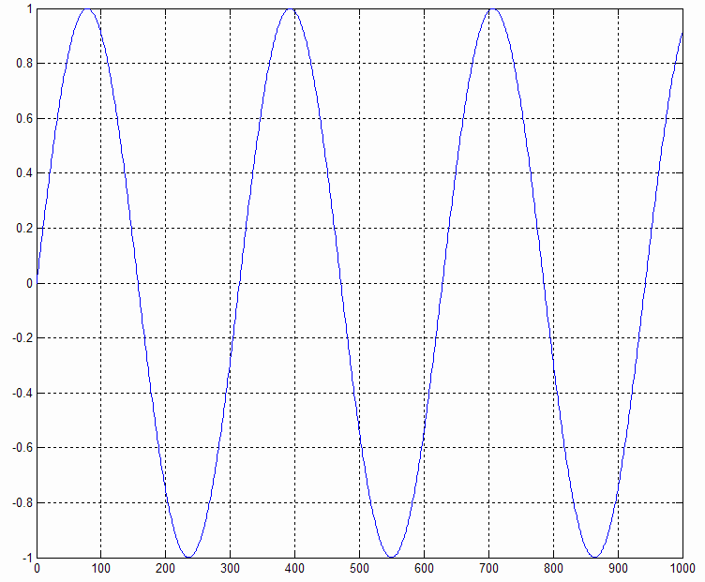
Periodicity
Â Try this:
ª n=0:1:1000;
ª x=sin(2*0.01*n);
ª plot(n,x)

Slide 18
Properties
of Discrete Signals
Property 1
- Consider x[n]=e^{jω1n} and y[n]=
e^{jω2n}
with 0<ω1<π and
2πk≤ ω2≤ 2π(k+1), where k is any positive integer.
If ω₂= ω₁+ 2πk, then x[n] = y[n]
Thus, x[n] and y[n] are indistinguishable
What does
this mean?
Two periodic discrete exponential sequences are indistinguishable,
if
their angular frequencies are 2πk apart from each other
!!!

Slide 19
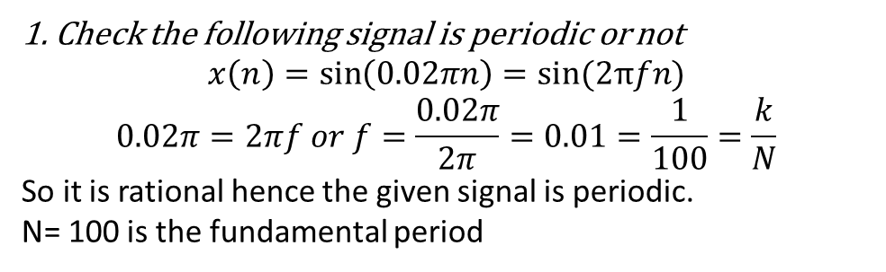
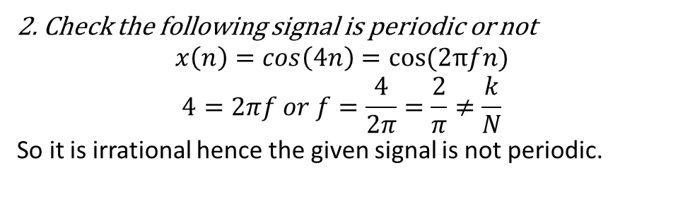
1. Check the following signal is periodic or not
$$x\left(n\right)=\sin\left(0.02πn\right)=sin(2πfn)$$
$$0.02π=2πf or f=\frac{0.02π}{2π}=0.01=\frac{1}{100}=\frac{k}{N}$$
So it is rational hence the given signal is periodic.
N= 100 is the fundamental period
2. Check the following signal is periodic or not
$$x\left(n\right)=\cos\left(4n\right)=cos(2πfn)$$
$$4=2πf or f=\frac{4}{2π}=\frac{2}{π}≠\frac{k}{N}$$
So it is irrational hence the given signal is not periodic.

Slide 20
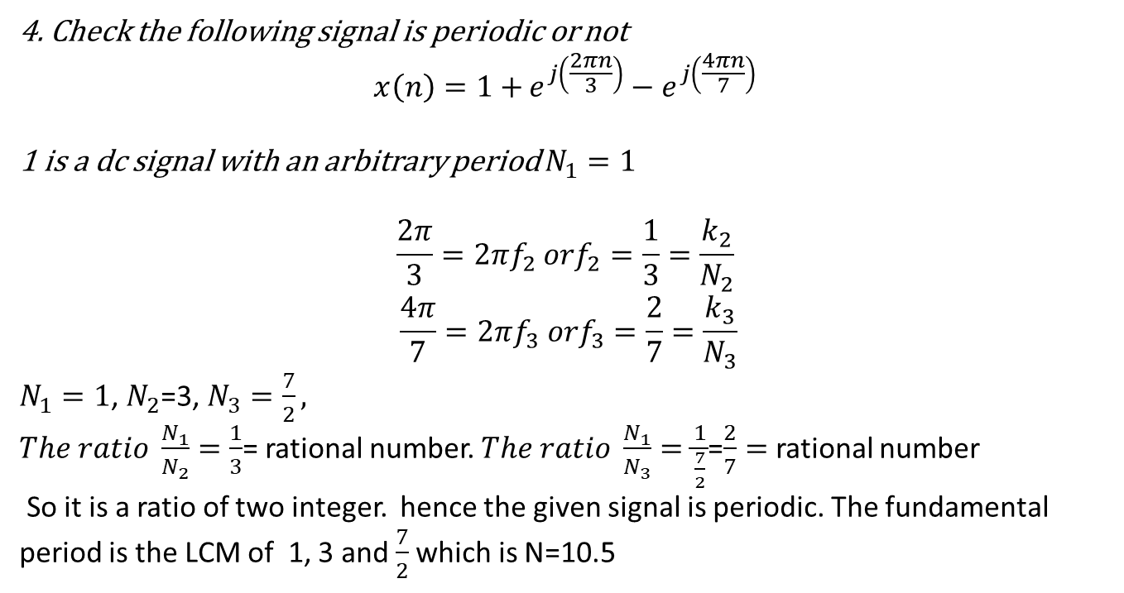
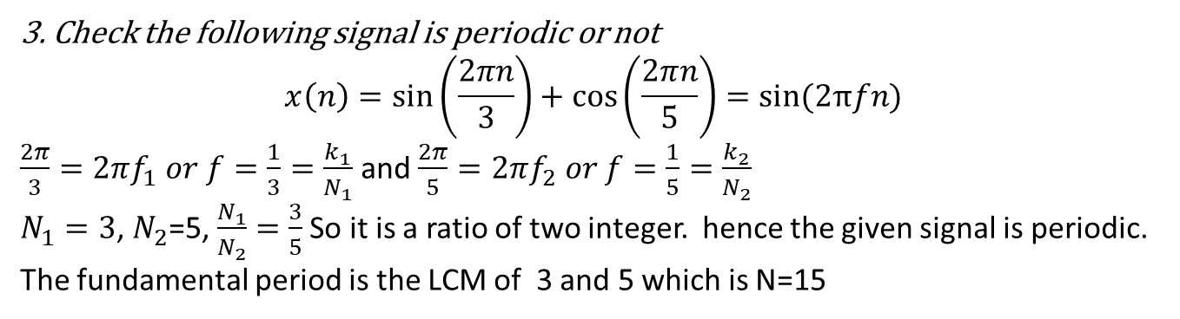
3. Check the following signal is periodic or not
$$x\left(n\right)=\sin\left(\frac{2πn}{3}\right)+\cos\left(\frac{2πn}{5}\right)=sin(2πfn)$$
$\frac{2π}{3}=2πf_{1} or f=\frac{1}{3}=\frac{k_{1}}{N_{1}}$ and$\frac{2π}{5}=2πf_{2} or f=\frac{1}{5}=\frac{k_{2}}{N_{2}}$
$N_{1}=3$, $N_{2}$=5, $\frac{N_{1}}{N_{2}}=\frac{3}{5}$ So it is a ratio of two integer. hence the given signal is periodic. The fundamental period is the LCM of 3 and 5 which is N=15
4. Check the following signal is periodic or not
$$x\left(n\right)=1+{e^{j\left(\frac{2πn}{3}\right)}−e^{j\left(\frac{4πn}{7}\right)}}$$
1 is a dc signal with an arbitrary period $N_{1}=1$
$$\frac{2π}{3}=2πf_{2} orf_{2}=\frac{1}{3}=\frac{k_{2}}{N_{2}}$$
$$\frac{4π}{7}=2πf_{3} orf_{3}=\frac{2}{7}=\frac{k_{3}}{N_{3}}$$
$N_{1}=1$, $N_{2}$=3, $N_{3}=\frac{7}{2},$
$The ratio \frac{N_{1}}{N_{2}}=\frac{1}{3}$= rational number. $The ratio \frac{N_{1}}{N_{3}}=\frac{1}{\frac{7}{2}}$=$\frac{2}{7}=$ rational number
So it is a ratio of two integer. hence the given signal is periodic. The fundamental period is the LCM of 1, 3 and $\frac{7}{2}$which is N=10.5

Slide 21
Classification
of
Signals
Â We have already seen some:
ª Continuous vs. discrete
ª Periodic vs. aperiodic
Â Here are some others:
ª Symmetric vs. antisymmetric vs. nonsymmetric
ª Energy vs. power sequences
ª Bounded vs. unbounded sequences
ª Absolutely
summable
vs. square summable
sequences*

Slide 22
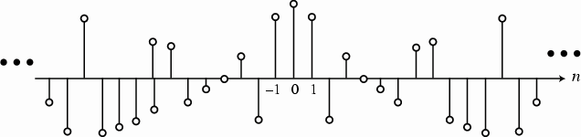
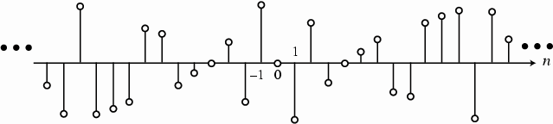
Symmetry
Â A discrete sequence is called
ª
ª
Symmetric if, x[n] = x[-n]
Conjugate-symmetric if x[n]=x*[-n],
•
if x[n] is real, then symmetric and conjugate-symmetric are the same, and the signal is also referred
to as an even sequence
Even sequence
ª
Conjugate-antisymmetric if x[n]=-x*[-n]
Symmetric if, x[n] = -x[-n]
•
If x[n] is real, the signal is called simply as antisymmetric or odd sequence
Odd sequence

Slide 23
Symmetry
Â Any real sequence can be expressed as a sum of its even part and its odd part:
x[n] = xev[n] + xod [n]
where
xev[n] = ¹ (x[n] + x[−n])
xod [n] = ¹ (x[n] − x[−n])
2
2
Â Any complex sequence can be expressed as a sum of its conjugate-symmetric part
and its conjugate-antisymmetric part:
x[n] = xcs [n] + xca [n]
where
x_{cs} [n] = ¹ (x[n] + x *[−n])
x_{ca} [n] = ¹ (x[n] − x *[−n])
2
2

Slide 24
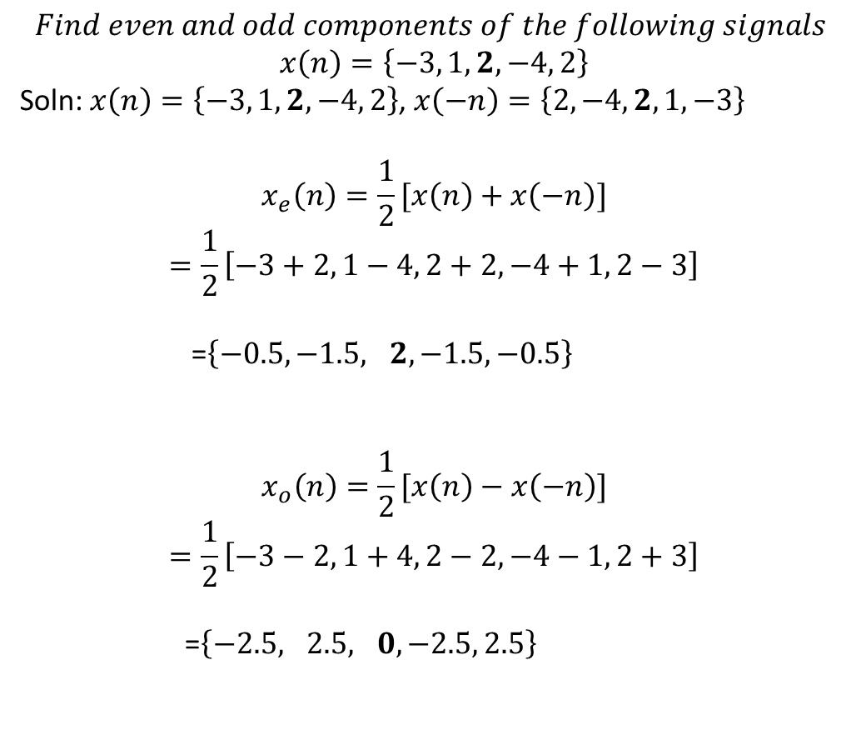
$$Find even and odd components of the following signals$$
$$x\left(n\right)=\left\{−3, 1,2,−4, 2\right\}$$
Soln: $x\left(n\right)=\left\{−3, 1,2,−4, 2\right\}$, $x\left(−n\right)=\left\{2, −4,2,1, −3\right\}$
$$x_{e}\left(n\right)=\frac{1}{2}[x\left(n\right)+x\left(−n\right)]$$
$$=\frac{1}{2}\left[−3+2, 1−4, 2+2, −4+1, 2−3\right]$$
=$\left\{−0.5, −1.5, 2, −1.5, −0.5\right\}$
$$x_{o}\left(n\right)=\frac{1}{2}[x\left(n\right)−x\left(−n\right)]$$
$$=\frac{1}{2}\left[−3−2, 1+4, 2−2, −4−1, 2+3\right]$$
=$\left\{−2.5, 2.5, 0, −2.5, 2.5\right\}$

Slide 25



Energy & Power
In Signals
Â It is often useful to define the “size” or “strength” of a signal. That is, we would like to be able to use a
single number that represents the average strength of the signal. How would we do that?
ª
A reasonable answer would be to use the area under the curve. The larger the area, the
stronger the signal.
ª
But if the signal has negative areas, then the total area is reduced by the negative parts. Yet, a
negative signal is not necessarily a weaker signal. In fact, -110 V will jolt you as much as
+110 V will. So, we need another approach. Calculating the area under the “square of the
absolute value of the signal” solves this problem
|x(t)|²
x(t)
_{∞ 2}
^{E =} ∫ ^{x (t ) dt}
ª
This area is defined as the energy of the (continuous time) signal.
−∞

Slide 26
Energy & Power
in Sequences
Â Total energy of a (discrete) sequence x[n] is similarly defined as
Â An infinite length sequence with finite sample values may or may not have finite
energy (see example 2.6, page 54, Mitra)
Â A finite length sequence with finite sample values has finite energy
Â We define the energy of a sequence x[n] over a finite interval -K<n<K as
ε _{x, K} = ∑ x[n]
K
2
n=− K
Â However, if the signal is infinitely long, say, such as the 60Hz mains, the energy
becomes infinite. Hence we define the average power of an aperiodic sequence as
the “energy per unit time”
K
^{x} K →∞ ^{2 K +1} _{n=− K}
P = lim
1
∑
x[n] ²

Slide 27
Energy & Power
in Sequences
Â Then
K ₂
P = lim ¹ ∑ x[n]
P_{x} = lim ¹ ε _{x.K}
_{K →∞} 2 K +1
x
K →∞ ^{2 K +1} n=− K
Â The average power of a periodic sequence
~x[n]
with a period N is
given by
N −1
^{P}x N ^{x[n]}
=
1
∑
n=0
~
2
ª The average
power of an infinite-length sequence may be finite or infinite
ª A signal with finite energy is called an energy signal. Energy signals has zero
power!
ª A signal with finite (and nonzero) power is called a power signal. A power
signal, with nonzero power, has infinite energy.

Slide 28
Energy & Power Sequences
Recap:
Â A sequence with finite average power is called a power signal. Unless
the power is zero, a power signal has infinite energy
ªA periodic sequence has a finite average power but infinite energy
Â A sequence with finite energy is called an energy signal. An energy
signal has zero average power.
ªA finite-length sequence has
finite energy but zero average power

Slide 29

$$Find the following signals are energy signal or power signal$$
$$x\left(n\right)={\left(\frac{1}{2}\right)}^{n}u\left(n\right)$$
$$\underset{N→∞}{=lim}{\sum_{n=0}^{N}{{\left[{\left(\frac{1}{2}\right)}^{n}\right]}^{2}}}$$
$$=\sum_{0}^{∞}{{\frac{1}{4}}^{n}}=\frac{1}{1−\frac{1}{4}}=\frac{4}{3}joules$$
Power of the signal
=0
K ₂
P = lim ¹ ∑ x[n]
x
K →∞ ^{2 K +1} n=− K

Slide 30

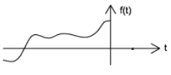
Causal and Anti-Causal signals
A signal is causal if,
A signal is Anti-causal if

Slide 31
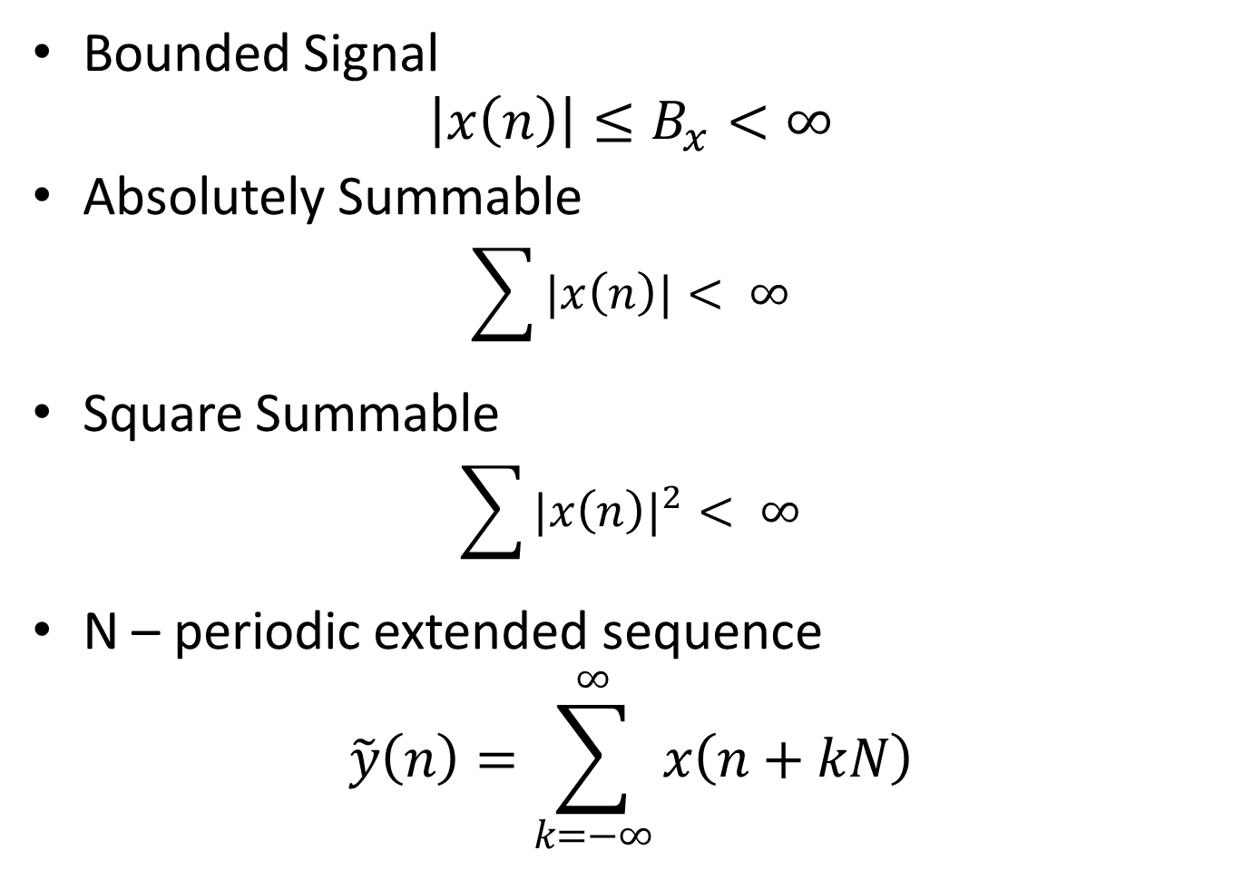
Continued……………
Bounded Signal
$$\left|x\left(n\right)\right|≤B_{x}<∞$$
Absolutely Summable
$$\sum{|x\left(n\right)|}< ∞$$
Square Summable
$$\sum{{|x\left(n\right)|}^{2}}< ∞$$
N – periodic extended sequence
$$\tilde{y}\left(n\right)=\sum_{k=−∞}^{∞}{x\left(n+kN\right)}$$

Slide 32
Length(Support) of a signal:
Finite Length
Infinite Length
Right Sided Sequence – Causal Sequence
Left Sided Sequence – anticausal Sequence
Two Sided Sequence

Slide 33
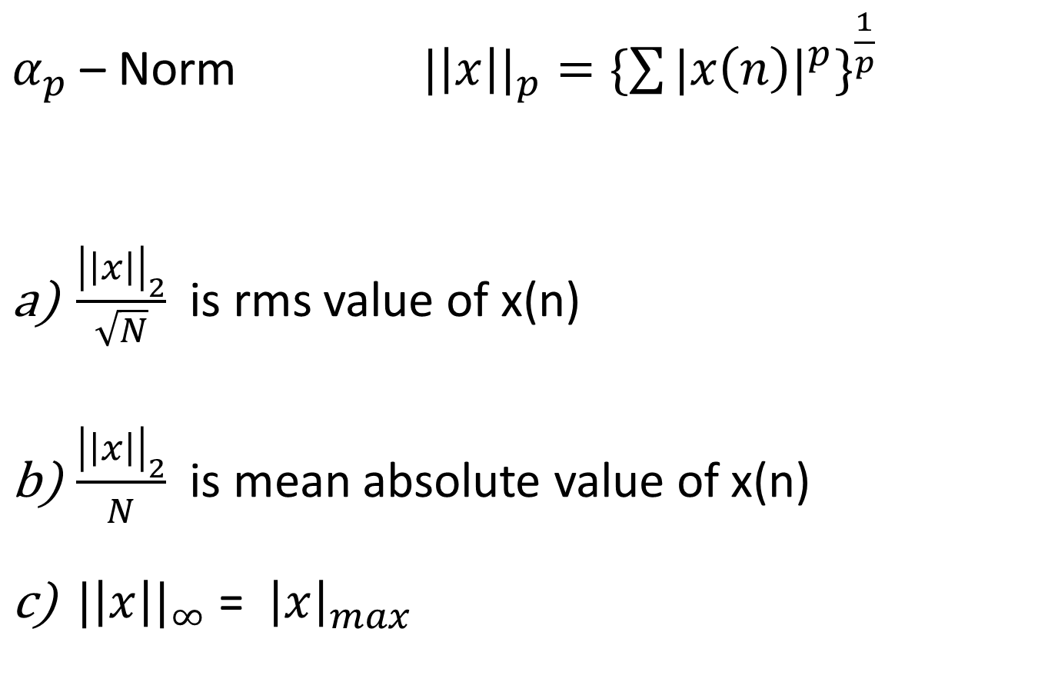
Size (Norm) of a Signal:
$α_{p}$ – Norm ${|\left|x\right||}_{p}={\{\sum{{|x\left(n\right)|}^{p}\}}}^{\frac{1}{p}}$
$\frac{{\left|\left|x\right|\right|}_{2}}{\sqrt{N}}$ is rms value of x(n)
$\frac{{\left|\left|x\right|\right|}_{2}}{N}$ is mean absolute value of x(n)
${|\left|x\right||}_{∞}$ = ${\left|x\right|}_{max}$

Slide 34

Relative absolute Error,
$$E_{rel}={\left\{\frac{\sum_{n=0 }^{N−1 }{{\left|\hat{x}\left(n\right)−x\left(n\right)\right|}^{2}}}{\sum{{|x\left(n\right)|}^{2}}}\right\}}^{\frac{1}{2}}$$

