Slide 1

Lecture -3 Operation on Discrete-time signals & discrete-time system
Dr K. Mohanaprasad
Associate Professor
School of Electronics Engineering (SENSE)
VIT Chennai

Slide 2
Some Basic Operations
on Sequences
Â Product (modulation) operation:
ª Modulator
x[n]
×
y[n]
y[n] = x[n] ⋅ w[n]
w[n]
Â Creating a finite-length sequence from an infinite-length
sequence by multiplying the latter with a finite-length sequence called a window sequence
Â Process called windowing

Slide 3
Some
Basic Operations on Sequences
Â Addition operation:
x[n]
+
y[n]
ª Adder
y[n] = x[n] + w[n]
w[n]
Â Multiplication
operation
ª Multiplier
A
x[n]
y[n]
y[n] = A ⋅ x[n]

Slide 4
Some Basic Operations
on
Sequences
Â Time-shifting operation:
where N is an integer
y[n] =
x[n −
N ]
Â If N > 0, it is delaying operation
ª Unit delay
_{z} −1
y[n]
y[n] =
x[n − 1]
x[n]
Â If N < 0, it is an advance
operation
ª Unit advance
x[n]
z
y[n]
y[n] =
x[n + 1]

Slide 5
Some Basic Operations
on
Sequences
Â Time-reversal (folding) operation:
y[n] = x[−n]
Â Branching operation: Used to provide multiple copies of
a
sequence
x[n]
x[n]
x[n]

Slide 6

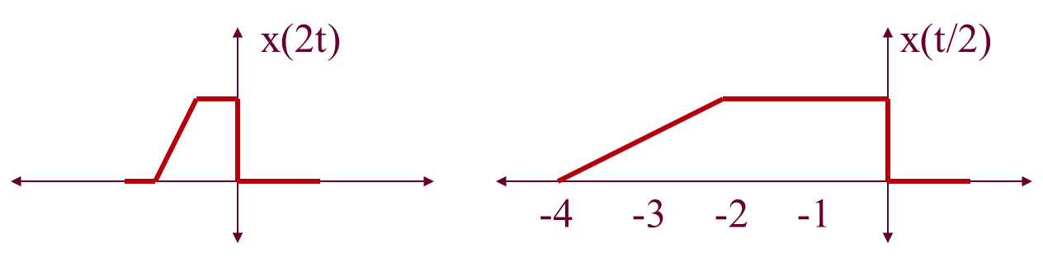
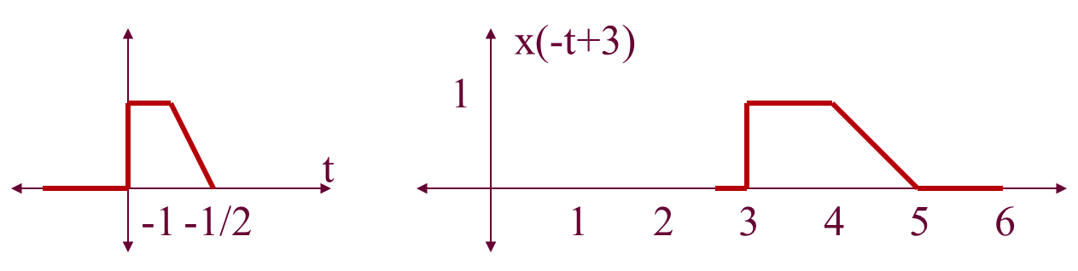
Time-scale example:

Slide 7
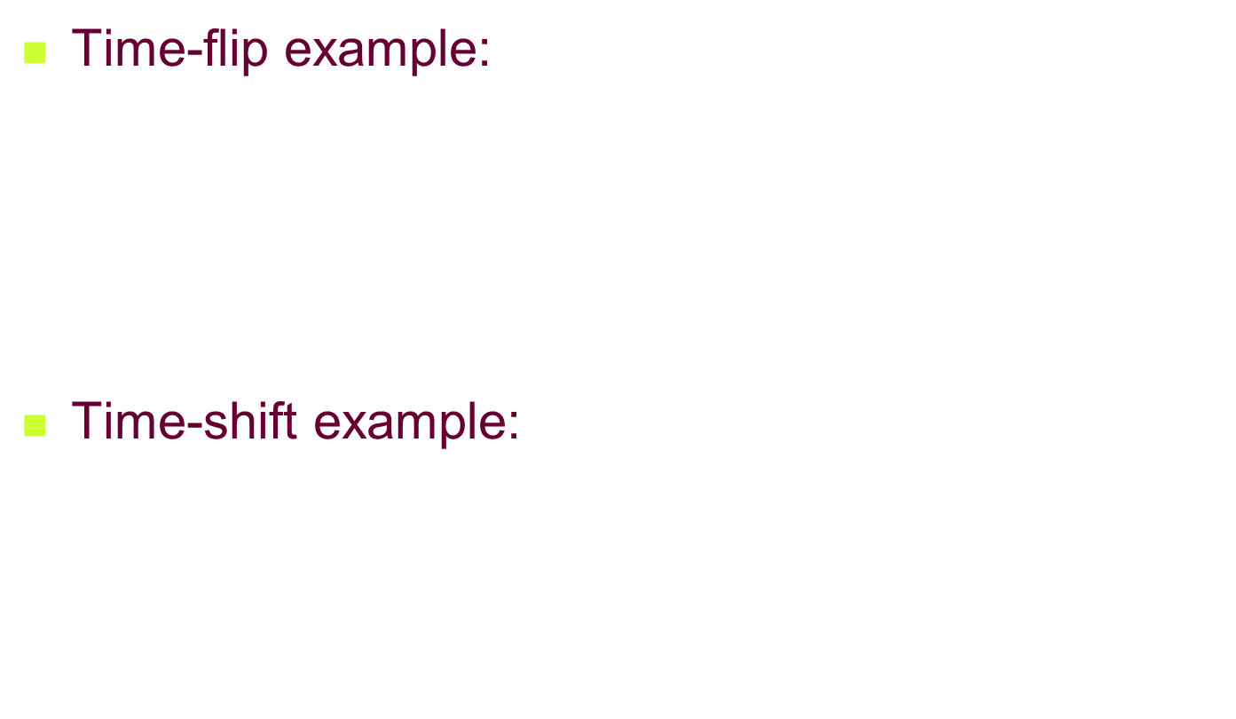
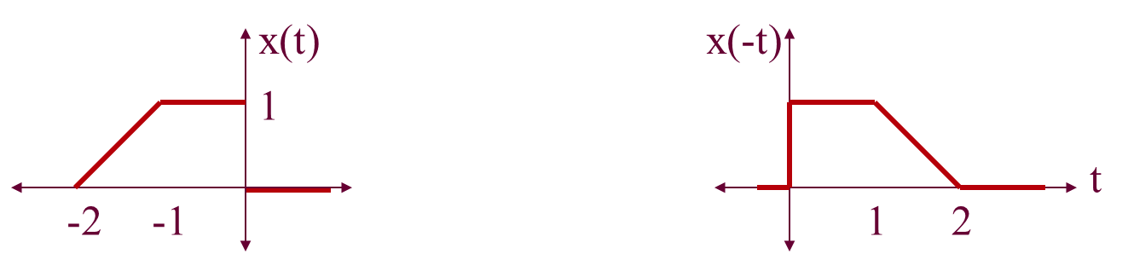
x(t-1)
x(t+1)
1
-2
-1
1

Slide 8
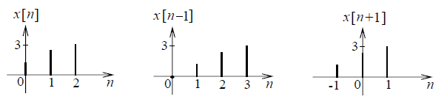

Slide 9
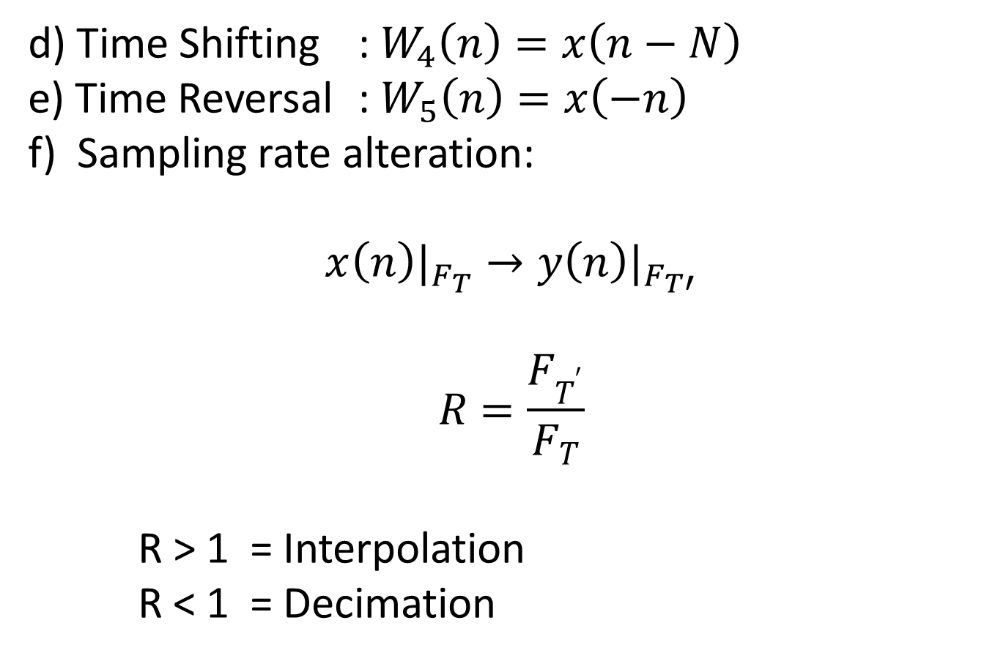
Continued……….
d) Time Shifting : $W_{4}\left(n\right)=x\left(n−N\right)$
e) Time Reversal : $W_{5}\left(n\right)=x\left(−n\right)$
f) Sampling rate alteration:
$${x\left(n\right)|}_{F_{T}}→{y\left(n\right)|}_{F_{T′}}$$
$$R=\frac{F_{T^{′}}}{F_{T}}$$
R > 1 = Interpolation
R < 1 = Decimation

Slide 10

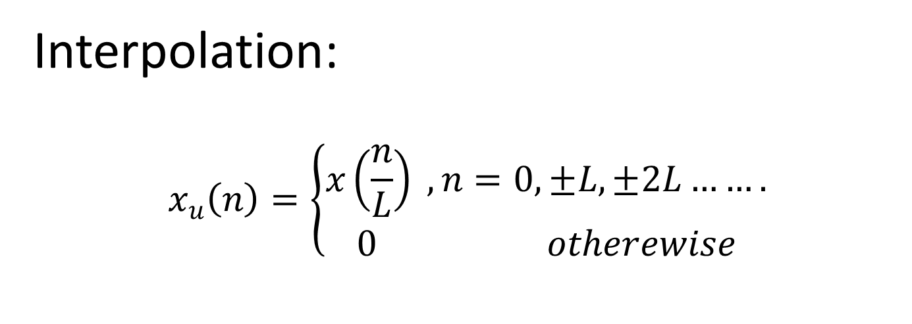
Continued……….
Interpolation:
$$x_{u}\left(n\right)=\left\{\begin{aligned}x\left(\frac{n}{L}\right) , n=0, ±L, ±2L……. \\ 0 otherewise\end{aligned}\right.$$

Slide 11

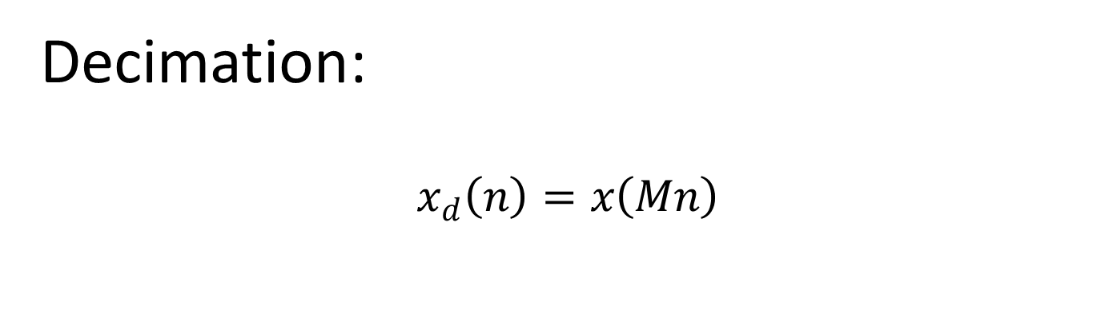
Continued……….
Decimation:
$$x_{d}\left(n\right)=x\left(Mn\right)$$

Slide 12
Discrete Systems
Â A discrete-time system processes a given input sequence x[n] to
generates an output sequence y[n] with more desirable properties
Â In most applications, the discrete-time system is a single-input, single-output system:
DISCRETE TIME SYSTEM
x[n]
Input sequence
y[n]
Output sequence
y[n] = ℜ{x[n]}
The operator that acts on the input sequence

Slide 13
Classification of Systems
Â Discrete time systems can be classified based on their properties
ª Discrete vs. continuous
ª Linear vs. non-linear
ª Shift-invariant or shift-variant
ª Causal vs. noncausal
ª Memoryless vs. with
ª Stable vs. unstable
memory

Slide 14
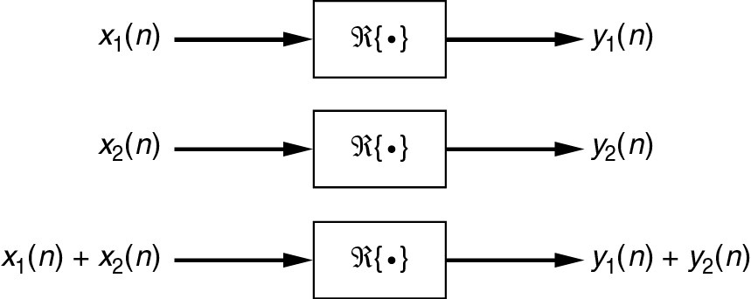
Linearity
Â Let y₁[n] be the output due to an input x₁[n] and y₂[n] be the output due to an input
x₂[n]. A system is said to be linear, if the following superposition & homogeneity
properties are satisfied
x[n] = α
x₁[n] + β x₂ [n]
y[n] = α y₁[n] + β
y₂ [n]
ℜ{αx1[n]+βx2[n]}= α.ℜ{x1[n]}+ β.{x2[n]}
Â This property must hold for any arbitrary constants α and β , and for all possible
inputs x₁[n] and x₂[n], and can also be generalized to any arbitrary number of inputs

Slide 15
An Example - Accumulator
Â A discrete system whose input / output relationship is given as
n
∑
y[n] =
x[l]
The second form is used, if the
signal is causal, in which case y[-1] is the initial condition
l=−∞
= y[−1] +
n
∑
l=0
x[l],
is known as an accumulator. The output at any given time, is simply the sum of all
inputs up to that time.
Â Is the accumulator linear?
Â How about the accumulator for the causal systems?
Â How about the system y[n]=ax₁[n]+b
Â As an exercise, try
y[n] = x²[n] − x[n − 1]x[n + 1]

Slide 16
Ex. Test the Linearity of the system
Hence the system is Non-Linear

Slide 17
Test the Linearity of the system
Hence the system is Linear

Slide 18
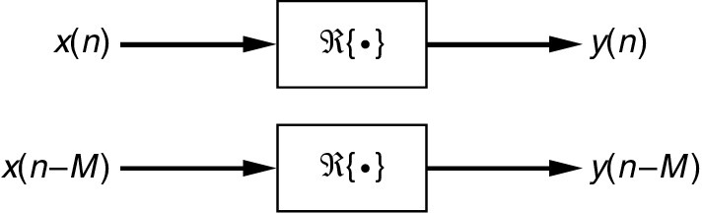
Shift - Invariance
Â A system is said to be shift-invariant if ℜ(x[n-M])=y[n-M], for all n, m.
Â For sequences and systems where the index n is related to discrete instants
of time, this property is also called the time-invariance property
Â Time-invariance property ensures that for a specified input, the output is
independent of the time the input is being applied

Slide 19
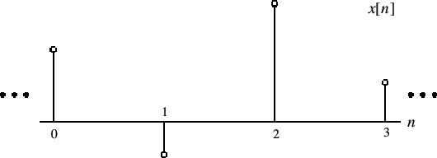
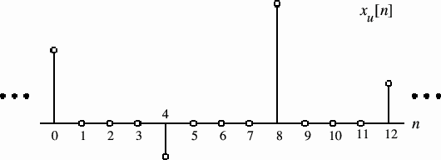
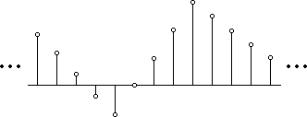
An Example - Upsampler
Â A system whose input / output characteristics can be written as
[n] = ⎧ x[n / L], n = 0, ± L, ± 2L,.....
x
⎨
u
⎩
0,
otherwise
is known as an upsampler.
Â This system inserts L zeros between every sample. If the samples are
inserted based on
their amplitudes,
then
the
system
is
called
an
interpolator.
y[n]
Is the upsampler a
time-
invariant system?
3
4
n
0
1
2
5
6
7
8
9 10
11 12

Slide 20
Linear
Time-Invariant Systems
Â A system that satisfies both the linearity and the time (shift)
invariance properties is called a linear time (shift) invariant system, LTI (LSI).
Â We will see that these group of systems play a particularly important
role in signal processing.
ª They are easy to characterize and analyze, and hence easy to design
ª Efficient
algorithms have been
developed
over
the
years
for
such systems

Slide 21
Test whether the system y(t) = e^{x(t)} is Time-Invariant or not
y(t, t₀) = e^{x(t-t0)}
y(t-t₀) = y(t)|_{t = t – t0}
y(t-t₀) = e^{x(t-t0)}
Therefore, y(t,t₀) = y(t-t₀)
Hence, the system is Time Invariant

Slide 22
Causality
Â A system is said to be causal, if the output at time n₀ does not depend
on the inputs that come after n₀.
Â In other words, in a causal system, the
n0th
output sample y[n0]
depends only on input samples x[n] for n ≤ n₀ and does not depend on
input samples for n>n₀.
Â Here are some examples: Which systems are causal?
y[n] = α1x[n] + α 2 x[n − 1] + α3 x[n − 2] + α 4 x[n − 3]
y[n] = b₀ x[n] + b₁x[n − 1] + b₂ x[n − 2]
+ a₁ y[n − 1] + a₂ y[n − 2]
y[n] = y[n − 1] + x[n]
1
y[n] = xu [n] + ( xu [n − 1] + xu [n + 1])
2
₊ 1
y
[n] = x
u ^{[n]} ₃ ^{( x}
u [n − 1] + x
u [n + 2])
+ ² ( x_{u} [n − 2] + x_{u} [n + 1])
3

Slide 23


Causal and non-causal System
A system is causal if the present value of the output signal depends only on the present or past values of the input signal.
A system is noncausal if the present value of the output signal depends on the future values of the input signal.

Slide 24
An Example - Downsampler
Â A system whose input-output characteristic satisfies
y[n] = x[Mn]
where M is a (+) integer, is called a downsampler or a decimator.
ª Such a system reduces the number of samples
by a factor
of
M
by
removing
M
samples from between
every
sample.
Â Is this system
ª Linear?
In class
exercise
ª Time (shift)
ª Causal?
invariant?

Slide 25
Memory
Â A system is said to be memoryless if the output depends only on the
current input, but not on any other past (or future) inputs.
the system is said to have memory.
Otherwise,
Â Which of the following systems have memory?
y[n] = y[n − 1] + x[n]
y[n] = x[Mn]
⎧ x[n / L], n = 0, ± L, ± 2L,.....
xu [n] = ⎨
0,
otherwise
n
∑
y[n] =
x[l]
l=−∞

Slide 26
Example
y(t) = x(t) sin (2t)
y[n] = u[n]
A system is said to possess memory (i.e. dynamic) if its output signal depends on past or future values of the input signal.
Example
y(t) = x(t+1) + 5
y[n] = x[n] + x[n-1]

Slide 27
Stability
Â There are several definitions of stability, which is of utmost
importance in filter design. We will use the definition of stability in the BIBO sense
Â A systems is said to be stable in the bounded input bounded output
sense, if the system produces a finite (bounded) output for any finite
(bounded) input, that is,
ª If y[n] is the response to an input x[n] that satisfies |x[n]|≤Bx^{<∞, and y[n] satisfies}
^{|y[n]| ]|≤B}y<∞, then the system is said to be stable in the BIBO sense.
Â A system (filter) that is not stable is rarely of any practical use (except
for very specialized applications), and therefore, most filters are designed to be BIBO stable.

Slide 28
An Example –
Moving Average
Filter
Â An M – point moving average system (filter) is defined as
M −1
M _{k =0}
1
y[n] =
∑
x[n −
k ]
Â What would you use such a system
Â Is this system stable?
for?

Slide 29
Discrete Convolution
Â The operation by far the most commonly used by DSP professionals,
and most commonly misused, abused
and confused by
students.
Â At the heart of any DSP system:
Discrete-time
System, h[n]
x[n]
Input sequence
y[n] = x[n] ∗ h[n]
∞
⁼ ∑ ^{x[m] ⋅ h[n − m]}
m=−∞
∞
⁼ ∑ ^{h[m] ⋅ x[n − m]}
m=−∞
y[n]
Output sequence
h[n]: Impulse response of the
system

Slide 30
Discrete Convolution
Â The “n” dependency of y[n] deserves some care: for each value of “n”
the convolution sum must be computed separately over all values of a dummy variable “m”. So, for each “n”
1.
Rename the independent variable as m.
over the origin. This is h[-m]
You now
have x[m] and h[m]. Flip h[m]
2.
Shift h[-m] as far left as possible to a point “n”, where the two signals barely
touch. This is h[n-m]
Multiply the two signals and sum over all values of m. This is the convolution sum for the specific “n” picked above.
3.
4.
Shift / move h[-m] to the right by
and sum over all m.
one sample, and obtain a new h[n-m]. Multiply
5.
Repeat 2~4 until h[n-m] no longer overlaps with x[m], i.e., shifted out of the x[m]
zone.
∞
m=−∞ m=−∞
^{y[n] = x[n] ∗ h[n] =} ∑ ^{x[m] ⋅ h[n − m] =}
∑ ^{h[m] ⋅ x[n − m]}

Slide 31



Properties of convolution
Commutative
Distributive
Associative

Slide 32
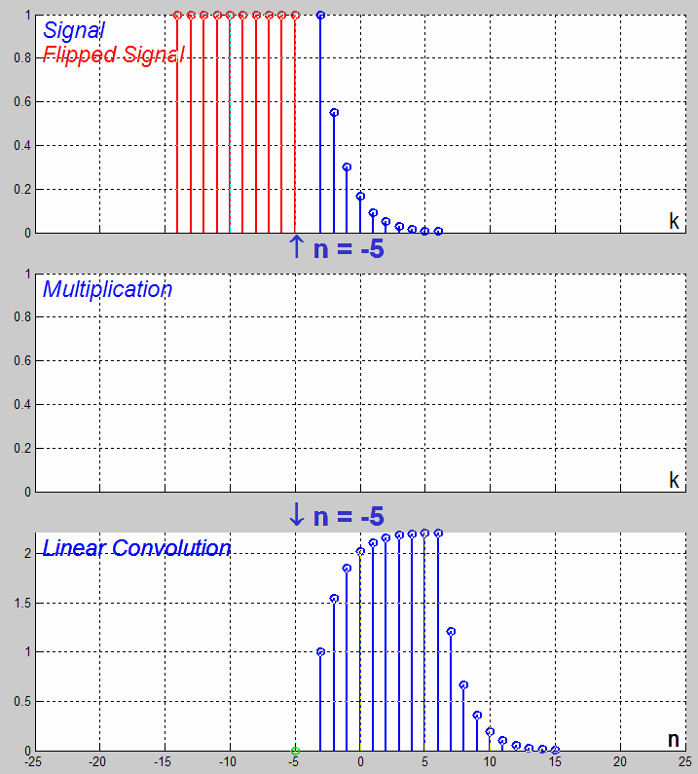
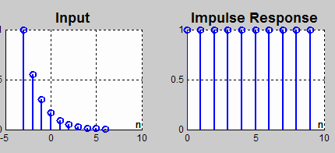
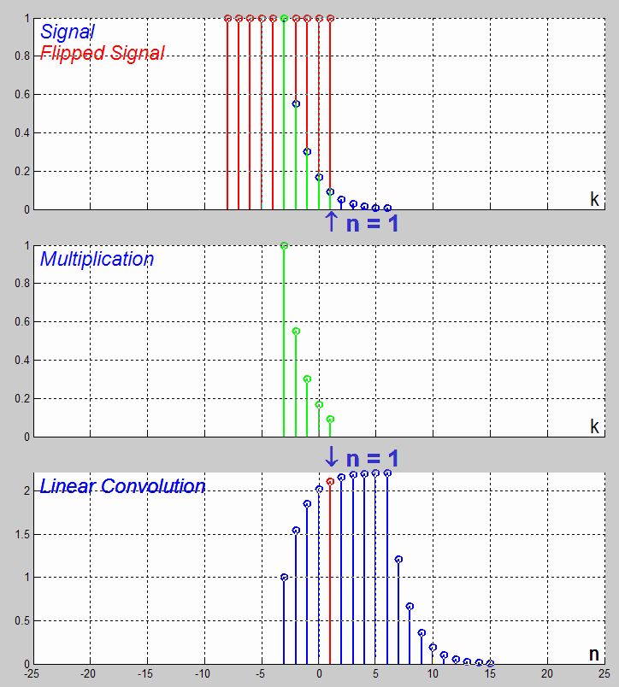
Convolution
Demo
x[n]=0.55^{n+3}(u[n+3]-u[n-7])
dconvdemo.m
h[n]=u[n]-u[n-10]

Slide 33
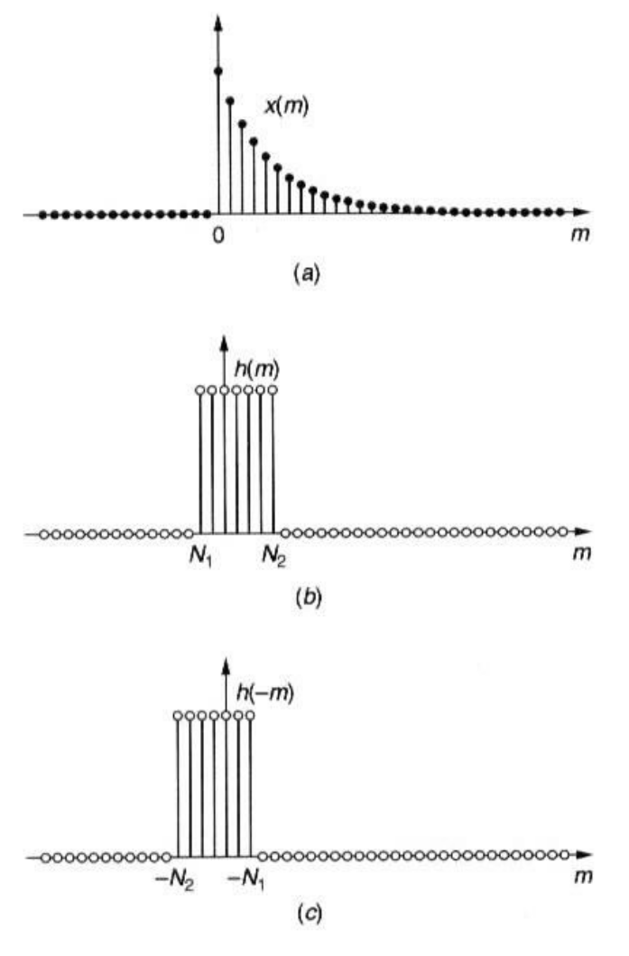
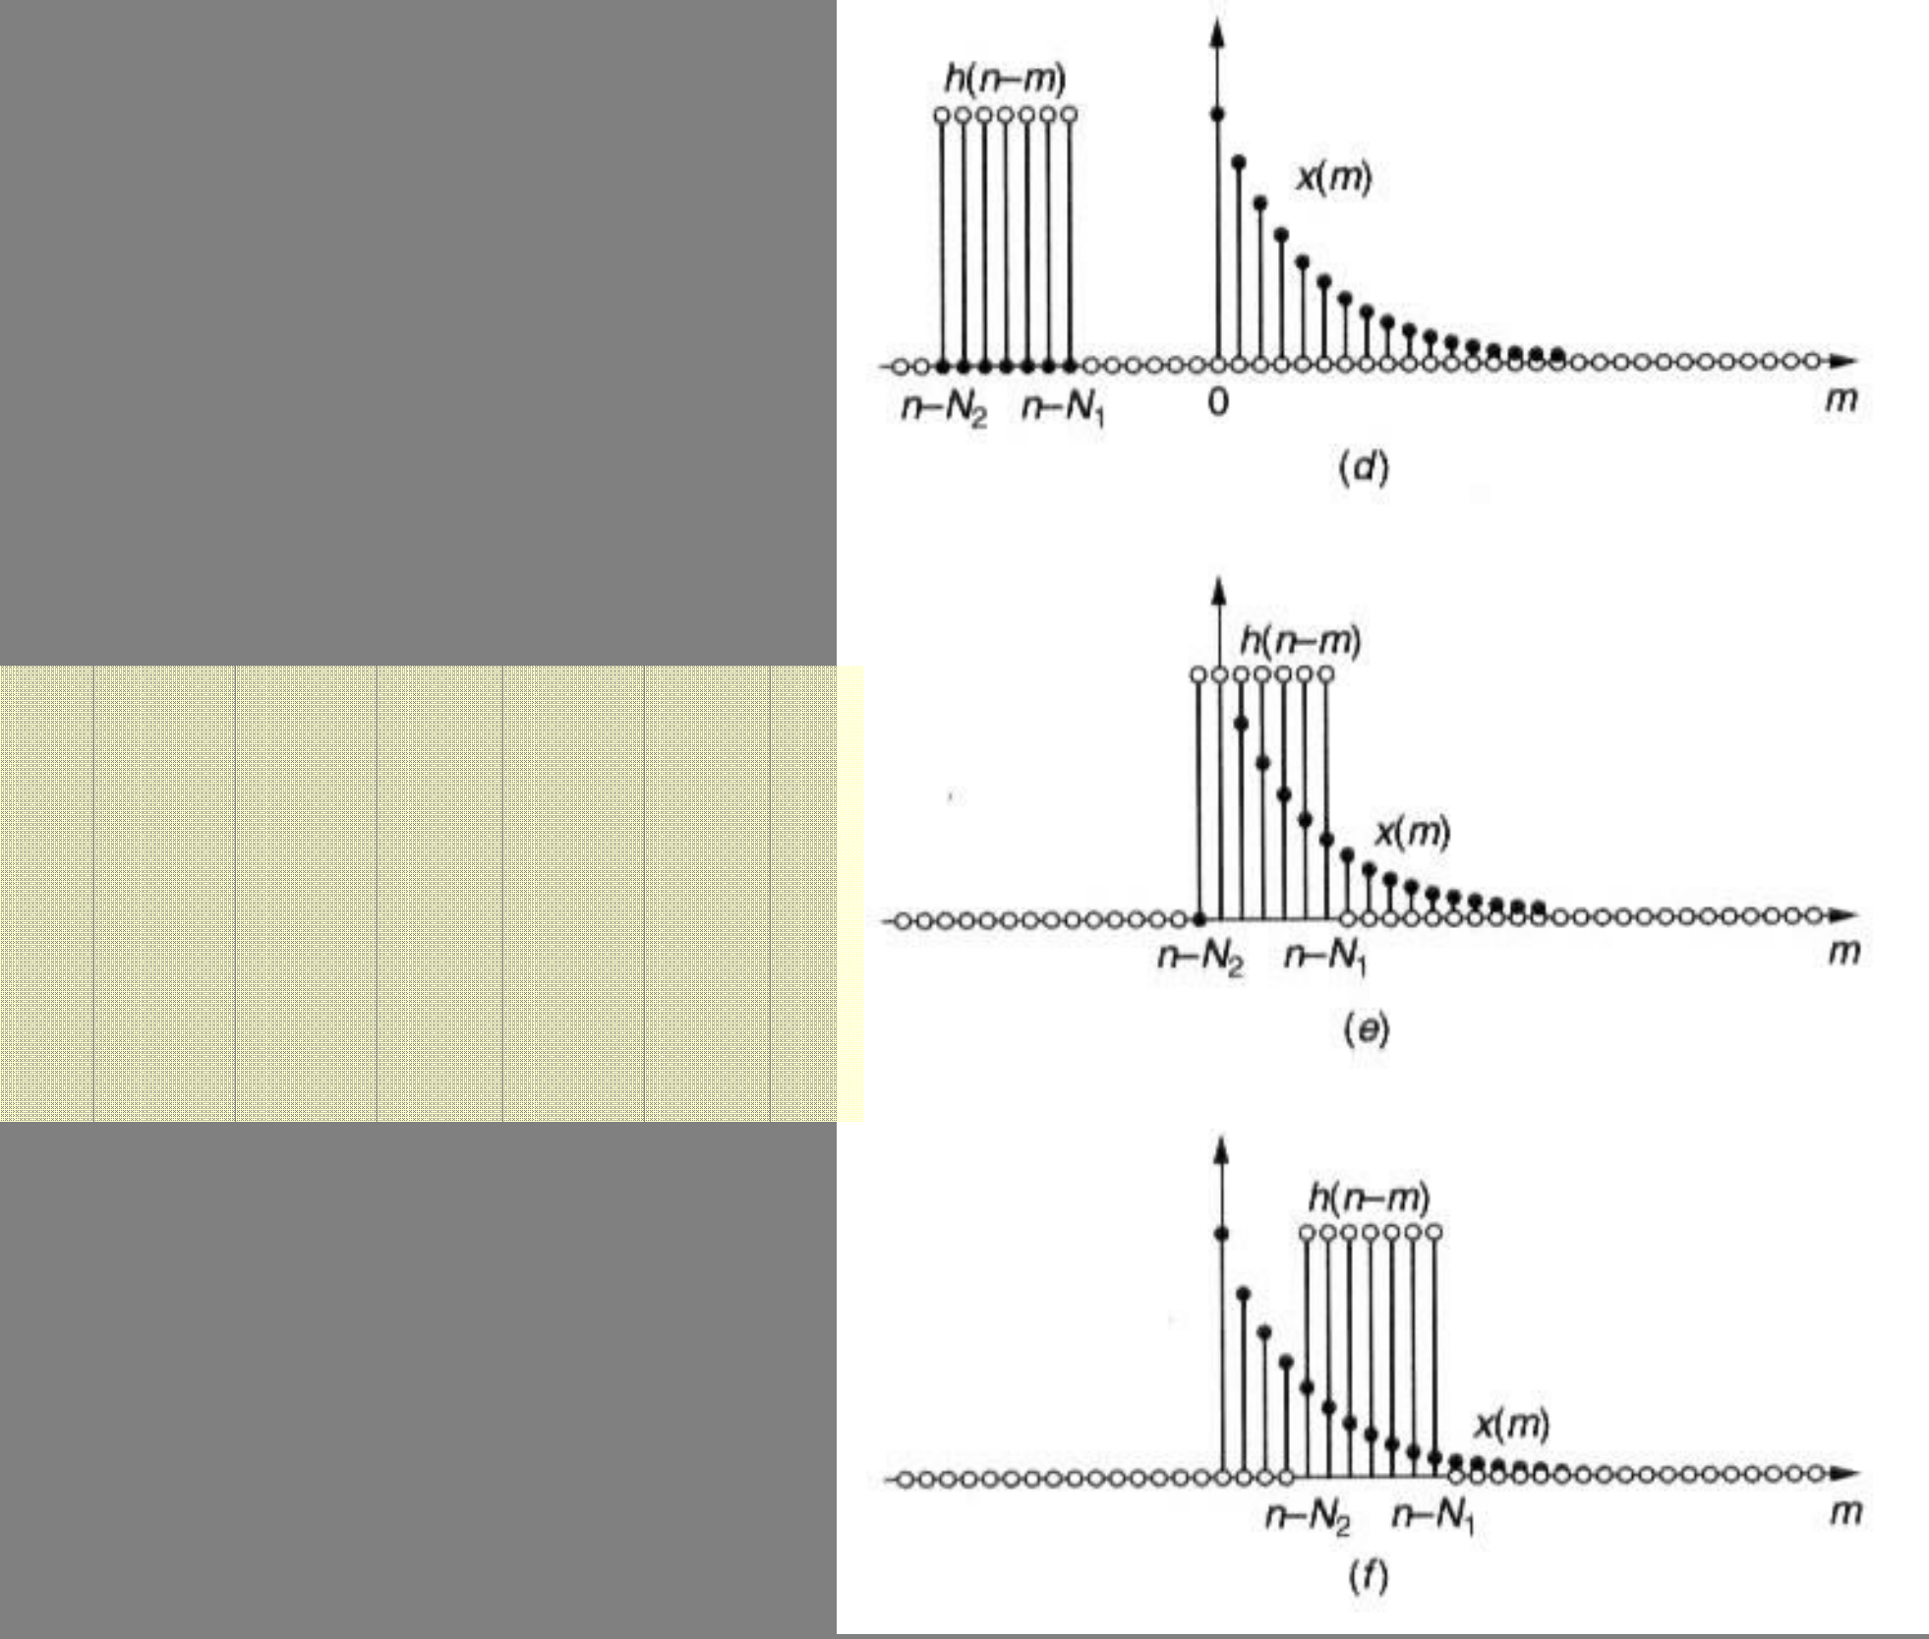

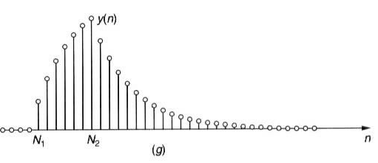
Convolution
Example
x[n] = a ^{n}u[n]
⎧1 N₁ ≤ n ≤ N ₂
⎩0 otherwise
n<N1
h[n] =
⎨
⎧
⎪
y[n] = ⎨ N₁ ≤ n < N ₂
⎪ _{n− N 1 − a} N ₂ − N₁ +1
⎩ 1 − a
N1<n<N2
⎪0
_{⎪1 − a} n− N₁ +1
n < N1
⎪
⎪a
1 − a
2
n ≥ N 2
n>N2

Slide 34
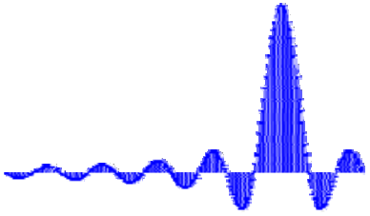
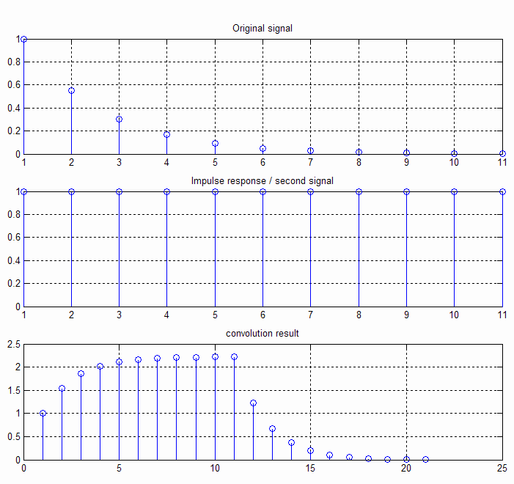
In
Matlab
Â Matlab has the built-in convolution function, conv(.)
Â Be careful, however in setting the time axis
n=-3:7;
x=0.55.^(n+3);
h=[1 1 1 1 1 1 1 1 1 1 1]; y=conv(x,h); subplot(311)
stem(x)
title(‘Original signal’)
subplot(312)
stem(h) % Use stem for discrete sequences title(‘Impulse response / second signal’) subplot(313)
stem(y)
title(‘ convolution result’)
Digital Signal Processing, © 2006 Robi Polikar, Rowan University

Slide 35
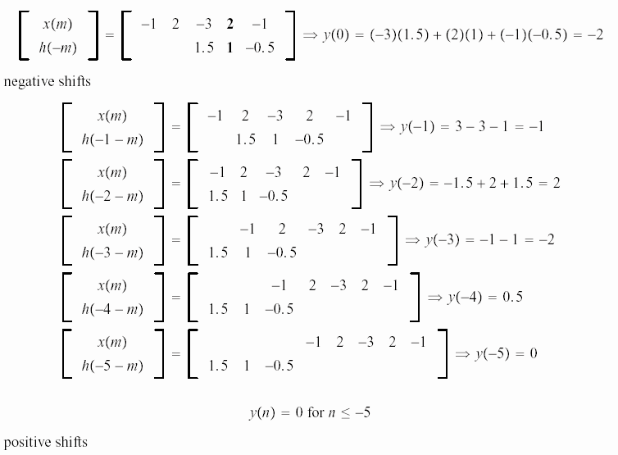
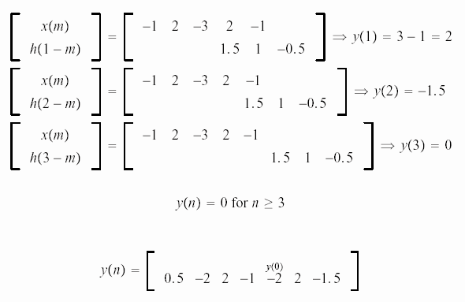
The
Vector Method for Convolution
of for
Finite
Sequences
Â (a) x[n]=[-1 2 -3 2 -1];
h[n]=[-0.5 1 1.5]
Negative shifts of n
Positive shifts of n

