Slide 1

Lecture -4 Z-Transform -I
Dr K. Mohanaprasad
Associate Professor
School of Electronics Engineering (SENSE)
VIT Chennai

Slide 2
Introducing the Z- transform
Why do we need yet another transform?
Z-transform – relation to the DTFT
Some examples and observations
Region of convergence (ROC)
Properties of z-transform
Some common z-transforms
Rational z-transforms
Z-transforms in the system theory
Poles and zeros of a system
Making physical sense of the z-transform
– relation to filtering

Slide 3
Think about all the transforms you have seen so far:
ª The Laplace transform
ª The Fourier series
ª The
ª The
ª The
continuous Fourier transform
discrete time Fourier transform discrete Fourier transform, and FFT
Why need yet another…?
ª Convergence issues with the Fourier transforms
ª The DTFT of a sequence exists if and only if the
sequence x[n] is absolutely
summable, that is, if
∞
n=−∞
∑
x[n]
< ∞
ª DTFT may not exist for many signals of practical or analytical signals, whose
frequency analysis can therefore not be obtained through DTFT

Slide 4
The z-Transform
A generalization of the DTFT leads to the z-transform that may exist
for many signals for which the DTFT does not.
ª DTFT is in fact a special case of the z-transform
Furthermore, the use of the z-transform allows simple algebraic
expressions to be used which greatly simplifies frequency domain analysis.
Digital filters are designed, expressed, applied and represented in terms of the z-transform
For a given sequence x[n], its z-transform X(z) is defined as
where z lies in the complex space, that is, z=a+jb=re^{jω}

Slide 5


Z Vs DTFT
Â From the definition of the z-variable
ª It follows that the DTFT is indeed a special case of the z-transform, specifically, z-
transform reduces to DTFT for the special case of r=1, that is, |z|=1, provided
that the latter exists.
ª The contour |z|=1 is a circle in the z-plane of unit radius Î the unit circle
ª Hence, the DTFT is really the z-transform evaluated on the unit circle
ª Just like the DTFT, z-transform too has its own, albeit less restrictive,
∞
convergence requirements, specifically, the infinite series
∑ x[n] z ^{− n must}
n = −∞
converge.
Â For a given sequence, the set R of values of z for which its z-
transform converges is called the region of convergence (ROC).

Slide 6
Convergence of
the z-transform
Â From our discussion with the DTFT, we know that the infinite series
^{jω} )
∞
e^{− jω n}
X ( z) = X (r e
= ∑ x[n] r ^{− n}
n = −∞
converges if x[n]r^{-n} is absolutely summable, that is, if
∞
n= −∞
∑
x[n] r ^{− n}
< ∞
Â The area where this is satisfied defines the ROC, which in general is
an annular region of the z-plane (since “z” is a complex number,
constant z-values describe
a
circle
in the z-plane)
R ⁻
<
<
R ⁺
where 0 ≤
R ⁻ R ⁺
z
<
≤ ∞

Slide 7
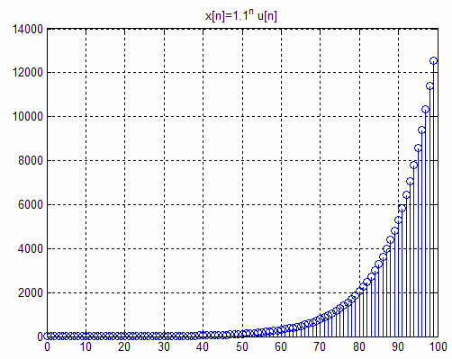
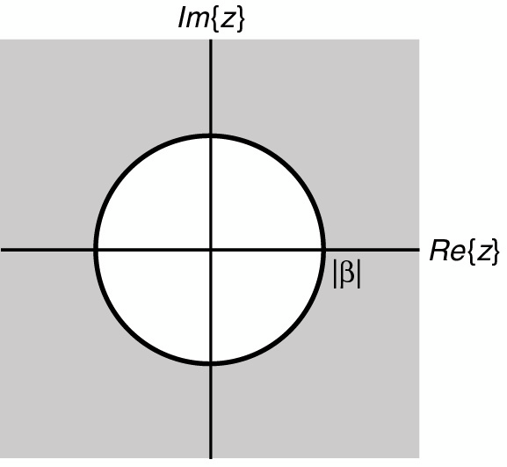
Examples
Â Determine the z-transform and the corresponding ROC of the causal
sequence x[n]=α^{n}u[n]
∞
∞
X ( z) = ∑α ^{n}u[n] z ^{− n} n = −∞
=
_{∑α} n _{z} − n
n =0
This power (geometric) series converges to
X ( z) =
¹ ,
α
z ⁻¹
< 1
for
1 − α
z ⁻¹
Î ROC is the annular region
|z| > |a|
=
^{z} ,
for ∞ >
>
α
z
z − α
•Note that this sequence
does not have a DTFT if
|α|>1, however, it does have a z-transform!
|α|
•This is a right-sided
sequence, which has an ROC that is outside of a circular area!

Slide 8
Examples
Â The z-transform of the unit step sequence u[n] can be obtained from
¹ ,
α
z ⁻¹
X ( z) =
for
< 1
1 − α
z ⁻¹
1
^{z} ,
z ⁻¹
by setting α=1 Î U ( z ) =
=
for
< 1
1 −
z ⁻¹
z − 1
ROC is the annular
regions
|z|>1.
Note
that
this
sequence
also
does
not
have
a
DTFT!

Slide 9
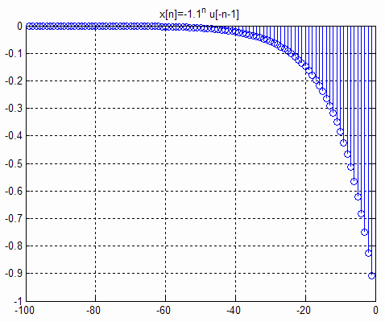
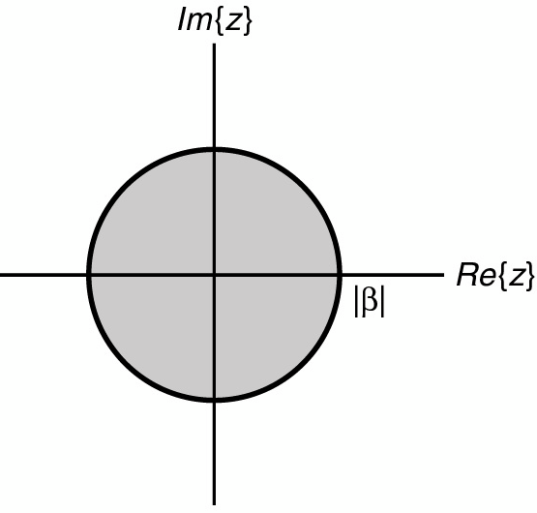
Examples
Â Now consider the anti-causal sequence
y[n] = −α ^{n}u[−n − 1]
−1
∞
Y ( z) =
_{∑ − α} n _{z} − n
n = −∞
= −
_{∑α} − m _{z} m
m =1
∞
−1
= −α ⁻¹z
∑α ^{− m} z ^{m}
− ^{α z}
=
1 − α ⁻¹z
m =0
^{1 z} ,
α ⁻¹z
α
=
=
for
< 1 ⇒
z
<
1 − α
z ⁻¹
z − α
ROC is the annular region
z
<
α
• The z-transforms of the two sequences α^{n}u[n] and
-α^{n}u[-n-1] are identical even though the two parent sequences are different
• Only way a unique sequence can be associated
with a z-transform is by specifying its ROC
• This is a left-sided sequence, which has an ROC
that is inside of a circular area!
|α|

Slide 10
Some Observations
Â
If the two sequences x[n] and y[n] denote the impulse responses of a
system (digital filter), then their z-transforms represent the transfer
functions
of these systems
Â
Both transfer functions have a pole at z=α, which make the transfer
function asymptotically approach to infinity at this value. Therefore,
z=α is not included in either of the ROCs.
Â
The circle with the radius of α is called the pole circle. A system may
have many poles, and hence many pole circles.
For right sided sequences, the ROC extend outside of the outermost
pole circle, whereas for left sided sequences, the ROC is the inside of
the innermost pole circle.
For two-sided sequences, the ROC will be the intersection of the two
ROC areas corresponding to the left and right sides of the sequence.
Â
Â

Slide 11
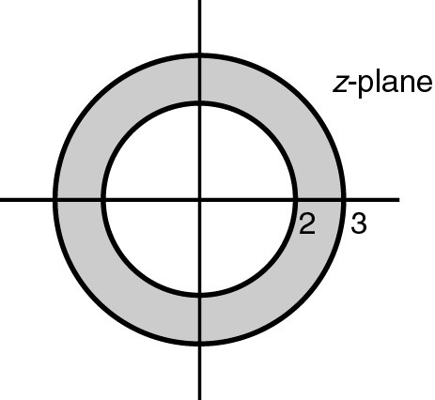
Example
Â Consider x[n]=5^{n}u[n]-8^{n}u[-n-1]
X ( z) =
^{z} + ^{z}
ª
ª
Corresponding ROCs are |z|>5 and |z|<8
Therefore the ROC for this signal is the
annular region 5<|z|<8
z − 5 z − 8
ª
Note that if the signal was x[n]=8^{n}u[n]-5^{n}u[-n-1]
the ROC would be empty! That is, the z-transform
of this sequence does not exist!
5
8
ª
Now recall that DTFT was z-transform evaluated on the unit circle, that is
for z=e^{jω}. Therefore, DTFT of a sequence exists (that is the series
converges), if and only if the ROC includes the unit circle!
ª
The DTFT for the above example clearly does not exist, since the ROC does not
include the unit circle!
Though, we must add that the existence of DTFT is not a guarantee for the
existence of the z-transform.
ª

Slide 12
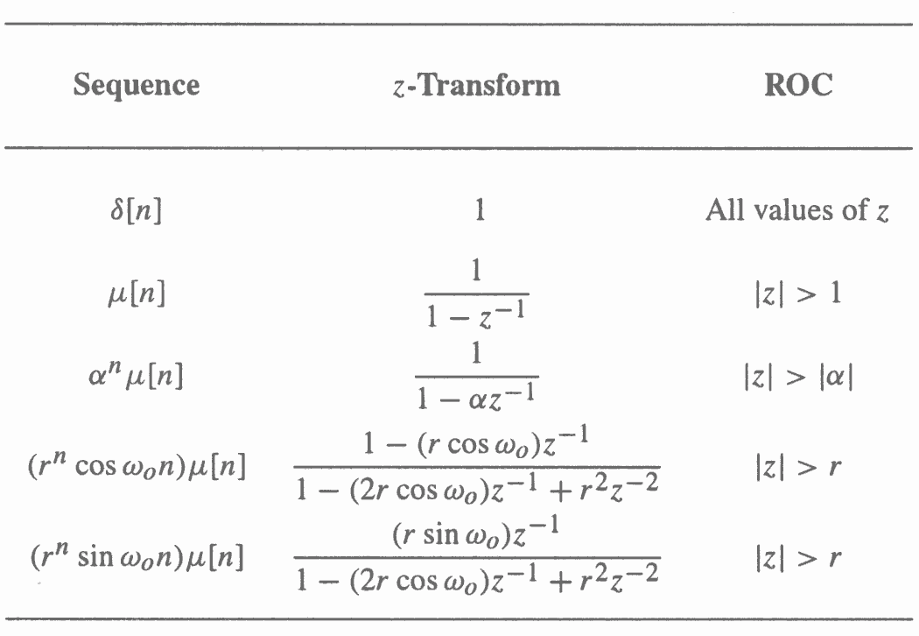
Commonly Used
z-Transform
Pairs
u[n]
u[n]
u[n]
u[n]

Slide 13
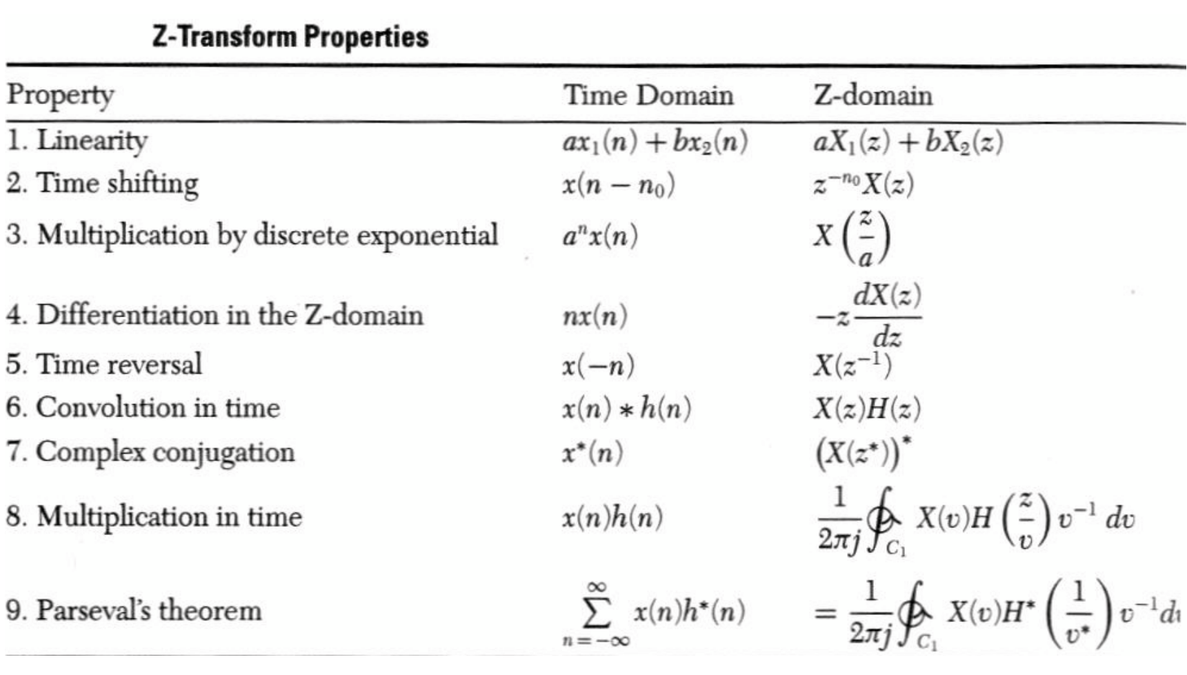
Z-transform Properties
Let x1[n] = X1(z), x2[n] =X2(z), h[n] = H(z) be z-transform pairs, with
individual ROC of Rx1, Rx2, and Rh, respectively. Also assume that any ROC is
of the form rin < |z| <
rout.
Then the following hold:
ROC
R_{x1} ∩ R_{x2}
R_{x}
a ri <
z
<
a ro
Rx
1 ro <
z
< 1 ri
^{R}x₁ ^{∩ R}h
R_{x}

Slide 14
Rational z-Transforms
Â The z-transforms of LTI systems can be expressed as a ratio of two
polynomials in
z⁻¹,
hence they are rational transforms.
ª Starting with the constant
an LTI system:
N
∑ ai y[n − i] =
i =0
coefficient
linear difference equation representation of
M
∑ b _{j} x[n − j], a₀ = 1
j =0
y[n] + a₁ y[n − 1] + a₂ y[n − 2] + La_{N} y[n − N ] = b₀ x[n] + b₁x[n − 1] + L + b_{M} x[n − M ]
Z
Z
Y ( z) + a1z ⁻¹Y ( z) + a2 z ⁻²Y ( z) + LaN z ^{− N} Y ( z) = b0 X ( z) + b1z ⁻¹X ( z) + L + bM
z ^{− M}
X ( z)
−1 −2 − M
H ( z) = ^{Y ( z)} = b0 + b1z + b2 z + L + bM z
^{X ( z)} 1 + a1z + a2 z + L + aN z
MATLAB uses this representation
−1
− 2
− N
for all digital filters / systems /
transfer functions!!!

Slide 15
Rational
Z-Transforms
Â A rational z-transform can be alternately
written in factored form as
Â At a root z=ζ_{ℓ} of the numerator polynomial H(ζ_{ℓ})=0, and as a result, these values of z are known as the zeros of H(z)
Â At a root z=p_{ℓ} of the denominator polynomial H(p_{ℓ})= ∞, and as a result, these values of z are known as the poles of H(z)
ª Note that H(z) has M finite zeros and N finite poles
ª If N > M there are additional N-M zeros at z = 0 (the origin in the z-plane)
ª If N < M there are additional M-N poles at z = 0

Slide 16
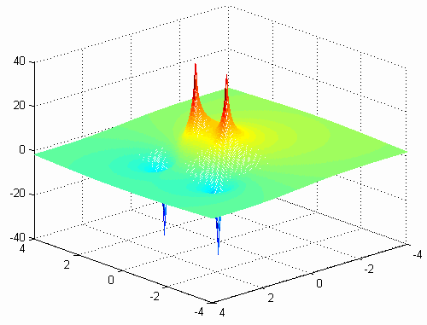
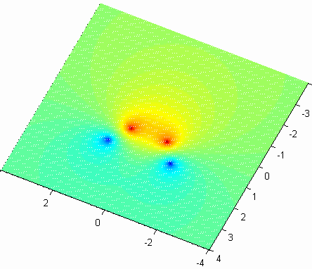
Some sense of Physical
Interpretation
of
this
Math
Crap!
What does this look like???
1 − 2.4 z ⁻¹ + 2.88 z ⁻²
poles
clear
G( z) =
−1
− 2
close all
N=256;
rez=linspace(-4, 4, N);
imz=linspace(-4,4,N);
1 − 0.8 z + 0.64 z
%create a uniform z-plane
for n=1:N
z(n,:)=ones(1,N)*rez(n)+j*ones(1,N).*imz(1:N);
end
%Compute the H function on the z-plane for n=1:N
for m=1:N Hz(n,m)=H_fun(z(n,m));
end end
%Logarithmic mesh plot of the H function
mesh(rez, imz, 20*log10(abs(Hz)))
zeros
=====================================
function Hz=H_fun(z);
%Compute the transfer function
Hz=(1-2.4*z^(-1)+2.88*z^(-2))/(1-0.8*z^(-1)+0.64*z^(-2));

Slide 17
In Matlab
Â Matlab has simple functions to determine and plot the poles and zeros
of a function in the z-plane:
tf2zpk() Discrete-time transfer function to zero-pole conversion.
[Z,P,K] = TF2ZPK(NUM,DEN) finds the zeros, poles, and gain:
(z-Z(1))(z-Z(2))...(z-Z(n))
H(z) = K ---------------------------------- (z-P(1))(z-P(2))...(z-P(n))
from a single-input, single-output transfer function in polynomial form:
NUM(z)
H(z) = ------------ DEN(z)
z =
1.2000 + 1.2000i
1.2000 - 1.2000i
0.4000 + 0.6928i
0.4000 - 0.6928i
b=[1 -2.4 2.88]; a=[1 -0.8 0.64];
[z,p,k] = tf2zpk(b,a)
p =
k=1

Slide 18
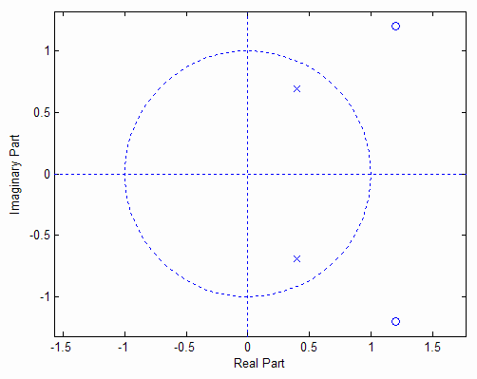
In Matlab
zplane Z-plane zero-pole plot.
zplane(Z,P) plots the zeros Z and poles P (in column vectors) with the unit circle for reference.
Each zero is represented with a 'o' and each pole with a 'x' on the plot. Multiple zeros and poles are indicated by the multiplicity number shown to the upper right of the zero or pole.
ZPLANE(B,A) where B and A are row vectors containing transfer function polynomial coefficients
plots the poles and zeros of B(z)/A(z).
b=[1 -2.4 2.88];
zplane(b,a)
a=[1 -0.8 0.64];

Slide 19
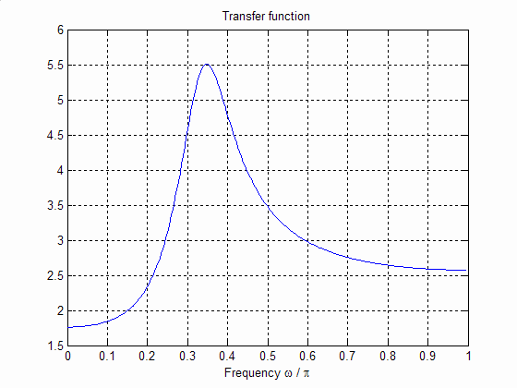
1 − 2.4 z ⁻¹ + 2.88 z ⁻²
G( z) =
−
1
− 2
1 − 0.8 z + 0.64 z
[H w]=freqz([1 -2.4 2.88],[1 -0.8 0.64],256);
figure
plot(w/pi, abs(H))
grid
title('Transfer function')
xlabel('Frequency \omega / \pi')
Created by
a pole
This system has two zeros
at z=1.2 ±j 1.2 and two poles at z=0.4 ± j0.6928
Created by a zero

Slide 20
Poles & ROC
Â The ROC of a rational z-transform cannot contain any poles and is
bounded by the poles
ª For a right sided sequence, the ROC is outside of the largest pole
ª For a left sided sequence, the ROC is inside of the smallest pole
ª For a two sided sequence, some of the poles contribute to terms in the parent
sequence for n<0 and other to terms for n>0. Therefore, the ROC is between the
circular regions: outside of the largest pole coming from the
n>0
sequence and
inside
of
the
smallest
pole coming
from
the
n<0
sequence

Slide 21
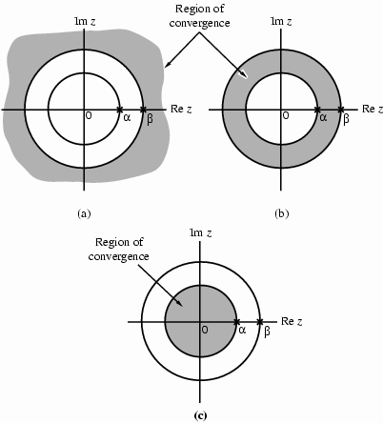
Poles
and
ROC
For a sequence that has two
poles, at z=α and β, the ROC
is one of these three options

