Slide 1

Lecture -5 Z-Transform -II
Dr K. Mohanaprasad
Associate Professor
School of Electronics Engineering (SENSE)
VIT Chennai

Slide 2
Â Matlab has simple functions to determine and plot the poles and zeros
of a function in the z-plane:
tf2zpk() Discrete-time transfer function to zero-pole conversion.
[Z,P,K] = TF2ZPK(NUM,DEN) finds the zeros, poles, and gain:
(z-Z(1))(z-Z(2))...(z-Z(n))
H(z) = K ---------------------------------- (z-P(1))(z-P(2))...(z-P(n))
from a single-input, single-output transfer function in polynomial form:
NUM(z)
H(z) = ------------ DEN(z)
z =
1.2000 + 1.2000i
1.2000 - 1.2000i
0.4000 + 0.6928i
0.4000 - 0.6928i
b=[1 -2.4 2.88]; a=[1 -0.8 0.64];
[z,p,k] = tf2zpk(b,a)
p =
k=1

Slide 3
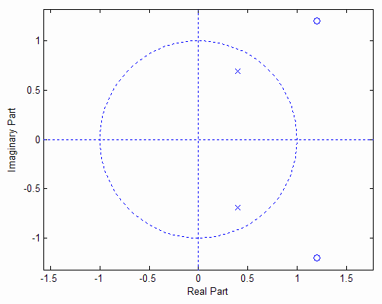
zplane Z-plane zero-pole plot.
zplane(Z,P) plots the zeros Z and poles P (in column vectors) with the unit circle for reference.
Each zero is represented with a 'o' and each pole with a 'x' on the plot. Multiple zeros and poles are indicated by the multiplicity number shown to the upper right of the zero or pole.
ZPLANE(B,A) where B and A are row vectors containing transfer function polynomial coefficients
plots the poles and zeros of B(z)/A(z).
b=[1 -2.4 2.88];
zplane(b,a)
a=[1 -0.8 0.64];

Slide 4
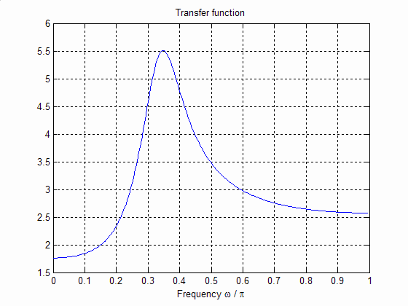
1 − 2.4 z ⁻¹ + 2.88 z ⁻²
G( z) =
−
1
− 2
1 − 0.8 z + 0.64 z
[H w]=freqz([1 -2.4 2.88],[1 -0.8 0.64],256);
figure
plot(w/pi, abs(H))
grid
title('Transfer function')
xlabel('Frequency \omega / \pi')
Created
by
a pole
This system has two zeros
at z=1.2 ±j 1.2 and two poles at z=0.4 ± j0.6928
Created by a zero

Slide 5
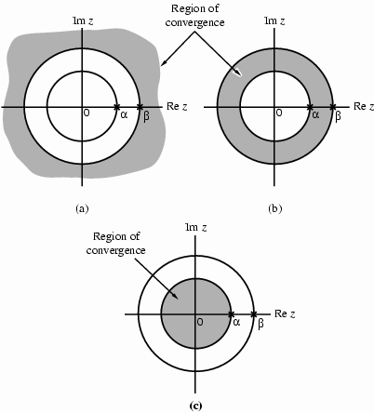
Poles
&
ROC
Â The ROC of a rational z-transform
cannot contain any poles and is bounded by the poles
ª
For a right sided sequence, the ROC is
outside of the largest pole
For a left sided sequence, the ROC is
inside of the smallest pole
For a two sided sequence, some of the
poles contribute to terms in the parent
sequence for n<0 and other to terms
for n>0. Therefore, the ROC is
between the circular regions: outside
of the largest pole coming from the n>0 sequence and inside of the smallest pole coming from the n<0 sequence
ª
ª
For a sequence that has two
poles, at z=α and β, the ROC
is one of these three options

Slide 6
Stability & ROC
In terms of Zeros & Poles
Â Recall that for a system to be causal, its impulse resp
o
must satisfy h[n]=0, n<0,
ided. Based on this, and
n
s
e
that is for a causal system, the impulse r
e
onse is
ol
s
p
r
i
g
h
t
s
our
ª
ª
previous observatio s we can ma
portant
er
nclusions:
ole circle
n
s,
ke
t
h
e
f
l
o
w
i
n
g
i
m
c
o
The ROC of a causal s
The ROC of an anticau
innermost pole circle
The ROC of
pole circles
xten
y
s
t
e
m
e
ds
o
u
t
s
i
d
e
o
f
t
h
e
o
u
t
m
o
s
t
p
s
f the
a
l
s
y
s
t
e
m
(
w
h
o
s
e
h
[
n
]
i
s
p
u
r
e
l
y
l
e
f
t
-
s
i
d
e
d
)
l
i
e
s
i
n
s
i
d
e
o
ª
a
n
o
n
c
a
u
s
a
l
s
y
d by two different
s
t
e
m
(
w
h
o
s
e
h
[
n
]
t
w
o
-
s
i
d
e
d
)
i
s
b
o
u
n
d
e
ª
For a system to be
s
Î An LTI system is
t
a
b
l
e
,
i
t
s
h
[
n
]
m
u
s
t
b
e
a
b
s
o
l
u
t
e
l
y
s
u
m
m
a
b
l
e
stable, if
a
n
d
o
n
l
des the unit circle!
y
i
f
t
h
e
R
O
C
o
f
i
t
s
t
r
a
n
s
f
e
r
f
u
n
c
t
i
o
n
H
(
z
)
i
n
c
l
u
ª
A causal sy
st
is also stable, its
d only if, all
e
m
’
s
R
O
C
l
i
e
s
o
u
t
s
i
d
e
o
f
a
p
o
l
e
c
i
r
c
l
e
.
I
f
t
h
a
t
s
y
s
t
e
m
ROC must inclu
poles are inside
d
Î
l
s stable,
e
u
n
i
t
c
i
r
c
l
e
T
h
e
n
a
c
a
u
s
a
s
y
s
t
e
m
i
i
f
a
n
t
i
ystem is stable, if and only if
h
e
u
n
i
t
c
i
r
c
l
e
!
S
i
m
i
l
a
r
l
y
,
a
n
a
n
t
c
a
u
s
a
l
s
its poles lie
o
u
t
s
i
d
e
t
h
e
u
n
i
t
c
i
r
c
l
e
.
•
An FIR filter is always
s
t
,
h
a
b
l
e
w
y
?

Slide 7
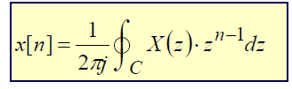
Inverse z-Transform
Â The inverse z-transform can be obtained as a generalization of the
inverse DTFT:
ª
Since the variable z is defined
on the complex (polar) plane, the integral is not a
Cartesian integral, but rather a contour integral, where the contour C is any
circular region that falls into the ROC of X(z).
Complicated procedure, yet several different procedures to compute
ª
1.
Perform a long division for X(z), and invert each (simple) term individually – tedious,
often does not result in a closed form (finds x[n] one by one for each n)
Direct evaluation of the contour integral using the Cauchy Residue theorem – tedious
Partial fraction expansion – most commonly used procedure.
2.
3.

Slide 8
Partial Fraction Expansion
Â Re-express the rational z-transform as a partial fraction expansion of
simpler terms, whose inverse z-transforms are known.
ª Slightly different procedure depending on whether the system has simple
multiple poles
ª A rational H(z) can be expressed as
poles
or
M
−i
−
−
− M
∑_{i =0} ^{b}i ^{z}
Y ( z ) P( z )
b₀ + b₁z ¹ + b₂ z ² + L + b_{M} z
H ( z) =
=
=
1 + a z ⁻¹ + a
z ⁻²
z ^{− N}
=
X ( z ) D( z )
N
−i
1
2
+ L + a
N
∑_{i =0} ªi ^{z}
ª If M ≥ N then H(z) can be re-expressed through long division
2 + 0.8 z ⁻¹ + 0.5 z ⁻² + 0.3 z ⁻³
−1
5.5 + 2.1 z ⁻¹
H ( z) =
H ( z) = −3.5 + 1.5 z +
−1
− 2
−
− 2
1 + 0.8 z ¹ + 0.2 z
1 + 0.8 z + 0.2 z
^{where the degree of P}1^{(z) is less than}
N. The rational fraction
P1( z) / D( z)
is then
called a proper fraction or proper polynomial .

Slide 9
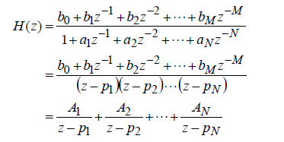
Partial Fraction Expansion
Simple Poles
Â If the system only has simple poles, then it can be written in the
following
form
Â Recall that α^{n}u[n]
↔ z/(z-α), |z|>|α|; and α^{n}u[-n-1]↔ -z/(z-α), |z|<|α|;
ª If we can put a z in the numerator, then we have a series of z/(z-pi^{), whose inverse}
z-transform is the geometric series

Slide 10

Partial Fraction Expansion
Simple
Poles
Â So, we simply compute the partial fraction of H(z)/z,
ª the constants
^{A}i ,
which
are the
residues at
the
poles
of
H(z)/z,
can
be
computed
as
follows:

Slide 11
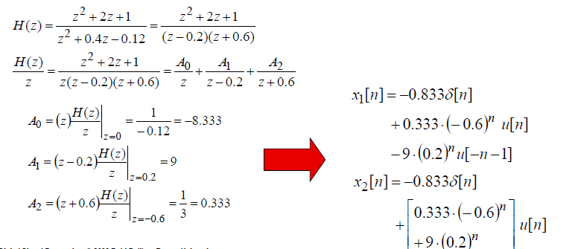
Example
See and Solve Examples on Page***
Â Find the inverse z-transform of H(z) given the ROC i) -0.6<|z|<0.2
z ²
+ 2z + 1
ii) |z|>0.2
H ( z) =
2
z + 0.4z − 0.12

Slide 12
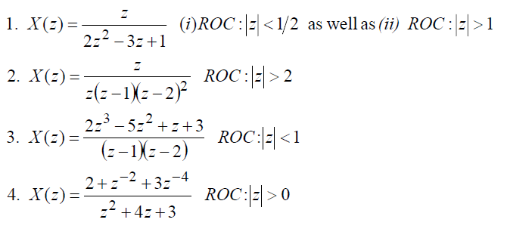
Exercises
Â Solve the following as an exercise – the solutions are given (next
slide)so that you can check your answer:

Slide 13
Answers
1.
2.
3.
4.
(i) x[n] = -u[-n-1]+(0.5)^{n}u[-n-1];
x[n] = (1-2^{n}+n*2^{n-1})u[n]
(ii) x[n]=u[n]-(0.5)^{n}u[n]
x[n] = 2δ[n+1]+1.5δ[n]+u[-n-1]-(0.5)(2)^{n}u[-n-1]
x[n] =
1 [(-1)^{n-1}-(-3)^{n-1}]u[n-1]
+0.5[(-1)^{n-3}-(-3)^{n-3}]u[n-3]
+1.5[(-1)^{n-5}-(-3)^{n-5}]u[n-5]

Slide 14
In Matlab
[r,p,k]= residuez(num,den) develops the partial-fraction expansion of a
rational z-transform with numerator and denominator coefficients given by vectors num and den. Vector r contains the residues, vector p contains the poles, vector k contains the direct term constants (the coefficients of z-terms if the ratio is made proper)
[num,den]=residuez(r,p,k) converts a z-transform expressed in a partial- fraction expansion form to its rational form.
See the matlab help files on residuez and residue for more details!
Â In residuez function, you do not need to divide by “z”! The coefficient normally used for 1/z will be in “k” variable. You can also use the continuous equivalent of this function, residue, for which you do need to divide the original function by “z” before you obtain the coefficients to get the correct results!

