Slide 1
FFT lecture 10

Slide 2



The Fast Fourier Transform (FFT)
➲ By far one of the most influential algorithms ever developed in signal
processing, revolutionalizing the field
➲ FFT: Computationally efficient calculation of the frequency spectrum
 Made many advances in signal processing possible
 Drastically reduces the number of additions and multiplications necessary to
compute the DFT
➲ Many competing algorithms
 Decimation in time FFT
 Decimation in frequency FFT
➲ Makes strategic use of the two
WN = e
− j 2π / N
Recall:
simple complex identities:
N / 2
_{W} N / 4 _{= j}
3N / 4
W ⁰ = 1
π 2π
N N 2
N 2π 2π N 2π 2π
W ^{k + 2} = e^{− j} N ^{k} ⋅ e^{− j} N ⋅ 2 = e^{− j} N ^{k} ⋅ e^{− jπ} = −e^{− j} N ^{k} = −W ^{k}
^{W}N
N
W_{N}
= −1
2
− j
W ²
− j 2
N 2
= e
N
= e
= W
= − j
N
N
N

Slide 3



Computational
Complexity of DFT
➲ Q: How many multiplications and additions are needed to compute DFT?
0
➲ Note that for each “k” we need N complex multiplications, and N-1 complex
additions (W_{N} ) does not depend on x[n], and hence can be precomputed and saved in a table
kn



Each complex multiplication is four real multiplications and two real additions
A complex addition requires two real additions
So for N values of “k”, we need N*N complex multiplications and N*(N-1) complex
additions
• This amounts to N² complex multiplications and N*(N-1)~N² (for large N) complex additions
• N² complex multiplications: 4N² real multiplications and ~2N² real additions
• N² complex additions: 2N² real additions
A grand total of 4N² real multiplications and 4N² real additions:

•
•
•
The computational complexity grows with the square of the signal size.
This computational complexity is referred to as O(N²), also called, order of N²
For , say 1000 point signal: 4,000,000 multiplications and 4,000,000 additions: OUCH!

Slide 4

➲ Assume that the signal is of length N=2^{p}, a power of two. If it is not,
zero-pad the signal with enough number of zeros to ensure power-of-
two length.
➲ N-point DFT can be computed as two N/2 point DFTs, both of which can then be computed as two N/4 point DFTs
 Therefore an N-point DFT can be computed as four N/4 point DFTs.
 Similarly, an N/4 point DFT can be computed as two N/8 point DFTs ➔ the
entire N-point DFT can then be computed as eight N/8 point DFTs
 Continuing in this fashion, an N-point DFT can be computed as N/2 2-point
DFTs
•
•
A two point DFT requires no multiplications (!) and just two additions.
We will see that we will need additional multiplications and additions to combine the 2- point DFTs, however, overall, the total number of operations will be much fewer than that would be required by the regular computation of DFT.

Slide 5




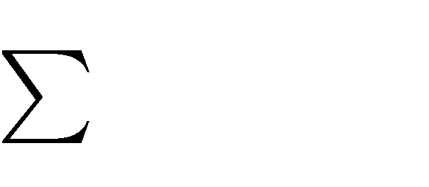
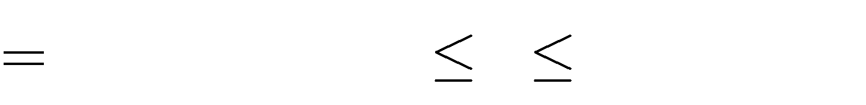
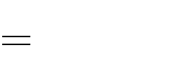
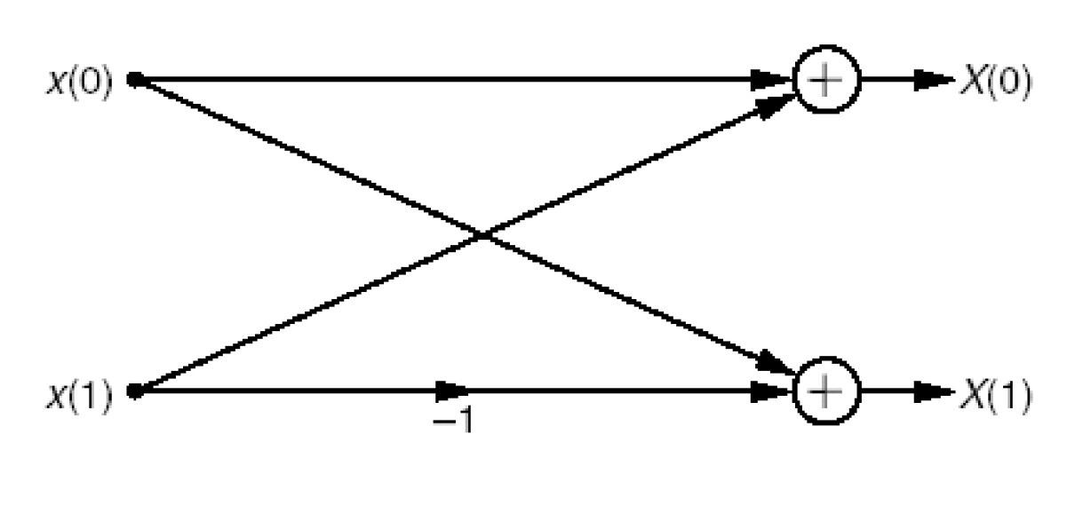
Two-point DFT
➲ How many operations do we need for 2-point DFT?
 X[0]=x[0]+x[1]
 X[1]=x[0]*1+x[1]*e^{-jπ}=x[0]-x[1]
X[ k ] [ ]
1
n
_{x n W} ^{nk} _{, 0 k 1}
N
e^{− j 2π / N}
WN =
0
2-point DFT requires no multiplication, just two
additions
(sign change is very inexpensive – reversal of one or more bits –
and hence does not even go into complexity computations)

Slide 6

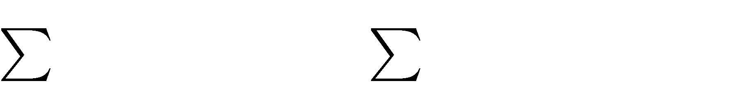
➲ For the first stage, we first “decimate” the time-domain signal into two half: even
indexed samples and odd indexed samples.

Using the first property of complex exponentials:
1 N 2 1
N 2
n
kn k kn
^{x 2n W} N 2 ^{W}N ^{x 2n 1W} N 2
X [ k ]
[
]
[
]
0 n 0
_{P k W} ^{k} _{S k , 0 k} ^{N} ₁
^{N} 2
[
]
[
]
A term needed to
combine the two
N/2 point DFT of odd
samples defined on k=[0, 1, …, (N/2)-1]
N/2 point DFT
of even samples



This configuration allows us
to compute X[k] for k=[0 ~ (N/2)-1]
However, we need all values of P[k] and S[k] for k=[0~N-1]
Since DFT for real sequences is even, P[k] and S[k] are identical in both [0 (N/2)-1] and
[(N/2)
N-1] intervals ➔ P[k]=P[k+N/2], and similarly, S[k]=S[k+N/2]

Slide 7


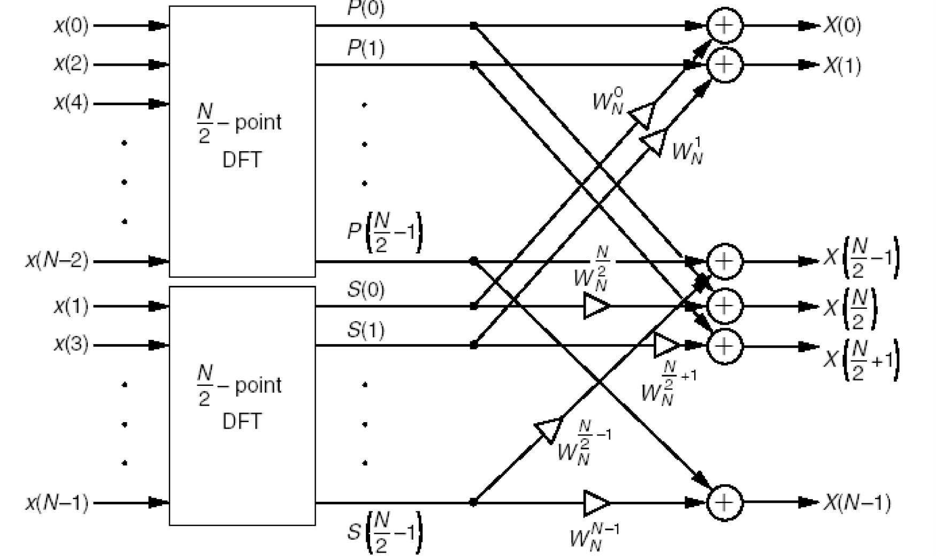


Decimation in Time
Stage
1
➲ Then:
k↔k+N/2
N
2
k + N 2
k N 2
k
◆
X [k ] = P[k ] + W ^{k} S[k ] 0 ≤ k ≤
−1
W_{N}
= W_{N} ⋅W_{N} = −W_{N}
N
❖ ^{X [k + N ] = P[k +}
^{N} ] + W ^{k + N}
^{N} ]
2
_{⇒ X [k +} ^{N} _{] = P[k ] + W} ^{k + N 2} _{S[k ] 0 ≤ k ≤} ^{N} ₋₁
2 ^{N} 2
² S[k +
2
2
N
◆
k=0~(N/2)-1
Even indexed
inputs
❖
k=(N/2)~N-1
Odd indexed
inputs

Slide 8

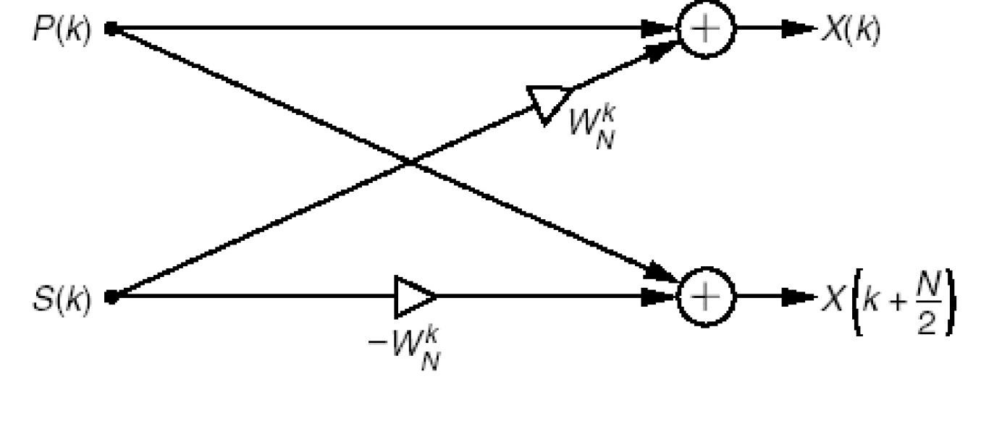
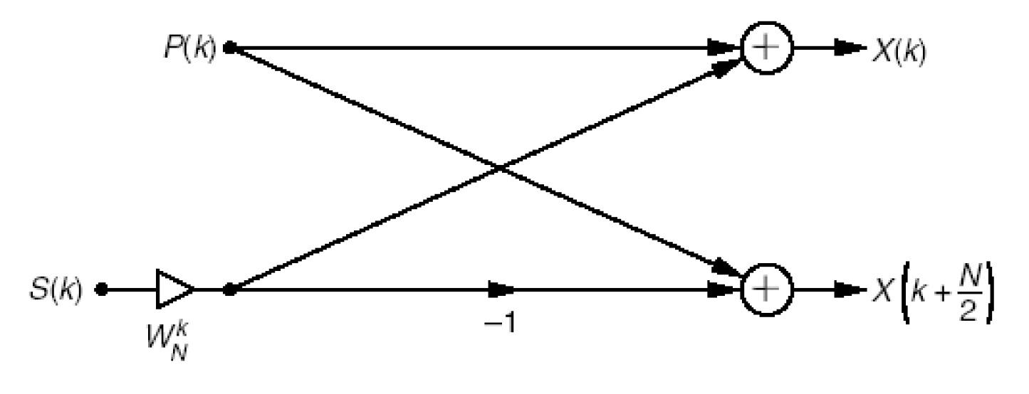
The Butterfly
Process
➲
The basic building block in
this implementation can be represented by the butterfly process.
 Two multiplications & two additions
But we can do even better, just by moving the multiplier before the node S[k]
 Reduced butterfly
 1 multiplication and two additions !
We need N/2 reduced
butterflies in stage 1 to
connect the even and odd
N/2 point DFTs
 A total of (N/2)
multiplications and
2*(N/2)=N additions
P[k]: Even indexed samples
➲
S[k]: Odd indexed
samples
➲

Slide 9

Stage
1
FFT
(N/2)² multiplications+
(N/2)² additions
_{k}
^{W}N
^{x}even^{[n]}
(N/2)-point
DFT
P[k ]
x[n]
2
+
X [k ]
−1
_{z}-1
k
^{W}N
^{x}odd ^{[n]}
(N/2)-point
DFT
k
N
2
WN
+
X [k +
]
S[k ]
2
(N/2)² multiplications+
(N/2)² additions
The butterfly
(N/2) mult. & N additions

Slide 10

Stage
2…&
3…&4…
➲ But wait…!
➲ We can continue the same process as long as we have
samples to split in half:






Each N/2-point DFT can be computed as two N/4-point DFT + a reduced butterfly
Each N/4-point DFT can be computed as two N/8-point DFT + a reduced butterfly.
…
…
…
2 2-point DFT (which requires no multiplications)+ a reduced butterfly
p-1 stages,
p=log₂N

Slide 11



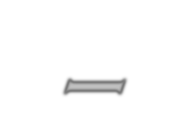

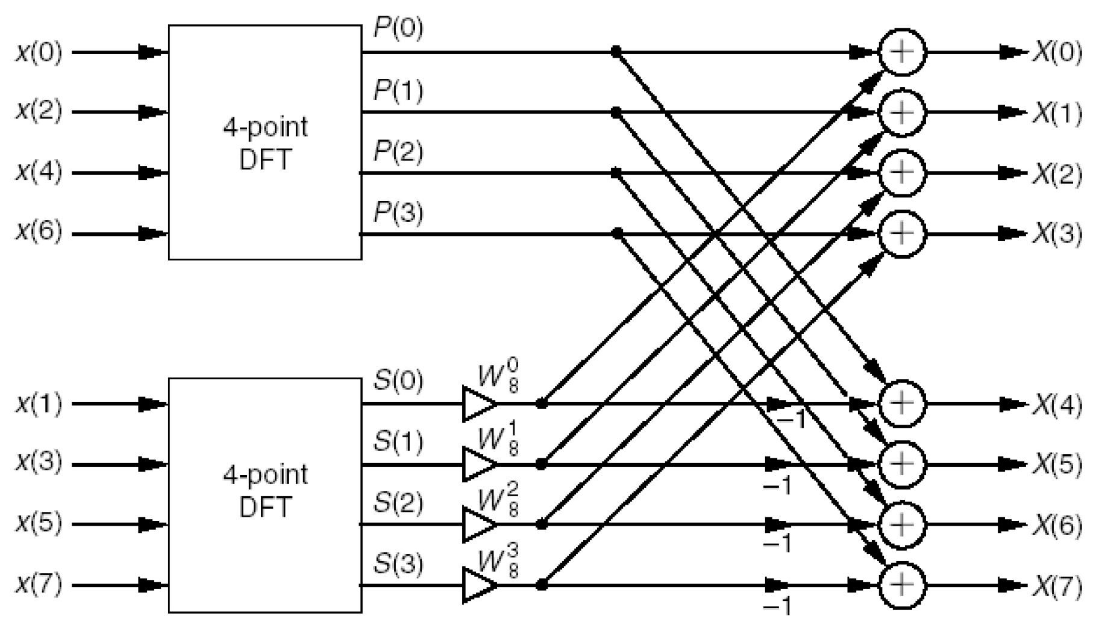
8-point FFT – Stage 1
…and what is in these?
What we need to combine two 4point DFTs

Slide 12



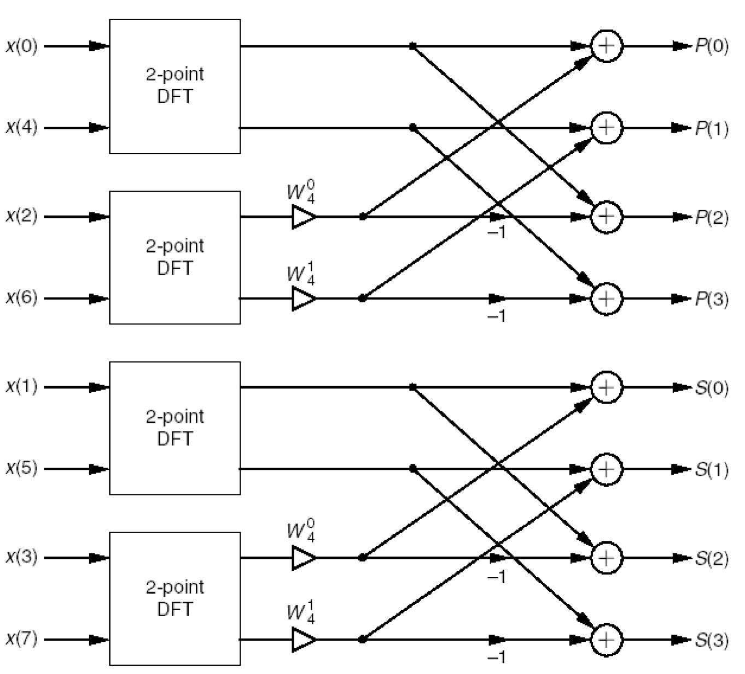
8-Point
FFT
–
Stage
2
4 point DFT combiner
X[0]
X[1] X[2] X[3] X[4] X[5] X[6] X[7]
X[0]
X[1] X[2] X[3] X[4] X[5] X[6] X[7]
X[0]
X[2] X[4] X[6] X[1] X[3] X[5] X[7]
4-p
oint DFT
X[0]
X[2] X[4] X[6] X[1] X[3] X[5] X[7]
X[0]
X[4] X[2] X[6] X[1] X[5] X[3] X[7]
4-p
oint DFT

Slide 13

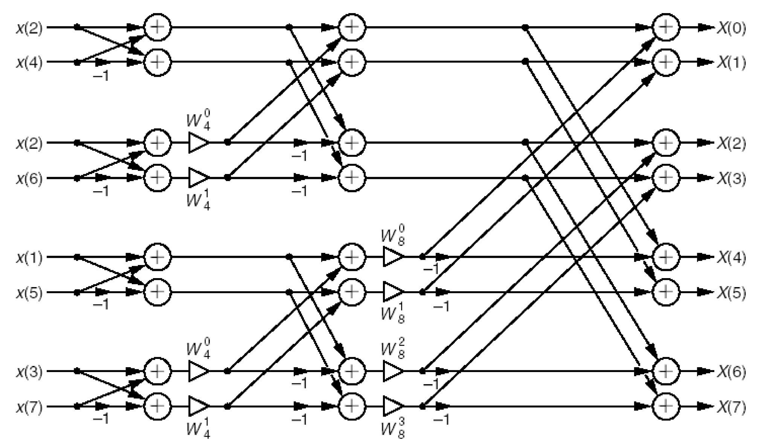

8-Point
FFT
–
Stage
3
4-point DFT
4-point DFT
8-point DFT
x(0)
2-point DFTs
Note that further reductions can be obtained by avoiding the following multiplications
^{W}N
N / 2
= −1
^{W}N
N / 4
= j
^{W}N
3N / 4
= − j
W ⁰
= 1
N
Digital Signal Processing, © 2011 Robi Polikar, Rowan University

Slide 14

So
How
did
we
do?
In log2N stages, total # of calculations:
(N/2)*(log2N-1)~(N/2)*log2N multiplications
Nlog2N additions
As opposed to
N²
multiplications and
N²
additions
➔FFT: 5,120 multiplications and additions
For N=4096 ➔DFT:16,777,216 multiplications and additions
Is that good…?

Slide 15

➲ Just like we started with time-domain samples and decimated them in
half, we can do the same thing with frequency samples:
 Compute the even indexed spectral samples k=0, 2, 4,…, 2N-1 and odd indexed
spectral components k=1, 3, 5, …, 2N-2 separately.
 Then further divide each by half to compute X[k] for 0, 4, 8,… and 2, 6, 10, … as
well as 1, 5, 9, … and 3, 7, 11 …separately
 Continuing in this manner, we can reduce the entire process to a series of 2-point
DFTs.

Slide 16




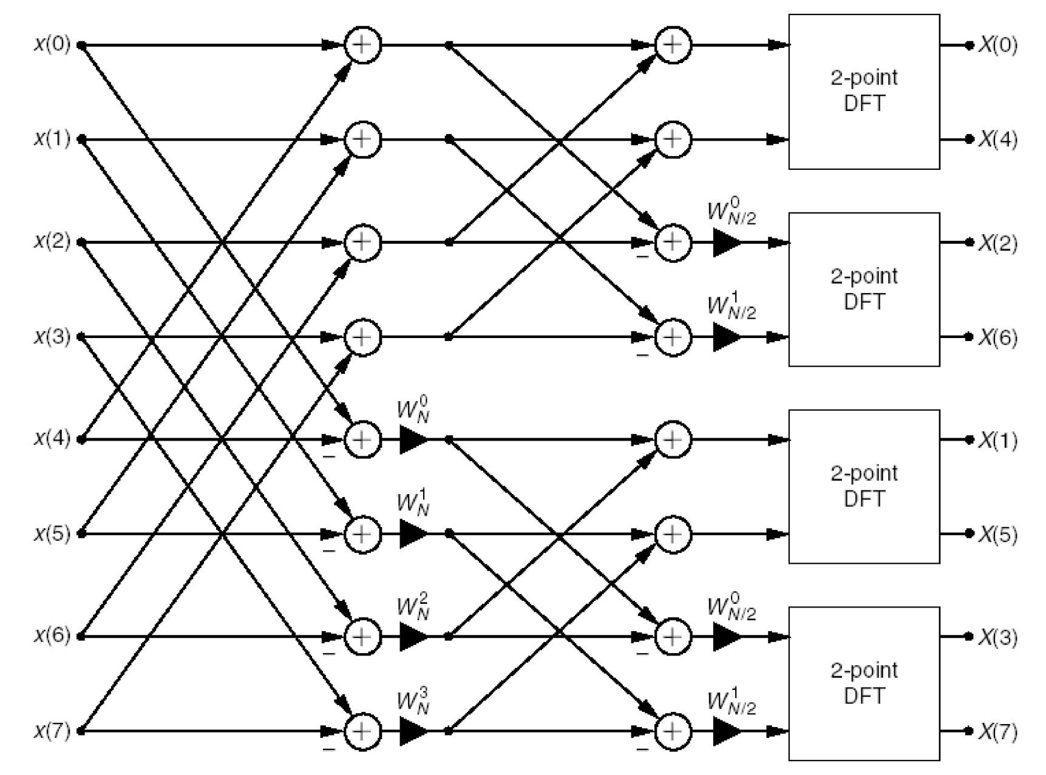

Slide 17

➲
In most real-world applications, the filter length is actually rather
small (typically, N<100); however, the input signal is obtained as a
streaming data, and therefore can be very long.
To calculate the output of the filter, we can
a) Wait until we receive all the data, and then do a full linear convolution of length
N filter and length M x[n], where M>>>>N ➔ y[n]=x[n]*h[n]
b) We can use the DFT based method ➔ y[n]=IDFT(X[k].H[k]), but we still
need to wait for the entire data to arrive to calculate X[k]
In either case, the calculation is very long, expensive, and need to
wait for the entire data to arrive.
Can we just process the data in batches, say 1000 samples at a time,
and then concatenate the results…?
➲
➲
➲

Slide 18

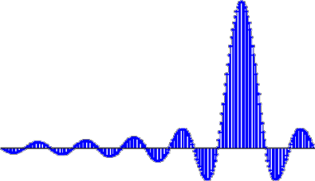

What
Happened…?
➲ An example:
 h[n]=[1 2 3 2 1]; (a short filter)
 x[n]=[1 2 3 4 5 -1 -2 4 5 6 4
h=[1 2 3 2 1]; % Some short filter N=5;
-2 -3 4 3 2 5 6 4 -1 -4 2 4 5 -1 2 3 4 -2 2 3 4 5 6 -2 1 2 3 1 -1 ]
Short, length 5 filter h[n]
x=[1 2 3 4 5 -1 -2 4 5 6 4 -2 -3 4 3 2 5 6 4 -1 -4 ...
2 4 5 -1 2 3 4 -2 2 3 4 5 6 -2 1 2 3 1 -1]; % M=40 y=conv(x, h); % regular convolution Length N+M-1
%Let's divide the long x[n] into smaller segments and
4
2
0
calculate the convolution of each segment
x1=x(1:5); y1=conv(x1, h);
x2=x(6:10); y2=conv(x2, h);
1
1.5
2
2.5
3
3.5
4
4.5
5
Long, length 40 signal
10
0
-10
x3=x(11:15);
x4=x(20:25); x5=x(21:30); x6=x(31:35); x7=x(36:40);
y3=conv(x3, h);
y4=conv(x4, h); y5=conv(x5, h); y6=conv(x6, h); y7=conv(x7, h);
0
5
10
15
20
25
30
35
40
Filtered signal obtained in one convolution, length=40+5-1=44
% Now add those segments together
y_batch=[y1 y2 y3 y4 y5 y6 y7];
%and compare to the original convolution subplot(411); stem(h, 'filled'); grid title('Short, length 5 filter h[n]') subplot(412); stem(x, 'filled'); grid title('Long, length 40 signal')
subplot(413); stem(y, 'filled'); grid title(‘Single convolution, length=40+5-1=44') subplot(414); stem(y_batch, 'filled'); grid
50
0
-50
0
5
10
15
20
25
30
35
40
45
Filtered signal obtained as concatenation of individual segments, length=...?
50
0
-50
0
10
20
30
40
50
60
70
title(‘Concatenation of individual segments, length=...?')

Slide 19



Overlap Add
➲ The border effect! Processing individual segments separately and then combining
them is possible, however, the border distortion needs to be addressed

Overlapp add is a method that allows us to compute the individual segments and then
concatenate them in such a way that the concatenated signal is the same as the one that
would be obtained if we processed the entire data at once.
x _{M}
*
h _{N}
=
y _{M+N-1}
x₁
x₂
x₃
x₄
x₅
x₆
x₇
x_{1M}
*
h _{N}
=
y_{1 K}
1
y₁
K
M = 7M
1
y₂
K
K=M +N-1
y₃
K
1
y₄
K
y₅
K
6M1+K=
=6M +M +N-1
y_{6 K}
1 1
=7M1+N-1
=M+N-1
y_{7 K}
M
2M₁
3M₁
y
5M₁
6M₁ 6M₁+K
1

Slide 20


Example
(Cont.)
nts
at
➲ So, here are the
OVERLAPP ADD
40
20
individual segm
ordered in an
e ₀
50
0
5
10
15
20
25
30
35
40
45
overlap-add form
0
-50
0
5
10
15
20
25
30
35
40
45
20
10
M=length(x); %Length of the original signal
M1=length(x1); % Length of each batch
0
20 25 30 35 40 45
50
0
5
10
15
N=length(h); %Length of the filter
K=length(y1); %Length of each filtered batch
L=M+N-1; %Length of the desired convolution
0
-50
0
5
10
15
20
25 30 35 40 45
O=K-M1; % Amount of overlap
50
Y1=[zeros(1, 0*M1) y1 zeros(1, L-(1*M1)-O)];
Y2=[zeros(1, 1*M1) y2 zeros(1, L-(2*M1)-O)]; Y3=[zeros(1, 2*M1) y3 zeros(1, L-(3*M1)-O)]; Y4=[zeros(1, 3*M1) y4 zeros(1, L-(4*M1)-O)]; Y5=[zeros(1, 4*M1) y5 zeros(1, L-(5*M1)-O)]; Y6=[zeros(1, 5*M1) y6 zeros(1, L-(6*M1)-O)]; Y7=[zeros(1, 6*M1) y7 zeros(1, L-(7*M1)-O)]; Y8=[zeros(1, 7*M1) y8 zeros(1, L-(8*M1)-O)];
0
-50
0
5
10
15
20
25
30 35 40 45
20
10
0
0
5
10
15
20
25
30
35 40 45
50
0
Y=Y1+Y2+Y3+Y4+Y5+Y6+Y7+Y8;
-50
0
5
10
15
20
25
30
35
40 45
20
0
-20
0
5
10
15
20
25
30
35
40
45

Slide 21
Example
(Cont.)
Individual filtering - Incorrect convolution
50
0
-50
0
10
20
30
40
50
60
70
80
Original correct filtering
50
0
-50
0
5
10
15
20
25
30
35
40
45
Filtering obtained by overlap add
50
0
-50
0
5
10
15
20
25
30
35
40
45

Slide 22

Exercise
➲ Something to ponder about:
 Considering that DFT and IDFT equations are so similar to each other, one may
wonder whether IDFT can be calculated by using the DFT formulation itself. The
answer is a not-so-surprising, YES!
 The original signal x[n] can be reconstructed from its DFT coefficients X[k],
simply by taking the DFT of X[k] again(!), with some minor modifications.
 Find out how this can be done. This will be a bonus question in the future.

