Slide 1

_{Lecture 6}
Representation of Signals in Frequency Domain
Dr K. Mohanaprasad
Associate Professor
School of Electronics Engineering (SENSE)
VIT Chennai

Slide 2
The Frequency Domain
Â Time domain operation are often not very informative and/or efficient
in signal processing
Â An alternative representation and characterization of signals and systems can be made in transform domain
ª Much more can be said, much more information can be extracted from a signal
the transform / frequency domain.
ª Many operations that are complicated in time domain become rather simple algebraic expressions in transform domain.
ª Most signal processing algorithms and operations become more intuitive in frequency domain, once the basic concepts of the frequency domain are
understood.

Slide 3
Frequency
Domain
t=-1:0.001:1;
x=sin(2*pi*50*t); subplot(211) plot(t(1001:1200),x(1:200)) grid
title('Sin(2\pi50t)') xlabel('Time, s') subplot(212) X=abs(fft(x)); X2=fftshift(X);
f=-499.9:1000/2001:500;
plot(f,X2);
grid
Sin(2π50t)
1
0.5
0
-0.5
-1
0
0.02
0.04
0.06
0.08 0.1 0.12
Time, s
0.14
0.16
0.18
0.2
title(' Frequency domain representation of …
Sin(2\pi50t)')
Frequency domain representation of Sin(2π50t)
xlabel('Frequency, Hz.')
1000
500
0
-500
-400
-300
-200
-100
0
100
200
300
400
500
Frequency, Hz.

Slide 4
Frequency
Domain
t=-1:0.001:1;
x=sin(2*pi*50*t)+sin(2*pi*75*t); subplot(211) plot(t(1001:1200),x(1:200))
grid title('Sin(2\pi50t)+Sin(2\pi75t)') xlabel('Time, s')
subplot(212)
X=abs(fft(x)); X2=fftshift(X);
f=-499.9:1000/2001:500;
plot(f,X2);
grid
Sin(2π50t)+Sin(2π75t)
2
1
0
-1
-2
0
0.02
0.04 0.06
0.08 0.1
Time, s
0.12
0.14
0.16
0.18
0.2
title(' Frequency domain representation of
Frequency domain representation of Sin(2π50t)+Sin(2π75t)
Sin(2\pi50t)+Sin(2\pi75t)')
xlabel('Frequency, Hz.')
1000
500
0
-500
-400
-300
-200
-100
0
100
200
300
400
500
Frequency, Hz.

Slide 5
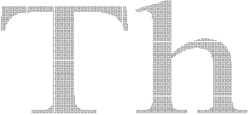

































The
Fourier
Transform
Spectrum: A compact representation of the frequency content of a signal
that is composed of sinusoids

Slide 6
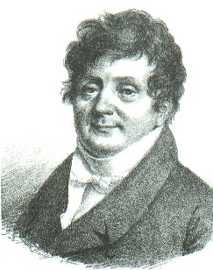
Fourier
“An arbitrary function, continuous or with
discontinuities, defined in a finite interval by an arbitrarily capricious graph can always be expressed as a sum of sinusoids”
J.B.J. Fourier
December 21, 1807
Jean B. Joseph Fourier
(1768-1830)
N −1
^{2π} i =0
F[k ] = f (t )e⁻
^{j 2πkt / N} dt
1
∑
F[k ]e ^{j 2πkt / N}
∫
f (t ) =

Slide 7
Fourier Transforms
Fourier Series (FS)
ª Fourier’s original work: A periodic function can be represented as a finite, weighted sum of
sinusoids that are integer multiples of the fundamental frequency Ω₀ of the signal. Î These
frequencies are said to be harmonically related, or simply harmonics.
(Continuous) Fourier Transform (FT)
ª Extension of Fourier series to non-periodic functions: Any continuous aperiodic function can be represented as an infinite sum (integral) of sinusoids. The sinusoids are no longer integer multiples of a specific frequency anymore.
Discrete Time Fourier Transform (DTFT)
ª Extension of FT to discrete sequences. Any discrete function can also be represented as an infinite sum (integral) of sinusoids.
Discrete Fourier Transform (DFT)
ª Because DTFT is defined as an infinite sum, the frequency representation is not discrete (but continuous). An extension to DTFT is DFT, where the frequency variable is also discretized.
Fast Fourier Transform (FFT)
ª Mathematically identical to DFT, however a significantly more efficient implementation.
FFT is what signal processing made possible today!

Slide 8
Dirichlet Conditions
(1829)
Before we dive into Fourier transforms, it is important to understand
for which type of functions, Fourier transform can be calculated.
Dirichlet put the final period to the discussion on the feasibility of Fourier transform by proving the necessary conditions for the existence of Fourier representations of signals
ª The
ª The
ª The
signal must have finite number of discontinuities
signal must have finite number of extremum points within
its period
signal must be absolutely integrable within its
period
t0 +T
∫
^{t}0
x(t )
dt < ∞

Slide 9
Fourier Series
Â This is the synthesis equation: x(t) is synthesized from its building
blocks, the complex exponentials at integer multiples of Ω₀
∞
k =−∞
x(t ) =
∑
c_{k} e
jkΩ t
0
^{K Ω}0: “kth” integer multiple – kth harmonic of the fundamental frequency Ω0
^{c}k: Fourier coefficients – how much of
k^{th}
harmonic exists in the signal
^{|c}k|: Magnitude of the kth harmonic Î magnitude spectrum of x(t)
< c_{k}: Phase of the k^{th} harmonic Î phase spectrum of x(t)
Spectrum
of
x(t)
Â How to compute the Fourier coefficients, ck?

Slide 10
Fourier Series
Â The coefficients ck can be obtained through the analysis equation.
t₀ +T₀
0 t₀
1
− jkΩ0t
ck =
∫
x(
t )e
dt
T
Â Note that, while x(t) is a sum,
complex values.
ck are obtained through an integral of
Â More importantly, if x(t) is real, then the coefficients satisfy c_{-k}=c*_{k},
that is |c_{-k}|=|c_{k}|

Slide 11
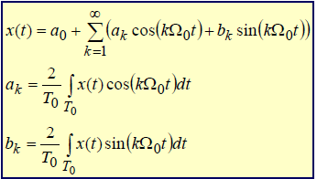
Trigonometric Fourier Series
Â Using the Euler’s rule, we can represent the complex Fourier series in
two
trigonometric forms:
Â As you might have already guessed the trigonometric Fourier
coefficients, ak and bk, are not independent
of the complex Fourier
coefficients
a0 = 2c0 ak = ck + c− k bk = j(ck − c− k )
_{c =} a − jb _{c =} a + jb
k
k
k
,
− k
k
k
2
2

Slide 12
Example
x (t ) = cos ( 4π t ) + 2 cos (16π t )
Original Signal
5
t=0:0.001:0.5;
x=cos(2*pi*2*t)+2*cos(2*pi*8*t);
w0=2*pi*2; K=5;
[X x_recon]=fourier_series(x,K,t,w0);
0
-5
0
0.05
0.1
0.15
0.2
0.25
0.3
0.35
0.4
0.45
0.5
Fourier Series Magnitude Coefficients
4
2
0
-5
-4
-3
-2
-1
0
1
2
3
4
5
Reconstructed Signal
10
0
p.s. fourier_series() is not
a standard Matlab function
-10
0
0.05
0.1
0.15
0.2
0.25
0.3
0.35
0.4
0.45
0.5

Slide 13
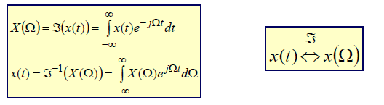
The Fourier Transform
Â Fourier series are defined only on periodic signals. Non-periodic
continuous time signals can also be represented as a sum of weighted complex exponentials; however
ª The complex exponentials are no longer discrete and integer multiples of a
fundamental frequency.
ª Unlike the FS, where we represented the signal with a finite sum of harmonics, for
non-periodic signals, we need a sum (integration) of continuum of frequencies.
ª The continuous Fourier transform (FT), can be obtained from the FS
representation of a signal, by assuming that
an infinite period. This results:
the
non-periodic signal is periodic with

Slide 14
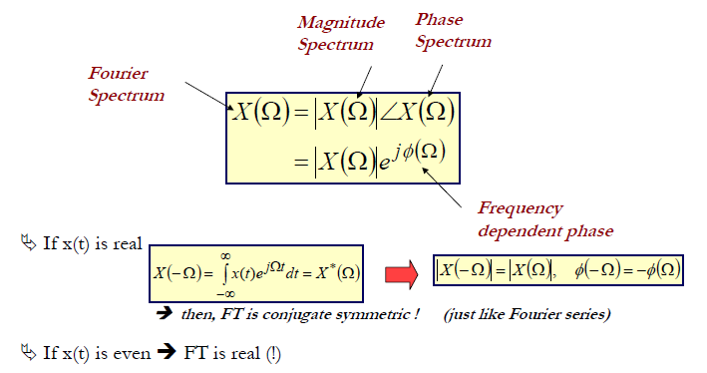
Fourier
Transform
Â The FT, X(Ω) is a complex transform

Slide 15
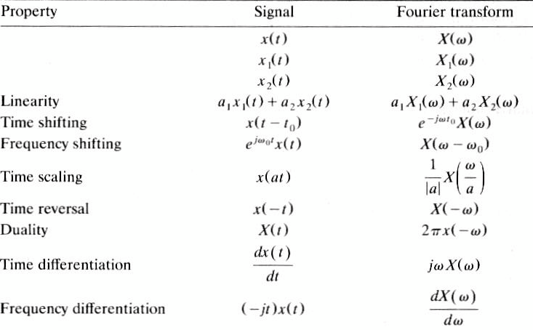
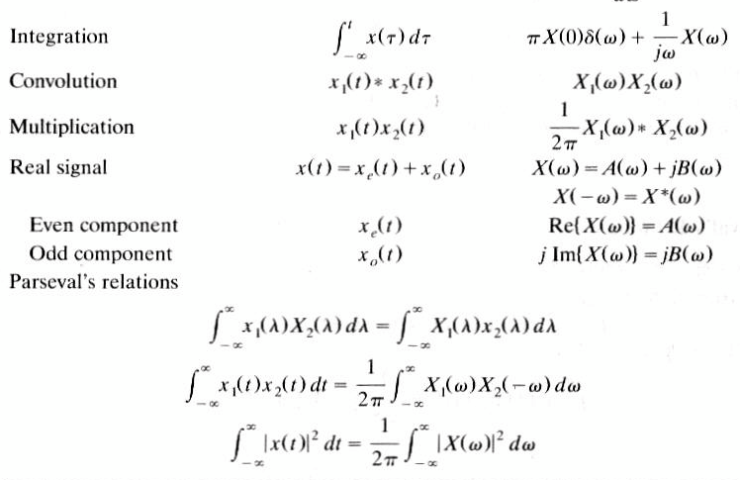
Fourier
Transform
Property
Signal
Fourier Transform
The table is from Signals and Systems, H.P. Hsu
(Schaum’s series), which uses ω for continuous frequencies. Replace all ω with Ω to be consistent with our, and the textbook notation.

Slide 16
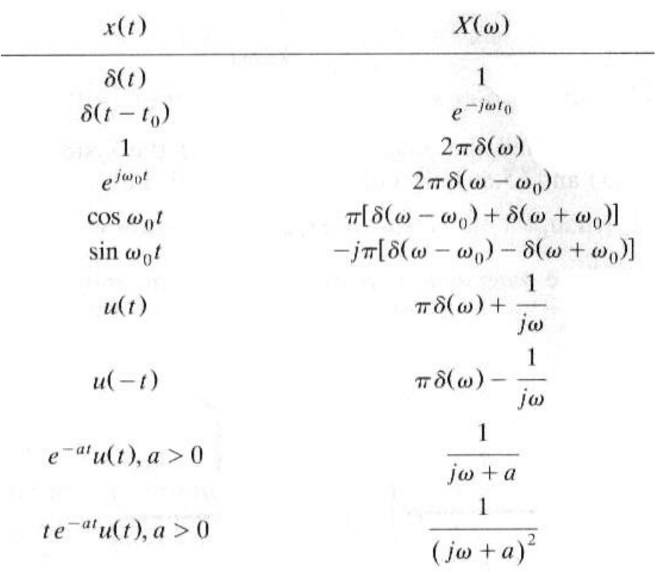
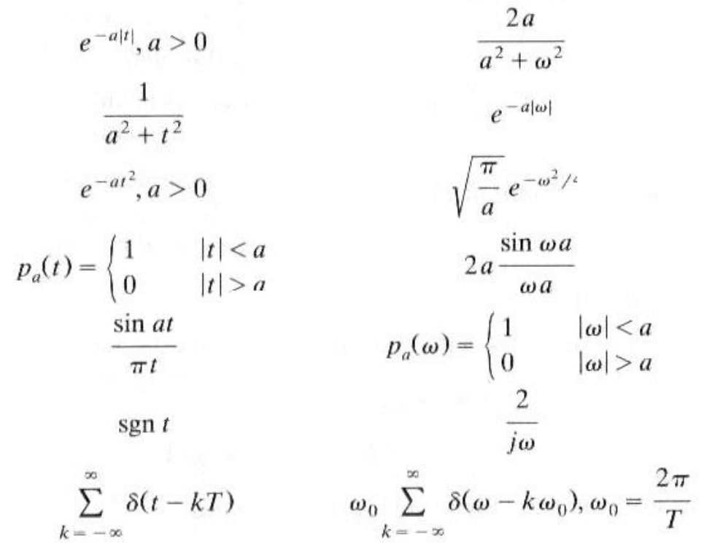
Fourier
Transform Pairs
x(t)
X(ω)

Slide 17
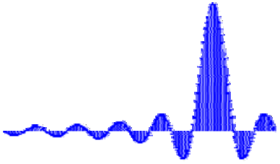
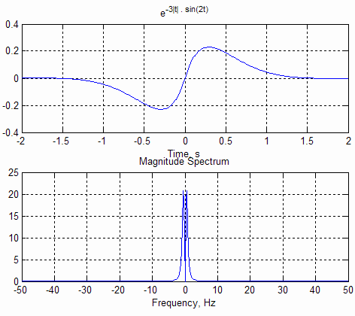
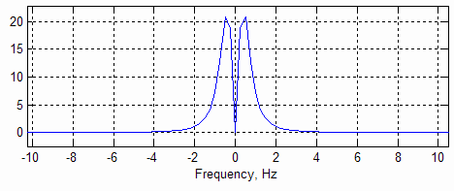
Exercises
x(t ) =
e^{−3 t}
sin(2t )
fs=100;
t=-2:1/fs:2;
x=exp(-3*abs(t)).*sin(2*t); Subplot(211)
plot(t,x)
grid
X=fft(x);
f=-fs/2:fs/(length(t)-1):fs/2;
subplot(212)
plot(f, abs(fftshift(X)))
grid

Slide 18
Exercises
Try the following at home. What is being demonstrated here? What is
the
outcome? How do
x=zeros(1000,1);
x(500)=1; plot(x) close
X=abs(fft(x));
plot(fftshift(X))
you
interpret it?
x=ones(1000,1);
plot(x) X=abs(fft(x)); plot(fftshift(X))

Slide 19
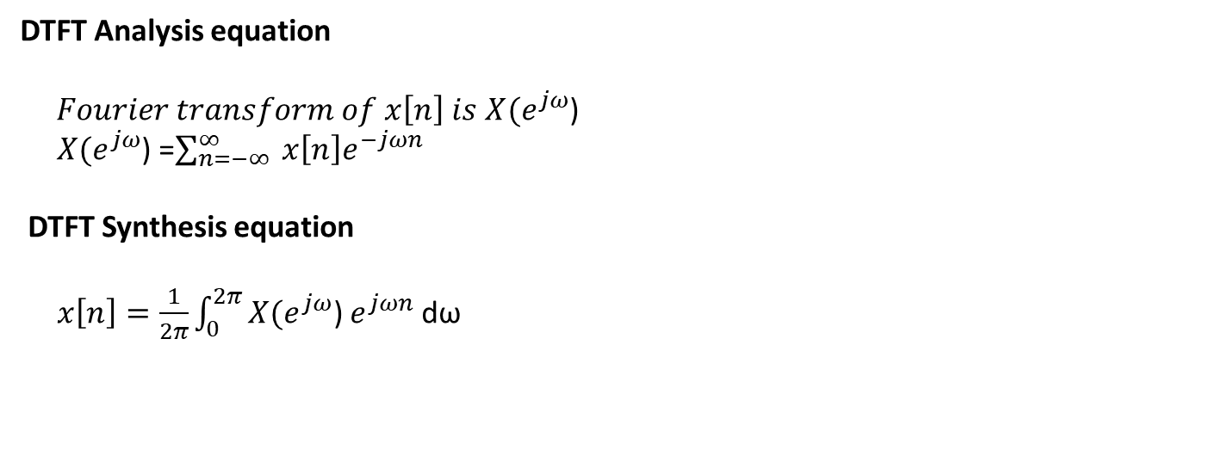
Discrete –Time Fourier Transform (DTFT)
Â Similar to continuous time signals, discrete time sequences can also be
periodic or non-periodic, resulting in discrete-time Fourier series or discrete
– time Fourier transform, respectively.
Â Most signals in engineering applications are non-periodic, so we will concentrate on DTFT.
Â We will represent the discrete frequency as ω, measured in radians/sample.
DTFT Analysis equation
$Fourier transform of x\left[n\right] is$ $X(e^{jω}$)
$X(e^{jω}$) =$\sum_{n=−∞}^{∞}{ x\left[n\right]e^{−jωn}}$
DTFT Synthesis equation
$x\left[n\right]=\frac{1}{2π}\int_{0}^{2π}{X(e^{jω}\text{)}}$ $e^{jωn}$ dω
•

Slide 20
Important Theorems
There are several important theorems related to DTFT.
Theorem 1:
ª If x[n] is input to an LTI system with an impulse response of h[n], then
the
DTFT
of
the
output
is the product of
X(ω)
and
H(ω)
x[n]
h[n]
y[n]=x[n]*h[n]
X(ω)
H(ω)
Y(ω) = X(ω) . H(ω)

Slide 21
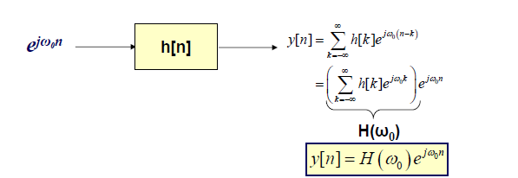
Frequency Response
Â Theorem 2:
ª If the input to an LTI system with an impulse response of h[n] is a complex exponential e^{jω0n ,} then the output is the SAME complex exponential whose
magnitude and phase
are given
by
|H(ω)|
and <H(ω), evaluated at ω
=
^{ω}0.
If the system input is a complex exponential at a
^{specific frequency ω}0^{, then}
the system
output is the same exponential, at the same frequency ω₀ but weighted by a complex
amplitude that is a function of the input frequency. This complex amplitude, H(ω₀), is
the DTFT of system impulse function h[n], evaluated at ω₀ , and it is called the
frequency response of the system.

Slide 22
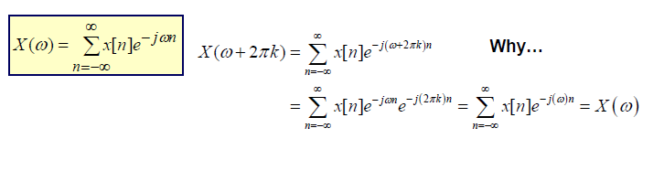
Periodicity of DTFT
Â Theorem 3:
ª The DTFT of a discrete sequence is periodic with the period 2π, that is
X(ω ) = X(ω + 2π k ) for any integer k
Â The periodicity of DTFT can be easily verified from the definition:

Slide 23
Existence of DTFT
Â Theorem 4:
ª The DTFT of a sequence exists if and only if, the sequence x[n] is absolutely
summable, that is, if
∞
n=−∞
∑
x[n]
< ∞
∞
ª This is because an infinite
series of
the
form
∑ x[n]e^{− jω n} n = −∞
converges
if
x[n] is
absolutely
summable.

Slide 24
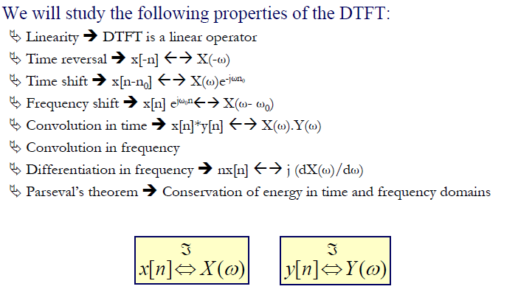

Slide 25
Linearity &Differentiation In Frequency
Â The DTFT is a linear operator
ℑ
ax[n] + by[n] ⇔ aX (ω ) + bY (ω )
Â Multiplying the time domain signal with the independent time variable
is
equivalent
to
differentiation in frequency
domain.
ℑ
dω
dX (ω )
nx[n] ⇔ j

Slide 26
Time Reversal , Time & Frequency Shift
A reversal in of the time domain variable causes a reversal of the
frequency variable
ℑ
x[−n] ⇔ X (−ω )
A shift in time domain by m samples causes a phase shift of
the frequency domain
e^{-jωm}
in
ℑ
jωm
x[n − m] ⇔ X (ω )e⁻
ª Note that the magnitude spectrum is unchanged by time shift. Why?
A shift in frequency domain by ω0 causes a time delay of
e^{jω0n}
ℑ
0
x[n]e ^{jω} ⇔ X (ω − ω₀)
n

Slide 27
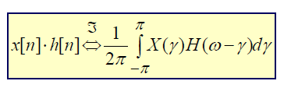
Convolution
Convolution in time domain is equivalent to multiplication in
frequency domain
ℑ
x[n]* h[n] ⇔ X (ω ) ⋅ H (ω )
ª This is one of the fundamental theorems in filtering. It allows us to compute the
filter response in frequency domain using the frequency response of the
filter.
Multiplication in time domain is equivalent to convolution in
frequency domain

Slide 28
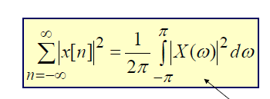
Parseval’s Theorem
Â The energy of the signal , whether computed in time domain or the
frequency
domain,
is the
same!
Energy of a continuous
periodic function

Slide 29
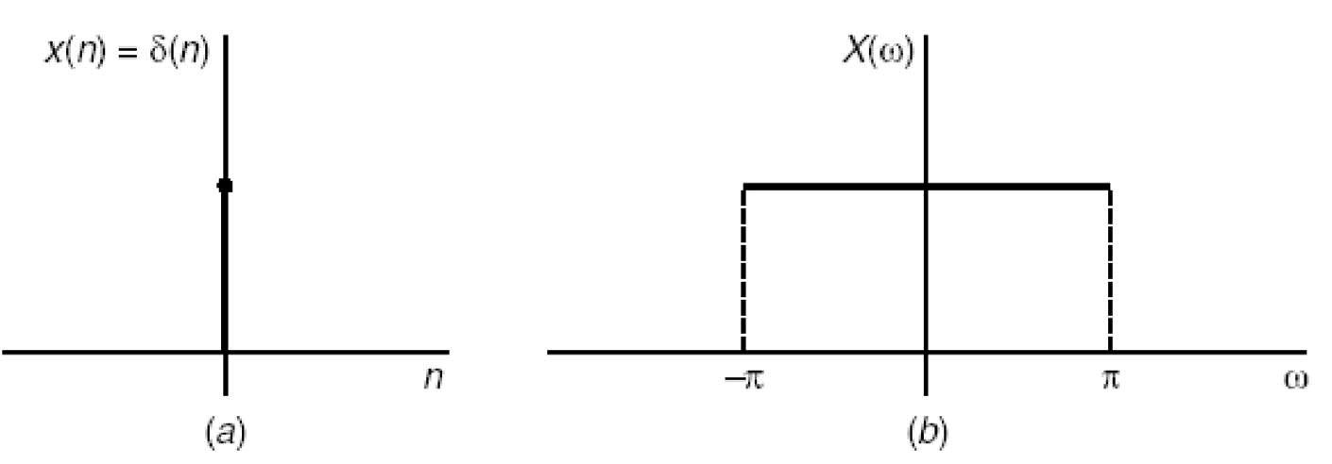
Important DTFT Pairs
Impulse Function
Â The DTFT of the impulse function is “1” over the entire frequency
band.
ℑ{δ [n]} = 1
Extend of the frequency band
in discrete frequency domain

Slide 30
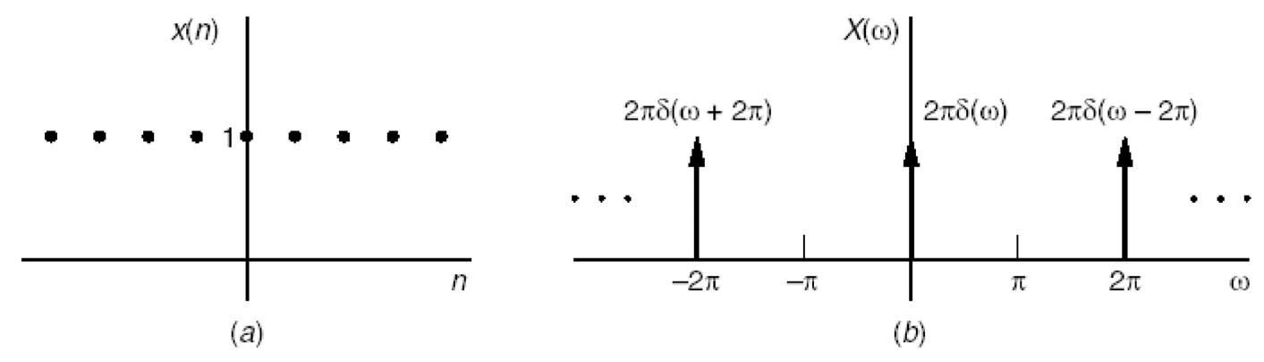
Important DTFT Pairs
Constant Function
Â Note that x[n]=1 (or any other constant) does not satisfy absolute
summability. However, we can sow that the DTFT of the constant
function
is
an
impulse at ω=0.
(this should make
sense!!!)
∞
m = −∞
ℑ{1} =
2π
∑ δ (ω − 2πm)

Slide 31

Important DTFT Pairs
The Complex Exponential
The DTFT of the complex exponential:
We are only interested in
[- π π] range, where there is
only one spectral component
Hence, the spectrum of a single
complex exponential at a specific
frequency is an impulse at that
frequency.
. . .
. .
.
ω0-4π
ω0-2π
ω0
ω0+2π
ω0+4π
This can be verified by computing
the inverse DTFT of X(ω) given
above.

Slide 32
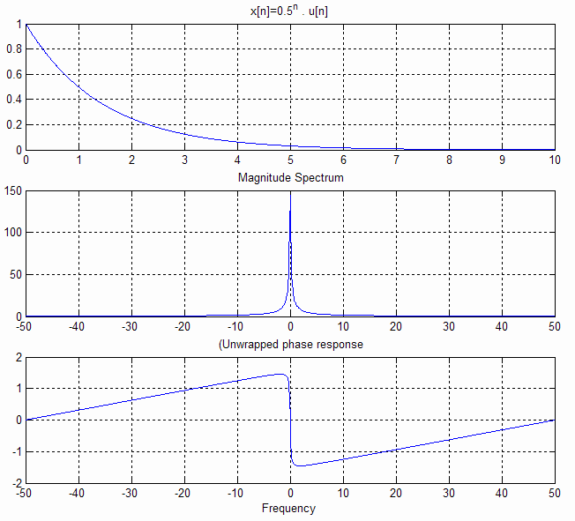
Important DTFT Pairs
Real Exponential
Â This is an important function in signal processing. Why?
ℑ
1
y
x[n] = α ^{n}u[n] ⇔
t=0:0.01:10; x=(0.5).^t; plot(t,x)
X=fftshift((fft(x))); subplot(311) plot(t,x); grid subplot(312) plot(abs(X)); grid f=-50:100/1000:50; plot(f,abs(X)); grid subplot(313)
1 − αe⁻
jω
plot(f, unwrap(angle(X))); grid

Slide 33

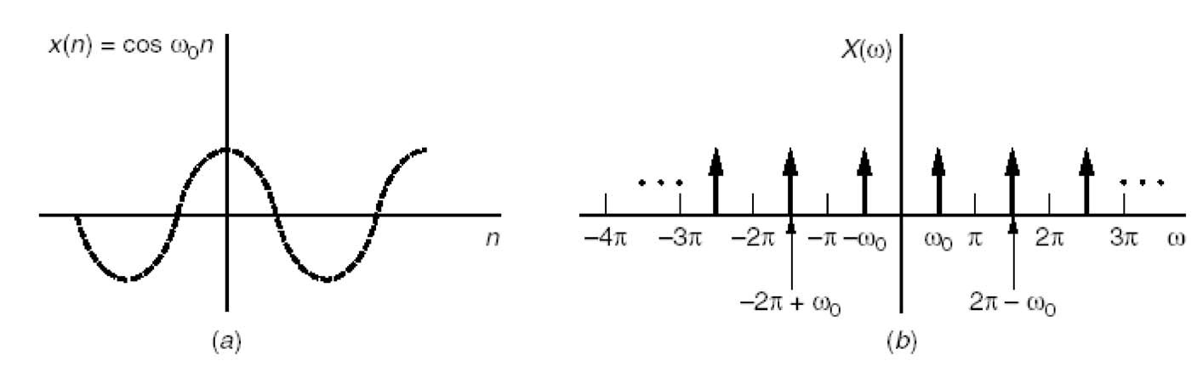
Important DTFT Pairs
ω0
The sinusoid at
Â By far the most often used DTFT pair (it is less complicated then it looks):
_{ℑ} ∞
^{x[n] = e jω0n ⇔ 2π} ∑ ^{δ} (^{ω − ω}0 ^{± 2π m} )
m=−∞
The above expression can also be obtained
from the DTFT of the complex exponential through the Euler’s formula.

Slide 34
Some Useful
Matlab Functions
Â
Matlab cannot explicitly calculate the DTFT, since the frequency axis is continuous.
However, it can calculate an approximation of the DTFT using a given number of points.
y=fft(x, N) – Calculates the discrete Fourier transform of the signal x at N points. If N is not provided, length of y is the same as x. DFT is a sampled version of the DTFT, where the samples are taken at N equidistant points around the unit circle from 0 to π
[h,w] = freqz(b,a,N,'whole') – Calculates the frequency response of a filter whose CCLDE coefficients are given as b and a, using N number of points around the unit circle. If ‘whole’ is included, it returns a frequency base of w from 0 to 2π, otherwise, from 0 to π.
y=abs(x)- Calculates the absolute value of signal x. For complex values signals, the output is the magnitude (spectrum) of the complex argument.
y=angle(x) – Calculates the phase (spectrum) of the signal x.
q = unwrap(p) corrects the radian phase angles in a vector p by adding multiples of 2π when absolute jumps between consecutive elements of p are greater than the default jump tolerance of π radians.
y = fftshift(x) rearranges the outputs of fft by moving the zero-frequency component to the center of the array. It is useful for visualizing a Fourier transform with the zero-frequency component in the middle of the spectrum.
Â
Â
Â
Â
Â
Â

