Slide 1

_{Lecture 7}
Discrete Fourier Transform (DFT)
Dr K. Mohanaprasad
Associate Professor
School of Electronics Engineering (SENSE)
VIT Chennai

Slide 2
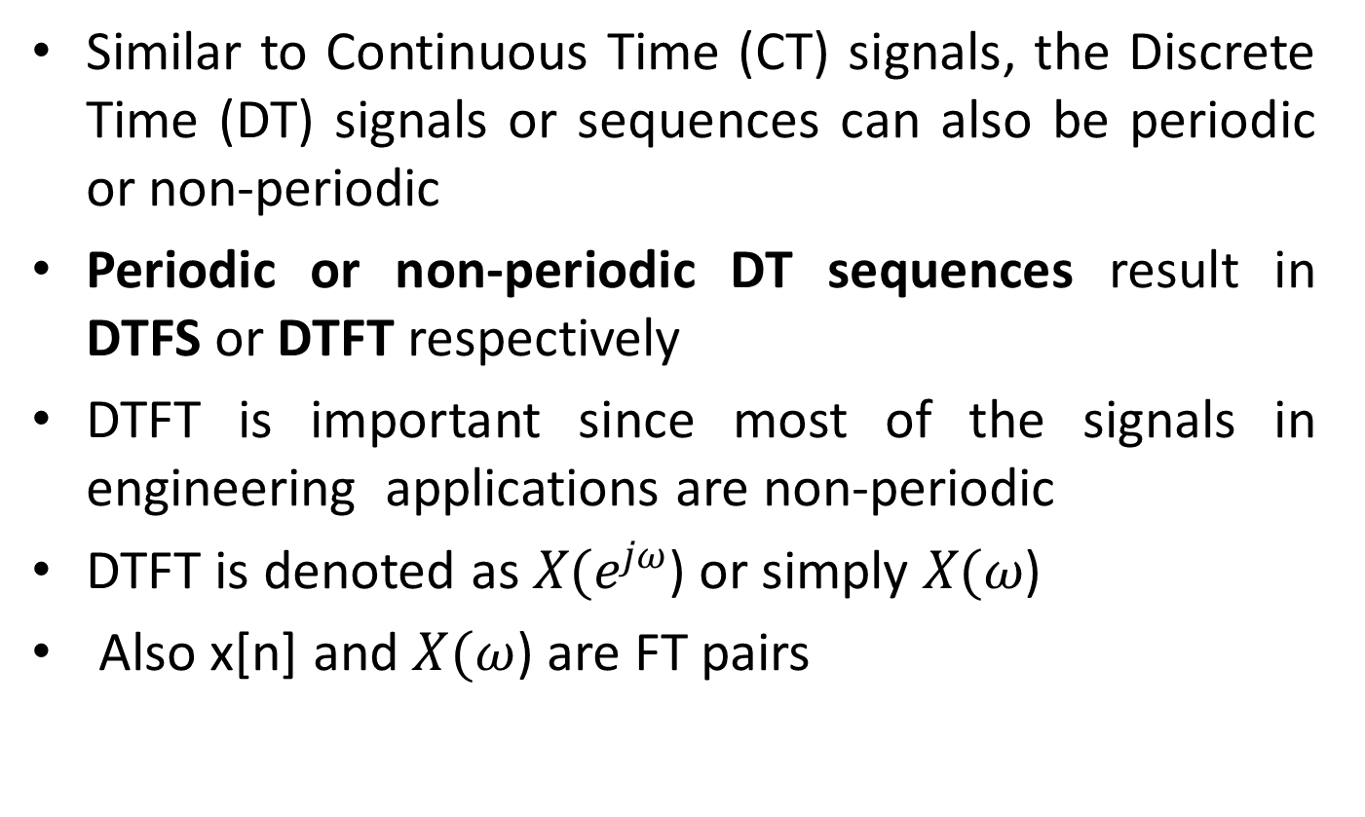
Introduction to Discrete Time Fourier Transform
Similar to Continuous Time (CT) signals, the Discrete Time (DT) signals or sequences can also be periodic or non-periodic
Periodic or non-periodic DT sequences result in DTFS or DTFT respectively
DTFT is important since most of the signals in engineering applications are non-periodic
DTFT is denoted as $X(e^{jω}$) or simply $X(ω$)
Also x[n] and $X(ω$) are FT pairs

Slide 3
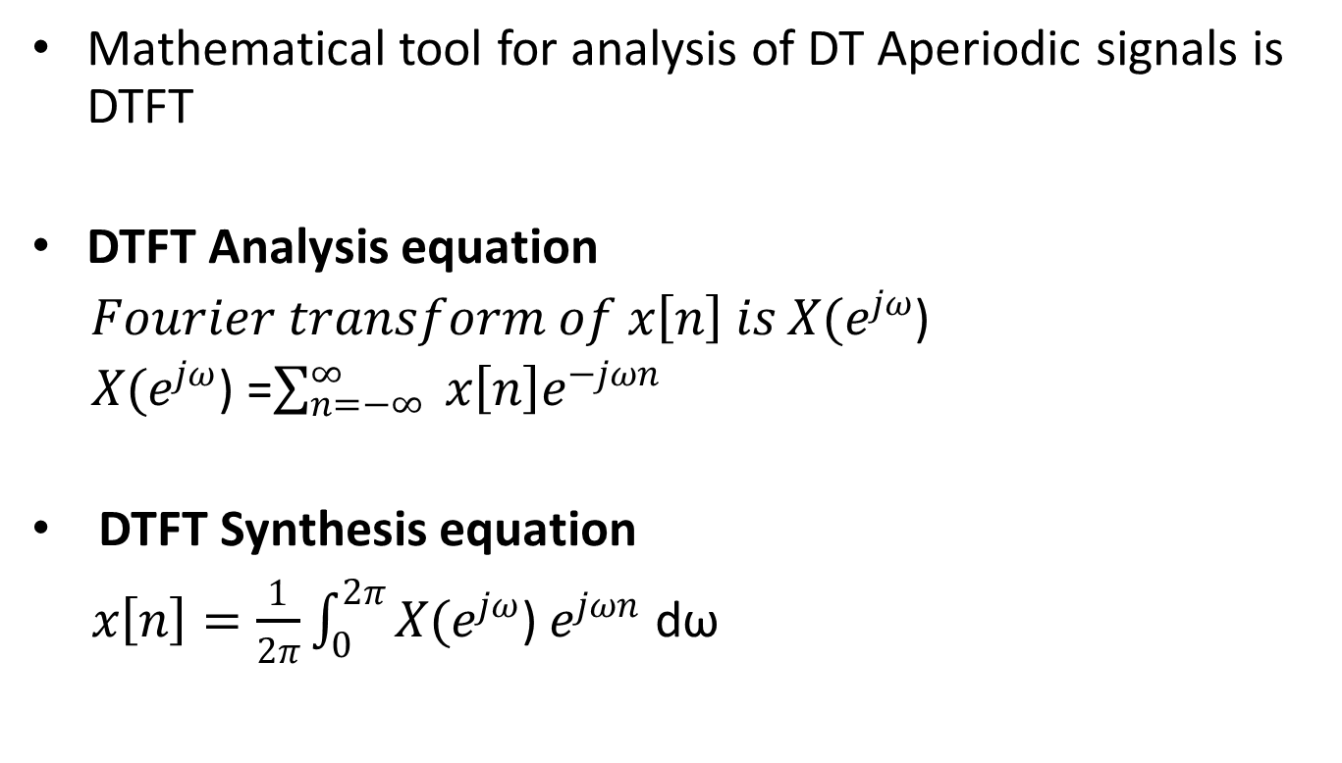
Discrete Time Fourier Transform (DTFT)
Mathematical tool for analysis of DT Aperiodic signals is DTFT
DTFT Analysis equation
$Fourier transform of x\left[n\right] is$ $X(e^{jω}$)
$X(e^{jω}$) =$\sum_{n=−∞}^{∞}{ x\left[n\right]e^{−jωn}}$
DTFT Synthesis equation
$x\left[n\right]=\frac{1}{2π}\int_{0}^{2π}{X(e^{jω}\text{)}}$ $e^{jωn}$ dω

Slide 4
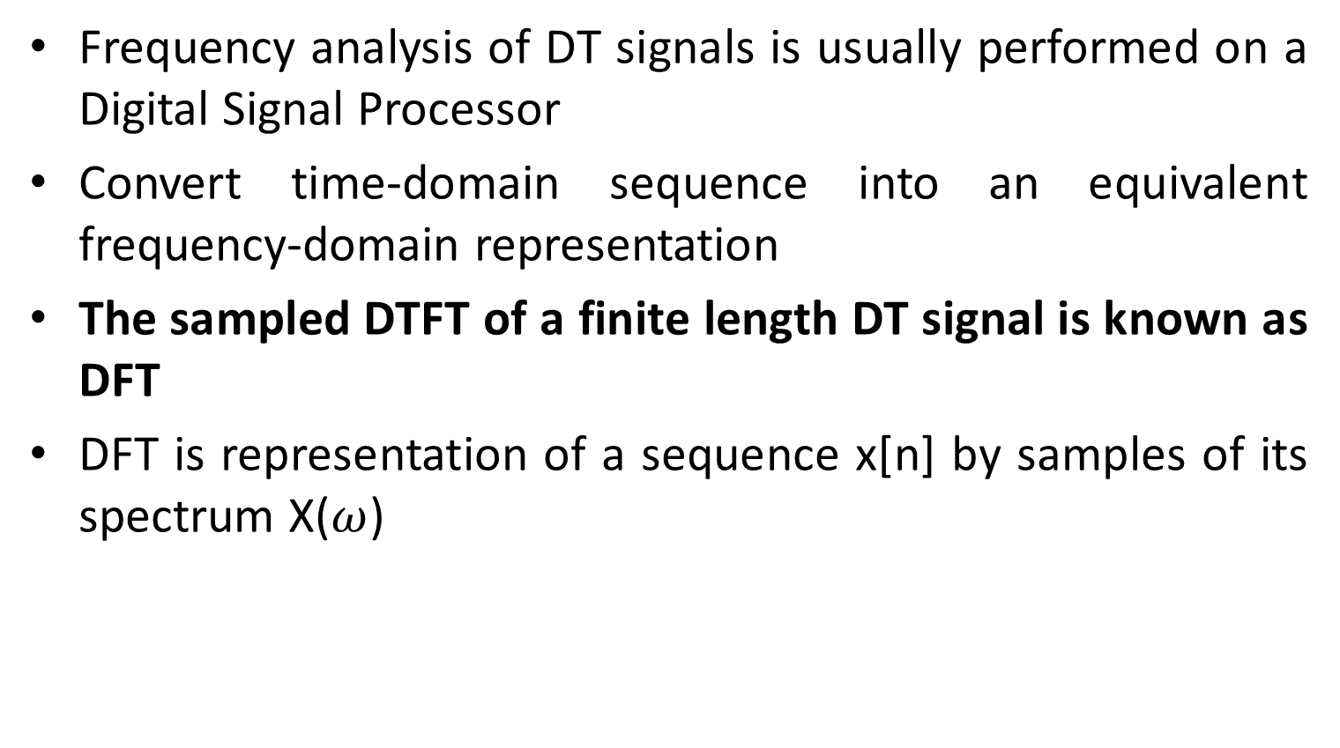
Discrete Fourier Transform (DFT)
Frequency analysis of DT signals is usually performed on a Digital Signal Processor
Convert time-domain sequence into an equivalent frequency-domain representation
The sampled DTFT of a finite length DT signal is known as DFT
DFT is representation of a sequence x[n] by samples of its spectrum X($ω$)
Definition - The simplest relation between a length-N
sequence x[n], defined for 0 ≤ n ≤ N-1, and its DTFT X(ω)
is obtained by uniformly sampling X(ω) on the ω-axis
0 ≤ ω ≤ 2π at ωk=2πk/N
0 ≤ k ≤ N-1

Slide 5
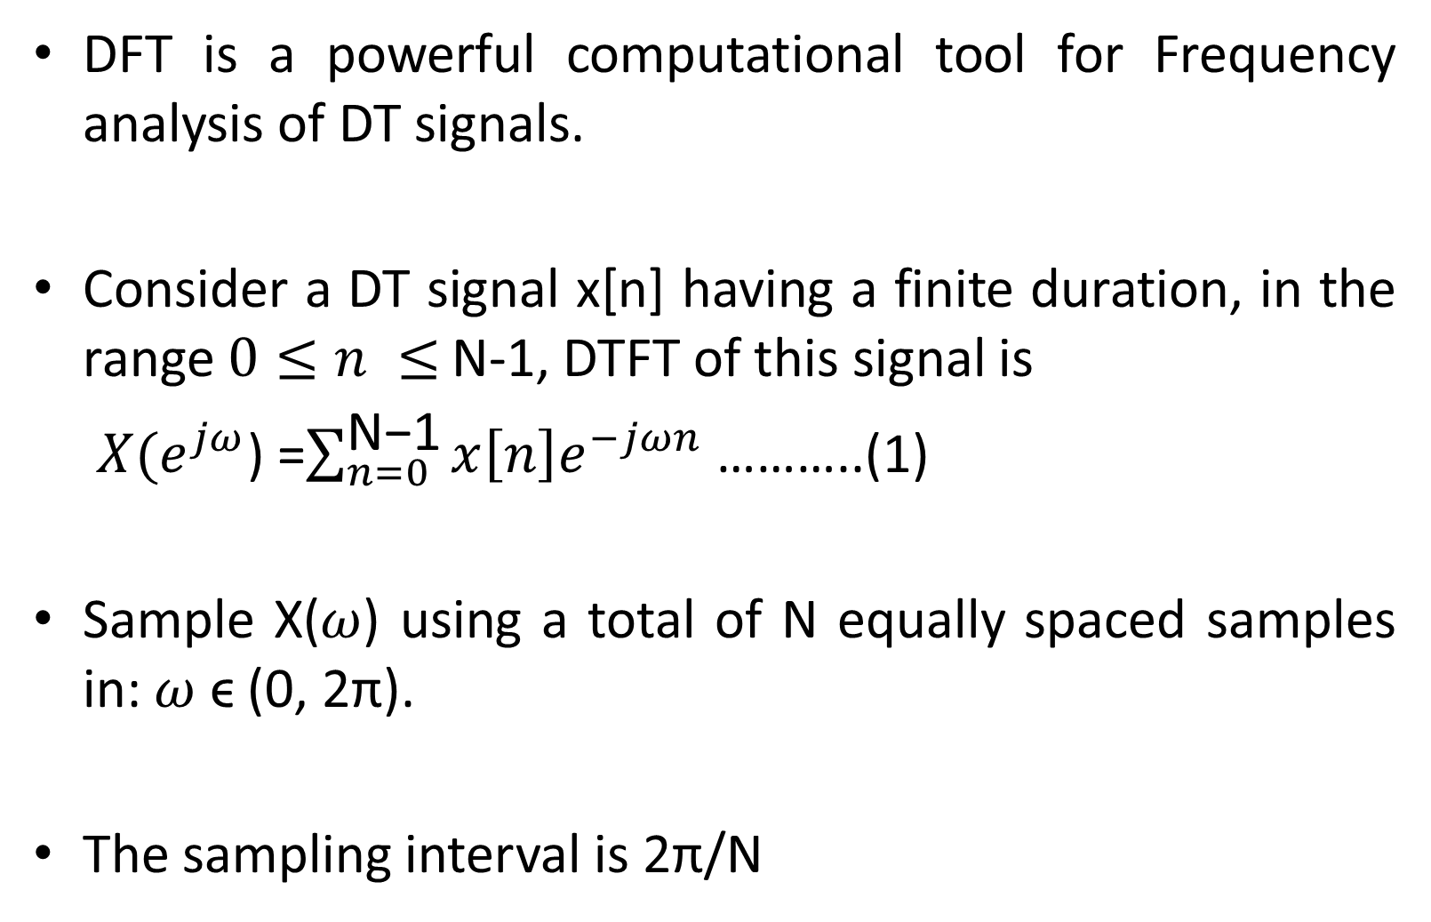
DFT evolving from DTFT
DFT is a powerful computational tool for Frequency analysis of DT signals.
Consider a DT signal x[n] having a finite duration, in the range$0≤n ≤$ N-1, DTFT of this signal is
$X(e^{jω}$) =$\sum_{n=0}^{\text{N}\text{−1}}{x\left[n\right]e^{−jωn}}$ ………..(1)
Sample X($ω$) using a total of N equally spaced samples in: $ω$ ϵ (0, 2π).
The sampling interval is 2π/N

Slide 6
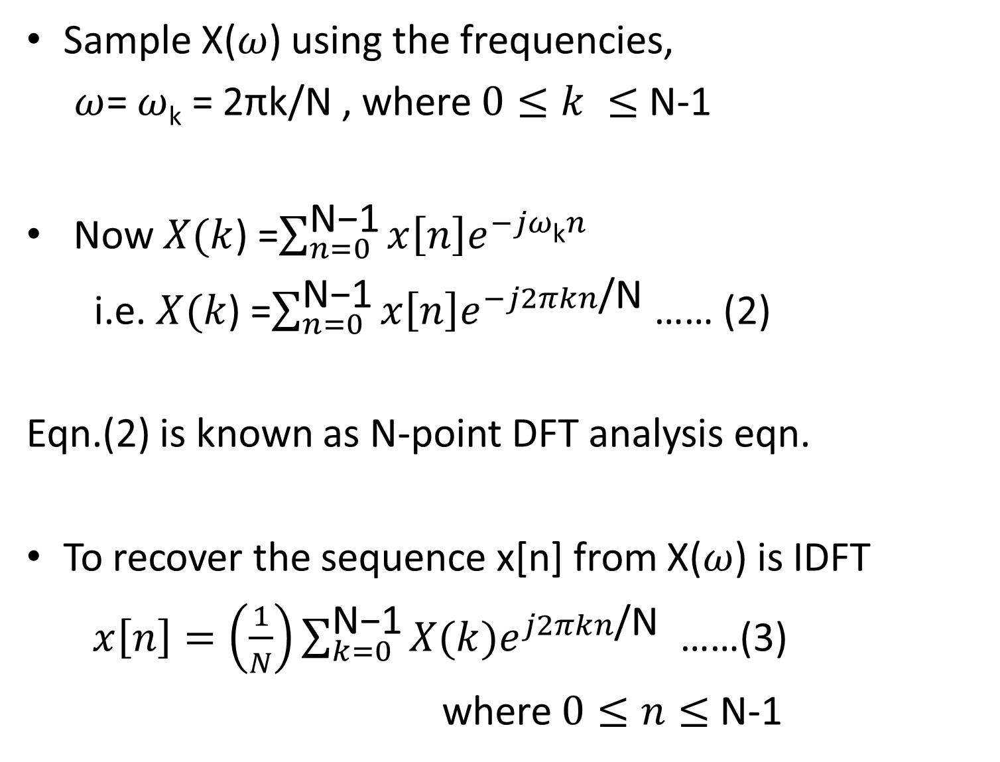
DFT from DTFT (continued)
Sample X($ω$) using the frequencies,
$ω$= $ω$_{k} = 2πk/N , where $0≤k ≤$ N-1
Now $X(k$) =$\sum_{n=0}^{\text{N}\text{−1}}{x\left[n\right]e^{−jω\text{k}n}}$
i.e. $X(k$) =$\sum_{n=0}^{\text{N}\text{−1}}{x\left[n\right]e^{−j2πkn\text{/}\text{N}}}$ …… (2)
Eqn.(2) is known as N-point DFT analysis eqn.
To recover the sequence x[n] from X($ω$) is IDFT
$x\left[n\right]=\left(\frac{1}{N}\right)\sum_{k=0}^{\text{N}\text{−1}}{X(k)e^{j2πkn\text{/}\text{N}}}$ ……(3)
where $0≤n≤$ N-1

Slide 7
Relation between DTFT and DFT
DTFT is a continuous transform. Sampling the DTFT at regularly spaced intervals around the unit circle gives the DFT
The sampling operation in one domain causes the transform in the other domain to be periodic
Similar to reconstructing a CT signal from its samples, DTFT can also be synthesized from its DFT samples
This reconstruction is possible, as long as the no. of points N at which DFT is computed is equal to or larger than the samples of original signal

Slide 8
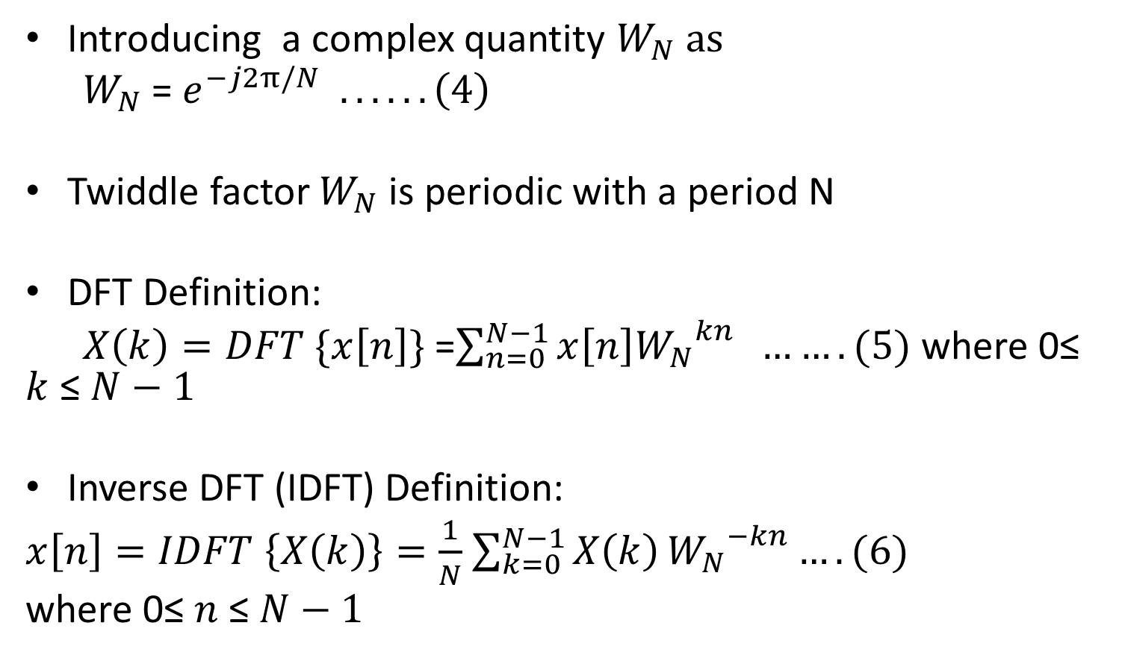
DFT and Inverse DFT
Introducing a complex quantity $W_{N} as$
$W_{N}$ = $e^{−j2π/N} ......\left(4\right)$
Twiddle factor $W_{N}$ is periodic with a period N
DFT Definition:
$X\left(k\right)=DFT \{x\left[n\right]\}$ =$\sum_{n=0}^{N−1}{x\left[n\right]{W_{N}}^{kn}} …….(5)$ where 0≤ $k$ ≤ $N−1$
Inverse DFT (IDFT) Definition:
$x\left[n\right]=IDFT \left\{X\left(k\right)\right\}=\frac{1}{N}$ $\sum_{k=0}^{N−1}{X\left(k\right)}{W_{N}}^{−kn}….(6)$
where 0≤$n$ ≤ $N−1$

Slide 9
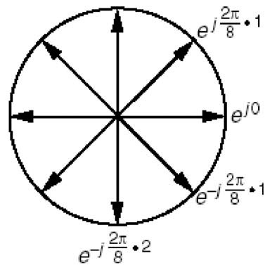
Computing
DFT
Â Recall the analysis equation:
^{N −1} − j 2π n k/ N
n=0
X [k ] =
∑
x[n] e
, 0 ≤ k ≤ N − 1
ª For any given k, the DFT is computed by multiplying
each x[n] with each of the complex exponentials
_{− j} ^{2π}
8
6
e
_{2π}
e^{− j 8 7}
_{− j} ^{2π} ₅
8
e^{j2πnk/N}
and then adding up all these components
e
ª If, for example, we wish to compute an 8 point
DFT, the complex exponentials are 8 unit vectors
placed at equal distances from each other on the
unit circle
X[0]=x[0]e^{j0}+ x[1]e^{j0}+ x[2]e^{j0}+ x[3]e^{j0}+ x[4]e^{j0}+ x[5]e^{j0}+ x[6]e^{j0}+ x[7]e^{j0}
_{− j} ^{2π} ₄
8
e
− j ^{2π} 3
e
8
X[1]=x[0]e^{j0}+x[1]e^{-j(2π/8).1}+x[2]e^{-j(2π/8).2}+x[3]e^{-j(2π/8).3}+x[4]e^{-j(2π/8).4}+x[5]e^{-j(2π/8).5}+x[6]e^{-j(2π/8).6}+x[7]e^{-j(2π/8).7}
_{X[2]=x[0]e}j0_{+x[1]e}-j(2π/8).2_{+x[2]e}-j(2π/8).4_{+x[3]e}-j(2π/8).6_{+x[4]e}-j(2π/8).0_{+x[5]e}-j(2π/8).2_{+x[6]e}-j(2π/8).4_{+x[7]e}-j(2π/8).6
_{X[3]=x[0]e}j0_{+x[1]e}-j(2π/8).3_{+x[2]e}-j(2π/8).6_{+x[3]e}-j(2π/8).1_{+x[4]e}-j(2π/8).4_{+x[5]e}-j(2π/8).7_{+x[6]e}-j(2π/8).2_{+x[7]e}-j(2π/8).5
_{X[4]=x[0]e}j0_{+x[1]e}-j(2π/8).4_{+x[2]e}-j(2π/8).0_{+x[3]e}-j(2π/8).4_{+x[4]e}-j(2π/8).0_{+x[5]e}-j(2π/8).4_{+x[6]e}-j(2π/8).0_{+x[7]e}-j(2π/8).4
_{X[5]=x[0]e}j0_{+x[1]e}-j(2π/8).5_{+x[2]e}-j(2π/8).2_{+x[3]e}-j(2π/8).7_{+x[4]e}-j(2π/8).4_{+x[5]e}-j(2π/8).1_{+x[6]e}-j(2π/8).6_{+x[7]e}-j(2π/8).3
_{X[6]=x[0]e}j0_{+x[1]e}-j(2π/8).6_{+x[2]e}-j(2π/8).4_{+x[3]e}-j(2π/8).2_{+x[4]e}-j(2π/8).0_{+x[5]e}-j(2π/8).6_{+x[6]e}-j(2π/8).4_{+x[7]e}-j(2π/8).2
_{X[7]=x[0]e}j0_{+x[1]e}-j(2π/8).7_{+x[2]e}-j(2π/8).6_{+x[3]e}-j(2π/8).5_{+x[4]e}-j(2π/8).4_{+x[5]e}-j(2π/8).3_{+x[6]e}-j(2π/8).2_{+x[7]e}-j(2π/8).1

Slide 10
DFT Computation
Eqn.(5) is known as N-point DFT analysis eqn.
Eqn.(6) is N-point DFT synthesis eqn. (expressed in terms of Twiddle factor)
Computation of each point of DFT requires N complex multiplications and (N-1) complex additions
N-point DFT values can be computed in a total of N² complex multiplications and N(N-1) complex additions

Slide 11
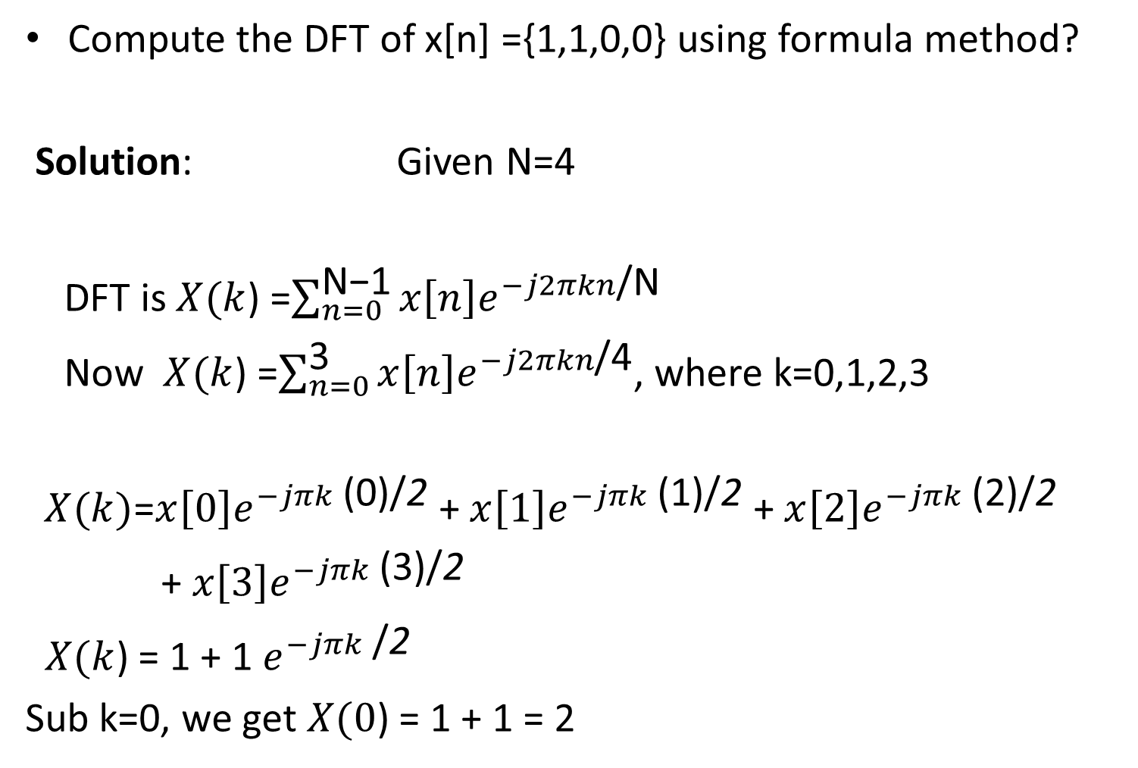
DFT example Problem
Compute the DFT of x[n] ={1,1,0,0} using formula method?
Solution: Given N=4
DFT is $X(k$) =$\sum_{n=0}^{\text{N}\text{−1}}{x\left[n\right]e^{−j2πkn\text{/}\text{N}}}$
Now $X(k$) =$\sum_{n=0}^{\text{3}}{x\left[n\right]e^{−j2πkn\text{/4}}}$, where k=0,1,2,3
$X(k)$=$x\left[0\right]e^{−jπk\text{ (0)}\text{/}\text{2}}$ +$x\left[1\right]e^{−jπk\text{ (1)}\text{/}\text{2}}$ +$x\left[2\right]e^{−jπk\text{ (2)}\text{/}\text{2}}$
+ $x\left[3\right]e^{−jπk\text{ (3)}\text{/}\text{2}}$
$X(k$) = 1 + 1 $e^{−jπk \text{/}\text{2}}$
Sub k=0, we get $X(0$) = 1 + 1 = 2

Slide 12
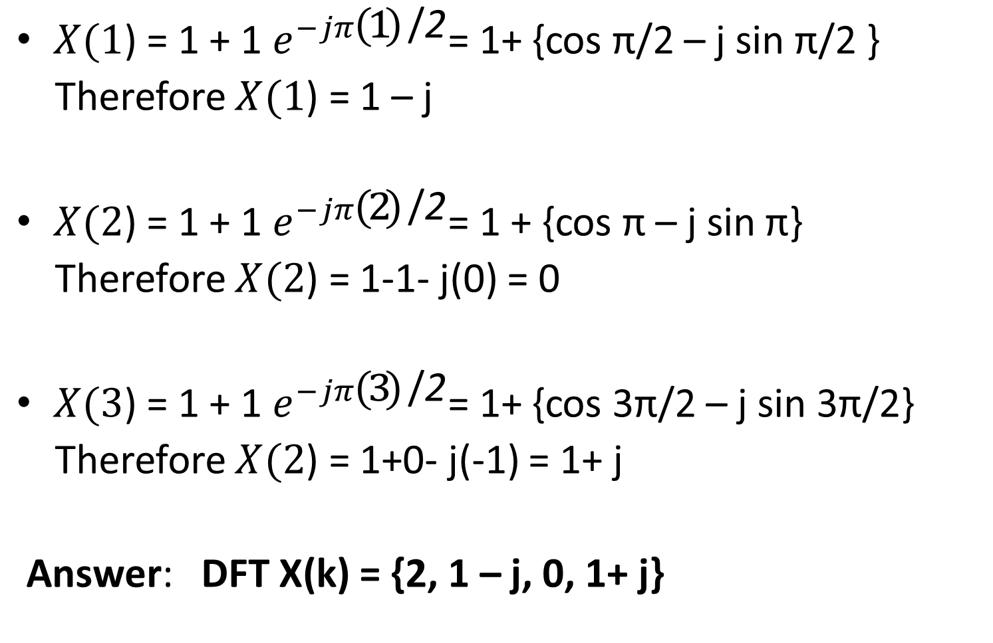
Problem continued
$X(1$) = 1 + 1 $e^{−jπ\text{(1)} \text{/}\text{2}}$= 1+ {cos π/2 – j sin π/2 }
Therefore $X(1$) = 1 – j
$X(2$) = 1 + 1 $e^{−jπ\text{(2)} \text{/}\text{2}}$= 1 + {cos π – j sin π}
Therefore $X(2$) = 1-1- j(0) = 0
$X(3$) = 1 + 1 $e^{−jπ\text{(3)} \text{/}\text{2}}$= 1+ {cos 3π/2 – j sin 3π/2}
Therefore $X(2$) = 1+0- j(-1) = 1+ j
Answer: DFT X(k) = {2, 1 – j, 0, 1+ j}

Slide 13
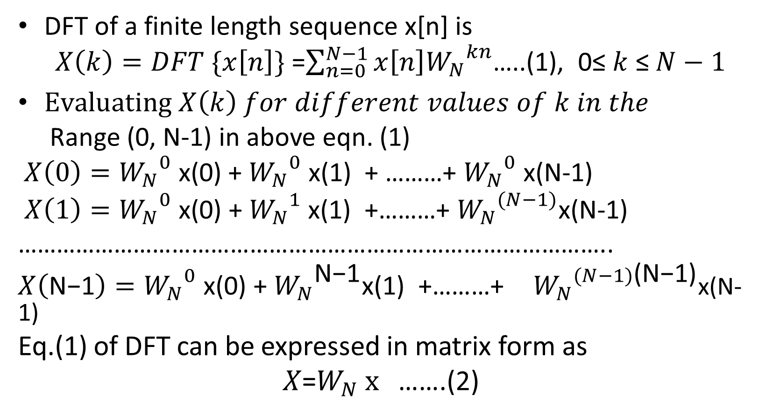
DFT as a linear transformation
DFT of a finite length sequence x[n] is
$X\left(k\right)=DFT \{x\left[n\right]\}$ =$\sum_{n=0}^{N−1}{x\left[n\right]{W_{N}}^{kn}}$…..(1), 0≤ $k$ ≤ $N−1$
$Evaluating X\left(k\right) for different values of k in the$
Range (0, N-1) in above eqn. (1)
$X\left(0\right)={W_{N}}^{0}$ x(0) + ${W_{N}}^{0}$ x(1) + ………+ ${W_{N}}^{0}$ x(N-1)
$X\left(1\right)={W_{N}}^{0} \text{x}\text{(0) + }{W_{N}}^{1} \text{x}\text{(1) +}$………+ ${W_{N}}^{(N−1)}$x(N-1)
………………………………………………………………………………..
$X\left(\text{N}\text{−1}\right)={W_{N}}^{0} \text{x}\text{(0) + }{W_{N}}^{\text{N}\text{−1}}\text{x}\text{(1) +}$………+ ${W_{N}}^{(N−1)\text{(}\text{N}\text{−1)}}$x(N-1)
Eq.(1) of DFT can be expressed in matrix form as
$X$=$W_{N} x$ …….(2)

Slide 14
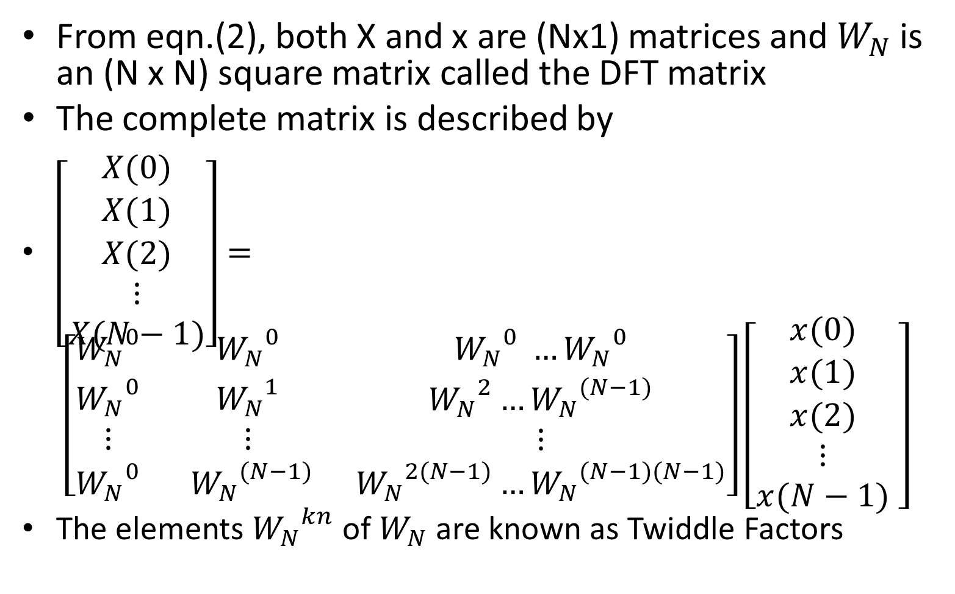
Matrix relation for computing DFT
From eqn.(2), both X and x are (Nx1) matrices and $W_{N}$ is an (N x N) square matrix called the DFT matrix
The complete matrix is described by
$\left[\begin{matrix}X(0) \\ X(1) \\ \begin{aligned}X(2) \\ ⋮ \\ X(N−1)\end{aligned}\end{matrix}\right]= \left[\begin{matrix}{W_{N}}^{0} & {W_{N}}^{0} & {W_{N}}^{0} …{W_{N}}^{0} \\ \begin{aligned}{W_{N}}^{0} \\ ⋮\end{aligned} & \begin{aligned}{W_{N}}^{1} \\ ⋮\end{aligned} & \begin{aligned}{W_{N}}^{2}…{W_{N}}^{(N−1)} \\ ⋮\end{aligned} \\ {W_{N}}^{0} & {{ W}_{N}}^{(N−1)} & {W_{N}}^{2(N−1)}…{W_{N}}^{(N−1)(N−1)}\end{matrix}\right]\left[\begin{matrix}x(0) \\ x(1) \\ \begin{aligned}x(2) \\ ⋮ \\ x(N−1)\end{aligned}\end{matrix} \right]$
The elements ${W_{N}}^{kn}$ of $W_{N}$ are known as Twiddle Factors

Slide 15
Matrix Computation
of
DFT
Â DFT has a simple matrix implementation: The DFT samples defined by
N −1
N
X [k ] =
∑
n=0
x[n]W
^{kn} ,
0 ≤ k ≤ N − 1
can be expressed in a matrix form
X = DN x
where X=[X[0] X[1] … X[N-1]]^{T} is the vectorized DFT sequence,
x=[x[0] x[1] … x[N-1]]^{T} is the vectorized time domain sequence, and
DN is the NxN DFT matrix
⎡1
⎢1
^{D}N ⁼ ⎢¹
⎢M
given by
1
W ¹
1
L
L
L
O
L
1
⎤
W
2
W ^{( N −1)}
⎥
N
2
N
N
⎢
4
2( N −1) ⎥
WN
WN
^{W}N
⎥
M
M
M
⎥
⎢
^{W}N
( N −1)
^{W}N
2( N −1)
^{W}N
( N −1)² ⎥
⎣¹
⎦

Slide 16
Matrix Computation
of
IDFT
•
Likewise, the IDFT relation given by
N −1
N
x[n] =
∑
k =0
X [k ]W ^{−kn} ,
0 ≤ n ≤
N − 1
can be expressed in matrix form as
x = D⁻¹X
N
where
DN⁻¹
is the NxN IDFT matrix
⎡1
⎢1
1
W ⁻¹
1
W ⁻²
L
L
L
O
L
1
⎤
W ^{−( N −1)}
⎥
N
−2
N
−4
N
−1
⎢
−2( N −1) ⎥
^{D}N ⁼ ⎢¹
⎢M
⎣1
WN
WN
^{W}N
⎥
⎥
⎥
⎦
M
M
M
⎢
^{W}N
−( N −1)
^{W}N
−2( N −1)
^{W}N
−( N −1)²
−1 1 *
Note that DFT and IDFT matrices
are related to each other
DN =
DN
N

Slide 17
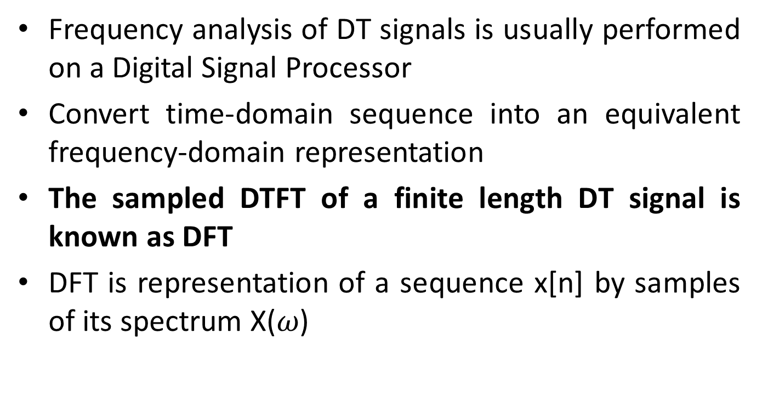
DFT matrix method
Compute the 4-point DFT of the sequence
x[n] = {1,2,1,0} ?
Solution: Given N = 4
$${Twiddle factor W}_{N}=e^{−j2π/N}$$
${W_{4}}^{0}$= 1, ${W_{4}}^{1}$= $e^{−j2π/4}$ = cos π/2 – j sin π/2 = – j
${W_{4}}^{2}$= ($e^{−j2π/4}$)² = cos π – j sin π = -1
${W_{4}}^{3}$= ($e^{−j2π/4}$)³ = cos 3π/2 – j sin 3π/2 = –j(-1)=j
$\text{DFT} \text{in} \text{matrix} \text{form} X$=$W_{N} x$

Slide 18
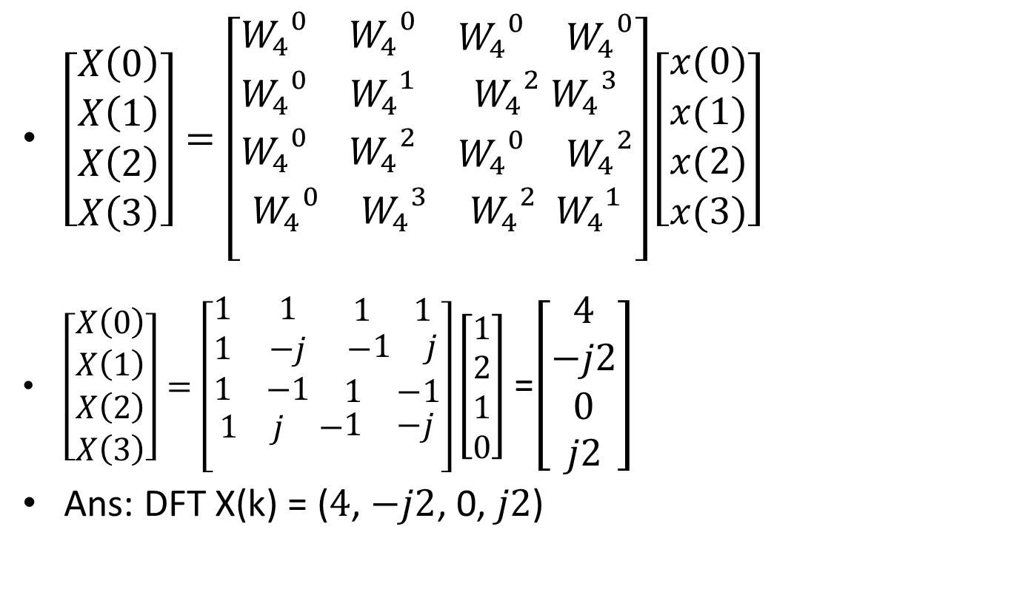
DFT matrix method
$\left[\begin{aligned}\begin{matrix}X\left(0\right) \\ X\left(1\right) \\ X\left(2\right)\end{matrix} \\ X\left(3\right)\end{aligned}\right]=\left[\begin{aligned}\begin{matrix}{W_{4}}^{0} & {W_{4}}^{0} & \begin{matrix}{W_{4}}^{0} & {W_{4}}^{0}\end{matrix} \\ {W_{4}}^{0} & {W_{4}}^{1} & {W_{4}}^{2} {W_{4}}^{3} \\ {W_{4}}^{0} & {W_{4}}^{2} & \begin{matrix}{W_{4}}^{0} & {W_{4}}^{2}\end{matrix}\end{matrix} \\ \begin{matrix}{W_{4}}^{0} & {W_{4}}^{3} & {W_{4}}^{2}{{ W}_{4}}^{1}\end{matrix} \\ \end{aligned}\right]\left[\begin{aligned}\begin{matrix}x(0) \\ x(1) \\ x(2)\end{matrix} \\ x(3)\end{aligned}\right]$
$\left[\begin{aligned}\begin{matrix}X\left(0\right) \\ X\left(1\right) \\ X\left(2\right)\end{matrix} \\ X\left(3\right)\end{aligned}\right]=\left[\begin{aligned}\begin{matrix}1 & 1 & \begin{matrix}1 & 1\end{matrix} \\ 1 & −j & −\begin{matrix}1 & j\end{matrix} \\ 1 & −1 & \begin{matrix}1 & −1\end{matrix}\end{matrix} \\ \begin{matrix}1 & j & −\begin{matrix}1 & −j\end{matrix}\end{matrix} \\ \end{aligned}\right]\left[\begin{aligned}1 \\ 2 \\ 1 \\ 0\end{aligned}\right]$ =$\left[\begin{matrix}4 \\ −j2 \\ \begin{aligned}0 \\ j2\end{aligned}\end{matrix}\right]$
Ans: DFT X(k) = ($4$, $−j2$, 0, $j2$)

Slide 19
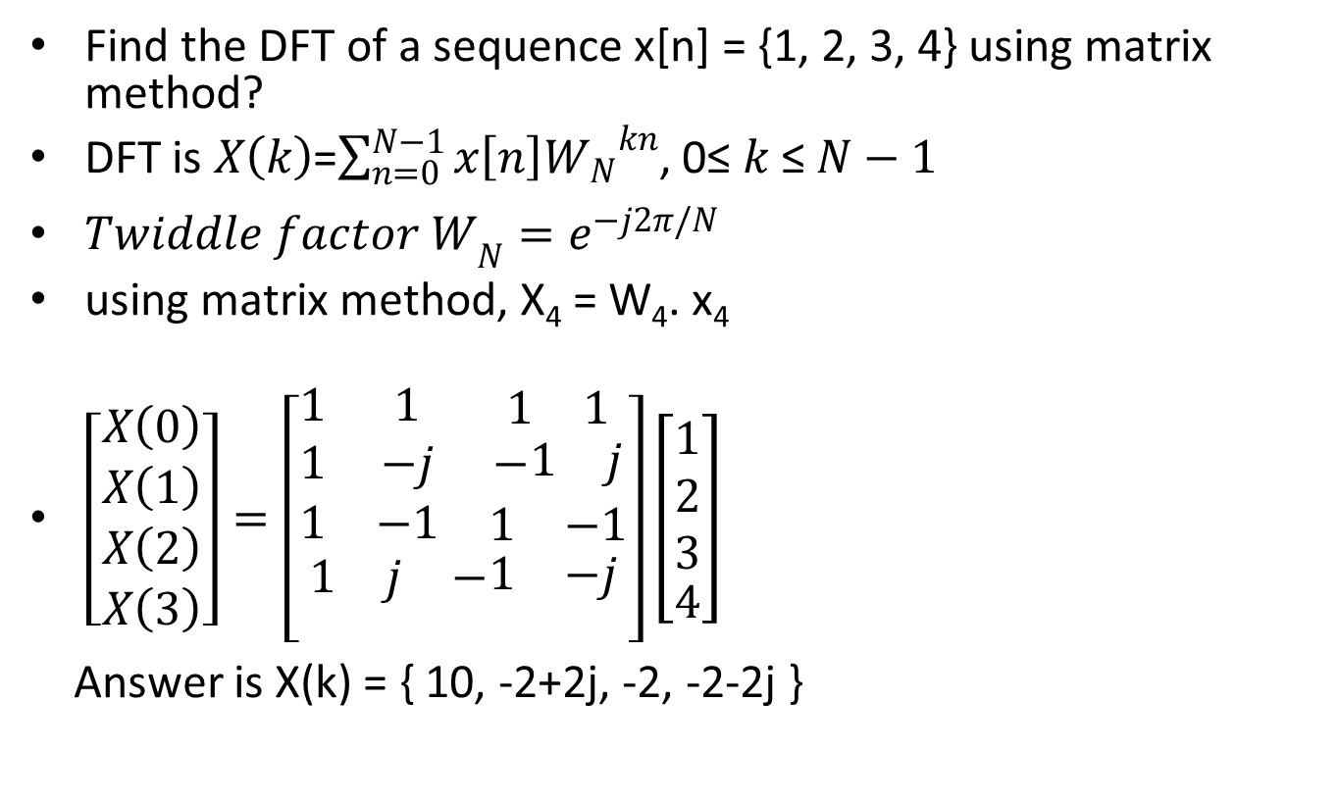
DFT Problems
Find the DFT of a sequence x[n] = {1, 2, 3, 4} using matrix method?
DFT is $X\left(k\right)$=$\sum_{n=0}^{N−1}{x\left[n\right]{W_{N}}^{kn}}$, 0≤ $k$ ≤ $N−1$
${Twiddle factor W}_{N}=e^{−j2π/N}$
using matrix method, X₄ = W₄. x₄
$\left[\begin{aligned}\begin{matrix}X\left(0\right) \\ X\left(1\right) \\ X\left(2\right)\end{matrix} \\ X\left(3\right)\end{aligned}\right]=\left[\begin{aligned}\begin{matrix}1 & 1 & \begin{matrix}1 & 1\end{matrix} \\ 1 & −j & −\begin{matrix}1 & j\end{matrix} \\ 1 & −1 & \begin{matrix}1 & −1\end{matrix}\end{matrix} \\ \begin{matrix}1 & j & −\begin{matrix}1 & −j\end{matrix}\end{matrix} \\ \end{aligned}\right]\left[\begin{aligned}\begin{matrix}1 \\ 2 \\ 3\end{matrix} \\ 4\end{aligned}\right]$
Answer is X(k) = { 10, -2+2j, -2, -2-2j }

Slide 20
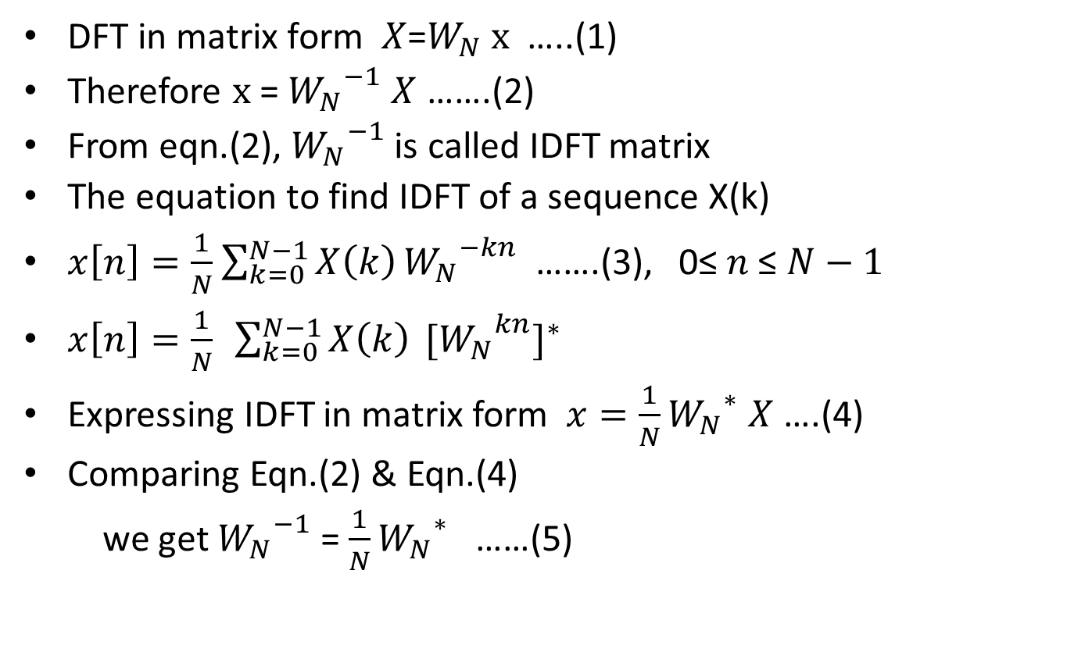
Matrix relation to compute IDFT
$\text{DFT} \text{in} \text{matrix} \text{form} X$=$W_{N} x$ …..(1)
Therefore $x$ = ${W_{N}}^{−1}$ $X$ …….(2)
From eqn.(2), ${W_{N}}^{−1}$ is called IDFT matrix
The equation to find IDFT of a sequence X(k)
$x\left[n\right]=\frac{1}{N}$ $\sum_{k=0}^{N−1}{X\left(k\right)}{W_{N}}^{−kn}$ …….(3), 0≤$n$ ≤ $N−1$
$x\left[n\right]=\frac{1}{N} \sum_{k=0}^{N−1}{X\left(k\right)} {{{[W}_{N}}^{kn}]}^{∗}$
Expressing IDFT in matrix form $x=\frac{1}{N}{W_{N}}^{∗}$ $X$ ….(4)
Comparing Eqn.(2) & Eqn.(4)
we get ${W_{N}}^{−1}$ = $\frac{1}{N}{W_{N}}^{∗}$ ……(5)

Slide 21
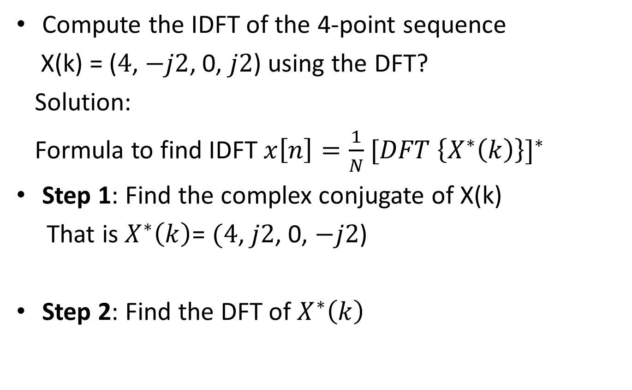
IDFT problem
Compute the IDFT of the 4-point sequence
X(k) = ($4$, $−j2$, 0, $j2$) using the DFT?
Solution:
Formula to find IDFT $x\left[n\right]=\frac{1}{N}$ ${[DFT \left\{X^{∗}\left(k\right)\right\}]}^{∗}$
Step 1: Find the complex conjugate of X(k)
That is $X^{∗}\left(k\right)$= $(4$, $j2$, 0, $−j2$)
Step 2: Find the DFT of $X^{∗}\left(k\right)$

Slide 22
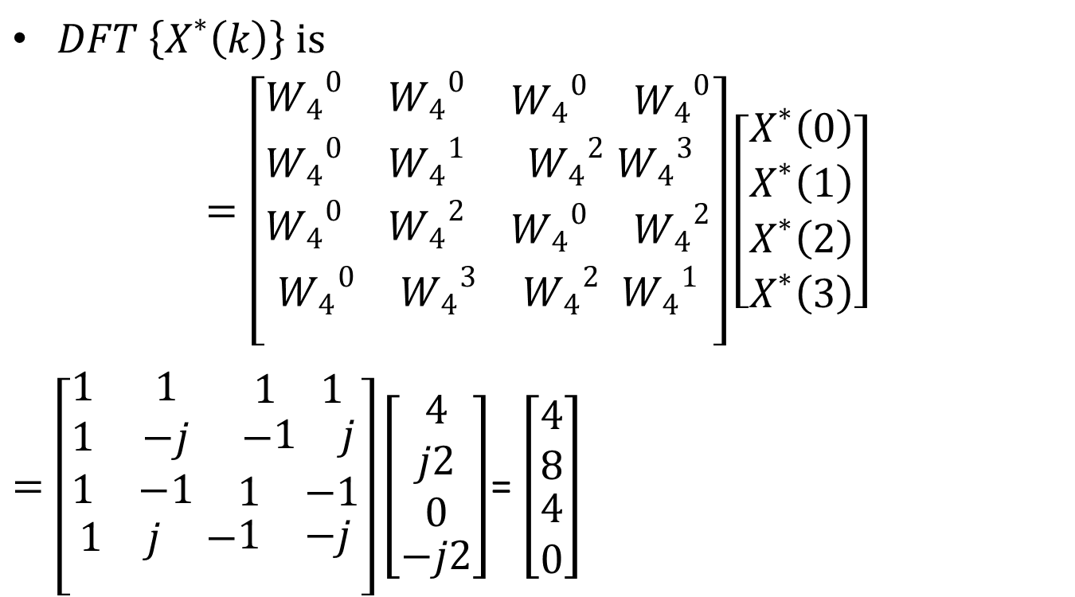
IDFT problem
$DFT \left\{X^{∗}\left(k\right)\right\} is$
$$=\left[\begin{aligned}\begin{matrix}{W_{4}}^{0} & {W_{4}}^{0} & \begin{matrix}{W_{4}}^{0} & {W_{4}}^{0}\end{matrix} \\ {W_{4}}^{0} & {W_{4}}^{1} & {W_{4}}^{2} {W_{4}}^{3} \\ {W_{4}}^{0} & {W_{4}}^{2} & \begin{matrix}{W_{4}}^{0} & {W_{4}}^{2}\end{matrix}\end{matrix} \\ \begin{matrix}{W_{4}}^{0} & {W_{4}}^{3} & {W_{4}}^{2}{{ W}_{4}}^{1}\end{matrix} \\ \end{aligned}\right]\left[\begin{aligned}\begin{matrix}X^{∗}\left(0\right) \\ X^{∗}\left(1\right) \\ X^{∗}\left(2\right)\end{matrix} \\ X^{∗}\left(3\right)\end{aligned}\right]$$
$=\left[\begin{aligned}\begin{matrix}1 & 1 & \begin{matrix}1 & 1\end{matrix} \\ 1 & −j & −\begin{matrix}1 & j\end{matrix} \\ 1 & −1 & \begin{matrix}1 & −1\end{matrix}\end{matrix} \\ \begin{matrix}1 & j & −\begin{matrix}1 & −j\end{matrix}\end{matrix} \\ \end{aligned}\right]\left[\begin{aligned}\begin{matrix}4 \\ j2 \\ 0\end{matrix} \\ −j2\end{aligned}\right]$= $\left[\begin{matrix}4 \\ 8 \\ \begin{aligned}4 \\ 0\end{aligned}\end{matrix}\right]$

Slide 23

Step 3: ${x\left[n\right]=\frac{1}{N}[DFT \left\{X^{∗}\left(k\right)\right\}]}^{∗}$
Find the conjugate of the result and divide it by N=4 to get IDFT IDFT {X(k)} = x[n] = $\frac{1}{4}$ (4,8,4,0)* = $\frac{1}{4}$ (4,8,4,0)
Ans: x[n] = (1,2,1,0)

