Slide 1

_{Lecture 8}
Discrete Fourier Transform (DFT properties-I)
Dr K. Mohanaprasad
Associate Professor
School of Electronics Engineering (SENSE)
VIT Chennai

Slide 2
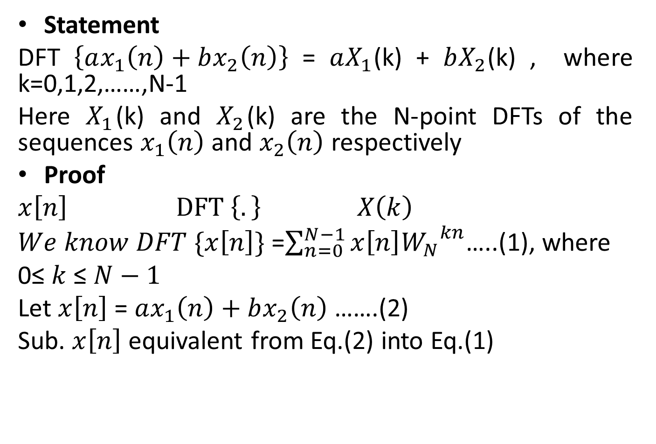
Linearity Property of DFT
Statement
DFT$\left\{ax_{1}\left(n\right)+bx_{2}\left(n\right)\right\}$=$aX_{1}\text{(}\text{k}\text{)}$+$bX_{2}\text{(}\text{k}\text{)}$, where k=0,1,2,……,N-1
Here $X_{1}$(k) and $X_{2}$(k) are the N-point DFTs of the sequences $x_{1}\left(n\right)$ and $x_{2}\left(n\right)$ respectively
Proof
$x\left[n\right]$ $DFT \left\{.\right\} X\left(k\right)$
$We know DFT \{x\left[n\right]\}$ =$\sum_{n=0}^{N−1}{x\left[n\right]{W_{N}}^{kn}}$…..(1), where
0≤ $k$ ≤ $N−1$
Let $x\left[n\right]$ = $ax_{1}\left(n\right)+bx_{2}\left(n\right)$ …….(2)
Sub. $x\left[n\right]$equivalent from Eq.(2) into Eq.(1)

Slide 3
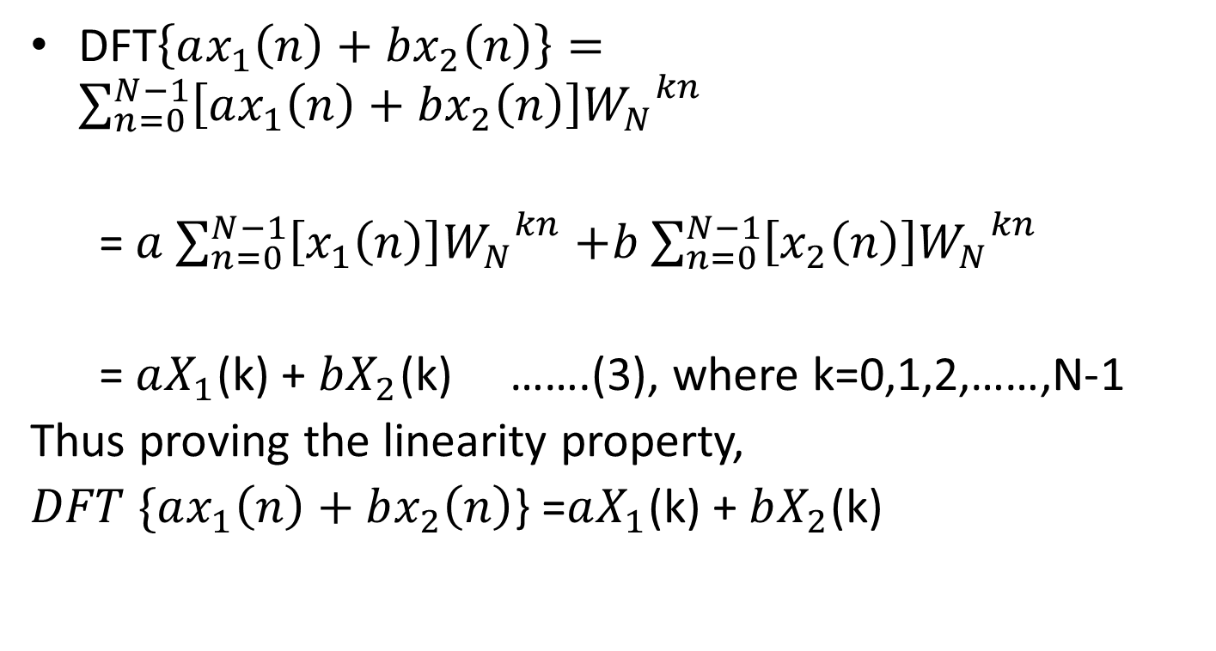
Linearity Property
DFT$\left\{ax_{1}\left(n\right)+bx_{2}\left(n\right)\right\}=\sum_{n=0}^{N−1}{\left[ax_{1}\left(n\right)+bx_{2}\left(n\right)\right]{W_{N}}^{kn}}$
= $a$ $\sum_{n=0}^{N−1}{\left[x_{1}\left(n\right)\right]{W_{N}}^{kn}}$ $+b$ $\sum_{n=0}^{N−1}{\left[x_{2}\left(n\right)\right]{W_{N}}^{kn}}$
= $aX_{1}$(k) + $bX_{2}$(k) …….(3), where k=0,1,2,……,N-1
Thus proving the linearity property,
$DFT \{ax_{1}\left(n\right)+bx_{2}\left(n\right)$} =$aX_{1}$(k) + $bX_{2}$(k)

Slide 4
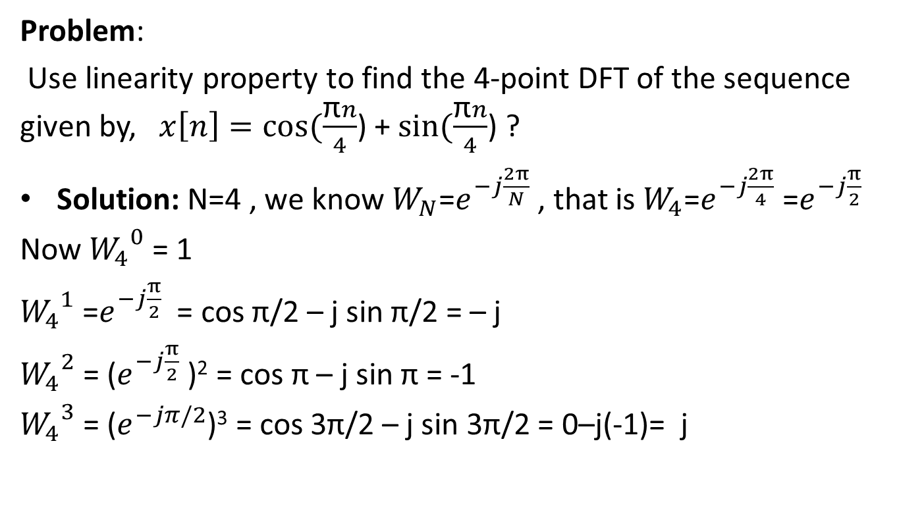
Problem applying linearity property
Problem:
Use linearity property to find the 4-point DFT of the sequence given by, $x\left[n\right]=cos⁡(\frac{\text{π}n}{4}$) + $sin⁡(\frac{\text{π}n}{4}$) ?
Solution: N=4 , we know $W_{N}$=$e^{−j\frac{2π}{N}}$ , that is $W_{4}$=$e^{−j\frac{2π}{4}}$ =$e^{−j\frac{π}{2}}$
Now ${W_{4}}^{0}$= 1
${W_{4}}^{1}$=$e^{−j\frac{π}{2}}$ = cos π/2 – j sin π/2 = – j
${W_{4}}^{2}$= ($e^{−j\frac{π}{2}}$ )² = cos π – j sin π = -1
${W_{4}}^{3}$= ($e^{−jπ/2}$)³ = cos 3π/2 – j sin 3π/2 = 0–j(-1)= j

Slide 5
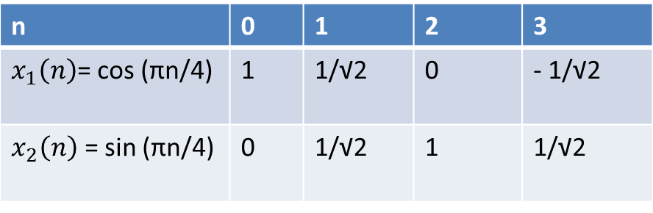
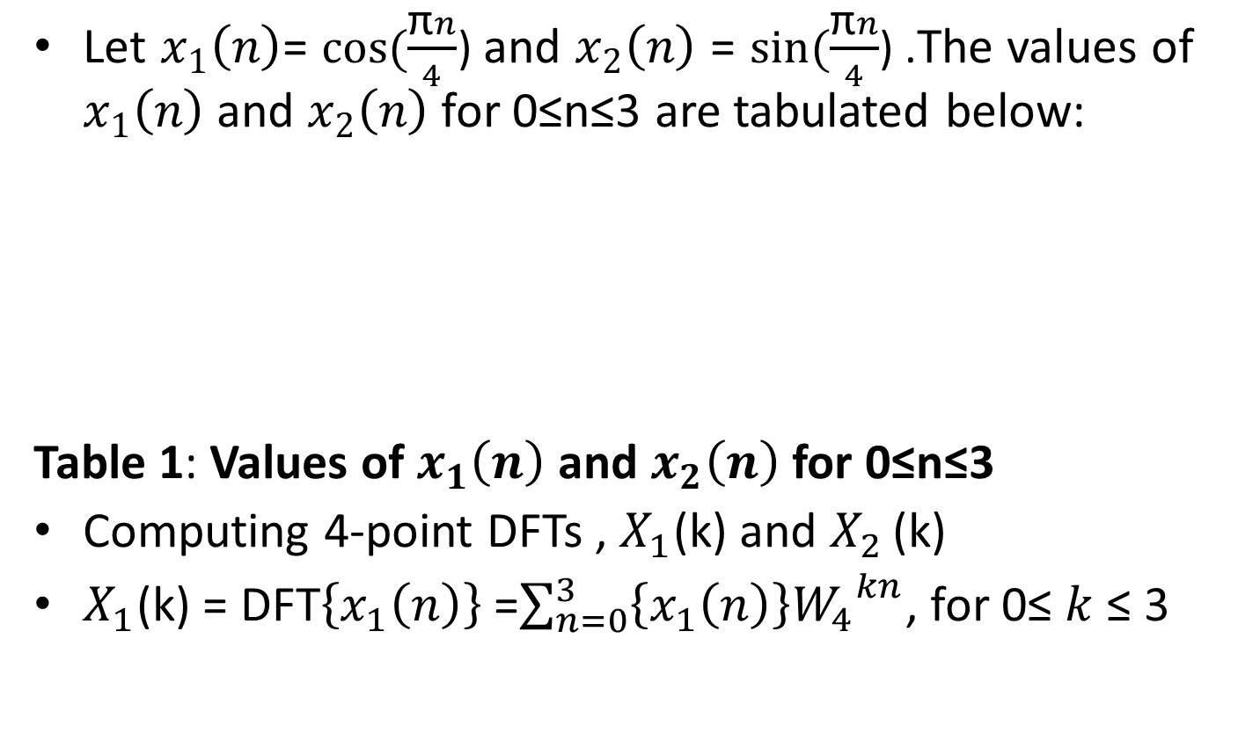
Linearity problem (continued)
Let $x_{1}\left(n\right)$= $cos⁡(\frac{\text{π}n}{4}$) and $x_{2}\left(n\right)$ = $sin⁡(\frac{\text{π}n}{4}$) .The values of $x_{1}\left(n\right)$ and $x_{2}\left(n\right)$ for 0≤n≤3 are tabulated below:
Table 1: Values of $x_{1}\left(n\right)$ and $x_{2}\left(n\right)$ for 0≤n≤3
Computing 4-point DFTs , $X_{1}$(k) and $X_{2 }$(k)
$X_{1}$(k) = DFT$\left\{x_{1}\left(n\right)\right\}$ =$\sum_{n=0}^{3}{\left\{x_{1}\left(n\right)\right\}{W_{4}}^{kn}}$, for 0≤ $k$ ≤ 3
n | 0 | 1 | 2 | 3
$x_{1}\left(n\right)$= cos (πn/4) | 1 | 1/√2 | 0 | - 1/√2
$x_{2}\left(n\right)$ = sin (πn/4) | 0 | 1/√2 | 1 | 1/√2

Slide 6
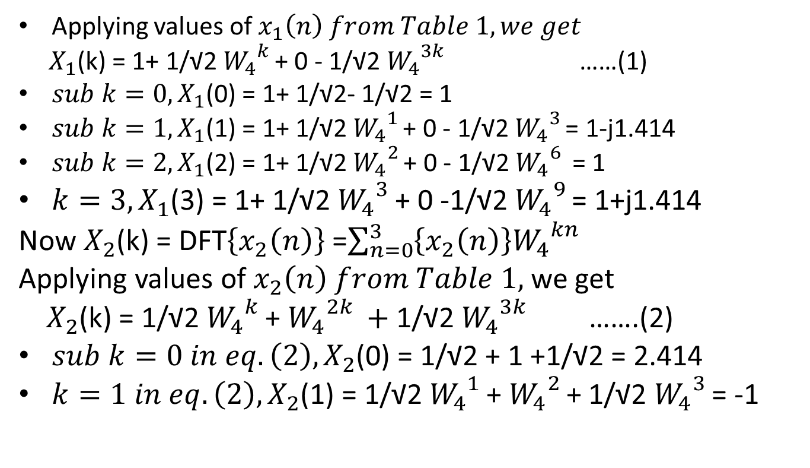
Problem continuation
Applying values of $x_{1}\left(n\right) from Table 1, we get$
$X_{1}$(k) = 1+ 1/√2 ${W_{4}}^{k }$+ 0 - 1/√2 ${W_{4}}^{3k }$ ……(1)
${sub k=0, X}_{1}$(0) = 1+ 1/√2- 1/√2 = 1
$sub k=1,X_{1}$(1) = 1+ 1/√2 ${W_{4}}^{1 }$+ 0 - 1/√2 ${W_{4}}^{3 }$= 1-j1.414
${sub k=2,X}_{1}$(2) = 1+ 1/√2 ${W_{4}}^{2 }$+ 0 - 1/√2 ${W_{4}}^{6 }$ = 1
${k=3, X}_{1}$(3) = 1+ 1/√2 ${W_{4}}^{3 }$+ 0 -1/√2 ${W_{4}}^{9 }$= 1+j1.414
Now $X_{2}$(k) = DFT$\left\{x_{2}\left(n\right)\right\}$ =$\sum_{n=0}^{3}{\left\{x_{2}\left(n\right)\right\}{W_{4}}^{kn}}$
Applying values of $x_{2}\left(n\right) from Table 1,$ we get
$X_{2}$(k) = 1/√2 ${W_{4}}^{k }$+ ${W_{4}}^{2k }+$ 1/√2 ${W_{4}}^{3k }$ …….(2)
$sub k=0 in eq.\left(2\right), X_{2}$(0) = 1/√2 + 1 +1/√2 = 2.414
${k=1 in eq.\left(2\right),X}_{2}$(1) = 1/√2 ${W_{4}}^{1 }$+ ${W_{4}}^{2 }$+ 1/√2 ${W_{4}}^{3 }$= -1

Slide 7
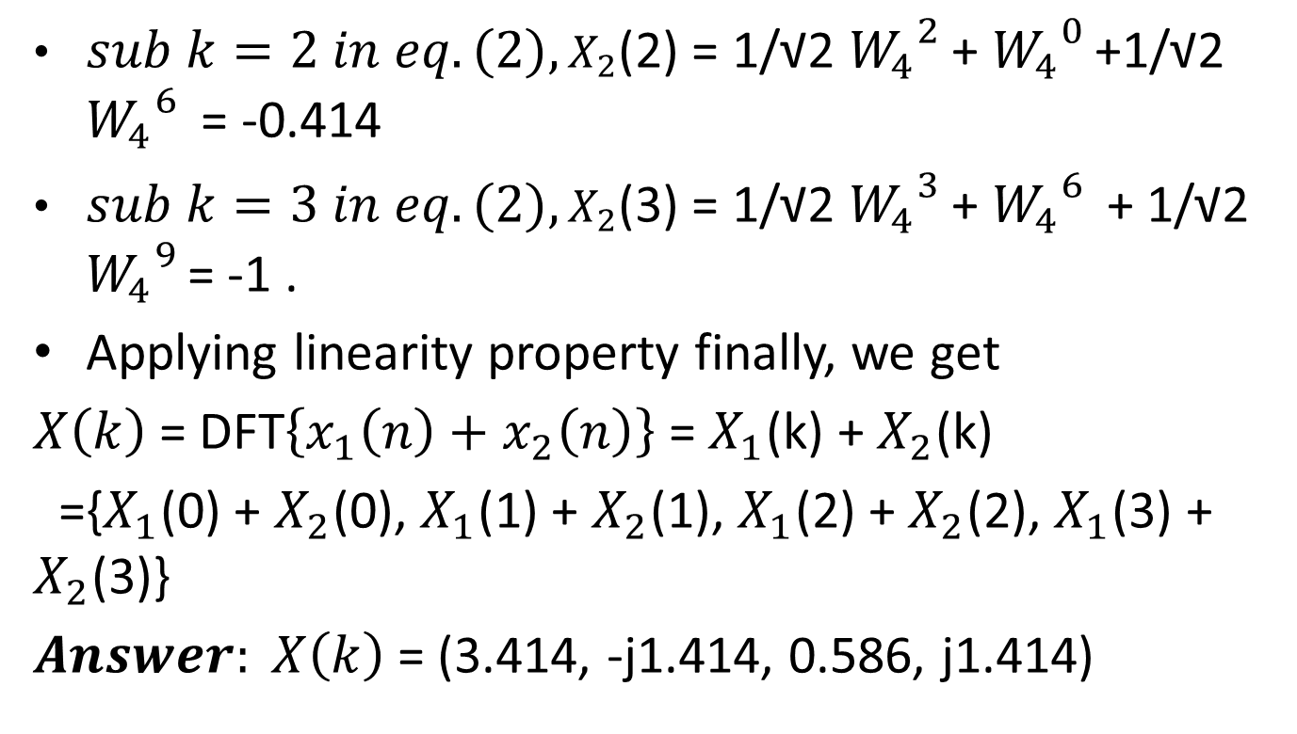
Problem applying linearity property
${sub k=2 in eq.\left(2\right),X}_{2}$(2) = 1/√2 ${W_{4}}^{2 }$+ ${W_{4}}^{0 }$+1/√2 ${W_{4}}^{6 }$ = -0.414
${sub k=3 in eq.\left(2\right),X}_{2}$(3) = 1/√2 ${W_{4}}^{3 }$+ ${W_{4}}^{6 }$ + 1/√2 ${W_{4}}^{9 }$= -1 .
Applying linearity property finally, we get
$X\left(k\right)$= DFT$\left\{x_{1}\left(n\right)+x_{2}\left(n\right)\right\}$ = $X_{1}$(k) + $X_{2}$(k)
={$X_{1}$(0) + $X_{2}$(0), $X_{1}$(1) + $X_{2}$(1), $X_{1}$(2) + $X_{2}$(2), $X_{1}$(3) + $X_{2}$(3)}
$Answer: X\left(k\right)$= (3.414, -j1.414, 0.586, j1.414)

Slide 8
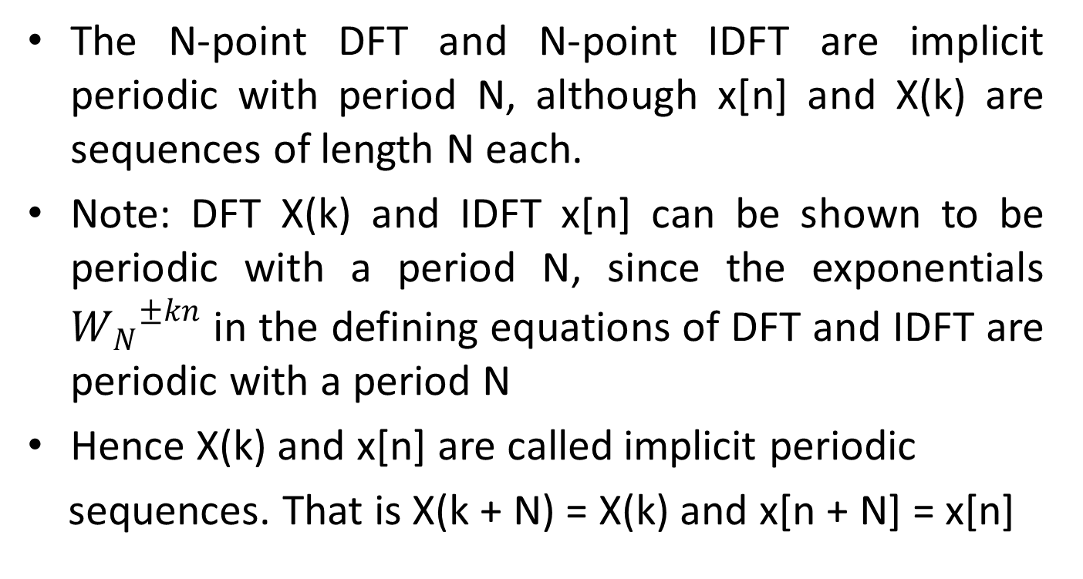
Periodicity Property
The N-point DFT and N-point IDFT are implicit periodic with period N, although x[n] and X(k) are sequences of length N each.
Note: DFT X(k) and IDFT x[n] can be shown to be periodic with a period N, since the exponentials ${W_{N}}^{±kn}$ in the defining equations of DFT and IDFT are periodic with a period N
Hence X(k) and x[n] are called implicit periodic
sequences. That is X(k + N) = X(k) and x[n + N] = x[n]

Slide 9
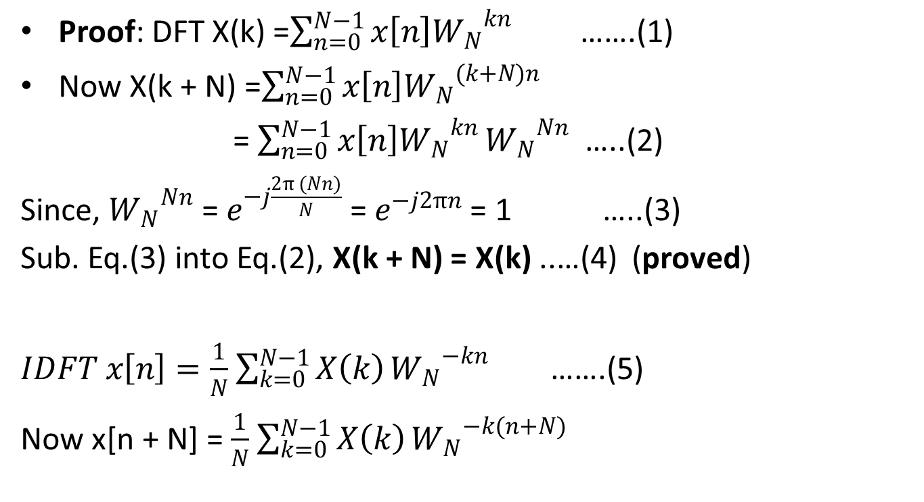
Proof of Periodicity Property
Proof: DFT X(k) =$\sum_{n=0}^{N−1}{x\left[n\right]{W_{N}}^{kn}}$ …….(1)
Now X(k + N) =$\sum_{n=0}^{N−1}{x\left[n\right]{W_{N}}^{(k+N)n}}$
= $\sum_{n=0}^{N−1}{x\left[n\right]{W_{N}}^{kn}}{W_{N}}^{Nn}$ …..(2)
Since, ${W_{N}}^{Nn}$ = $e^{−j\frac{2π (Nn)}{N}}$ = $e^{−j2πn}$ = 1 …..(3)
Sub. Eq.(3) into Eq.(2), X(k + N) = X(k) ..…(4) (proved)
$IDFT x\left[n\right]=\frac{1}{N}$ $\sum_{k=0}^{N−1}{X\left(k\right)}{W_{N}}^{−kn}$ …….(5)
Now x[n + N] = $\frac{1}{N}$ $\sum_{k=0}^{N−1}{X\left(k\right)}{W_{N}}^{−k(n+N)}$

Slide 10

Proof of Periodicity Property
x[n + N] = $\frac{1}{N}$ $\sum_{k=0}^{N−1}{X\left(k\right)}{W_{N}}^{−kn}{W_{N}}^{−kN}$ ……(6)
Since, ${W_{N}}^{−kN}$ = $e^{j\frac{2π (kN)}{N}}$ = $e^{j2πk}$ = 1 …..(7)
Sub. Eq.(7) into Eq.(6), x[n + N) = x[n] ..…(8) (proved)
Activity 1: Apply Linearity Property for N= 8 samples
Activity 2: Plot magnitude and phase response of DFT

Slide 11
Periodicity in DFT
Â
DFT is periodic in both time and frequency domains!!!
ª Even though the original time domain sequence to be transformed is not periodic!
There are several ways to explain this phenomenon. Mathematically , we can easily show that both the analysis and synthesis equations are periodic by N.
Now, understanding that DFT is periodic in frequency domain is straightforward: DFT is obtained by sampling DTFT at 2π/N intervals. Since DTFT was periodic with 2π Æ DFT is periodic by N.
This can also be seen easily from the complex exponential wheel. Since there are only N vectors around a unit circle, the transform will repeat itself every N points.
But what does it mean that DFT is also periodic in time domain?
Â
Â
Â
Â

Slide 12
Periodicity in DFT
Â Recall how we obtained the frequency spectrum of a sampled signal:
ª The spectrum of the sampled signal was identical to that of the continuous signal, except,
with periodically replications of itself every 2π.
ª That is, sampling the signal in time domain, caused the frequency domain to be periodic
with 2π.
Â In obtaining DFT, we did the opposite: sample the frequency domain
ª
From the duality of the Fourier transform, this corresponds to making the time domain
periodic.
However, the original signal was not periodic!
This is an artifact of the mathematical manipulations.
ª
ª
Â Here is what is happening:
ª When we sample the DTFT in frequency domain, the resulting “discrete spectrum”
is not spectrum of the original discrete signal. Rather, the sampled spectrum is in
fact the spectrum of a time domain signal that consists of periodically replicated
versions of the original discrete signal.
ª Similar to sampling theorem, under rather mild conditions, we can reconstruct the DTFT
X(ω), from its DFT samples X[k]. More on this later!

Slide 13
Circular time shift
Statement
If DFT { x[n] } = X(k), then$DFT \{ {x(\left(n−m\right))}_{N}$} = ${W_{N}^{}}^{km}$ X(k), 0≤ k ≤ N
Proof Consider DFT viewed as a linear operator
$x\left[n\right]$ $DFT \left\{.\right\} X\left(k\right)$
This means that x[n] and X(k) are of same length N
From Inverse DFT definition, we know
$IDFT x\left[n\right]=\frac{1}{N}$ $\sum_{k=0}^{N−1}{X\left(k\right)}{W_{N}}^{−kn}$ , 0≤ n ≤ N-1 ………(1)
Implies, $x\left[n−m\right]=\frac{1}{N}$ $\sum_{k=0}^{N−1}{X\left(k\right)}{W_{N}}^{−k(n−m)}$ ………(2)
Since, the time shift is circular, we can write eq.(2) as
${x(\left(n−m\right))}_{N}$ = $\frac{1}{N}$ $\sum_{k=0 }^{N−1}{[X\left(k\right)}{W_{N}}^{km}{{] W}_{N}}^{−kn}$ ……(3)
${x(\left(n−m\right))}_{N}$ = $IDFT$ $[ X\left(k\right){W_{N}^{}}^{km}$ ] ……..(4)
(OR)
$DFT \{ {x(\left(n−m\right))}_{N}$} = ${W_{N}^{}}^{km}$ X(k) ……..(5) (Hence the proof)

Slide 14
Time shift property
Problem
Find the 4-point DFT of the sequence, $x\left[n\right]=$ (1,-1,1,-1). Also using time shift property, find the DFT of the sequence, $y\left[n\right]=$ ${x(\left(n−2\right))}_{4}$ ?
Solution: Given N=4
${W_{4}}^{0}$= 1, ${W_{4}}^{1}$= – j, ${W_{4}}^{2}$= -1 and ${W_{4}}^{3}$= j
$X\left(k\right)=DFT \{x\left[n\right]\}$ =$\sum_{n=0}^{N−1}{x\left[n\right]{W_{N}}^{kn}}$ = $\sum_{n=0}^{3}{x\left[n\right]{W_{4}}^{kn}}$, 0≤ k ≤ 3
= 1 x ${W_{4}}^{0k}$ - 1 x ${W_{4}}^{k}$ + 1 x ${W_{4}}^{2k}$ - 1 x ${W_{4}}^{3k}$
$X\left(k\right)=$ 1 - ${W_{4}}^{k}$ + ${W_{4}}^{2k}$ - ${W_{4}}^{3k}$ ……(1)
Sub k=0 in eq.(1) , $X\left(0\right)=$ 1-1+1-1 = 0
Sub k=1 in eq.(1) , $X\left(1\right)=$ 1- ${W_{4}}^{1}$ + ${W_{4}}^{2}$ - ${W_{4}}^{3}$ = 1 + j -1 –j = 0
Sub k=2 in eq.(1) , $X\left(2\right)=$ 1- ${W_{4}}^{2}$ + ${W_{4}}^{4}$ - ${W_{4}}^{6}$ = 1- ${W_{4}}^{2}$ + ${W_{4}}^{0}$ - ${W_{4}}^{2}$
$X\left(2\right)=$ 1+1+1+1 =4
Sub k=3 in eq.(1) , $X\left(3\right)=$ 1- ${W_{4}}^{3}$ + ${W_{4}}^{6}$ - ${W_{4}}^{9}$ = 1- ${W_{4}}^{3}$ + ${W_{4}}^{2}$ - ${W_{4}}^{1}$
$X\left(3\right)=$ 1-j-1+j = 0
Therefore DFT $X\left(k\right)=$ (0,0,4,0)

Slide 15
Circular time shift property
G$iven, y\left[n\right]=$ ${x(\left(n−2\right))}_{4}$ and we now found $X\left(k\right)=$ (0,0,4,0)
Applying circular time shift property, we get
DFT Y(k) = ${W_{4}^{}}^{2k}$ X(k) , where k=0,1,2,3 ……….(2)
Sub k=0 in eq.(2) , Y$\left(0\right)=$ ${W_{4}^{}}^{0}$ X(0) = 1 X 0 = 0
Sub k=1 in eq.(2) , Y$\left(1\right)=$ ${W_{4}^{}}^{2}$ X(1) = -1 X 0 = 0 Sub k=2 in eq.(2) , Y$\left(2\right)=$ ${W_{4}^{}}^{4}$ X(2) = ${W_{4}^{}}^{0}$ X(2) = 1 x 4 = 4
Sub k=3 in eq.(2) , Y$\left(3\right)=$ ${W_{4}^{}}^{6}$ X(3) = ${W_{4}^{}}^{2}$ X(3) = -1 x 0 = 0
Hence, DFT Y$\left(k\right)=$ (0,0,4,0)

Slide 16
Circular time shift property
Problem 2
Suppose $x\left[n\right]$ is an 8-point sequence defined as $x\left[n\right]=$ {0,1,2,3,4,5,6,7}
Illustrate ${x(\left(n−2\right))}_{8}$
If DFT { x[n] } = X(k),what is DFT {${x(\left(n−2\right))}_{8}$} ?
Solution: (a) Given N=8 and $x\left[n\right]=$ {0,1,2,3,4,5,6,7}
To generate ${x(\left(n−2\right))}_{8}$ , move the last 2 samples of $x\left[n\right]$ to the beginning
That is , ${ x(\left(n−2\right))}_{8}$ = {6,7,0,1,2,3,4,5}
It should be noted that ${x(\left(n−2\right))}_{8}$ is implicitly periodic with N=8
(b) Let $y\left[n\right]=$ ${x(\left(n−2\right))}_{8}$
Applying circular time shift property, we get
DFT Y(k) = ${W_{8}^{}}^{2k}$ X(k) , where k=0,1,2,3,4,5,6,7

Slide 17
Time-Reversal / Circular Folding Property of DFT
Statement:
It states that reversing the N-Point sequence in time-domain is equivalent to reversing the DFT sequence in frequency domain
That is, if DFT {x[n]} = X(k), then DFT {x[N-n]} = X(N-k)
Implies, $DFT \{{x\left(\left(−n\right)\right)}_{N}\}$ = ${X\left(\left(−k\right)\right)}_{N}$
Proof: DFT {x[N-n]} = $\sum_{n=0}^{N−1}{x\left[N−n\right]e^{−j2πkn\text{/}\text{N}}}$ ….(1)
Let m = N-n , therefore n=N-m ….(2)
Eq.(1) implies, DFT {x[N-n]} = $\sum_{m=0}^{N−1}{x\left[m\right]e^{−j2πk\left(N−m\right)\text{/}\text{N}}}$
= $\sum_{m=0}^{N−1}{x\left[m\right]e^{−j2πkN\text{/}\text{N}}}$ $e^{j2πkm/N}$
= $\sum_{m=0}^{N−1}{x\left[m\right]}$ ${e^{−j2πk} e}^{j2πkm/N}$ ……..(3)
DFT {x[N-n]} = $\sum_{m=0}^{N−1}{x\left[m\right]}$ $e^{j2πkm/N}$ (Since $e^{−j2πk}$ = 1 )

Slide 18
Circular Folding Property of DFT
DFT {x[N-n]} =$\sum_{m=0}^{N−1}{x\left[m\right]}$ $e^{j2πkm/N}$ ……(4)
= $\sum_{m=0}^{N−1}{x\left[m\right]}$ ${e^{−j2πm} e}^{j2πkm/N}$
= $\sum_{m=0}^{N−1}{x\left[m\right]}$ ${e^{−j2πmN/N}e}^{j2πkm/N}$
= $\sum_{m=0}^{N−1}{x\left[m\right]}$ $e^{−\frac{j2πm\left(N−k\right)}{N}}$ ………(5)
= X(N-k)
Implies, DFT {x[N-n]} = X(N-k)
(OR)
$DFT \{{x\left(\left(−n\right)\right)}_{N}\}$ = ${X\left(\left(−k\right)\right)}_{N}$ ……(6) (hence the proof)

Slide 19
Circular Folding
Problem
Compute the 4-point DFT of the sequence $x\left[n\right]$={1,2,1,0}
Also, find DFT Y(k) if $y\left[n\right]=$ ${x(\left(−n\right))}_{4}$ , 0 ≤ k ≤ 3 ?
Solution
(I) We know that ${ Twiddle Factor W}_{N}$ = $e^{−j\frac{2π}{N}}$
Since N=4, we get ${ W}_{4}$ = $e^{−j\frac{ 2π}{4}}$ = $e^{−j\frac{ π}{2}}$
${{Hence, W}_{4}}^{0}$= 1, ${W_{4}}^{1}$= – j, ${W_{4}}^{2}$= -1 and ${W_{4}}^{3}$= j
$X\left(k\right)=DFT \{x\left[n\right]\}$ = $\sum_{n=0}^{3}{x\left[n\right]{W_{4}}^{kn}}$, 0≤ k ≤ 3
= 1 x ${W_{4}}^{0k}$ + 2 x ${W_{4}}^{k}$ + 1 x ${W_{4}}^{2k}$ + 0 x ${W_{4}}^{3k}$
$X\left(k\right)=$ 1 + ${{2W}_{4}}^{k}$ + ${W_{4}}^{2k}$ ……(1)

Slide 20
Circular Folding
Now DFT $X\left(k\right)=$ 1 + ${{2W}_{4}}^{k}$ + ${W_{4}}^{2k}$ ……(1)
Sub k=0 in eq.(1) , $X\left(0\right)=$ 1+2+1 = 4
Sub k=1 in eq.(1) , $X\left(1\right)=$ 1 + 2${W_{4}}^{1}$ + ${W_{4}}^{2}$ = –j2
Sub k=2 in eq.(1) , $X\left(2\right)=$ 1 + 2${W_{4}}^{2}$ + ${W_{4}}^{4}$ = 1 + 2${W_{4}}^{2}$ + ${W_{4}}^{0}$ =0
Sub k=3 in eq.(1) , $X\left(3\right)=$ 1 + 2${W_{4}}^{3}$ + ${W_{4}}^{6}$ = 1 + 2${W_{4}}^{3}$ + ${W_{4}}^{2}$ =j2
Thus, DFT values of X(k) = {4, –j2, 0, j2} …..(2)
ii)
Since $x\left[n\right]$ is real, it may be noted that the symmetry property,
$X\left(k\right)=X^{∗}$(N-k) …….(3)
Given: $y\left[n\right]=$ ${x(\left(−n\right))}_{4}$
Hence, Y(k) = X(4-k) = ${X\left(\left(−k\right)\right)}_{4}$ …….(4)

Slide 21

Circular Folding
${X\left(\left(−k\right)\right)}_{4}$=${ X}^{∗}$(k) , 0 ≤ k ≤ 3 (since $x\left[n\right]$ is real)
Hence, Y(k) = ${ X}^{∗}$(k)
Implies, Y(k) = {4, j2, 0, -j2}
Therefore, DFT Y(k) = {4, j2, 0, -j2}

Slide 22
DFT & Circular Shift
Â We compute the N-point DFT of a periodic discrete sequence x[n],
with the understanding that the computed DFT is in fact the spectrum
of a periodic sequence
~x[n] ,
which is obtained by periodically
replicating x[n] with a period of N samples.
Â This nuance makes it necessary to introduce the concept of circular shift.
ª A circularly shifted sequence is denoted by x[(n-L)_{N}], where L is the amount of
shift, and N is the length of the previously determined base interval (by default,
unless defined otherwise, this is equal to the length of the sequence).
ª The circularly shifted sequence is defined only in the same interval as the original sequence!
ª To obtain a circularly shifted sequence, we first linearly shift the sequence by L, and then rotate the sequence in such a manner that the shifted sequence remain in the same interval originally defined by N.

Slide 23
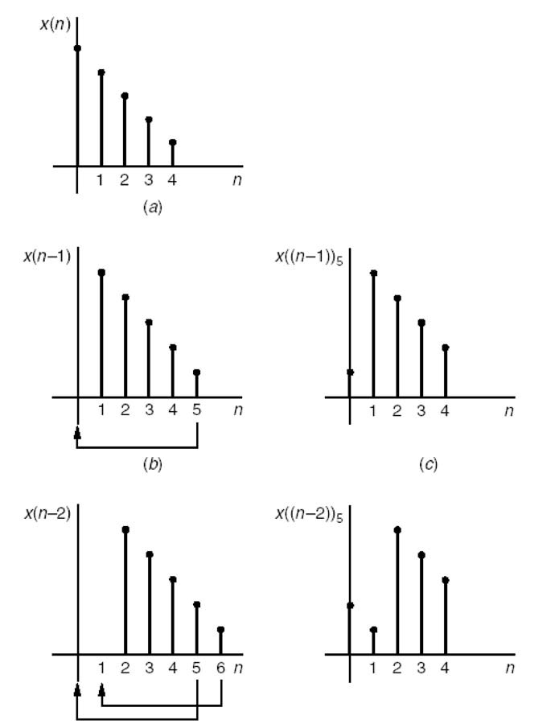
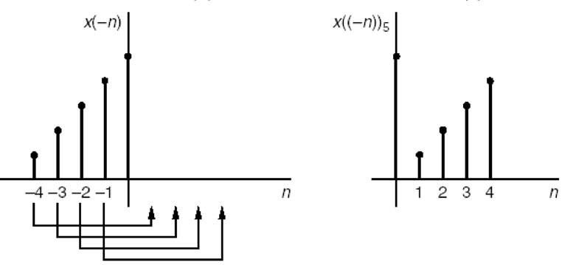
Circular
Shift
Original sequence
Linear shift
Circular shift
If the original sequence is defined in the time interval N₁
to N₂, then the circular shift can mathematically be
represented as follows:
^{x}c ^{[n] = x}[(^{n − L})]N
= x[(n − L + rN ), such that N₁ ≤ n − L ≤ N ₂ ]
= x[(n − L)mod N ]
The circularly shifted sequence is obtained by finding an
integer r such that n-L+rN remains in the same domain as the original sequence.

Slide 24
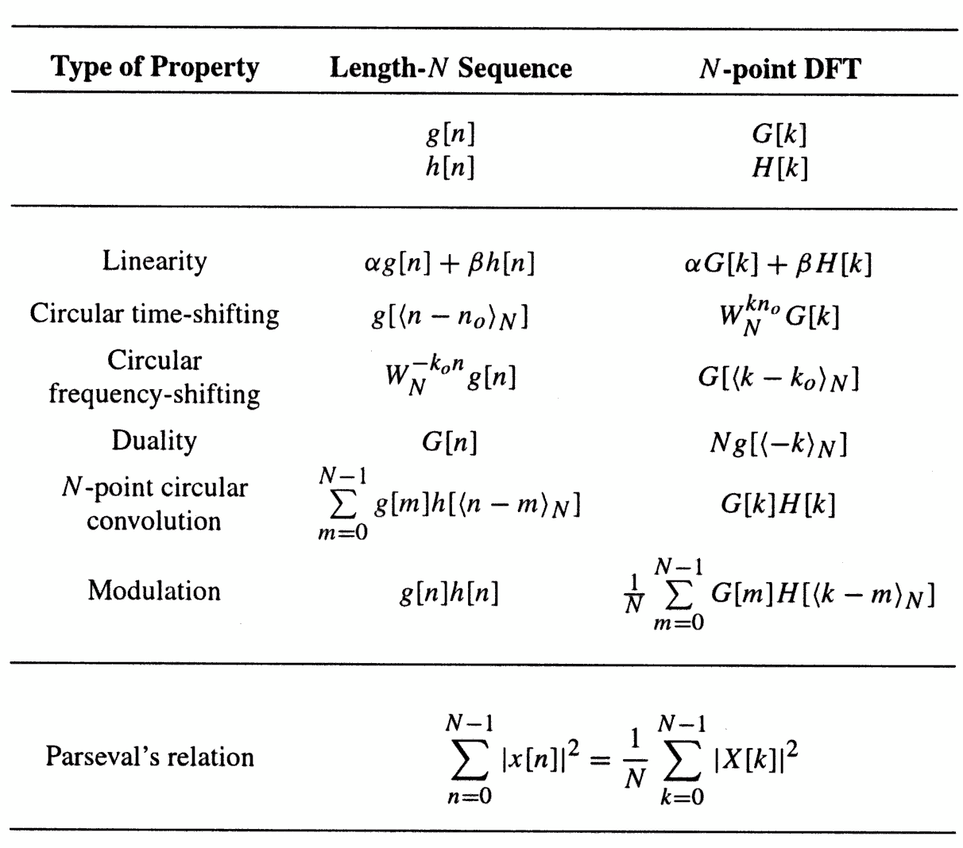
Properties
of
the
DFT
2π
− j kn0
= e
N
G[k ]
2π
= e
j k₀ n
N
g[n]
(^{g[n]* h[n]})_{N}
1
⁼ (^{G[k ]* H [k ]})_{N}
(Circular convolution in frequency)
N

Slide 25
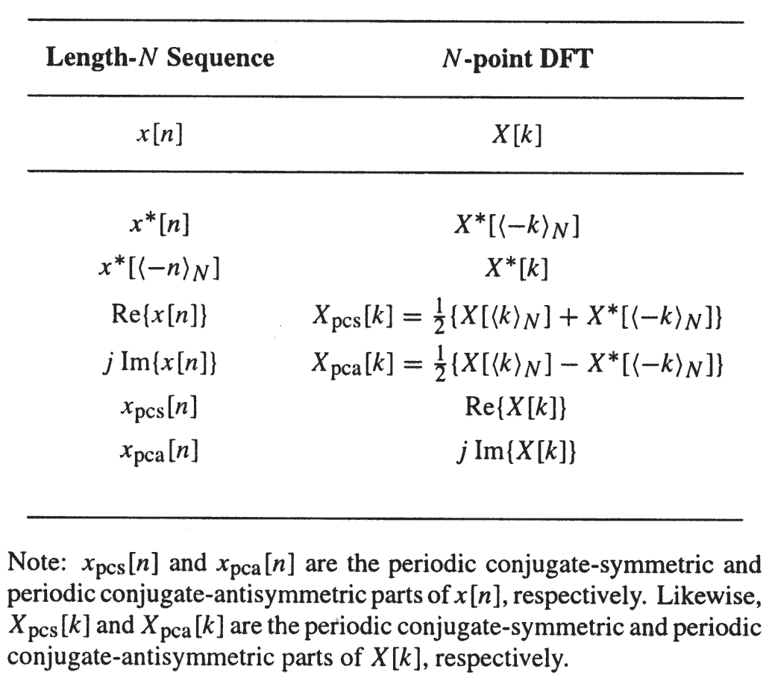
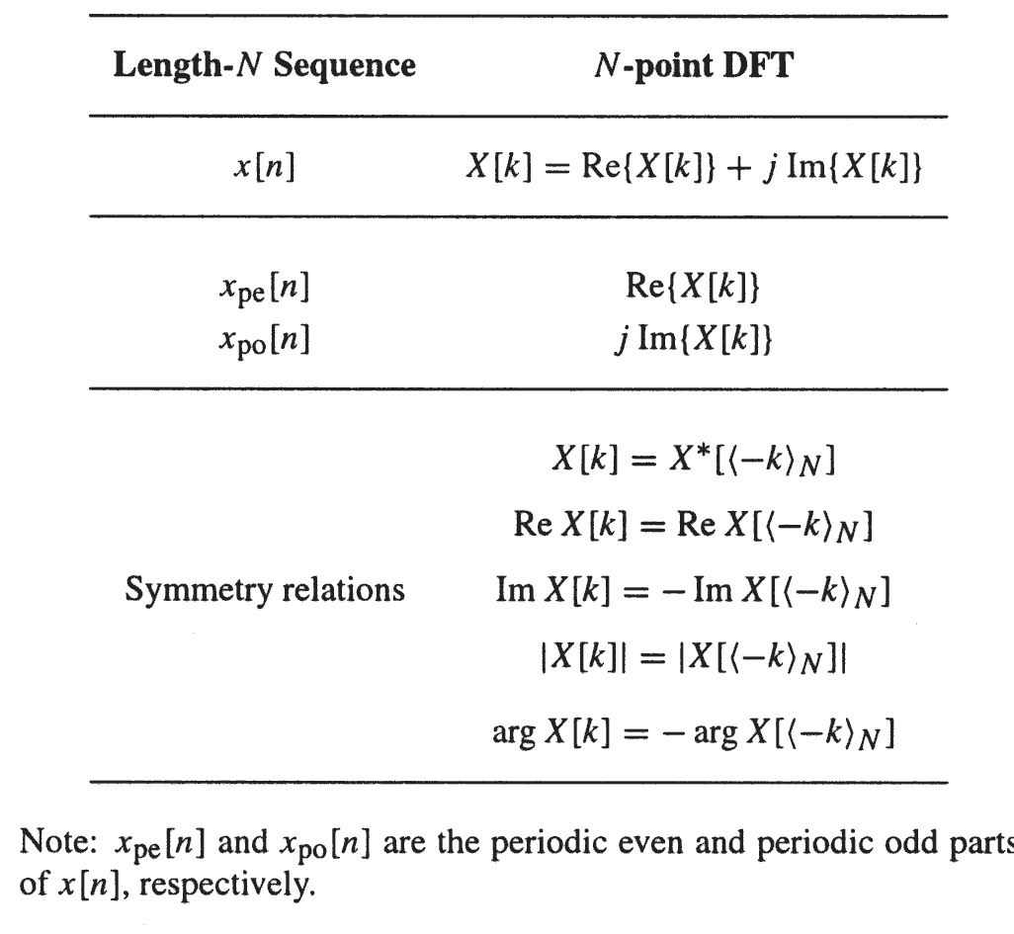
DFT
Symmetry
relations

