Slide 1

_{Lecture 9}
Discrete Fourier Transform (DFT properties II)
Dr K. Mohanaprasad
Associate Professor
School of Electronics Engineering (SENSE)
VIT Chennai

Slide 2
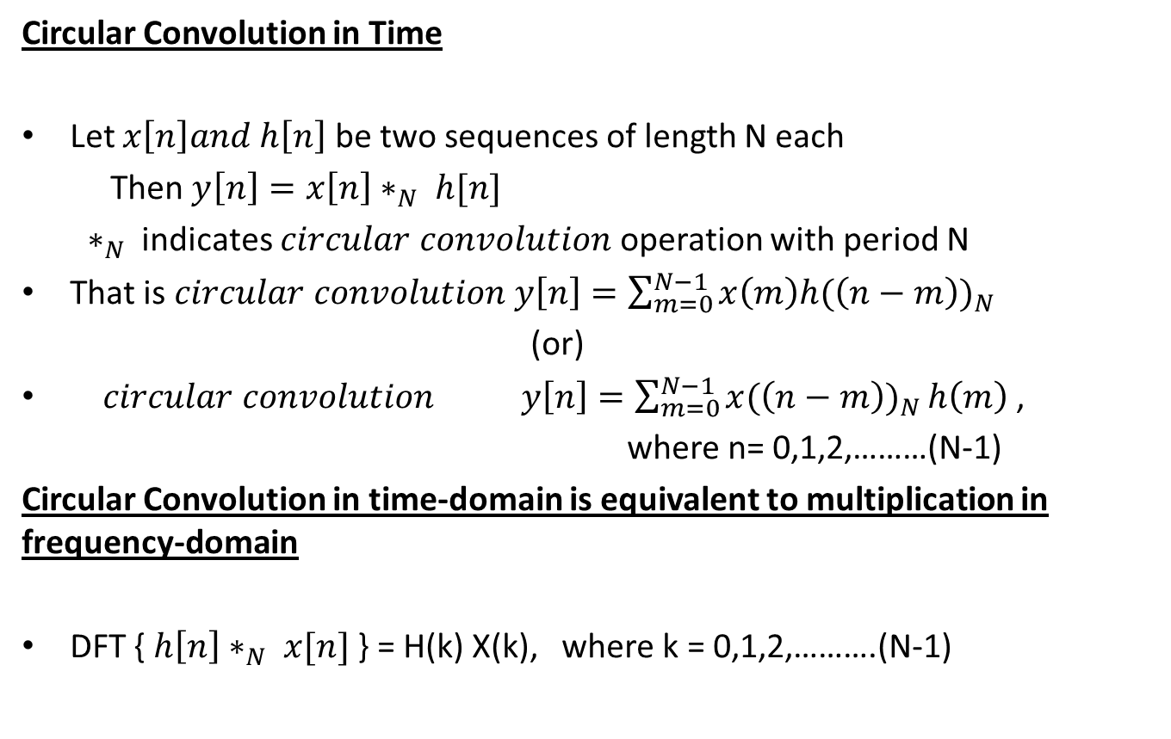
Circular Convolution Property of DFT
Circular Convolution in Time
Let $x\left[n\right]and h\left[n\right]$ be two sequences of length N each
Then $y\left[n\right]=x\left[n\right]∗_{N} h[n]$
$∗_{N}$ indicates $circular convolution$operation with period N
That is $circular convolution y\left[n\right]=\sum_{m=0}^{N−1}{x\left(m\right)h{(\left(n−m\right))}_{N}}$
(or)
$circular convolution y\left[n\right]=\sum_{m=0}^{N−1}{x{(\left(n−m\right))}_{N}}h\left(m\right)$ ,
where n= 0,1,2,………(N-1)
Circular Convolution in time-domain is equivalent to multiplication in frequency-domain
DFT { $h\left[n\right]∗_{N} x[n]$ } = H(k) X(k), where k = 0,1,2,……….(N-1)

Slide 3
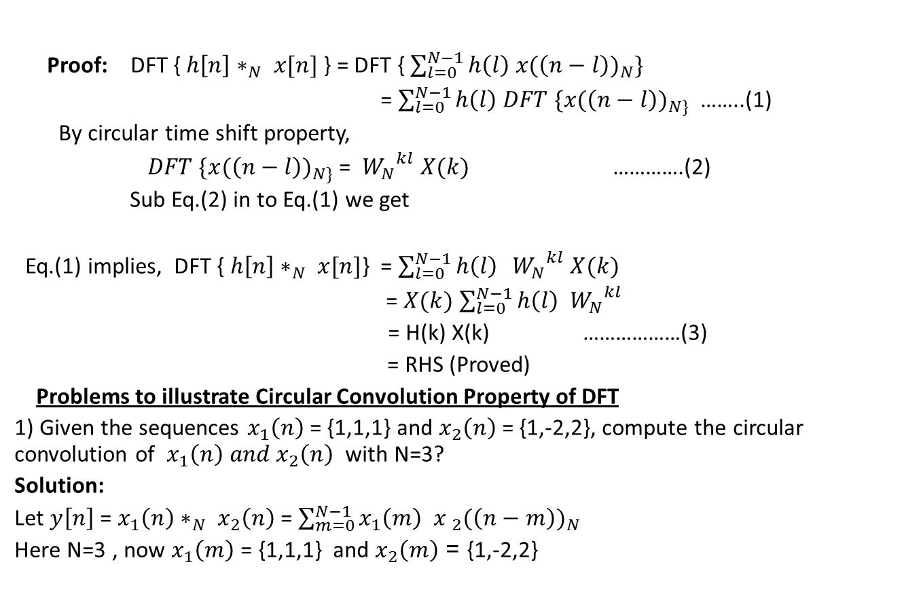
Circular Convolution Property
Proof: DFT { $h\left[n\right]∗_{N} x[n]$ } = DFT { $\sum_{l=0}^{N−1}{h\left(l\right) x{(\left(n−l\right))}_{N}}\}$
= $\sum_{l=0}^{N−1}{h\left(l\right) DFT \{x{(\left(n−l\right))}_{N\}}}$ ……..(1)
By circular time shift property,
$DFT \{x{(\left(n−l\right))}_{N\}}$ = ${ W_{N}}^{kl} X(k)$ ………….(2)
Sub Eq.(2) in to Eq.(1) we get
Eq.(1) implies, DFT { $h\left[n\right]∗_{N} x[n]$} = $\sum_{l=0}^{N−1}{h\left(l\right) }{ W_{N}}^{kl} X(k)$
= $X(k)$ $\sum_{l=0}^{N−1}{h\left(l\right) }{ W_{N}}^{kl}$
= H(k) X(k) ………………(3)
= RHS (Proved)
Problems to illustrate Circular Convolution Property of DFT
1) Given the sequences $x_{1}\left(n\right)$ = {1,1,1} and $x_{2}\left(n\right)$= {1,-2,2}, compute the circular convolution of $x_{1}\left(n\right) and x_{2}\left(n\right)$ with N=3?
Solution:
Let $y\left[n\right]$ = $x_{1}\left(n\right)∗_{N} x_{2}\left(n\right)$ = $\sum_{m=0}^{N−1}{x_{1}\left(m\right){ x }_{2}{(\left(n−m\right))}_{N}}$
Here N=3 , now $x_{1}\left(m\right)$ = {1,1,1} and $x_{2}\left(m\right)$ = {1,-2,2}

Slide 4
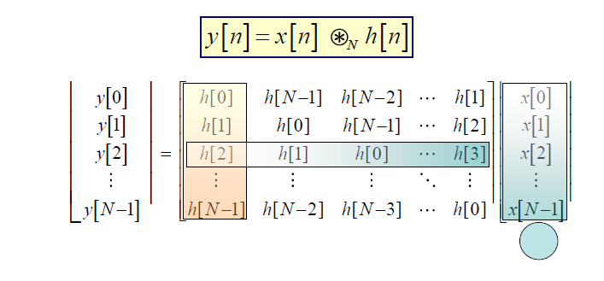

Slide 5
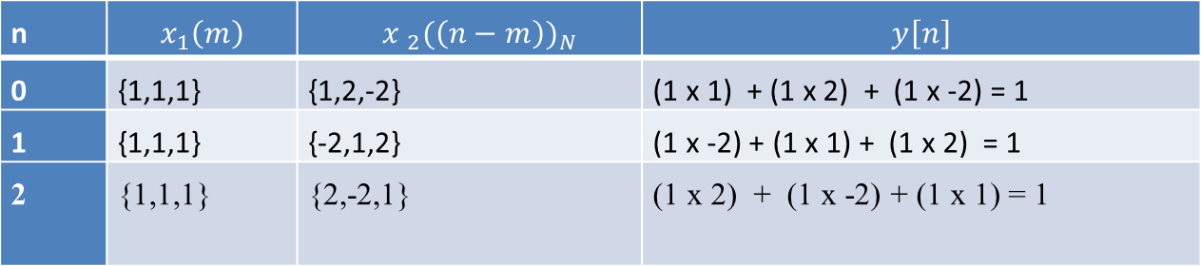
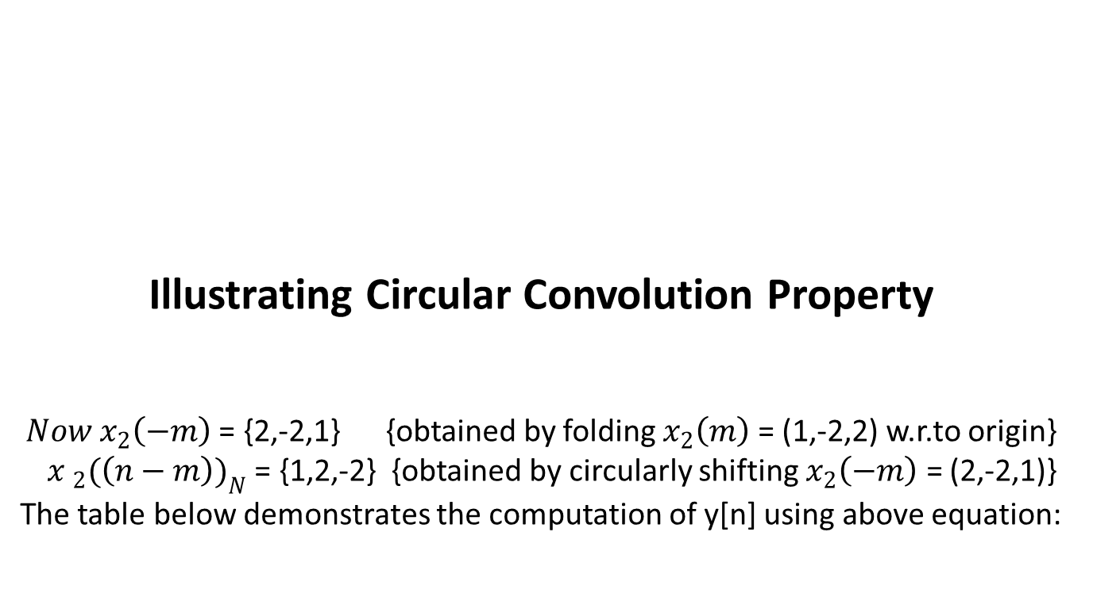
Illustrating Circular Convolution Property ${Now x}_{2}\left(−m\right)$ = {2,-2,1} {obtained by folding $x_{2}\left(m\right)$ = (1,-2,2) w.r.to origin} ${ x }_{2}{(\left(n−m\right))}_{N}$ = {1,2,-2} {obtained by circularly shifting $x_{2}\left(−m\right)$ = (2,-2,1)} The table below demonstrates the computation of y[n] using above equation:
n | $$x_{1}\left(m\right)$$ | $${ x }_{2}{(\left(n−m\right))}_{N}$$ | $$y\left[n\right]$$
0 | {1,1,1} | {1,2,-2} | (1 x 1) + (1 x 2) + (1 x -2) = 1
1 | {1,1,1} | {-2,1,2} | (1 x -2) + (1 x 1) + (1 x 2) = 1
2 | {1,1,1} | {2,-2,1} | (1 x 2) + (1 x -2) + (1 x 1) = 1
Answer: Circular convolution $y\left[n\right]$ = {1,1,1}

Slide 6
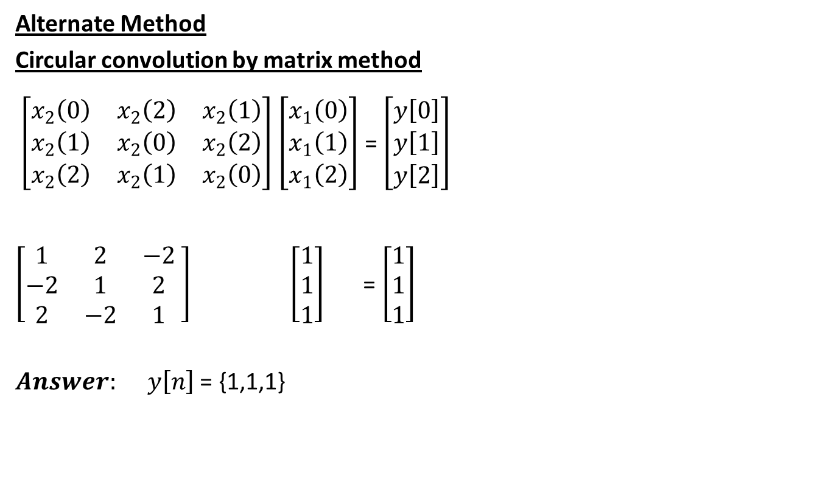
Illustrating Circular Convolution Property
Alternate Method
Circular convolution by matrix method
$\left[\begin{matrix}x_{2}\left(0\right) & x_{2}\left(2\right) & x_{2}\left(1\right) \\ x_{2}\left(1\right) & x_{2}\left(0\right) & x_{2}\left(2\right) \\ x_{2}\left(2\right) & x_{2}\left(1\right) & x_{2}\left(0\right)\end{matrix}\right]$ $\left[\begin{matrix}x_{1}\left(0\right) \\ x_{1}\left(1\right) \\ x_{1}\left(2\right)\end{matrix}\right]$ = $\left[\begin{matrix}y\left[0\right] \\ y\left[1\right] \\ y\left[2\right]\end{matrix}\right]$
$\left[\begin{matrix}1 & 2 & −2 \\ −2 & 1 & 2 \\ 2 & −2 & 1\end{matrix} \right] \left[\begin{matrix}1 \\ 1 \\ 1\end{matrix}\right]$ = $\left[\begin{matrix}1 \\ 1 \\ 1\end{matrix}\right]$
$Answer: y\left[n\right]$ = {1,1,1}

Slide 7
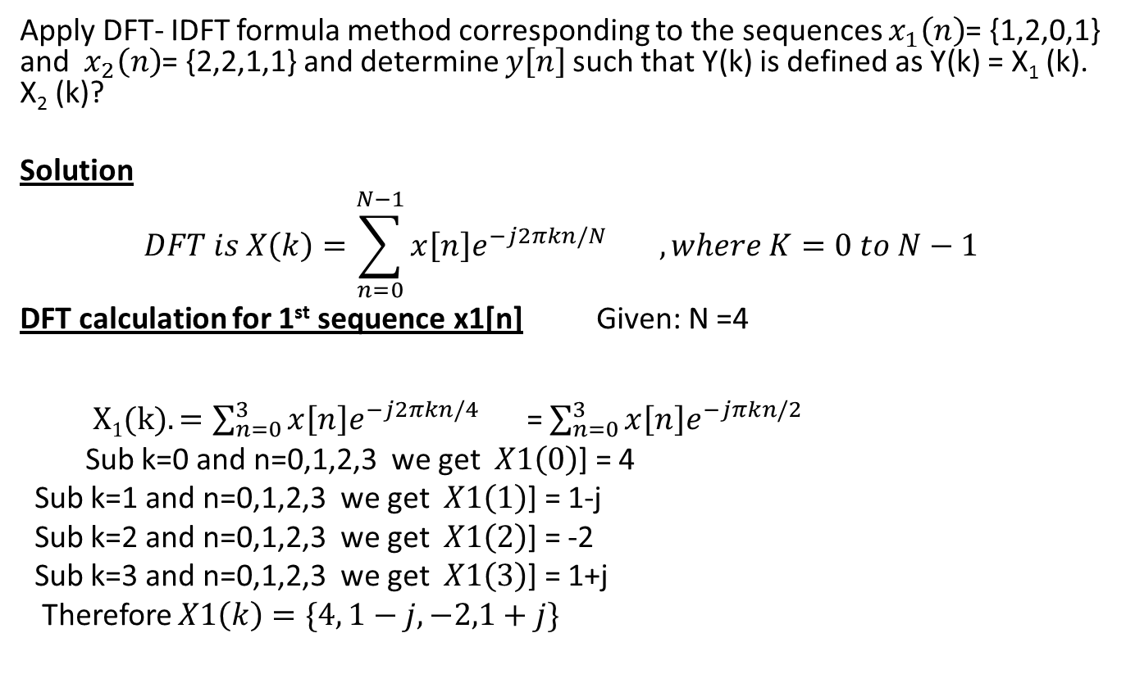
DFT- IDFT formula method
Apply DFT- IDFT formula method corresponding to the sequences $x_{1}\left(n\right)$= {1,2,0,1} and $x_{2}\left(n\right)$= {2,2,1,1} and determine $y\left[n\right]$such that Y(k) is defined as Y(k) = X₁ (k). X₂ (k)?
Solution
$$DFT is X\left(k\right)=\sum_{n=0}^{N−1}{x\left[n\right]{{e^{−j2πkn/N}}^{}}^{}}, where K=0 to N−1$$
DFT calculation for 1st sequence x1[n] Given: N =4
$X1(k). =\sum_{n=0}^{3}{x\left[n\right]{{e^{−j2πkn/4}}^{}}^{}}$= $\sum_{n=0}^{3}{x\left[n\right]{{e^{−jπkn/2}}^{}}^{}}$
Sub k=0 and n=0,1,2,3 we get $X1\left(0\right)$] = 4
Sub k=1 and n=0,1,2,3 we get $X1\left(1\right)$] = 1-j
Sub k=2 and n=0,1,2,3 we get $X1\left(2\right)$] = -2
Sub k=3 and n=0,1,2,3 we get $X1\left(3\right)$] = 1+j
Therefore $X1\left(k\right)=\{4, 1−j,−2,1+j\}$

Slide 8
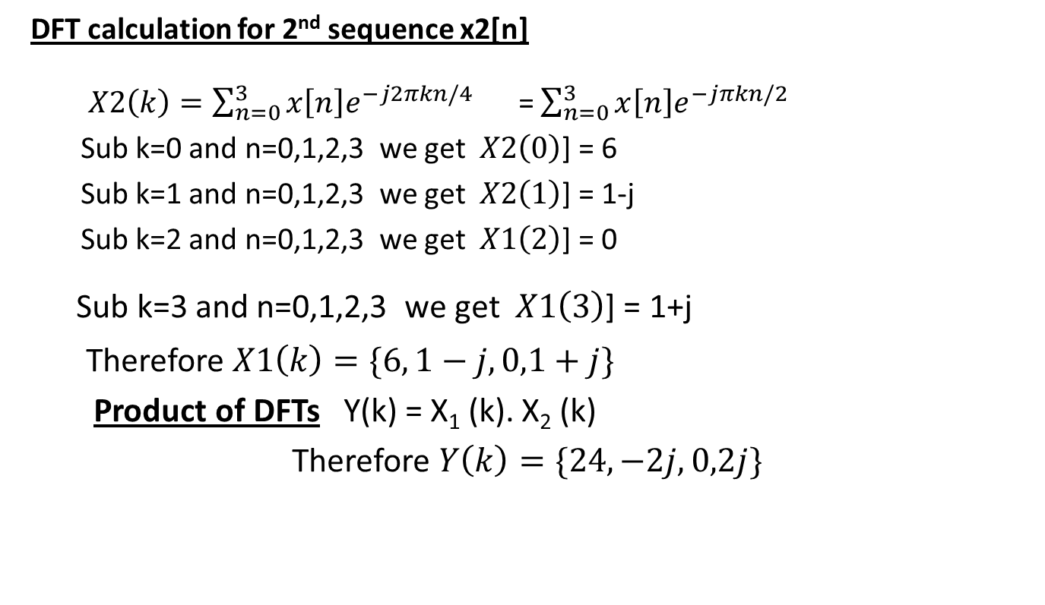
DFT- IDFT formula method
DFT calculation for 2nd sequence x2[n]
$X2\left(k\right)=\sum_{n=0}^{3}{x\left[n\right]{{e^{−j2πkn/4}}^{}}^{}}$= $\sum_{n=0}^{3}{x\left[n\right]{{e^{−jπkn/2}}^{}}^{}}$
Sub k=0 and n=0,1,2,3 we get $X2\left(0\right)$] = 6
Sub k=1 and n=0,1,2,3 we get $X2\left(1\right)$] = 1-j
Sub k=2 and n=0,1,2,3 we get $X1\left(2\right)$] = 0
Sub k=3 and n=0,1,2,3 we get $X1\left(3\right)$] = 1+j
Therefore $X1\left(k\right)=\{6, 1−j,0,1+j\}$
Product of DFTs Y(k) = X₁ (k). X₂ (k)
Therefore $Y\left(k\right)=\{24, −2j,0,2j\}$

Slide 9
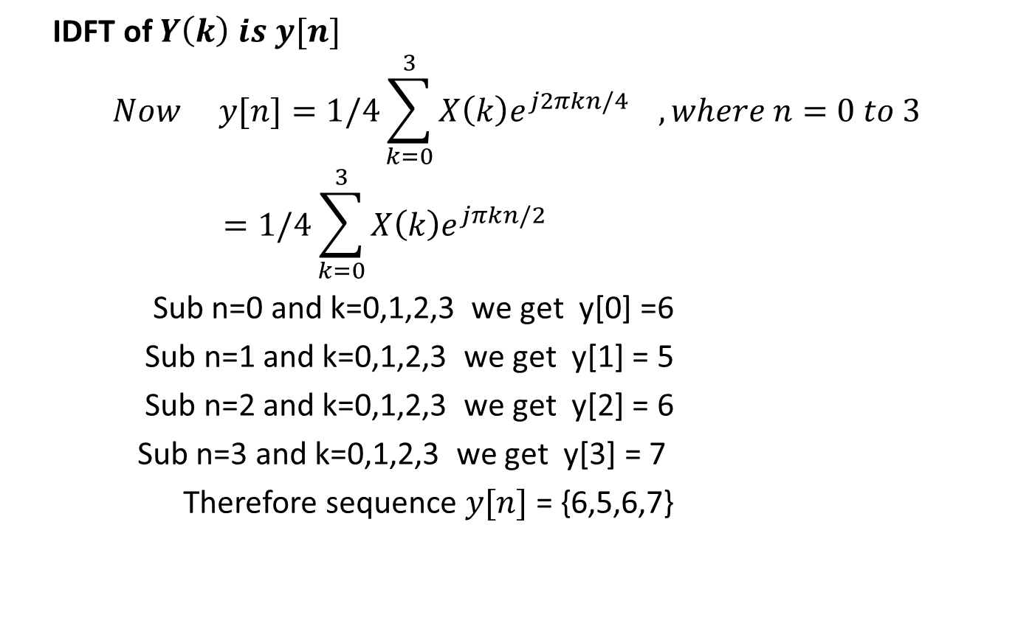
Problem Continued
IDFT of $Y\left(k\right) is y[n]$
$$Now y[n]=1/4\sum_{k=0}^{3}{X\left(k\right){e^{j2πkn/4}}^{}}, where n=0 to 3=1/4\sum_{k=0}^{3}{X\left(k\right){e^{jπkn/2}}^{}}$$
Sub n=0 and k=0,1,2,3 we get y[0] =6
Sub n=1 and k=0,1,2,3 we get y[1] = 5
Sub n=2 and k=0,1,2,3 we get y[2] = 6
Sub n=3 and k=0,1,2,3 we get y[3] = 7
Therefore sequence $y[n]$ = {6,5,6,7}

Slide 10
Alternative Approach to DFT-IDFT Method
To obtain the same result of multiplication in frequency domain, the alternative approach is to perform circular convolution in time domain
Two methods are widely used to perform circular convolution:
1. Concentric Circle Method
2. Matrix Method

Slide 11
Circular Convolution
Â Since the convolution operation involves shifting, we need to redefine the
convolution for circularly shifted sequences.
ª The process is fairly straightforward, one simply needs to ensure that the shifting in
convolution is done in a circular fashion.
ª Example: Compute circular convolution of the following sequences:
^{x}₁^{[n]=[-1 2 -3 2]}
Recall the expression:
y[n] = (x₁[n]* x₂[n])₄
^{x}₂^{[n]=[-0.5 1 1.5]}
•
3
3
= ∑ x1[m]x2 [(n − m)₄ ] = ∑ x2[m]x1[(n − m)₄ ]
m =0
m =0
^{x}1[-m]=[2 -3 2 -1] Î This sequence has nonzero values for m=-3, -2, -1 and 0. However,
this shift to circular shift, by rotating x₁[-m] enough to land all values in the original domain
circular shift is only defined on the original interval of [0 3]. Therefore we need to convert
xc [n] = x[(n − L)mod N ] = x[(n − L + rN ), N1 ≤ n − L ≤ N2 ]
^{x}1^{[(-m)}4^{]=[-1 2 -3 2]}
^{Î y[0]=Σx}2^{[m].x}1^{[(-m)}4]=-1(-0.5)+2(1)+-3(1.5)+2(0)=-2
^{x}1^{[(1-m)}4]=[2 -1 2 -3] (shift right) Î y[1]=Σx2^{[m].x}1^{[(1-m)}4^{]=2(-0.5)+(-1)1+2(1.5)-3(0)=1}
^{x}1^{[(2-m)}4^{]=[-3 2 -1 2 ]}
^{x}1^{[(3-m)}4^{]=[2 -3 2 -1]}
Î y[2]=Σx2[m].x1[(2-m)4]=-3(-0.5)+2(1)+-1(1.5)-2(0)=2
^{Î y[3]=Σx}2^{[m].x}1^{[(3-m)}4^{]=2(-0.5)+(-3)1+2(1.5)-1(0)=-1}

Slide 12
Circular Convolution
Example
Â Compute circular convolution of x[n]=[1 3 2 -1 4], h[n]=[2 0 1 7 -3]
y[n] = (x[n]* h[n])₅ = ∑ x[m]h[(n − m)₅ ] = ∑ h[m]x[(n − m)₅ ]
4
4
x[m]=[1 3 2 -1 4]
h[-m]=[-3 7 1 0 2]
m =0
m =0
^{h[(-m)}5^{]=[2 -3 7 1 0] Î}
^{y[0]=Σx[m].h[(-m)}5^{]=1*2+3(-3)+2*7+-1(1)+4(0)=6}
^{h[(1-m)}5]=[0 2 -3 7 1] Î y[0]=Σx[m].h[(1-m)5^{]=-3}
^{h[(2-m)}5]=[1 0 2 -3 7] Î y[0]=Σx[m].h[(2-m)5^{]= 36}
h[(3-m)₅]=[7 1 0 2 -3] Î y[0]=Σx[m].h[(3-m)₅]= -4
h[(4-m)₅]=[-3 7 1 0 2] Î y[0]=Σx[m].h[(4-m)₅]= 28
Linear convolution results: [ 2 6 5 8 28 4 -9 31 -12]

Slide 13
Linear vs. Circular
Convolution
Â Note that the results of linear and circular convolution are different.
This is a problem! Why?
Â All LTI systems are based on the principle of linear convolution, as the output of an LTI system is the linear convolution of the system impulse response and the input to the system, which is equivalent to the product of the respective DTFTs in the frequency domain.
ª However, if we use DFT instead of DTFT (so that we can compute it using a
computer), then the result appear to be invalid:
•
•
DTFT is based on linear convolution, and DFT is based on circular convolution, and
they are not the same!!!
For starters, they are not even of equal length: For two sequences of length N and M, the linear convolution is of length N+M-1, whereas circular convolution of the same two sequences is of length max(N,M), where the shorter sequence is zero padded to make it the same length as the longer one.
Is there any relationship between the linear and circular convolutions? Can one be obtained from the other? OR can they be made equivalent?
•

Slide 14
Linear vs. Circular
Convolution
Â YES!, rather easily, as a matter of fact!
ª FACT: If we zero pad both sequences x[n] and h[n], so that they are both of
length N+M-1, then linear convolution and circular convolution result in identical
sequences
ª Furthermore: If the respective DFTs of the zero padded sequences are X[k] and
H[k], then the inverse DFT of X[k]·H[k] is equal to the linear convolution of x[n]
and h[n]
ª Note that, normally, the inverse DFT of X[k].H[k] is the circular convolution
of
x[n] and h[n]. If they are
convolution of the two.
zero
padded,
then
the
inverse
DFT
is
the
linear

Slide 15
Example
Â Compute circular convolution of x[n]=[1 3 2 -1 4], h[n]=[2 0 1 7 -3],
by
appropriately zero padding the two
ª We need 5+5-1=9 samples
• x[n]=[1 3 2 -1 4 0 0 0 0], h[n]=[2 0 1 7 -3 0 0 0 0]
Zero pad signals!
8 8
y[n] = (x[n]* h[n])₉ = ∑ x[m]h[(n − m)₉ ] = ∑ h[m]x[(n − m)₉ ]
m =0 m =0
Corresponding convolution formula
x[m]=[1 3 2 -1 4 0 0 0 0]
h[-m]=[0 0 0 0-3 7 1 0 2]
h[(-m)₉]=[2 0 0 0 0-3 7 1 0] Î y[0]=Σx[m].h[(-m)₉]=1(2)+3(0)+2(0)+-1(0)+4(0)+0(-3)+0(7)+0(1)+0(0)=2
h[(1-m)₉]=[0 2 0 0 0 0 -3 7 1] Î y[0]=Σx[m].h[(1-m)₉]=6
h[(2-m)9]=[1 0 2 0 0 0 0 -3 7] Î y[0]=Σx[m].h[(2-m)9]= 5
h[(3-m)9]=[7 1 0 2 0 0 0 0 -3] Î y[0]=Σx[m].h[(3-m)9]= 8
h[(4-m)9]=[-3 7 1 0 2 0 0 0 0] Î y[0]=Σx[m].h[(4-m)9]= 28
h[(5-m)9]=[0 -3 7 1 0 2 0 0 0] Î y[0]=Σx[m].h[(5-m)9]= 4
h[(6-m)9]=[0 0 -3 7 1 0 2 0 0] Î y[0]=Σx[m].h[(6-m)9]= -9
h[(7-m)9]=[0 0 0 -3 7 1 0 2 0] Î y[0]=Σx[m].h[(7-m)9]= 31
^{h[(8-m)}9]=[0 0 0 0 -3 7 1 0 2] Î y[0]=Σx[m].h[(8-m)9^{]= -12}
Solution
Linear convolution results: [ 2 6 5 8 28 4 -9 31 -12] SAME!!!
nnaall ProProcessincessingg,, ©© 20062006 RoRobbii Polikar,Polikar, RoRowanwan UnUniversityiversity

Slide 16
Computing Convolution
Using DFT
Â
Note that we can compute the convolution using no time domain
operation, using the convolution property of DFT, that is, the inverse
DFT of X[k]·H[k] is equal to the linear convolution of x[n] and h[n].
Since we can compute DFT very efficiently using FFT ( more on this later), it is actually more computationally efficient to compute the
Â
DFTs X[k] and H[k], multiply them, and take the inverse DFT then
compute the convolution in time domain:
to
(^{x[n]* h[n]})N ^{= IDFT{X [k ] ⋅ H [k ]}}
Note, however, the IDFT gives the circular convolution. To ensure
that one gets linear convolution, both sequences in the time domain must be zero padded to appropriate length.

Slide 17
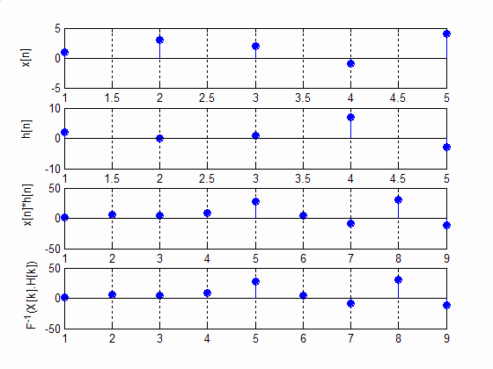
Example
x=[1 3 2 -1 4];
h=[2 0 1 7 -3];
x2=[1 3 2 -1 4 0 0 0 0]; h2=[2 0 1 7 -3 0 0 0 0]; C1=conv(x,h); X=fft(x2); H=fft(h2); C2=ifft(X.*H); subplot(411)
stem(x, 'filled'); grid subplot(412)
stem(h, 'filled'); grid subplot(413)
stem(C1, 'filled'); grid
subplot(414)
stem(real(C2), 'filled');
grid

Slide 18
DFT Exercises
Â Compute the indicated N-point DFTs of the following sequences
ª x[n]=δ[n] (general N)
ª x[n]=u[n]-u[n-N] (general N)
ª x[n]=(0.5)^{n} (N=32)

Slide 19
In Matlab
Â In Matlab, the fft() computes DFT using a fast algorithm, called fast Fourier
transform (FFT).
Â X = fft(x) returns the discrete Fourier transform (DFT) of vector X, computed with a fast Fourier transform (FFT) algorithm.
ª
If x is a matrix, fft returns the Fourier transform of each column of the matrix. In this case,
the length of X and the length of x are identical.
X = fft(x,N) returns the N-point DFT. If the length of X is less than N, X is padded with trailing zeros to length N. If the length of X is greater than N, the sequence X is truncated.
The N points returned by fft corresponds to frequencies in the [0 2π] range, equally spaced with an interval of 2π/N.
ª
ª
ª
Note that the
frequency.
N^{th}
FFT point corresponds to 2π, which in turn corresponds to the sampling
ª
If x[n] is real, X[k] is symmetric. Using the fftshift() function shifts the center of symmetry
so that the FFT is given in the [-π to π] interval, rather then [0 2π].
Â X=ifft(X,N) returns the N-point inverse discrete Fourier transform

Slide 20
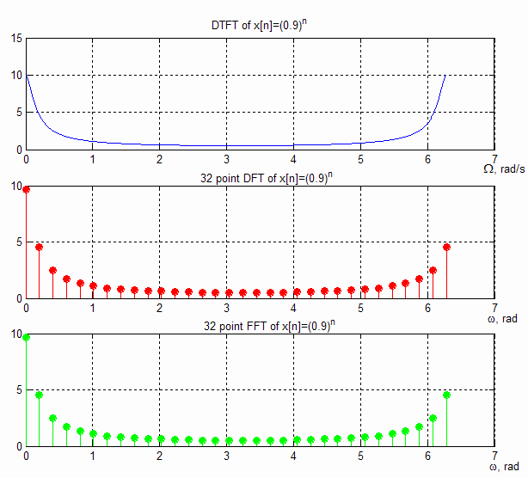
Back
to
Example
Let’s show that
i.
DFT is indeed the sampled version of
DTFT and
DFT and FFT produce identical results
ii.
n=0:31; k=0:31;
x=0.9.^n;
w=linspace(0, 2*pi, 512); K=linspace(0, 2*pi, 32); X1=1./(1-0.9*exp(-j*w));
X2=(1-(0.9*exp(-j*(2*pi/32)*k)).^32)./ (1-0.9*exp(-j*(2*pi/32)*k));
X=fft(x);
subplot(311)
plot(w, abs(X1)); grid subplot(312)
stem(K, abs(X2), 'r', 'filled'); grid subplot(313)
stem(K, abs(X), 'g', 'filled'); grid

Slide 21
Parseval’s Theorem in DFT
Statement:
“For complex valued sequences x(n) and y(n), if DFT {x(n)} is X(k) and DFT {y(n)} is Y(k) then
$\sum_{n=0}^{N−1}{x∗\left(n\right).y\left(n\right)=\frac{1}{N}}\sum_{k=0}^{N−1}{X∗\left(k\right).Y\left(k\right) }$……………(1)
Parseval’s theorem also states that, “energy of the signal in time domain can be expressed in terms of the frequency components {X(k)} in the frequency domain”.Parseval’s theorem in DFT is stated
as $\sum_{n=0}^{N−1}{{|x\left[n\right]|}^{2}}=\frac{1}{N}\sum_{k=0}^{N−1}{{|X\left(k\right)|}^{2}}$ ……………(2)

Slide 22
Parseval’s Theorem in DFT
Proof of Parseval’s Theorem
From definition of IDFT, we have $x\left[n\right]=1/N\sum_{k=0}^{N−1}{X\left(k\right)e^{j2πkn/N}}$
Take conjugate on both sides,
$x∗\left[n\right]=1/N\sum_{k=0}^{N−1}{X∗\left(k\right)e^{−j2πkn/N}}$
LHS = $\sum_{n=0}^{N−1}{x∗\left(n\right).y\left(n\right)=\sum_{n=0}^{N−1}{\{1/N\sum_{k=0}^{N−1}{X∗\left(k\right)e^{−j2πkn/N}}\}y\left(n\right)}}$
=$1/N\sum_{k=0}^{N−1}{X∗\left(k\right)\{\sum_{n=0}^{N−1}{y\left(n\right)}e^{−\frac{j2πkn}{N}}}\}$
= 1/N $\sum_{k=0}^{N−1}{X∗\left(k\right)Y\left(k\right)}$ …..(1)
= RHS (Proved)

Slide 23
Parseval’s Identity in DFT
Suppose if y[n] = x[n], then
$\sum_{n=0}^{N−1}{x∗\left(n\right).x\left(n\right)=\frac{1}{N}}\sum_{k=0}^{N−1}{X∗\left(k\right).X\left(k\right)}$
Taking Magnitude we get,
$\sum_{n=0}^{N−1}{{|x\left[n\right]|}^{2}}=\frac{1}{N}\sum_{k=0}^{N−1}{{|X\left(k\right)|}^{2}}$ …….(2)
= RHS (Proved)

Slide 24
Problem to illustrate Parseval’s Theorem
If the energy of the signal in time domain can be expressed in terms of the frequency components {X(k)} in the frequency domain, then apply this property to this signal x[n] = {1,2,0,3,-2,4,7,5} and evaluate the following: (i) X(4) (ii)$\sum_{k=0}^{7}{X\left(k\right)}$ (iii)$\sum_{k=0}^{7}{{|X\left(k\right)|}^{2}}$ ?
Solution:
From given data, N=8 , implies n=0 to 7
$DFT is X\left(k\right)=\sum_{n=0}^{N−1}{x\left[n\right]{{e^{−j2πkn/N}}^{}}^{}}, where K=0 to N−1$

Slide 25
Problem to illustrate Parseval’s Theorem
Here k=4
(i) $X\left(4\right)$ = $\sum_{n=0}^{7}{x\left[n\right]{{e^{−j2π4n/8}}^{}}^{}}$
= $\sum_{n=0}^{7}{x\left[n\right]{{e^{−jπn}}^{}}^{}}$ =$\sum_{n=0}^{7}{x\left[n\right]{{{(−1)}^{n}}^{}}^{}}$
= x[0] ${(−1)}^{0}$ + x[1] ${(−1)}^{1}$ +….
= 1-2-3-2-4+7-5
Therefore $X\left(4\right)= −8$

Slide 26
Parseval’s Identity
(ii) By using IDFT definition
$x[n]=1/N\sum_{k=0}^{N−1}{X\left(k\right){e^{j2πkn/N}}^{}, where n=0 to N−1}$
Sub n=0 we get $x[0]=1/8$ $\sum_{k=0}^{7}{X\left(k\right)}$
Therefore$\sum_{k=0}^{7}{X\left(k\right)}=8 x[0$] = 8 (1) = 8
(iii) By Parseval’s identity we know
$\sum_{n=0}^{N−1}{{|x\left[n\right]|}^{2}}=\frac{1}{N}\sum_{k=0}^{N−1}{{|X\left(k\right)|}^{2}}$

