Slide 1

INTRODUCTION TO FILTERS
Dr K. Mohanaprasad
Associate Professor
School of Electronics Engineering (SENSE)
VIT Chennai

Slide 2
Need for Filter
Signal Separation
Signal restoration
Filter classification
Based on length Impulse response
Based on the magnitude spectrum
Based on the phase spectrum
Based on the type of input
Analog filter specification

Slide 3
Need for Filters
Most of the signals we deal with in real life get corrupted in some way or another by some unwanted signals.
In signal processing and analysis, it is imperative to get rid of these interferences, or at least reduce their effects.
This is achieved through applying signal Filtering techniques.
Filters have two uses: Signal separation and Signal restoration.

Slide 4
Signal separation
Signal separation is needed when a signal has been contaminated with interference, noise, or other signals.
Imagine a device for measuring the electrical activity of a human heart (ECG).
The raw signal will likely be corrupted by the interference caused by shaking the wire of the ECG lead.
The measuring the electrical activity of a baby's heart while still in the womb. The raw signal will likely be corrupted by the breathing and heartbeat of the mother.
A filter might be used to separate these signals so that they can be individually analyzed.

Slide 5
Signal restoration
Signal restoration is used when a signal has been distorted in some way.
An audio recording made with poor equipment may be filtered to better represent the sound as it actually occurred.
Another example is the deburring of an image acquired with an improperly focused lens, or a shaky camera.

Slide 6
Filter Classification
Based on the transfer function (It depends on the length of its impulse response
Finite impulse response (FIR) transfer function
Infinite impulse response (IIR) transfer function
For digital transfer functions with frequency-selective frequency responses, one classification is based on the shape of the magnitude function |H(ω)| or the form of the phase function θ(ω)
Based on the magnitude spectrum, one of four types of ideal filters are usually defined
Low pass
High pass
Band pass
Band stop

Slide 7
Ideal Filter
An ideal filter is a digital filter designed to pass signal components of certain frequencies without distortion, which therefore has a frequency response equal to 1 at these frequencies, and has a frequency response equal to 0 at all other frequencies
The range of frequencies where the frequency response takes the value of one is called the passband
The range of frequencies where the frequency response takes the value of zero is called the stopband
The transition frequency from a passband to stopband region is called the cutoff frequency

Slide 8
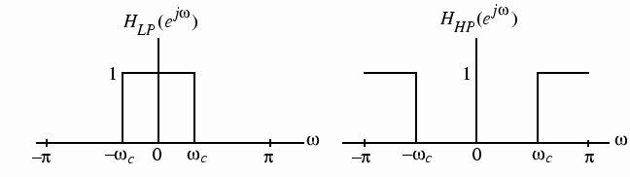
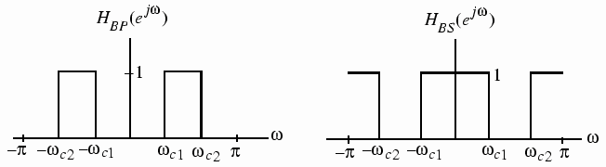
Ideal filters
Lowpass
Highpass
Bandpass
Bandstop
Passband
Stopband

Slide 9
A third classification of a transfer function is with respect to its phase characteristics
Zero phase
One way to avoid any phase distortion is to make sure the frequency response of the filter does not delay any of the spectral components. Such a transfer function is said to have a zero – phase characteristic.
Linear phase
For a causal transfer function with a nonzero phase response, the phase distortion can be avoided by ensuring that the transfer function has (preferably) a unity magnitude and a linear-phase characteristic in the frequency band of interest
Generalized linear phase
As long as the system response does not change signs for different values of ω, it can be written as a linear phase transfer function. Therefore, such systems are said to have generalized linear phase
Non-linear phase
Phase response of filter with non linear phase or non constant group delay

Slide 10
Filters are further classified as Analog and Digital filter
Digital and analog filters both take out unwanted noise or signal components, but filters work differently in the analog and digital domains.
Analog filters will remove everything above or below a chosen cutoff frequency.
Digital filters can be more precise in filtering, but the signal must be digital.

Slide 11
Placing a digital filter in an analog signal chain would require the analog signal to be converted to a digital signal before the digital filtering could be applied and, with any conversion, there are trade-offs in signal integrity.
Digital filters work by oversampling and averaging, and are programmable. But it is wise to apply an analog filter prior to signal conversion so that all unwanted frequencies above or below where the desired signal is reasonably expected to operate are removed first.

Slide 12
Specifications | Analog Filter | Digital Filter
Components | resistors, capacitors, inductors, and op amps | embedded in a chip that operates on digital signals, such as an MCU, SoC, processor, or DSP.
Programmable coefficients | No | Yes
Complexity | Higher, usually seen in high performance based analog filters. | Lower
Accuracy | Lower | Higher
Cost | Higher, it depends on analog components used in the design. | Lower
Additive noise introduction | It adds component based thermal noise in the bands | It adds digital noise due to quantization process
Storing information | Difficult | Easy

Slide 13
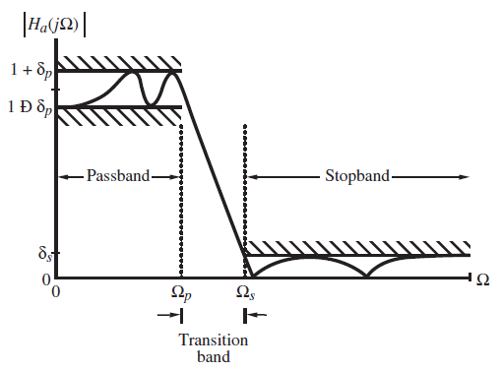
Analog Filter Specifications
The magnitude |Ha(jΩ)| of an analog low pass filter is usually specified as indicated in the figure above

Slide 14
In the passband defined by 0 ≤ Ω ≤ Ω_{p}
1 − δp ≤ |H_{a}(jΩ)| ≤ 1 + δp, for |Ω| ≤ Ω_{p}
In the stopband defined by Ωs ≤ |Ω| ≤ ∞
|H_{a}(jΩ)| ≤ δs, for Ωs ≤ |Ω| ≤ ∞
implying that the magnitude approximate zero within an error of δs.
The frequencies Ωp and Ωs are called, respectively, the passband edge frequency and the stopband edge frequency.
The parameter δp and δs is the tolerance of the magnitude response in the pass band and stop band respectively.

Slide 15
The desired magnitude response in the passband is 1 or (1+δp) and in the stop band is 0.
Pass band ripple in dB defined by Ap= - 20 log(1-δp).
Pass band gain at Ω= Ωp, Kp= - Ap =20 log(1- δp)
Stop band attenuation defined by As = -20 log(δs)
Stop band gain at Ω= Ωs, Ks=- As =20 log(δs)

