Slide 1

Analog IIR Filter Design Part I
Dr K. Mohanaprasad
Associate Professor
School of Electronics Engineering (SENSE)
VIT Chennai

Slide 2
IIR Filter
IIR filters are one of two primary types of digital filters used in Digital Signal Processing (DSP) applications (the other type being FIR). “IIR” means “Infinite Impulse Response.”
The impulse response is “infinite” because there is feedback in the filter; if you put in an impulse (a single “1” sample followed by many “0” samples), an infinite number of non-zero values will come out (theoretically.)

Slide 3
General Difference Equation for IIR Filter
IIR:
Y[n] = b₀ X[n] + b₁ X[n-1]+b₂ X[n-2]+…………..+b_{M-1}X[n-M] -a₁y[n-1]-a₂y[n-2]-……………...-a_{N}y[n-N].
FIR:
Y[n] = b₀ X[n] + b₁ X[n-1]+b₂ X[n-2]+…………..+b_{M-1}X[n-M].

Slide 4
Analog IIR Filter Types
Butterworth Filters
Chebyshev I Filters
Chebyshev II Filters
Elliptic Filters

Slide 5
Butterworth Filters Vs Chebyshev Filters
Butterworth filters have a very smooth passband, relatively wide transmission region.
Chebyshev–I filter is equiripple in the passband and monotonic in the stopband.
Chebyshev-II filter is equiripple in the stopband and monotonic in the passband.
Elliptic filter is equiripple in the both stopband and passband.

Slide 6
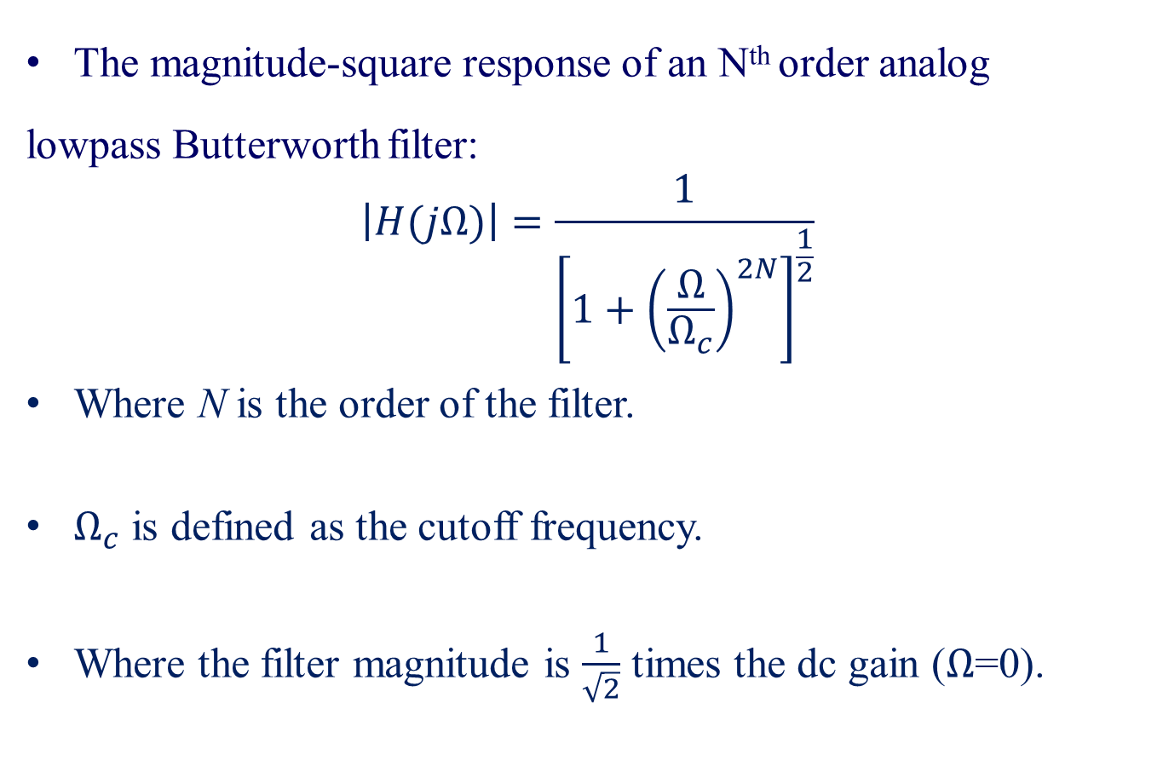
Butterworth Filters
The magnitude-square response of an N^{th} order analog
lowpass Butterworth filter:
$$\left|H(jΩ)\right|=\frac{1}{{\left[1+{\left(\frac{Ω}{Ω_{c}}\right)}^{2N}\right]}^{\frac{1}{2}}}$$
Where N is the order of the filter.
$Ω_{c}$ is defined as the cutoff frequency.
Where the filter magnitude is $\frac{1}{\sqrt{2}}$ times the dc gain ($Ω$=0).

Slide 7
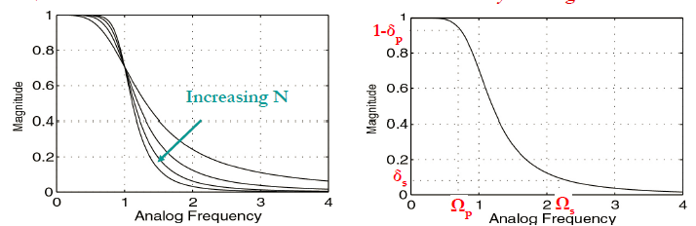
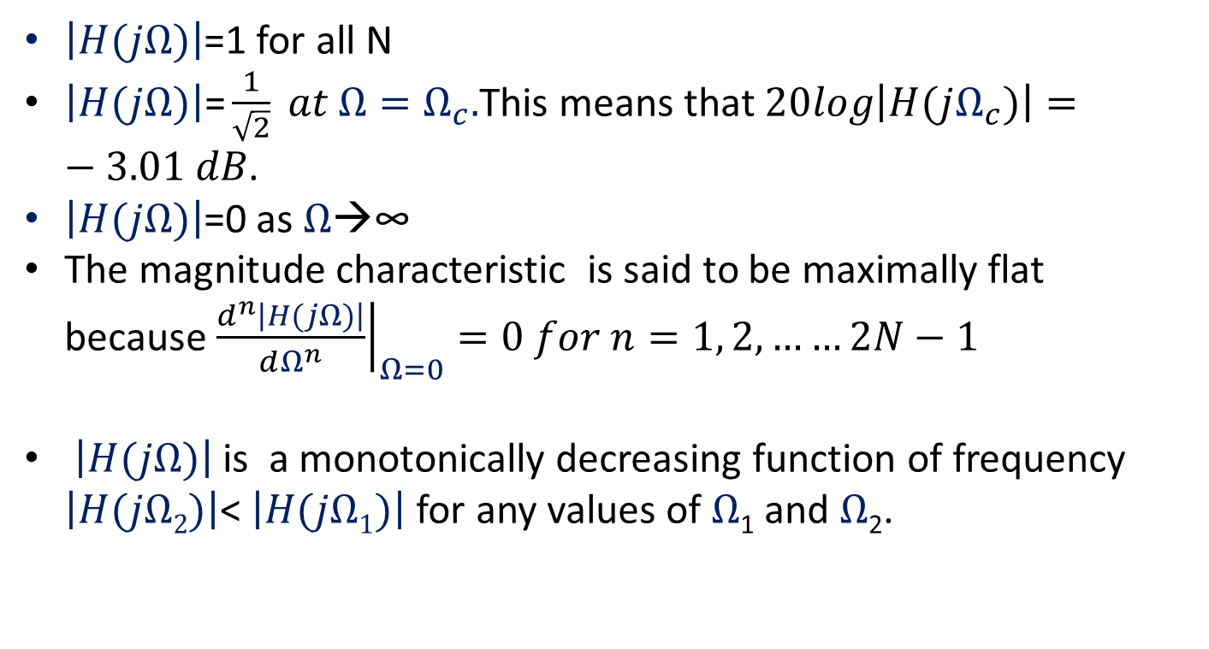
$\left|H(jΩ)\right|$=1 for all N
$\left|H(jΩ)\right|\text{=}\frac{1}{\sqrt{2}} at Ω=Ω_{c}.$This means that $20log\left|H(jΩ_{c})\right|=−3.01 dB$.
$\left|H(jΩ)\right|$=0 as $Ω$→∞
The magnitude characteristic is said to be maximally flat because ${\left.\frac{d^{n}\left|H(jΩ)\right|}{dΩ^{n}}\right|}_{Ω=0}=0 for n=1, 2, ……2N−1$
$\left|H(jΩ)\right|$ is a monotonically decreasing function of frequency $\left|H(jΩ2)\right|$< $\left|H(jΩ1)\right|$ for any values of $Ω$₁ and $Ω$₂.

Slide 8
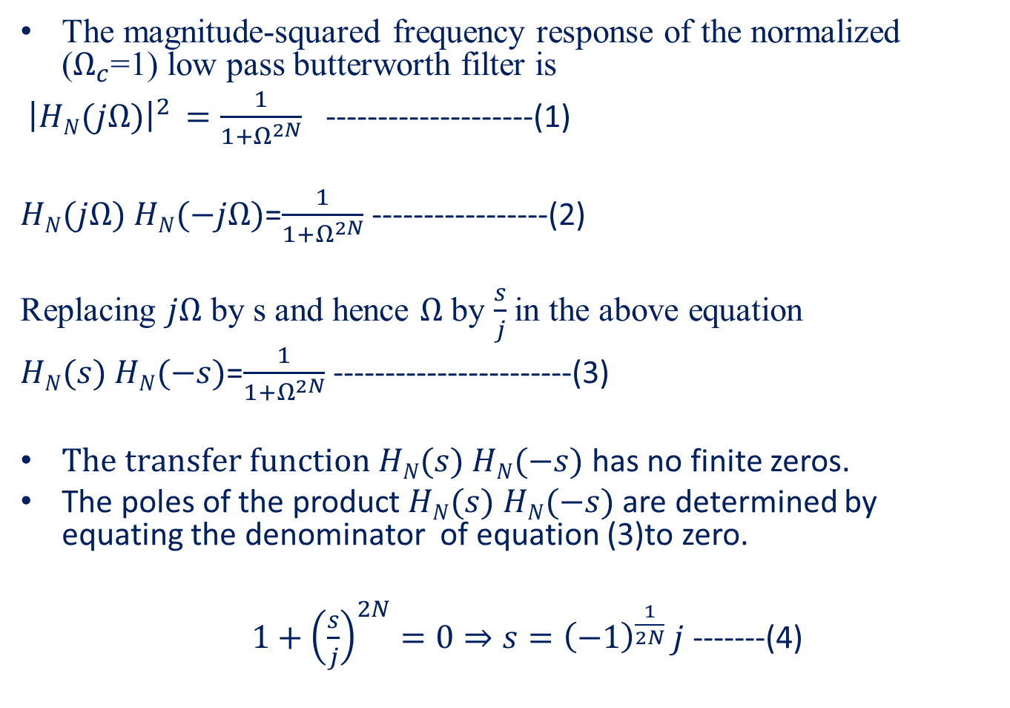
Normalized Butterworth Polynomial
The magnitude-squared frequency response of the normalized ($Ω_{c}$=1) low pass butterworth filter is
${\left|HN(jΩ)\right|}^{2 }=\frac{1}{1+Ω^{2N}}$ --------------------(1)
$HN(jΩ)$ $HN(−jΩ)$=$\frac{1}{1+Ω^{2N}}$ -----------------(2)
Replacing $jΩ$ by s and hence $Ω$ by $\frac{s}{j}$in the above equation
$HN(s)$ $HN(−s)$=$\frac{1}{1+Ω^{2N}}$ -----------------------(3)
$The transfer function HN(s)$ $HN(−s)$ has no finite zeros.
The poles of the product $HN(s)$ $HN(−s)$ are determined by equating the denominator of equation (3)to zero.
$1+{\left(\frac{s}{j}\right)}^{2N}=0⇒s={\left(−1\right)}^{\frac{1}{2N} }j$ -------(4)

Slide 9
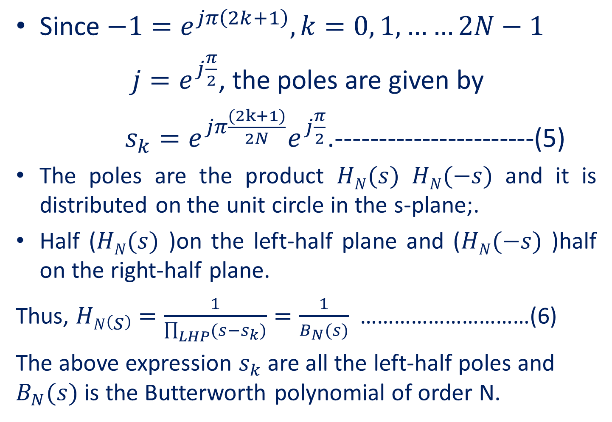
Since $−1=e^{jπ\left(2k+1\right)}, k=0, 1, ……2N−1$
$j=e^{j\frac{π}{2}}$, the poles are given by
$s_{k}=e^{jπ\frac{(2k+1)}{2N}}e^{j\frac{π}{2}}$.-----------------------(5)
The poles are the product $HN(s)$ $HN(−s)$ and it is distributed on the unit circle in the s-plane;.
Half ($HN(s)$ )on the left-half plane and ($HN(−s)$ )half on the right-half plane.
Thus, $HN\left(s\right)=\frac{1}{\prod_{LHP}{(s−s_{k})}}=\frac{1}{B_{N}(s)}$ …………………………(6)
The above expression $s_{k}$ are all the left-half poles and $B_{N}(s)$ is the Butterworth polynomial of order N.

Slide 10
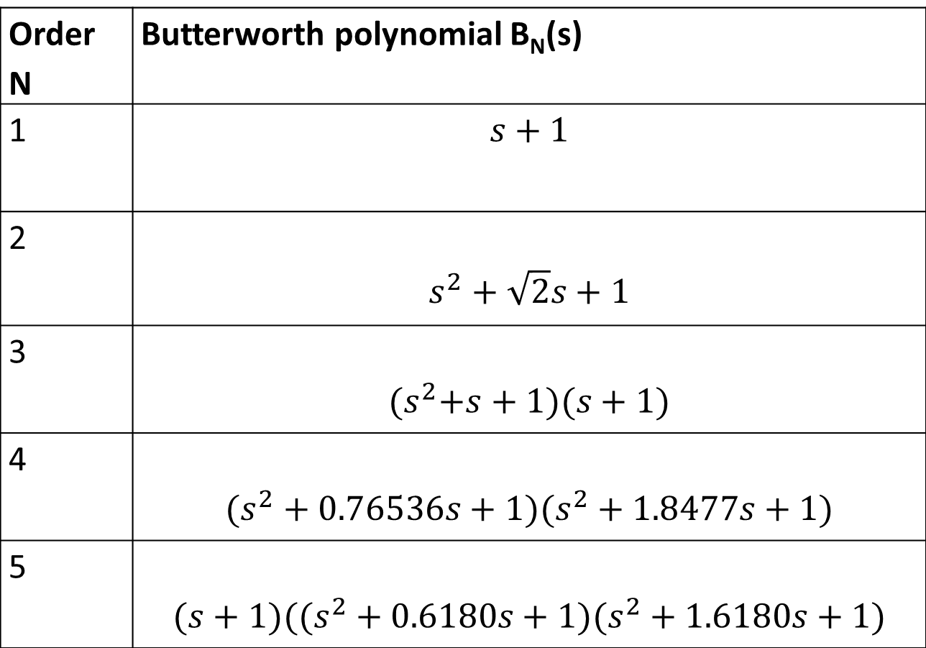
Order N | Butterworth polynomial B_{N}(s)
1 | $$s+1$$
2 | $$s^{2}+\sqrt{2}s+1$$
3 | $${(s}^{2}+s+1)(s+1)$$
4 | $$(s^{2}+0.76536s+1)(s^{2}+1.8477s+1)$$
5 | $$(s+1)((s^{2}+0.6180s+1)(s^{2}+1.6180s+1)$$

Slide 11




Design of Lowpass Butterworth filter
$$20\log\left|H(jΩ)\right|$$
0
K_{P}
…………………………………………..……
…………………………………...........
K_{S}
……………………………………………………………………….
…………..
$$Ω$$
$Ω$_{P}
$$Ωs$$

Slide 12
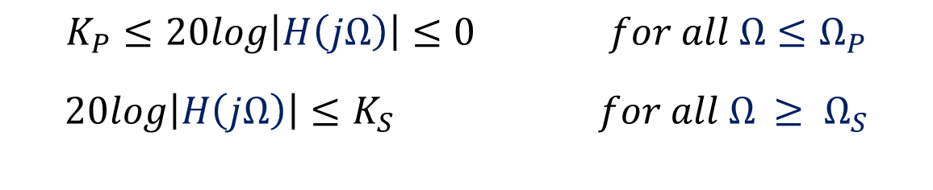
Pass band ripple in dB defined by Ap= - 20 log(1-δp).
Pass band gain at Ω= Ωp, Kp= - Ap =20 log(1- δp)
Stop band attenuation defined by As = -20 log(δs)
Stop band gain at Ω= Ωs, Ks=- As =20 log(δs)

Slide 13
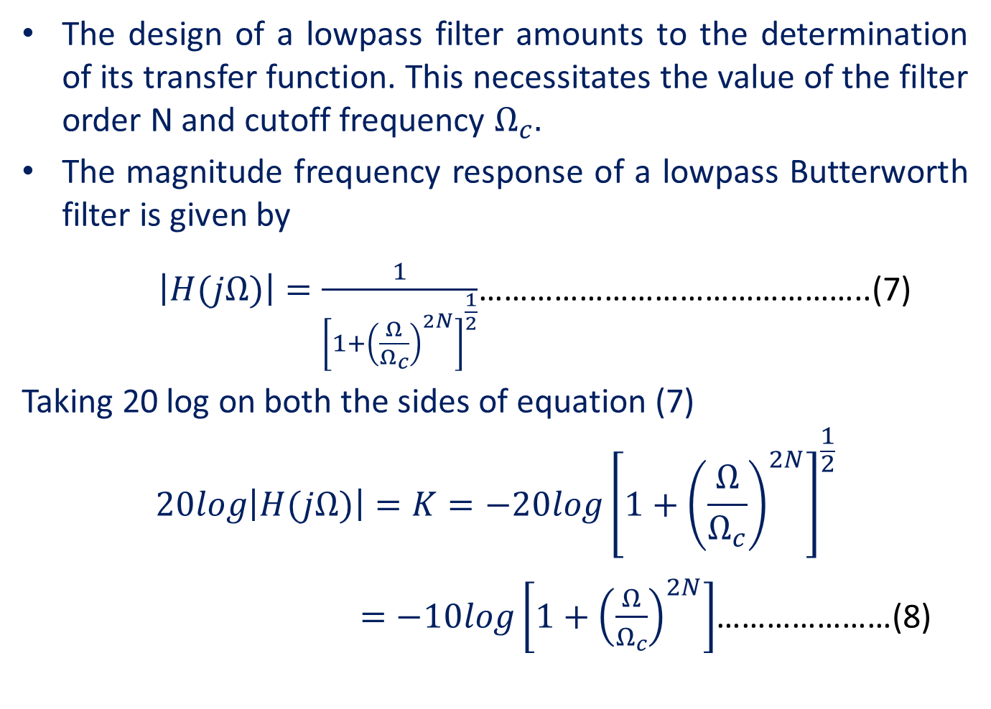
The design of a lowpass filter amounts to the determination of its transfer function. This necessitates the value of the filter order N and cutoff frequency $Ω_{c}.$
The magnitude frequency response of a lowpass Butterworth filter is given by
$\left|H(jΩ)\right|=\frac{1}{{\left[1+{\left(\frac{Ω}{Ω_{c}}\right)}^{2N}\right]}^{\frac{1}{2}}}$………………………………………..(7)
Taking 20 log on both the sides of equation (7)
$$20log\left|H(jΩ)\right|=K=−20log{\left[1+{\left(\frac{Ω}{Ω_{c}}\right)}^{2N}\right]}^{\frac{1}{2}}$$
$=−10log\left[1+{\left(\frac{Ω}{Ω_{c}}\right)}^{2N}\right]$…………………(8)

Slide 14
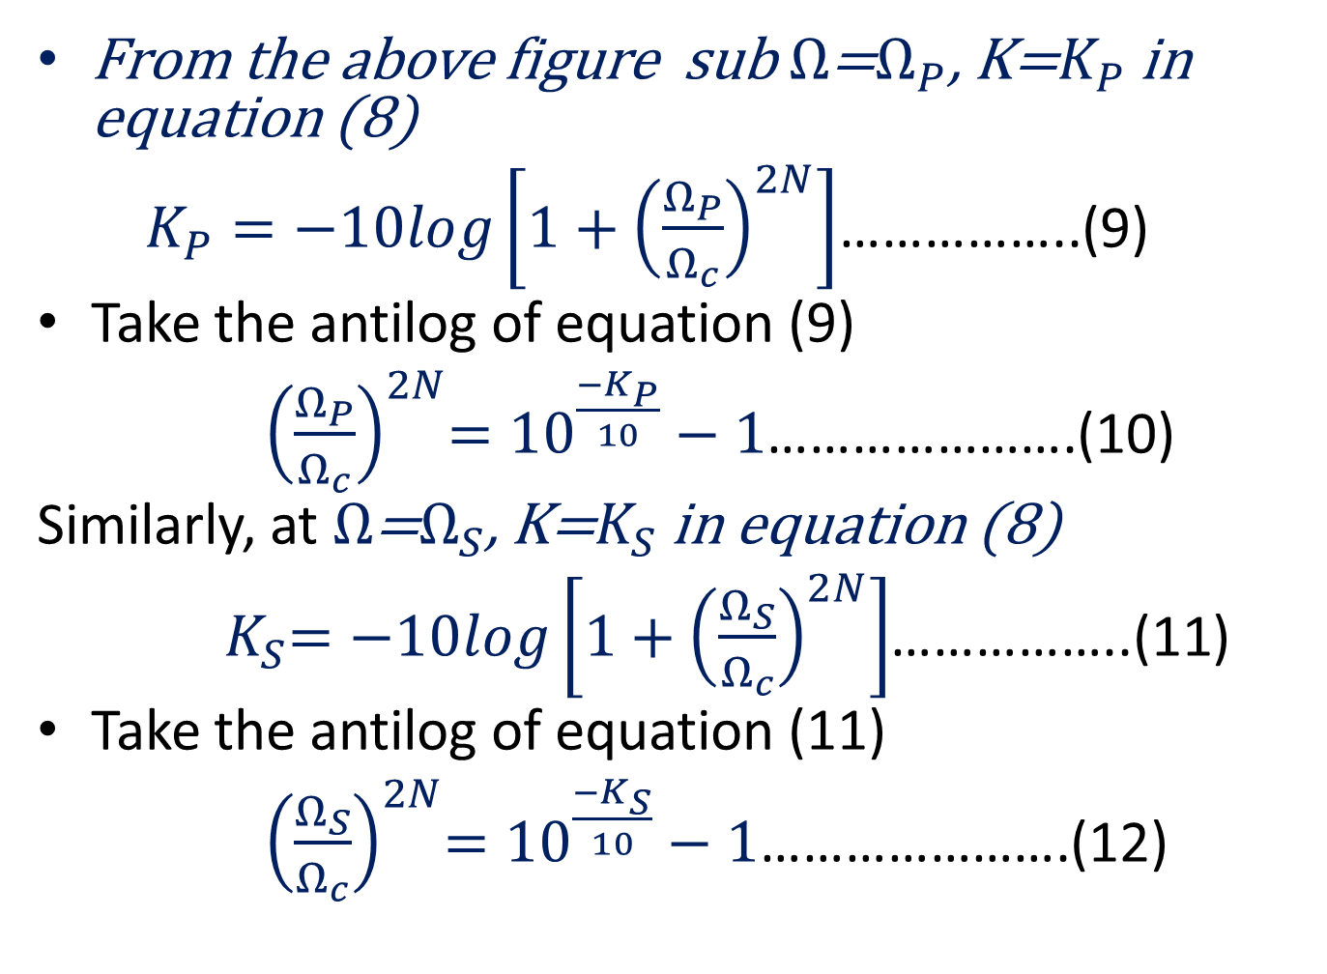
From the above figure sub $Ω$=$Ω_{P}$, K=$K_{P}$ in equation (8)
$K_{P}=−10log\left[1+{\left(\frac{Ω_{P}}{Ω_{c}}\right)}^{2N}\right]$……………..(9)
Take the antilog of equation (9)
${ \left(\frac{Ω_{P}}{Ω_{c}}\right)}^{2N}={10}^{\frac{{−K}_{P}}{10}}−1$………………….(10)
Similarly, at $Ω$=$Ω_{S}$, K=$K_{S}$ in equation (8)
${ K}_{S}=−10log\left[1+{\left(\frac{Ω_{S}}{Ω_{c}}\right)}^{2N}\right]$……………..(11)
Take the antilog of equation (11)
${ \left(\frac{Ω_{S}}{Ω_{c}}\right)}^{2N}={10}^{\frac{{−K}_{S}}{10}}−1$………………….(12)

Slide 15
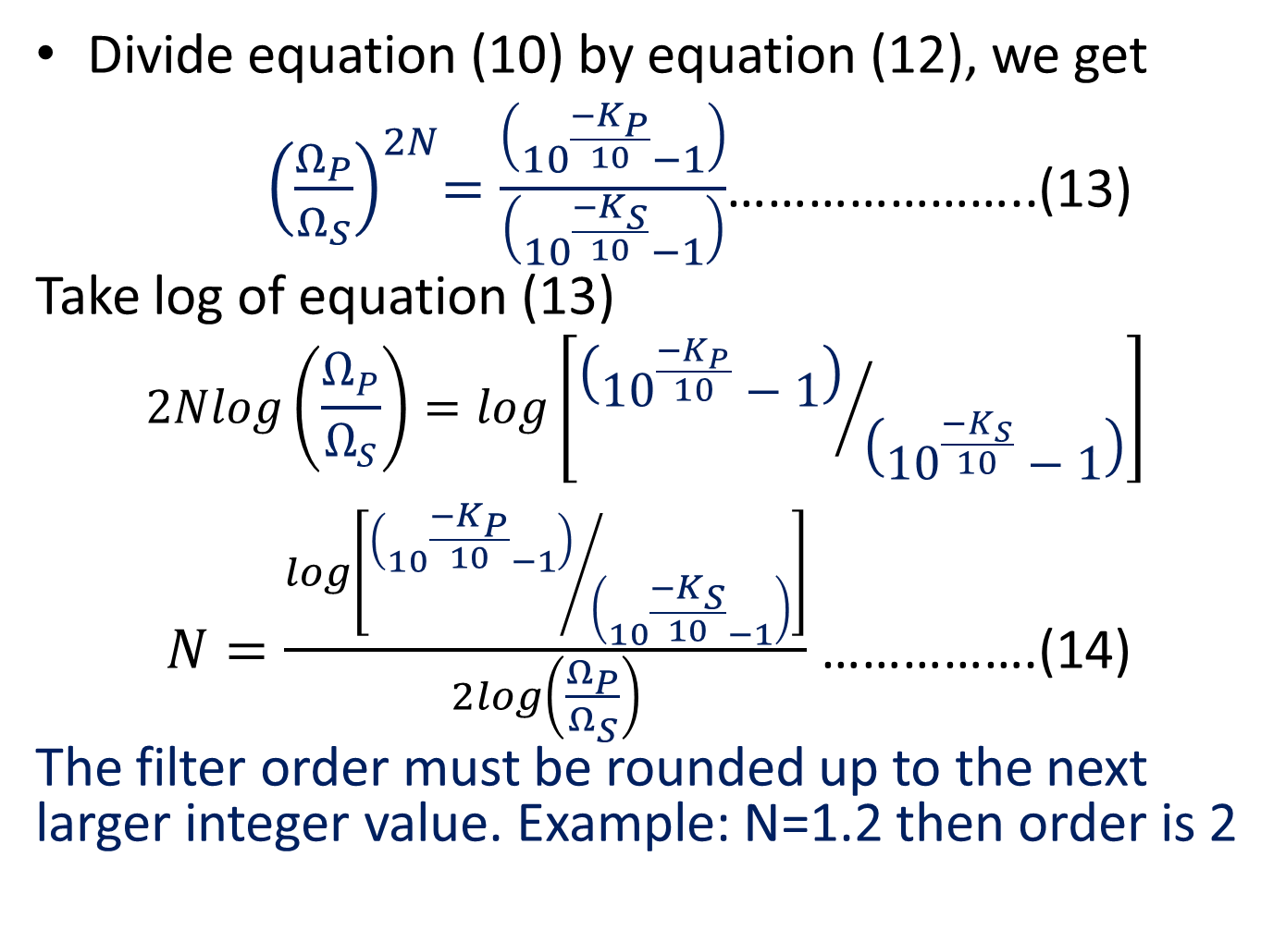
Divide equation (10) by equation (12), we get
${ \left(\frac{Ω_{P}}{Ω_{S}}\right)}^{2N}=\frac{\left({10}^{\frac{{−K}_{P}}{10}}−1\right)}{\left({10}^{\frac{{−K}_{S}}{10}}−1\right)}$…………………..(13)
Take log of equation (13)
$$2Nlog\left(\frac{Ω_{P}}{Ω_{S}}\right)=log\left[{\left({10}^{\frac{{−K}_{P}}{10}}−1\right)}/{\left({10}^{\frac{{−K}_{S}}{10}}−1\right)}\right]$$
$N=\frac{log\left[{\left({10}^{\frac{{−K}_{P}}{10}}−1\right)}/{\left({10}^{\frac{{−K}_{S}}{10}}−1\right)}\right]}{2log\left(\frac{Ω_{P}}{Ω_{S}}\right)}$ …………….(14)
The filter order must be rounded up to the next larger integer value. Example: N=1.2 then order is 2

Slide 16
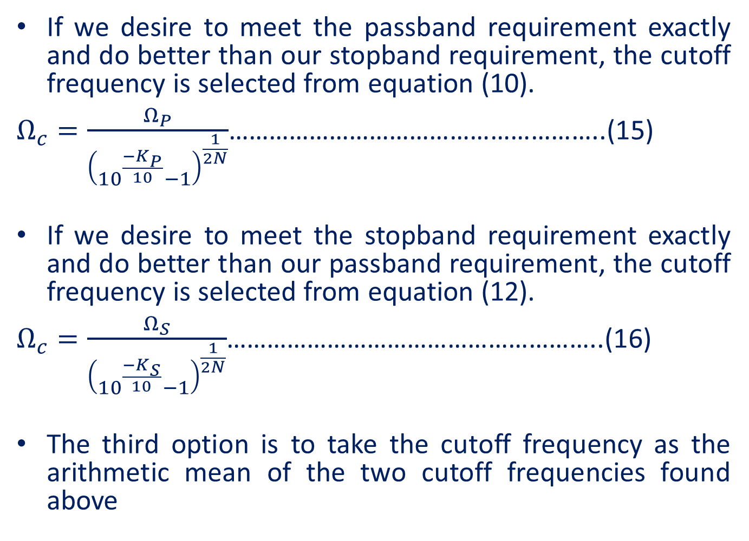
If we desire to meet the passband requirement exactly and do better than our stopband requirement, the cutoff frequency is selected from equation (10).
$Ω_{c}=\frac{Ω_{P}}{{\left({10}^{\frac{{−K}_{P}}{10}}−1\right)}^{\frac{1}{2N}}}$………………………………………………..(15)
If we desire to meet the stopband requirement exactly and do better than our passband requirement, the cutoff frequency is selected from equation (12).
$Ω_{c}=\frac{Ω_{S}}{{\left({10}^{\frac{{−K}_{S}}{10}}−1\right)}^{\frac{1}{2N}}}$………………………………………………..(16)
The third option is to take the cutoff frequency as the arithmetic mean of the two cutoff frequencies found above

Slide 17
Thank you

