Slide 1

Analog IIR Filter Design Part II
Dr K. Mohanaprasad
Associate Professor
School of Electronics Engineering (SENSE)
VIT Chennai

Slide 2
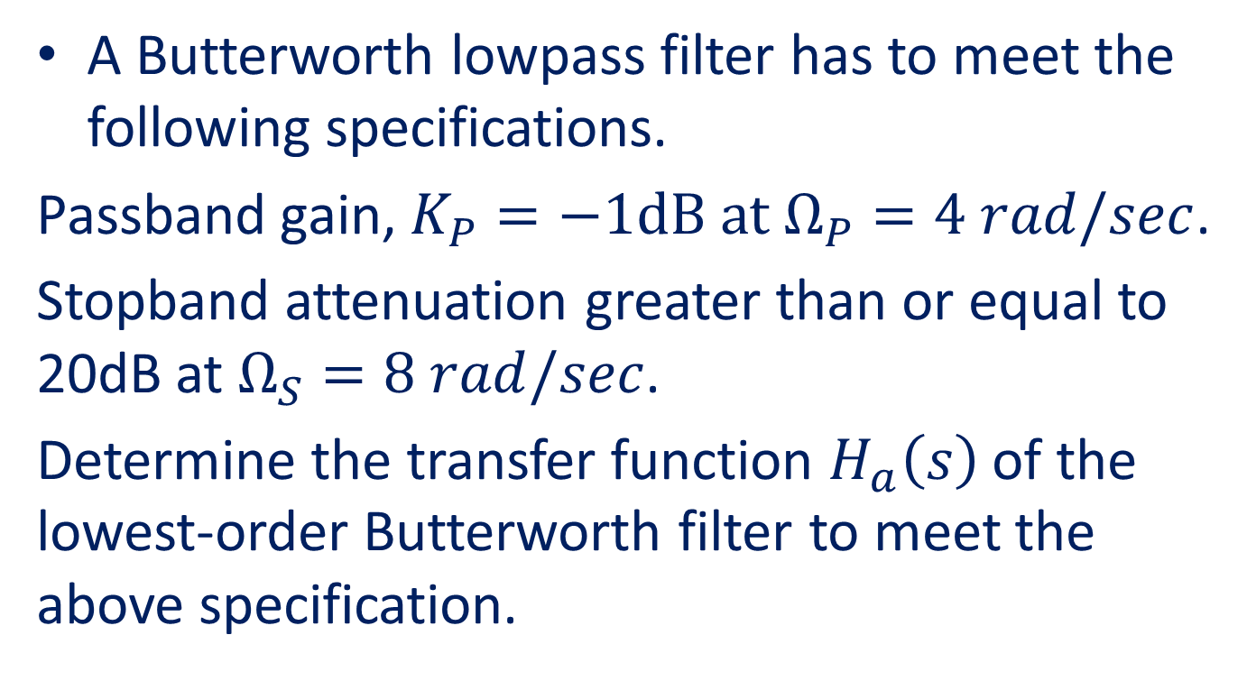
Problem 1
A Butterworth lowpass filter has to meet the following specifications.
Passband gain, $K_{P}=−1dB at{ Ω}_{P}=4 rad/sec$.
Stopband attenuation greater than or equal to 20dB at $Ω_{S}=8$ $rad/sec$.
Determine the transfer function $H_{a}\left(s\right)$ of the lowest-order Butterworth filter to meet the above specification.

Slide 3




Solution: Step 1
$$20\log\left|H(jΩ)\right|$$
0
K_{P}=-1dB
……………………………………………
………………………………….....
K_{S}=-20dB
…………………………………………………………………
…………..
$$Ω$$
$$Ω\text{P}=4 rad/sec$$
$$Ωs=8 rad/sec$$
Specified magnitude frequency response of the lowpass Butterworth filter

Slide 4


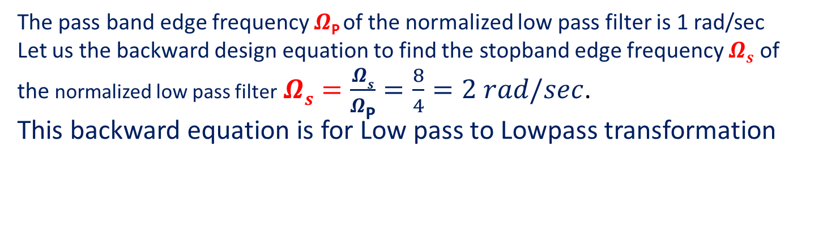
Step 2: Magnitude frequency response of the normalized lowpass filter
$$20\log\left|H(jΩ)\right|$$
0
K_{P}=-1dB
……………………………………………
………………………………….....
K_{S}=-20dB
…………………………………………………………………
…………..
$$Ω$$
$$Ω\text{P}=1 rad/sec$$
$$Ωs=2 rad/sec$$
The pass band edge frequency $Ω\text{P}$of the normalized low pass filter is 1 rad/sec
Let us the backward design equation to find the stopband edge frequency $Ωs$ of the normalized low pass filter$Ωs=\frac{Ωs}{Ω\text{P}}=\frac{8}{4}=2 rad/sec$.
This backward equation is for Low pass to Lowpass transformation

Slide 5
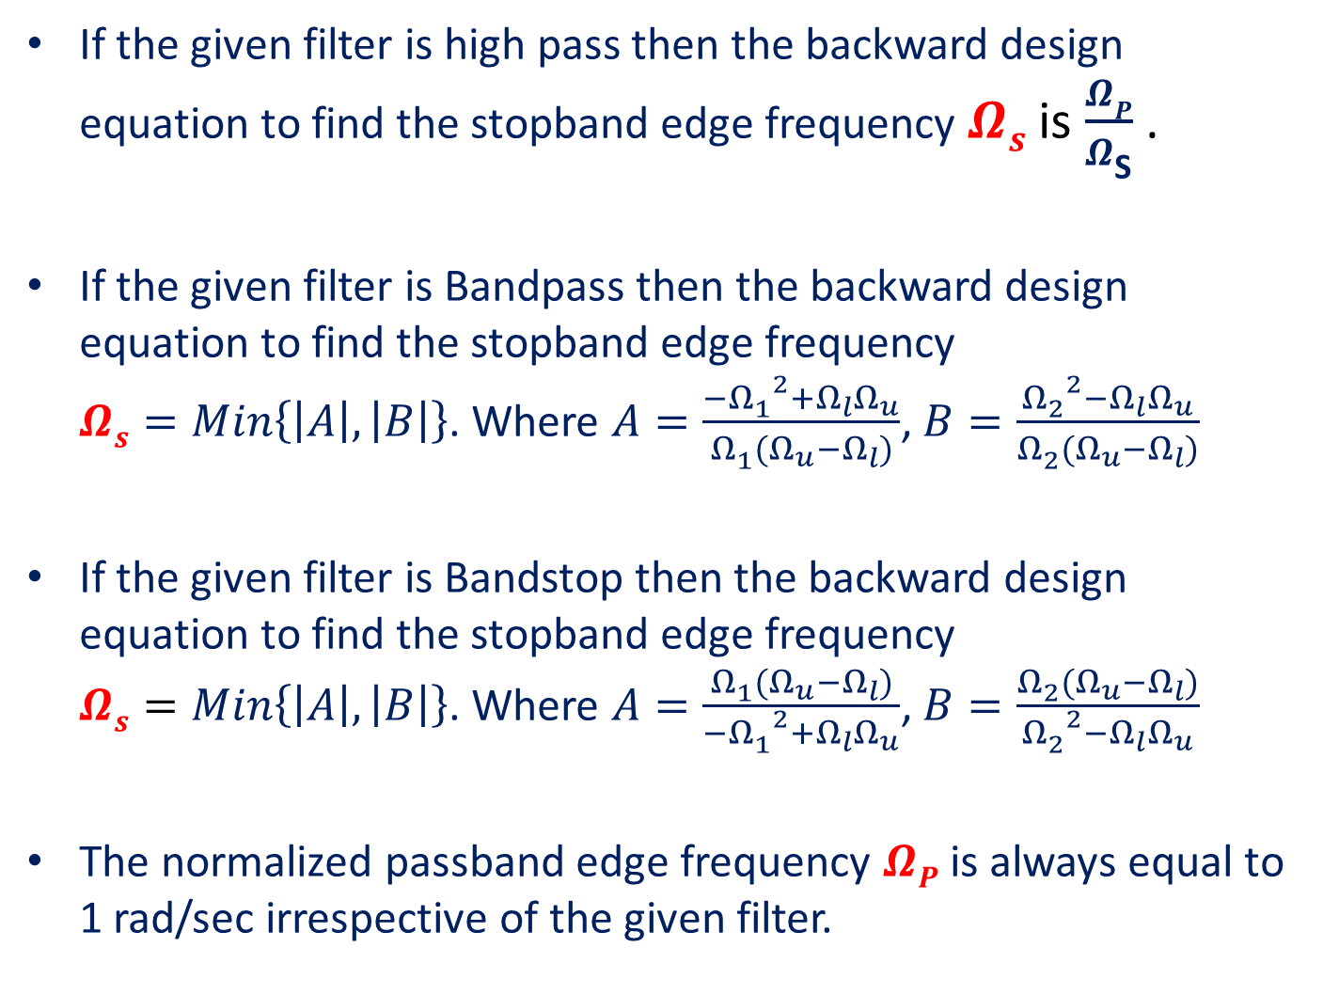
If the given filter is high pass then the backward design equation to find the stopband edge frequency $Ωs$ is $\frac{ΩP}{Ω\text{S}}$ .
If the given filter is Bandpass then the backward design equation to find the stopband edge frequency $Ωs=Min\left\{\left|A\right|,\left|B\right|\right\}$. Where $A=\frac{{{−Ω}_{1}^{}}^{2}+Ω_{l}Ω_{u}}{Ω_{1}^{}(Ω_{u}−Ω_{l})}$, $B=\frac{{Ω_{2}^{}}^{2}−Ω_{l}Ω_{u}}{Ω_{2}^{}(Ω_{u}−Ω_{l})}$
If the given filter is Bandstop then the backward design equation to find the stopband edge frequency $Ωs=Min\left\{\left|A\right|,\left|B\right|\right\}$. Where $A=\frac{Ω_{1}^{}(Ω_{u}−Ω_{l})}{{{−Ω}_{1}^{}}^{2}+Ω_{l}Ω_{u}}$, $B=\frac{Ω_{2}^{}(Ω_{u}−Ω_{l})}{{Ω_{2}^{}}^{2}−Ω_{l}Ω_{u}}$
The normalized passband edge frequency $ΩP$ is always equal to 1 rad/sec irrespective of the given filter.

Slide 6
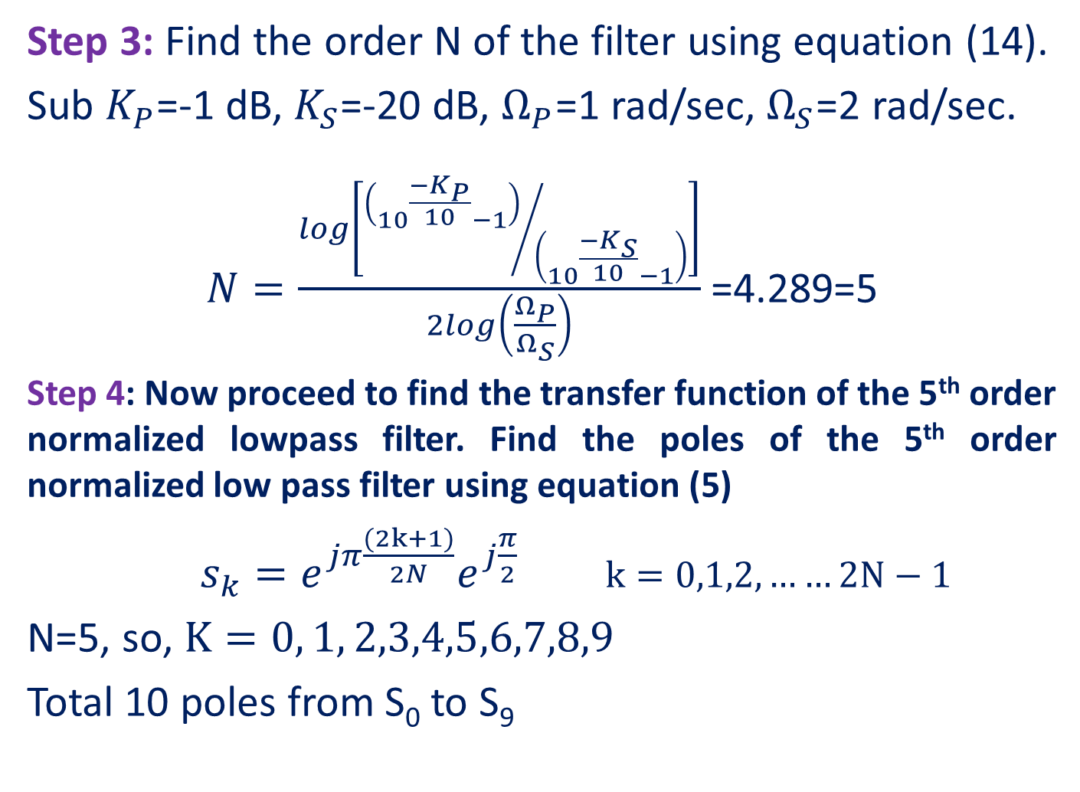
Step 3: Find the order N of the filter using equation (14).
Sub $K_{P}$=-1 dB, $K_{S}$=-20 dB, $Ω_{P}$=1 rad/sec, $Ω_{S}$=2 rad/sec.
$N=\frac{log\left[{\left({10}^{\frac{{−K}_{P}}{10}}−1\right)}/{\left({10}^{\frac{{−K}_{S}}{10}}−1\right)}\right]}{2log\left(\frac{Ω_{P}}{Ω_{S}}\right)}$ =4.289=5
Step 4: Now proceed to find the transfer function of the 5th order normalized lowpass filter. Find the poles of the 5th order normalized low pass filter using equation (5)
$s_{k}=e^{jπ\frac{(2k+1)}{2N}}e^{j\frac{π}{2}}$ $k=0,1,2,……2N−1$
N=5, so, $K=0, 1, 2,3,4,5,6,7,8,9$
Total 10 poles from S₀ to S₉

Slide 7

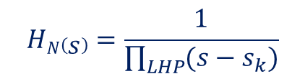


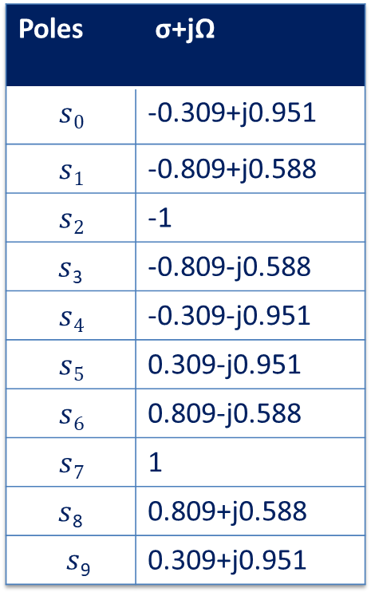







jΩ
S-plane
Poles | σ+jΩ
$$s0$$ | -0.309+j0.951
$$s1$$ | -0.809+j0.588
$$s2$$ | -1
$s$₃ | -0.809-j0.588
$$s4$$ | -0.309-j0.951
$$s5$$ | 0.309-j0.951
$$s6$$ | 0.809-j0.588
$$s7$$ | 1
$s$₈ | 0.809+j0.588
$s$₉ | 0.309+j0.951
$$s0$$
$s$₉
$s$₈
$s$₁
$s$₇
$$s2$$
σ
$$s3$$
$s$₆
$s$₄
$s$₅
Left-half poles of H₅(s)
Right-half poles of H₅(-s)
Step 5:
Hence, the transfer function of the 5th order normalized lowpass Butterworth filter is
$$HN\left(s\right)=\frac{1}{\prod_{LHP}{(s−s_{k})}}$$

Slide 8
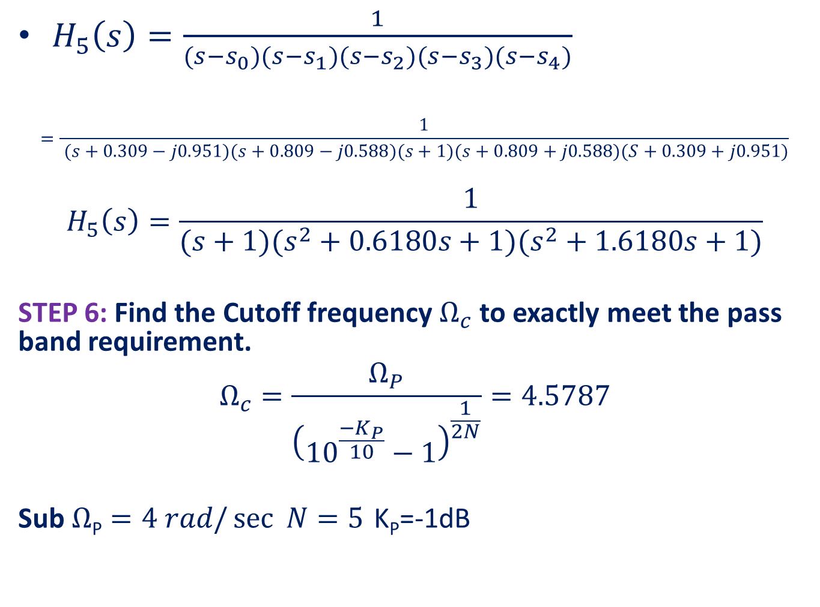
$H_{5}\left(s\right)=\frac{1}{(s−s_{0})(s−s_{1})(s−s_{2})(s−s_{3})(s−s_{4})}$
$$=\frac{1}{ (s+0.309−j0.951)(s+0.809−j0.588)(s+1)(s+0.809+j0.588)(S+0.309+j0.951)}$$
$$H_{5}\left(s\right)=\frac{1}{(s+1)(s^{2}+0.6180s+1)(s^{2}+1.6180s+1)}$$
STEP 6: Find the Cutoff frequency $Ω_{c}$ to exactly meet the pass band requirement.
$$Ω_{c}=\frac{Ω_{P}}{{\left({10}^{\frac{{−K}_{P}}{10}}−1\right)}^{\frac{1}{2N}}}=4.5787$$
Sub $Ω\text{P}=4 rad/\sec{ N=5}$ K_{P}=-1dB

Slide 9
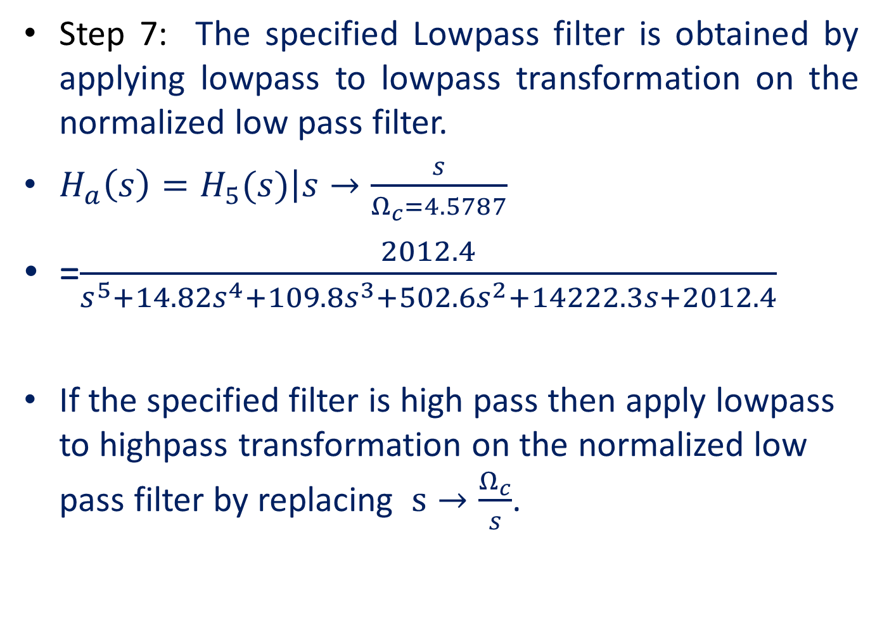
Step 7: The specified Lowpass filter is obtained by applying lowpass to lowpass transformation on the normalized low pass filter.
$H_{a}\left(s\right)=\left.H_{5}(s)\right|s→\frac{s}{Ω_{c}=4.5787}$
=$\frac{2012.4}{s^{5}+14.82s^{4}+109.8s^{3}+502.6s^{2}+14222.3s+2012.4}$
If the specified filter is high pass then apply lowpass to highpass transformation on the normalized low pass filter by replacing $s→\frac{Ω_{c}}{s}$.

Slide 10
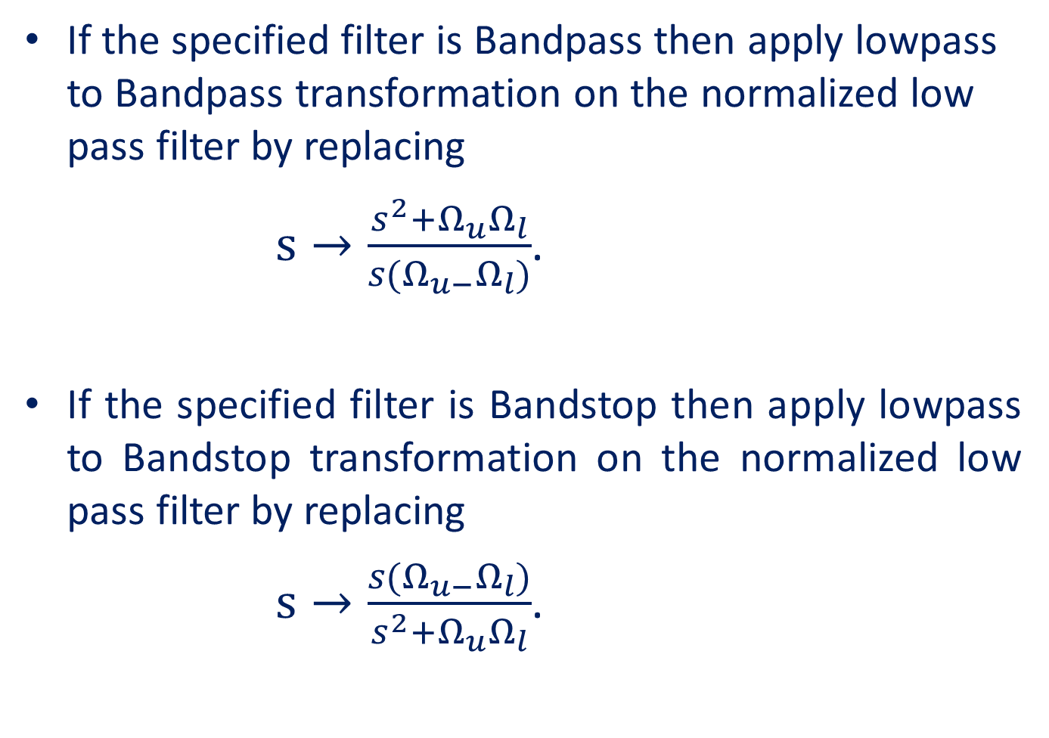
If the specified filter is Bandpass then apply lowpass to Bandpass transformation on the normalized low pass filter by replacing
$s→\frac{s^{2}+Ω_{u}Ω_{l}}{s(Ω_{u−}Ω_{l})}$.
If the specified filter is Bandstop then apply lowpass to Bandstop transformation on the normalized low pass filter by replacing
$s→\frac{s(Ω_{u−}Ω_{l})}{s^{2}+Ω_{u}Ω_{l}}$.

