Slide 1

Analog IIR Filter Design part III
Dr K. Mohanaprasad
Associate Professor
School of Electronics Engineering (SENSE)
VIT Chennai

Slide 2
Problem 2
Design an analog bandpass filter to meet the following frequency-domain specification:
a -3.0103 dB lower and upper cutoff frequency of 50 Hz and 20 KHz.
a stopband attenuation of atleast 20 dB at 20 Hz and 45 KHz, and
a monotonic frequency response.
Solution :
The monotonic frequency response can be achieved by using Butterworth filter.

Slide 3
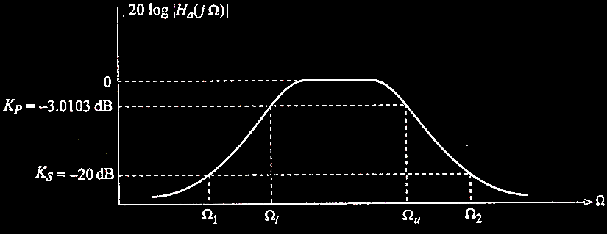



Step : 1 : Specified magnitude frequency response of the bandpass Butterworth filter.
$Ω_{1}$=2$π×20=125.663 rad/sec$
$Ω_{2}$=2$π×45×{10}^{3}=2.827×{10}^{5}rad/sec$
$Ω_{u}$=2$π×20×{10}^{3}=1.257{×10}^{5}rad/sec$
$Ω_{l}$=2$π×50=314.159 rad/sec$

Slide 4


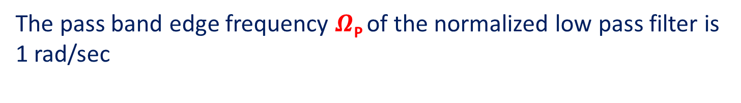


Step 2: Magnitude frequency response of the normalized lowpass filter
$$20\log\left|H(jΩ)\right|$$
0
K_{P}=-3.0103dB
……………………………………………
…………………………………........
K_{S}=-20dB
…………………………………………………………………
…………..
$$Ω$$
$$Ω\text{P}=1 rad/sec$$
$$Ωs=2.25 rad/sec$$
The pass band edge frequency $Ω\text{P}$of the normalized low pass filter is 1 rad/sec

Slide 5
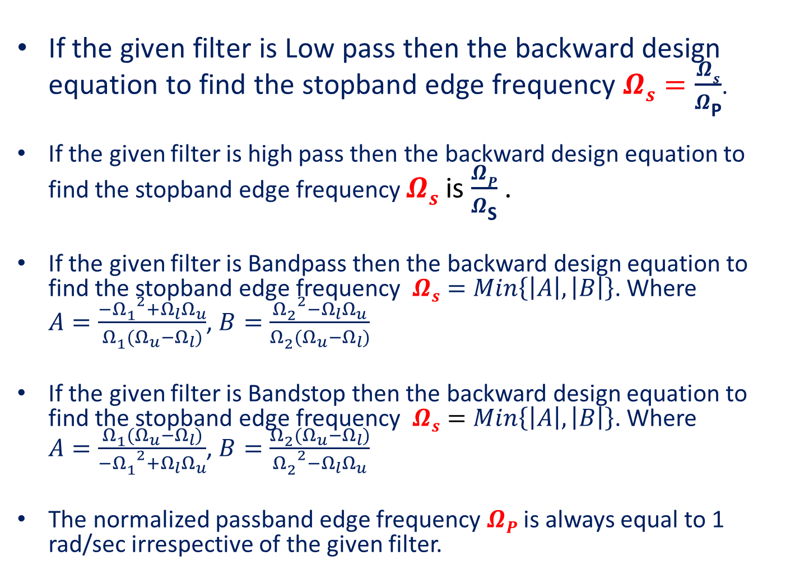
$\text{If} \text{the} \text{given} \text{filter} \text{is} \text{Low} \text{pass} \text{then} \text{the} \text{backward} \text{design} \text{equation} \text{to} \text{find} \text{the} \text{stopband} \text{edge} \text{frequency} Ωs=\frac{Ωs}{Ω\text{P}}$.
If the given filter is high pass then the backward design equation to find the stopband edge frequency $Ωs$ is $\frac{ΩP}{Ω\text{S}}$ .
If the given filter is Bandpass then the backward design equation to find the stopband edge frequency $Ωs=Min\left\{\left|A\right|,\left|B\right|\right\}$. Where $A=\frac{{{−Ω}_{1}^{}}^{2}+Ω_{l}Ω_{u}}{Ω_{1}^{}(Ω_{u}−Ω_{l})}$, $B=\frac{{Ω_{2}^{}}^{2}−Ω_{l}Ω_{u}}{Ω_{2}^{}(Ω_{u}−Ω_{l})}$
If the given filter is Bandstop then the backward design equation to find the stopband edge frequency $Ωs=Min\left\{\left|A\right|,\left|B\right|\right\}$. Where $A=\frac{Ω_{1}^{}(Ω_{u}−Ω_{l})}{{{−Ω}_{1}^{}}^{2}+Ω_{l}Ω_{u}}$, $B=\frac{Ω_{2}^{}(Ω_{u}−Ω_{l})}{{Ω_{2}^{}}^{2}−Ω_{l}Ω_{u}}$
The normalized passband edge frequency $ΩP$ is always equal to 1 rad/sec irrespective of the given filter.

Slide 6
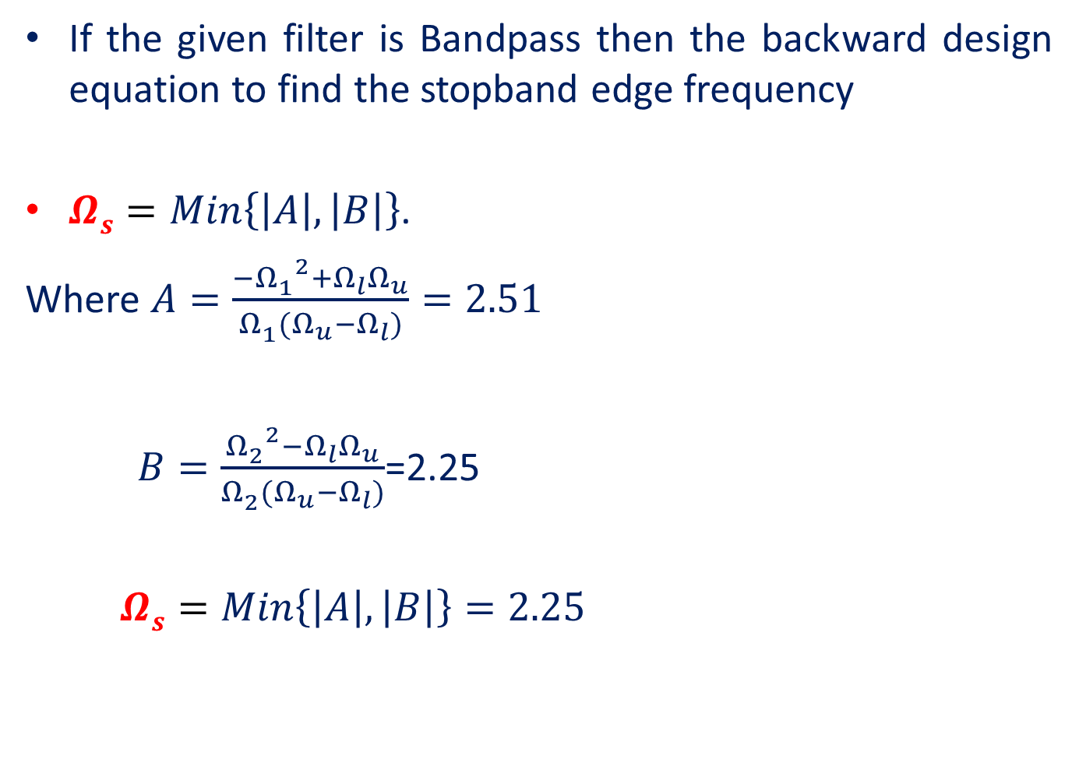
If the given filter is Bandpass then the backward design equation to find the stopband edge frequency
$Ωs=Min\left\{\left|A\right|,\left|B\right|\right\}$.
Where $A=\frac{{{−Ω}_{1}^{}}^{2}+Ω_{l}Ω_{u}}{Ω_{1}^{}(Ω_{u}−Ω_{l})}=2.51$
$B=\frac{{Ω_{2}^{}}^{2}−Ω_{l}Ω_{u}}{Ω_{2}^{}(Ω_{u}−Ω_{l})}$=2.25
$Ωs=Min\left\{\left|A\right|,\left|B\right|\right\}=2.25$

Slide 7
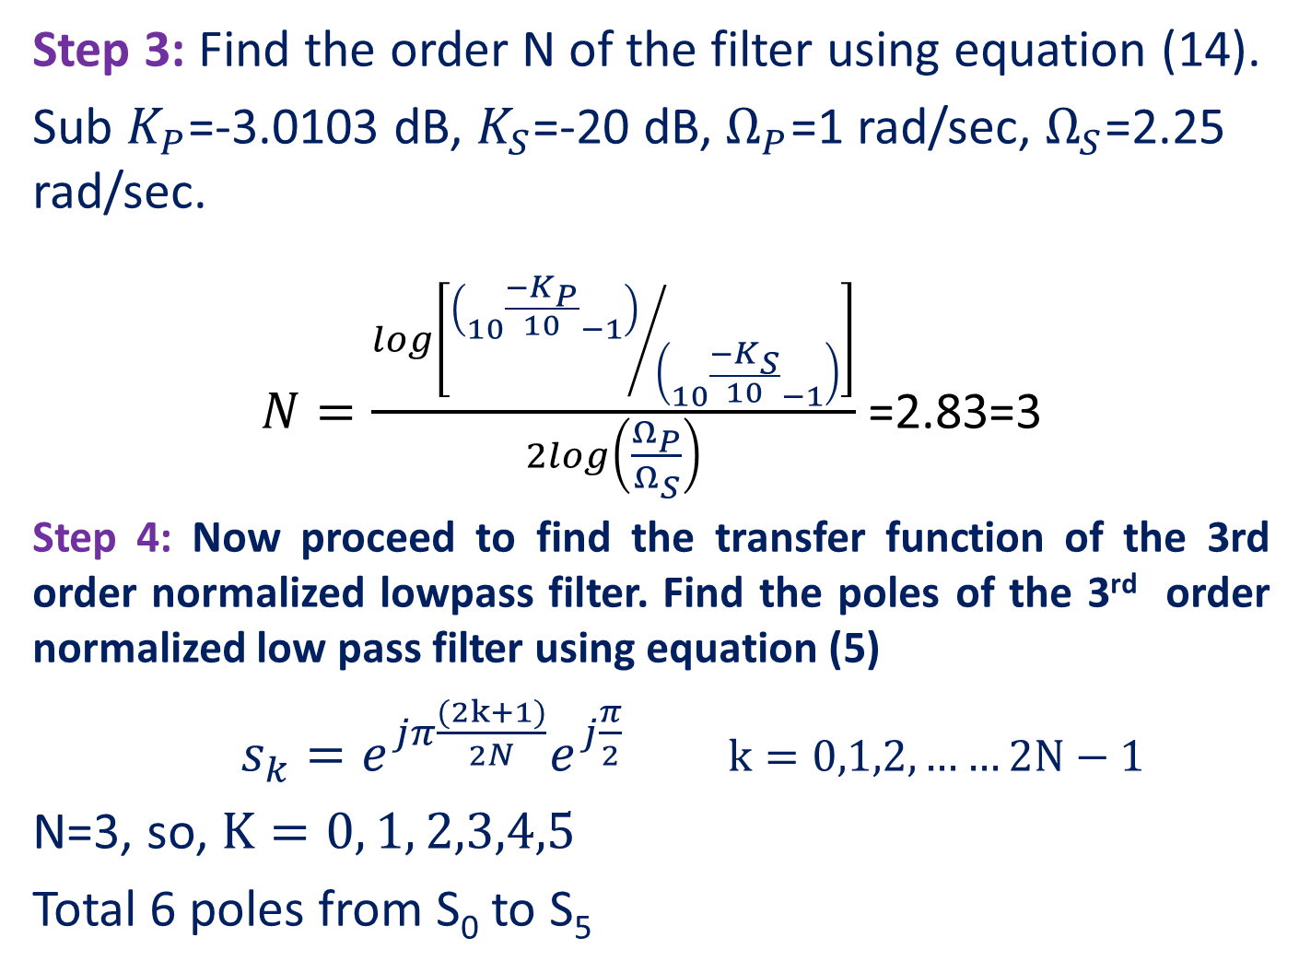
Step 3: Find the order N of the filter using equation (14).
Sub $K_{P}$=-3.0103 dB, $K_{S}$=-20 dB, $Ω_{P}$=1 rad/sec, $Ω_{S}$=2.25 rad/sec.
$N=\frac{log\left[{\left({10}^{\frac{{−K}_{P}}{10}}−1\right)}/{\left({10}^{\frac{{−K}_{S}}{10}}−1\right)}\right]}{2log\left(\frac{Ω_{P}}{Ω_{S}}\right)}$ =2.83=3
Step 4: Now proceed to find the transfer function of the 3rd order normalized lowpass filter. Find the poles of the 3rd order normalized low pass filter using equation (5)
$s_{k}=e^{jπ\frac{(2k+1)}{2N}}e^{j\frac{π}{2}}$ $k=0,1,2,……2N−1$
N=3, so, $K=0, 1, 2,3,4,5$
Total 6 poles from S₀ to S₅

Slide 8

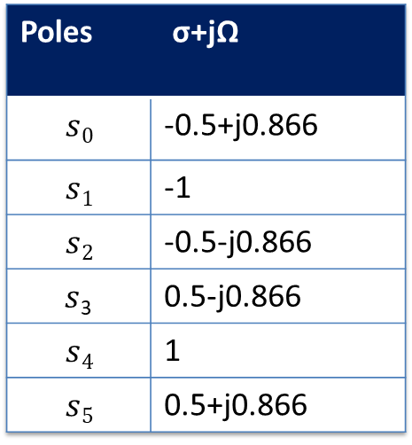





jΩ
S-plane
Poles | σ+jΩ
$$s0$$ | -0.5+j0.866
$$s1$$ | -1
$$s2$$ | -0.5-j0.866
$s$₃ | 0.5-j0.866
$$s4$$ | 1
$$s5$$ | 0.5+j0.866
$$s0$$
$s$₅
$s$₁
$s$₄
σ
$$s3$$
$$s2$$
Left-half poles of H₃(s)
Right-half poles of H₃(-s)

Slide 9
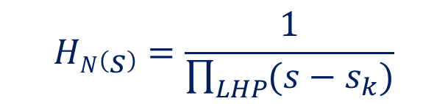

Step 5:
Hence, the transfer function of the 3rd order normalized lowpass Butterworth filter is
$H_{3}\left(s\right)=\frac{1}{(s−s_{0})(s−s_{1})(s−s_{2})}$
$H_{3}\left(s\right)=\frac{1}{s^{3}+{2s}^{2}+2s+1}$
$$HN\left(s\right)=\frac{1}{\prod_{LHP}{(s−s_{k})}}$$

Slide 10
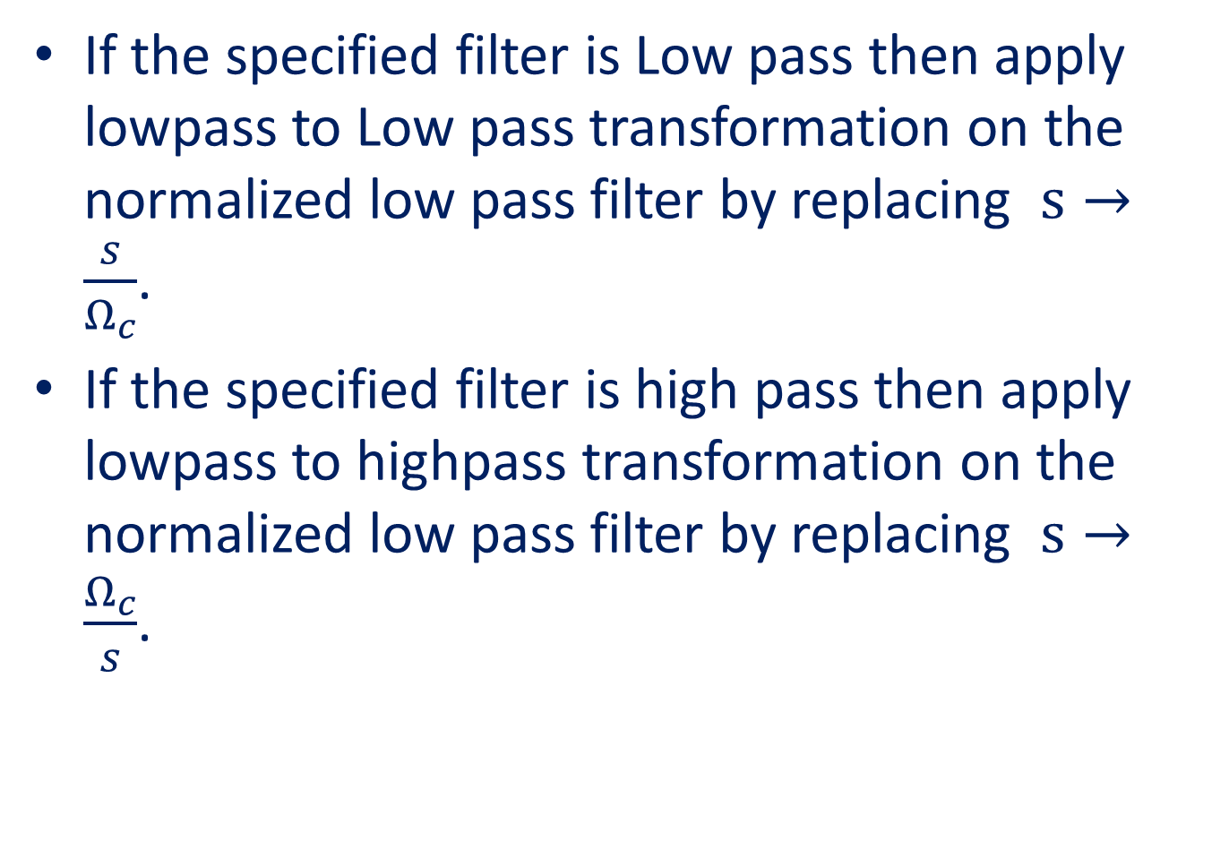
If the specified filter is Low pass then apply lowpass to Low pass transformation on the normalized low pass filter by replacing $s→\frac{s}{Ω_{c}}$.
If the specified filter is high pass then apply lowpass to highpass transformation on the normalized low pass filter by replacing $s→\frac{Ω_{c}}{s}$.

Slide 11
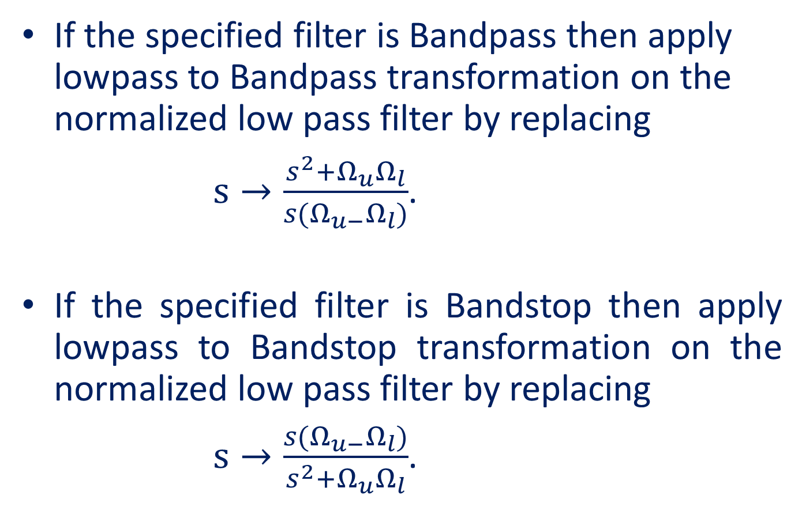
If the specified filter is Bandpass then apply lowpass to Bandpass transformation on the normalized low pass filter by replacing
$s→\frac{s^{2}+Ω_{u}Ω_{l}}{s(Ω_{u−}Ω_{l})}$.
If the specified filter is Bandstop then apply lowpass to Bandstop transformation on the normalized low pass filter by replacing
$s→\frac{s(Ω_{u−}Ω_{l})}{s^{2}+Ω_{u}Ω_{l}}$.

Slide 12
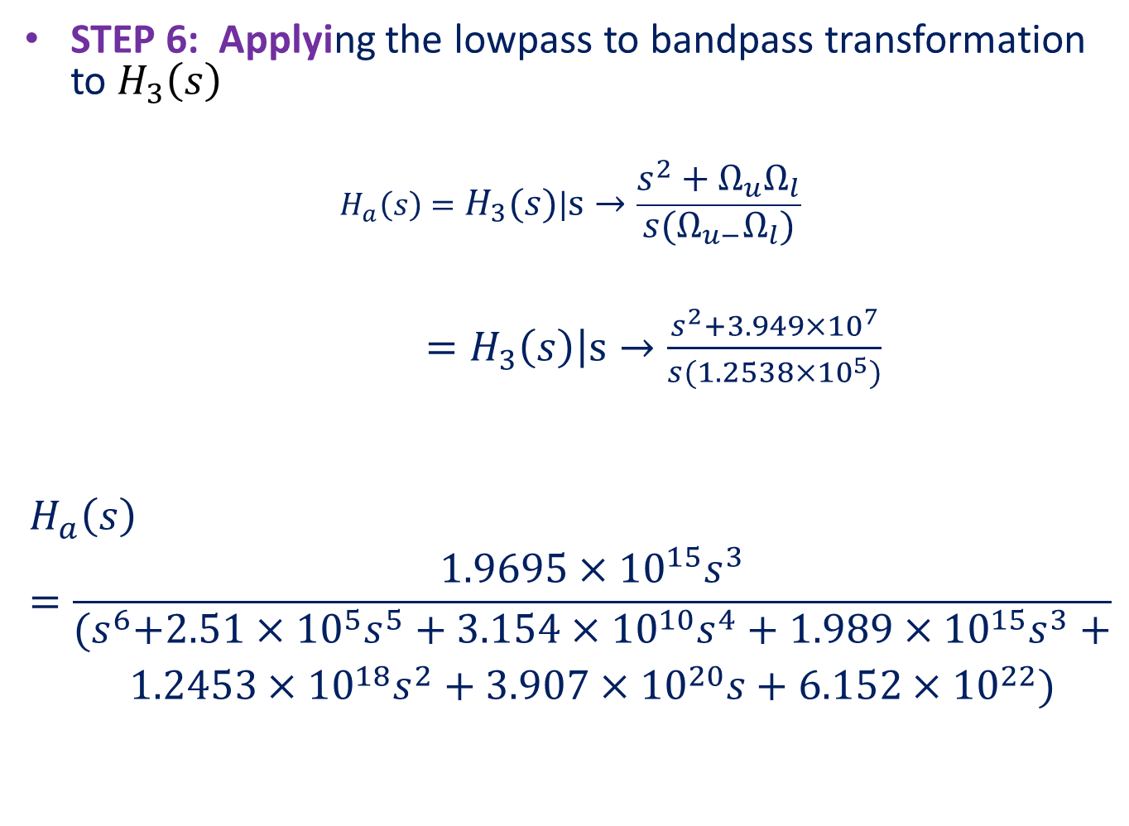
STEP 6: Applying the lowpass to bandpass transformation to $H_{3}\left(s\right)$
$$H_{a}\left(s\right)=\left.H_{3}\left(s\right)\right|s→\frac{s^{2}+Ω_{u}Ω_{l}}{s(Ω_{u−}Ω_{l})}$$
$=\left.H_{3}\left(s\right)\right|s→\frac{s^{2}+3.949×{10}^{7}}{s(1.2538×{10}^{5})}$
$$H_{a}\left(s\right)=\frac{1.9695×{10}^{15}s^{3}}{\begin{aligned}{(s}^{6}+2.51×{10}^{5}s^{5}+3.154×{10}^{10}s^{4}+1.989×{10}^{15}s^{3}+ \\ 1.2453×{10}^{18}s^{2}+3.907×{10}^{20}s+6.152×{10}^{22})\end{aligned}}$$

