Slide 1

Analog IIR Filter Design part IV
Dr K. Mohanaprasad
Associate Professor
School of Electronics Engineering (SENSE)
VIT Chennai

Slide 2
Chebyshev Filter
Chebyshev–I filter is equiripple in the passband and monotonic in the stopband.
Chebyshev-II filter is equiripple in the stopband and monotonic in the passband.
In order to understand the frequency-domain behavior of Chebyshev filters, it is utmost important to define a Chebyshev polynomial and then its properties

Slide 3
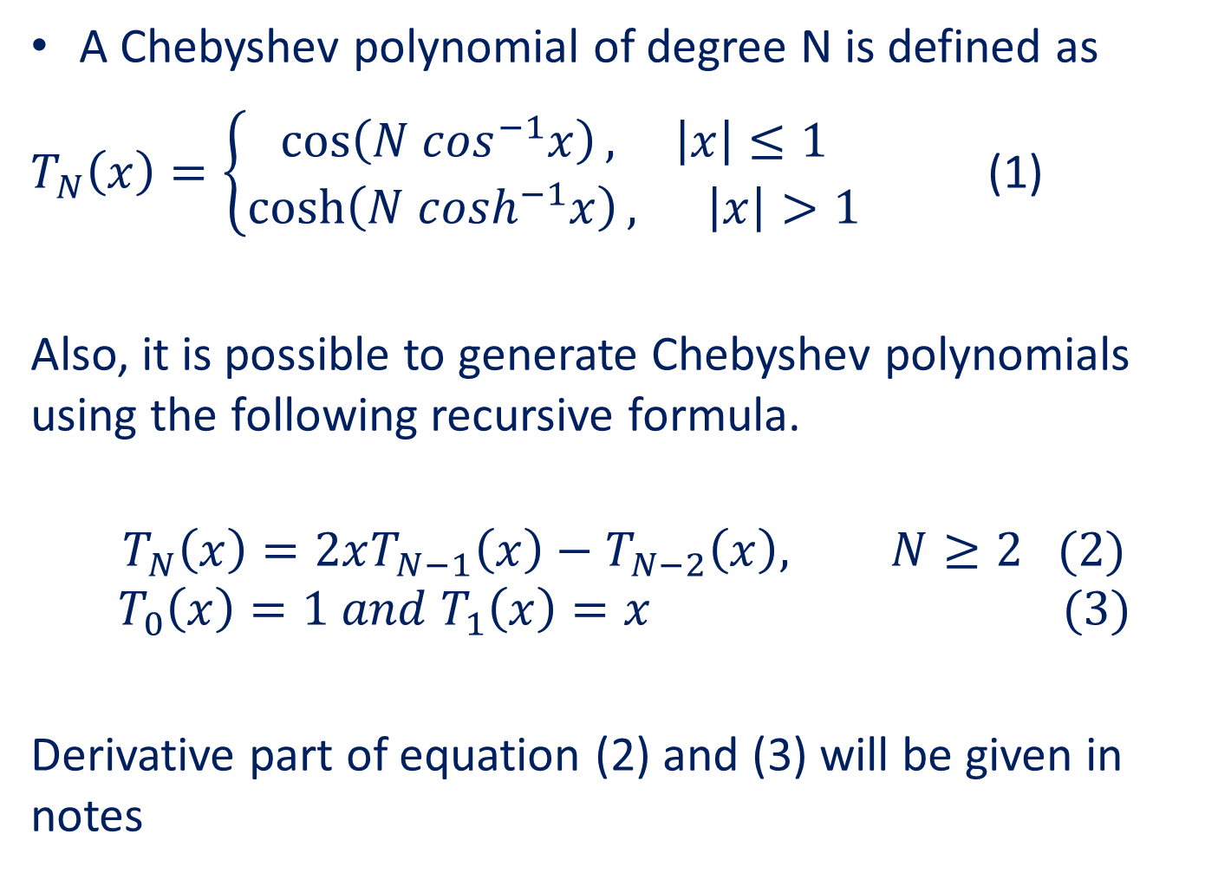
A Chebyshev polynomial of degree N is defined as
$T_{N}\left(x\right)=\left\{\begin{aligned}\cos\left(N \cos^{−1}x\right), \left|x\right|≤1 \\ \cosh\left(N \cosh^{−1}x\right), \left|x\right|>1\end{aligned}\right.$ (1)
Also, it is possible to generate Chebyshev polynomials using the following recursive formula.
$$T_{N}\left(x\right)=2xT_{N−1}\left(x\right)−T_{N−2}\left(x\right), N≥2 (2)$$
$${ T}_{0}\left(x\right)=1 and T_{1}\left(x\right)=x (3)$$
Derivative part of equation (2) and (3) will be given in notes

Slide 4
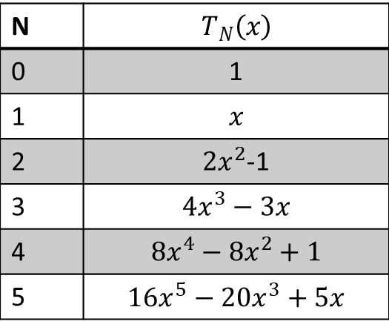
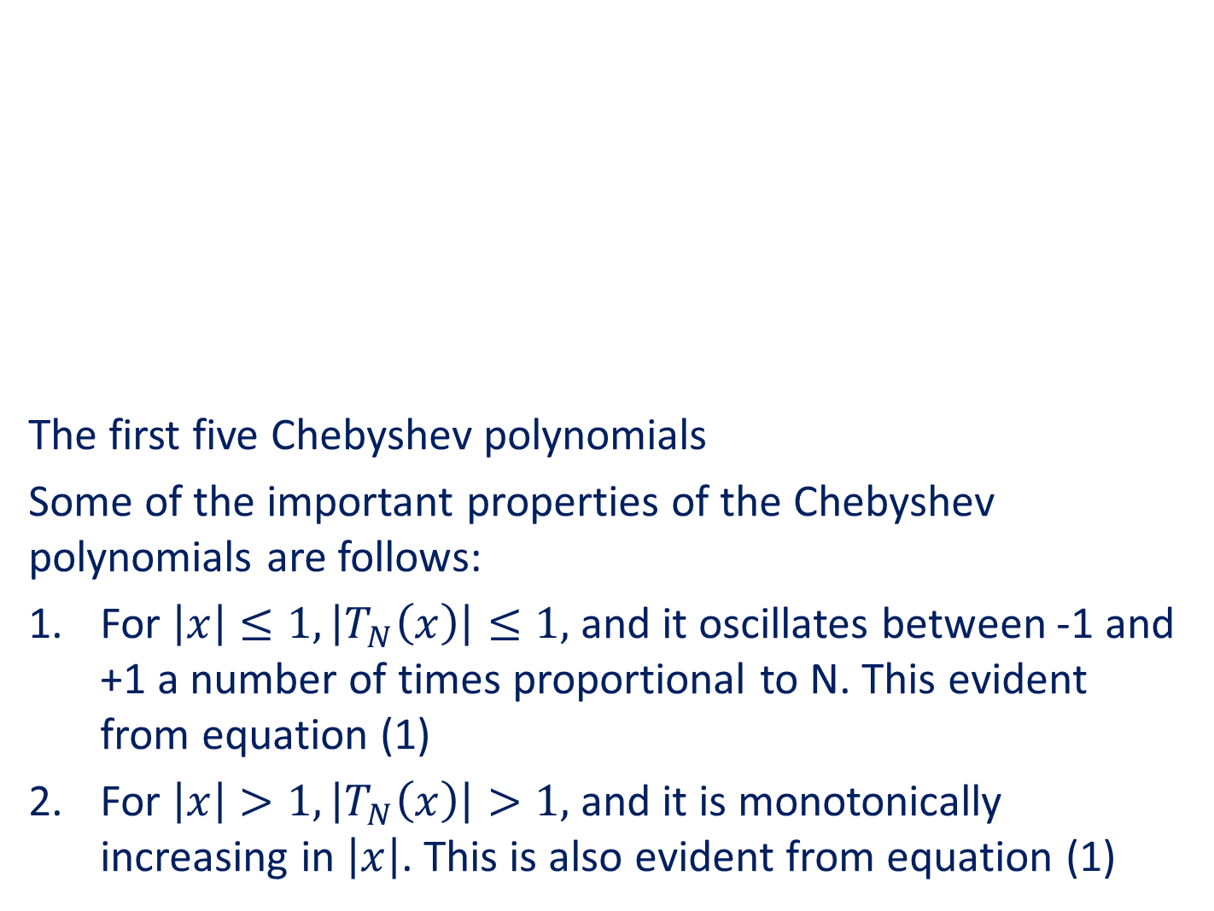
The first five Chebyshev polynomials
Some of the important properties of the Chebyshev polynomials are follows:
For $\left|x\right|≤1, \left|T_{N}\left(x\right)\right|≤1,$and it oscillates between -1 and +1 a number of times proportional to N. This evident from equation (1)
For $\left|x\right|>1,\left|T_{N}\left(x\right)\right|>1,$and it is monotonically increasing in $\left|x\right|$. This is also evident from equation (1)

Slide 5
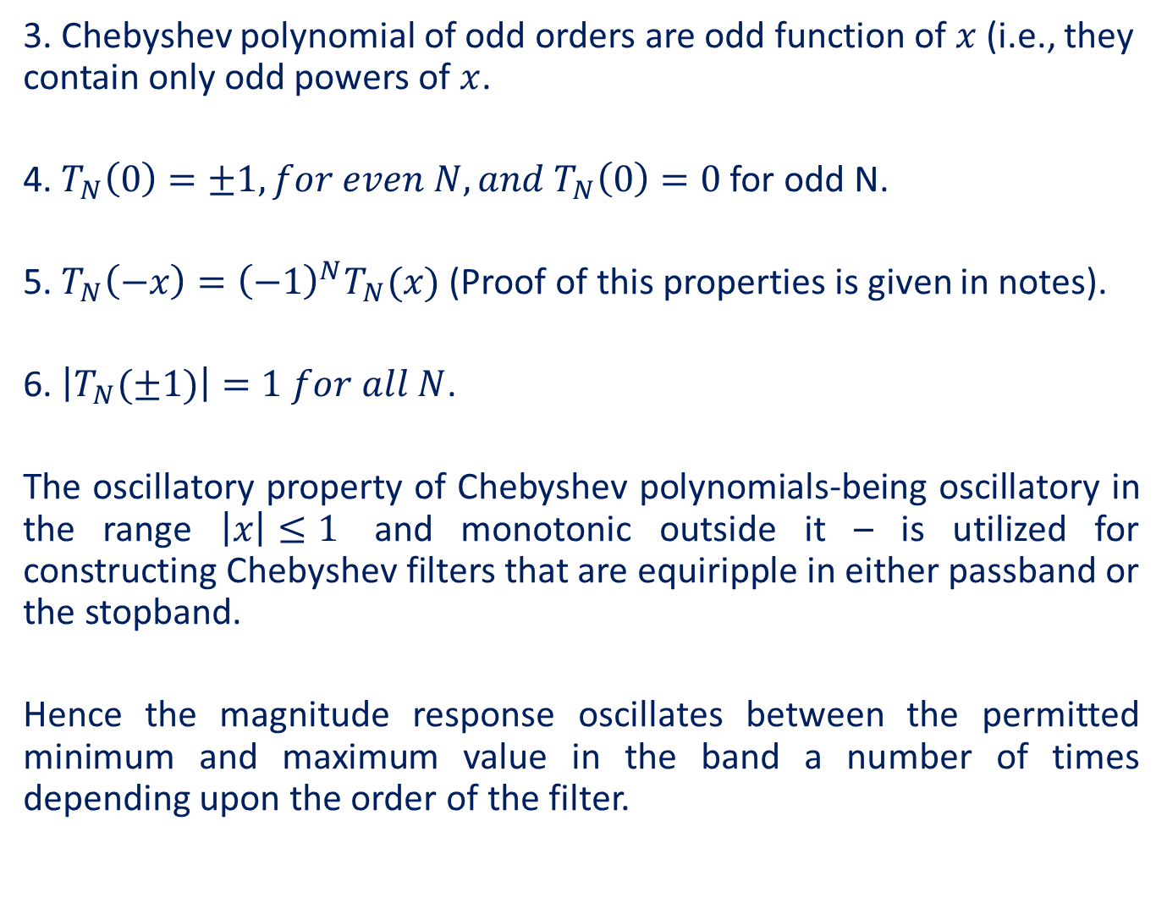
3. Chebyshev polynomial of odd orders are odd function of $x$ (i.e., they contain only odd powers of $x$.
4. $T_{N}\left(0\right)=±1, for even N, and{ T}_{N}\left(0\right)=0$ for odd N.
5. $T_{N}\left(−x\right)={\left(−1\right)}^{N}T_{N}(x)$ (Proof of this properties is given in notes).
6. $\left|T_{N}(±1)\right|=1 for all N$.
The oscillatory property of Chebyshev polynomials-being oscillatory in the range $\left|x\right|≤1$ and monotonic outside it – is utilized for constructing Chebyshev filters that are equiripple in either passband or the stopband.
Hence the magnitude response oscillates between the permitted minimum and maximum value in the band a number of times depending upon the order of the filter.

Slide 6
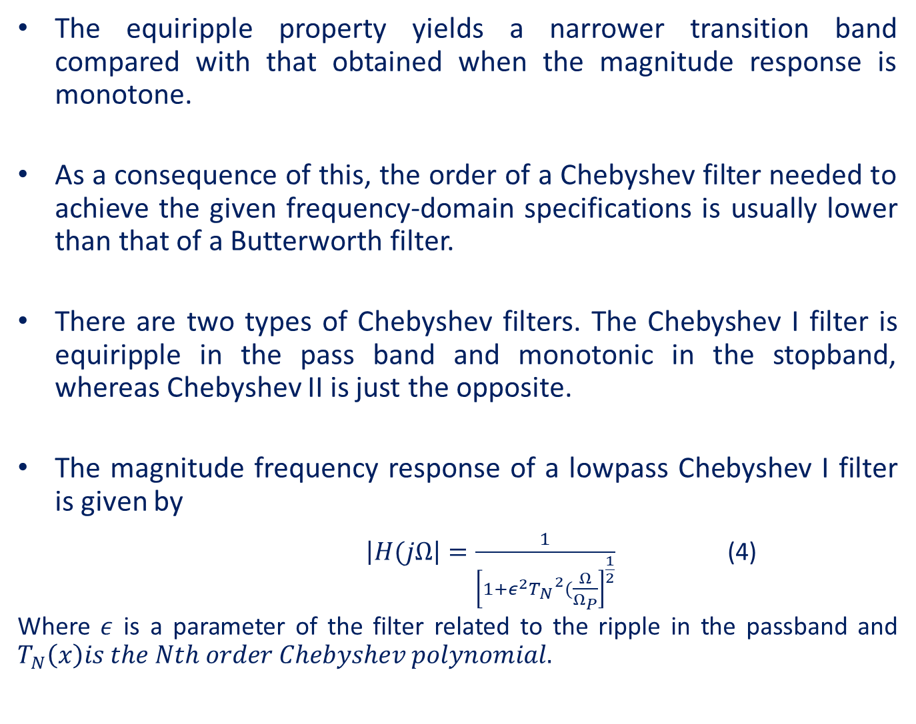
The equiripple property yields a narrower transition band compared with that obtained when the magnitude response is monotone.
As a consequence of this, the order of a Chebyshev filter needed to achieve the given frequency-domain specifications is usually lower than that of a Butterworth filter.
There are two types of Chebyshev filters. The Chebyshev I filter is equiripple in the pass band and monotonic in the stopband, whereas Chebyshev II is just the opposite.
The magnitude frequency response of a lowpass Chebyshev I filter is given by
$\left|H(jΩ\right|=\frac{1}{{\left[1+ε^{2}{T_{N}}^{2}(\frac{Ω}{Ω_{P}}\right]}^{\frac{1}{2}}}$ (4)
Where $ε$ is a parameter of the filter related to the ripple in the passband and $T_{N}\left(x\right)is the Nth order Chebyshev polynomial.$

Slide 7







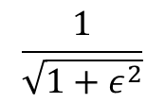

$$\left|H(jΩ)\right|$$
$$Maximum$$
……………
$$1$$
$$\frac{1}{\sqrt{1+ε^{2}}}$$
……………
$$Minimum$$
...……………………………..
...…………………………..
$$δs$$
……
$$Ωp$$
$$Ωs$$
$$Ω$$
N odd (N=5)
Magnitude frequency response of a Chebyshev I filter for N being odd

Slide 8

$$\left|H(jΩ)\right|$$
$$Maximum$$
………………
$$1$$
$$\frac{1}{\sqrt{1+ε^{2}}}$$
……………
$$Minimum$$
...……………………………..
...……………………….…..
$$δs$$
……
$$Ωp$$
$$Ωs$$
$$Ω$$
N odd (N=4)
Magnitude frequency response of a Chebyshev I filter for N being even

Slide 9
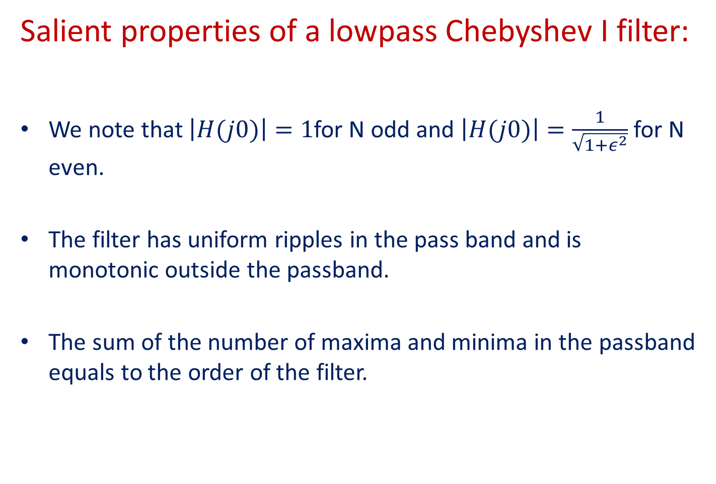
Salient properties of a lowpass Chebyshev I filter:
We note that $\left|H(j0)\right|=1$for N odd and $\left|H(j0)\right|=\frac{1}{\sqrt{1+ε^{2}}}$ for N even.
The filter has uniform ripples in the pass band and is monotonic outside the passband.
The sum of the number of maxima and minima in the passband equals to the order of the filter.

Slide 10
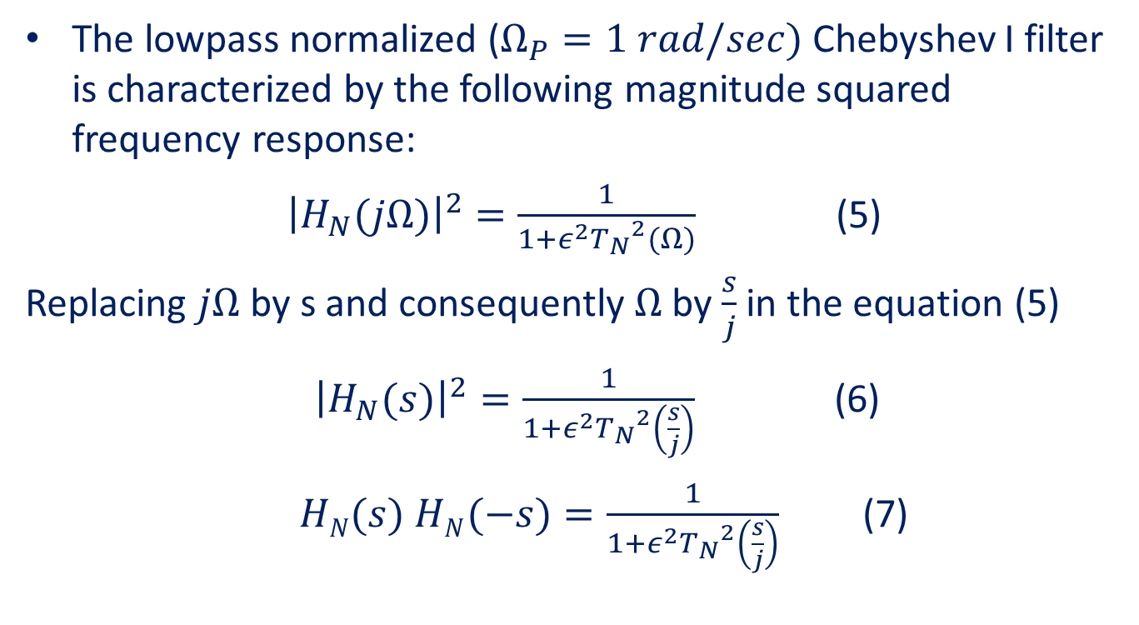

Chebyshev Normalized Transfer function $H_{N}(s)$
The lowpass normalized ($Ω_{P}=1 rad/sec)$Chebyshev I filter is characterized by the following magnitude squared frequency response:
${\left|H_{N}(jΩ)\right|}^{2}=\frac{1}{1+ε^{2}{T_{N}}^{2}(Ω)}$ (5)
Replacing $jΩ$ by s and consequently $Ω$ by $\frac{s}{j}$in the equation (5)
${\left|H_{N}(s)\right|}^{2}=\frac{1}{1+ε^{2}{T_{N}}^{2}\left(\frac{s}{j}\right)}$ (6)
$HN(s)$ $HN(−s)=\frac{1}{1+ε^{2}{T_{N}}^{2}\left(\frac{s}{j}\right)}$ (7)

Slide 11











$The transfer function HN(s)$ $HN(−s)$ has no finite zeros.
The poles of the product $HN(s)$ $HN(−s)$ are determined by equating the denominator of equation (7) to zero.
$1+ε^{2}{T_{N}}^{2}\left(\frac{s}{j}\right)=0$ (8)
Equation (8) is known as the characteristic equation of the filter. The roots of this equation or poles of $HN(s)$ $HN(−s)$ are found to lie on an ellipse in the s-plane as shown in figure.
jΩ
$$s0$$
...…
$s$₉
S-plane
jΩ_{k}
$s$₁
$s$₉
$s$₈
...…………
$$s2$$
$s$₇
σ_{k}
σ
$$s3$$
$s$₆
$s$₄
$s$₅
Left-half poles of H₅(s)
Right-half poles of H₅(-s)

Slide 12
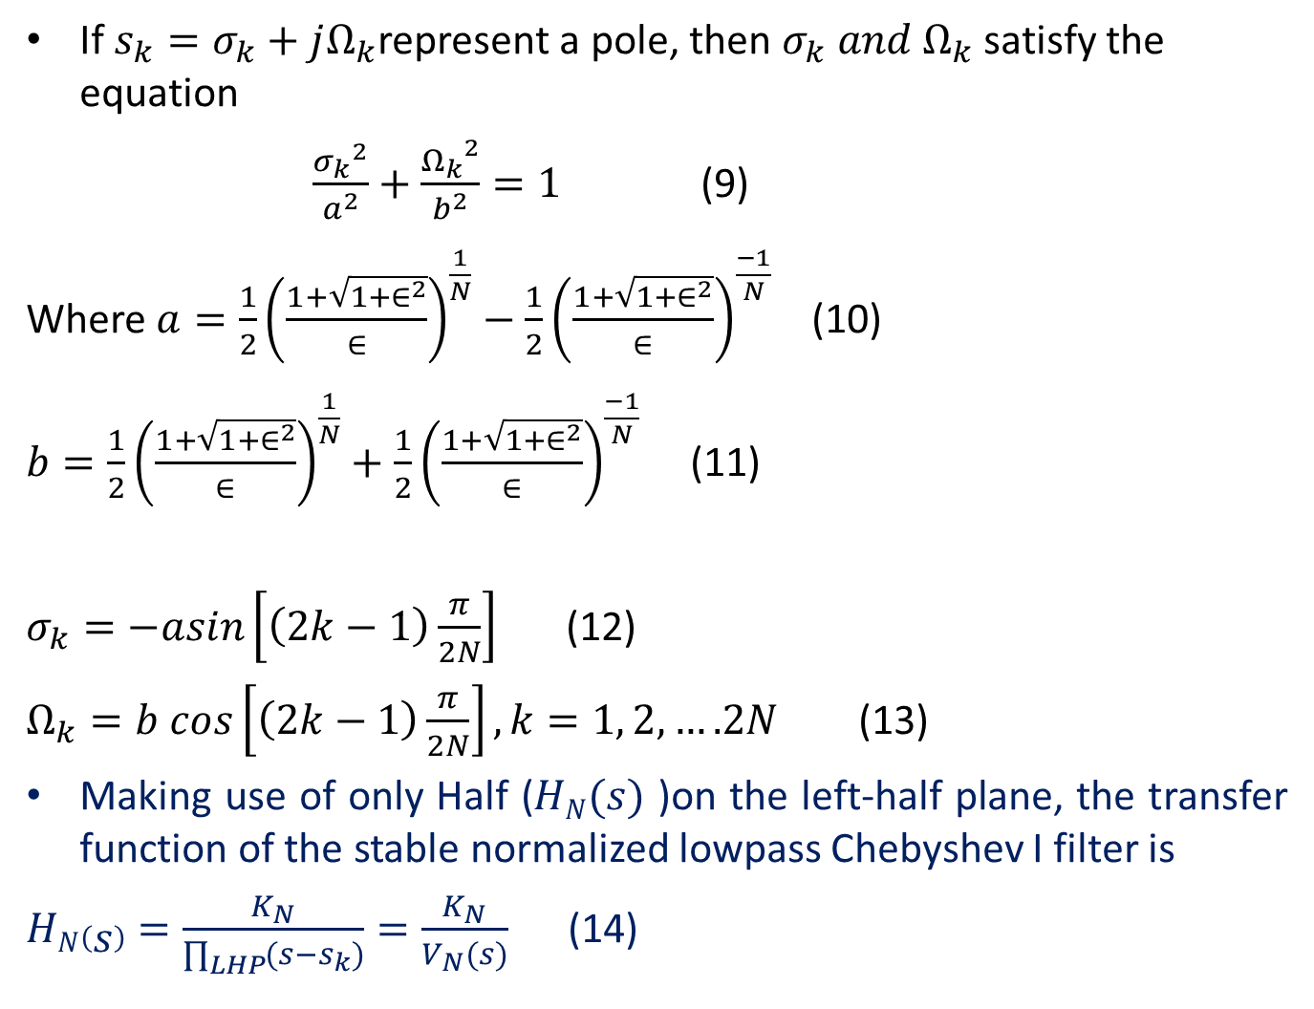
If $s_{k}=σ_{k}+jΩ_{k}$represent a pole, then $σ_{k} and Ω_{k}$ satisfy the equation
$\frac{{σ_{k}}^{2}}{a^{2}}+\frac{{Ω_{k}}^{2}}{b^{2}}=1$ (9)
Where $a=\frac{1}{2}{\left(\frac{1+\sqrt{1+∈^{2}}}{∈}\right)}^{\frac{1}{N}}−\frac{1}{2}{\left(\frac{1+\sqrt{1+∈^{2}}}{∈}\right)}^{\frac{−1}{N}}$ (10)
$b=\frac{1}{2}{\left(\frac{1+\sqrt{1+∈^{2}}}{∈}\right)}^{\frac{1}{N}}+\frac{1}{2}{\left(\frac{1+\sqrt{1+∈^{2}}}{∈}\right)}^{\frac{−1}{N}}$ (11)
$σ_{k}=−asin\left[\left(2k−1\right)\frac{π}{2N}\right]$ (12)
$Ω_{k}=b cos\left[\left(2k−1\right)\frac{π}{2N}\right], k=1, 2,….2N$ (13)
Making use of only Half ($HN(s)$ )on the left-half plane, the transfer function of the stable normalized lowpass Chebyshev I filter is
$HN\left(s\right)=\frac{K_{N}}{\prod_{LHP}{(s−s_{k})}}=\frac{K_{N}}{V_{N}(s)}$ (14)

Slide 13
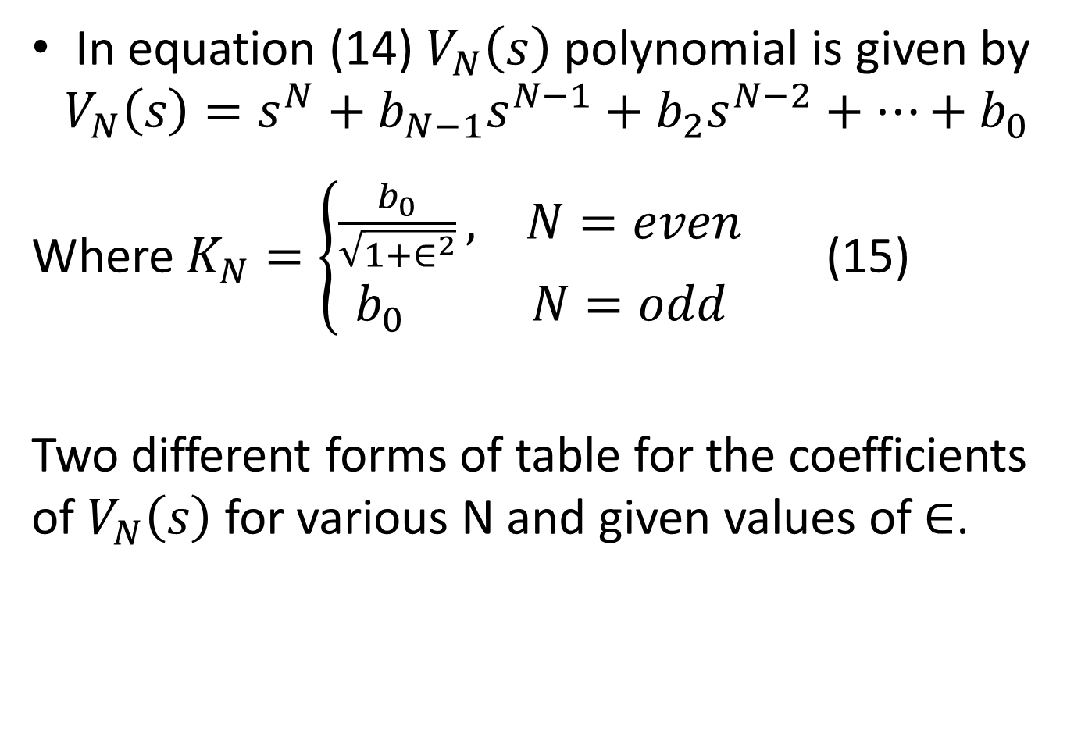
In equation (14) $V_{N}\left(s\right)$ polynomial is given by
$$V_{N}\left(s\right)=s^{N}+b_{N−1}s^{N−1}+b_{2}s^{N−2}+…+b_{0}$$
Where $K_{N}=\left\{\begin{aligned}\frac{b_{0}}{\sqrt{1+∈^{2}}}, N=even \\ b_{0} N=odd\end{aligned}\right.$ (15)
Two different forms of table for the coefficients of $V_{N}\left(s\right)$ for various N and given values of $∈$.

Slide 14
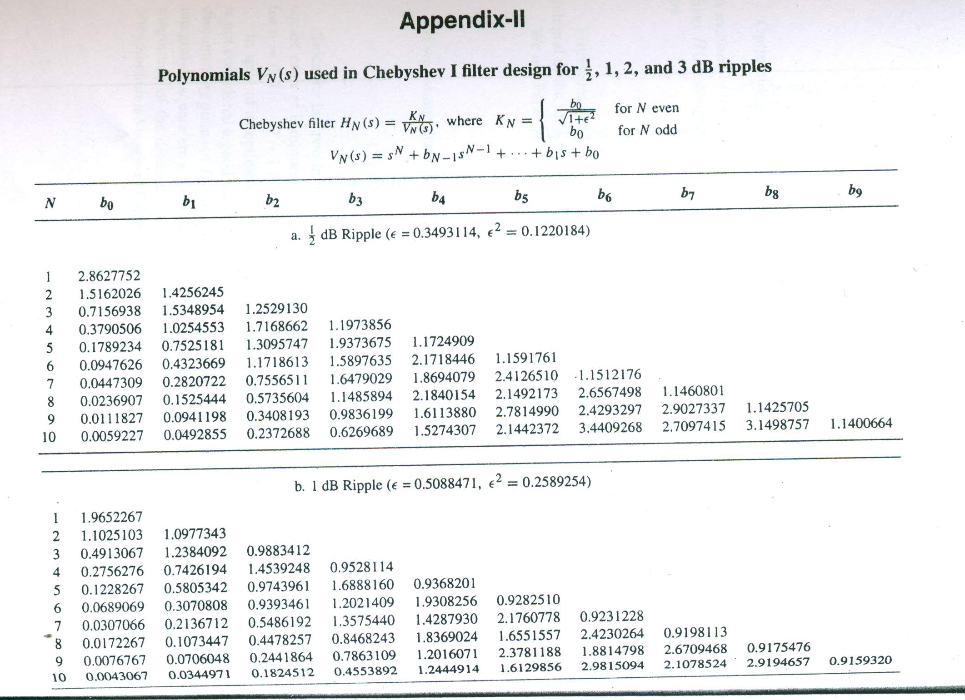

Slide 15
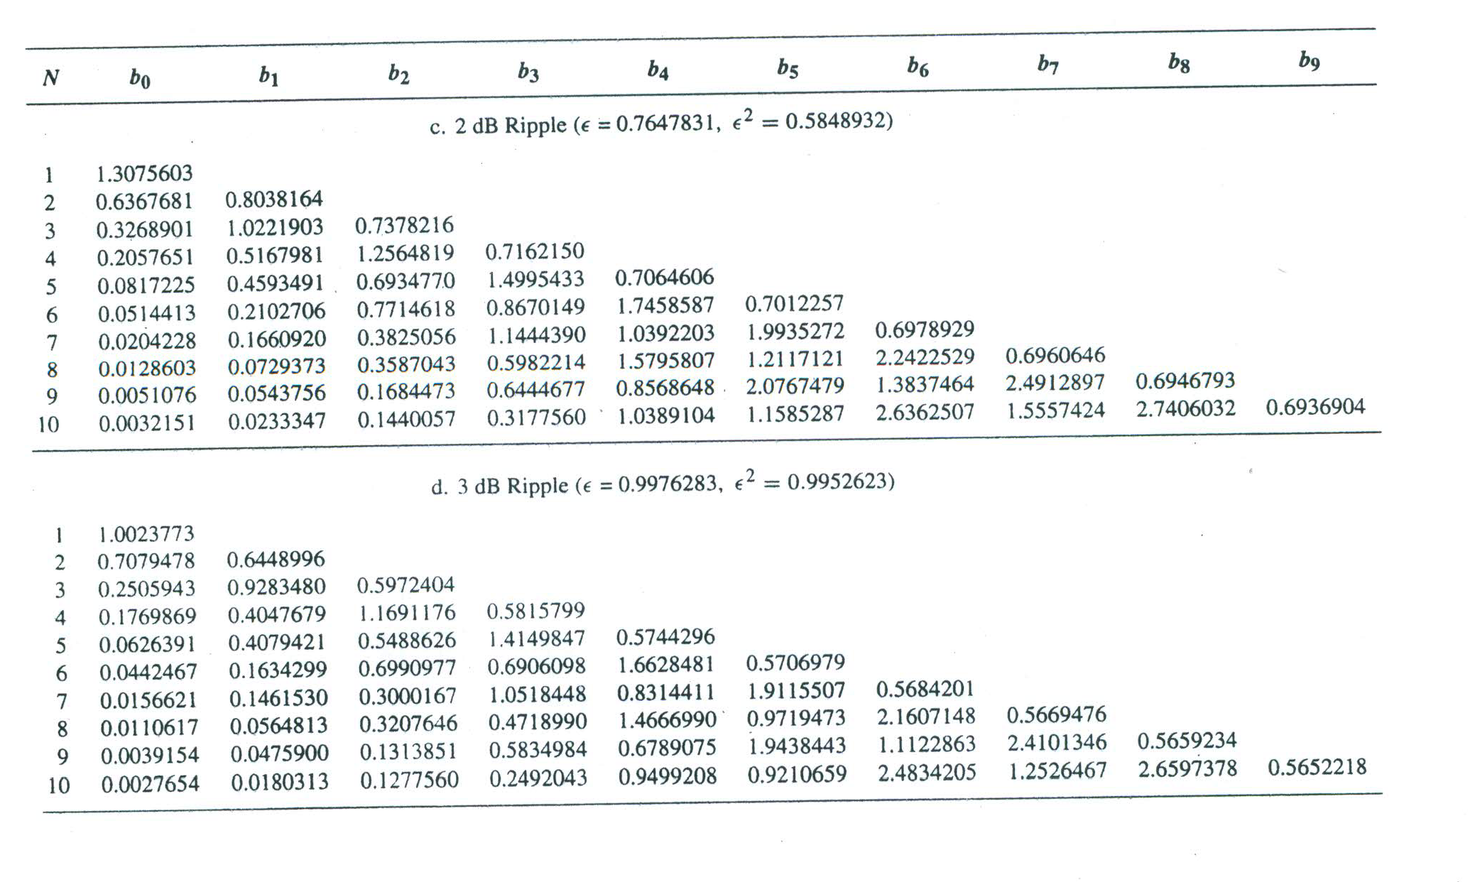

Slide 16
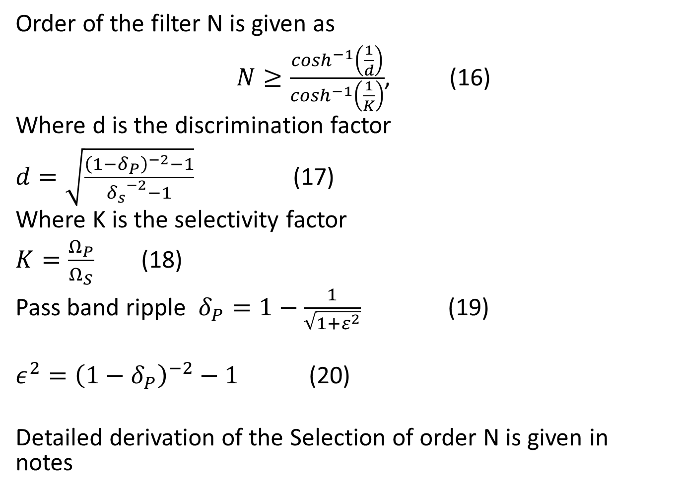
Selection of N
Order of the filter N is given as
$N≥\frac{\cosh^{−1}\left(\frac{1}{d}\right)}{\cosh^{−1}\left(\frac{1}{K}\right)}$, (16)
Where d is the discrimination factor
$d=\sqrt{\frac{{\left(1−δ_{P}\right)}^{−2}−1}{{δ_{s}}^{−2}−1}}$ (17)
Where K is the selectivity factor
$K=\frac{Ω_{P}}{Ω_{S}}$ (18)
Pass band ripple $δ_{P}=1−\frac{1}{\sqrt{1+ε^{2}}}$ (19)
$ε^{2}={\left(1−δ_{P}\right)}^{−2}−1$ (20)
Detailed derivation of the Selection of order N is given in notes

Slide 17
Thank you

