Slide 1

Analog IIR Filter Design part V
Dr K. Mohanaprasad
Associate Professor
School of Electronics Engineering (SENSE)
VIT Chennai

Slide 2
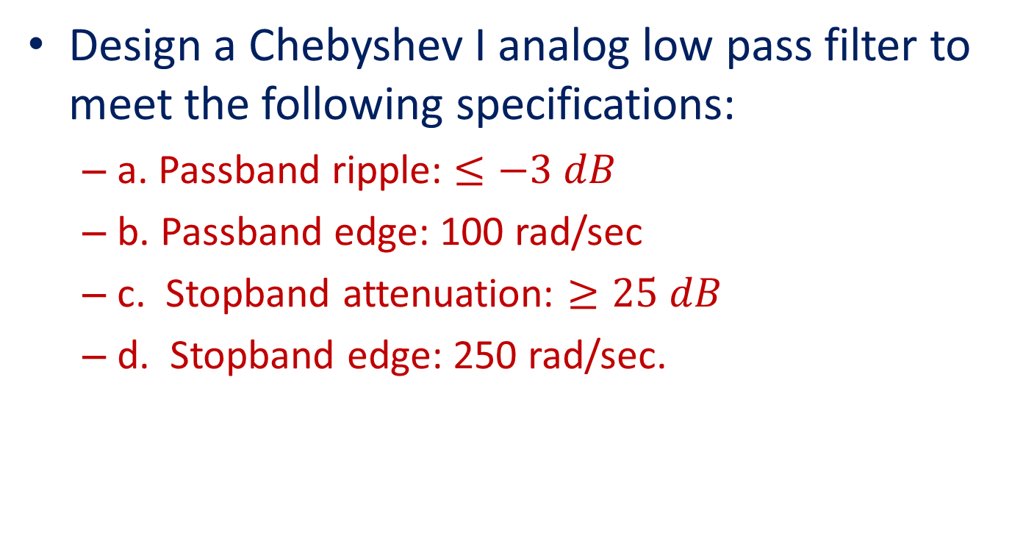
Problem 1
Design a Chebyshev I analog low pass filter to meet the following specifications:
a. Passband ripple: $≤−3 dB$
b. Passband edge: 100 rad/sec
c. Stopband attenuation: $≥25 dB$
d. Stopband edge: 250 rad/sec.

Slide 3






20$\left|H(jΩ)\right|$
Step 1
……………
0
Kp=-3 dB
……………
$$Minimum$$
...……………………………..
...…………………………..
$$Ks=−25 dB$$
……
$Ωp=1$00 rad/sec
$$Ωs=250 rad/sec$$
$$Ω$$
N odd (N=3)
The specified Magnitude frequency response of a Chebyshev I filter is shown above

Slide 4
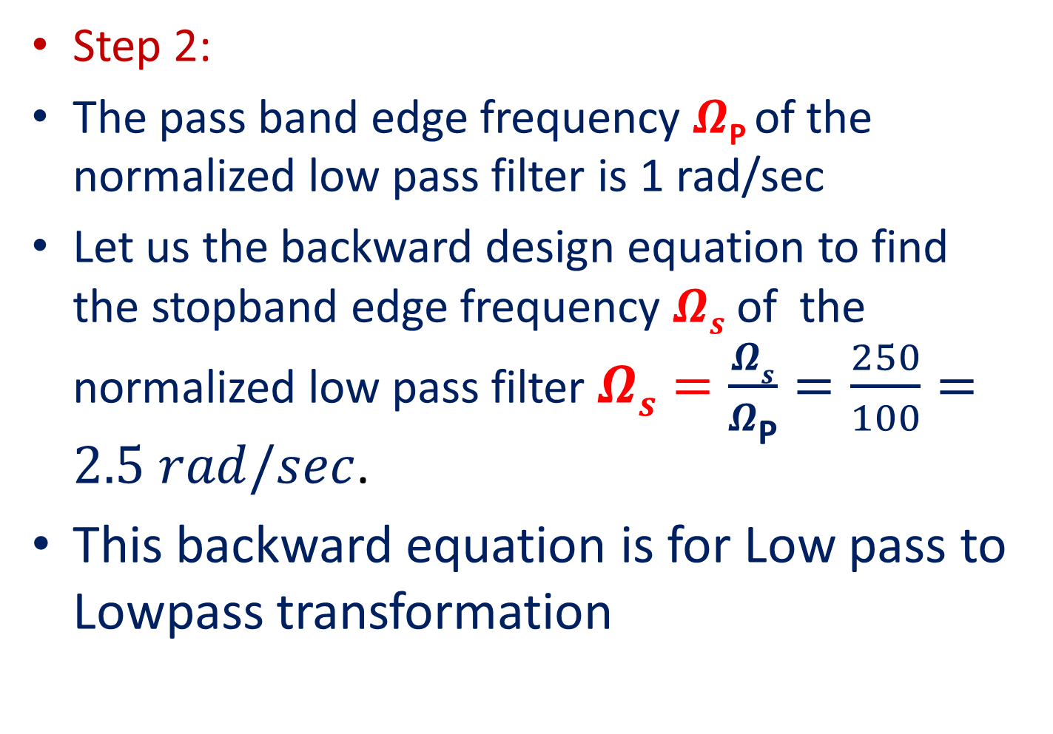
Step 2:
The pass band edge frequency $Ω\text{P}$of the normalized low pass filter is 1 rad/sec
Let us the backward design equation to find the stopband edge frequency $Ωs$ of the normalized low pass filter$Ωs=\frac{Ωs}{Ω\text{P}}=\frac{250}{100}=2.5 rad/sec$.
This backward equation is for Low pass to Lowpass transformation

Slide 5


20$\left|H(jΩ)\right|$
Step 2
……………
0
Kp=-3 dB
……………
$$Minimum$$
...……………………………..
...…………………………..
$$Ks=−25 dB$$
……
$Ωp=1$ rad/sec
$$Ωs=2.5 rad/sec$$
$$Ω$$
N odd (N=3)
Normalized Magnitude frequency response of a Chebyshev I Low pass filter for N being odd

Slide 6
If the given filter is high pass then the backward design equation to find the stopband edge frequency $Ωs$ is $\frac{ΩP}{Ω\text{S}}$ .
If the given filter is Bandpass then the backward design equation to find the stopband edge frequency $Ωs=Min\left\{\left|A\right|,\left|B\right|\right\}$. Where $A=\frac{{{−Ω}_{1}^{}}^{2}+Ω_{l}Ω_{u}}{Ω_{1}^{}(Ω_{u}−Ω_{l})}$, $B=\frac{{Ω_{2}^{}}^{2}−Ω_{l}Ω_{u}}{Ω_{2}^{}(Ω_{u}−Ω_{l})}$
If the given filter is Bandstop then the backward design equation to find the stopband edge frequency $Ωs=Min\left\{\left|A\right|,\left|B\right|\right\}$. Where $A=\frac{Ω_{1}^{}(Ω_{u}−Ω_{l})}{{{−Ω}_{1}^{}}^{2}+Ω_{l}Ω_{u}}$, $B=\frac{Ω_{2}^{}(Ω_{u}−Ω_{l})}{{Ω_{2}^{}}^{2}−Ω_{l}Ω_{u}}$
The normalized passband edge frequency $ΩP$ is always equal to 1 rad/sec irrespective of the given filter.

Slide 7
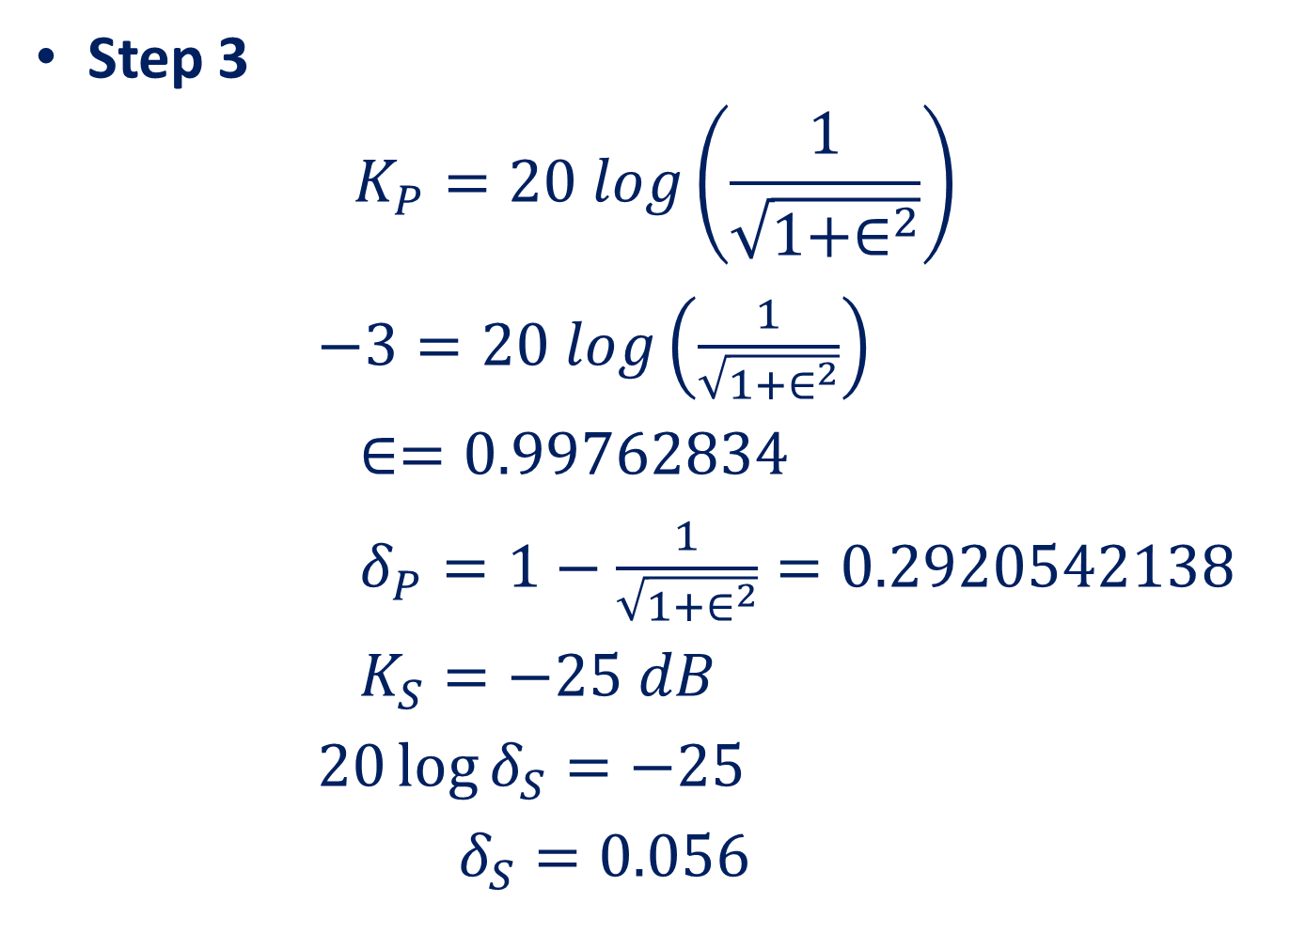
Step 3
$$K_{P}=20 log\left(\frac{1}{\sqrt{1+∈^{2}}}\right)$$
$−3=20 log\left(\frac{1}{\sqrt{1+∈^{2}}}\right)$
$∈=0.99762834$
$δ_{P}=1−\frac{1}{\sqrt{1+∈^{2}}}=0.2920542138$
$K_{S}=−25 dB$
$20\log{δ_{S}=−25}$
$δ_{S}=0.056$

Slide 8
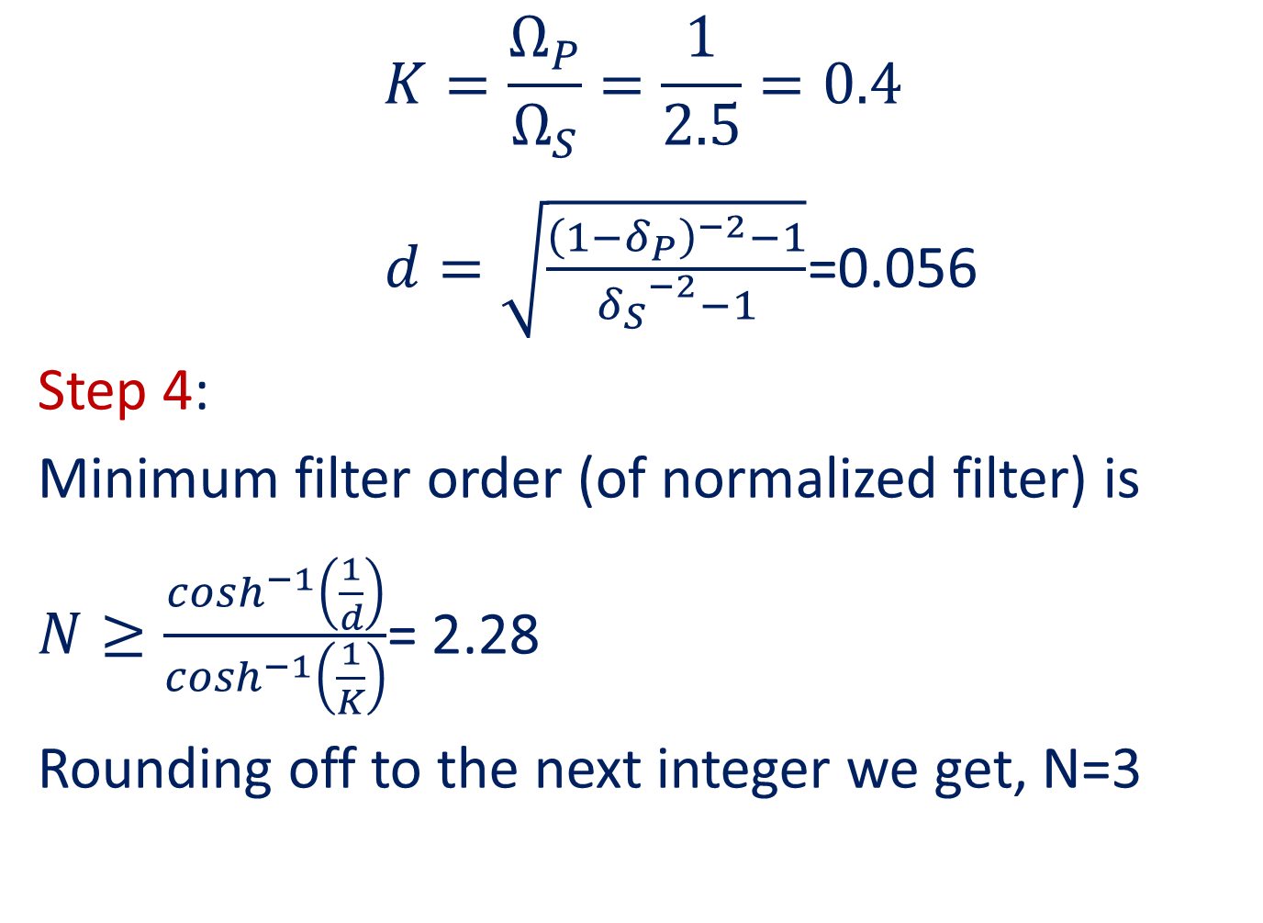
$$K=\frac{Ω_{P}}{Ω_{S}}=\frac{1}{2.5}=0.4$$
$d=\sqrt{\frac{{\left(1−δ_{P}\right)}^{−2}−1}{{δ_{S}}^{−2}−1}}$=0.056
Step 4:
Minimum filter order (of normalized filter) is
$N≥\frac{\cosh^{−1}\left(\frac{1}{d}\right)}{\cosh^{−1}\left(\frac{1}{K}\right)}$= 2.28
Rounding off to the next integer we get, N=3

Slide 9
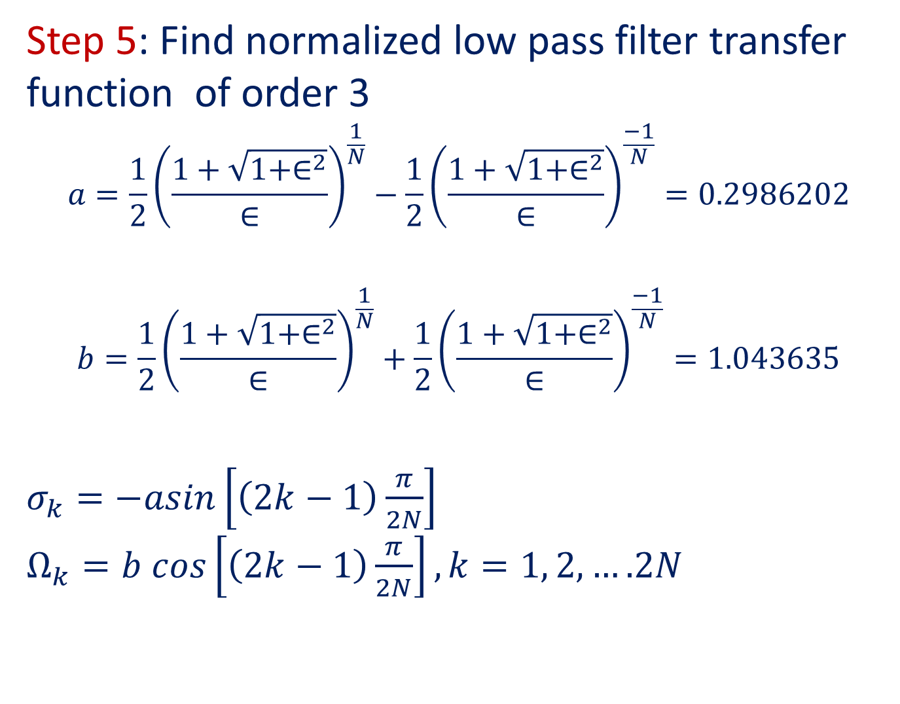
Step 5: Find normalized low pass filter transfer function of order 3
$$a=\frac{1}{2}{\left(\frac{1+\sqrt{1+∈^{2}}}{∈}\right)}^{\frac{1}{N}}−\frac{1}{2}{\left(\frac{1+\sqrt{1+∈^{2}}}{∈}\right)}^{\frac{−1}{N}}=0.2986202$$
$$b=\frac{1}{2}{\left(\frac{1+\sqrt{1+∈^{2}}}{∈}\right)}^{\frac{1}{N}}+\frac{1}{2}{\left(\frac{1+\sqrt{1+∈^{2}}}{∈}\right)}^{\frac{−1}{N}}=1.043635$$
$σ_{k}=−asin\left[\left(2k−1\right)\frac{π}{2N}\right]$ $Ω_{k}=b cos\left[\left(2k−1\right)\frac{π}{2N}\right], k=1, 2,….2N$

Slide 10
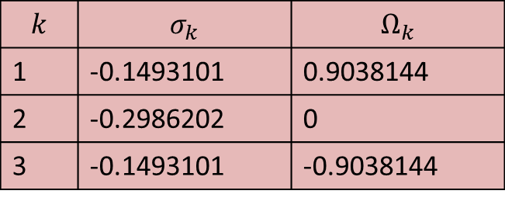
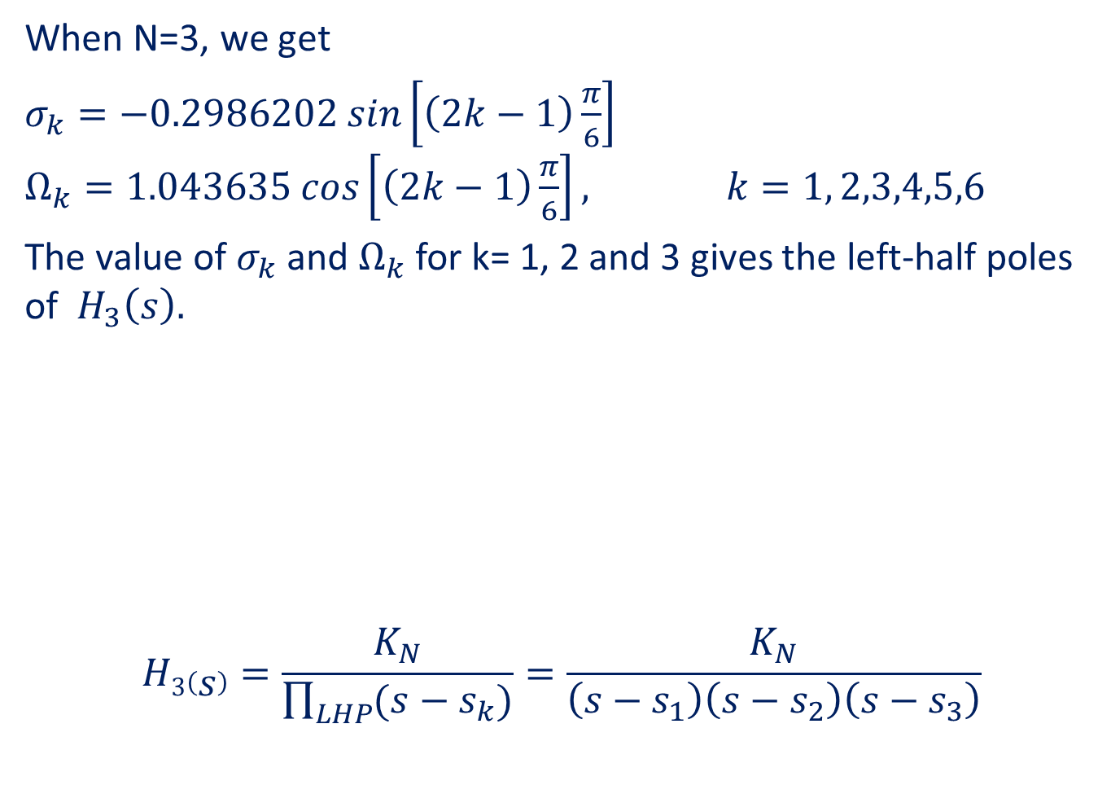
When N=3, we get
$σ_{k}=−0.2986202 sin\left[\left(2k−1\right)\frac{π}{6}\right]$ $Ω_{k}=1.043635 cos\left[\left(2k−1\right)\frac{π}{6}\right], k=1, 2,3,4,5,6$
The value of $σ_{k}$ and $Ω_{k}$ for k= 1, 2 and 3 gives the left-half poles of $H_{3}\left(s\right).$
$$H3\left(s\right)=\frac{K_{N}}{\prod_{LHP}{(s−s_{k})}}=\frac{K_{N}}{\left(s−s_{1}\right)\left(s−s_{2}\right)\left(s−s_{3}\right)}$$
$$k$$ | $$σ_{k}$$ | $$Ω_{k}$$
1 | -0.1493101 | 0.9038144
2 | -0.2986202 | 0
3 | -0.1493101 | -0.9038144

Slide 11
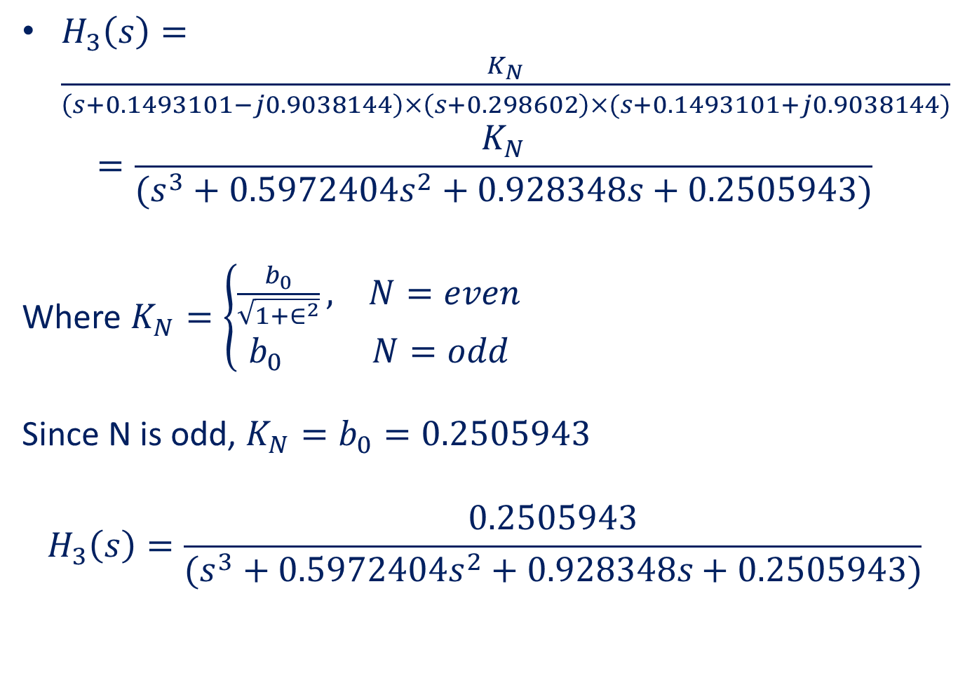
$H_{3}\left(s\right)=\frac{K_{N}}{\left(s+0.1493101−j0.9038144\right)×\left(s+0.298602\right)×(s+0.1493101+j0.9038144)}$
$$=\frac{K_{N}}{(s^{3}+0.5972404s^{2}+0.928348s+0.2505943)}$$
Where $K_{N}=\left\{\begin{aligned}\frac{b_{0}}{\sqrt{1+∈^{2}}}, N=even \\ b_{0} N=odd\end{aligned}\right.$
Since N is odd, $K_{N}=b_{0}=0.2505943$
$$H_{3}\left(s\right)=\frac{0.2505943}{(s^{3}+0.5972404s^{2}+0.928348s+0.2505943)}$$

Slide 12
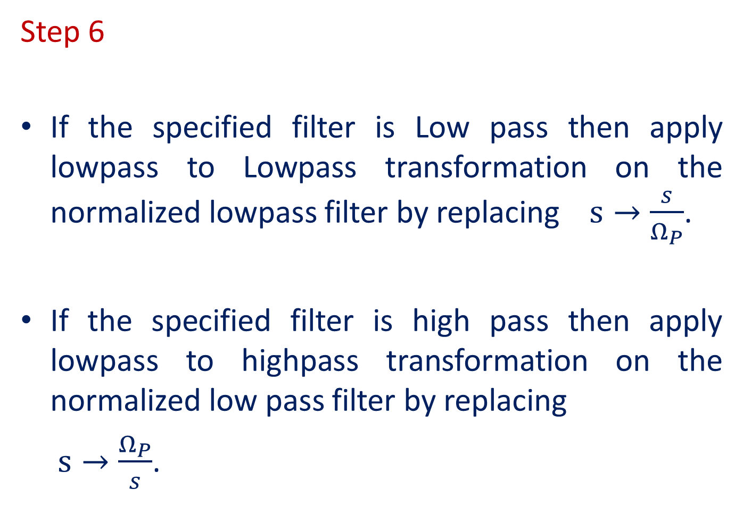
Step 6
If the specified filter is Low pass then apply lowpass to Lowpass transformation on the normalized lowpass filter by replacing $s→\frac{s}{Ω_{P}}$.
If the specified filter is high pass then apply lowpass to highpass transformation on the normalized low pass filter by replacing
$s→\frac{Ω_{P}}{s}$.

Slide 13
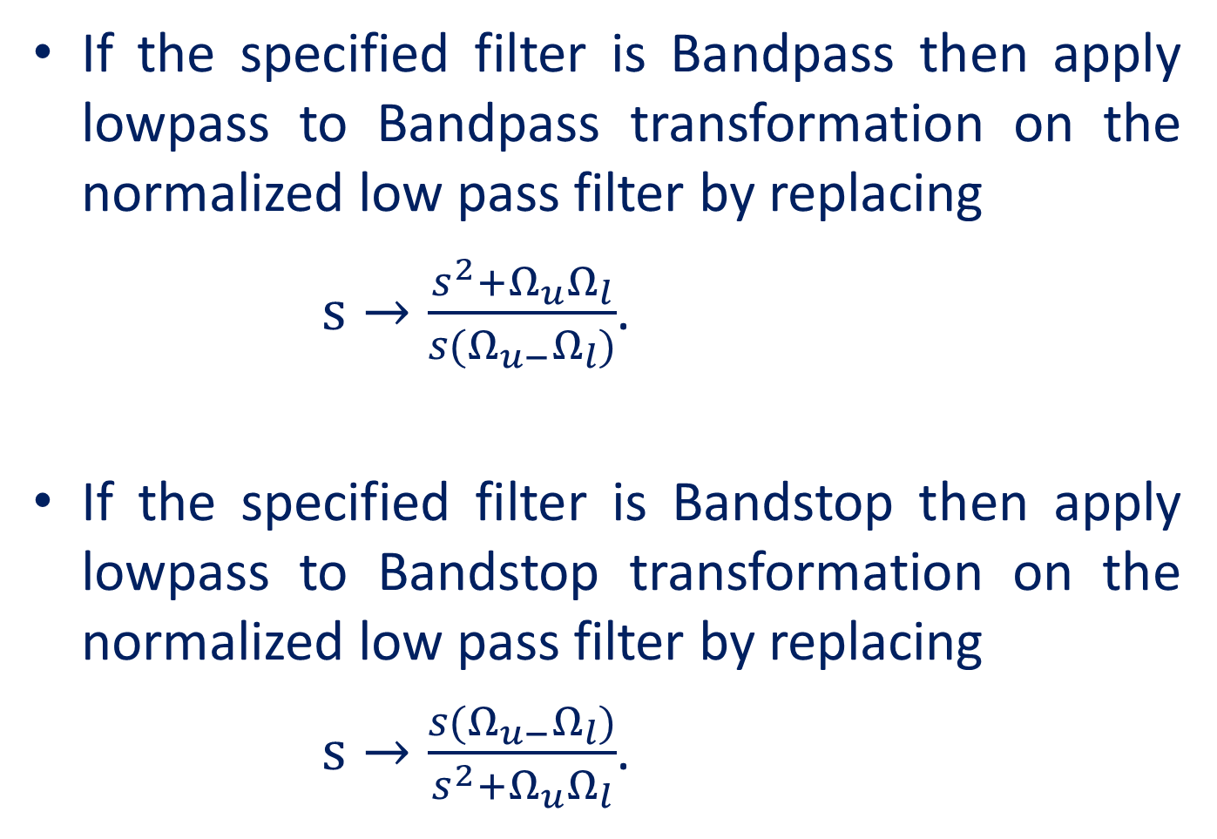
If the specified filter is Bandpass then apply lowpass to Bandpass transformation on the normalized low pass filter by replacing
$s→\frac{s^{2}+Ω_{u}Ω_{l}}{s(Ω_{u−}Ω_{l})}$.
If the specified filter is Bandstop then apply lowpass to Bandstop transformation on the normalized low pass filter by replacing
$s→\frac{s(Ω_{u−}Ω_{l})}{s^{2}+Ω_{u}Ω_{l}}$.

Slide 14
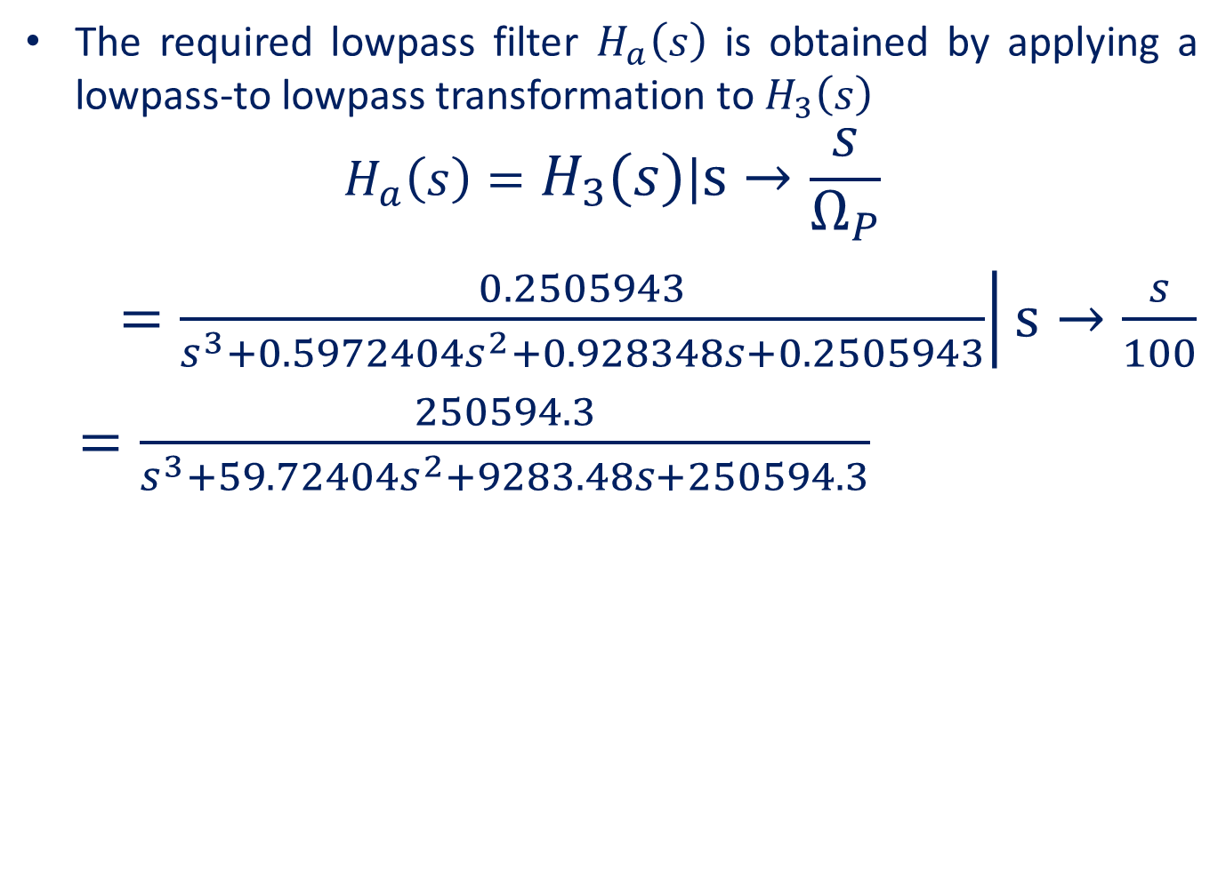
The required lowpass filter $H_{a}\left(s\right)$ is obtained by applying a lowpass-to lowpass transformation to $H_{3}\left(s\right)$
$$H_{a}\left(s\right)=\left.H_{3}\left(s\right)\right|s→\frac{s}{Ω_{P}}$$
$=\left.\frac{0.2505943}{s^{3}+0.5972404s^{2}+0.928348s+0.2505943}\right|s→\frac{s}{100}$
$=\frac{250594.3}{s^{3}+59.72404s^{2}+9283.48s+250594.3}$

