Slide 1

Analog IIR Filter Design part VI
Dr K. Mohanaprasad
Associate Professor
School of Electronics Engineering (SENSE)
VIT Chennai

Slide 2
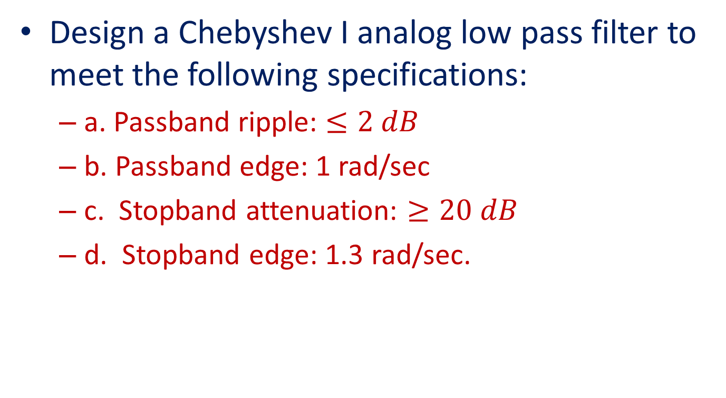
Problem 2
Design a Chebyshev I analog low pass filter to meet the following specifications:
a. Passband ripple: $≤2 dB$
b. Passband edge: 1 rad/sec
c. Stopband attenuation: $≥20 dB$
d. Stopband edge: 1.3 rad/sec.

Slide 3






20$\left|H(jΩ)\right|$
Step 1
……………
0
Kp=-2 dB
……………
$$Minimum$$
...……………………………..
...…………………………..
$$Ks=−20 dB$$
……
$Ωp=$1 rad/sec
$$Ωs=1.3 rad/sec$$
$$Ω$$
N odd (N=5)
The specified Magnitude frequency response of a Chebyshev I filter is shown above

Slide 4
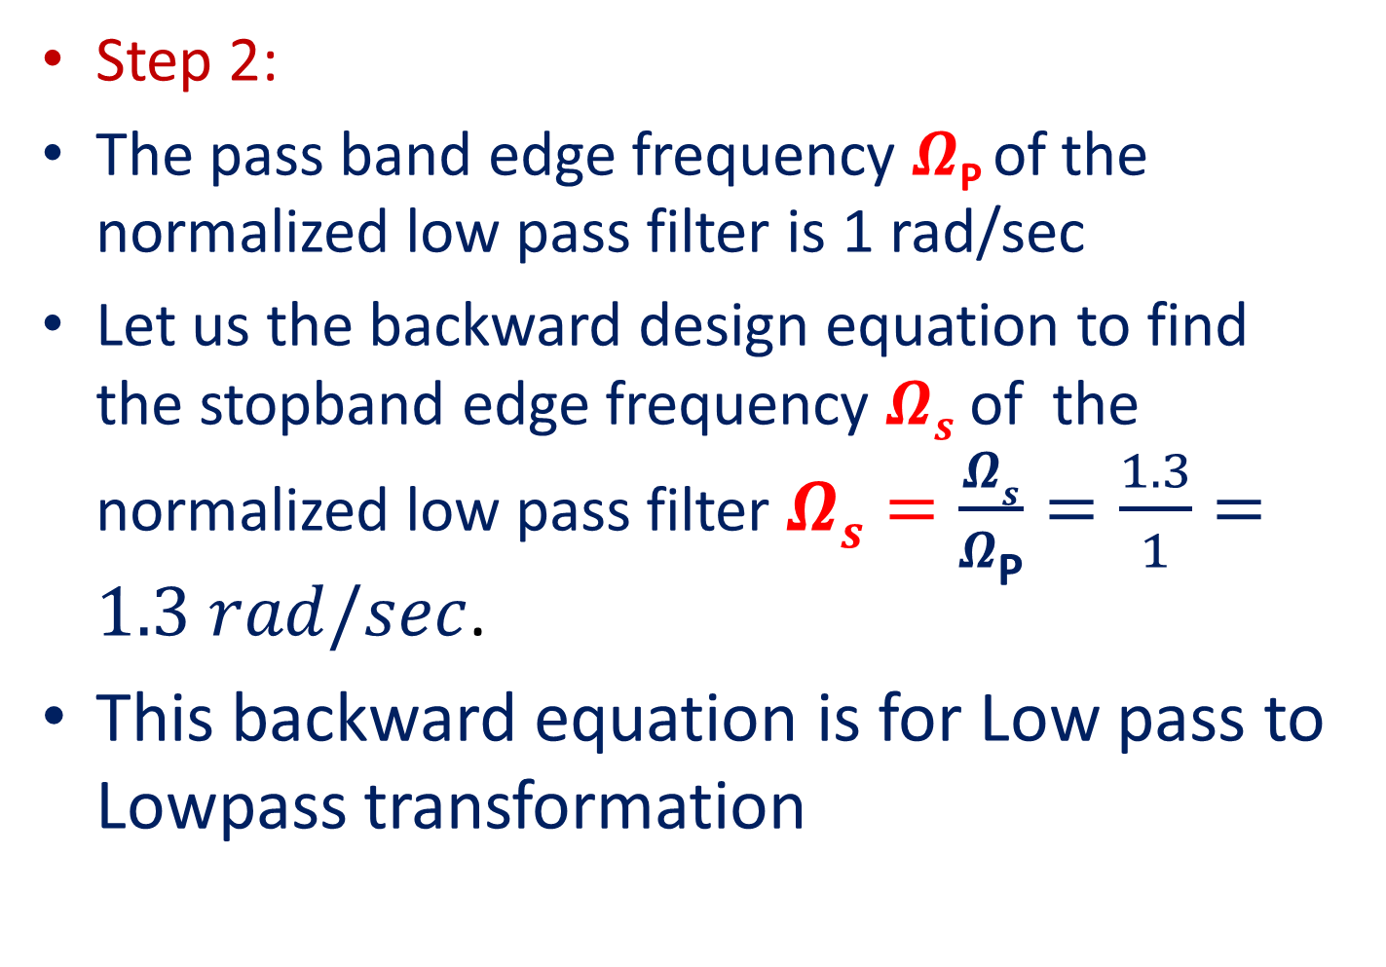
Step 2:
The pass band edge frequency $Ω\text{P}$of the normalized low pass filter is 1 rad/sec
Let us the backward design equation to find the stopband edge frequency $Ωs$ of the normalized low pass filter$Ωs=\frac{Ωs}{Ω\text{P}}=\frac{1.3}{1}=1.3 rad/sec$.
This backward equation is for Low pass to Lowpass transformation

Slide 5

20$\left|H(jΩ)\right|$
Step 2
……………
0
Kp=-2 dB
……………
$$Minimum$$
...……………………………..
...…………………………..
$$Ks=−20 dB$$
……
$Ωp=1$ rad/sec
$$Ωs=1.3 rad/sec$$
$$Ω$$
N odd (N=5)
Normalized Magnitude frequency response of a Chebyshev I Low pass filter for N being odd

Slide 6
If the given filter is high pass then the backward design equation to find the stopband edge frequency $Ωs$ is $\frac{ΩP}{Ω\text{S}}$ .
If the given filter is Bandpass then the backward design equation to find the stopband edge frequency $Ωs=Min\left\{\left|A\right|,\left|B\right|\right\}$. Where $A=\frac{{{−Ω}_{1}^{}}^{2}+Ω_{l}Ω_{u}}{Ω_{1}^{}(Ω_{u}−Ω_{l})}$, $B=\frac{{Ω_{2}^{}}^{2}−Ω_{l}Ω_{u}}{Ω_{2}^{}(Ω_{u}−Ω_{l})}$
If the given filter is Bandstop then the backward design equation to find the stopband edge frequency $Ωs=Min\left\{\left|A\right|,\left|B\right|\right\}$. Where $A=\frac{Ω_{1}^{}(Ω_{u}−Ω_{l})}{{{−Ω}_{1}^{}}^{2}+Ω_{l}Ω_{u}}$, $B=\frac{Ω_{2}^{}(Ω_{u}−Ω_{l})}{{Ω_{2}^{}}^{2}−Ω_{l}Ω_{u}}$
The normalized passband edge frequency $ΩP$ is always equal to 1 rad/sec irrespective of the given filter.

Slide 7
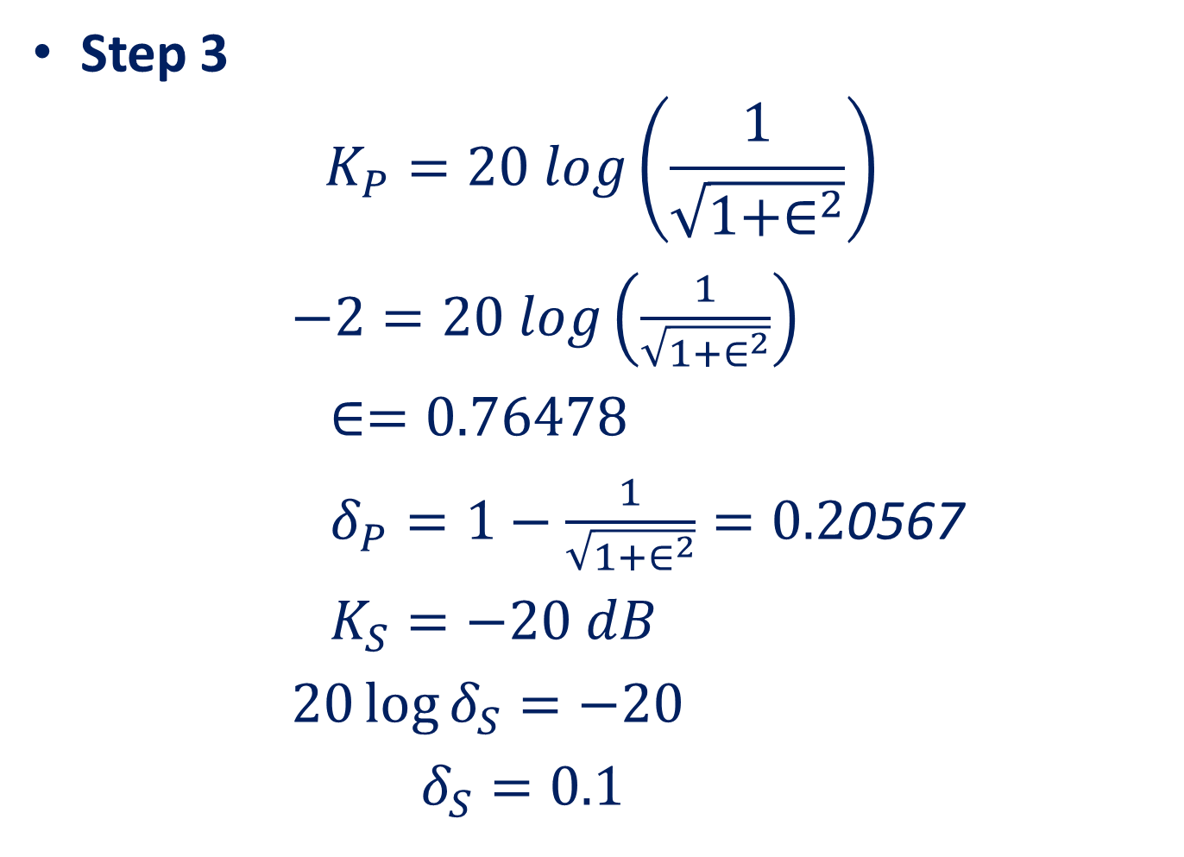
Step 3
$$K_{P}=20 log\left(\frac{1}{\sqrt{1+∈^{2}}}\right)$$
$−2=20 log\left(\frac{1}{\sqrt{1+∈^{2}}}\right)$
$∈=0.76478$
$δ_{P}=1−\frac{1}{\sqrt{1+∈^{2}}}=0.2$0567
$K_{S}=−20 dB$
$20\log{δ_{S}=−20}$
$δ_{S}=0.1$

Slide 8
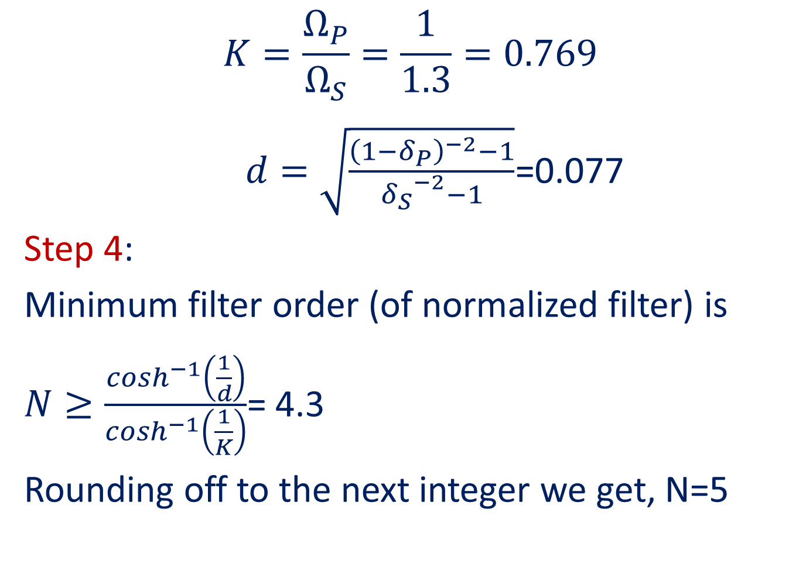
$$K=\frac{Ω_{P}}{Ω_{S}}=\frac{1}{1.3}=0.769$$
$d=\sqrt{\frac{{\left(1−δ_{P}\right)}^{−2}−1}{{δ_{S}}^{−2}−1}}$=0.077
Step 4:
Minimum filter order (of normalized filter) is
$N≥\frac{\cosh^{−1}\left(\frac{1}{d}\right)}{\cosh^{−1}\left(\frac{1}{K}\right)}$= 4.3
Rounding off to the next integer we get, N=5

Slide 9
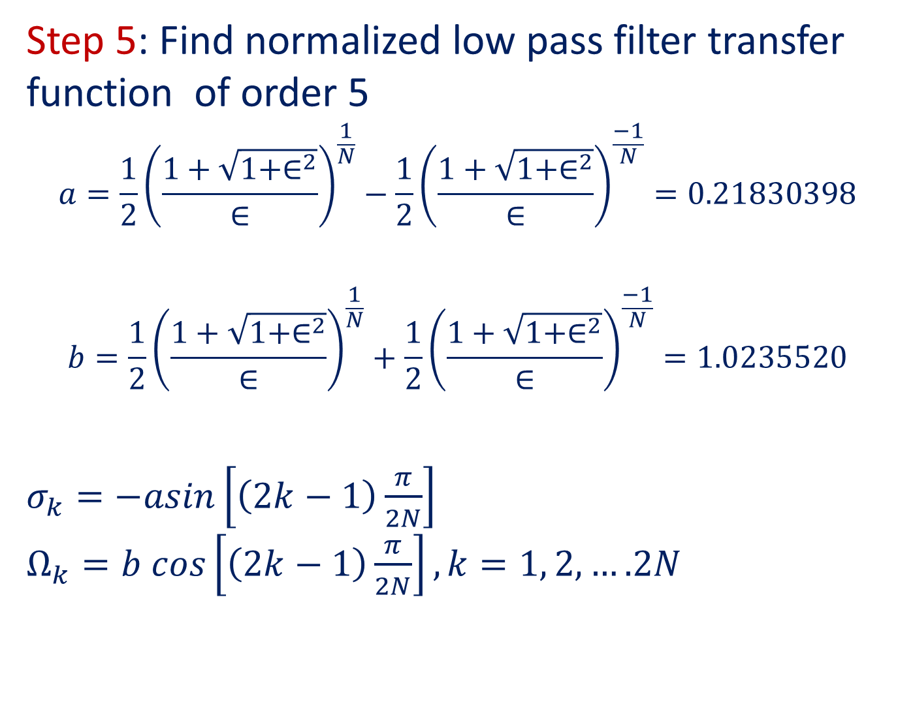
Step 5: Find normalized low pass filter transfer function of order 5
$$a=\frac{1}{2}{\left(\frac{1+\sqrt{1+∈^{2}}}{∈}\right)}^{\frac{1}{N}}−\frac{1}{2}{\left(\frac{1+\sqrt{1+∈^{2}}}{∈}\right)}^{\frac{−1}{N}}=0.21830398$$
$$b=\frac{1}{2}{\left(\frac{1+\sqrt{1+∈^{2}}}{∈}\right)}^{\frac{1}{N}}+\frac{1}{2}{\left(\frac{1+\sqrt{1+∈^{2}}}{∈}\right)}^{\frac{−1}{N}}=1.0235520$$
$σ_{k}=−asin\left[\left(2k−1\right)\frac{π}{2N}\right]$ $Ω_{k}=b cos\left[\left(2k−1\right)\frac{π}{2N}\right], k=1, 2,….2N$

Slide 10
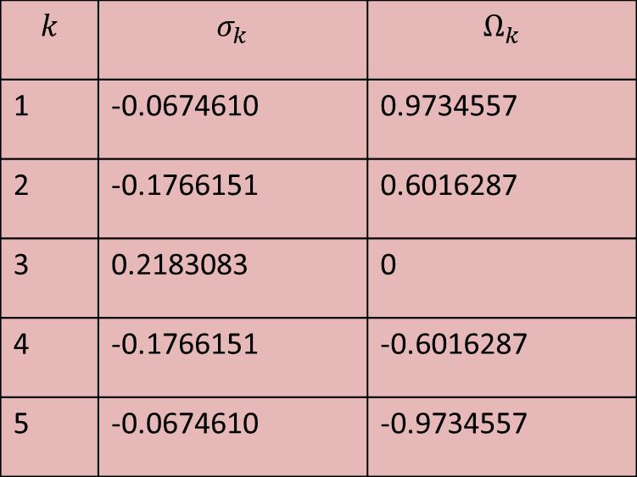

When N=5, we get
$σ_{k}=−0.21830398 sin\left[\left(2k−1\right)\frac{π}{10}\right]$ $Ω_{k}=1.0235520 cos\left[\left(2k−1\right)\frac{π}{10}\right], k=1, 2,3,4,5,6$,7,8,9,10
The value of $σ_{k}$ and $Ω_{k}$ for k= 1, 2,3,4 and 5 gives the left-half poles of $H_{5}\left(s\right).$
$$k$$ | $$σ_{k}$$ | $$Ω_{k}$$
1 | -0.0674610 | 0.9734557
2 | -0.1766151 | 0.6016287
3 | 0.2183083 | 0
4 | -0.1766151 | -0.6016287
5 | -0.0674610 | -0.9734557

Slide 11
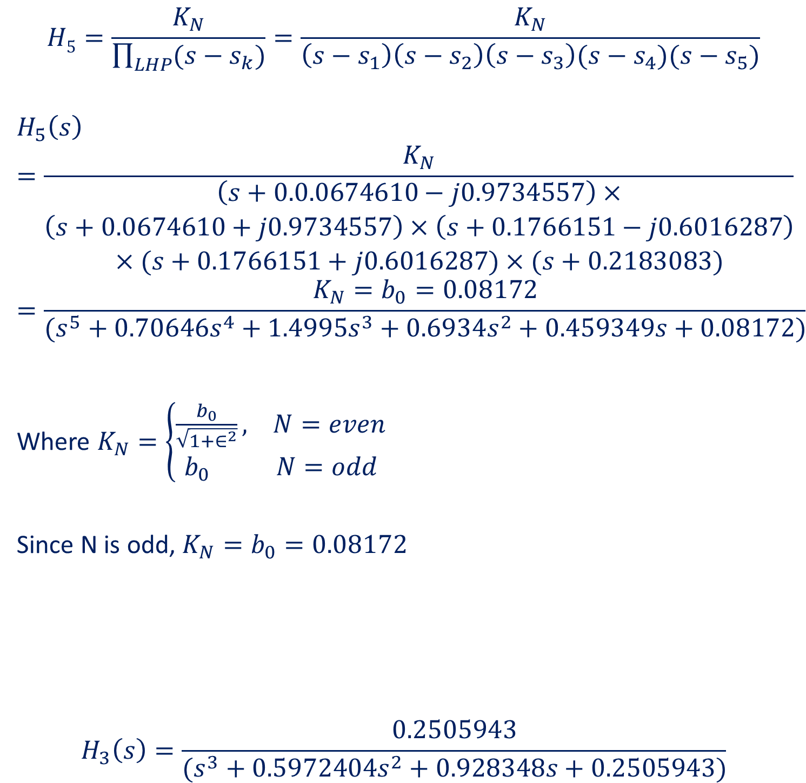
$$H5=\frac{K_{N}}{\prod_{LHP}{(s−s_{k})}}=\frac{K_{N}}{\left(s−s_{1}\right)\left(s−s_{2}\right)\left(s−s_{3}\right)(s−s_{4})(s−s_{5})}$$
$$H_{5}\left(s\right)=\frac{K_{N}}{\begin{aligned}\left(s+0.0.0674610−j0.9734557\right)× \\ \left(s+0.0674610+j0.9734557\right)×\left(s+0.1766151−j0.6016287\right) \\ ×(s+0.1766151+j0.6016287)×(s+0.2183083)\end{aligned}}$$
$$=\frac{K_{N}=b_{0}=0.08172}{(s^{5}+0.70646s^{4}+1.4995s^{3}+0.6934s^{2}+0.459349s+0.08172)}$$
Where $K_{N}=\left\{\begin{aligned}\frac{b_{0}}{\sqrt{1+∈^{2}}}, N=even \\ b_{0} N=odd\end{aligned}\right.$
Since N is odd, $K_{N}=b_{0}=0.08172$
$$H_{3}\left(s\right)=\frac{0.2505943}{(s^{3}+0.5972404s^{2}+0.928348s+0.2505943)}$$

Slide 12
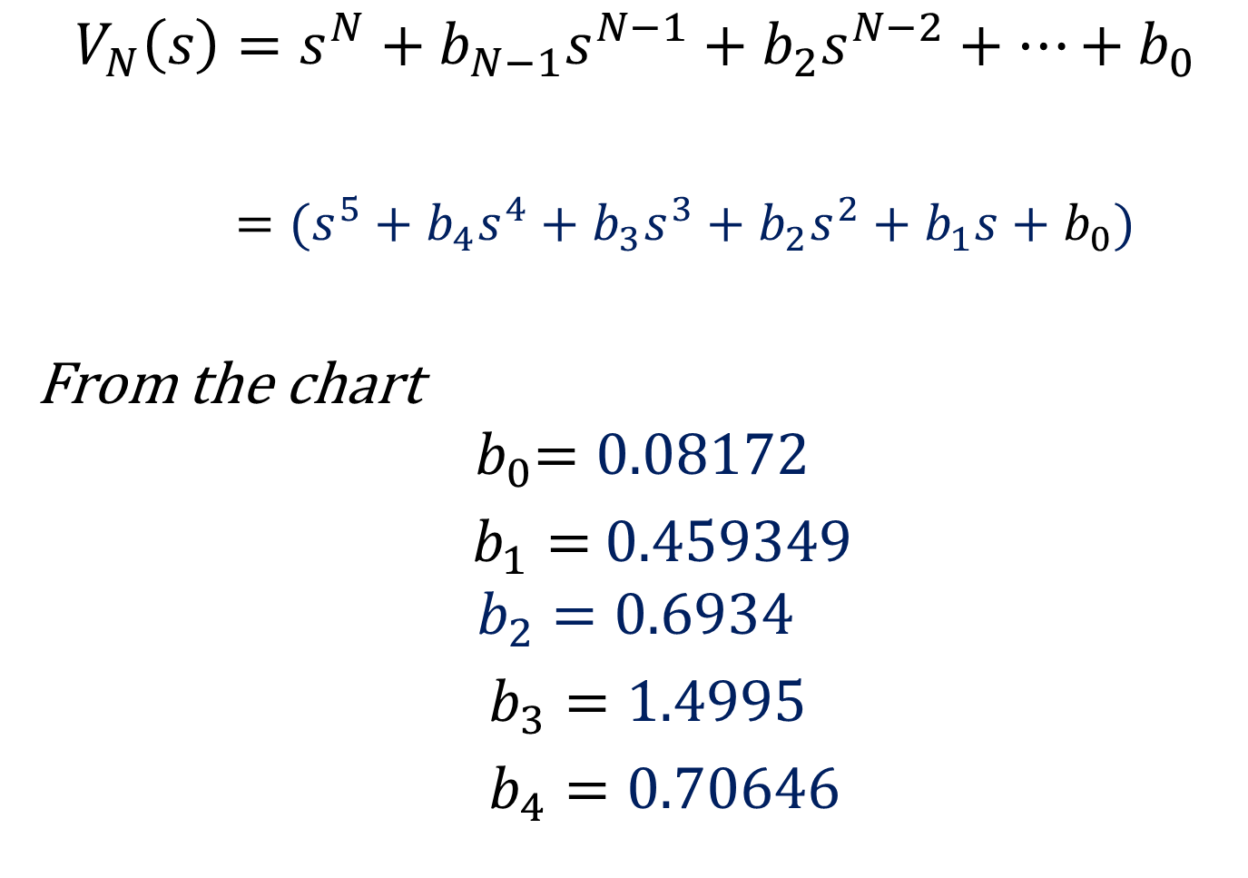
$$V_{N}\left(s\right)=s^{N}+b_{N−1}s^{N−1}+b_{2}s^{N−2}+…+b_{0}$$
$=(s^{5}+b_{4}s^{4}+b_{3}s^{3}+b_{2}s^{2}+b_{1}s+b_{0})$
From the chart
$${ b}_{0}=0.08172$$
$b_{1}=$ $0.459349$
$$b_{2}=0.6934$$
$b_{3}=1.4995$
$b_{4}=0.70646$

Slide 13
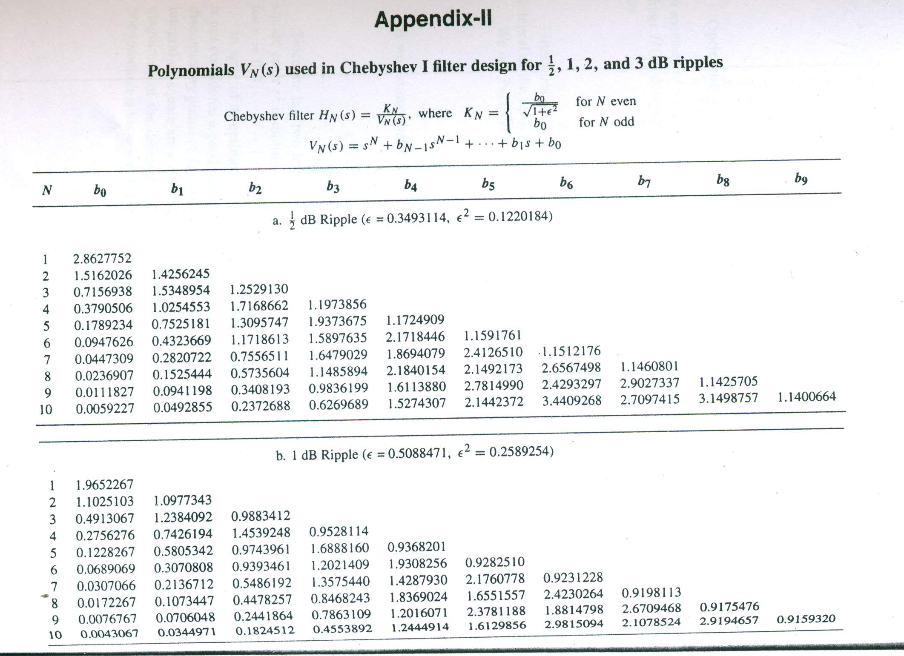

Slide 14
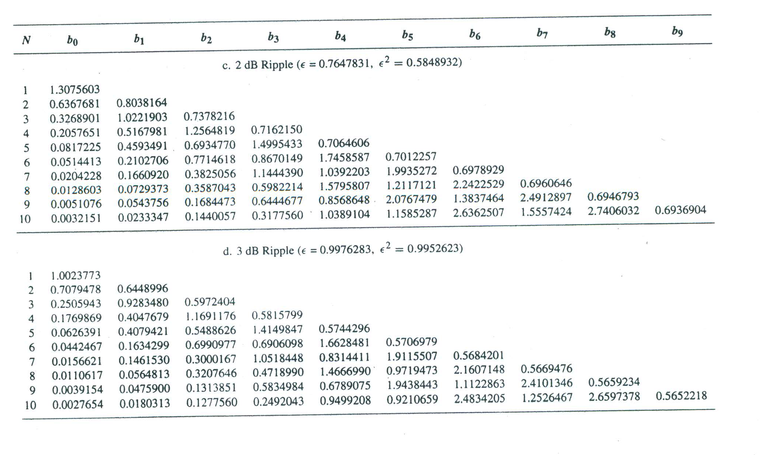

Slide 15
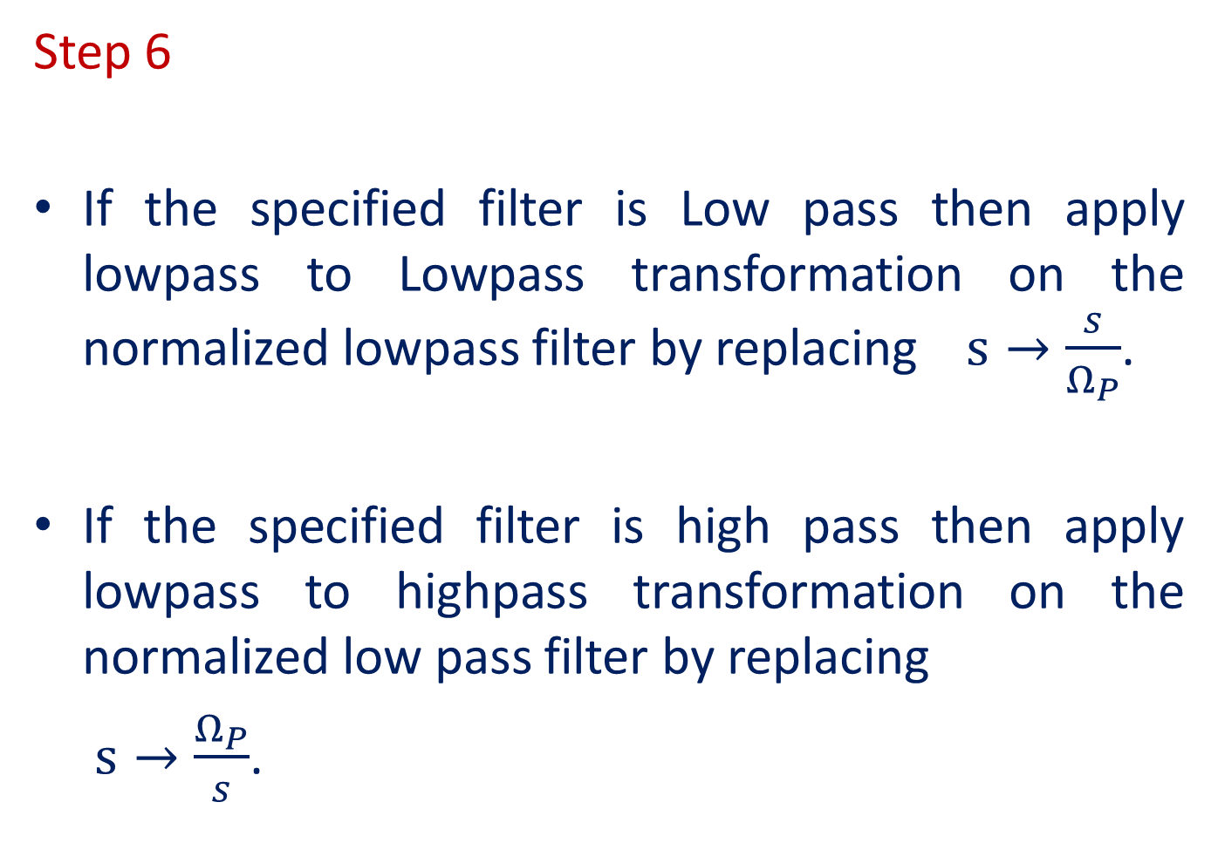
Step 6
If the specified filter is Low pass then apply lowpass to Lowpass transformation on the normalized lowpass filter by replacing $s→\frac{s}{Ω_{P}}$.
If the specified filter is high pass then apply lowpass to highpass transformation on the normalized low pass filter by replacing
$s→\frac{Ω_{P}}{s}$.

Slide 16
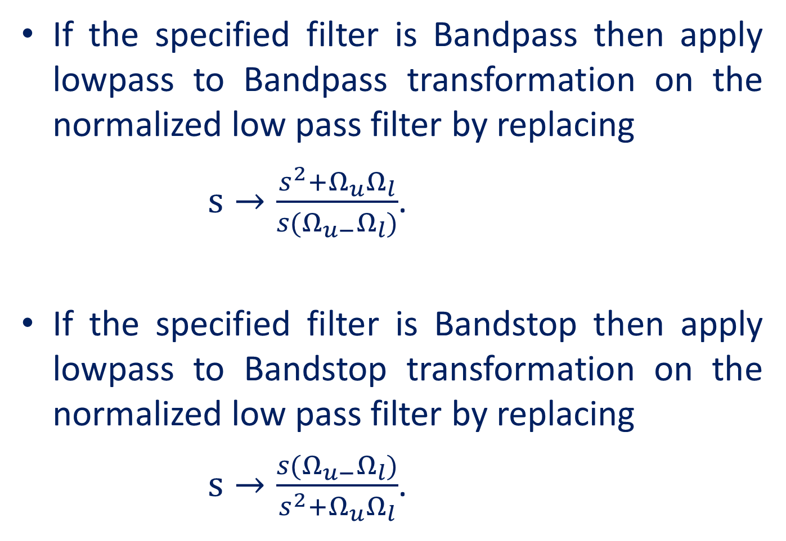
If the specified filter is Bandpass then apply lowpass to Bandpass transformation on the normalized low pass filter by replacing
$s→\frac{s^{2}+Ω_{u}Ω_{l}}{s(Ω_{u−}Ω_{l})}$.
If the specified filter is Bandstop then apply lowpass to Bandstop transformation on the normalized low pass filter by replacing
$s→\frac{s(Ω_{u−}Ω_{l})}{s^{2}+Ω_{u}Ω_{l}}$.

Slide 17
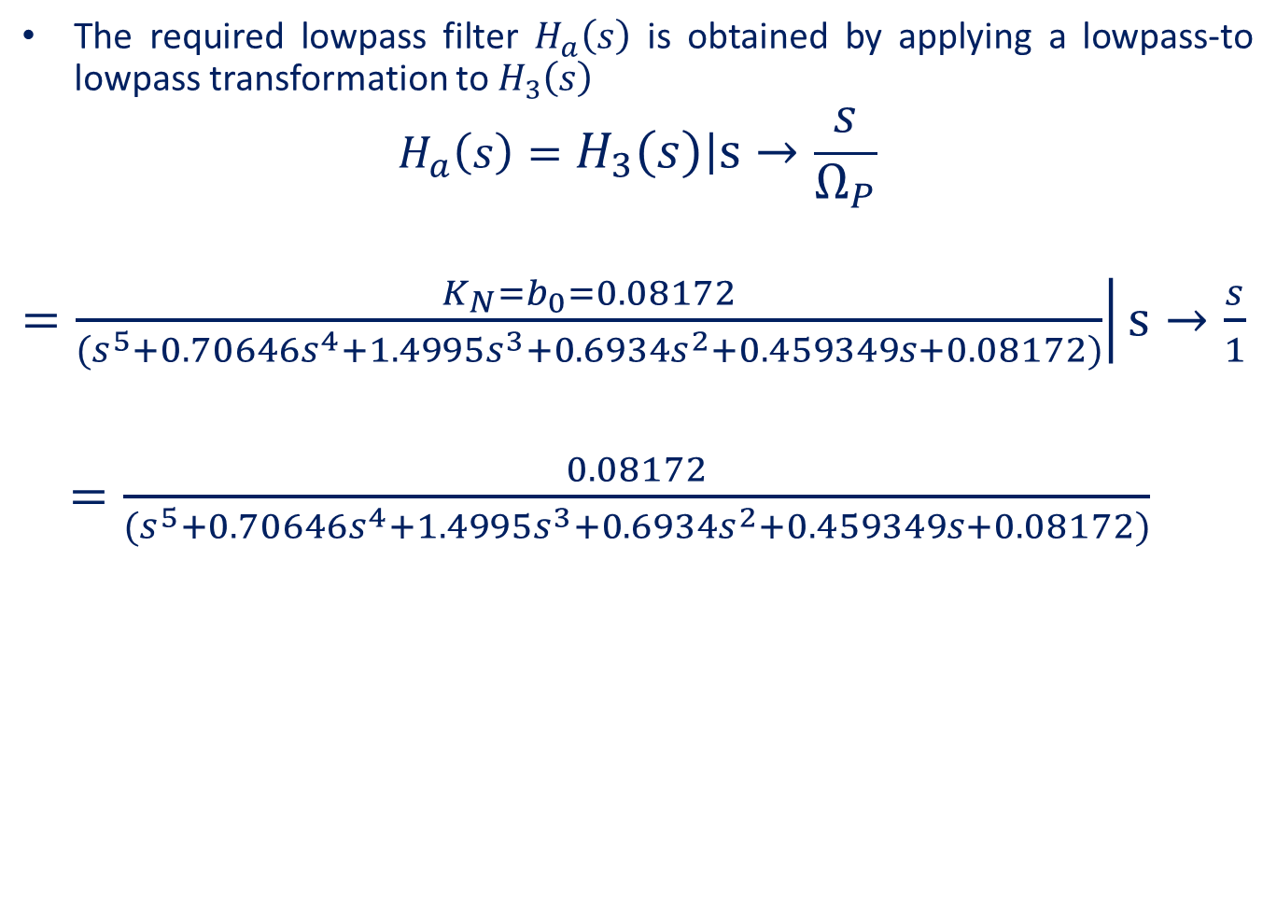
The required lowpass filter $H_{a}\left(s\right)$ is obtained by applying a lowpass-to lowpass transformation to $H_{3}\left(s\right)$
$$H_{a}\left(s\right)=\left.H_{3}\left(s\right)\right|s→\frac{s}{Ω_{P}}$$
$\left.=\frac{K_{N}=b_{0}=0.08172}{(s^{5}+0.70646s^{4}+1.4995s^{3}+0.6934s^{2}+0.459349s+0.08172)}\right|s→\frac{s}{1}$
$=\frac{0.08172}{(s^{5}+0.70646s^{4}+1.4995s^{3}+0.6934s^{2}+0.459349s+0.08172)}$

