Slide 1

Design of IIR Digital Filters
Dr K. Mohanaprasad
Associate Professor
School of Electronics Engineering (SENSE)
VIT Chennai

Slide 2

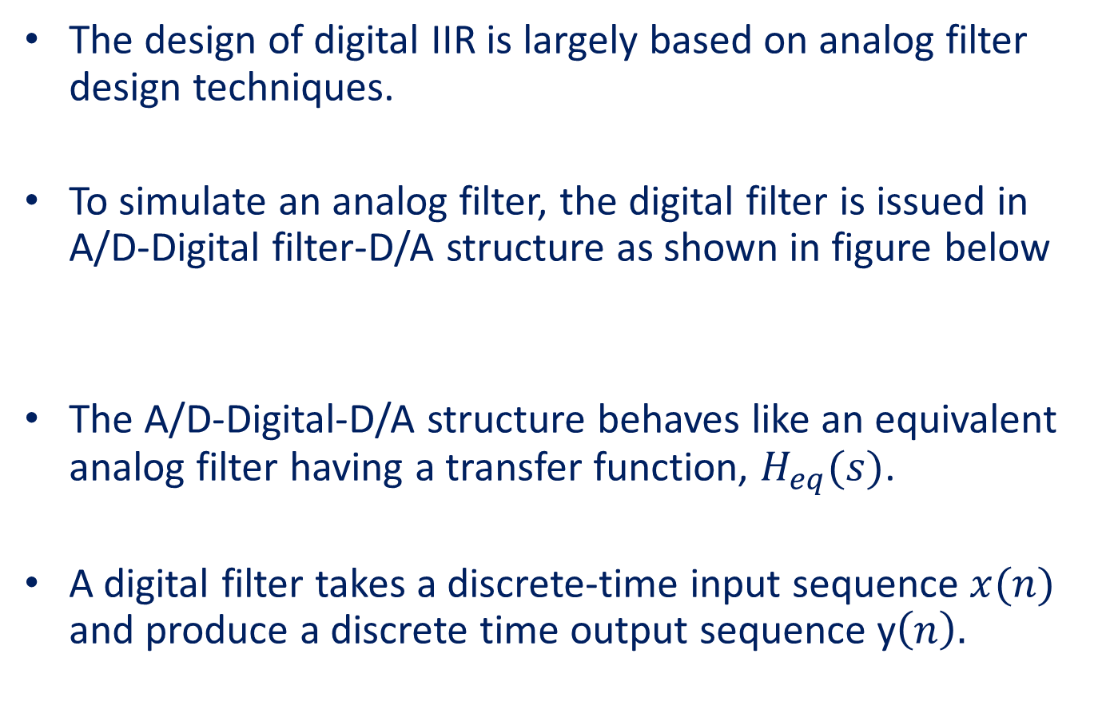



Design of IIR Digital Filters
The design of digital IIR is largely based on analog filter design techniques.
To simulate an analog filter, the digital filter is issued in A/D-Digital filter-D/A structure as shown in figure below
The A/D-Digital-D/A structure behaves like an equivalent analog filter having a transfer function, $H_{eq}(s)$.
A digital filter takes a discrete-time input sequence $x(n)$ and produce a discrete time output sequence y$\left(n\right).$
$$x(n)$$
A/D converter
Digital Filter
y$(n)$
A/D converter
$$x(t)$$
$$y(t)$$

Slide 3
Steps for typical Design procedure of a digital IIR filter
Selecting a method of transformation of a given analog filter to a digital filter having roughly the same frequency response.
Mapping the specification of the digital IIR filter to equivalent specifications of an analog IIR filter such that, after mapping from analog to digital is carried out, the digital IIR filter will meet the given specifications.
Designing the analog IIR filter according to the mapped specifications.
Transforming the analog filter to an equivalent digital filter.

Slide 4
The different transformation that map a given analog filter to digital filter having roughly the same frequency response. They are
The backward difference method
The bilinear transformation
The impulse invariant transformation, and
The matched-Z transform

Slide 5
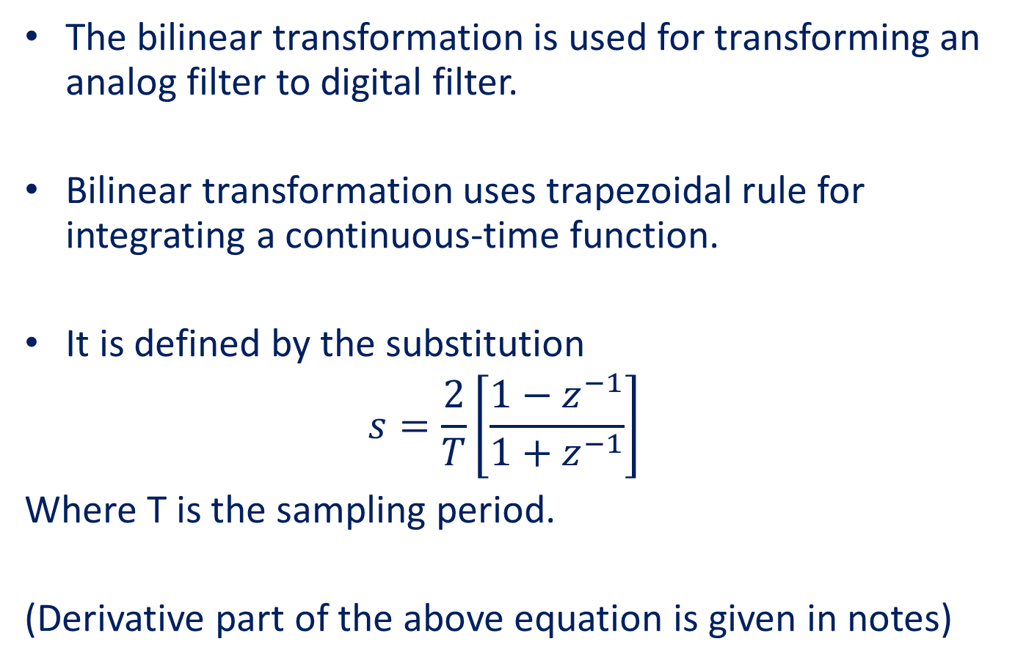
Bilinear Transformation
The bilinear transformation is used for transforming an analog filter to digital filter.
Bilinear transformation uses trapezoidal rule for integrating a continuous-time function.
It is defined by the substitution
$$s=\frac{2}{T}\left[\frac{1−z^{−1}}{1+z^{−1}}\right]$$
Where T is the sampling period.
(Derivative part of the above equation is given in notes)

Slide 6






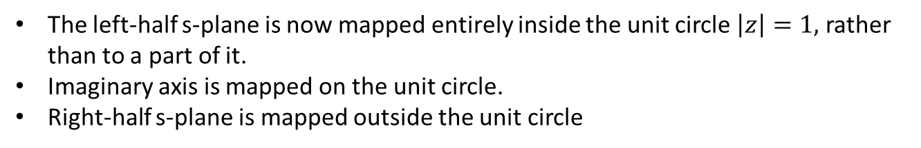

Mapping of the s-plane into the z-plane with bilinear transformation.
Im{z}
Unit circle
r=1, $σ$=0
c
b
c
a
r>1, $σ$>0
$$σ>0$$
b
a
$$σ<0$$
$$σ=0$$
Re{s}=$σ$
Re{z}
r>1, $σ$>0
The left-half s-plane is now mapped entirely inside the unit circle $\left|z\right|=1,$ rather than to a part of it.
Imaginary axis is mapped on the unit circle.
Right-half s-plane is mapped outside the unit circle

Slide 7
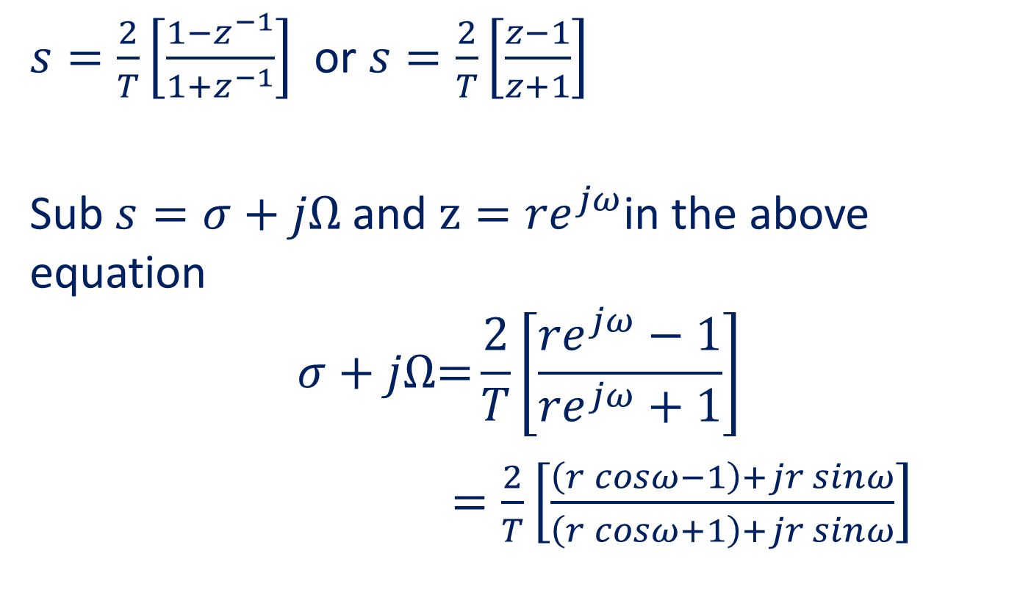
Bilinear is Frequency to Frequency transformation
$s=\frac{2}{T}\left[\frac{1−z^{−1}}{1+z^{−1}}\right]$ or $s=\frac{2}{T}\left[\frac{z−1}{z+1}\right]$
Sub $s=σ+j\text{Ω}$and $z={re}^{jω}$in the above equation
$$σ+j\text{Ω}\text{=}\frac{2}{T}\left[\frac{{re}^{jω}−1}{{re}^{jω}+1}\right]$$
$=\frac{2}{T}\left[\frac{\left(r cosω−1\right)+jr sinω}{\left(r cosω+1\right)+jr sinω}\right]$

Slide 8
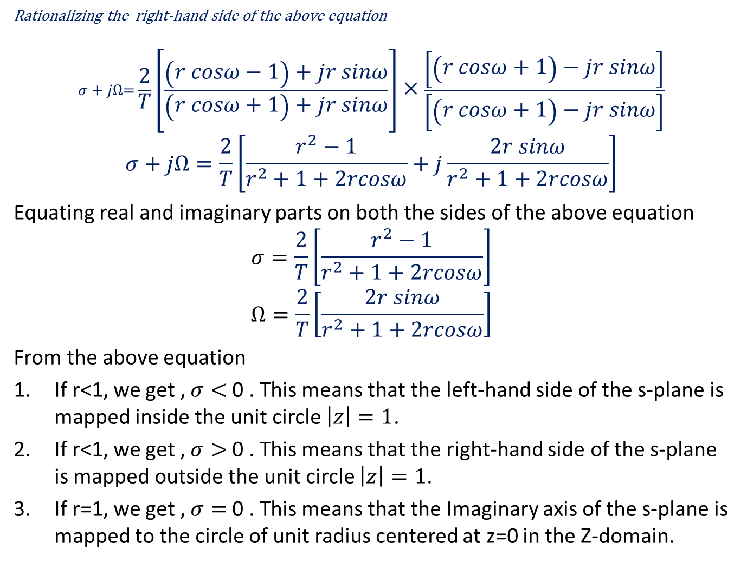
Rationalizing the right-hand side of the above equation
$$σ+j\text{Ω}\text{=}\frac{2}{T}\left[\frac{\left(r cosω−1\right)+jr sinω}{\left(r cosω+1\right)+jr sinω}\right]×\frac{\left[\left(r cosω+1\right)−jr sinω\right]}{\left[\left(r cosω+1\right)−jr sinω\right]}$$
$$σ+j\text{Ω}=\frac{2}{T}\left[\frac{r^{2}−1}{r^{2}+1+2rcosω}+j\frac{2r sinω}{r^{2}+1+2rcosω}\right]$$
Equating real and imaginary parts on both the sides of the above equation
$$σ=\frac{2}{T}\left[\frac{r^{2}−1}{r^{2}+1+2rcosω}\right]$$
$$Ω=\frac{2}{T}\left[\frac{2r sinω}{r^{2}+1+2rcosω}\right]$$
From the above equation
If r<1, we get , $σ<$0 . This means that the left-hand side of the s-plane is mapped inside the unit circle $\left|z\right|=1$.
If r<1, we get , $σ>$0 . This means that the right-hand side of the s-plane is mapped outside the unit circle $\left|z\right|=1$.
If r=1, we get , $σ=$0 . This means that the Imaginary axis of the s-plane is mapped to the circle of unit radius centered at z=0 in the Z-domain.

Slide 9
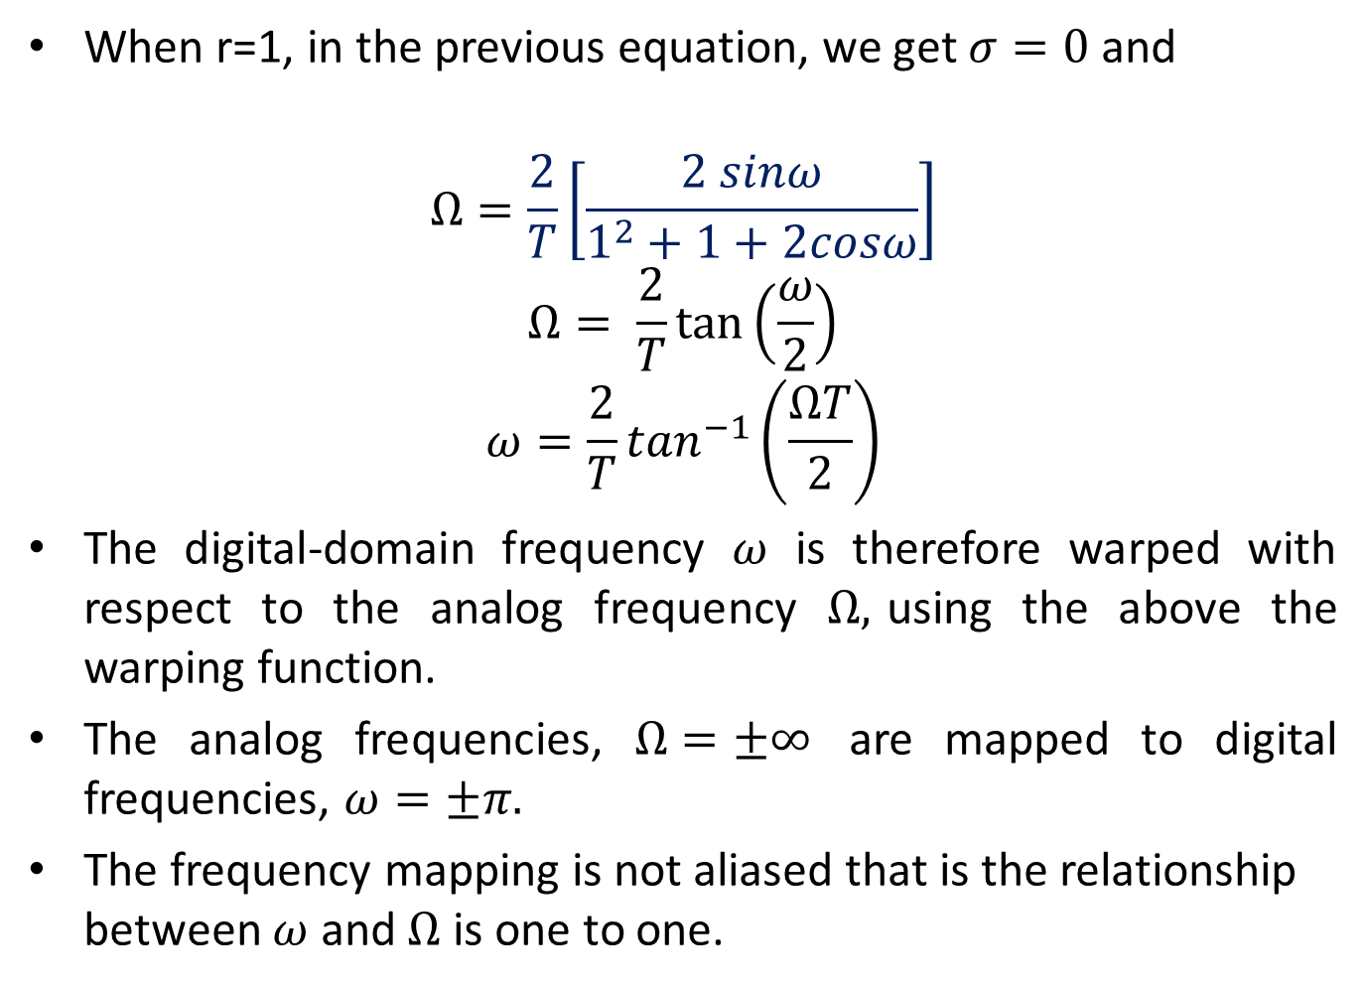
Frequency warping
When r=1, in the previous equation, we get $σ=0$ and
$$Ω=\frac{2}{T}\left[\frac{2 sinω}{1^{2}+1+2cosω}\right]$$
$$Ω= \frac{2}{T}tan⁡\left(\frac{ω}{2}\right)$$
$$ω=\frac{2}{T}\tan^{−1}\left(\frac{ΩT}{2}\right)$$
The digital-domain frequency $ω$ is therefore warped with respect to the analog frequency $Ω,$using the above the warping function.
The analog frequencies, $Ω=±∞$ are mapped to digital frequencies, $ω=±π.$
The frequency mapping is not aliased that is the relationship between $ω$ and $Ω$ is one to one.

Slide 10
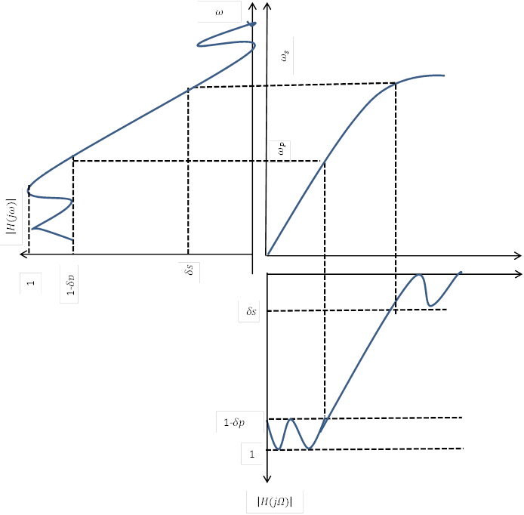
Frequency warping introduced by the bilinear transformation

Slide 11
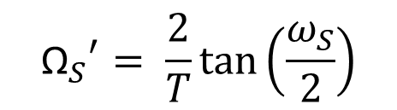
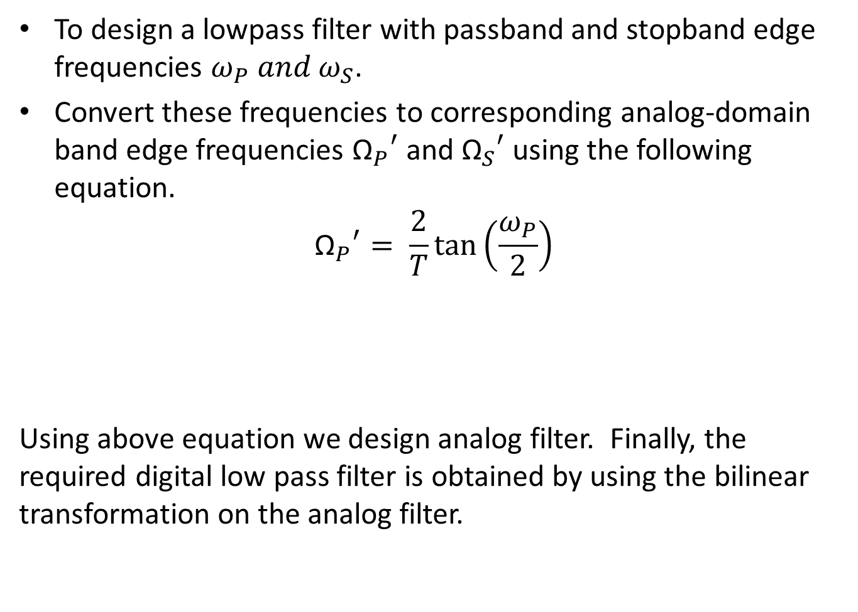
To design a lowpass filter with passband and stopband edge frequencies $ω_{P} and ω_{S}$.
Convert these frequencies to corresponding analog-domain band edge frequencies ${{\text{Ω}}_{P}}^{′}$ and ${{\text{Ω}}_{S}}^{′}$ using the following equation.
$${{\text{Ω}}_{P}}^{′}= \frac{2}{T}\tan\left(\frac{ω_{P}}{2}\right)$$
Using above equation we design analog filter. Finally, the required digital low pass filter is obtained by using the bilinear transformation on the analog filter.
$${{\text{Ω}}_{S}}^{′}= \frac{2}{T}tan⁡\left(\frac{ω_{S}}{2}\right)$$

Slide 12
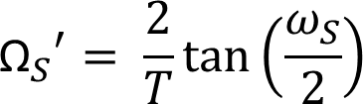
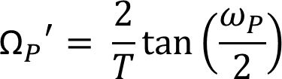
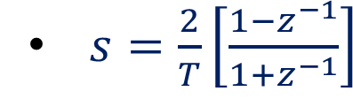
Flowchart for digital filter design
Digital specification${ ω}_{P}, ω_{S}, { K}_{P}, K_{S}$
Digital specification〖 𝜔〗_𝑃, 𝜔_𝑆, 〖 𝐾〗_𝑃, 𝐾_𝑆
Prewarped analog specifications
$${{\text{Ω}}_{P}}^{′}, {{\text{Ω}}_{S}}^{′}, { K}_{P}, K_{S}$$
Prewarped analog specifications
〖"Ω" _𝑃〗^′, 〖"Ω" _𝑆〗^′, 〖 𝐾〗_𝑃, 𝐾_𝑆
Step 2: Design of analog filter
$$H_{a}(s)$$
Step 2: Design of analog filter
𝐻_𝑎 (𝑠)
Desired H(z)
Step 3 : Using T=1 sec , apply bilinear transformation
Step 1: Prewarp using T= 1 sec

Slide 13
Thank you

