Slide 1

Design of IIR Digital Filters part II
Dr K. Mohanaprasad
Associate Professor
School of Electronics Engineering (SENSE)
VIT Chennai

Slide 2
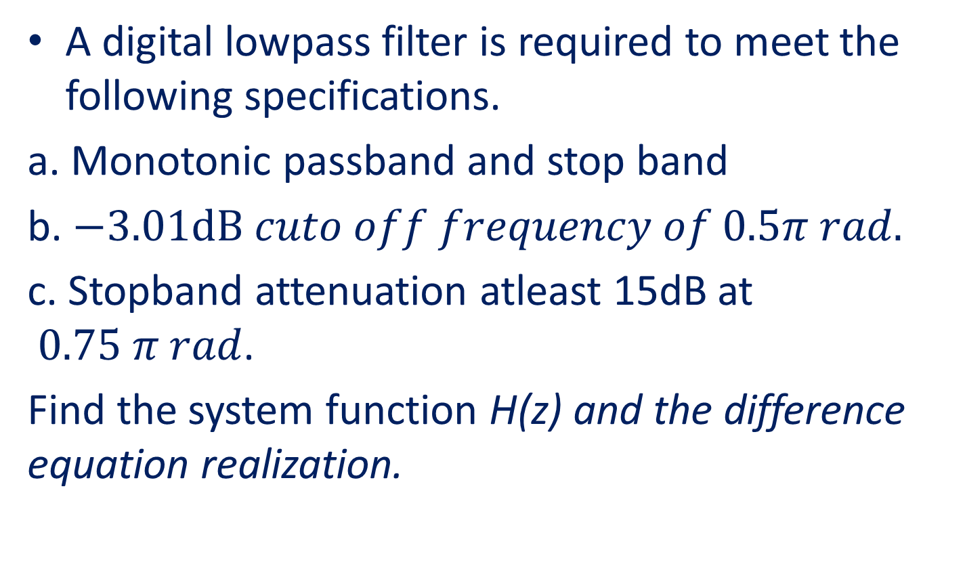
Problem 1
A digital lowpass filter is required to meet the following specifications.
a. Monotonic passband and stop band
b. $−3.01dB cuto off frequency of 0.5π rad.$
c. Stopband attenuation atleast 15dB at $0.75 π rad$.
Find the system function H(z) and the difference equation realization.

Slide 3




Solution: Step 1
$$20\log\left|H(ω)\right|$$
0
K_{P}=-3.01dB
……………………………………………
………………………………….....
K_{S}=-15dB
…………………………………………………………………
…………..
$$Ω$$
$$ω\text{P}=0.5π rad$$
$$ωs=0.75π rad$$
Specified magnitude frequency response of the lowpass digital Butterworth filter

Slide 4
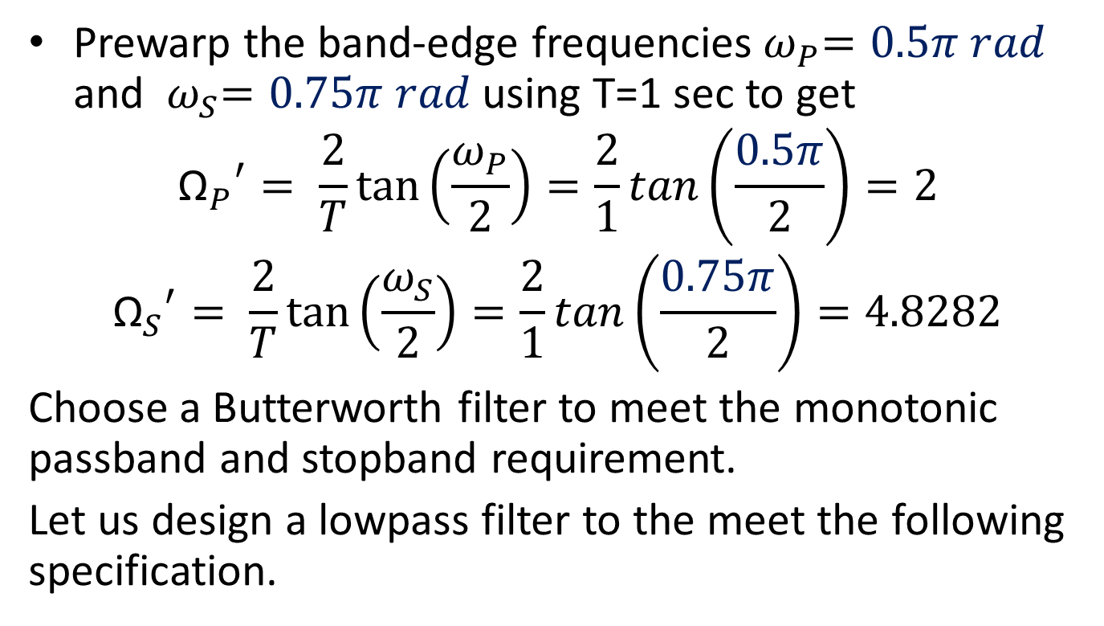
Step: 1: Prewarp
Prewarp the band-edge frequencies${ ω}_{P}=0.5π rad$ and ${ ω}_{S}=0.75π rad$using T=1 sec to get
$${{\text{Ω}}_{P}}^{′}= \frac{2}{T}\tan\left(\frac{ω_{P}}{2}\right)=\frac{2}{1}tan\left(\frac{0.5π}{2}\right)=2$$
$${{\text{Ω}}_{S}}^{′}= \frac{2}{T}\tan\left(\frac{ω_{S}}{2}\right)=\frac{2}{1}tan\left(\frac{0.75π}{2}\right)=4.8282$$
Choose a Butterworth filter to meet the monotonic passband and stopband requirement.
Let us design a lowpass filter to the meet the following specification.

Slide 5


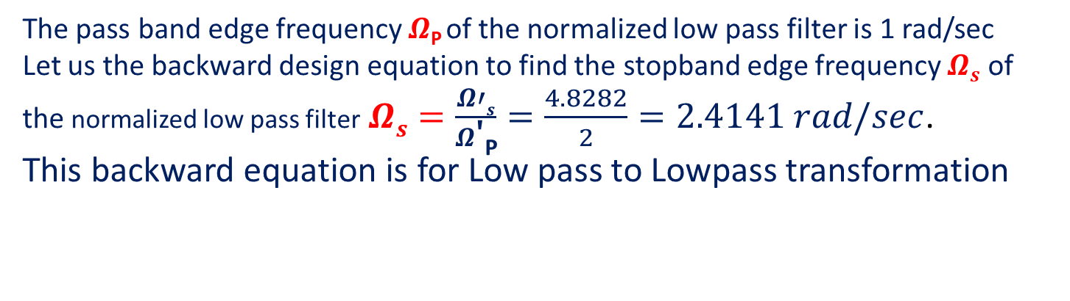

Step 2: Magnitude frequency response of the normalized lowpass filter
$$20\log\left|H(jΩ)\right|$$
0
K_{P}=-3.01dB
……………………………………………
………………………………….....
K_{S}=-15dB
…………………………………………………………………
…………..
$$Ω$$
$$Ω\text{P}=1 rad/sec$$
$$Ωs=2.4141 rad/sec$$
The pass band edge frequency $Ω\text{P}$of the normalized low pass filter is 1 rad/sec
Let us the backward design equation to find the stopband edge frequency $Ωs$ of the normalized low pass filter$Ωs=\frac{Ω′s}{Ω\text{′}\text{P}}=\frac{4.8282}{2}=2.4141 rad/sec$.
This backward equation is for Low pass to Lowpass transformation

Slide 6
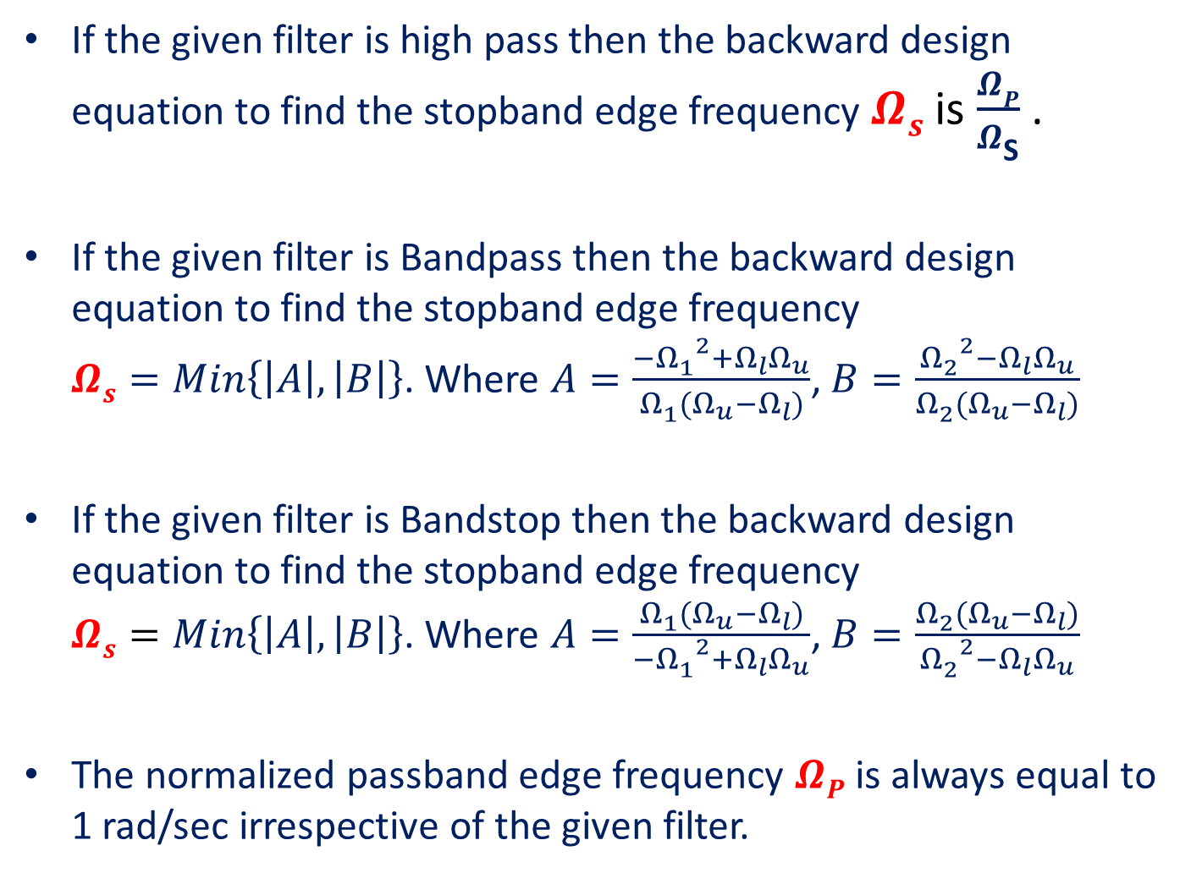
If the given filter is high pass then the backward design equation to find the stopband edge frequency $Ωs$ is $\frac{ΩP}{Ω\text{S}}$ .
If the given filter is Bandpass then the backward design equation to find the stopband edge frequency $Ωs=Min\left\{\left|A\right|,\left|B\right|\right\}$. Where $A=\frac{{{−Ω}_{1}^{}}^{2}+Ω_{l}Ω_{u}}{Ω_{1}^{}(Ω_{u}−Ω_{l})}$, $B=\frac{{Ω_{2}^{}}^{2}−Ω_{l}Ω_{u}}{Ω_{2}^{}(Ω_{u}−Ω_{l})}$
If the given filter is Bandstop then the backward design equation to find the stopband edge frequency $Ωs=Min\left\{\left|A\right|,\left|B\right|\right\}$. Where $A=\frac{Ω_{1}^{}(Ω_{u}−Ω_{l})}{{{−Ω}_{1}^{}}^{2}+Ω_{l}Ω_{u}}$, $B=\frac{Ω_{2}^{}(Ω_{u}−Ω_{l})}{{Ω_{2}^{}}^{2}−Ω_{l}Ω_{u}}$
The normalized passband edge frequency $ΩP$ is always equal to 1 rad/sec irrespective of the given filter.

Slide 7
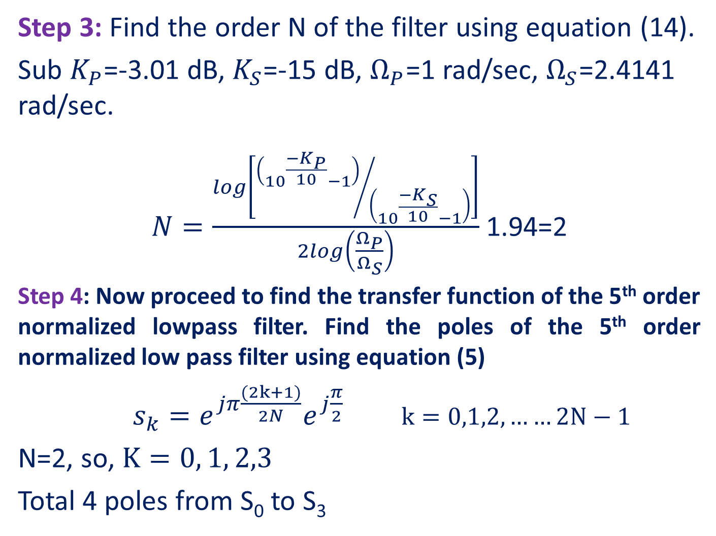
Step 3: Find the order N of the filter using equation (14).
Sub $K_{P}$=-3.01 dB, $K_{S}$=-15 dB, $Ω_{P}$=1 rad/sec, $Ω_{S}$=2.4141 rad/sec.
$N=\frac{log\left[{\left({10}^{\frac{{−K}_{P}}{10}}−1\right)}/{\left({10}^{\frac{{−K}_{S}}{10}}−1\right)}\right]}{2log\left(\frac{Ω_{P}}{Ω_{S}}\right)}$ 1.94=2
Step 4: Now proceed to find the transfer function of the 5th order normalized lowpass filter. Find the poles of the 5th order normalized low pass filter using equation (5)
$s_{k}=e^{jπ\frac{(2k+1)}{2N}}e^{j\frac{π}{2}}$ $k=0,1,2,……2N−1$
N=2, so, $K=0, 1, 2,3$
Total 4 poles from S₀ to S₃

Slide 8
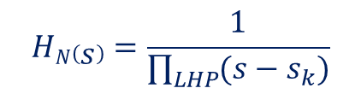


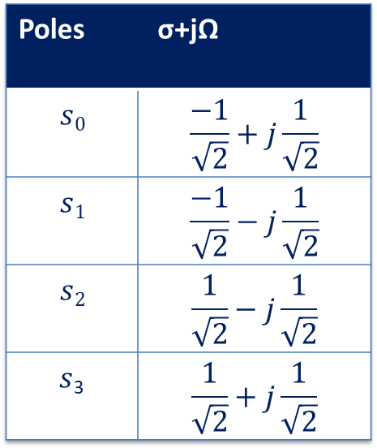


jΩ
Poles | σ+jΩ
$$s0$$ | $$\frac{−1}{\sqrt{2}}+j\frac{1}{\sqrt{2}}$$
$$s1$$ | $$\frac{−1}{\sqrt{2}}−j\frac{1}{\sqrt{2}}$$
$$s2$$ | $$\frac{1}{\sqrt{2}}−j\frac{1}{\sqrt{2}}$$
$s$₃ | $$\frac{1}{\sqrt{2}}+j\frac{1}{\sqrt{2}}$$
S-plane
$$s0$$
$$s3$$
σ
$$s2$$
$s$₁
Left-half poles of H₅(s)
Right-half poles of H₅(-s)
Step 5:
Hence, the transfer function of the 2nd order normalized lowpass Butterworth filter is
$$HN\left(s\right)=\frac{1}{\prod_{LHP}{(s−s_{k})}}$$

Slide 9
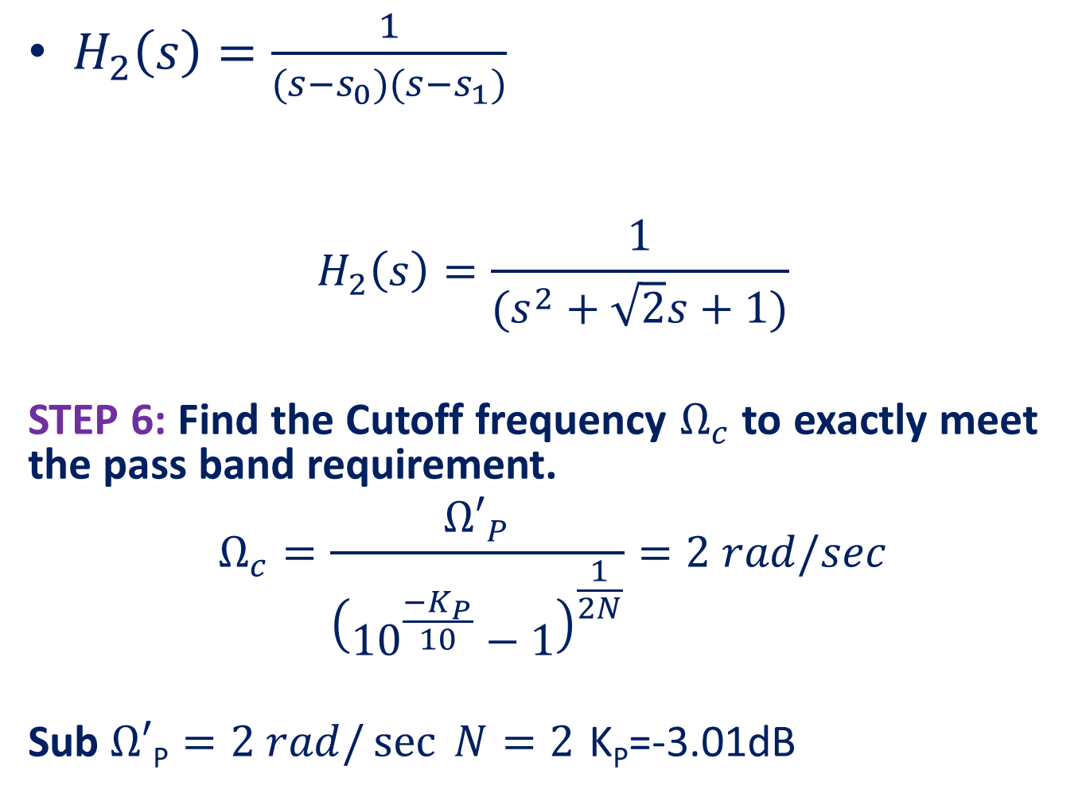
$H_{2}\left(s\right)=\frac{1}{(s−s_{0})(s−s_{1})}$
$$H_{2}\left(s\right)=\frac{1}{(s^{2}+\sqrt{2}s+1)}$$
STEP 6: Find the Cutoff frequency $Ω_{c}$ to exactly meet the pass band requirement.
$$Ω_{c}=\frac{{Ω′}_{P}}{{\left({10}^{\frac{{−K}_{P}}{10}}−1\right)}^{\frac{1}{2N}}}=2 rad/sec$$
Sub $Ω′\text{P}=2 rad/\sec{ N=2}$ K_{P}=-3.01dB

Slide 10
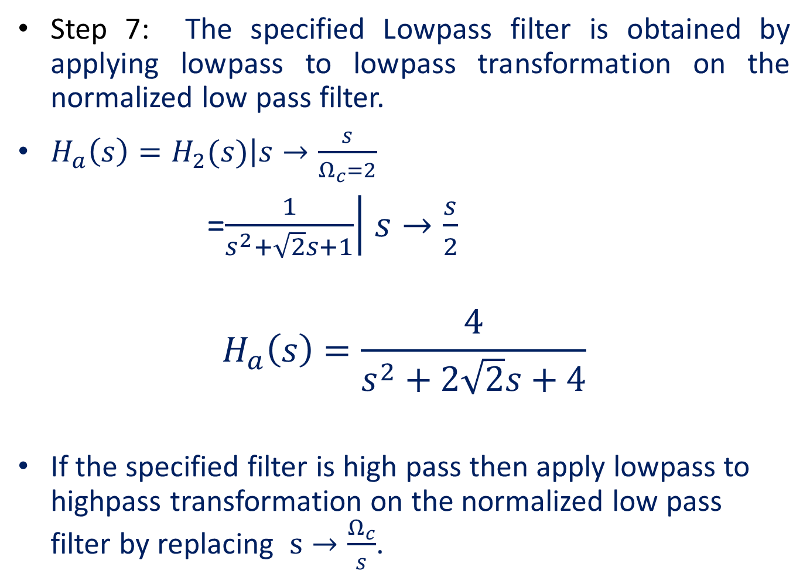
Step 7: The specified Lowpass filter is obtained by applying lowpass to lowpass transformation on the normalized low pass filter.
$H_{a}\left(s\right)=\left.H_{2}(s)\right|s→\frac{s}{Ω_{c}=2}$
=$\left.\frac{1}{s^{2}+\sqrt{2}s+1}\right|$ $s→\frac{s}{2}$
$$H_{a}\left(s\right)=\frac{4}{s^{2}+2\sqrt{2}s+4}$$
If the specified filter is high pass then apply lowpass to highpass transformation on the normalized low pass filter by replacing $s→\frac{Ω_{c}}{s}$.

Slide 11
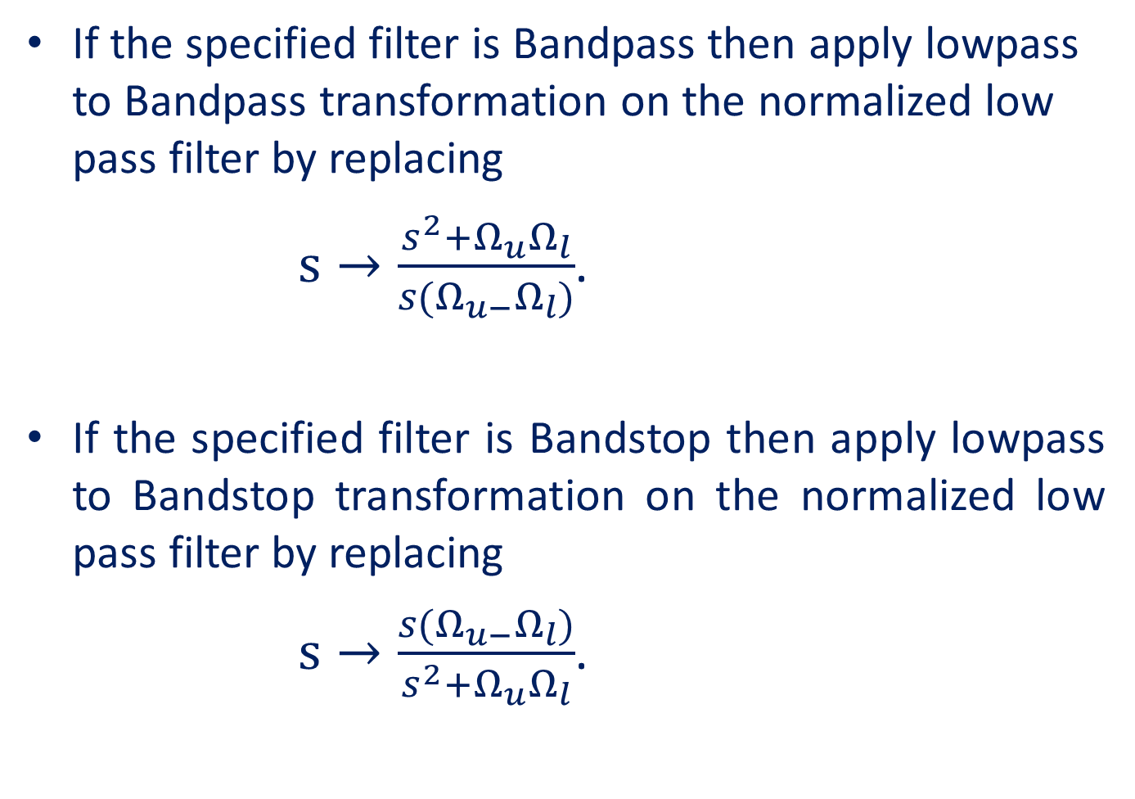
If the specified filter is Bandpass then apply lowpass to Bandpass transformation on the normalized low pass filter by replacing
$s→\frac{s^{2}+Ω_{u}Ω_{l}}{s(Ω_{u−}Ω_{l})}$.
If the specified filter is Bandstop then apply lowpass to Bandstop transformation on the normalized low pass filter by replacing
$s→\frac{s(Ω_{u−}Ω_{l})}{s^{2}+Ω_{u}Ω_{l}}$.

Slide 12
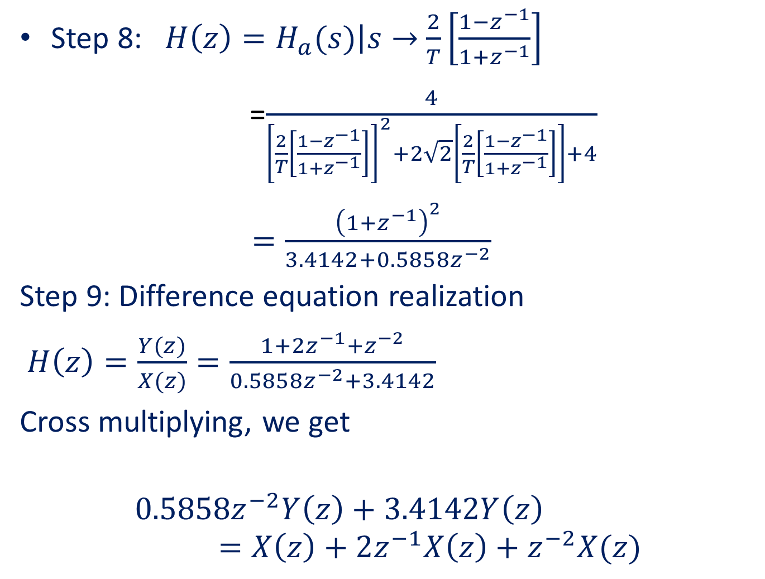
Step 8: $H\left(z\right)=\left.H_{a}(s)\right|s→$ $\frac{2}{T}\left[\frac{1−z^{−1}}{1+z^{−1}}\right]$
=$\frac{4}{{\left[\frac{2}{T}\left[\frac{1−z^{−1}}{1+z^{−1}}\right]\right]}^{2}+2\sqrt{2}\left[\frac{2}{T}\left[\frac{1−z^{−1}}{1+z^{−1}}\right]\right]+4}$
$=\frac{{\left(1+z^{−1}\right)}^{2}}{3.4142+0.5858z^{−2}}$
Step 9: Difference equation realization
$H\left(z\right)=\frac{Y(z)}{X(z)}=\frac{1+2z^{−1}+z^{−2}}{0.5858z^{−2}+3.4142}$
Cross multiplying, we get
$${0.5858z}^{−2}Y\left(z\right)+3.4142Y\left(z\right)=X\left(z\right)+2z^{−1}X\left(z\right)+z^{−2}X(z)$$

Slide 13

Step 9: Take inverse Z-transform on both the sides and rearranging
$y\left(n\right)=−0.1715y\left(n−2\right)+0.2928x\left(n\right)+0.5857x\left(n−1\right)+0.2928x(n−2)$

