Slide 1

Design of IIR Digital Filters part III
Dr K. Mohanaprasad
Associate Professor
School of Electronics Engineering (SENSE)
VIT Chennai

Slide 2
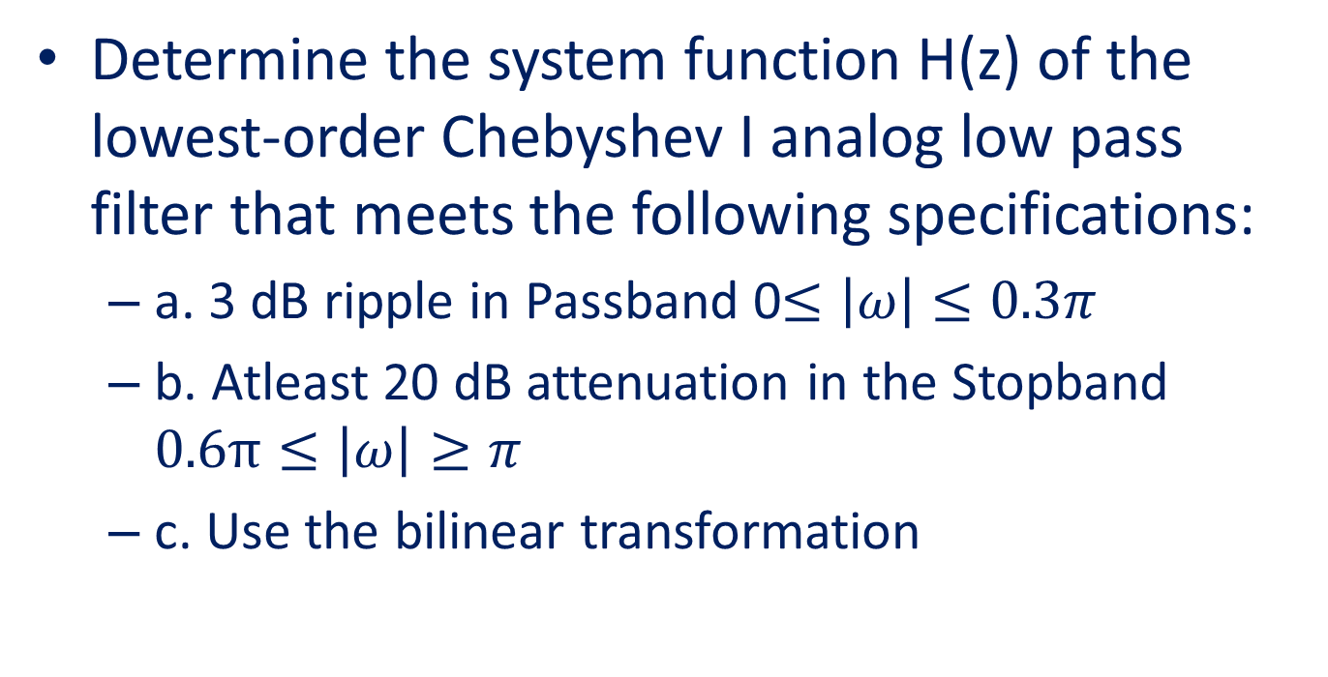
Problem 2
Determine the system function H(z) of the lowest-order Chebyshev I analog low pass filter that meets the following specifications:
a. 3 dB ripple in Passband 0$≤\left|ω\right|$ $≤0.3π$
b. Atleast 20 dB attenuation in the Stopband $0.6π≤\left|ω\right|≥π$
c. Use the bilinear transformation

Slide 3






20$\left|H(ω)\right|$
Step 1
……………
0
Kp=-3 dB
……………
$$Minimum$$
...……………………………..
...…………………………..
$$Ks=−20 dB$$
……
$ωp=$0.3$π$
$$ωs=0.6π$$
$$Ω$$
The specified Magnitude frequency response of a Chebyshev I filter is shown above

Slide 4
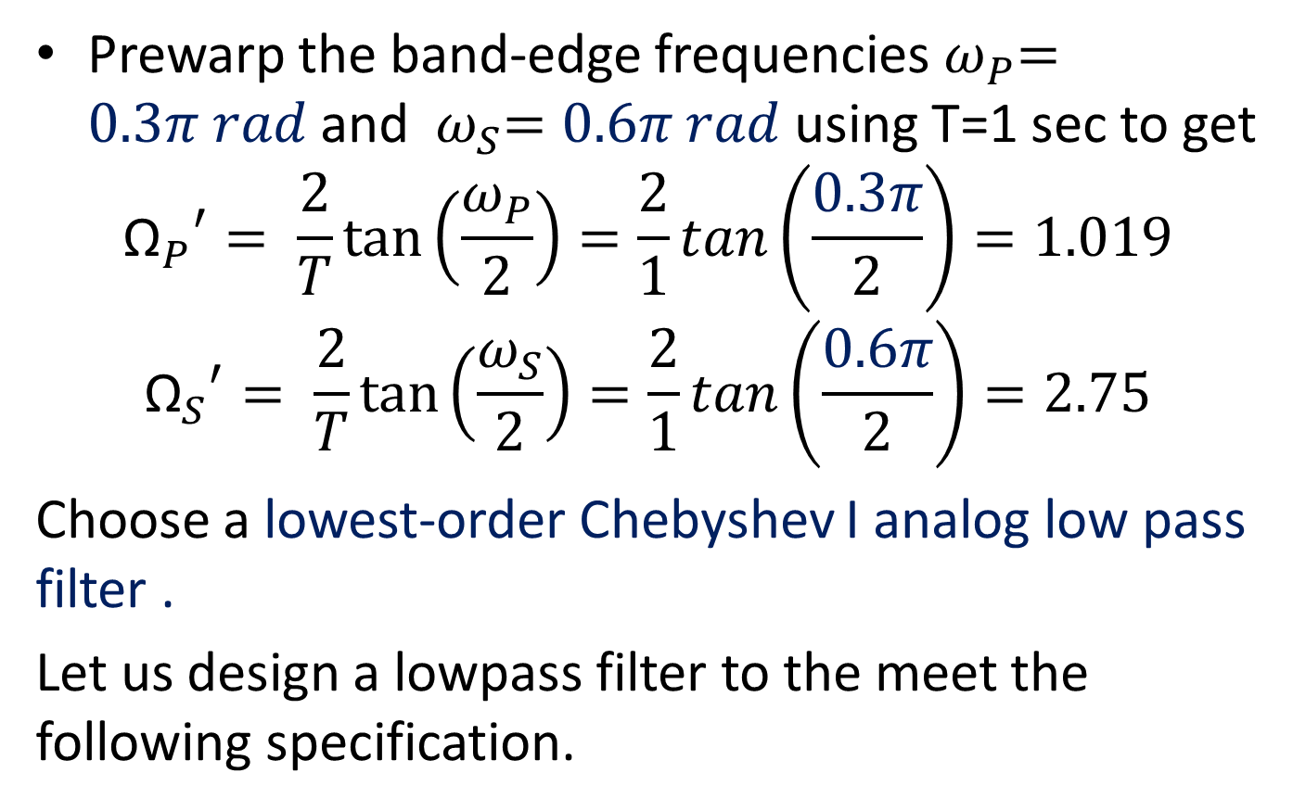
Prewarping
Prewarp the band-edge frequencies${ ω}_{P}=0.3π rad$ and ${ ω}_{S}=0.6π rad$using T=1 sec to get
$${{\text{Ω}}_{P}}^{′}= \frac{2}{T}\tan\left(\frac{ω_{P}}{2}\right)=\frac{2}{1}tan\left(\frac{0.3π}{2}\right)=1.019$$
$${{\text{Ω}}_{S}}^{′}= \frac{2}{T}\tan\left(\frac{ω_{S}}{2}\right)=\frac{2}{1}tan\left(\frac{0.6π}{2}\right)=2.75$$
Choose a lowest-order Chebyshev I analog low pass filter .
Let us design a lowpass filter to the meet the following specification.

Slide 5
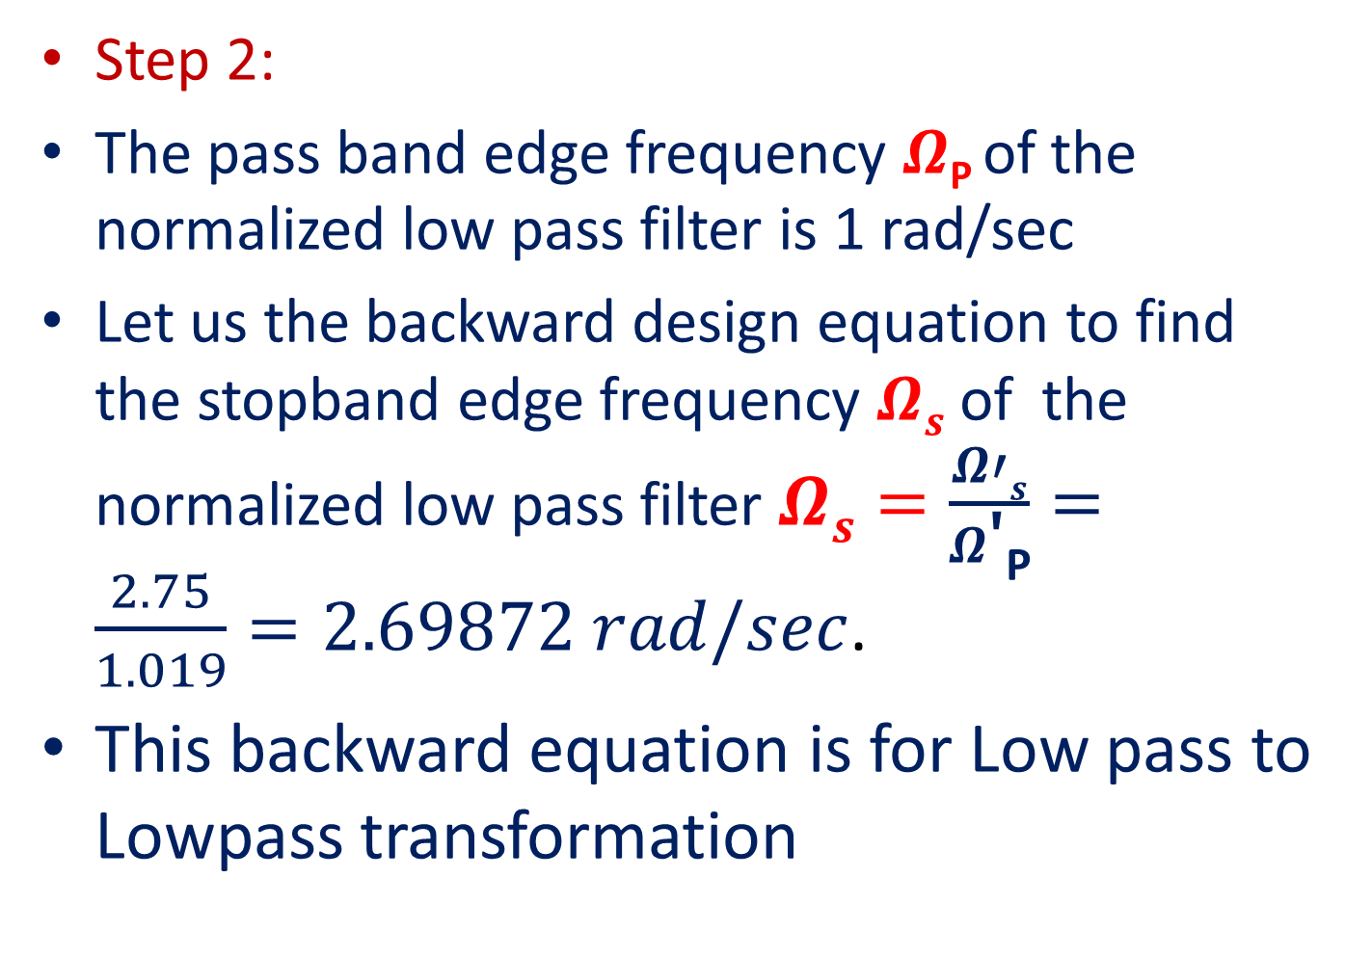
Step 2:
The pass band edge frequency $Ω\text{P}$of the normalized low pass filter is 1 rad/sec
Let us the backward design equation to find the stopband edge frequency $Ωs$ of the normalized low pass filter$Ωs=\frac{Ω′s}{Ω\text{′}\text{P}}=\frac{2.75}{1.019}=2.69872 rad/sec$.
This backward equation is for Low pass to Lowpass transformation

Slide 6



20$\left|H(jΩ)\right|$
Step 2
……………
0
Kp=-2 dB
……………
$$Minimum$$
...……………………………..
...…………………………..
$$Ks=−20 dB$$
……
$Ωp=1$ rad/sec
$$Ωs=3.769 rad/sec$$
$$Ω$$
Normalized Magnitude frequency response of a Chebyshev I Low pass filter for N being odd

Slide 7
If the given filter is high pass then the backward design equation to find the stopband edge frequency $Ωs$ is $\frac{ΩP}{Ω\text{S}}$ .
If the given filter is Bandpass then the backward design equation to find the stopband edge frequency $Ωs=Min\left\{\left|A\right|,\left|B\right|\right\}$. Where $A=\frac{{{−Ω}_{1}^{}}^{2}+Ω_{l}Ω_{u}}{Ω_{1}^{}(Ω_{u}−Ω_{l})}$, $B=\frac{{Ω_{2}^{}}^{2}−Ω_{l}Ω_{u}}{Ω_{2}^{}(Ω_{u}−Ω_{l})}$
If the given filter is Bandstop then the backward design equation to find the stopband edge frequency $Ωs=Min\left\{\left|A\right|,\left|B\right|\right\}$. Where $A=\frac{Ω_{1}^{}(Ω_{u}−Ω_{l})}{{{−Ω}_{1}^{}}^{2}+Ω_{l}Ω_{u}}$, $B=\frac{Ω_{2}^{}(Ω_{u}−Ω_{l})}{{Ω_{2}^{}}^{2}−Ω_{l}Ω_{u}}$
The normalized passband edge frequency $ΩP$ is always equal to 1 rad/sec irrespective of the given filter.

Slide 8
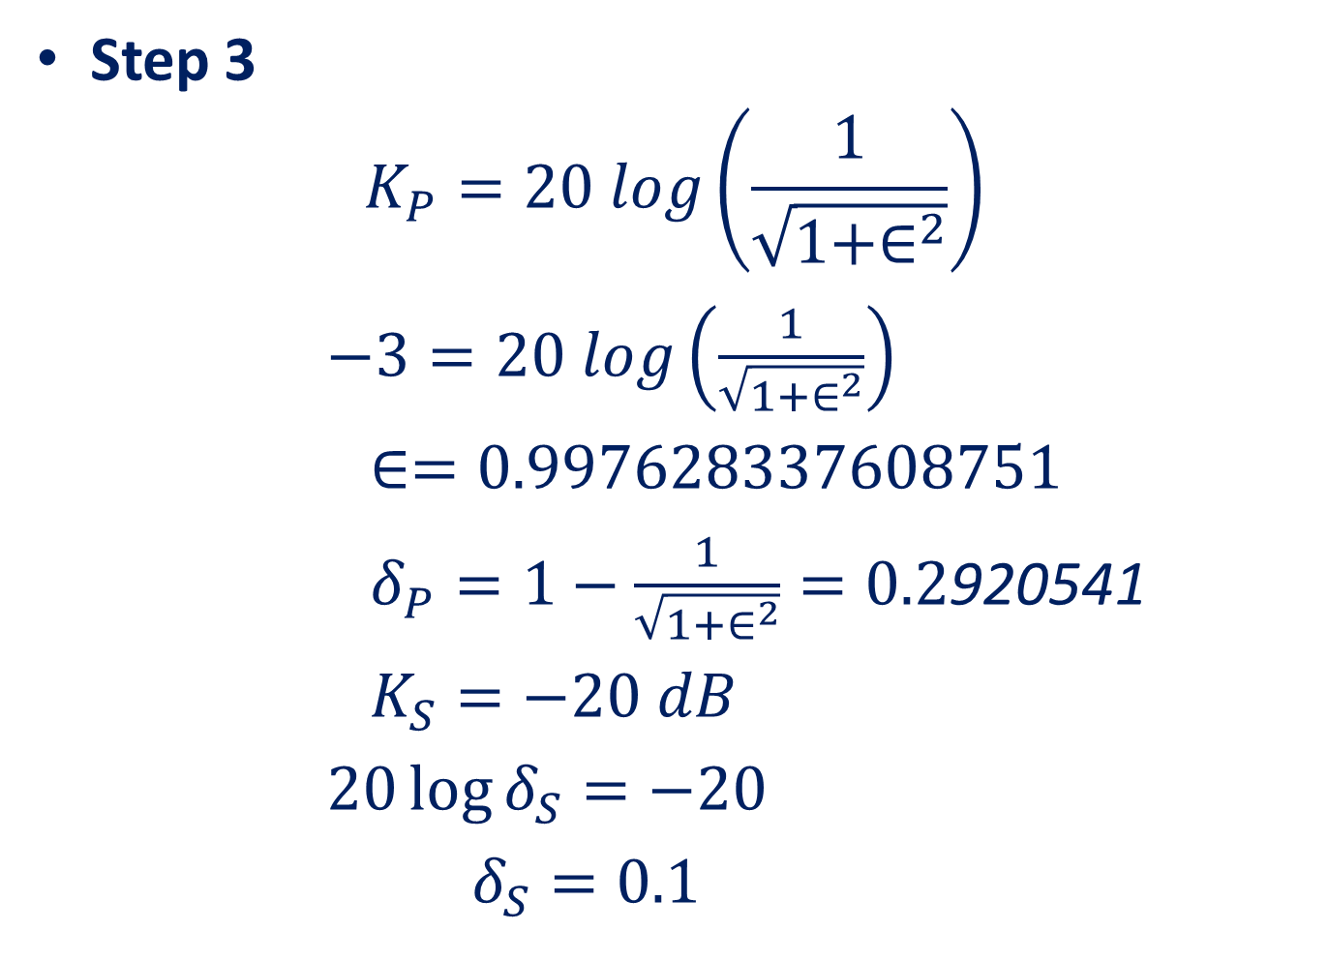
Step 3
$$K_{P}=20 log\left(\frac{1}{\sqrt{1+∈^{2}}}\right)$$
$−3=20 log\left(\frac{1}{\sqrt{1+∈^{2}}}\right)$
$∈=0.997628337608751$
$δ_{P}=1−\frac{1}{\sqrt{1+∈^{2}}}=0.2$920541
$K_{S}=−20 dB$
$20\log{δ_{S}=−20}$
$δ_{S}=0.1$

Slide 9
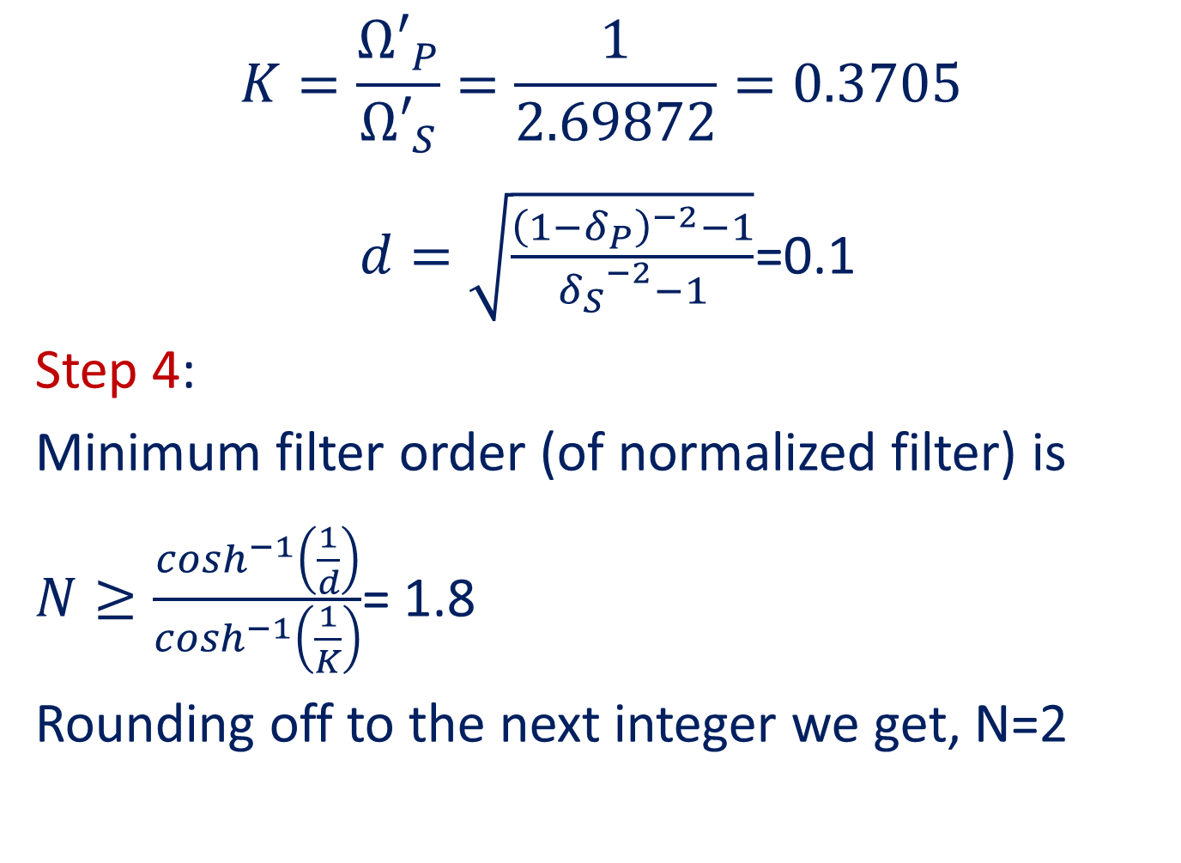
$$K=\frac{{Ω′}_{P}}{{Ω′}_{S}}=\frac{1}{2.69872}=0.3705$$
$d=\sqrt{\frac{{\left(1−δ_{P}\right)}^{−2}−1}{{δ_{S}}^{−2}−1}}$=0.1
Step 4:
Minimum filter order (of normalized filter) is
$N≥\frac{\cosh^{−1}\left(\frac{1}{d}\right)}{\cosh^{−1}\left(\frac{1}{K}\right)}$= 1.8
Rounding off to the next integer we get, N=2

Slide 10
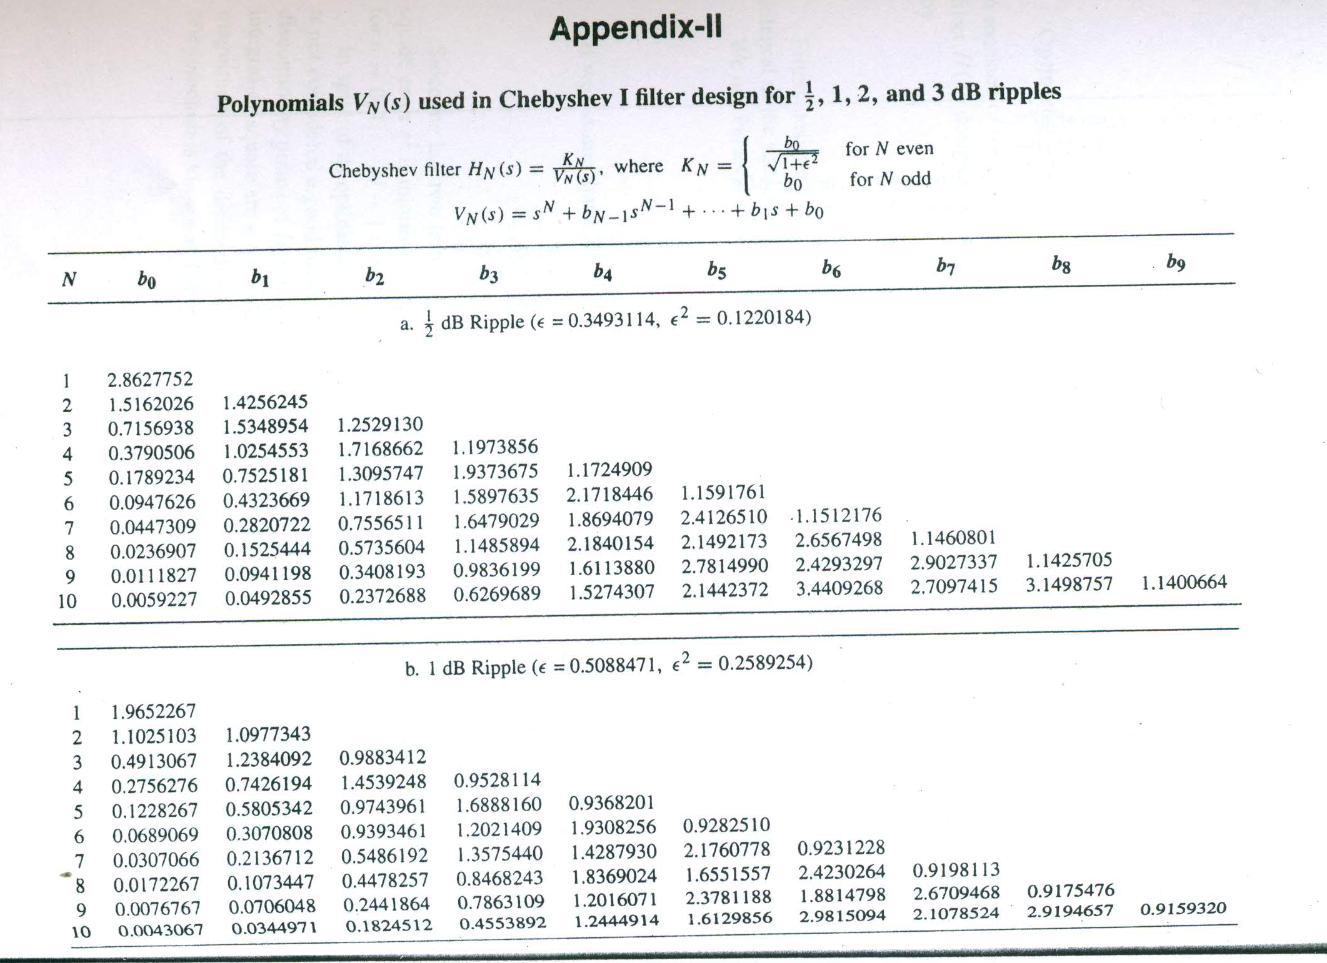

Slide 11
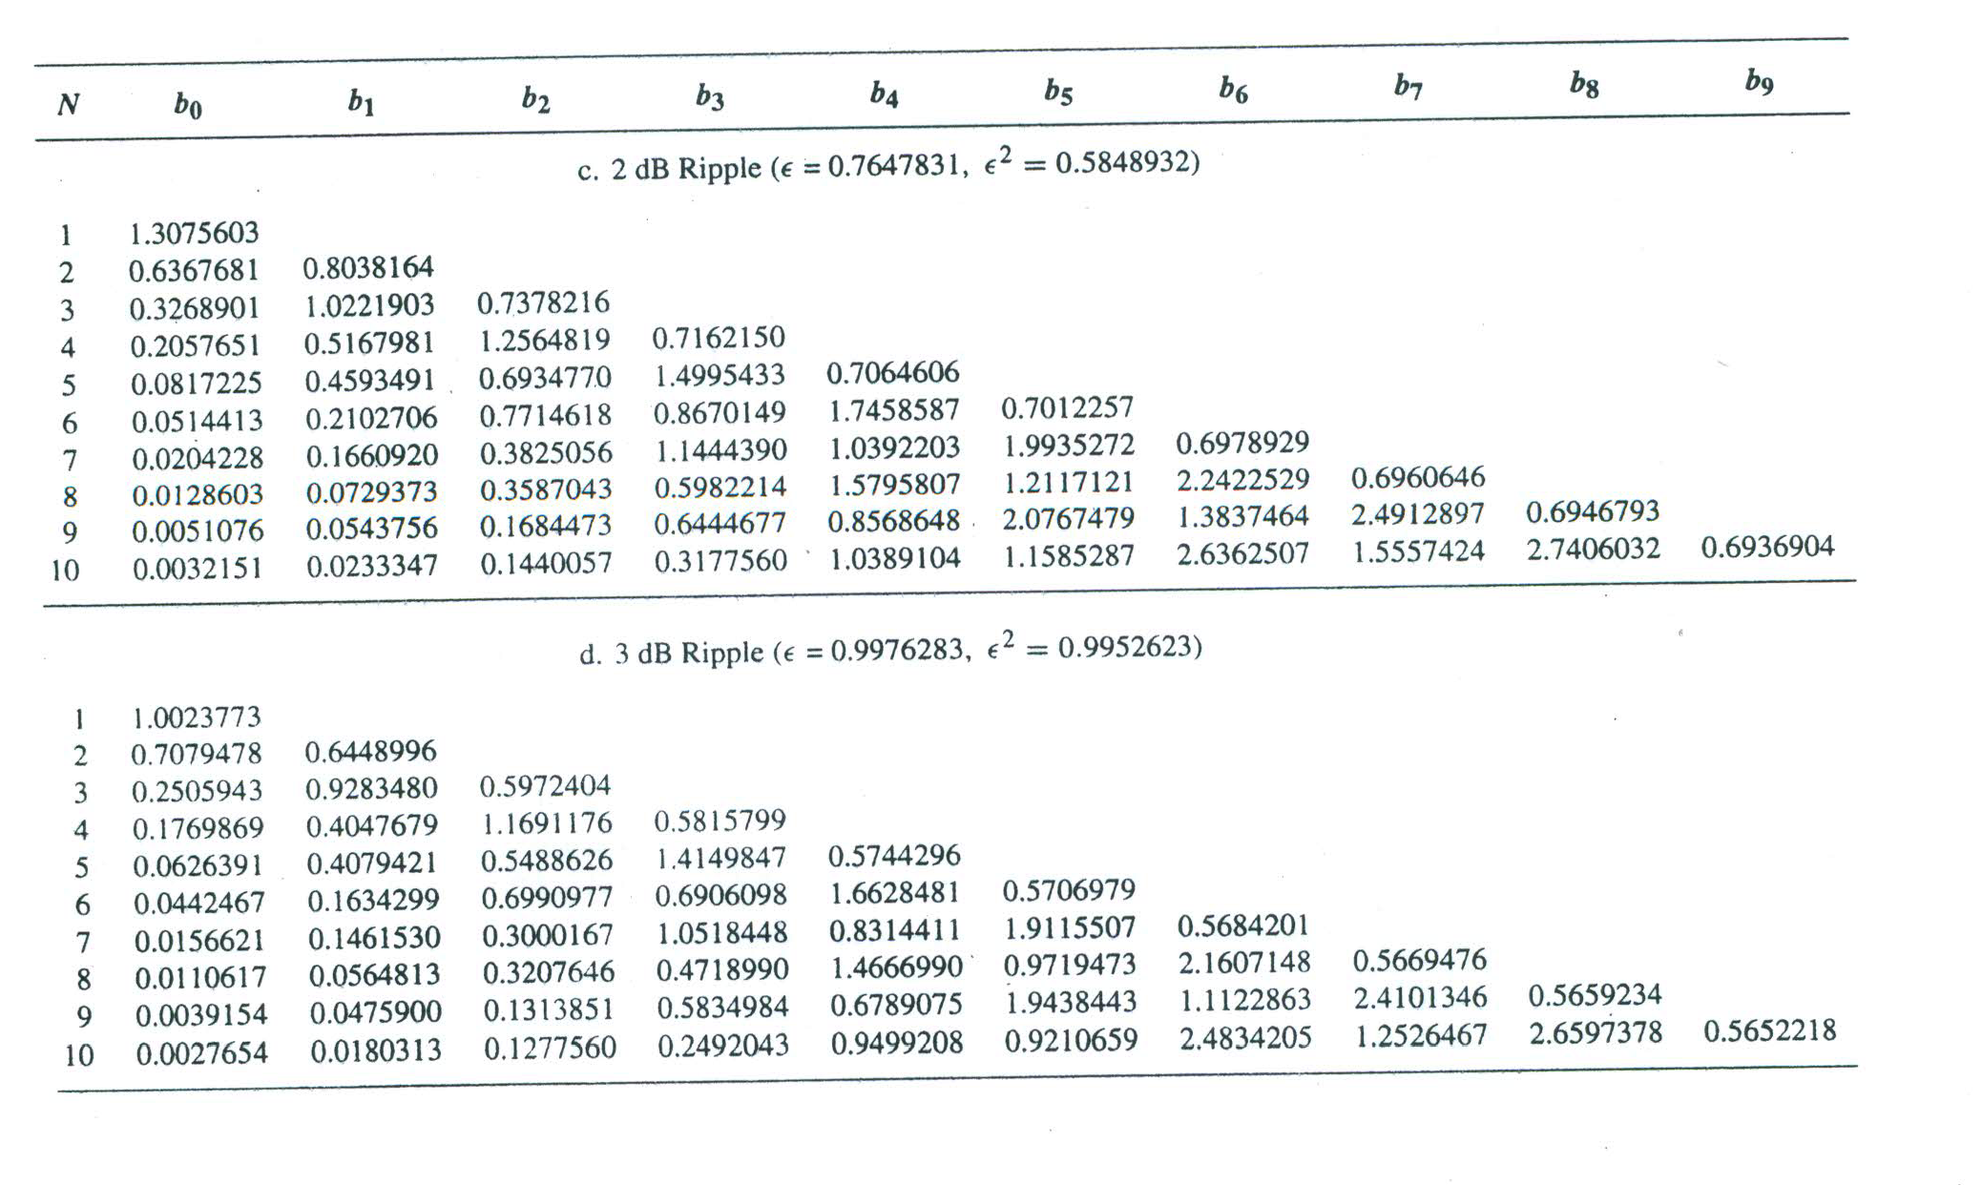

Slide 12
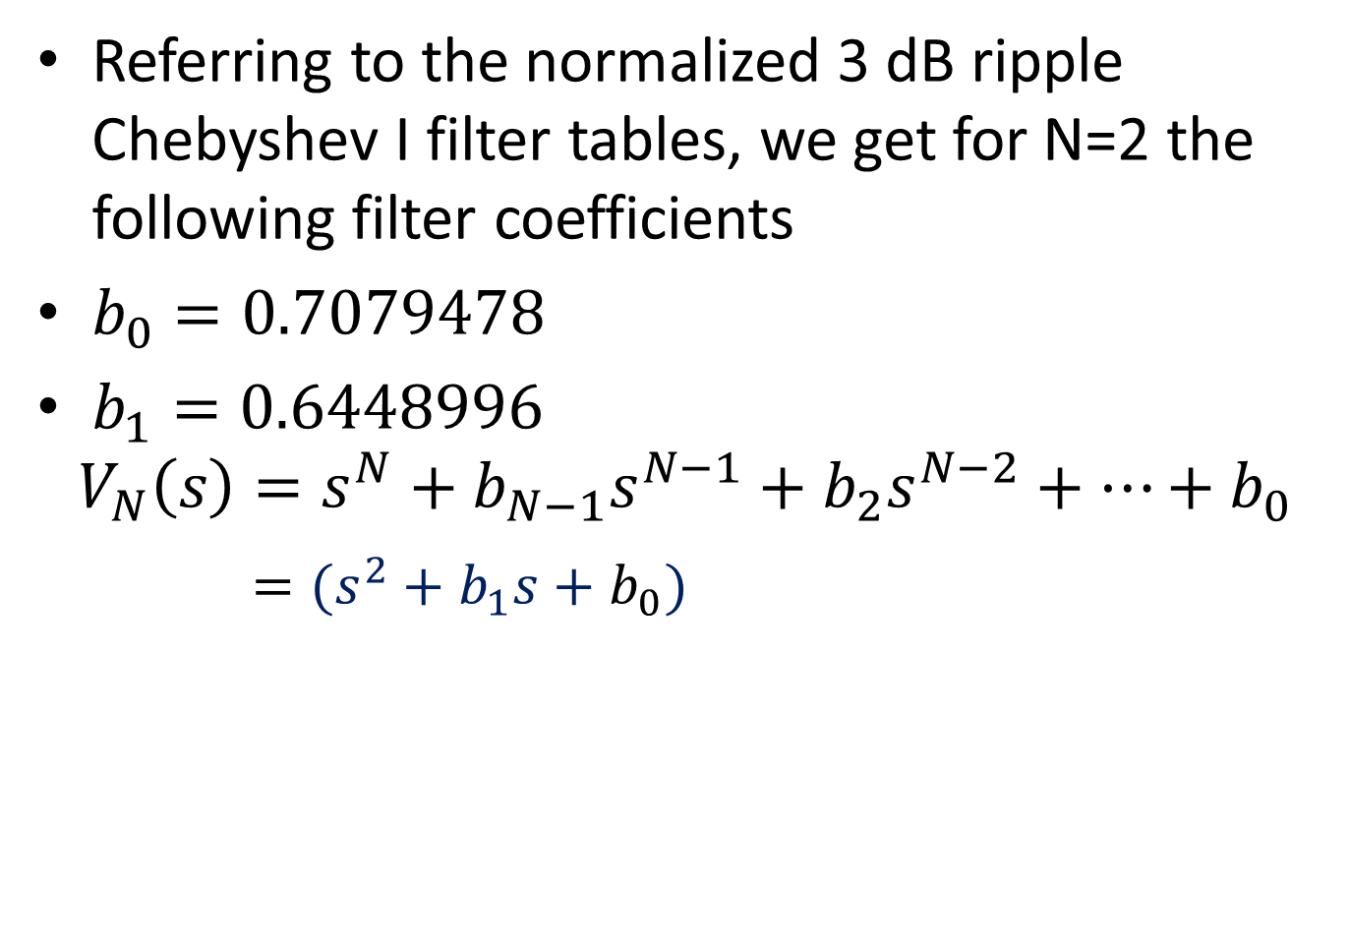
Referring to the normalized 3 dB ripple Chebyshev I filter tables, we get for N=2 the following filter coefficients
$b_{0}=0.7079478$
$b_{1}=0.6448996$
$$V_{N}\left(s\right)=s^{N}+b_{N−1}s^{N−1}+b_{2}s^{N−2}+…+b_{0}$$
$=(s^{2}+b_{1}s+b_{0})$

Slide 13
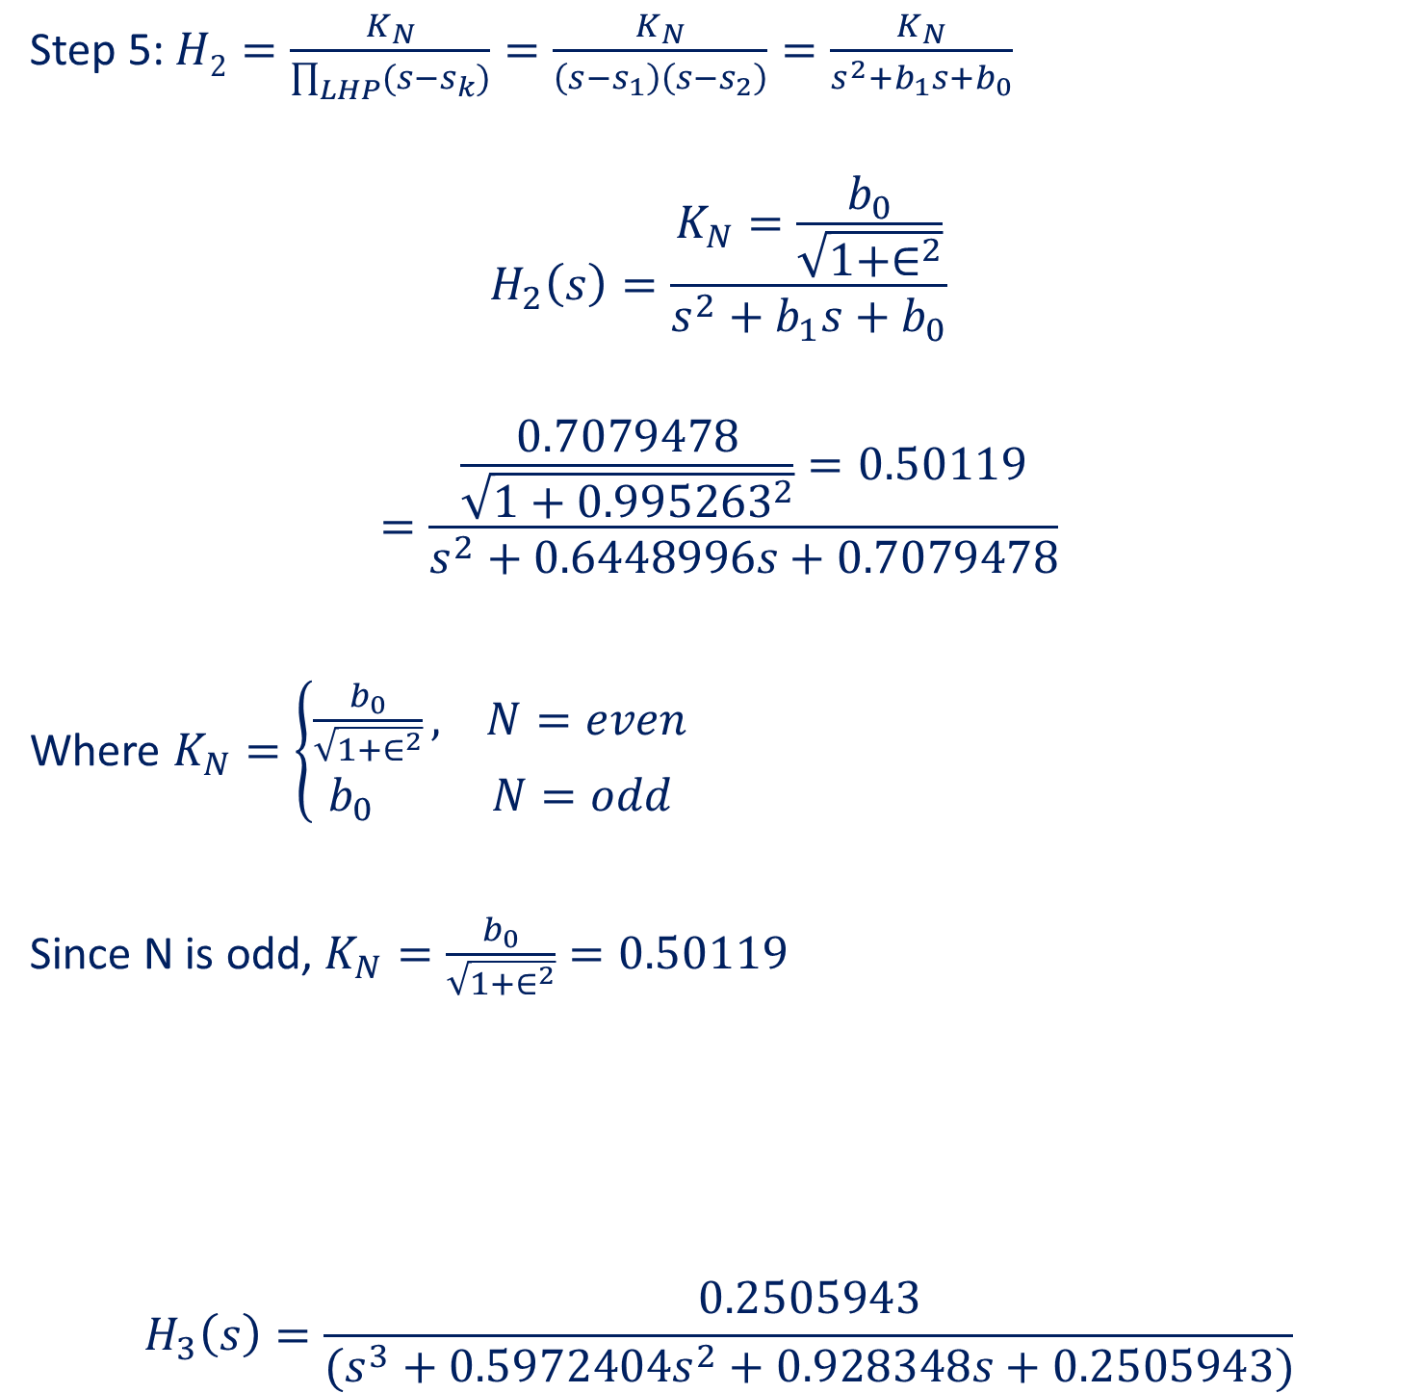
Step 5: $H2=\frac{K_{N}}{\prod_{LHP}{(s−s_{k})}}=\frac{K_{N}}{\left(s−s_{1}\right)\left(s−s_{2}\right)}=\frac{K_{N}}{s^{2}+b_{1}s+b_{0}}$
$$H_{2}\left(s\right)=\frac{K_{N}=\frac{b_{0}}{\sqrt{1+∈^{2}}}}{s^{2}+b_{1}s+b_{0}}$$
$$=\frac{\frac{0.7079478}{\sqrt{1+{0.995263}^{2}}}=0.50119}{s^{2}+0.6448996s+0.7079478}$$
Where $K_{N}=\left\{\begin{aligned}\frac{b_{0}}{\sqrt{1+∈^{2}}}, N=even \\ b_{0} N=odd\end{aligned}\right.$
Since N is odd, $K_{N}=\frac{b_{0}}{\sqrt{1+∈^{2}}}=0.50119$
$$H_{3}\left(s\right)=\frac{0.2505943}{(s^{3}+0.5972404s^{2}+0.928348s+0.2505943)}$$

Slide 14
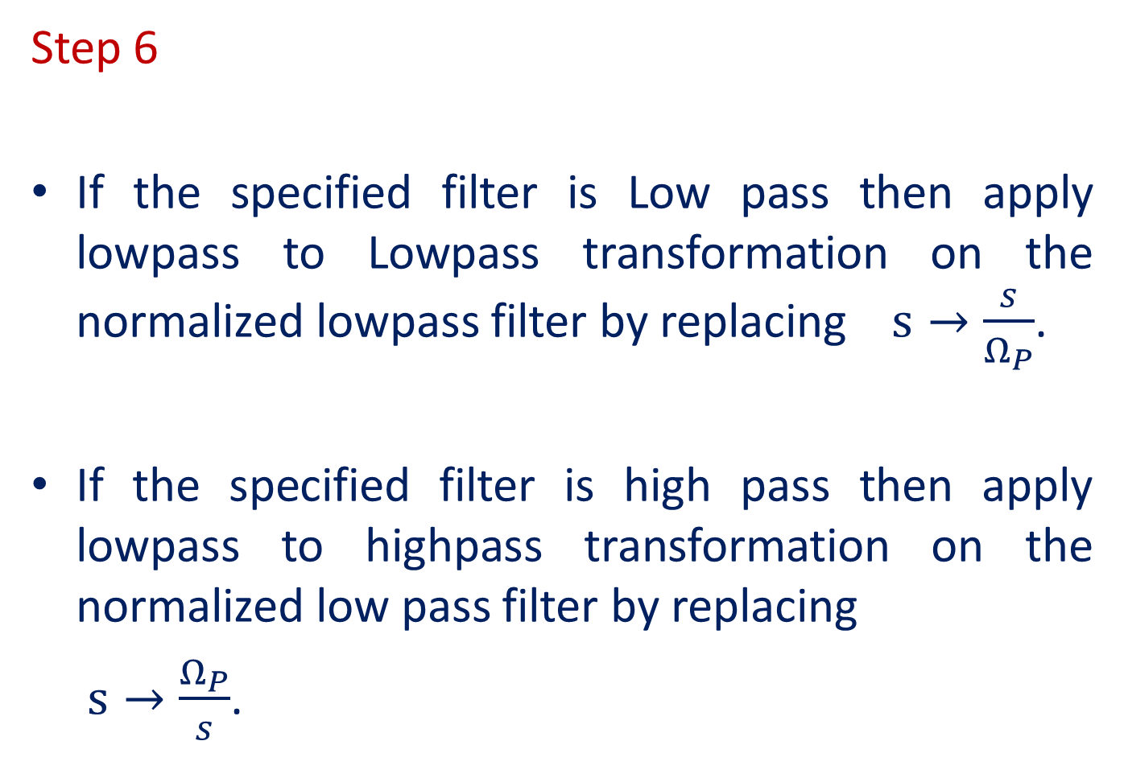
Step 6
If the specified filter is Low pass then apply lowpass to Lowpass transformation on the normalized lowpass filter by replacing $s→\frac{s}{Ω_{P}}$.
If the specified filter is high pass then apply lowpass to highpass transformation on the normalized low pass filter by replacing
$s→\frac{Ω_{P}}{s}$.

Slide 15
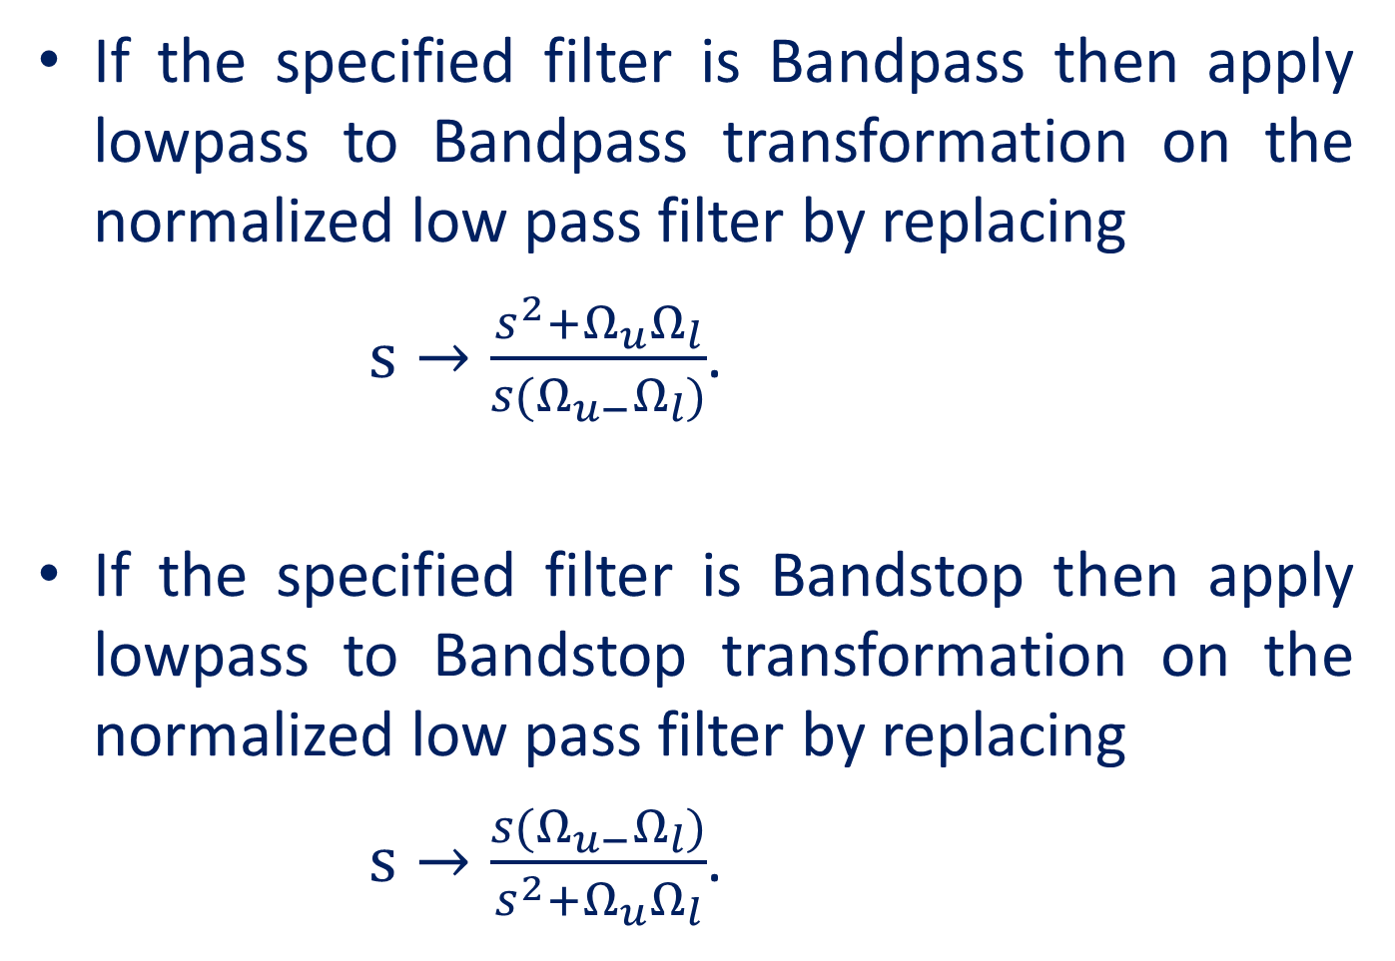
If the specified filter is Bandpass then apply lowpass to Bandpass transformation on the normalized low pass filter by replacing
$s→\frac{s^{2}+Ω_{u}Ω_{l}}{s(Ω_{u−}Ω_{l})}$.
If the specified filter is Bandstop then apply lowpass to Bandstop transformation on the normalized low pass filter by replacing
$s→\frac{s(Ω_{u−}Ω_{l})}{s^{2}+Ω_{u}Ω_{l}}$.

Slide 16
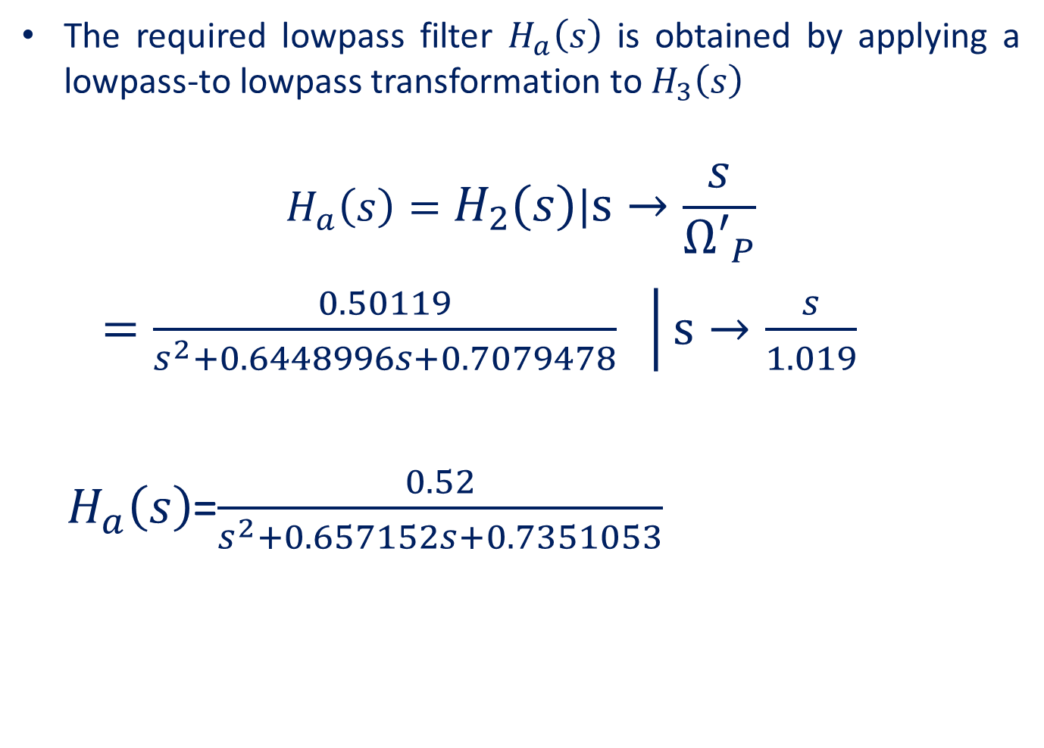
The required lowpass filter $H_{a}\left(s\right)$ is obtained by applying a lowpass-to lowpass transformation to $H_{3}\left(s\right)$
$$H_{a}\left(s\right)=\left.H_{2}\left(s\right)\right|s→\frac{s}{{Ω′}_{P}}$$
$\left.=\frac{0.50119}{s^{2}+0.6448996s+0.7079478} \right|s→\frac{s}{1.019}$
$H_{a}\left(s\right)$=$\frac{0.52}{s^{2}+0.657152s+0.7351053}$

Slide 17
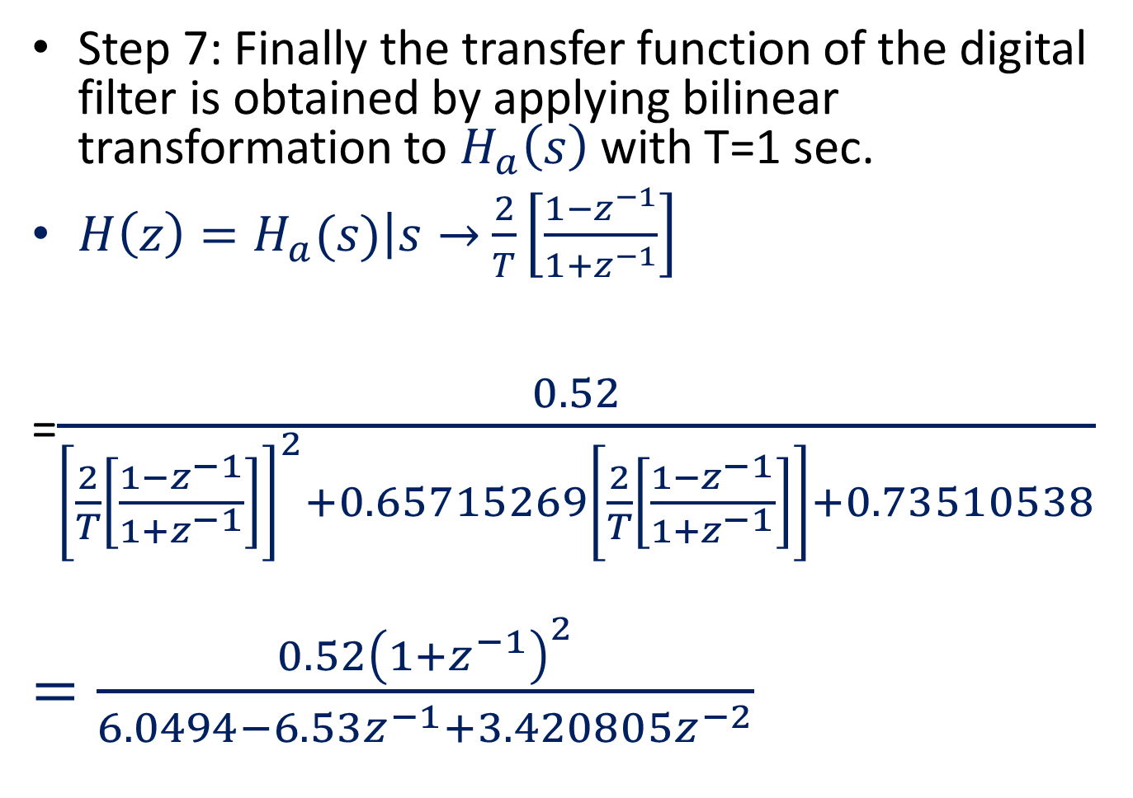
Step 7: Finally the transfer function of the digital filter is obtained by applying bilinear transformation to $H_{a}\left(s\right)$ with T=1 sec.
$H\left(z\right)=\left.H_{a}(s)\right|s→$ $\frac{2}{T}\left[\frac{1−z^{−1}}{1+z^{−1}}\right]$
=$\frac{0.52}{{\left[\frac{2}{T}\left[\frac{1−z^{−1}}{1+z^{−1}}\right]\right]}^{2}+0.65715269\left[\frac{2}{T}\left[\frac{1−z^{−1}}{1+z^{−1}}\right]\right]+0.73510538}$
$=\frac{0.52{\left(1+z^{−1}\right)}^{2}}{6.0494−6.53z^{−1}+3.420805z^{−2}}$

