Slide 1
Introduction
IIR filter have infinite-duration impulse responses, hence they can be matched to analog filters, all of which generally have infinitely long impulse responses
The basic technique of IIR filter design transforms well-known analog filters into digital filters using complex-valued mappings.
The advantage of this technique lies in the fact that both analog filter design (AFD) tables and the mappings are available extensively in the literature

Slide 2
Introduction
However, the AFD tables are available only for lowpass filters. We also want design other frequency-selective filters (highpass, bandpass, bandstop, etc.)
To do this, we need to apply frequency-band transformations to lowpass filters. These transformations are also complex-valued mappings, and they are also available in the literature

Slide 3
Two methods
Approach: 1
Approach: 2

Slide 4
Approach: 1
Filter Type | Transformation
High Pass
Band Pass
Band Stop
Q- Quality factor

Slide 5
Approach:2

Slide 6
The main problem
We have no control over the phase characteristics of the IIR filter
Hence IIR filter designs will be treated as magnitude-only designs

Slide 7
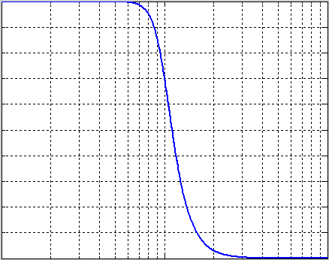
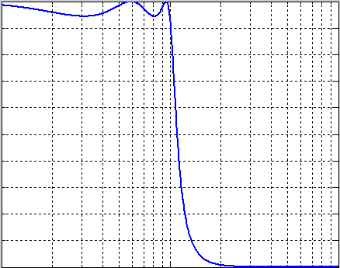
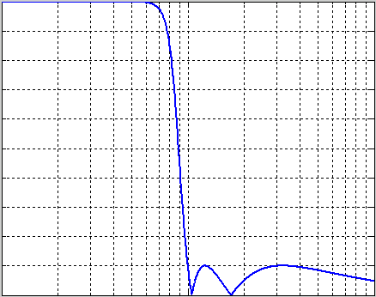
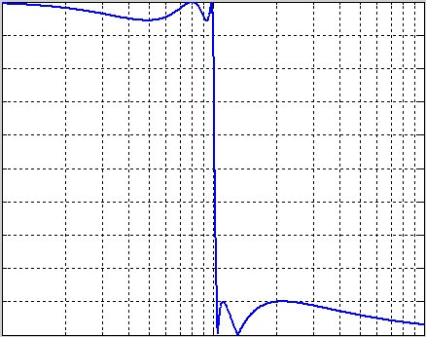
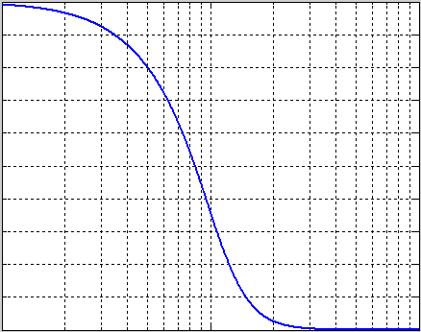
Widely used analog filters
Butterworth
Chebyshev Type I
Chebyshev Type II
Elliptic
Bessel

Slide 8
Calculating filter coefficients
Simple way: place the poles and zeros judiciously in the z-plane such that resulting filter has the desired frequency response, called pole-zero placement method
It is useful only for simple filters like notch filter
Impulse invariant method
Matched z transform
Bilinear z transform

Slide 9
Impulse InVariant (IIV) method
Suitable analog transfer function H(s) is chosen
h(t) is obtained by using inverse Laplace tranform
h(t) is sampled to produce h(nT), where T is the sampling interval
The desired transfer function is obtained by z transforming h(nT)

Slide 10
When H(s) have distinct poles, it can be expressed through partial fraction as
On taking inverse Laplace transform we get

Slide 11
IIV method continued
On taking Z transform we get

Slide 12
Relationship b/w analog & digital filter poles
Analog poles are the roots of : s-p_{i} for i=1,2,…N
Digital poles are the roots of: 1-e^{piT}z⁻¹ for i=1,2…N
Since z=e^{jw} on the unit circle and s=j Ω on the imaginary axis, we have the transformation from the s-plane to the z-plane as z=e^{sT}

Slide 13
Relationship between analog & digital frequency
According to the sampling theorem H(e^{jω}) is a periodic version of H( jΩ) where,
Ω = Analog frequency in rad /s
ω = Digital frequency in rad / s
z = re^{jω} point on z-plane
s=σ+jΩ be corresponding point in s-plane
We know
On equating we get

Slide 14
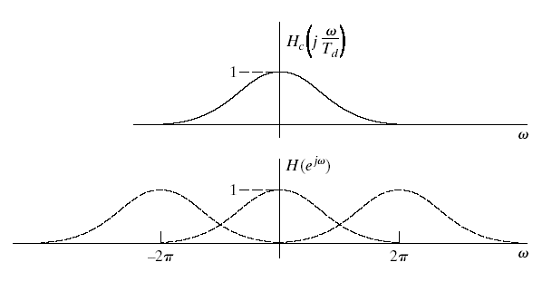
Observation
The impulse response of the discrete filter is identical to that of the analog filter at discrete time instances. That’s why this method is called impulse invariant method
Sampling frequency affects the frequency response of the impulse invariant digital filter. Need high sampling frequency to have frequency response close to analog filter.
The spectrum of impulse invariant filter corresponding to H(z) would be same as that of original analog filter H(s), but it repeats and leads to aliasing
Hence, this method is not suitable for high pass and band stop filters design

Slide 15
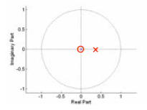
Example: First Order Butterworth Filter Designed Using the Impulse Invariant Method (T=1)
zero at z=0
pole at z=1/e

Slide 16
For the analog TF H(s), find H(z) if T = 1s
When T = 1s
On solving PF we have
We know

Slide 17
Design procedure for Butterworth filter using IIV method (assuming T = 1 s )
A_{p} = Gain at a pass band frequency
A_{s} = Gain at a stop band frequency
Ω_{p} = Analog frequency corresponding to pass band
Ω_{s} = Analog frequency corresponding to stop band

Slide 18
Step 1: Find the order(N) of the filter
Step 2: calculate the analog cut off frequency Ω_{c} for impulse invariant transformation

Slide 19
Step 3: Determine the transfer function H(s)
If N = even,
If N= odd

Slide 20
Step 4: choose your required transform technique to convert H(s) to H(z)
Step 5: Realize the digital filter transfer function H(z) by suitable structure

Slide 21
Design Butterworth IIR filter using IIV method for the below specification
Given, A_{p}= 0.8; Ω_{p} = 0.2π A_{s} = 0.2; Ω_{s} = 0.32π

Slide 22
So order of the filter is 4

Slide 23
Transfer function of the analog filter
Analog cut off frequency

Slide 24
The roots are

Slide 28
Change in specification
Pass band ripple ( δ_{p} )in dB and Stop band attenuation ( α_{s} ) in dB will be given
The relationship between gain and pass band ripple and stop band attenuation are

Slide 29
Change in specification
For example, the above problem can be given as,
Pass band edge frequency = 0.2π
Stop band edge frequency = 0.32π
Pass band ripple ( δ_{p} ) ≤ 1.9382 dB
Stop band attenuation ( α_{s} )≥ 13.9794 dB

