Slide 1

Analog Communication Systems
BECE304L
Module-6
Analog Communication Systems

Slide 2
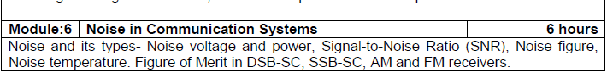
Course- module-6

Slide 3
Noise in Communication Systems
Introduction
Thermal Noise
Shot Noise
Low Frequency or Flicker Noise
Excess Resister Noise
Burst or Popcorn Noise
General Comments
Noise Evaluation – Overview
Analysis of Noise in Communication Systems
Thermal Noise
Noise Voltage Spectral Density
Resistors in Series
Resistors in Parallel
Matched Communication Systems
11. Signal - to – Noise
12. Noise Factor – Noise Figure
13. Noise Figure / Factor for Active Elements
14. Noise Temperature
15. Noise Figure / Factors for Passive Elements
16. Review – Noise Factor / Figure / Temperature
17. Cascaded Networks
18. System Noise Figure
19. System Noise Temperature
20. Algebraic Representation of Noise
21. Additive White Gaussian Noise

Slide 4
1. Introduction
Noise is a general term which is used to describe an unwanted signal which affects a wanted signal. These unwanted signals arise from a variety of sources which may be considered in one of two main categories:-
Interference, usually from a human source (man made)
Naturally occurring random noise
Interference
Interference arises for example, from other communication systems (cross talk), 50 Hz supplies (hum) and harmonics, switched mode power supplies, thyristor circuits, ignition (car spark plugs) motors … etc.

Slide 5
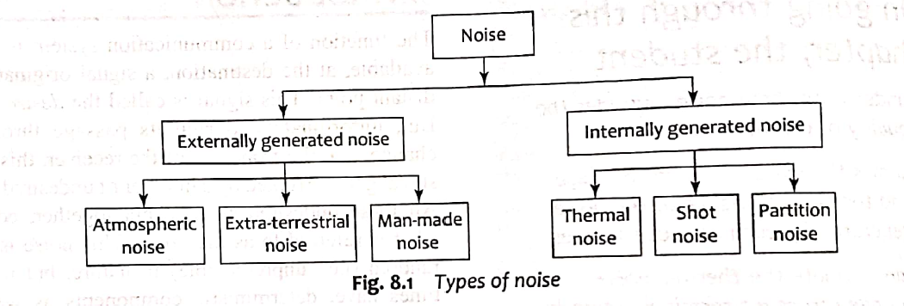
TYPES OF NOISE

Slide 6
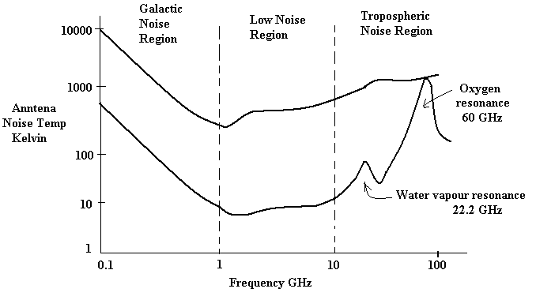
1. Introduction (Cont’d)
Natural Noise
Naturally occurring external noise sources include atmosphere disturbance (e.g. electric storms, lighting, ionospheric effect etc), so called ‘Sky Noise’ or Cosmic noise which includes noise from galaxy, solar noise and ‘hot spot’ due to oxygen and water vapour resonance in the earth’s atmosphere.

Slide 7
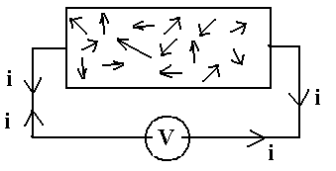
2. Thermal Noise (Johnson Noise)
This type of noise is generated by all resistances (e.g. a resistor, semiconductor, the resistance of a resonant circuit, i.e. the real part of the impedance, cable etc).
Experimental results (by Johnson) and theoretical studies (by Nyquist) give the mean square noise voltage as
Where k = Boltzmann’s constant = 1.38 x 10⁻²³ Joules per K
T = absolute temperature
B = bandwidth noise measured in (Hz)
R = resistance (ohms)

Slide 8
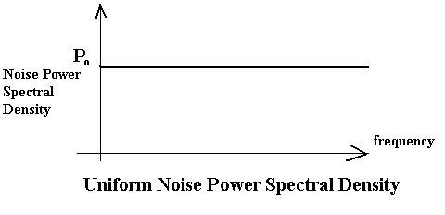
2. Thermal Noise (Johnson Noise) (Cont’d)
The law relating noise power, N, to the temperature and bandwidth is
N = k TB watts
Thermal noise is often referred to as ‘white noise’ because it has a uniform ‘spectral density’.

Slide 9
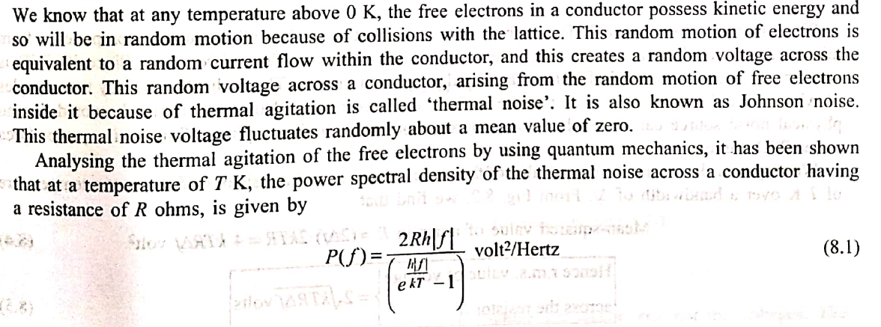
Thermal Noise (Johnson Noise)

Slide 10
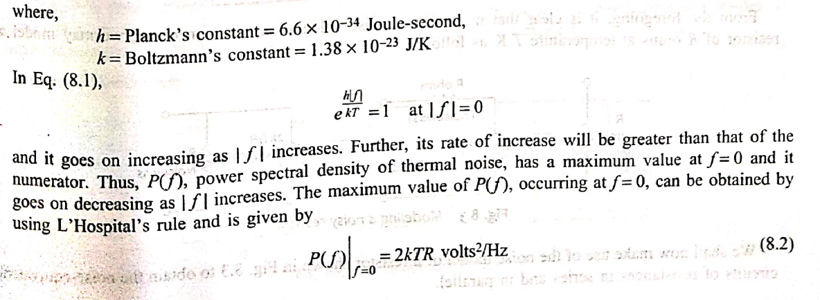
Thermal Noise (Johnson Noise)

Slide 11
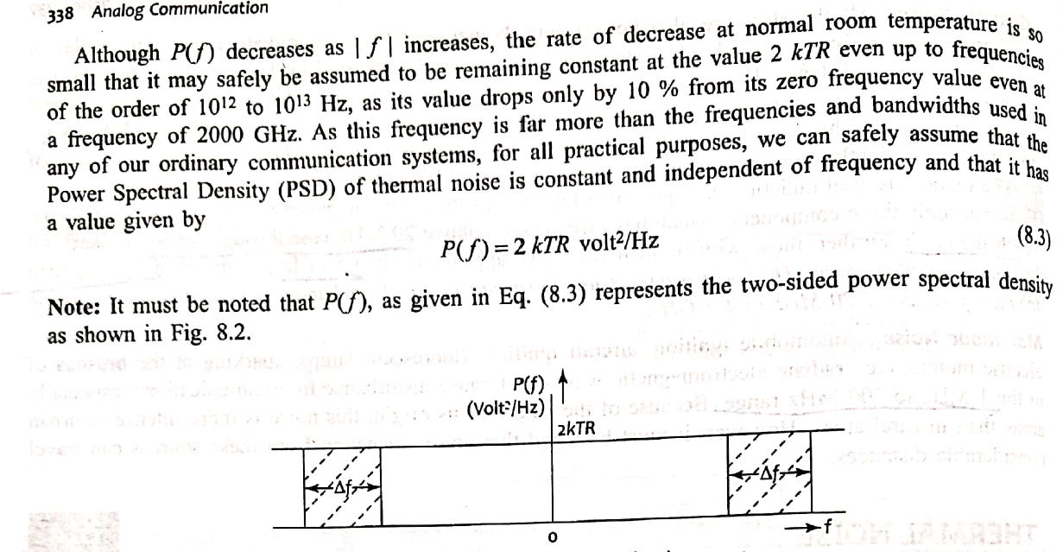
Thermal Noise (Johnson Noise)

Slide 12
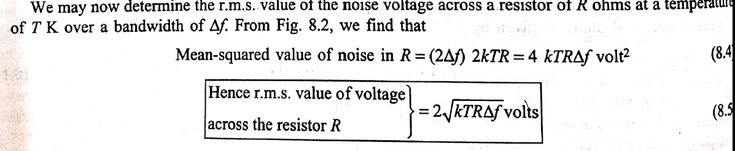
Thermal Noise (Johnson Noise)

Slide 13
3. Shot Noise
Shot noise was originally used to describe noise due to random fluctuations in electron emission from cathodes in vacuum tubes (called shot noise by analogy with lead shot).
Shot noise also occurs in semiconductors due to the liberation of charge carriers.
For pn junctions the mean square shot noise current is
Where
is the direct current as the pn junction (amps)
is the reverse saturation current (amps)
is the electron charge = 1.6 x 10-19 coulombs
B is the effective noise bandwidth (Hz)
Shot noise is found to have a uniform spectral density as for thermal noise

Slide 14
4. Low Frequency or Flicker Noise
Active devices, integrated circuit, diodes, transistors etc also exhibits a low frequency noise, which is frequency dependent (i.e. non uniform) known as flicker noise or ‘one – over – f’ noise.
5. Excess Resistor Noise
Thermal noise in resistors does not vary with frequency, as previously noted, by many resistors also generates as additional frequency dependent noise referred to as excess noise.
6. Burst Noise or Popcorn Noise
Some semiconductors also produce burst or popcorn noise with a spectral density which is proportional to

Slide 15
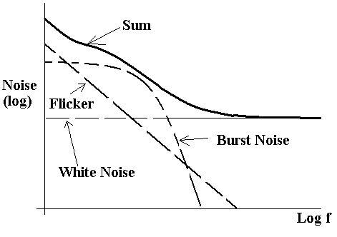
7. General Comments
For frequencies below a few KHz (low frequency systems), flicker and popcorn noise are the most significant, but these may be ignored at higher frequencies where ‘white’ noise predominates.

Slide 16
8. Noise Evaluation
The essence of calculations and measurements is to determine the signal power to Noise power ratio, i.e. the (S/N) ratio or (S/N) expression in dB.

Slide 17
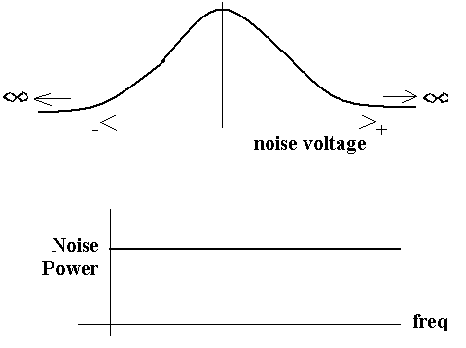
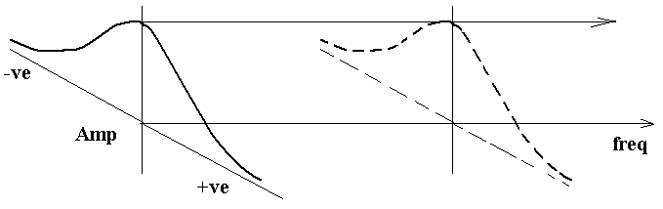
8. Noise Evaluation (Cont’d)
The probability of amplitude of noise at any frequency or in any band of frequencies (e.g. 1 Hz, 10Hz… 100 KHz .etc) is a Gaussian distribution.

Slide 18
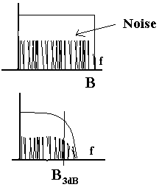
8. Noise Evaluation (Cont’d)
Noise may be quantified in terms of noise power spectral density, p_{o} watts per Hz, from which Noise power N may be expressed as
N= p_{o} B_{n} watts
Ideal low pass filter
Bandwidth B Hz = B_{n}
N= p_{o} B_{n} watts
Practical LPF
3 dB bandwidth shown, but noise does not suddenly cease at B_{3dB}
Therefore, Bn > B_{3dB}, Bn depends on actual filter.
N= p0 B_{n}
In general the equivalent noise bandwidth is > B_{3dB}.

Slide 19
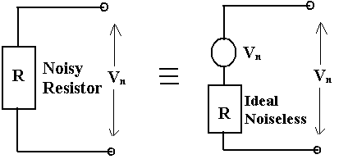
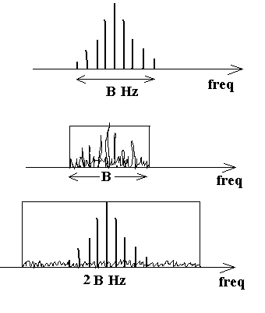
9. Analysis of Noise In Communication Systems
Thermal Noise (Johnson noise)
This thermal noise may be represented by an equivalent circuit as shown below
(mean square value , power)
then V_{RMS} =
i.e. V_{n} is the RMS noise voltage.
A) System BW = B Hz
N= Constant B (watts) = KB
B) System BW
N= Constant 2B (watts) = K2B
For A,
For B,

Slide 20
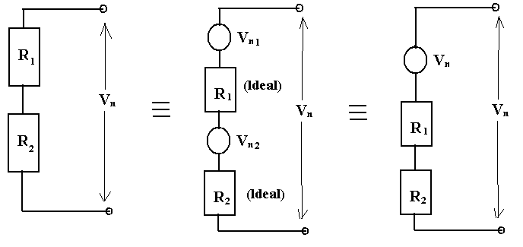
9. Analysis of Noise In Communication Systems (Cont’d)
Resistors in Series
Assume that R₁ at temperature T₁ and R₂ at temperature T_{2,} then
i.e. The resistor in series at same temperature behave as a single resistor

Slide 21
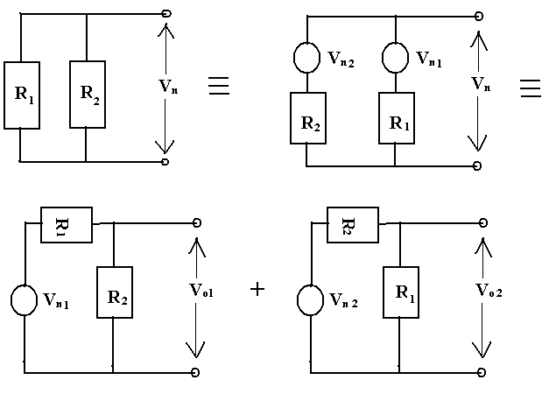
9. Analysis of Noise In Communication Systems (Cont’d)
Resistance in Parallel

Slide 22

11. Signal to Noise
The signal to noise ratio is given by
The signal to noise in dB is expressed by
for S and N measured in mW.
12. Noise Factor- Noise Figure
Consider the network shown below,

Slide 23
12. Noise Factor- Noise Figure (Cont’d)
The amount of noise added by the network is embodied in the Noise Factor F, which is defined by
Noise factor F =
F equals to 1 for noiseless network and in general F > 1. The noise figure in the noise factor quoted in dB
i.e. Noise Figure F dB = 10 log10 F F ≥ 0 dB
The noise figure / factor is the measure of how much a network degrades the (S/N)IN, the lower the value of F, the better the network.

Slide 24
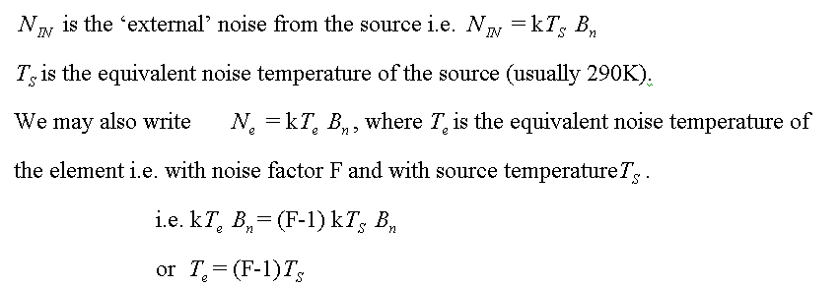
14. Noise Temperature

Slide 25
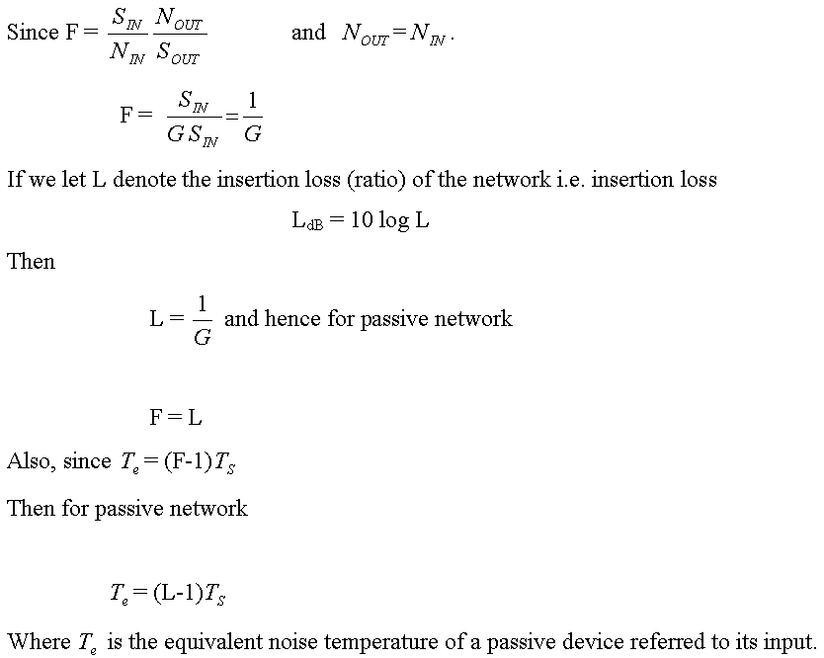
15. Noise Figure – Noise Factor for Passive Elements

Slide 26
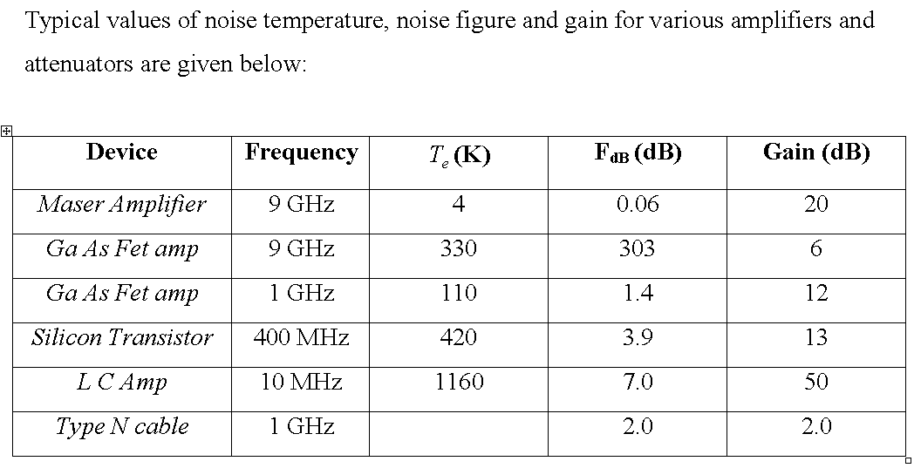
16. Review of Noise Factor – Noise Figure –Temperature

Slide 27
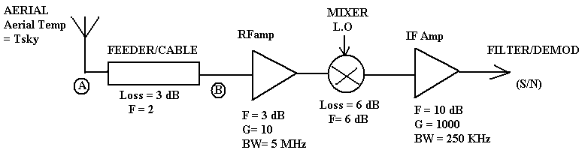

17. Cascaded Network
A receiver systems usually consists of a number of passive or active elements connected in series. A typical receiver block diagram is shown below, with example
In order to determine the (S/N) at the input, the overall receiver noise figure or noise temperature must be determined. In order to do this all the noise must be referred to the same point in the receiver, for example to A, the feeder input or B, the input to the first amplifier.
or
is the noise referred to the input.

Slide 28
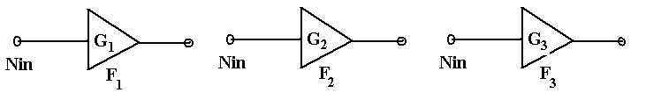
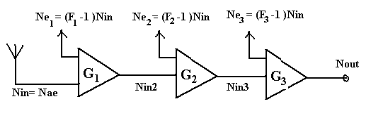
18. System Noise Figure
Assume that a system comprises the elements shown below,
Assume that these are now cascaded and connected to an aerial at the input, with
from the aerial.
Now ,
Since
similarly

Slide 29
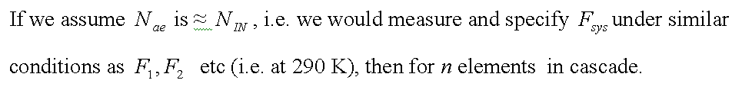
18. System Noise Figure (Cont’d)
The overall system Noise Factor is
The equation is called FRIIS Formula.

Slide 30
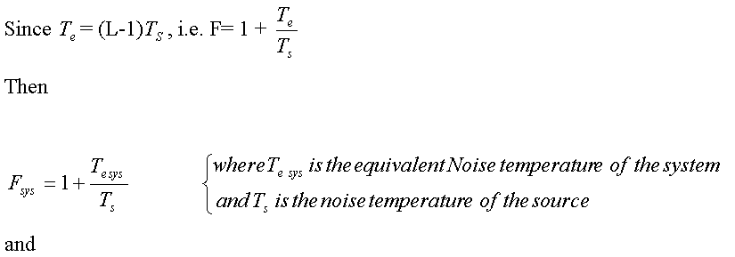
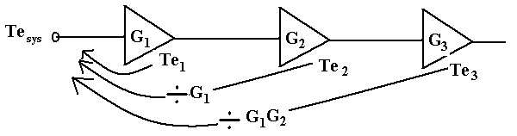
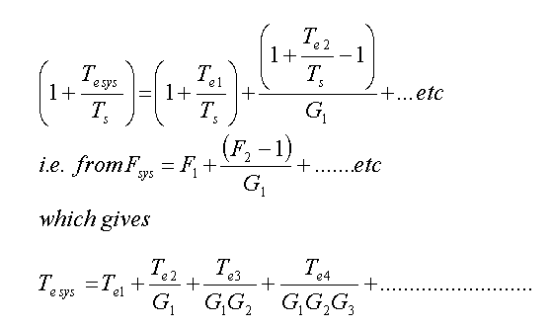
19. System Noise Temperature

