Slide 1
Module 6
Introduction to Noise + AM Receivers
(Contents are as per syllabus)

Slide 2
Noise
Noise refers to random and unpredictable electrical signals that affects the signal in (any!) communication systems.
Since noise is superimposed on information bearing signal, the message is partially corrupted or totally erased.
Noise can be reduced by filtering but can’t be totally eliminated!
Sources of noise
The following (in next slide) shows the various sources of noise, of which the thermal noise is important (as most of the noise introduced in communication systems is due to thermal noise)

Slide 3
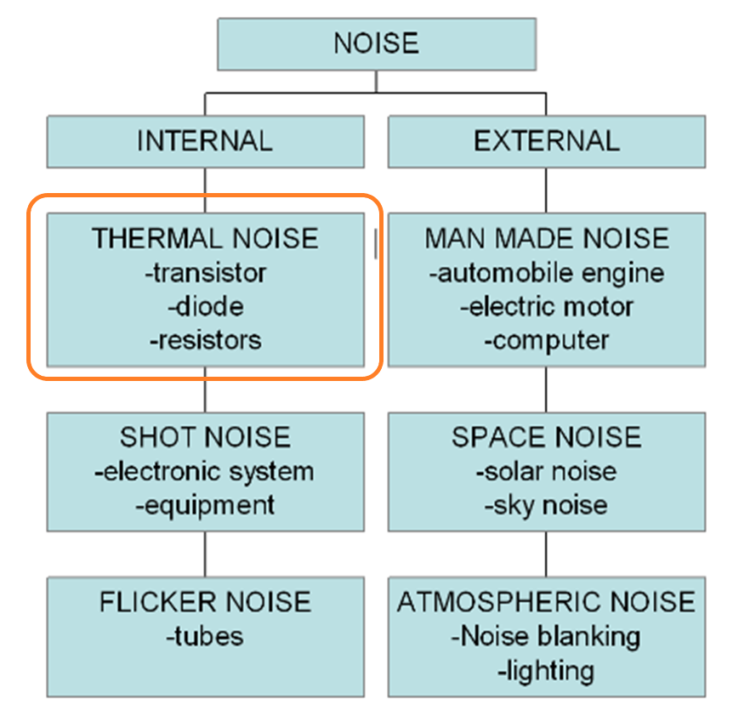

Slide 4
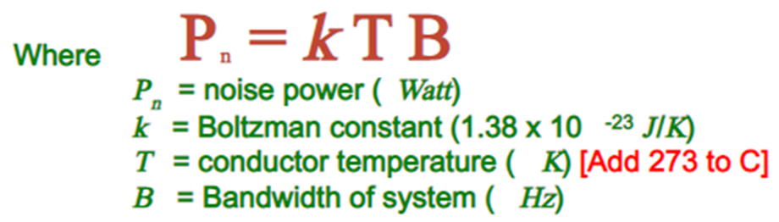

Thermal noise power
Thermal noise power can be calculated using the following formula:
Thermal noise voltage
Thermal noise voltage can be calculated using the following formula:
Where R is the resistance

Slide 5
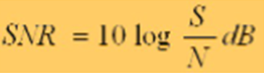
Signal-to-Noise Ratio
The presence of noise degrades the performance of analog and digital communication.
The extent to which the noise affects the performance of communication system is measured by the output signal power to noise power ratio or SNR (for analog communication) and probability of error (for digital communication systems).
Since SNR is a ratio, it is a dimensionless quantity, but engineers usually specify SNR (and any dimensionless number!) in dB
A communication systems should have high SNR or low SNR? (Discuss yourself and/or with Faculty)

Slide 6
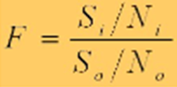
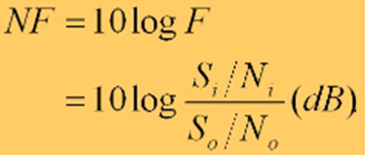
Noise Factor: It is defined as the ratio of SNR at input to SNR at output of any communication system.
Similar to SNR, Noise Factor is also a dimensionless quantity, and engineers usually specify Noise Factor in dB
Noise Figure: When Noise Factor is expressed in dB it is called as Noise Figure
A communication systems should have high Noise Factor value or low? (Discuss yourself and/or with Faculty)

Slide 7
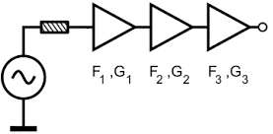

Friis Formula: When system are cascaded (practically systems are designed by different entity and cascaded to perform the overall task!) the overall Noise Factor is calculated using Friis Formula given by:

Slide 8
Noise Analysis in different AM systems
(Contents are as per syllabus)

Slide 9
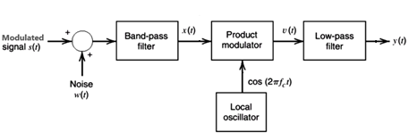
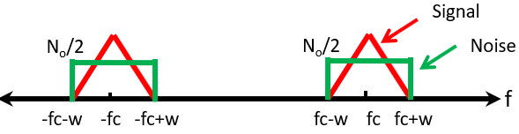
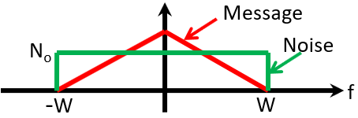
Noise in DSB-SC AM Systems
Consider a linear DSB-SC receiver using coherent demodulation as shown FIGURE 1 below
FIGURE 1a: A linear DSB-SC receiver using coherent demodulation
FIGURE 1b: Signal plus Noise PSD at band-pass filter output
FIGURE 1c: Signal plus *In-phase Noise PSD at low-pass filter output

Slide 10
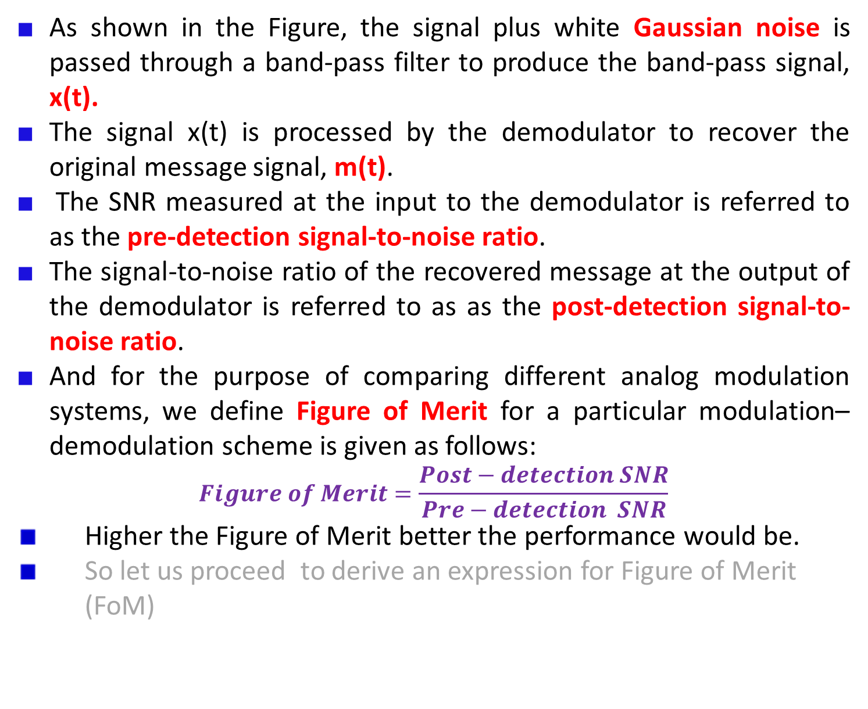
As shown in the Figure, the signal plus white Gaussian noise is passed through a band-pass filter to produce the band-pass signal, x(t).
The signal x(t) is processed by the demodulator to recover the original message signal, m(t).
The SNR measured at the input to the demodulator is referred to as the pre-detection signal-to-noise ratio.
The signal-to-noise ratio of the recovered message at the output of the demodulator is referred to as as the post-detection signal-to-noise ratio.
And for the purpose of comparing different analog modulation systems, we define Figure of Merit for a particular modulation–demodulation scheme is given as follows:
$$Figure of Merit=\frac{Post−detection SNR}{Pre−detection SNR}$$
Higher the Figure of Merit better the performance would be.
So let us proceed to derive an expression for Figure of Merit (FoM)

Slide 11
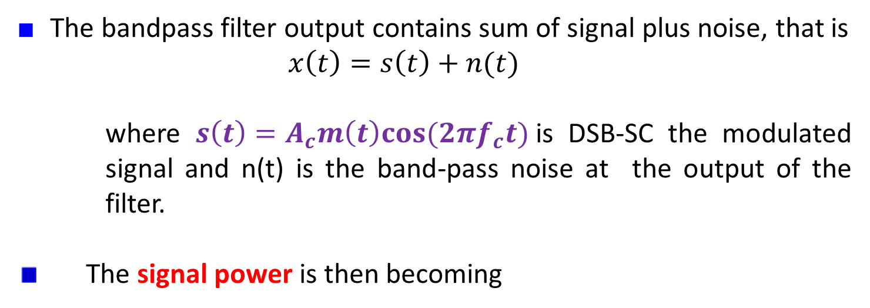
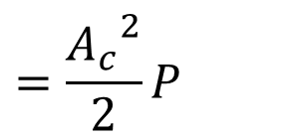
Pre-detection SNR Estimation
The bandpass filter output contains sum of signal plus noise, that is
$x\left(t\right)=s\left(t\right)+n(t)$
where $s\left(t\right)=A_{c}m\left(t\right)cos⁡(2πf_{c}t)$is DSB-SC the modulated signal and n(t) is the band-pass noise at the output of the filter.
The signal power is then becoming
$E\left[s^{2}\left(t\right)\right]=$ $E[{{(A}_{c}m(t)\cos\left(2πf_{c}t\right))}^{2}]$
$$=E[{{(A}_{c}\cos\left(2πf_{c}t\right))}^{2}]×E\left[m^{2}(t)\right]$$
$$=\frac{{A_{c}}^{2}}{2}P$$
→(1)

Slide 12
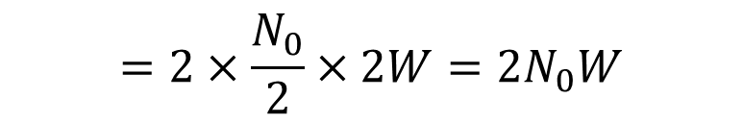

The noise power, at the bandpass filter can be calculated from the noise PDF given in FIGURE 1b
$$E\left[n^{2}\left(t\right)\right]=Area under the PSD of FIGURE 1b$$
$$=2×\frac{N_{0}}{2}×2W=2N_{0}W$$
→(2)
The pre-detection SNR is then becoming as :
$${SNR}_{pre}^{DSBSC}=\frac{A_{c}^{2}P}{4N_{0}W}$$
→(3)

Slide 13
Post-detection SNR Estimation:
The noise at the output of bandpass filter can be expressed in-terms of in-phase component n_{i}(t) and quadrature component n_{q}(t); so that x(t) can be written as
Therefore, the output of the product detector becomes
$x\left(t\right)=s\left(t\right)+n_{i}\left(t\right)\cos\left(2πf_{c}t\right)−$ $n_{q}\left(t\right)\sin\left(2πf_{c}t\right)$
→(4)
$$v\left(t\right)=x\left(t\right)\cos\left(2πf_{c}t\right)$$
$=[s\left(t\right)+n_{i}\left(t\right)\cos\left(2πf_{c}t\right)−$ $n_{q}\left(t\right)\sin\left(2πf_{c}t\right)]\cos\left(2πf_{c}t\right)$
$=[A_{c}m(t)cos\left(2πf_{c}t\right)+n_{i}\left(t\right)\cos\left(2πf_{c}t\right)−$ $n_{q}\left(t\right)\sin\left(2πf_{c}t\right)]\cos\left(2πf_{c}t\right)$
$$=\frac{1}{2}A_{c}m\left(t\right)+\frac{1}{2}A_{c}m\left(t\right)cos\left(4πf_{c}t\right)+{\frac{1}{2}n}_{i}\left(t\right)+\frac{1}{2}n_{i}\left(t\right)\cos\left(4πf_{c}t\right)−\frac{1}{2}n_{q}\left(t\right)\sin\left(4πf_{c}t\right)$$
→(5)

Slide 14
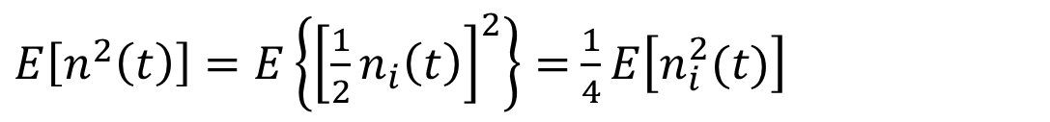

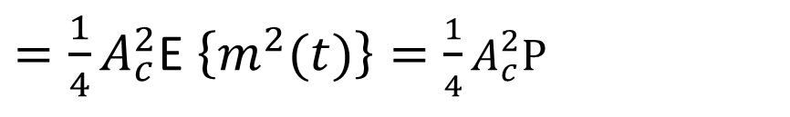


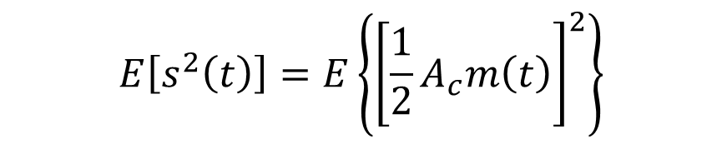
The lowpass filter will pass only 2 terms from equation (5) to its output. Therefore,
The signal power from equation (6) becomes
The noise power from equation (6) becomes
$$y(t)=\frac{1}{2}A_{c}m\left(t\right)+{\frac{1}{2}n}_{i}\left(t\right)$$
→(6)
$$E\left[s^{2}\left(t\right)\right]=E\left\{{\left[\frac{1}{2}A_{c}m\left(t\right)\right]}^{2}\right\}$$
$=\frac{1}{4}A_{c}^{2}$E $\left\{m^{2}(t)\right\}=\frac{1}{4}A_{c}^{2}P$
→(7)
$E\left[n^{2}\left(t\right)\right]=E\left\{{\left[\frac{1}{2}n_{i}\left(t\right)\right]}^{2}\right\}=$ $\frac{1}{4}E\left[n_{i}^{2}(t)\right]$
$$=\frac{1}{4}Area under the PSD of FIGURE 1c$$
$$={\frac{1}{4}(2N}_{0}W)$$
→(8)

Slide 15
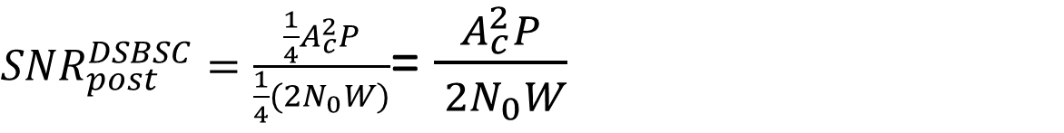
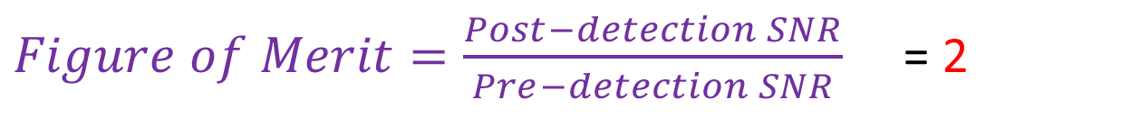
The post-detection SNR is then becoming as :
From equation (3) and (9)
This illustrates the post-detection SNR is twice the pre-detection SNR. This is due to the fact that the quadrature component of the noise has been discarded by the synchronous demodulator.
NOTE: The above Figure of merit value depends on definition.In the above we have defined FoM as the ratio of post-detection SNR to pre-detection SNR. If the FoM is defined as the ratio of post-detection SNR to baseband SNR, then FoM would be 1. Both is correct, So advise not to confuse. You need to define FoM first, and derive accordingly is enough (and correct) in the exam.
${SNR}_{post}^{DSBSC}=\frac{\frac{1}{4}A_{c}^{2}P}{{\frac{1}{4}(2N}_{0}W)}$= $\frac{A_{c}^{2}P}{{ 2N}_{0}W}$
→(9)
$Figure of Merit=\frac{Post−detection SNR}{Pre−detection SNR}$ = 2

Slide 16
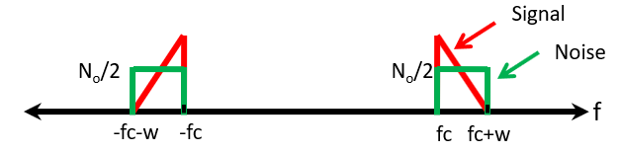
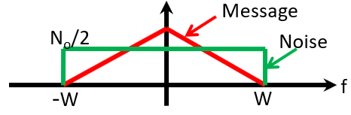
Noise in SSB AM Systems
Consider a linear SSB receiver using coherent demodulation as shown FIGURE 2 below
FIGURE 2a: A linear DSB-SC receiver using coherent demodulation
FIGURE 2b: Signal plus Noise PSD at band-pass filter output
FIGURE 2c: Signal plus *In-phase Noise PSD at low-pass filter output

Slide 17
As shown in the Figure, the signal plus white Gaussian noise is passed through a band-pass filter to produce the band-pass signal, x(t).
The signal x(t) is processed by the demodulator to recover the original message signal, m(t).
The SNR measured at the input to the demodulator is referred to as the pre-detection signal-to-noise ratio.
The signal-to-noise ratio of the recovered message at the output of the demodulator is referred to as as the post-detection signal-to-noise ratio.
And for the purpose of comparing different analog modulation systems, we define Figure of Merit for a particular modulation–demodulation scheme is given as follows:
$$Figure of Merit=\frac{Post−detection SNR}{Pre−detection SNR}$$
Higher the Figure of Merit better the performance would be.
So let us proceed to derive an expression for Figure of Merit (FoM)

Slide 18
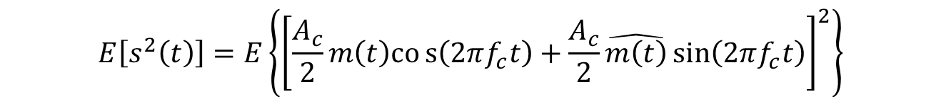
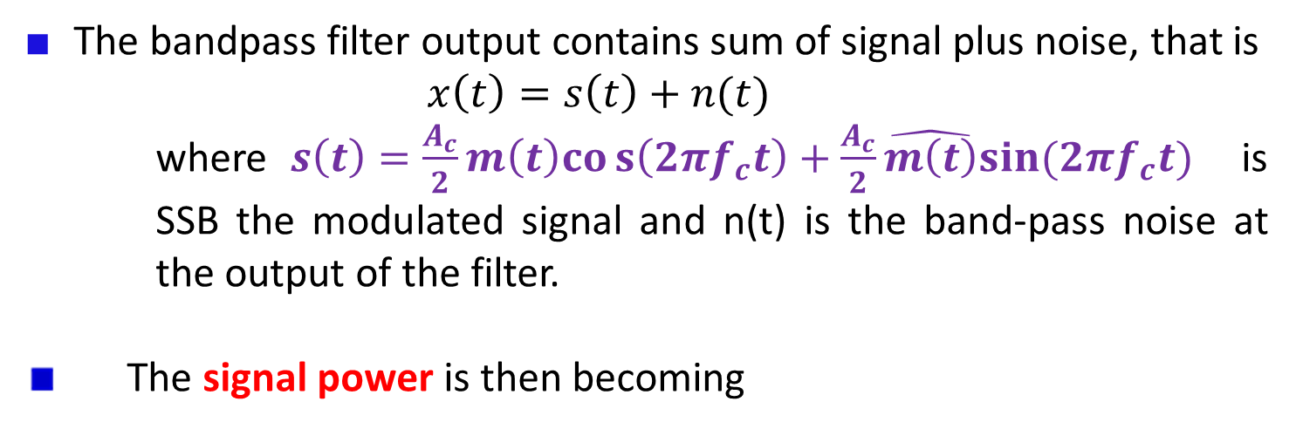
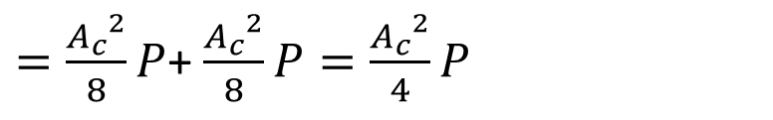
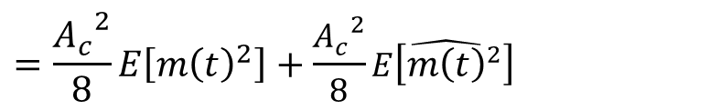

Pre-detection SNR Estimation
The bandpass filter output contains sum of signal plus noise, that is
$x\left(t\right)=s\left(t\right)+n(t)$
where$s\left(t\right)=\frac{A_{c}}{2}m\left(t\right)cos\left(2πf_{c}t\right)+\frac{A_{c}}{2}\hat{m\left(t\right)}sin⁡(2πf_{c}t)$ is SSB the modulated signal and n(t) is the band-pass noise at the output of the filter.
The signal power is then becoming
$$E\left[s^{2}\left(t\right)\right]=E\left\{{\left[\frac{A_{c}}{2}m\left(t\right)cos\left(2πf_{c}t\right)+\frac{A_{c}}{2}\hat{m\left(t\right)}\sin\left(2πf_{c}t\right)\right]}^{2}\right\}$$
$$=E\left\{{\left[\frac{A_{c}}{2}m\left(t\right)cos\left(2πf_{c}t\right)\right]}^{2}\right\}+E\left\{{\left[\frac{A_{c}}{2}\hat{m\left(t\right)}\sin\left(2πf_{c}t\right)\right]}^{2}\right\}$$
$$=\frac{{A_{c}}^{2}}{8}E\left[{m\left(t\right)}^{2}\right]+\frac{{A_{c}}^{2}}{8}E\left[{\hat{m\left(t\right)}}^{2}\right]$$
$=\frac{{A_{c}}^{2}}{8}P$+ $\frac{{A_{c}}^{2}}{8}P=\frac{{A_{c}}^{2}}{4}P$
→(1)

Slide 19


The noise power, at the bandpass filter can be calculated from the noise PDF given in FIGURE 2b
$$E\left[n^{2}\left(t\right)\right]=Area under the PSD of FIGURE 2b$$
$$=2×\frac{N_{0}}{2}×W=N_{0}W$$
→(2)
The pre-detection SNR is then becoming as :
$${SNR}_{pre}^{SSB}=\frac{A_{c}^{2}P}{4N_{0}W}$$
→(3)

Slide 20
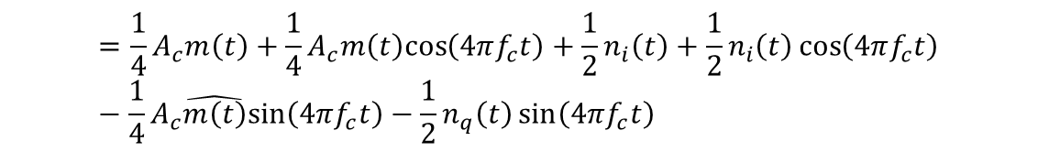
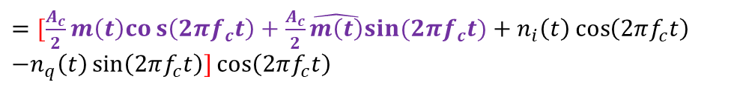
Post-detection SNR Estimation:
The noise at the output of bandpass filter can be expressed in-terms of in-phase component n_{i}(t) and quadrature component n_{q}(t); so that x(t) can be written as
Therefore, the output of the product detector becomes
$x\left(t\right)=s\left(t\right)+n_{i}\left(t\right)\cos\left(2πf_{c}t\right)−$ $n_{q}\left(t\right)\sin\left(2πf_{c}t\right)$
→(4)
$$v\left(t\right)=x\left(t\right)\cos\left(2πf_{c}t\right)$$
$=[s\left(t\right)+n_{i}\left(t\right)\cos\left(2πf_{c}t\right)−$ $n_{q}\left(t\right)\sin\left(2πf_{c}t\right)]\cos\left(2πf_{c}t\right)$
$=[\frac{A_{c}}{2}m\left(t\right)cos\left(2πf_{c}t\right)+\frac{A_{c}}{2}\hat{m\left(t\right)}sin⁡(2πf_{c}t)+n_{i}\left(t\right)\cos\left(2πf_{c}t\right)$ ${−n}_{q}\left(t\right)\sin\left(2πf_{c}t\right)]\cos\left(2πf_{c}t\right)$
$$=\frac{1}{4}A_{c}m\left(t\right)+\frac{1}{4}A_{c}m\left(t\right)cos\left(4πf_{c}t\right)+{\frac{1}{2}n}_{i}\left(t\right)+\frac{1}{2}n_{i}\left(t\right)\cos\left(4πf_{c}t\right)−\frac{1}{4}A_{c}\hat{m\left(t\right)}sin\left(4πf_{c}t\right)−\frac{1}{2}n_{q}\left(t\right)\sin\left(4πf_{c}t\right)$$
→(5)

Slide 21





The lowpass filter will pass only 2 terms from equation (5) to its output. Therefore,
The signal power from equation (6) becomes
The noise power from equation (6) becomes
$$y(t)=\frac{1}{4}A_{c}m\left(t\right)+{\frac{1}{2}n}_{i}\left(t\right)$$
→(6)
$$E\left[s^{2}\left(t\right)\right]=E\left\{{\left[\frac{1}{4}A_{c}m\left(t\right)\right]}^{2}\right\}$$
$$=\frac{1}{16}A_{c}^{2}E\left\{m^{2}(t)\right\}=\frac{1}{16}A_{c}^{2}P$$
→(7)
$E\left[n^{2}\left(t\right)\right]=E\left\{{\left[\frac{1}{2}n_{i}\left(t\right)\right]}^{2}\right\}=$ $\frac{1}{4}E\left[n_{i}^{2}(t)\right]$
$$=\frac{1}{4}Area under the PSD of FIGURE 2c$$
$$={\frac{1}{4}(N}_{0}W)$$
→(8)

Slide 22
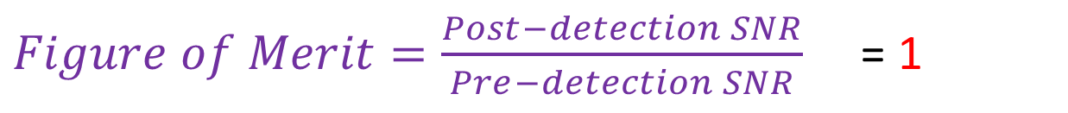
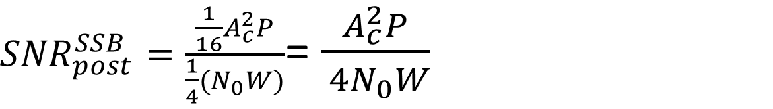
The post-detection SNR is then becoming as :
From equation (3) and (9)
This illustrates post-detection SNR is same as the pre-detection SNR. Though the Figure of Merit of SSB is poor than that of DSB-SC, SSB transmission requires only half the bandwidth of that DSB-SC.
NOTE: The above Figure of merit value depends on definition.In the above we have defined FoM as the ratio of post-detection SNR to pre-detection SNR. If the FoM is defined as the ratio of post-detection SNR to baseband SNR, then FoM would be 1. Both is correct, So advise not to confuse. You need to define FoM first, and derive accordingly is enough (and correct) in the exam.
${SNR}_{post}^{SSB}=\frac{\frac{1}{16}A_{c}^{2}P}{{\frac{1}{4}(N}_{0}W)}$= $\frac{A_{c}^{2}P}{{ 4N}_{0}W}$
→(9)
$Figure of Merit=\frac{Post−detection SNR}{Pre−detection SNR}$ = 1

Slide 23
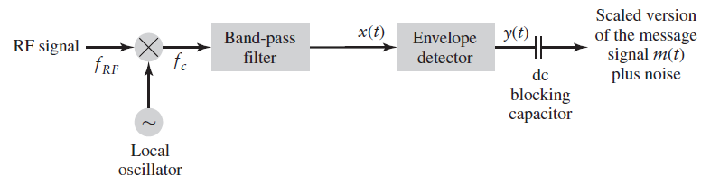
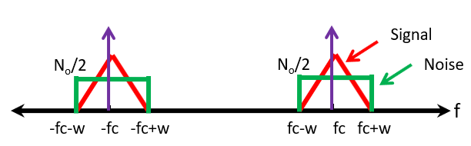
Noise in Conventional (DSB-FC) AM Systems
Consider a linear AM receiver using envelop detection as shown FIGURE 3 below
FIGURE 3a: A linear AM receiver using envelop detection
FIGURE 3b: Signal plus Noise PSD at band-pass filter output
FIGURE 3c: Signal plus *In-phase Noise PSD at low-pass filter output

Slide 24
As shown in the Figure, the signal plus white Gaussian noise is passed through a band-pass filter to produce the band-pass signal, x(t).
The signal x(t) is processed by the demodulator to recover the original message signal, m(t).
The SNR measured at the input to the demodulator is referred to as the pre-detection signal-to-noise ratio.
The signal-to-noise ratio of the recovered message at the output of the demodulator is referred to as as the post-detection signal-to-noise ratio.
And for the purpose of comparing different analog modulation systems, we define Figure of Merit for a particular modulation–demodulation scheme is given as follows:
$$Figure of Merit=\frac{Post−detection SNR}{Pre−detection SNR}$$
Higher the Figure of Merit better the performance would be.
So let us proceed to derive an expression for Figure of Merit (FoM)

Slide 25
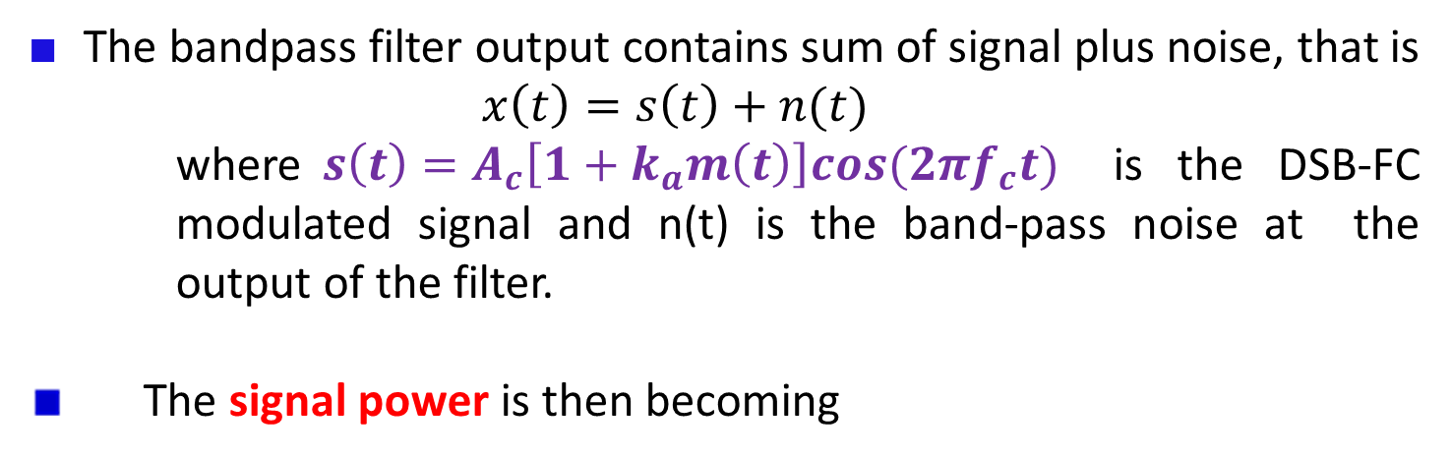
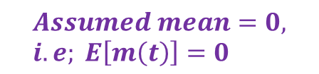
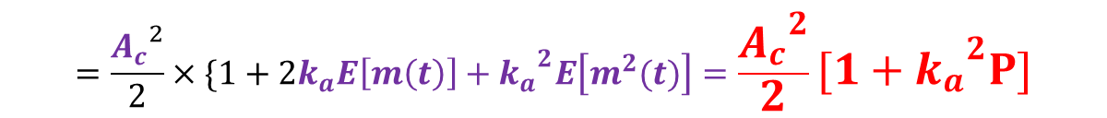

Pre-detection SNR Estimation
The bandpass filter output contains sum of signal plus noise, that is
$x\left(t\right)=s\left(t\right)+n(t)$
where$s\left(t\right)=A_{c}\left[1+k_{a}m\left(t\right)\right]cos⁡(2πf_{c}t)$ is the DSB-FC modulated signal and n(t) is the band-pass noise at the output of the filter.
The signal power is then becoming
$$E\left[s^{2}\left(t\right)\right]=E\left\{{[A_{c}\left[1+k_{a}m\left(t\right)\right]cos⁡(2πf_{c}t)]}^{2}\right\}$$
$$=E\left\{{[A_{c}cos⁡(2πf_{c}t)]}^{2}\right\}×E\left\{{[1+k_{a}m\left(t\right)]}^{2}\right\}$$
$$=\frac{{A_{c}}^{2}}{2}×E\left\{{[1+k_{a}m\left(t\right)]}^{2}\right\}$$
$$Assumed mean=0, i.e; E\left[m\left(t\right)\right]=0$$
$$=\frac{{A_{c}}^{2}}{2}×\{1+2k_{a}E\left[m\left(t\right)\right]+{k_{a}}^{2}E\left[m^{2}(t)\right]=\frac{{A_{c}}^{2}}{2}[1+{k_{a}}^{2}P]$$
→ (1)

Slide 26
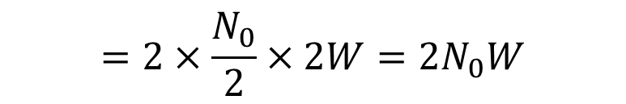

The noise power, at the bandpass filter can be calculated from the noise PDF given in FIGURE 3b
$$E\left[n^{2}\left(t\right)\right]=Area under the PSD of FIGURE 3b$$
$$=2×\frac{N_{0}}{2}×2W={2N}_{0}W$$
→(2)
The pre-detection SNR is then becoming as :
$${SNR}_{pre}^{AM}=\frac{A_{c}^{2} [1+{k_{a}}^{2}P]}{4N_{0}W}$$
→(3)

Slide 27
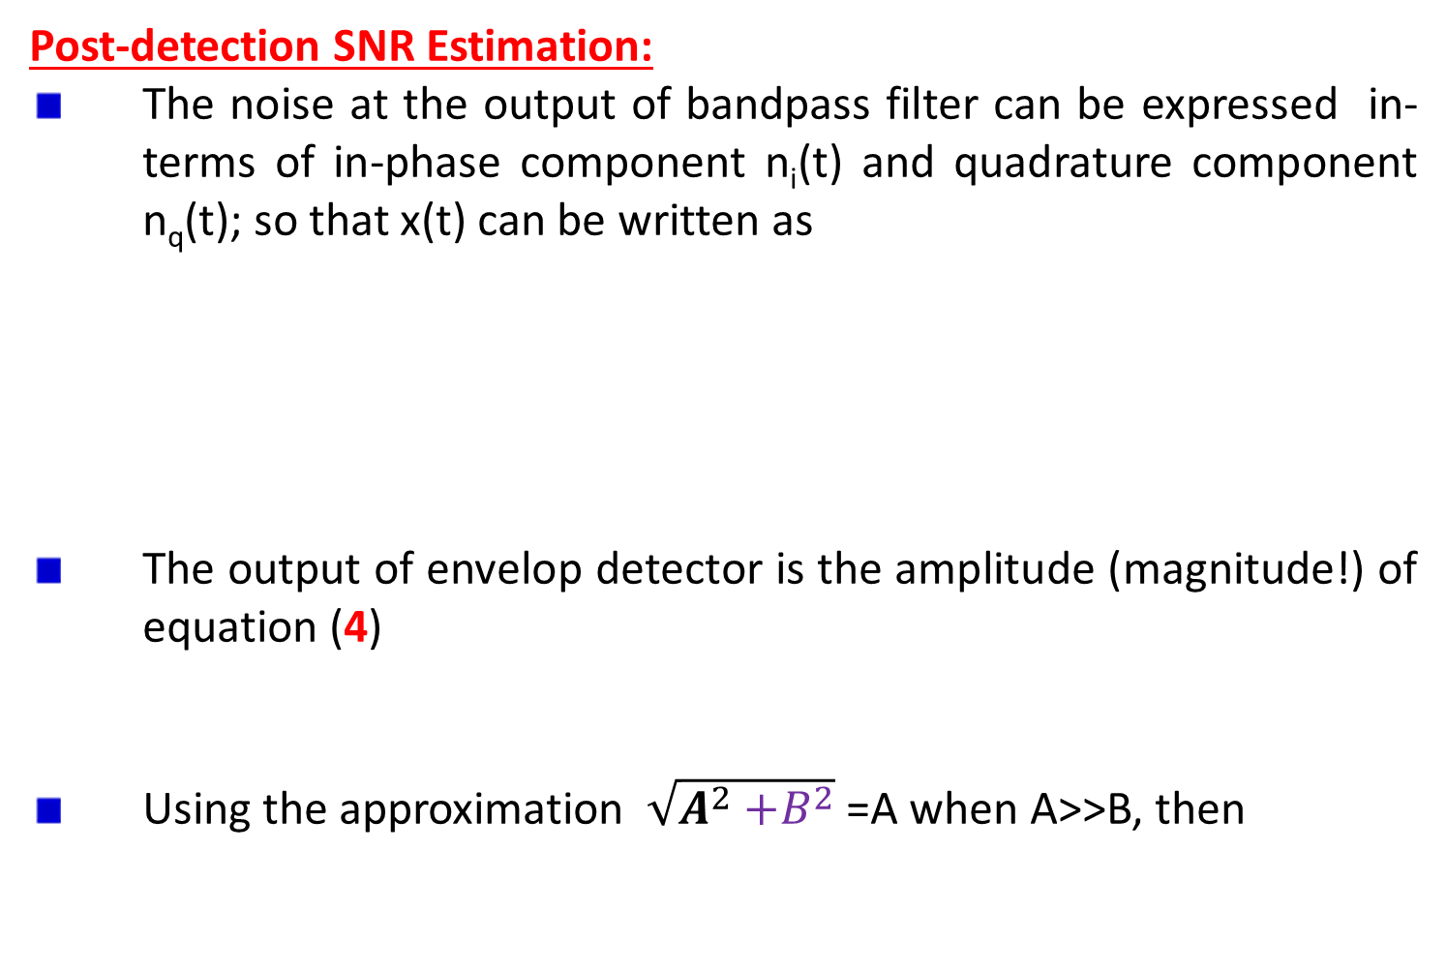
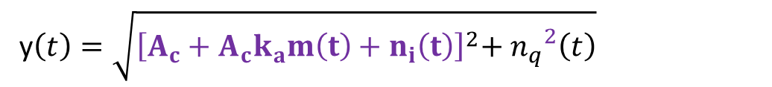
Post-detection SNR Estimation:
The noise at the output of bandpass filter can be expressed in-terms of in-phase component n_{i}(t) and quadrature component n_{q}(t); so that x(t) can be written as
The output of envelop detector is the amplitude (magnitude!) of equation (4)
Using the approximation $\sqrt{A^{2}{+B}^{2}}$ =A when A>>B, then
$x\left(t\right)=s\left(t\right)+n_{i}\left(t\right)\cos\left(2πf_{c}t\right)−$ $n_{q}\left(t\right)\sin\left(2πf_{c}t\right)$
${=A}_{c}\left[1+k_{a}m\left(t\right)\right]cos⁡(2πf_{c}t)+n_{i}\left(t\right)\cos\left(2πf_{c}t\right)$ ${−n}_{q}\left(t\right)\sin\left(2πf_{c}t\right)$
→(4)
=$\left[A_{c}+{A_{c}k}_{a}m\left(t\right)+n_{i}\left(t\right)\right]cos⁡(2πf_{c}t)$ ${−n}_{q}\left(t\right)\sin\left(2πf_{c}t\right)$
y$\left(t\right)=\sqrt{{\left[A_{c}+{A_{c}k}_{a}m\left(t\right)+n_{i}\left(t\right)\right]}^{2}{{+ n}_{q}}^{2}\left(t\right)}$
y$\left(t\right)=$ $A_{c}+{A_{c}k}_{a}m\left(t\right)+n_{i}\left(t\right)$
→(5)

Slide 28
Equation (5) consists of three components: DC component+ signal component + noise
The DC component is blocked by the capacitor leaving only the signal and noise component to the output.
The signal power from equation (6) becomes
The noise power from equation (6) becomes
y$\left(t\right)=$ ${A_{c}k}_{a}m\left(t\right)+n_{i}\left(t\right)$
→(6)
$${=E\left[{\left({A_{c}k}_{a}m\left(t\right)\right)}^{2}\right]=A}_{c}^{2}k_{a}^{2}E\left[m^{2}(t)\right]=A_{c}^{2}k_{a}^{2}P$$
→(7)
$$E\left[n^{2}\left(t\right)\right]=E\left[n_{i}^{2}\left(t\right)\right]$$
$$=Area under the PSD of FIGURE 3c$$
$$=2N_{0}W$$
→(8)

Slide 29
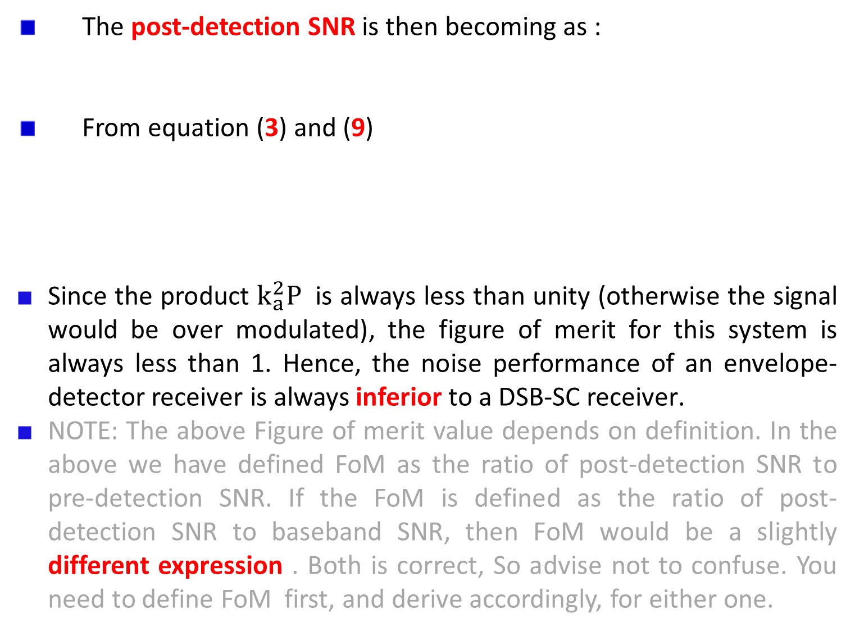
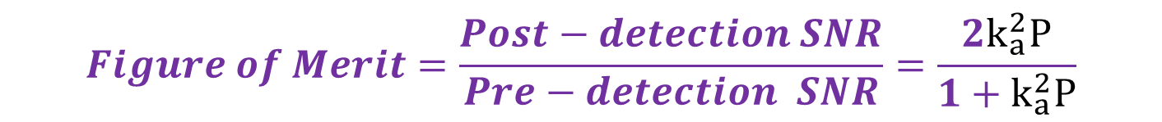

The post-detection SNR is then becoming as :
From equation (3) and (9)
Since the product $k_{a}^{2}P$ is always less than unity (otherwise the signal would be over modulated), the figure of merit for this system is always less than 1. Hence, the noise performance of an envelope-detector receiver is always inferior to a DSB-SC receiver.
NOTE: The above Figure of merit value depends on definition. In the above we have defined FoM as the ratio of post-detection SNR to pre-detection SNR. If the FoM is defined as the ratio of post-detection SNR to baseband SNR, then FoM would be a slightly different expression . Both is correct, So advise not to confuse. You need to define FoM first, and derive accordingly, for either one.
$${SNR}_{post}^{AM}=\frac{A_{c}^{2}k_{a}^{2}P}{{2N}_{0}W}$$
→(9)
$$Figure of Merit=\frac{Post−detection SNR}{Pre−detection SNR}=\frac{2k_{a}^{2}P}{1+k_{a}^{2}P}$$

Slide 30
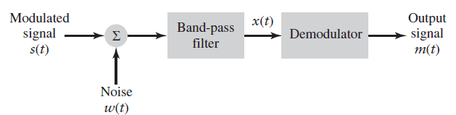
FM Noise Analysis
Consider the block diagram of a typical analog communication receiver presented in FIGURE 1 below.
The signal plus white Gaussian noise is passed through a band-pass filter to produce the band-pass signal, x(t).
The signal x(t) is processed by the demodulator to recover the original message signal, m(t).
The SNR measured at the input to the demodulator is referred to as the pre-detection signal-to-noise ratio.
The signal-to-noise ratio of the recovered message at the output of the demodulator is referred to as as the post-detection signal-to-noise ratio.
FIGURE 1: High-level block diagram of a communications receiver.

Slide 31
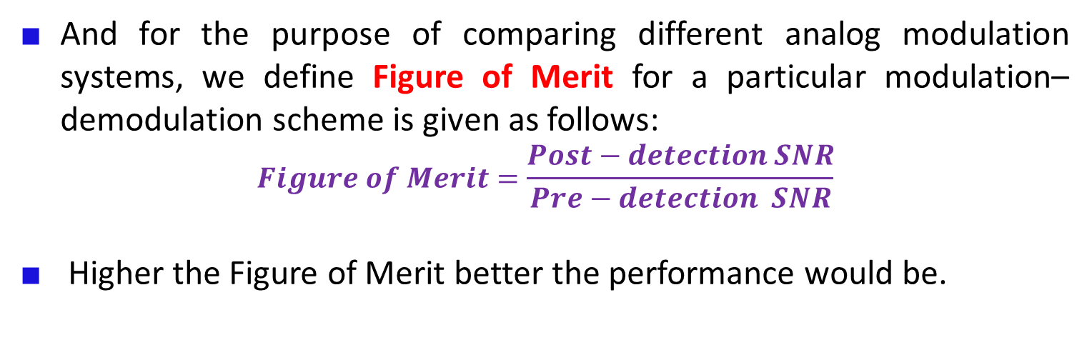
And for the purpose of comparing different analog modulation systems, we define Figure of Merit for a particular modulation–demodulation scheme is given as follows:
$$Figure of Merit=\frac{Post−detection SNR}{Pre−detection SNR}$$
Higher the Figure of Merit better the performance would be.

Slide 32
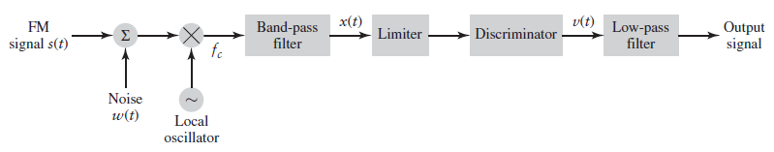
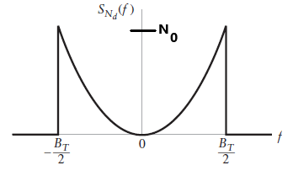
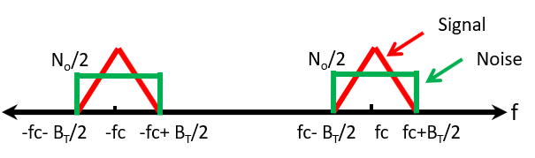
Pre-detection SNR Estimation
Consider a linear FM receiver as shown FIGURE (i) below
FIGURE (2a): A linear FM receiver
FIGURE (2b): Signal plus Noise PSD at band-pass filter output
FIGURE (2c): *Quadrature noise PSD at discriminator output

Slide 33

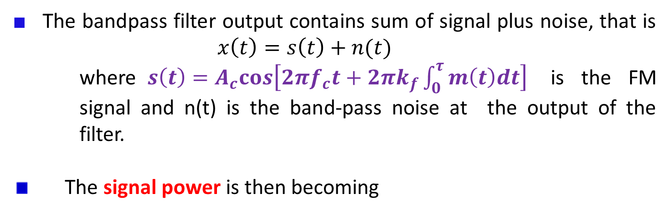

The bandpass filter output contains sum of signal plus noise, that is $x\left(t\right)=s\left(t\right)+n(t)$
where$s\left(t\right)=A_{c}cos\left[2πf_{c}t+2πk_{f}\int_{0}^{τ}{m\left(t\right)dt}\right]$ is the FM signal and n(t) is the band-pass noise at the output of the filter.
The signal power is then becoming
$$E\left[s^{2}\left(t\right)\right]=E\left\{{\left[A_{c}cos\left(2πf_{c}t+2πk_{f}\int_{0}^{τ}{m\left(t\right)dt}\right)\right]}^{2}\right\}$$
$$=\frac{{A_{c}}^{2}}{2}$$
→(1)

Slide 34
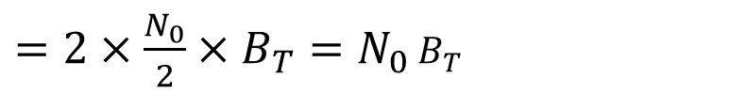

The noise power, at the bandpass filter can be calculated from the noise PDF given in FIGURE (2b) above
$$E\left[n^{2}\left(t\right)\right]=Area under the PSD of FIGURE (2b)$$
$=2×\frac{N_{0}}{2}×B_{T}=N_{0}$ $B_{T}$
→(2)
The pre-detection SNR is then becoming as :
$${SNR}_{pre}^{FM}=\frac{A_{c}^{2}}{2N_{0}B_{T}}$$
→(3)

Slide 35
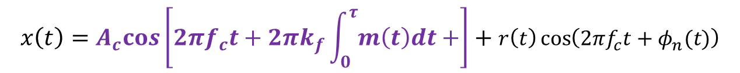
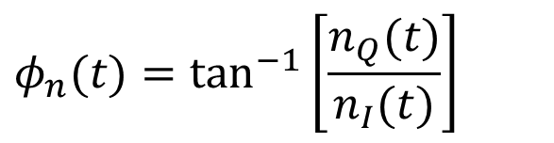
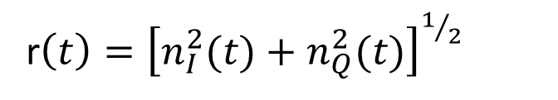
Post-detection SNR Estimation:
The noise at the output of bandpass filter can be expressed in-terms of in-phase component n_{I}(t) and quadrature component n_{Q}(t); so that x(t) can be written as
We can express the noise n(t) in-terms of its envelop and phase reference to the carrier as follows:
Therefore, the noisy signal at the bandpass filter output becomes
$x\left(t\right)=s\left(t\right)+n_{I}\left(t\right)\cos\left(2πf_{c}t\right)−$ $n_{Q}\left(t\right)\sin\left(2πf_{c}t\right)$
→(4)
n$\left(t\right)=r\left(t\right)\cos\left(2πf_{c}t+φ_{n}(t)\right)$
$$φ_{n}(t)=\tan^{−1}\left[\frac{n_{Q}(t)}{n_{I}(t)}\right]$$
r$\left(t\right)={\left[n_{I}^{2}(t)+n_{Q}^{2}(t)\right]}^{1/2}$
$$x\left(t\right)=A_{c}cos\left[2πf_{c}t+2πk_{f}\int_{0}^{τ}{m\left(t\right)dt+}\right]+r\left(t\right)\cos\left(2πf_{c}t+φ_{n}(t)\right)$$
→(5)
Carrier phase
noise phase

Slide 36
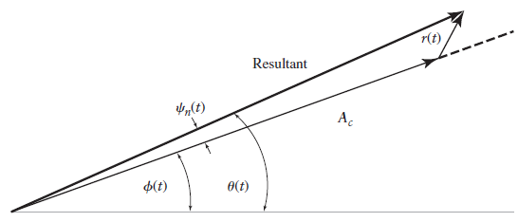

It is informative to represent equation (5) as phasor diagram as shown in FIGURE (3) where the amplitude of the noise is r(t) and $Ψ_{n}\left(n\right)=φ_{n}\left(t\right)−φ\left(t\right)$ is the angle between signal phasor and noise phasor.
The resultant phase is given as
FIGURE (3): Phasor diagram for FM signal plus narrow-band noise assuming high carrier-to-noise ratio.
→(6)

Slide 37

Under high carrier-to-noise ratio, p(r(t)<<A_{c})=1, meaning that (probability) the carrier power always exceeds noise power. And also knowing that as x→0, tan⁻¹(x)=x, the above equation (6) can be approximated as
If $φ\left(t\right)$ is independent of $φ_{n}(t)$ then
$Ψ_{n}(t)=φ_{n}\left(t\right)−φ(t)≈φ_{n}\left(t\right)$ and
$$r\left(t\right)\sin\left[Ψ_{n}\left(t\right)\right]=r\left(t\right)\sin\left[φ_{n}\left(t\right)\right]=n_{Q}(t)$$
Under this assumption, equation (7) is further approximated as
→(7)
→(8)

Slide 38
With the discriminator assumed ideal, its output is proportional to derivative of Ɵ(t) , that is derivative of equation (8) .
Where the noise term n_{d}(t) is defined as
→(9)
→(9a)

Slide 39
The differentiation of a function respect to time corresponds to multiplication of its Fourier transform by j2πf. We may obtain the noise term by passing n_{Q}(t) though a linear filter with a transfer.
Therefore, from equation (9a), we can obtain the following relationship
→(10)
→(10a)

Slide 40



The output power , from equation (9), becomes
The noise power becomes
The post-detection SNR is then becoming as :
$$E\left[{\left(k_{f}m\left(t\right)\right)}^{2}\right]=k_{f}^{2}E\left[{\left(m\left(t\right)\right)}^{2}\right]=k_{f}^{2}P$$
→(11)
$$E\left[n^{2}\left(t\right)\right]=Area under the PSD of FIGURE 2c and as per equation (10)$$
$$=\int_{−W}^{+W}{\frac{f^{2}}{A_{c}^{2}}}N_{0}df=\frac{N_{0}}{A_{c}^{2}}\int_{−W}^{+W}{f^{2}df=\frac{2N_{0}W^{3}}{3A_{c}^{2}}}$$
→(12)
$${SNR}_{post}^{FM}=\frac{{3A}_{c}^{2}k_{f}^{2}P}{2N_{0}W^{3}}$$
→(13)

Slide 41



From equation (3) and (13):
According to Carson’s rule the transmission bandwidth B_{T} is related to message bandwidth W as $B_{T}=2\left[k_{f}P^{1/2}+W\right]≈2k_{f}P^{1/2}$. Therefore, substituting this in equation (14)
It shows that increase in the transmission bandwidth provides a corresponding cubic increase in the output signal-to-noise ratio in FM.
$$Figure of Merit=\frac{Post−Detection SNR}{Pre−Detection SNR}=\frac{\frac{{3A}_{c}^{2}k_{f}^{2}P}{2N_{0}W^{3}}}{\frac{A_{c}^{2}}{2N_{0}B_{T}}}=\frac{3k_{f}^{2}PB_{T}}{W^{3}}$$
→(14)
$$Figure of Merit=\frac{3}{4}{\left(\frac{B_{T}}{W}\right)}^{3}$$

Slide 42
Threshold Effect in Angle Modulation
Recall: that the output signal-to-noise ratio (post-detection SNR) in the FM receiver, discussed earlier, is given by:
We know that the modulation index of FM is given by:
Therefore eqn. (1) can be written as
→(1)
→(2)
→(3a)

Slide 43
→(3b)
→(3c)
→(3d)
From the above equation (3d) it is seen that increasing β increases the output SNR even with low received power. This is in contrast to amplitude modulation where such an increase in the received SNR is not possible.

Slide 44
The increase in the received SNR is obtained by increasing the bandwidth. Therefore, angle modulation provides a way to trade-off bandwidth for transmitted power.
Although we can increase the output SNR by increasing β, having a large β means having a large B_{T}(by Carson’s rule bandwidth).
Having a large B_{T} means having a large noise power at the input of the demodulator.
This means that the approximation p(r(t)<< Ac)≈1, we assumed earlier in the FM noise analysis, will no longer apply and that the analysis will not hold.
Thus, if we increase β, a phenomenon known as the threshold effect will occur, and the signal will be lost in the noise. This is called as threshold effect in FM.

