Slide 1

Analog Communication Systems
BECE304L
Module-4

Slide 2
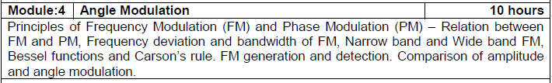
Course- module-4

Slide 3
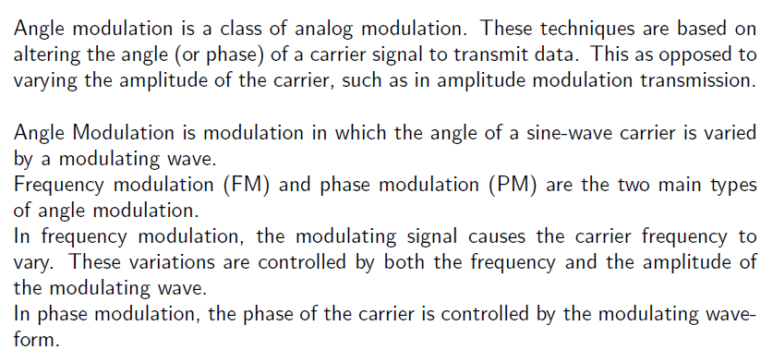
Angle modulation

Slide 4
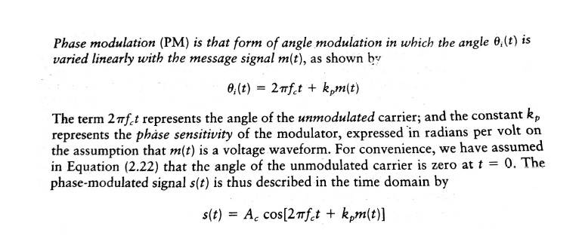
Phase modulation

Slide 5
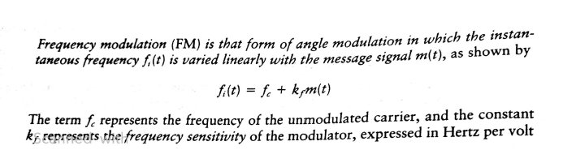
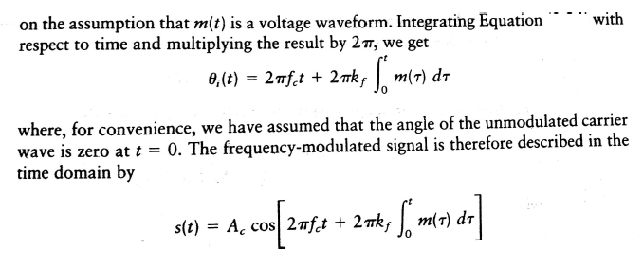
Frequency modulation

Slide 6
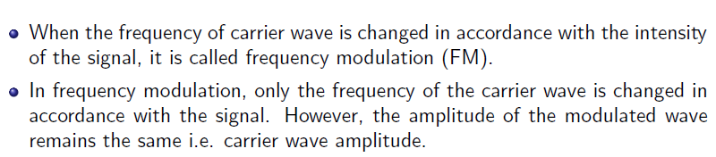
Frequency modulation

Slide 7
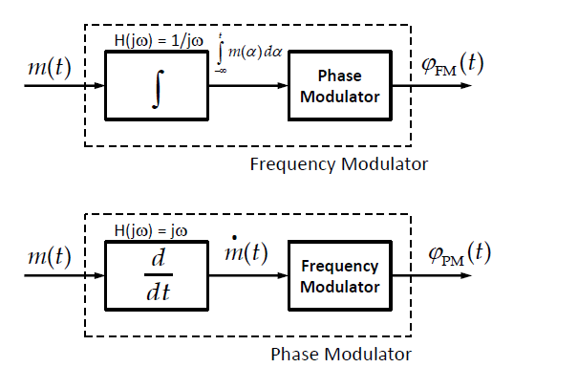
Relationship between frequency- phase modulation

Slide 8
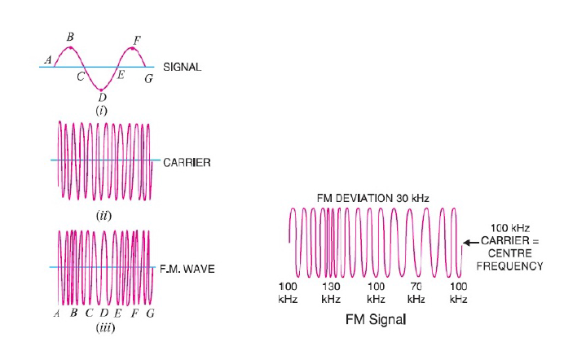
Frequency modulation

Slide 9
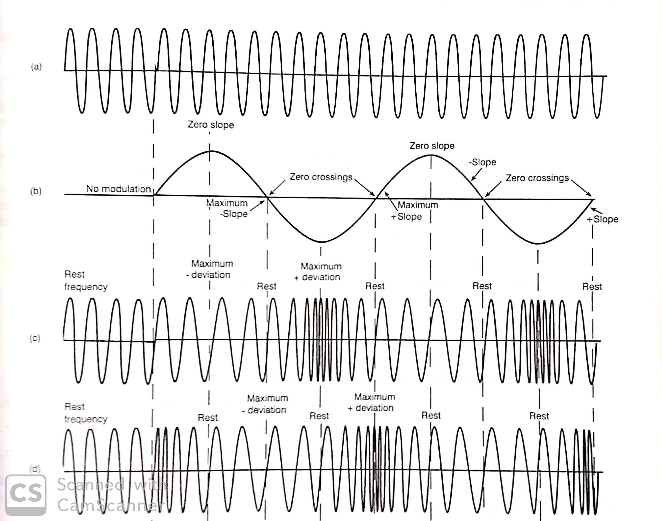

Slide 10
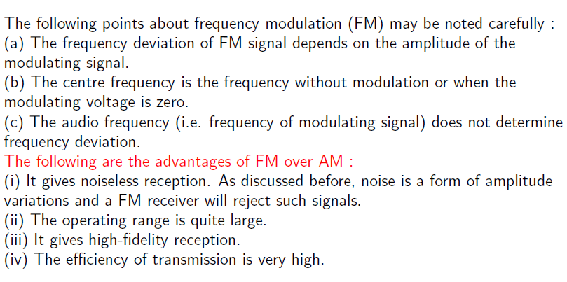
Frequency modulation

Slide 11
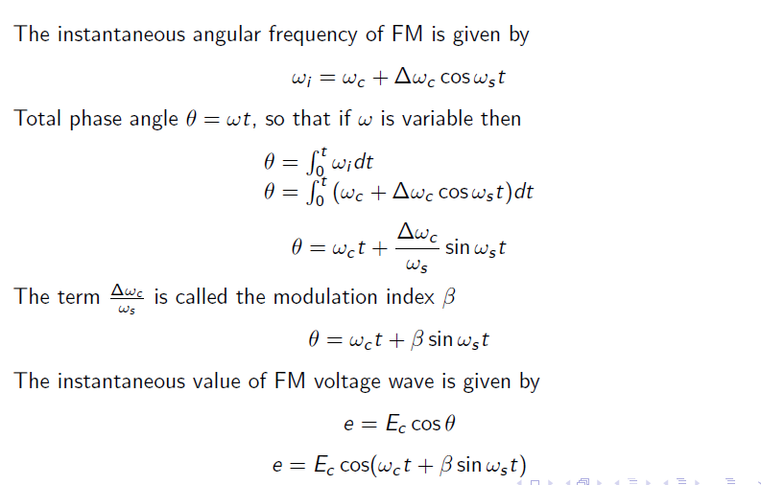
Frequency modulation

Slide 12
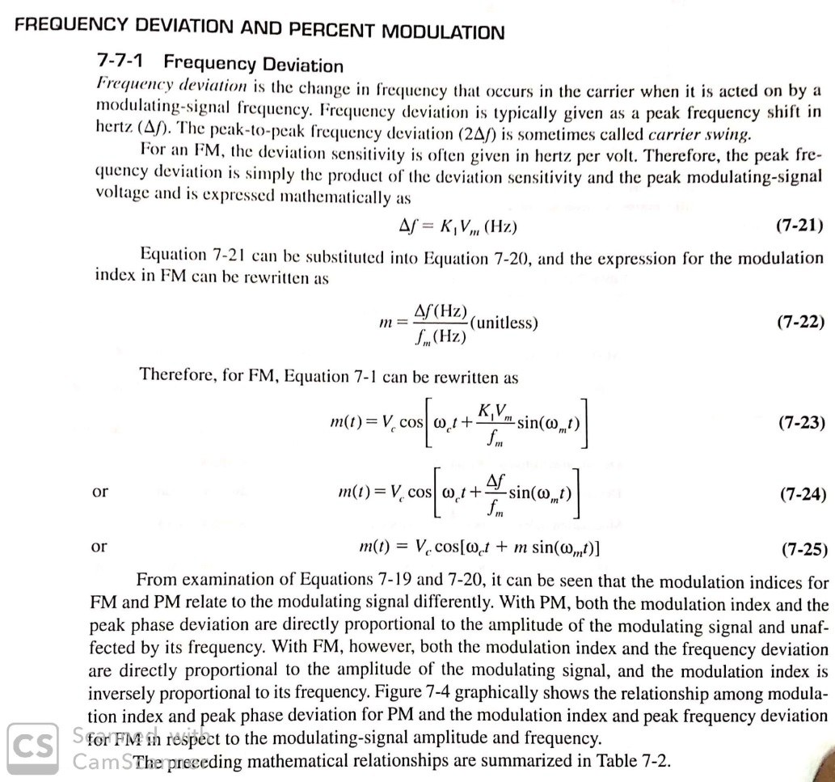

Slide 13
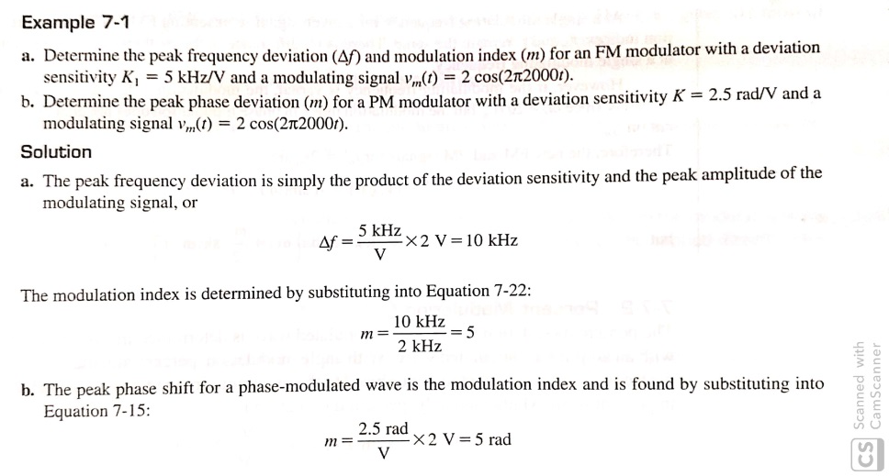
Numerical-frequency deviation

Slide 14
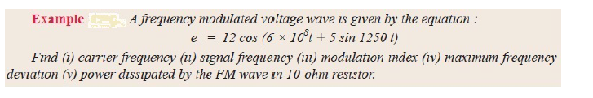
Numericals-fm

Slide 15
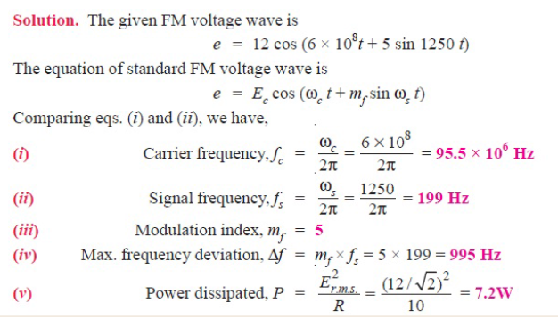
Numericals-fm

Slide 16

Numericals-fm

Slide 17
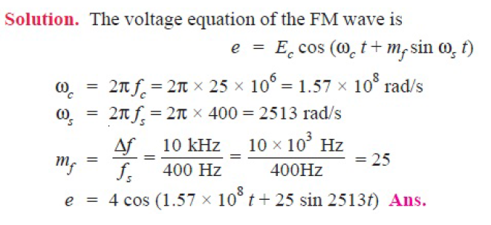
Numericals-fm

Slide 18
Numericals-fm

Slide 19
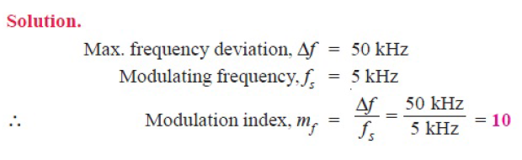
Numericals-fm

Slide 20
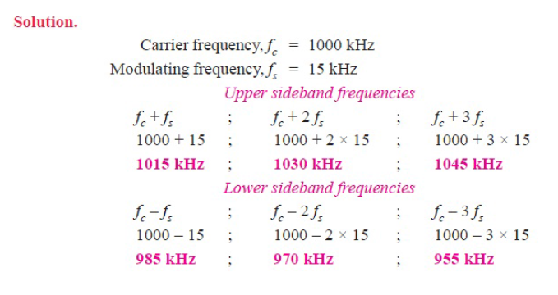
Numericals-fm

Slide 21

Numericals-fm

