Slide 1

Analog Communication Systems
BECE304L
Module-4

Slide 2
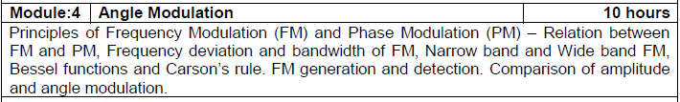
Course- module-4

Slide 3
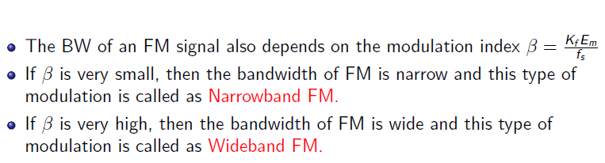
Types of fm

Slide 4
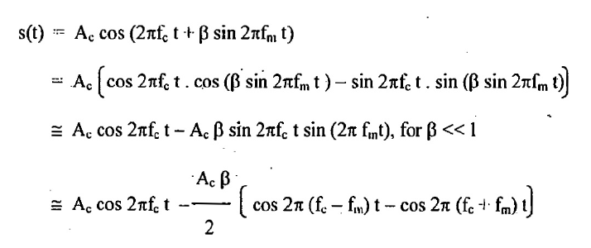
Narrowband FM

Slide 5
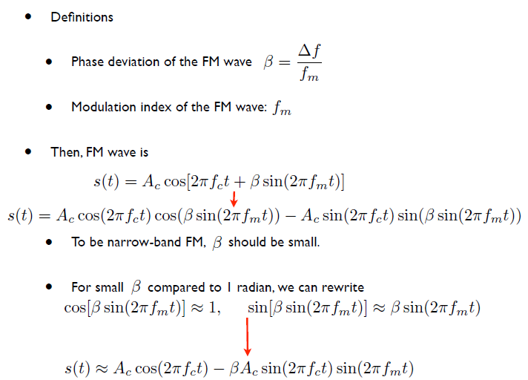
Narrowband FM

Slide 6
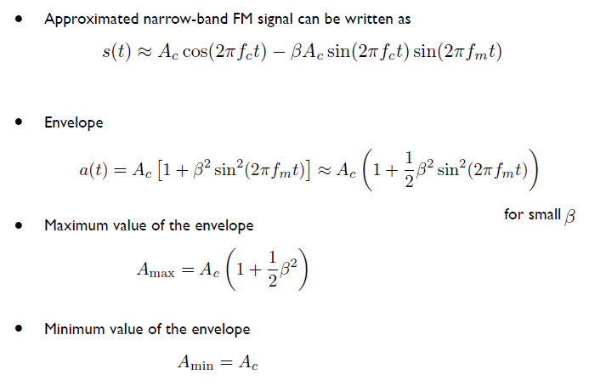
Narrowband FM

Slide 7
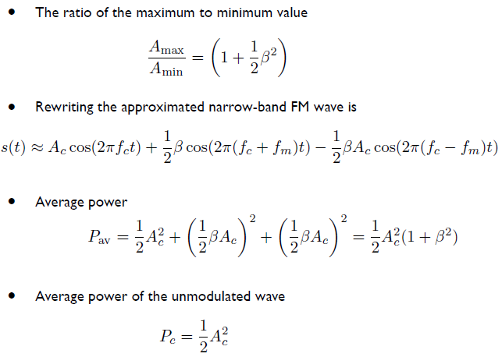
Narrowband FM

Slide 8
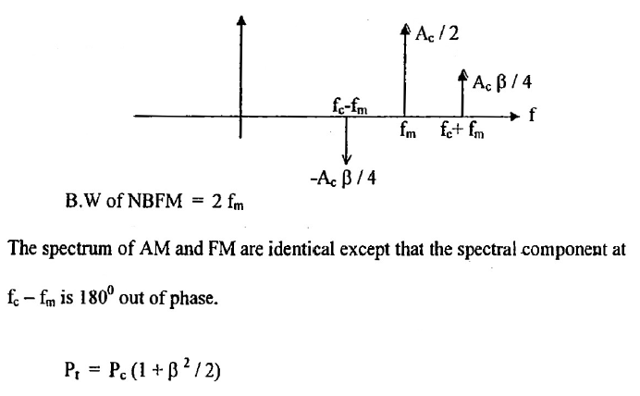
Spectrum of Narrowband FM

Slide 9
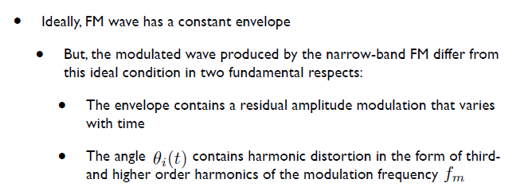
Amplitude Distortion of Narrow-band FM

Slide 10
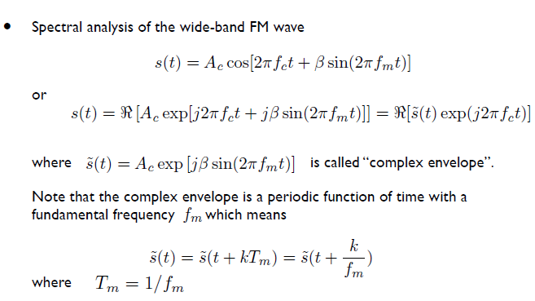
Wide-Band Frequency Modulation

Slide 11
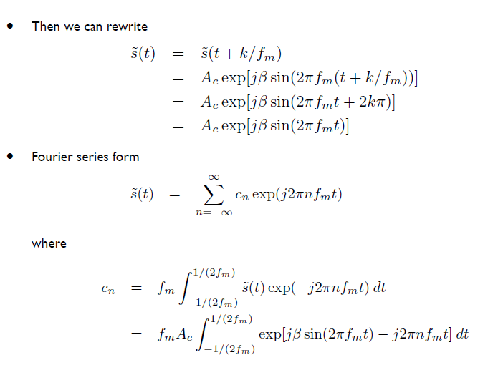
Wide-Band Frequency Modulation

Slide 12
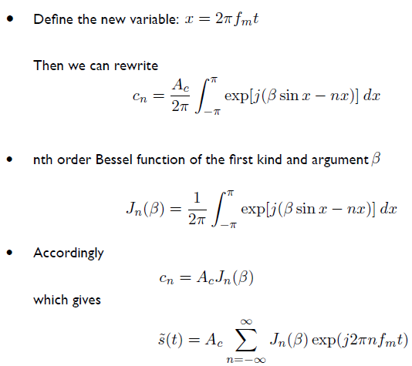
Wide-Band Frequency Modulation

Slide 13
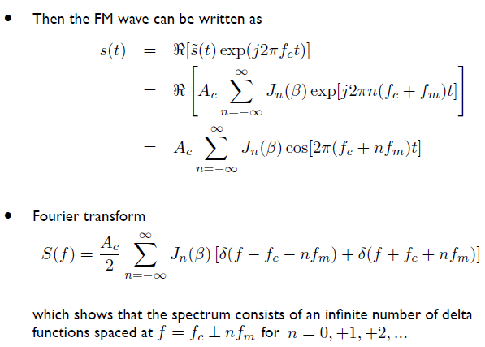
Wide-Band Frequency Modulation

Slide 14
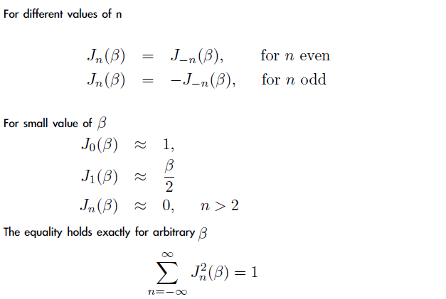
Wide-Band-fm Properties of Single-Tone FM for Arbitrary Modulation Index

Slide 15
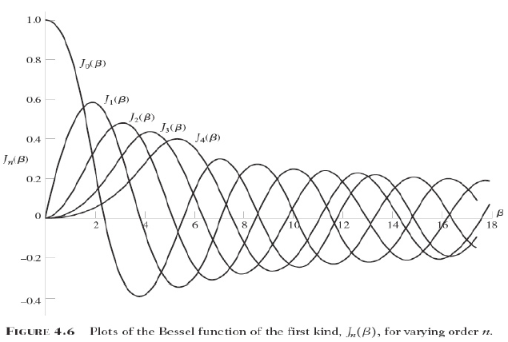
Wide-Band-fm

Slide 16
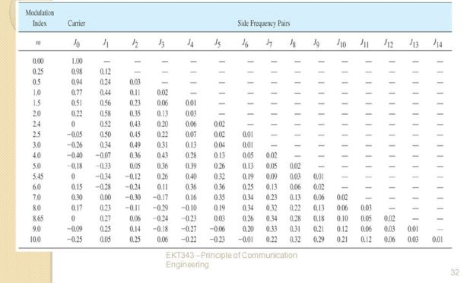
Bessel function -table

Slide 17
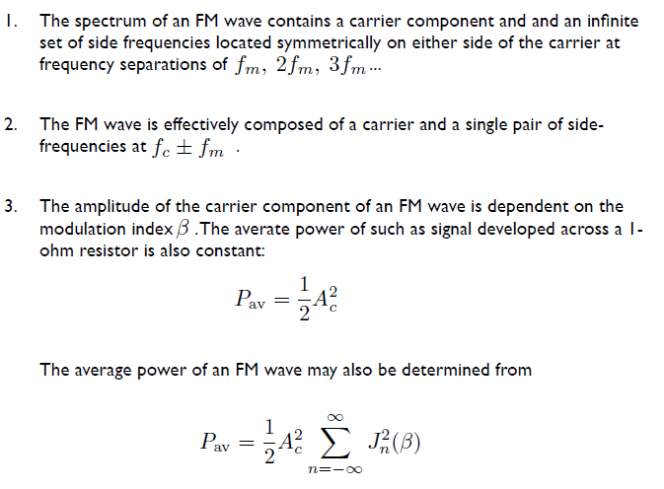
Wide-Band-fm-analysis

Slide 18
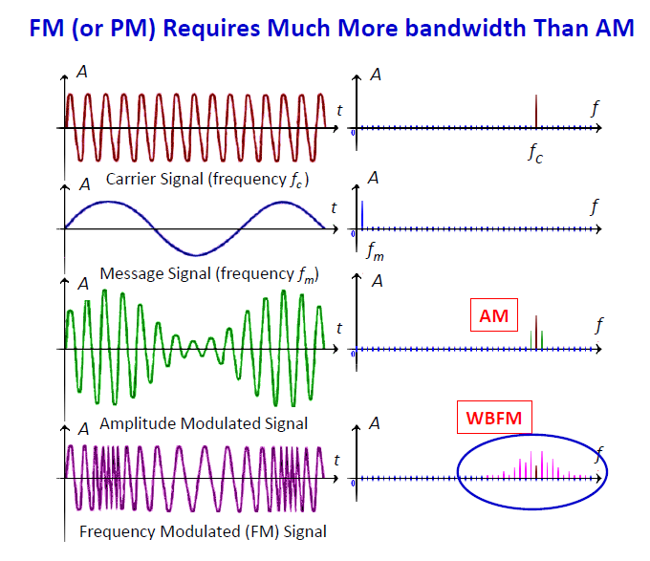

Slide 19
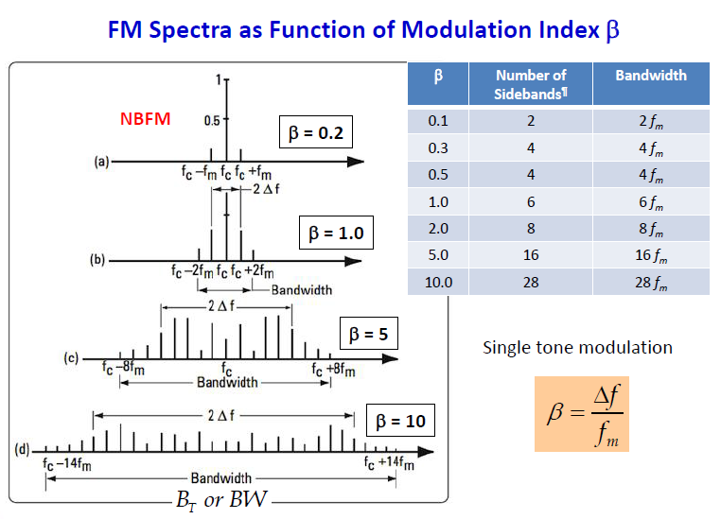

Slide 20
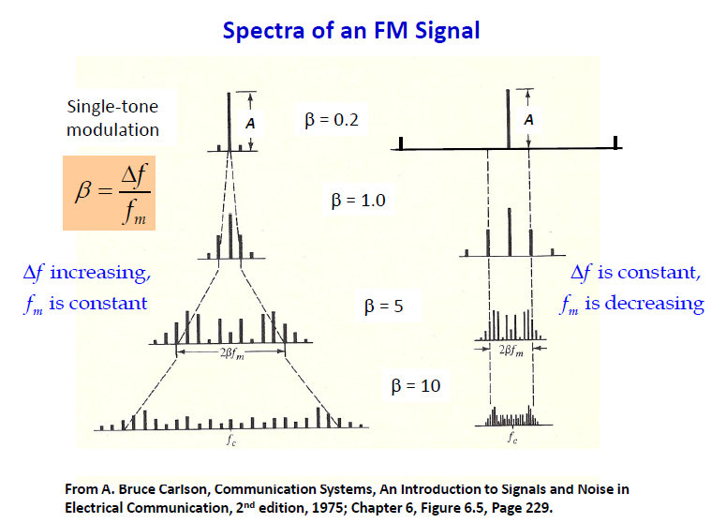

Slide 21
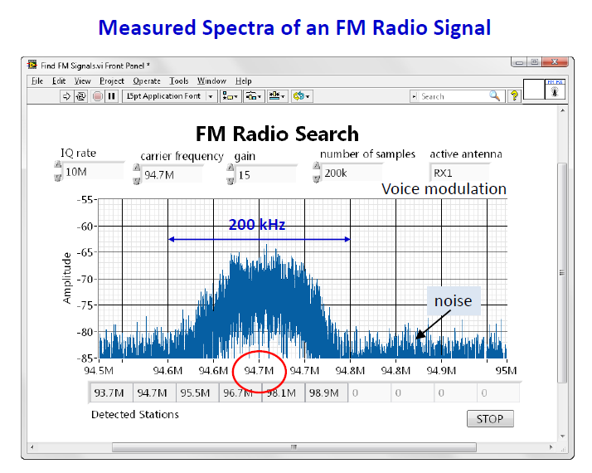

Slide 22
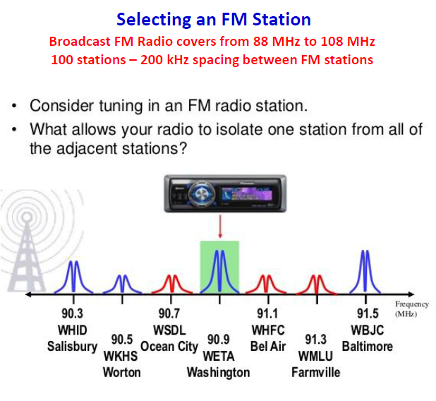

Slide 23
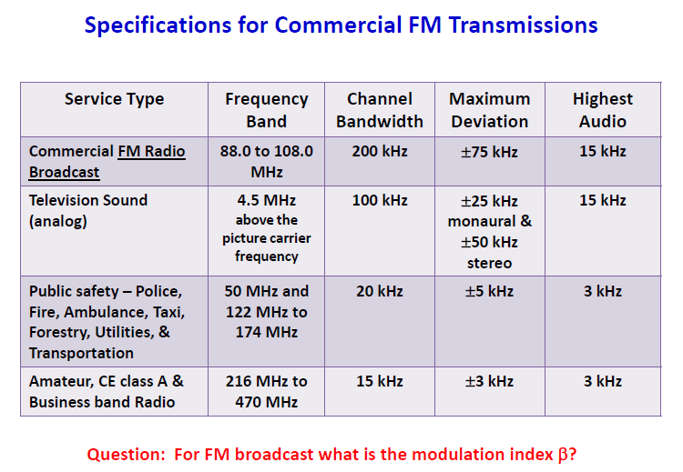

Slide 24
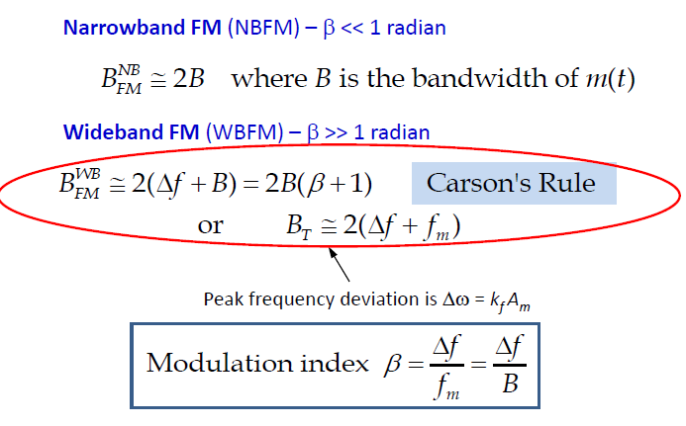
Carson’s rule

Slide 25
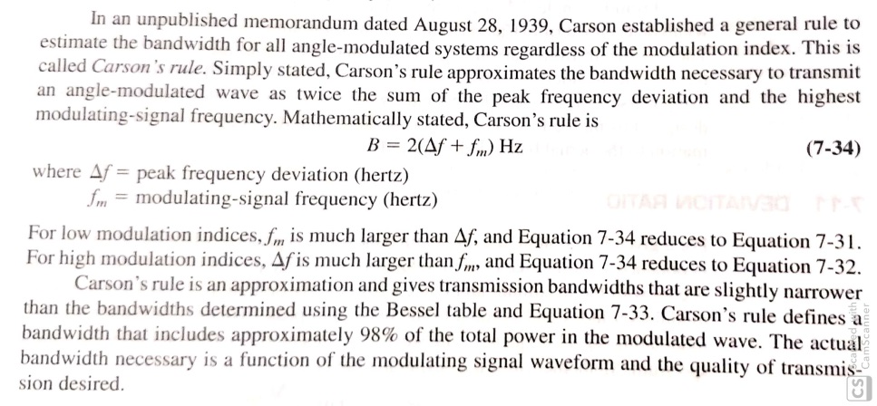
Carson’s rule

Slide 26
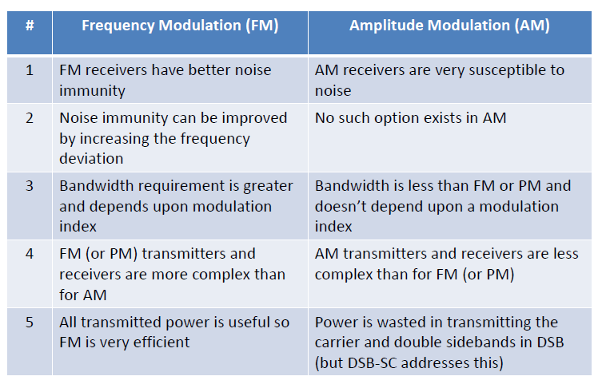
Am vs FM

