Slide 1
20ECE109 ANALOG COMMUNICATION

Slide 2
ANGLE MODULATION SYSTEMS
(contents are as per the syllabus)

Slide 3
RECALL THAT:
Modulation is defined as a process by which some characteristic of a carrier wave is varied in accordance with the message signal.
AM – Amplitude modulation is a process in which the amplitude of the carrier signal is varied in accordance with the instantaneous amplitude of the message signal.
FM – Frequency modulation is a process in which the frequency of the carrier signal is varied in accordance with the instantaneous amplitude of the message signal
PM – Phase modulation is a process in which the phase of the carrier signal is varied in accordance with the instantaneous amplitude of the message signal.
We will focus on FM and PM in this unit THREE

Slide 4
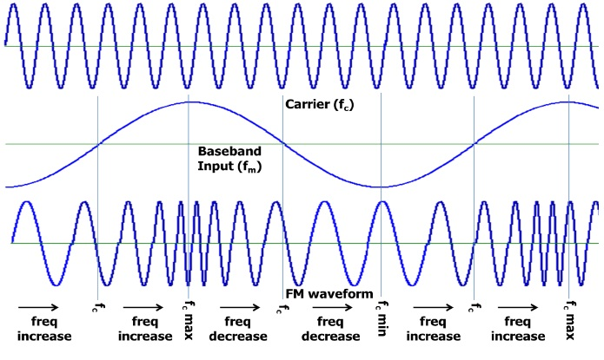
ANGLE MODULATION
Figure : 1

Slide 5
Angle modulation, is the modulation in which the angle of the carrier wave is varied according to the information-bearing signal. In angle modulation techniques, the amplitude of the carrier wave is maintained constant.
Whatever the terms within the parenthesis of ‘cos’ function is angle.
Angle modulation is of two types: FM and PM
How do you understand FM?
Consider the waveforms in Figure 1 (in previous slide). The input is a single tone sine wave. The carrier and the FM waveforms also are shown in the same Figure.
The frequency of a carrier (fc) will increase as the amplitude of modulating signal increases. The carrier frequency will be maximum (fc max) when the input signal is at its peak.

Slide 6
The frequency of a carrier will decrease as the amplitude of the modulating signal decreases. The carrier frequency will be minimum (fc min) when the input signal is at its lowest.
The carrier frequency will be at its normal value (free running) fc when the input signal value is 0V. That is , there is no deviation in the carrier.
The amount of change in the carrier frequency produced, by the amplitude of the input modulating signal, is called frequency deviation.
The Carrier frequency swings between “fmax” and “fmin” as the input varies in its amplitude.
The difference between fmax and fc is known as frequency deviation. Δf = f_{max} – f_{c}

Slide 7
Similarly, the difference between fc and fmin also is known as frequency deviation. Δf = f_{c} – f_{min}
Therefore in FM, the total frequency deviation is 2Δf = f_{max} – f_{min.} Or the frequency deviation, Δf = (f_{max} – f_{min})/2
How do you understand PM?
The FM and PM waveform produced by a sinusoidal message is shown in Figure 2. One can’t easily! distinguish the difference between FM and PM (if the message is hidden, to compare)
And the FM and PM waveform produced by a square message is shown in Figure 3. Here, one can easily! distinguish the difference between FM and PM (even if the message is hidden, to compare)
A further illustration FM and PM waveform produced by a linearly increasing message is shown in Figure 4. Here, one can easily! distinguish the difference between FM and PM.

Slide 8
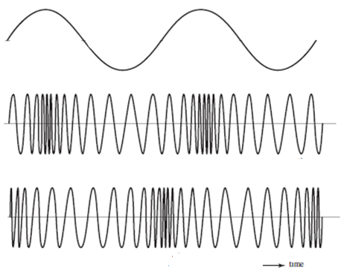
Figure : 2 (a) Sinusoidal message, corresponding (b) FM waveform (c) PM waveform

Slide 9
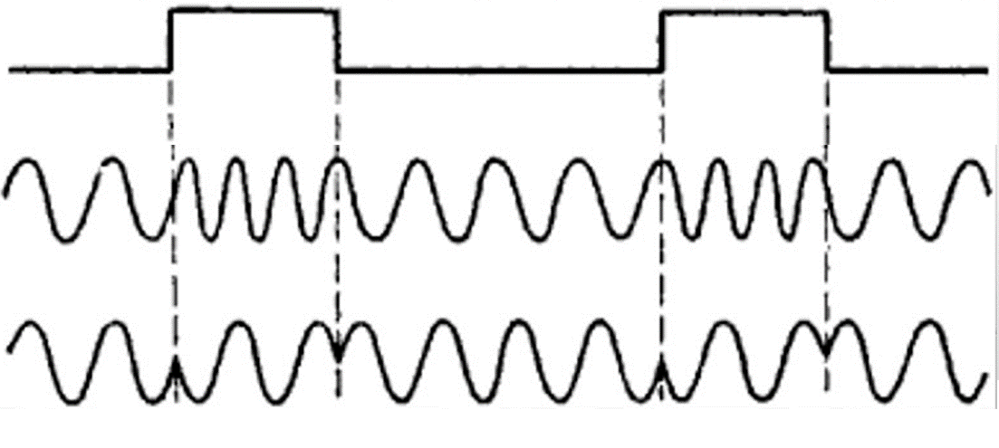
Figure : 3 (a) Square wave message, corresponding (b) FM waveform (c) PM waveform

Slide 10
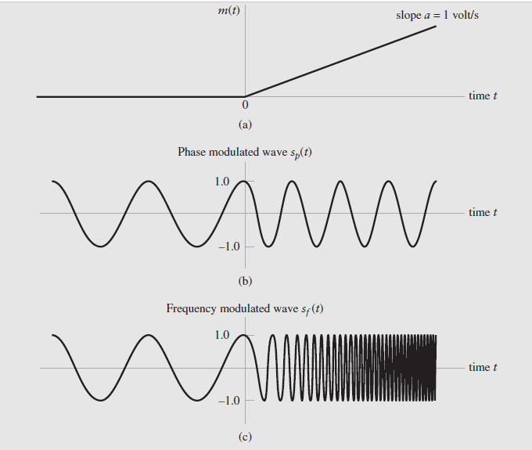
Figure : 4 (a) Linearly increasing message, corresponding (b) PM waveform (c) FM waveform

Slide 11
Mathematical Expression for PM and FM
Let θ_{i}(t) denote the angle of a modulated sinusoidal carrier at time t; it is assumed to be a function of the information-bearing signal or message signal. We express the resulting angle-modulated wave as
Where A_{c} is the carrier amplitude, and θ_{i}(t) is the angle. In the simple case of an unmodulated carrier, the angle is θ_{i}(t) is
where A_{c} is the carrier amplitude, f_{c} is the frequency, and ɸ_{c} is phase
Phase modulation (PM) is that form of angle modulation in which the phase angle is instantaneously varied linearly with the message m(t) signal
the constant k_{p} represents the phase sensitivity factor of the modulator, expressed in radians per volt .Therefore, the phase-modulated wave s(t) is correspondingly described in the time domain by
For convenience , if the unmodulated carrier phase is taken as zero , then
Eqn.(5) is the equation for PM wave
→(1)
→(2)
→(3)
→(4)
→(5)

Slide 12
Frequency modulation (FM) is that form of angle modulation in which the frequency is instantaneously varied linearly with the message m(t) signal
the constant k_{f} represents the frequency sensitivity factor of the modulator, expressed in Hertz per volt
Integrating Eqn.(6) with respect to time and multiplying by 2π
Therefore, substituting Eqn. (7c) in Eqn. (1)
Eqn.(8) is the equation for FM wave
→(6)
→(7a)
→(7b)
→(7c)
→(8)

Slide 13
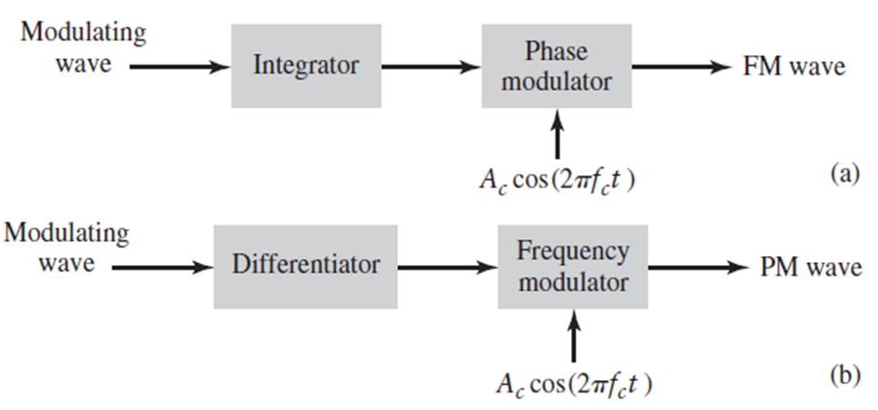
Can we see any (mathematical) relationship between PM and FM?
Yes,…Examining the definitions of Eqns. (5) and (8), we understand that:
Modulating signal varies the angle of the carrier signal, means an we get PM wave; If the integrated form of modulating signal varies the angle of the carrier signal, means we get FM wave.
Eqns (5) and (8) also reveals that:
FM wave can be generated by first integrating the message signal with respect to time t and then using the resulting signal as the input to a phase modulator, as shown in Fig. 5(a).
Conversely, PM wave can be generated by first differentiating with respect to time t and then using the resulting signal as the input to a frequency modulator, as shown in Fig 5(b).
Figure 5: Illustration of the relationship between frequency modulation and phase modulation.
(a) Scheme for generating an FM wave by using a phase modulator.
(b) Scheme for generating a PM wave by using a frequency modulator.

Slide 14
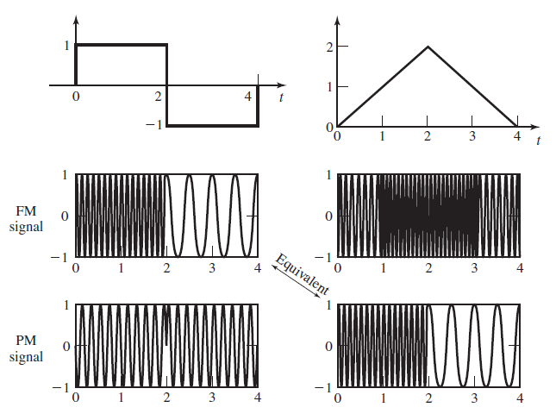


$$\underset{→}{When integrated}$$
$$\underset{←}{When differentiated}$$
Figure 5: Further Illustration of PM and FM waves produced by
square and sawtooth waves.

Slide 15
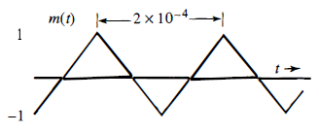
Question 1(a): Discuss the relationship between FM and PM showing appropriate sketches and mathematical expressions.
Refer to the previous slides
Question 1(b): Consider that the modulating signal shown in the following Figure is applied to the FM and PM modulators. The constants k_{f} and k_{p} are 2π x 10⁵ and 10π , respectively, and the carrier frequency f_{c} is 100 MHz. Determine the instantaneous frequency for FM and PM waves and sketch the waveform for both.

Slide 16
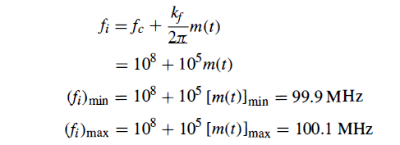
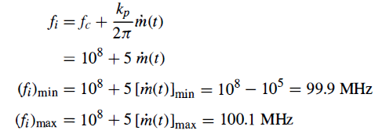
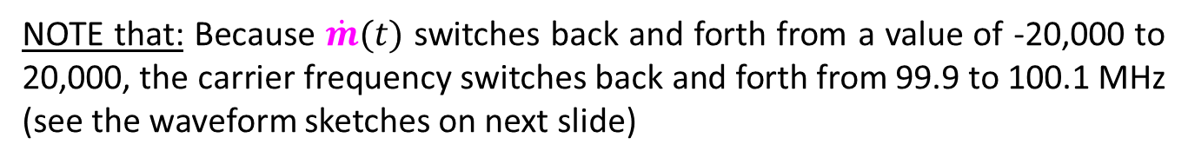
for FM
NOTE that: Because m(t) increases and decreases linearly with time, the instantaneous frequency increases and decreases linearly between 99.9 to 100.l MHz (see the waveform sketches on next slide)
for PM
NOTE that: Because $\dot{m}(t)$ switches back and forth from a value of -20,000 to 20,000, the carrier frequency switches back and forth from 99.9 to 100.1 MHz (see the waveform sketches on next slide)

Slide 17
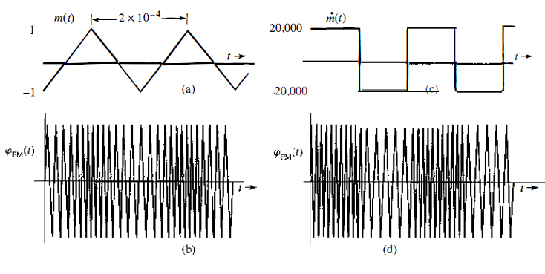
Figure (a) and (b): Sketch of FM waveform of Question 1 (b)
Figure (c) and (d): Sketch of PM waveform of Question 1 (b)

Slide 18
Narrow band and Wideband FM
Narrow-Band Frequency Modulation
Consider a sinusoidal modulating wave defined by
The instantaneous frequency of the resulting FM wave is
where
The quantity ∆f is called the frequency deviation, representing the maximum departure of the instantaneous frequency of the FM wave from the carrier frequency f_{c}.
Integrating Eqn.(10) with respect to time and multiplying , both sides, by 2π
where
The ratio of the frequency deviation to the modulation frequency is commonly called the modulation index of the FM wave, and is denoted by β.
Therefore,
(or)
→(9)
→(10)
→(11)
→(12)
Eqn.(12) is the general equation for FM wave

Slide 19
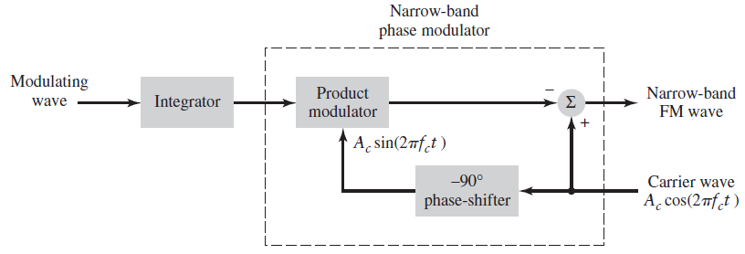
In the FM wave s(t) of Eq. (12) , when the modulation index is small compared to one radian, then it is called as narrow-band FM
Under the condition β is small compared to one radian
and
Accordingly, the Eqn. (13) simplifies to
From this (narrow band) approximate representation of Eqn (14), we deduce the modulator shown in block diagram in Figure (6) below, and this is called as narrow-band FM modulator.
→(13)
→(14)
Figure 6: Block diagram of an indirect method for generating a narrow-band FM wave

Slide 20
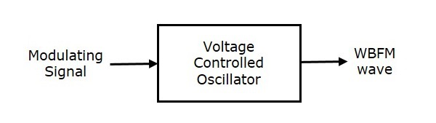
Wide-Band Frequency Modulation
There are two basic methods of generating frequency-modulated waves, one direct and the other indirect.
DIRECT METHOD
In direct method, a Voltage Controlled Oscillator (VCO) is used to generate WBFM. VCO produces an output signal, whose frequency is proportional to the input signal voltage.
In conceptual terms, the direct method is therefore straightforward to implement. Moreover, it is capable of providing large frequency deviations.
However, a serious limitation of the direct method is the tendency for the carrier frequency to drift, which is usually unacceptable for commercial radio applications.
To overcome this limitation, frequency stabilization of the FM generator is required, which is realized through the use of feedback around the oscillator.
Although the oscillator may itself be simple to build, the use of frequency stabilization adds system complexity to the design of the frequency modulator.
Figure 7: Direct FM generation using VCO

Slide 21
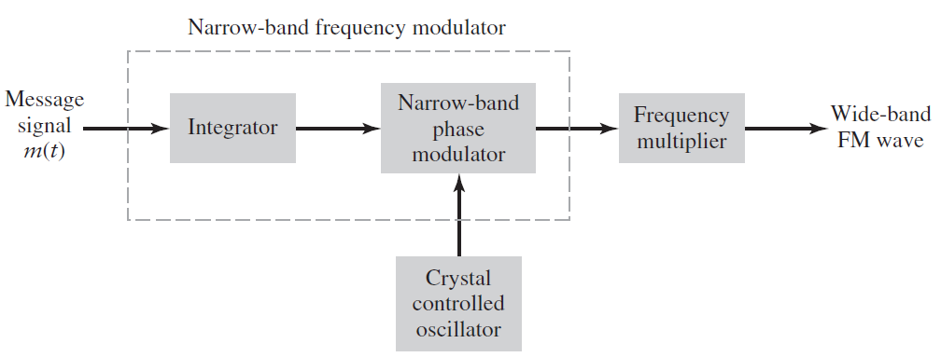
INDIRECT METHOD
In the indirect method, on the other hand, the message signal is first used to produce a narrow-band FM, which is followed by frequency multiplication to increase the frequency deviation to the desired level.
In this indirect method, the carrier-frequency stability problem is alleviated by using a highly stable oscillator (e.g., crystal oscillator) in the narrowband FM generation; this modulation scheme is called the Armstrong wide-band frequency modulator, in recognition of its inventor.
Figure 8: Block diagram of an indirect (Armstrong) method for generating a wide-band FM

Slide 22
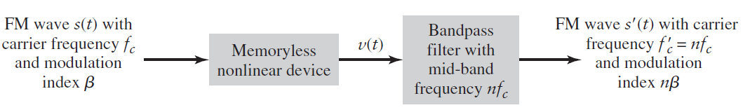
As shown in Figure (8), the message signal m(t) is first integrated and then used to phase-modulate a crystal-controlled oscillator; the use of crystal control provides frequency stability.
In order to minimize the distortion inherent in the phase modulator, the maximum phase deviation or modulation index β is purposely kept small, thereby resulting in a narrow-band FM wave.
The narrow-band FM wave is next multiplied in frequency by means of a frequency multiplier so as to produce the desired wide-band FM wave.
A frequency multiplier consists of a memoryless nonlinear device followed by a band pass filter, as shown in Figure (9).
A simplified diagram of a commercial FM transmitter using Armstrong's method is shown in Figure 10.(NOTE: This Figure is not required to explain wideband FM concept)
Figure 9: Block diagram of frequency multiplier.

Slide 23
The memoryless nonlinear device is an nth power-law device, and the input–output relation of such a device may be expressed in the general form
The input s(t) is an FM wave defined by
Suppose that
(1) the mid-band frequency of the bandpass filter in FIGURE above is set equal to nf_{c} where f_{c} is the carrier frequency of the incoming FM wave
(2) the bandpass filter is designed to have a bandwidth equal to n times the transmission bandwidth of s(t).
Therefore, we have a new FM wave defined by
Here, both the carrier frequency and frequency sensitivity (hence frequency deviation) gets multiplied by a factor of n; hence the output is a wide-band FM
→(15)
→(16)
→(17)

Slide 24
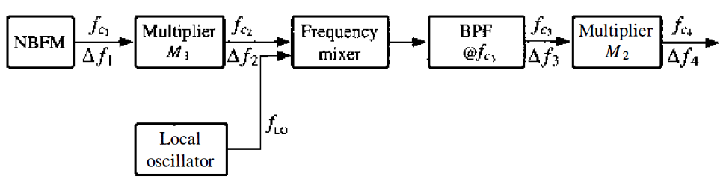
Figure 10: A simplified diagram of a commercial FM transmitter using Armstrong's method (NOTE: This Figure is not required to explain wideband FM concept. We will use it later for FM transmitter design/calculation purpose )

Slide 25
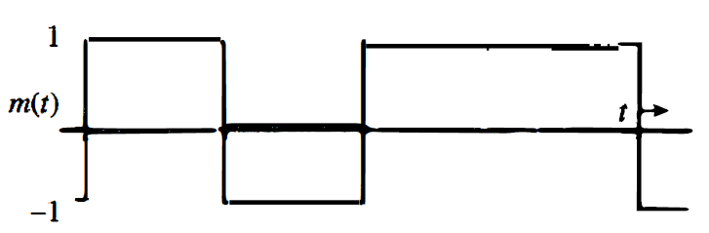
Question 2: Discuss the Indirect method of generation of wideband FM with appropriate diagram and mathematical expressions.
Refer to the previous slides
Question 3(a): Discuss the generation of narrow band FM with appropriate diagram and mathematical expressions.
Refer to the previous slides
Question 3(b) Consider that the modulating signal shown in the following Figure is applied to the FM and PM modulators. The constants k_{f} and k_{p} are 2π x 10⁵ and π/2 , respectively, and the carrier frequency f_{c} is 100 MHz. Determine the instantaneous frequency for FM and PM waves and sketch the waveform for both.

Slide 26


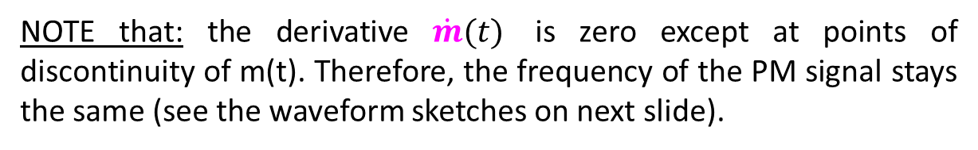
for FM
NOTE that: Because m(t) switches from 1 to - 1 and vice versa, the FM wave frequency switches back and forth between 99.9 and 100.1MHz, (see the waveform sketches on next slide)
for PM
NOTE that: the derivative $\dot{m}(t)$ is zero except at points of discontinuity of m(t). Therefore, the frequency of the PM signal stays the same (see the waveform sketches on next slide).

Slide 27
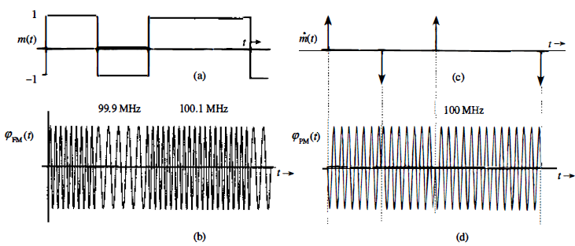
Figure (a) and (b): Sketch of FM waveform of Question 3 (b)
Figure (c) and (d): Sketch of PM waveform of Question 3 (b)

Slide 28

Transmission bandwidth and power of FM
1. Bandwidth (by Bessel Function approach)
Recall the equation of FM wave given in Eqn. (12) reproduced below that:
The FM signal spectrum is quite complex (function of function), which when we expand will give an infinite series, i.e., FM mathematically will produce infinite number of sidebands.
However, The number of significant sidebands is determined by Bessel function. The Bessel function ignores sidebands amplitude less 1% of the carrier amplitude.
The Bessel function TABLE is shown in next page. It shows how the spectrum expands as the modulation index increases. Sidebands are separated from the carrier by fc ± fm, fc ± 2fm, fc ± 3fm and so on.
From the Bessel function table, the bandwidth of FM wave is approx. as
where N is the number of significant sidebands, and f_{max} is the maximum frequency of the modulating signal.
$$2Nf_{max}$$

Slide 29
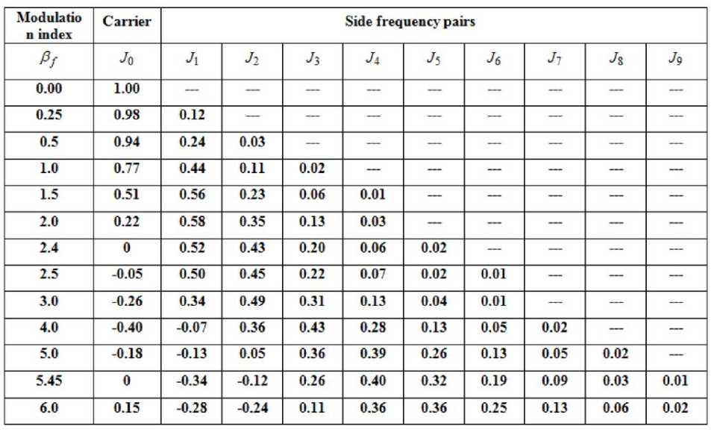
TABLE :Table of Bessel Functions (Note: only sidebands more than 1% of carrier power is significant)

Slide 30
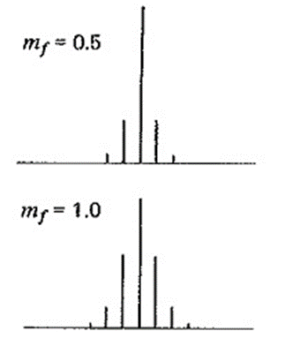
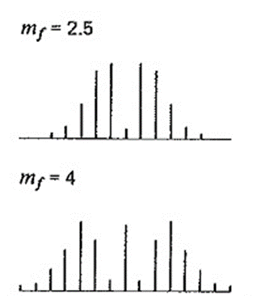
FIGURE : Illustrates the discrete amplitude spectra of an FM wave, normalized with respect to the unmodulated carrier amplitude, for different modulation index m_{f}. And we can understand that the bandwidth of the FM wave varies with modulation index.

Slide 31



2. Bandwidth (by Carson’s Rule approach)
In theory, an FM wave contains an infinite number of side-frequencies so that the bandwidth required to transmit such a modulated wave is infinite in extent. In practice, however, we find that the FM wave is effectively limited to a finite number of significant side-frequencies compatible with a specified amount of distortion.
Carson found that
For large values of the modulation index β, the bandwidth approaches, and is only slightly greater than the total frequency excursion 2∆f.
For small values of the modulation index β, the spectrum of the FM wave is effectively limited to the carrier frequency f_{c}, and one pair of side-frequencies at f_{c}±f_{m}, so that the bandwidth approaches 2f_{m}.
Accordingly, the Carson’s rule (ignores sidebands amplitude less 2% of the carrier amplitude) bandwidth is given as
$$BW=2∆f+2f_{m}$$
$$BW=2\left(∆f+f_{m}\right)$$
$$BW=2\left(β+1\right)f_{m}$$

Slide 32

Transmission Power of FM Waves
From Eqn. (8) and/or (12), we readily see that the amplitude of FM waves is maintained at a constant value equal to the carrier amplitude A_{c} , for all time t, irrespective of the sensitivity factors k_{f} .
Consequently, the average transmitted power of angle-modulated waves (FM or PM) is a constant, as shown by
$$P_{ave}=\frac{1}{2}A_{c}^{2}$$

Slide 33
Summary of formulas related to FM and PM (for immediate reference, to solve Tutorials in this unit)
If message m(t)= A_{m}cos2πf_{m}t, and carrier c(t)= A_{c}cos2πf_{c}t,
,for PM
,for FM
,for PM
,for FM
,for PM
,for FM
,for PM
,for FM
Modulation index
Deviation
constant
,for PM
,for FM
,for PM
,for FM
Bandwidth
,for PM
,for FM
,for PM
,for FM

Slide 34
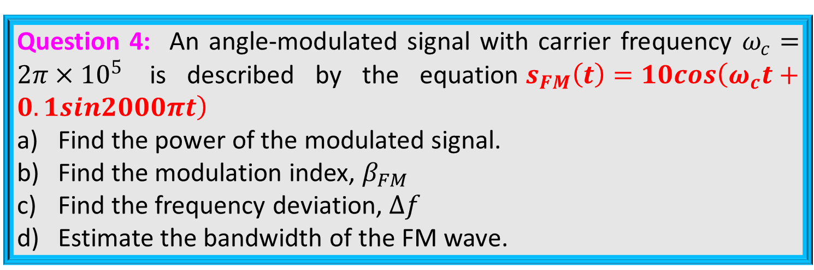
Question 4: An angle-modulated signal with carrier frequency $ω_{c}=2π×{10}^{5}$ is described by the equation$s_{FM}\left(t\right)=10cos\left(ω_{c}t+0.1sin2000πt\right)$
Find the power of the modulated signal.
Find the modulation index, $β_{FM}$
Find the frequency deviation, $∆f$
Estimate the bandwidth of the FM wave.
$$\left(a\right) Power=\frac{1}{2}A_{c}^{2}=\frac{1}{2}{\left(10\right)}^{2}=50W$$
$$\left(b\right) Modulation index , β=10$$
$$\left(c\right) Frequenccy deviation , ∆f=β×f_{m}=10×1000=10kHz$$
$$\left(d\right) Bandwidth=2\left(∆f+f_{m}\right)=2\left(10k+1k\right)=22kHz$$

Slide 35
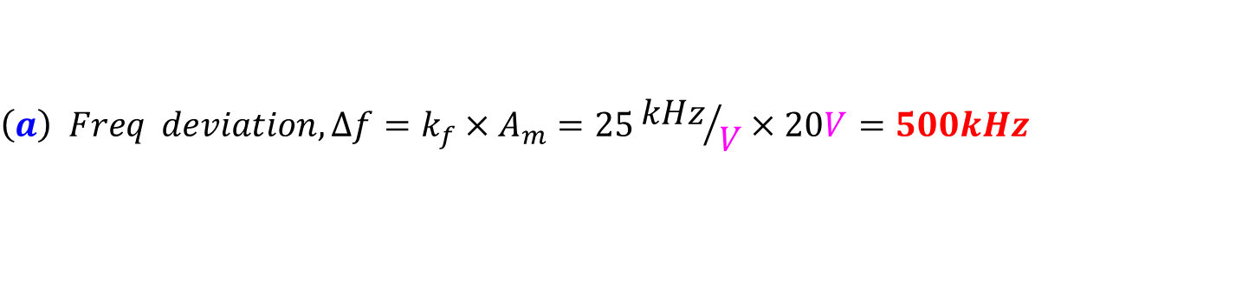
Question 5:
A carrier wave of frequency 100 MHz is frequency modulated by a sinusoidal wave of amplitude 20V and frequency 100 kHz. The frequency sensitivity of the modulator is 25 kHz/V. Determine the approximate bandwidth of the FM wave using Carson’s rule.
Recalculate and compare the bandwidth when the amplitude of modulating signal is doubled.
$$\left(a\right) Freq deviation, ∆f=k_{f}×A_{m}=25{kHz}/V×20V=500kHz$$
$$The corresponding mod index, β=\frac{∆f}{f_{m}}=\frac{500kHz}{100kHz}=5$$
$$∴Bandwidth \left(Carson^{′}s Rule\right)=2\left(∆f+f_{m}\right)=2\left(500k+100k\right)=1.2MHz$$
$$\left(b\right) When the modulating voltage is doubled$$
$$∆f=25{kHz}/V×40V=1MHz and β=\frac{1MHz}{100kHz}=10$$
$$∴Bandwidth \left(Carson^{′}s Rule\right)=2\left(1M+100k\right)=2.2MHz$$

Slide 36
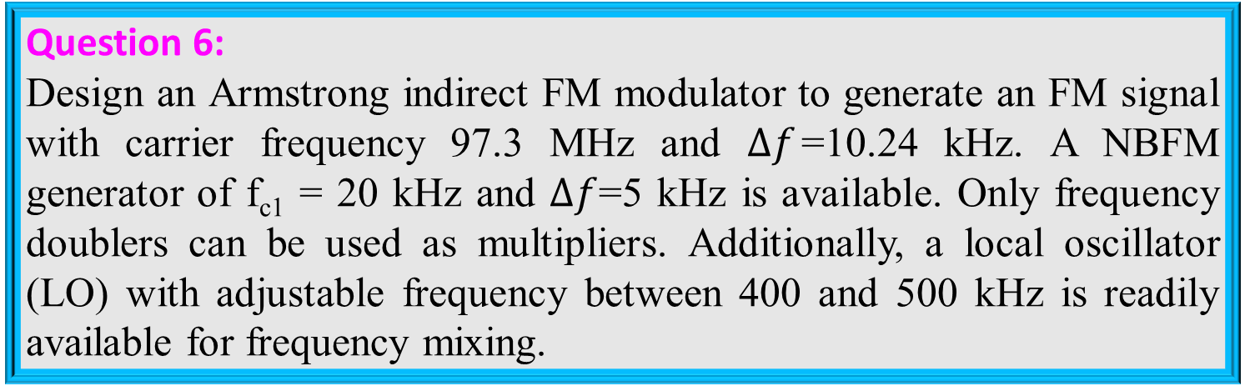
Question 6:
Design an Armstrong indirect FM modulator to generate an FM signal with carrier frequency 97.3 MHz and $∆f$=10.24 kHz. A NBFM generator of f_{c1} = 20 kHz and $∆f$=5 kHz is available. Only frequency doublers can be used as multipliers. Additionally, a local oscillator (LO) with adjustable frequency between 400 and 500 kHz is readily available for frequency mixing.

Slide 37
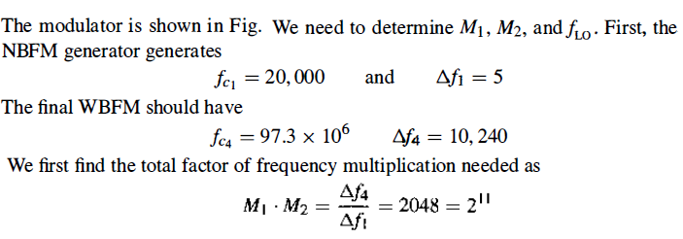
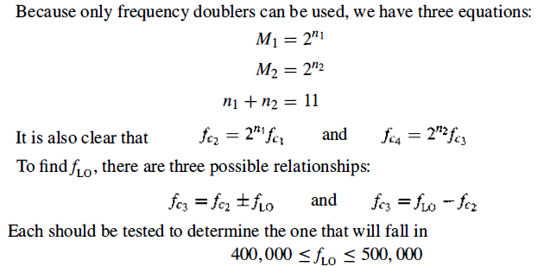

Slide 38
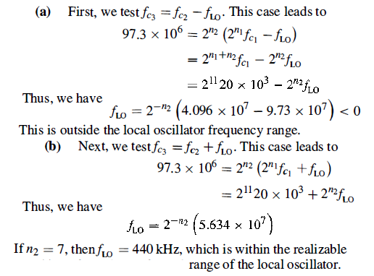

Slide 39
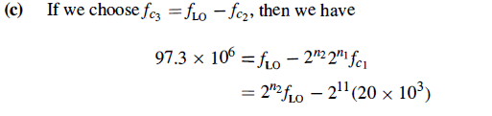
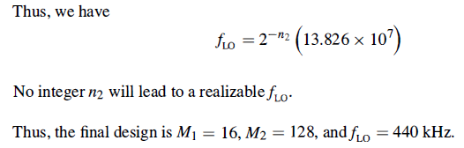

Slide 40

FM Demodulation
RECALL the definition of FM. FM is really just changing the instantaneous frequency of the signal about the carrier in response to the modulation amplitude.
Thus, what is conceptually need is that, to perform FM demodulation we need to track the received signal frequency .
To develop a conceptual diagram, imagine a frequency-selective filter that produced a higher average output for higher frequencies and a lower average output for lower frequencies. In other words, a higher frequency is converted back into an increase in voltage (and the converse – a lower frequency to a lower voltage).
To set out on a solution path, it is reasonable to start with the FM signal equation for single-tone modulation:
→(a)

Slide 41

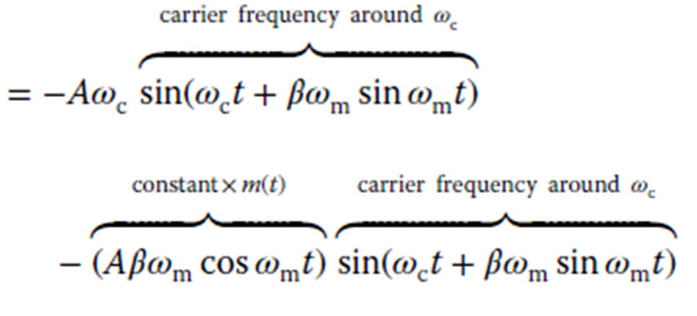
The problem is to recover the original modulation signal m(t). In this simplified single-tone case, we should be able to recover the sinusoidal signal m(t) = A_{m}cos𝜔_{m}t.
What would happen if we took the derivative of the FM signal described by Eqn.(a)? This might not be an obvious step, but it will lead the way to creation of a frequency-selective discriminator.
→(b)
→(c)

Slide 42

Since 𝜔_{c} ≫ 𝜔_{m}, , as an approximation, we can ignore the extra part involving 𝜔_{m} wherever it occurs in conjunction with 𝜔_{c}.
Also, using 𝛽 = k_{f}A_{m}∕𝜔_{m}, the term A𝛽𝜔_{m}cos𝜔_{m}t may be simplified to Ak_{f}A_{m} cos𝜔_{m}t.
So as an approximation, Eqn. (c) can get simplified as :
→(d)

Slide 43
Eqn. (d) is, in effect, an amplitude-modulated signal. In other words, the FM signal has been converted into an AM one, and we know how to demodulate that already.
Thus, the FM demodulator is implemented using a differentiator, AM detector and low pass filter as shown in the FIGURE below.
Therefore , the output is a message signal (FM demodulated signal!!).
NOTE: This is the practical method of FM demodulation. The waveform sketches are shown in the next slide.
m(t)
x_{FM}(t)
Differentiator
AM Detector
Filter
Figure: FM demodulation (Frequency Discriminator)

Slide 44
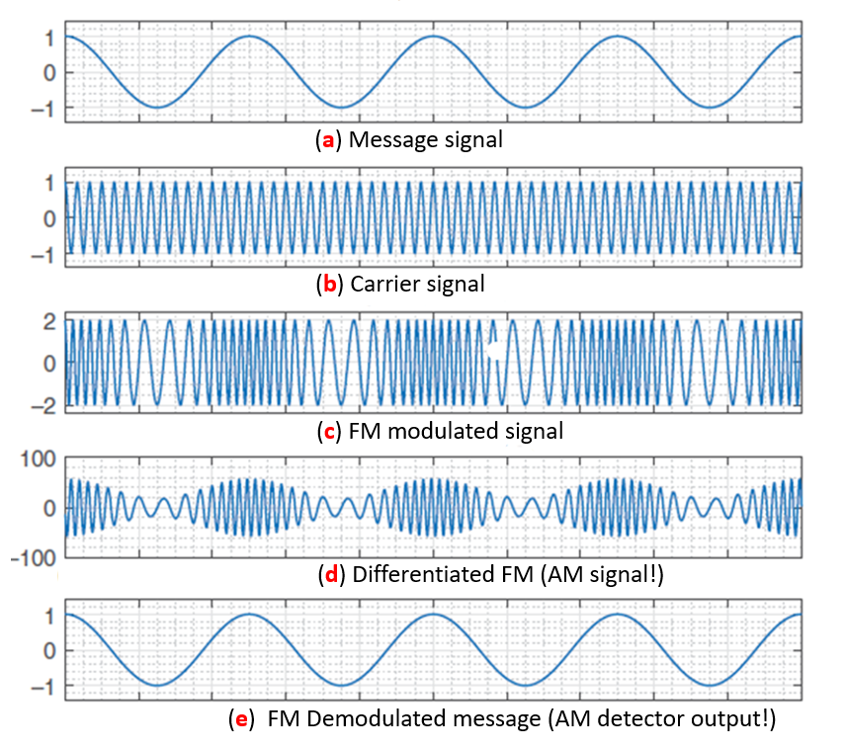

Slide 45
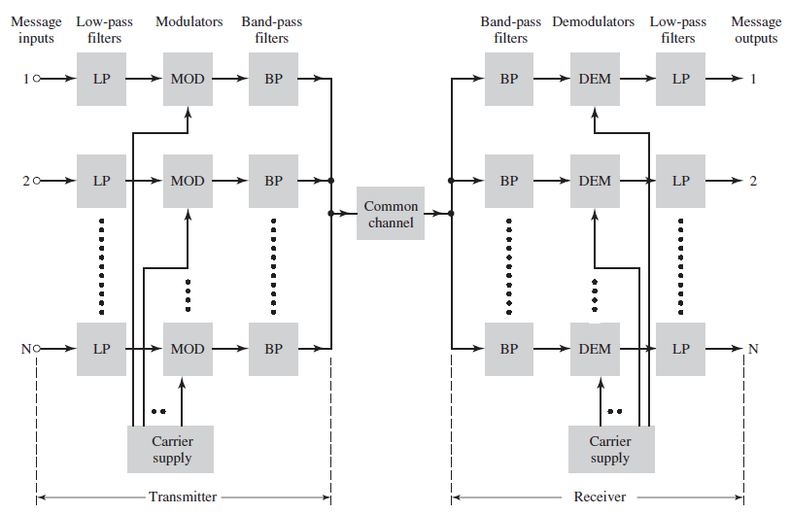
Frequency Division Multiplexing
Just an introductory NOTE that FDM is the application of AM, not an application of FM. However, it is an important concept of analog communication. Hence let us discuss it here.
Figure (1): TDM Balock diagram

Slide 46
RECALL, in general, Multiplex means “many into one”.
Multiplexing is important signal processing operation, whereby a number of independent signals can be combined into a composite signal suitable for transmission over a common channel.
Voice frequencies transmitted over telephone systems, are in the range from 300 to 3100 Hz. To transmit a number of these signals over the same channel, the signals must be kept apart so that they do not interfere with each other, and thus they can be separated at the receiving end.
This is accomplished by separating the signals either in frequency or in time. The technique of separating the signals in frequency is referred to as frequency-division multiplexing (FDM), whereas the technique of separating the signals in time is called time- division multiplexing (TDM).

Slide 47
Refer to the TDM block diagram shown in the Figure (1) above that:
The input voice signal is first applied to a low-pass filter, which is designed to remove high-frequency components that do not contribute significantly to signal representation but are capable of disturbing other message signals that share the common channel.
The filtered signals are then applied to modulators (usually SSB modulators) that shift the frequency ranges of the signals so as to occupy mutually exclusive frequency intervals.
The necessary carrier frequencies needed to perform these frequency translations are obtained from a carrier supply.

Slide 48
In practice, each voice input is usually assigned a bandwidth of 4 kHz.
The band-pass filters following the modulators are used to restrict the band of each modulated wave to its prescribed range. The resulting bandpass filter outputs are next combined in parallel to form the input to the common channel.
At the receiving terminal, a bank of band-pass filters, with their inputs connected in parallel, is used to separate the message signals on a frequency-occupancy basis.
Finally, the original message signals are recovered by individual demodulators.

Slide 49
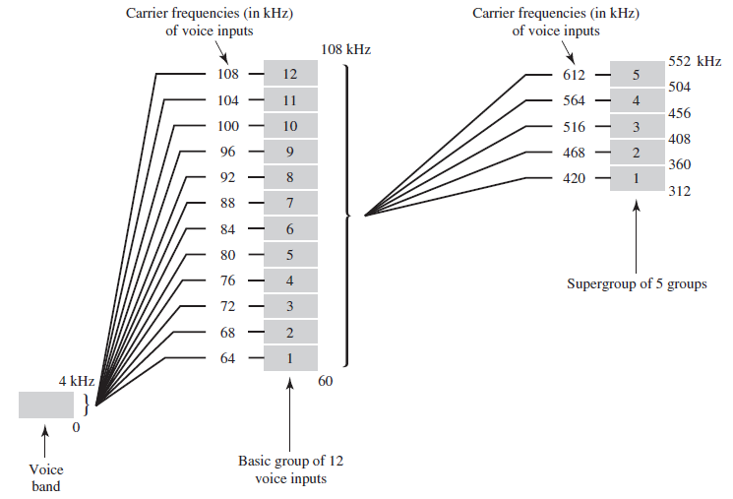
Figure (2): Practical TDM implementation

Slide 50
The practical implementation of an FDM system is shown in Figure (2) above. The system usually involves many steps of modulation and demodulation, as illustrated in the Figure.
The first multiplexing step combines 12 voice inputs into a basic group, thus the basic group occupies the frequency band 60 to 108 kHz.
The next step in the FDM hierarchy involves the combination of 5 basic groups into a supergroup, thus supergroup occupying the band 312 to 552 kHz.
In a similar manner, supergroups are combined into mastergroups, and mastergroups are combined into very large groups.

Slide 51
Question 7: Explain the practical method of demodulation of FM of signal with suitable waveform sketches and mathematical expressions.
Refer to the previous slides
Question 8: Discuss the pre-emphasis and de-emphasis in FM communication
Refer to the previous slides
Question 9: Explain the threshold effect in FM
Refer to the previous slides
Question 10: Discuss the noise performance FM by deriving suitable mathematical expression for Figure of Merit.
Refer to the previous slides
Question 11: Explain about Time Division Multiplexing with suitable block diagram.
Refer to the previous slides

Slide 52



