Slide 1

Analog Communication Systems
BECE304L
Module-5

Slide 2
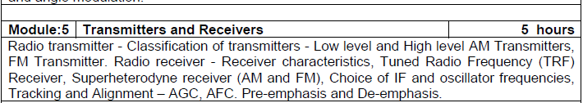
Course-modules

Slide 3
AM Transmitters
Transmitters that transmit AM signals are known as AM transmitters. These transmitters are used in medium wave (MW) and short wave (SW) frequency bands for AM broadcast.
The MW band has frequencies between 550 KHz and 1650 KHz, and the SW band has frequencies ranging from 3 MHz to 30 MHz. The two types of AM transmitters that are used based on their transmitting powers are:
· High Level
· Low Level

Slide 4
Low and High Level Transmitters –am Transmitters
There are two approaches to generating an AM signal. These are known as low and high level modulation.
A low level AM transmitter performs the process of modulation near the beginning of the transmitter.
A high level transmitter performs the modulation step last, at the last or "final" amplifier stage in the transmitter.
Each method has advantages and disadvantages, and both are in common use.

Slide 5
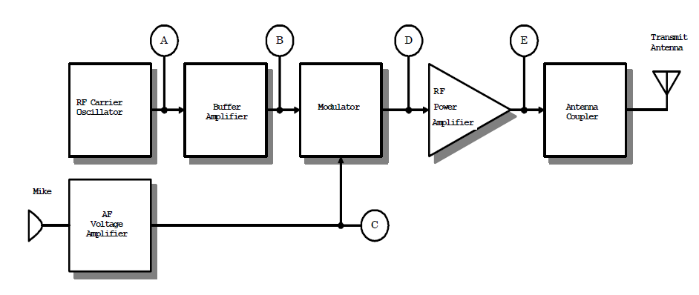
Low Level Transmitters –am Transmitters

Slide 6
Low Level Transmitters
There are two signal paths in the transmitter, audio frequency (AF) and radio frequency (RF).
The RF signal is created in the RF carrier oscillator. At test point A the oscillator's output signal is present.
The output of the carrier oscillator is a fairly small AC voltage, perhaps 200 to 400 mV RMS.

Slide 7
Low Level Transmitters
RF Carrier Oscillator
The oscillator is a critical stage in any transmitter. It must produce an accurate and steady frequency.
Recall that every radio station is assigned a different carrier frequency. The dial (or display) of a receiver displays the carrier frequency.
If the oscillator drifts off frequency, the receiver will be unable to receive the transmitted signal without being readjusted.
Worse yet, if the oscillator drifts onto the frequency being used by another radio station, interference will occur.
This is hardly desirable! Two circuit techniques are commonly used to stabilize the oscillator, buffering and voltage regulation.

Slide 8
Low Level Transmitters
Buffer Amplifier
You might have guessed that the buffer amplifier has something to do with buffering or protecting the oscillator.
An oscillator is a little like an engine (with the speed of the engine being similar to the oscillator's frequency).
If the load on the engine is increased (the engine is asked to do more work), the engine will respond by slowing down.
If the current drawn from the oscillator's output is increased or decreased, the oscillator may speed up or slow down slightly. We would say that its frequency has been pulled.

Slide 9
Low Level Transmitters
Modulator
Right after this stage is the modulator. Because the modulator is a nonlinear amplifier, it may not have a constant input resistance -- especially when information is passing into it.
But since there is a buffer amplifier between the oscillator and modulator, the oscillator sees a steady load resistance, regardless of what the modulator stage is doing.

Slide 10
Low Level Transmitters
Voltage Regulation
An oscillator can also be pulled off frequency if its power supply voltage isn't held constant. In most transmitters, the supply voltage to the oscillator is regulated at a constant value.
The regulated voltage value is often between 5 and 9 volts; zener diodes and three-terminal regulator ICs are commonly used voltage regulators.
Voltage regulation is especially important when a transmitter is being powered by batteries or an automobile's electrical system.

Slide 11
Low Level Transmitters
Modulator
The stabilized RF carrier signal feeds one input of the modulator stage. The modulator is a variable-gain (nonlinear) amplifier.
To work, it must have an RF carrier signal and an AF information signal. In a low-level transmitter, the power levels are low in the oscillator, buffer, and modulator stages; typically, the modulator output is around 10 mW (700 mV RMS into 50 ohms) or less.

Slide 12
Low Level Transmitters
AF Voltage Amplifier
In order for the modulator to function, it needs an information signal.
A microphone is one way of developing the intelligence signal, however, it only produces a few millivolts of signal.
This simply isn't enough to operate the modulator, so a voltage amplifier is used to boost the microphone's signal.
The signal level at the output of the AF voltage amplifier is usually at least 1 volt RMS; it is highly dependent upon the transmitter's design.

Slide 13
Low Level Transmitters
RF Power Amplifier
At test point D the modulator has created an AM signal by impressing the information signal from test point C onto the stabilized carrier signal from test point B at the buffer amplifier output.
This signal (test point D) is a complete AM signal, but has only a few milliwatts of power.
The RF power amplifier is normally built with several stages. These stages increase both the voltage and current of the AM signal. We say that power amplification occurs when a circuit provides a current gain.

Slide 14
Low Level Transmitters
Antenna Coupler
The antenna coupler is usually part of the last or final RF power amplifier, and as such, is not really a separate active stage. It performs no amplification, and has no active devices.
It performs two important jobs: Impedance matching and filtering. For an RF power amplifier to function correctly, it must be supplied with a load resistance equal to that for which it was designed.
The antenna coupler also acts as a low-pass filter. This filtering reduces the amplitude of harmonic energies that may be present in the power amplifier's output.

Slide 15
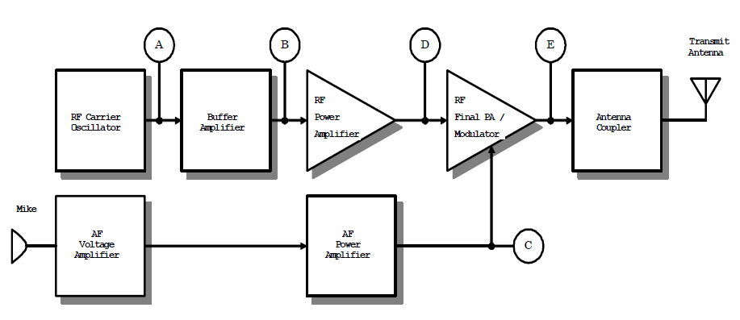
High Level AM Transmitter

Slide 16
High Level AM Transmitter
The high-level transmitter of Figure is very similar to the low-level unit. The RF
section begins just like the low-level transmitter; there is an oscillator and buffer amplifier.
The difference in the high level transmitter is where the modulation takes place.
Instead of adding modulation immediately after buffering, this type of transmitter amplifies the unmodulated RF carrier signal first.

Slide 17
High Level AM Transmitter
Thus, the signals at points A, B, and D in Figure all look like unmodulated RF carrier waves. The only difference is that they become bigger in voltage and current as they approach test point D.
The modulation process in a high-level transmitter takes place in the last or final power amplifier. Because of this, an additional audio amplifier section is needed.
In order to modulate an amplifier that is running at power levels of several watts (or more), comparable power levels of information are required. Thus, an audio power amplifier is required.

Slide 18
High Level AM Transmitter
The final power amplifier does double-duty in a high-level transmitter.
First, it provides power gain for the RF carrier signal, just like the RF power amplifier did in the low-level transmitter.
In addition to providing power gain, the final PA also performs the task of modulation.
The RF power amplifier operates in a nonlinear class, Classes A and B are considered linear amplifier classes.
The final power amplifier in a high-level transmitter usually operates in class C, which is a highly nonlinear amplifier class.

Slide 19
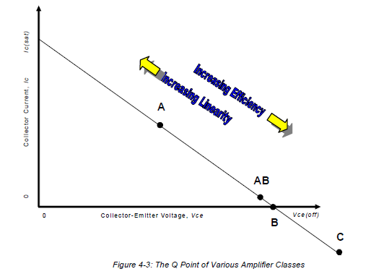
Low and High Level Transmitter Efficiency

Slide 20
Low and High Level Transmitter Efficiency
Figure shows the relative location of the quiescent operating point ("Q point") for several different classes of amplifier.
Note that as we move away from class A operation, efficiency increases, but distortion (caused by nonlinearity) also increases

Slide 21
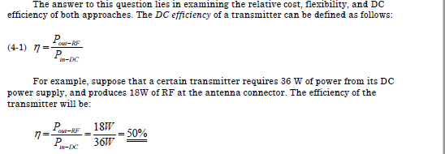
Low and High Level Transmitter Efficiency
You might wonder why two different approaches are used to build AM transmitters, when the results of both methods are essentially the same (a modulated AM carrier wave is sent to the antenna circuit).

Slide 22
Low and High Level Transmitter Efficiency
This transmitter converts 50% of the battery power to useful RF energy at the antenna, and 50% is converted to heat (and lost.)
Naturally, we'd like all of our electronic devices to be as efficient as possible, especially in certain cases. Suppose that a transmitter is operated from battery power – as in a walkie-talkie, or aircraft ELT (emergency locator transmitter).
We would want to get maximum life from the batteries, and we would use the most efficient approach possible.

Slide 23
Low and High Level Transmitter Efficiency
Broadcasting uses tremendous amounts of electricity, due to the high power levels. It makes good economic sense to use the most efficient transmitter layout available.
Overall, the high-level transmitter supports better DC efficiency than the low-level approach, and is normally the first choice in battery-operated AM transmitters, and commercial AM broadcast.
This is because the high-level transmitter is able to use class C RF power amplifiers, which are more efficient than the class A or B RF amplifiers required for a low-level transmitter.
A high-level transmitter still requires a linear power amplifier, but it is an audio frequency (AF) type. It is much easier to build efficient linear amplifiers for audio than it is for RF, so the high-level approach wins in efficiency contests.

Slide 24
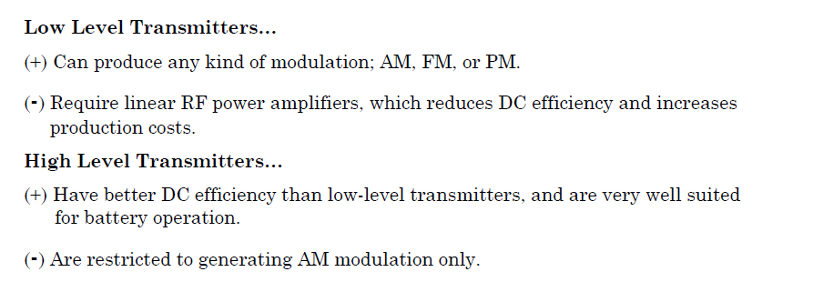
A Summary of Low-Level and High Level Characteristics

