Slide 1

Analog Communication Systems
BECE304L
Module-5

Slide 2
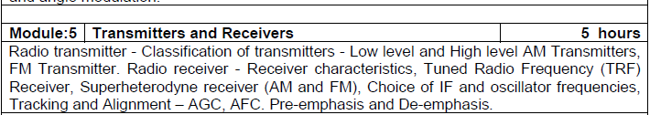
Course-modules

Slide 3
Radio receivers
Of the various forms of receivers proposed at one time or another, only two have any reaI practical or commercial significance-
The Tuned Radio-Frequency (TRF) receiver
The Super Heterodyne receiver.
Only the second of these is used to a large extent today, but it is convenient to explain the operation of the TRF receiver first since it is the simpler of be two.
The best way of justifying the existence and overwhelming popularity of the superheterodync receiver is by showing the shortcomings of the TRF type.

Slide 4
Tuned Radio-Frequency (TRF) Receiver
The TRF receiver block diagram is shown in Fig.
The TRF receiver is a simple "logical" receiver. A person with just a little knowledge of communications would probably expect all radio receivers to have this form.
The virtues of this type, which is now not used except as a fixed-frequency receiver in special applications are its simplicity and high sensitivity.

Slide 5
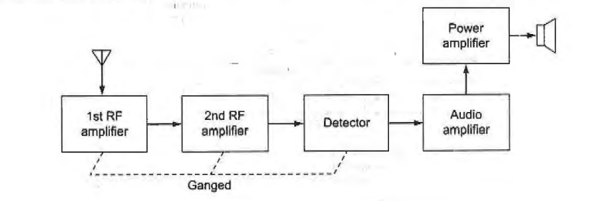
Tuned Radio-Frequency (TRF) Receiver

Slide 6
Tuned Radio-Frequency (TRF) Receiver
Two or perhaps three RF amplifiers, all tuning together, were employed to select and amplify the incoming frequency and simultaneously to reject all others.
After the signal was amplified to a suitable level, it was demodulated (detected) and fed to the loudspeaker after being passed through the appropriate audio amplifying stages.
Such receivers were simple to design and align at broadcast frequencies (53~ to 1640 kHz), but they presented difficulties at higher frequencies.
This was mainly because of the instability associated with high gain being achieved at one frequency by a multistage amplifier. ln addition the TRF receiver suffered from a variation in bandwidth over the tuning range.

Slide 7
Tuned Radio-Frequency (TRF) Receiver
It was unable to achieve sufficient selectivity at high frequencies, partly as a result of the enforced use of single-tuned circuits.
It was not possible to use double-tuned RF amplifiers in this receiver, although it was realized that they would naturally yield better selectivity.
This was due to the fact that all such amplifiers had to be tunable, and the difficulties of making several double-tuned amplifiers tune in unison were too great.
The problems of instability, insufficient adjacent-frequency rejection, and bandwidth variation can all be solved by the use of a superhe terodyne receiver which introduces relatively few problems of its own.

Slide 8
Super heterodyne Receiver
In the super heterodyne receiver, the incoming signal voltage is combined with a signal generated in the receiver.
This local oscillator voltage is normally converted into a signal of a lower fixed frequency.
The signal at this intermediate frequency contains the same modulation as the original carrier, and it is now amplified and detected to reproduce the original information.
The superhet has the same essential components as the TRF receiver, in addition to the mixer, local oscillator and intermediate-frequency (IF) amplifier.

Slide 9
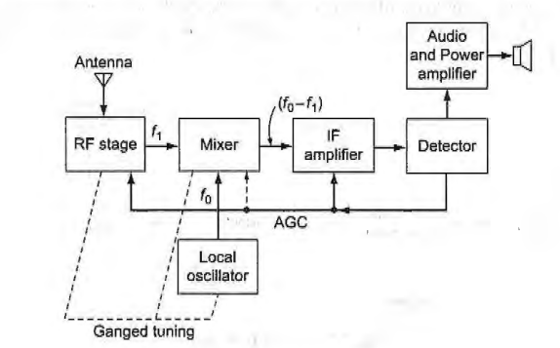
Super heterodyne Receiver

Slide 10


Image frequency and its rejection
ln a standard broadcast receiver the local oscillator frequency is made higher than the incoming signal frequency for reasons that will become apparent.
It is made equal at all times to the signal frequency plus the intermediate frequency. Thus.
No matter what the signal frequency may be. When are mixed, the difference frequency, which is one of the by-products, is equal to fi. As such, it is the only one passed and amplified by the IF stage.

Slide 11


Image frequency and its rejection
If a frequency fsi manages to reach the mixer, such that ,
then this frequency
will also produce fi when mixed with fo. Unfortunately, this spurious intermediate frequency signal will also be amplified by the IF stage and will therefore provide interference. This has the effect of two stations being received simultaneously and is naturally undesirable.
The term fsi is called the image frequency and is defined as the signal frequency plus twice the intermediate frequency. Reiterating, we have

Slide 12
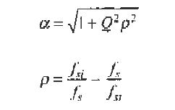
Image frequency and its rejection
The rejection of an image frequency by a single tuned circuit, i.e., the ratio of the gain at the signal frequency to the gain at the image frequency, is given by
Q-loaded Q of tuned circuit

Slide 13
Image frequency and its rejection
If the receiver has an RF stage, then there are two tuned circuits, both tuned to fs. The rejection of each will be calculated by the same formula, and the total rejection will be the product of the two.
Whatever applies to gain calculations applies also to those involving rejection.
Image rejection depends on the front-end selectivity of the receiver and must be achieved before the IF stage. Once the spurious frequency enters the first IF amplifier, it becomes impossible to remove it from the wanted signal.
It can be seen that if fsi/fs is large, as it is in the AM broadcast band, the use of an RF stage is not essential for good image-frequency rejection, but it does become necessary above about 3 MHz.

Slide 14
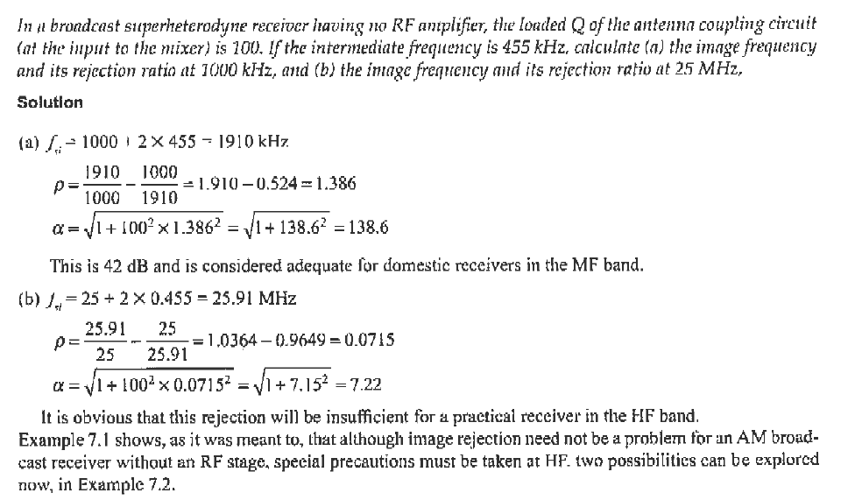
Image frequency and its rejection

Slide 15
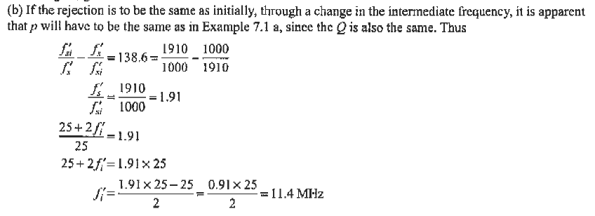
Image frequency and its rejection

Slide 16
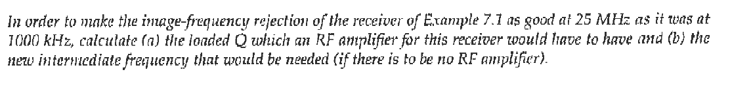
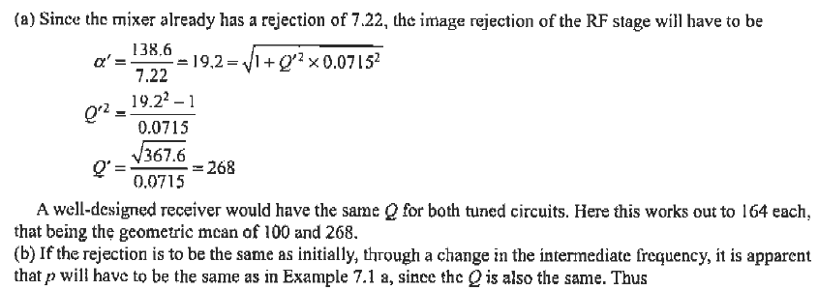
Image frequency and its rejection

