Slide 1
Presentation Outline
Transmitters and Receivers:
–AM Radio Transmitters
–FM Transmitters
–AM Receivers
–FM Receivers
–Problems

Slide 2
The increase in the received SNR is obtained by increasing the bandwidth. Therefore, angle modulation provides a way to trade-off bandwidth for transmitted power.
Although we can increase the output SNR by increasing β, having a large β means having a large B_{T}(by Carson’s rule bandwidth).
Having a large B_{T} means having a large noise power at the input of the demodulator.
This means that the approximation p(r(t)<< Ac)≈1, we assumed earlier in the FM noise analysis, will no longer apply and that the analysis will not hold.
Thus, if we increase β, a phenomenon known as the threshold effect will occur, and the signal will be lost in the noise. This is called as threshold effect in FM.

Slide 3
AM Radio Transmitters
Transmitter must generatea signal with the right type of modulation, with sufficient power, at the right carrier frequency, and with reasonable efficiency.
Earlier, we have studied the basic concepts of amplitude modulation. Now, we are going to study the two basic topologies to generate and transmit amplitude modulated waves. They are
1. Low level modulation
In low level modulation, the generation of AM wave takes place in the initial stage of amplification, i.e at a low power level. The generated AM signal then amplified using number of amplifier stages.

Slide 4
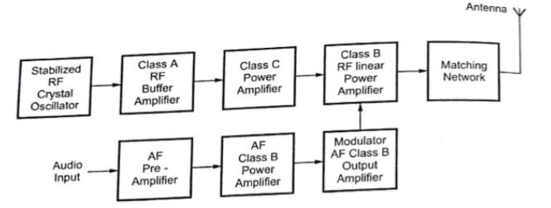
AM Low-Level Transmitter
Figure: AM transmitter Block diagram with Low Level Transmitter

Slide 5
Radio Transmitters Contd.,
2. High level modulation
In high level modulation, modulation takes place in the final stage of amplification and therefore modulation circuitry has to handle high power.
Figure: transmitter Block diagram with High Level Transmitter

Slide 6
It can be seen that stable RF source, buffer amplifier and subsequent RF power amplifiers are common for both low level modulation transmitter and high level modulation transmitter
The stable RF source is provided by crystal oscillator with a carrier frequency or submultiple of it
The buffer amplifiers are usually class A amplifier where as power amplifiers are class C amplifiers in both, audio and power audio frequency (AF) amplifiers are present
In fact, the only differnce is the point at which the modulation takes place In case of low level modulation, modulation takes place at low power level, i e before the final output amplifier

Slide 7
In low level modulation system amplifier efficiency and bandwidth preservations are important factors since audio signal is having low power
For high level modulation other than efficiency of amplifier power handling capability, distortion, capability of handling amplitude variations are important parameter
The output of final amplifier is passed through an impedance matching network that includes the tank circuit of the final amplifier For tank circuits, Q is kept low enough to pass all sideband signals without amplitude and frequency distortion

Slide 8
.
Effect of Feedback on Performance of AM Transmitter Contd.,
Generally, negative feedback is provided in AM transmitters This negative feedback reduces the distortion in a class C modulator system It also linearizes the output of the class C modulator
The negative feedback circuitry samples the RF signal send to the antenna This sample signal is demodulated by linear demodulator to produce feedback signal
Tuned class C amplifier must provide sufficient power gain to drive the final power amplifier
Antenna systems for AM transmitters must be located at some point remote from the studio operations

Slide 9
Effect of Feedback on Performance of AM Transmitter
Figure: Negative Feedback Circuitry

Slide 10
FM Transmitters
FM signals have no amplitude variation, therefore FM transmitter can employ class C throughout, even after modulation
There are two types of FM transmitters
Directly modulated (Variable Reactance Type) FM transmitter
Indirectly ( modulated FM transmitter

Slide 11
Directly Modulated FM Transmitter
Direct frequency modulation can be employed using any of the FM circuits However, direct FM at the final carrier frequency is not feasible because of the problem of maintaining high frequency stability of the carrier while at the same time obtaining adequate frequency deviation
To solve this problem, in directly modulated FM transmitters, the frequency modulation is carried out at a lower frequency and with a smaller frequency deviation Then passing this FM wave through frequency multiplier circuit, the desired carrier frequency and desired frequency deviation is achieved
With frequency multiplication, the instantaneous frequency is multiplied
With frequency mixing, the deviation is not altered

Slide 12
Indirect (Phase) Modulated FM Transmitter
One of the difficulties encountered in FM transmitters which depend upon the direct method of frequency modulation is that because of the variable nature of the tuning of the tank circuit, crystal controlled oscillators cannot be used and therefore the stability inherent in such crystal controlled units is not available
An alternative technique for the generation of a frequency modulated signal which permits the use of crystal control is called the “Indirect Method” In this technique, the phase angle is made to vary while holding the frequency constant
By this technique a phase modulated signal is generated and it can be passed off as an FM signal

Slide 13
Indirect (Phase) Modulated FM Transmitter
Figure: FM transmitter in which FM is achieved through Phase Modulation

Slide 14
FM Transmitter (Armstrong Method) Contd.,
In this method, the initial modulation takes place as an amplitude modulated DSBSC signal so that a crystal controlled oscillator can be used if desired
The crystal oscillator generates the subcarrier, which can be low, say on the order of 100 KHz One output from the oscillator is phase shifted by 90 degrees to produce the sine term, which is then DSBSC modulated in the balanced modulator by Vm(t) This is combined with the direct output from the oscillator in the summing amplifier, the result then being the phase modulated signal
The modulating signal is passed through an integrator to the modulated to get the frequency modulated signal At this stage, the equivalent frequency deviation will be low

Slide 15
FM Transmitter (Armstrong Method)
Figure: FM transmitter in which FM is achieved through Armstrong Method

Slide 16
AM Radio Receivers
AM radio receiver is a device which receives the desired AM signal, amplifies it followed by demodulation to get back the original modulating signal
Radio receivers are broadly of TWO types
pending on the application AM, FM, COMM .., RADAR
Depending on the fundamental aspect/ principle
Based on principle of operation, the TWO popular radio receivers are there, they are
Tuned Radio Frequency ( Receiver
Superheterodyne Receiver

Slide 17
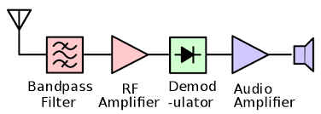
TRF (Tuned Radio Frequency) Receivers
The above Figure shows the block diagram of TRF receiver.
The various components of the systems are:
Antenna: It intercepts the incoming electromagnetic wave and convert it to electrical signals.

Slide 18
Feeder cable: It connects the antenna to the receiver front end
Bandpass Filer: It selects only one (modulated carrier) signal from the many received signals at the antenna output.
RF Amplifier: It amplifies the selected signal to the level required to drive the demodulator.
Demodulator: It converts (modulated carrier) signal back to message signal.
Audio Amplifier: It amplifies the demodulated message to the level required to drive the loudspeaker.
Loud Speaker: It produces the sound corresponding to message signal.

Slide 19
Advantages of TRF receiver
Simplest type of receiver since it does not involve mixing and IF operation.
TRF receives have good sensitivity.
Disadvantage TRF receiver
It suffers from variations in BW over the tuning range
The gain of TRF receiver is not uniform over the tuning range.
The TRF is unstable at high frequency.
Gang tuning of a greater number of capacitors simultaneously is difficult.

Slide 20
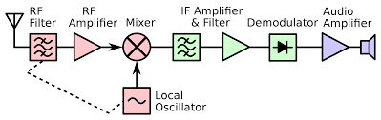
Superheterodyne Receivers
The above Figure shows the block diagram of Superhetrodyne receiver.
The various components in the systems are:
Antenna: It intercepts the incoming electromagnetic wave and convert it to electrical signals.

Slide 21
Feeder cable: It connects the antenna to the receiver front end
RF Filer: It selects only one (modulated carrier) signal from the many received signals at the antenna output.
RF Amplifier: It amplifies the selected signal to the level required to drive the next unit, that is the Mixer.
Mixer and Local Oscillator:
This combination converts (modulated carrier) signal frequency into intermediate frequency (IF).
Mixer is basically a non-linear device, and it produces infinite number of components in its output.
For example, if fs is the signal frequency and fo is the local oscillator frequency, then the mixer output will

Slide 22
contain: fs, fo, fs-fo, fs+fo, fs-2fs, fs+2fs, fs-3fs, fs+3fs, …..
The fs-fo frequency is called as intermediate frequency, that is f_{IF} = fs-fo
IF Filter: It selects only the intermediate frequency from the mixer output
IF Amplifier: It amplifies the IF signal to the level required to drive the demodulator.
Demodulator: It perform demodulation, that is, it converts IF signal back to message signal.
Audio Amplifier: It amplifies the demodulated message to the level required to drive the loudspeaker.
Loud Speaker: It produces the sound corresponding to message signal.

Slide 23
Note: The IF frequency is internationally constant (fixed!). Can you research yourself (and/or discuss with Faculty) about the IF frequency for different application.
Advantages of Superhetrodyne receiver
As it converts high frequency to low frequency, all processing takes place at lower frequencies. The devices are cheaper at such lower frequencies compare to higher frequencies.
It is easy to filter IF signal compare to RF signal.
It offers better sensitivity compare to TRF receiver architecture.
Disadvantage Superhetrodyne receiver
It requires additional LOs (Local Oscillators) and RF Mixers to convert signal from RF to IF before conversion to baseband. This increases cost of overall receiver.

Slide 24
RECEIVERS:
Receivers are hardware circuits that receives modulated signals, and reproduce message signal back at the destination (end of communication)
The basic performance characteristics of a any receiver are:
sensitivity,
selectivity, and
stability.
Sensitivity is (defined as) the ability of the receiver to respond to weak signals!
Selectivity is (defined as) the ability of the receiver to select a required signal from many incoming signals
Stability is (defined as) the ability of the receiver to provide constant output irrespective of any changes (such as supply voltage, temperature, aging of components, and etc)
Receivers are of two architecture:
Tuned Radio Frequency (TRF) receivers, and
Superhetrodyne receivers
Let us explain the two architecture here

Slide 25
Characteristics of Radio Receivers
The characteristics of a Radio Receiver are as follows
Sensitivity
Selectivity
Fidelity
Adjacent Channel Selectivity (Double Spotting)
Image Frequency
Image Frequency Rejection Ratio

Slide 26
Sensitivity:
The minimum RF signal level that can be detected at the input of the receiver and produce a usable demodulated information signal with a minimum acceptable signal to noise ratio Typical sensitivity for commercial broadcast band AM
receiver is 50 μV
Figure: Sensitivity curve of AM Receiver

Slide 27
Selectivity:
Used to measure the ability of the receiver to accept a given Bband of frequencies and reject all other unwanted signal frequencies
Figure: Selectivity curve of AM Receiver

Slide 28
Fidelity
The receiver’s ability to reproduce all the modulating frequencies of the original information
Figure: Fidelity curve of AM Receiver

Slide 29
Adjacent Channel Selectivity (Double Spotting):
This is well known phenomenon, which manifests itself by the picking up of the same short wave station at two near by points on the receiver dial It is caused by poor front end selectivity
The front end of the receiver does not select different adjacentN signals very well, but the IF stage eliminating almost all of them
Double spotting may be used to calculate the intermediate frequency of an unknown receiver, since the spurious point on the dial is precisely 2 fi below the correct frequency

Slide 30
Image Frequency:
The image frequency is defined as the received signal frequency plus twice the intermediate frequency Image
Frequency Rejection Ratio
The image frequency rejection ratio of an image frequency
signal by a single tuned circuit may be defined as the ratio of the gain at the signal frequency to the gain at the image frequency

Slide 33
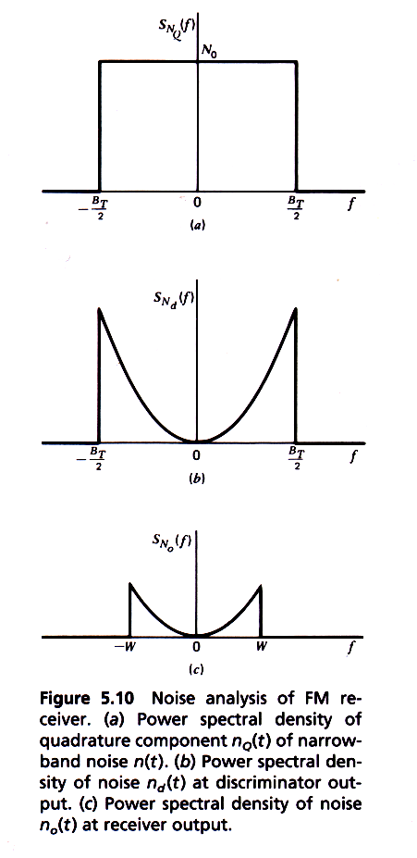
Pre-emphasis and De-emphasis in FM
Recall: We have seen during the FM noise analysis, that power spectral density S_{Nd}(f) of noise at an FM receiver (discriminator) output has a square law dependence on the operating frequency, as given by:
The above Equation and Figure shows that the high-frequency noise is dominant at the output of an FM receiver.
Noise PSD at BPF output
→(1)
Noise PSD at detector output
Noise PSD at receiver output

Slide 34
In other words, high frequency signals are more affected by noise than the low frequency content of the signal.
To combat the behavior of noise in FM, the high frequency content of the message is emphasized (boosted), prior to the modulation process in the transmitter; and this is called as pre-emphasis. A high-pass filter is a good approximation for pre-emphasis.
And conversely, the high frequency content of the message is de-emphasized (attenuated), after the demodulation in the receiver; and this is called as de-emphasis. A low-pass filter is a good approximation for de-emphasis.

Slide 35
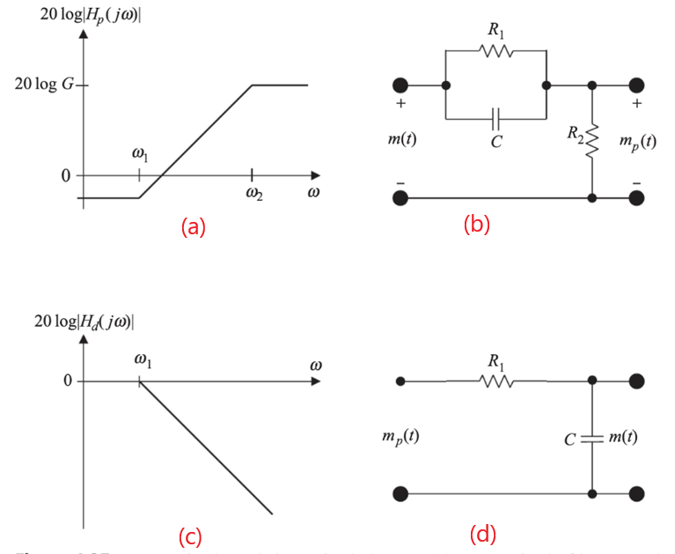
Pre-Emphasis
H_{pre}(f)
FM Modulation
FM Demodulation
De-Emphasis
H_{de}(f)
+
m(t)
m(t) plus noise
Noise
Figure: (a) Pre-emphasis Filter response (b) Pre-emphasis Filter circuit
Figure: (a) De-emphasis Filter response (b) De-emphasis Filter circuit

Slide 36
The frequency response of the pre-emphasis (at transmitter) filter is given by
The inverse effect of the de-emphasis (at receiver) filter is given by
The combined effect of pre-emphasis and de-emphasis becomes
The combined effect cancel each other, resulting in no changes in the signal but improvement in the noise performance of the FM communication.
→(2)
→(3)
→(4)

