Slide 1
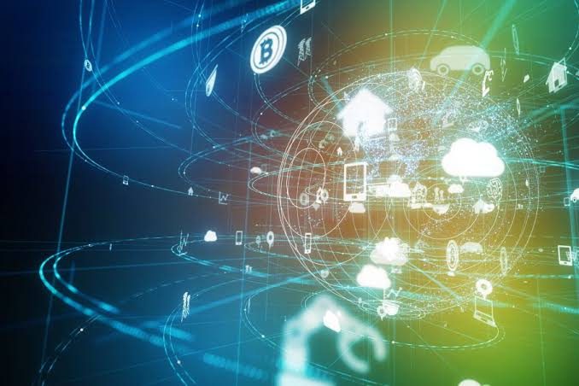
Analog Communication Systems
BECE304L
Module-7

Slide 2
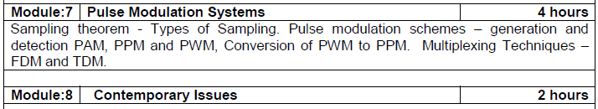
Course-modules

Slide 3
Multiplexing
Multiplexing is the set of techniques that allows the simultaneous transmission of multiple signals across a single data link.
A Multiplexer (MUX) is a device that combines several signals into a single signal.
A Demultiplexer (DEMUX) is a device that performs the inverse operation.

Slide 4
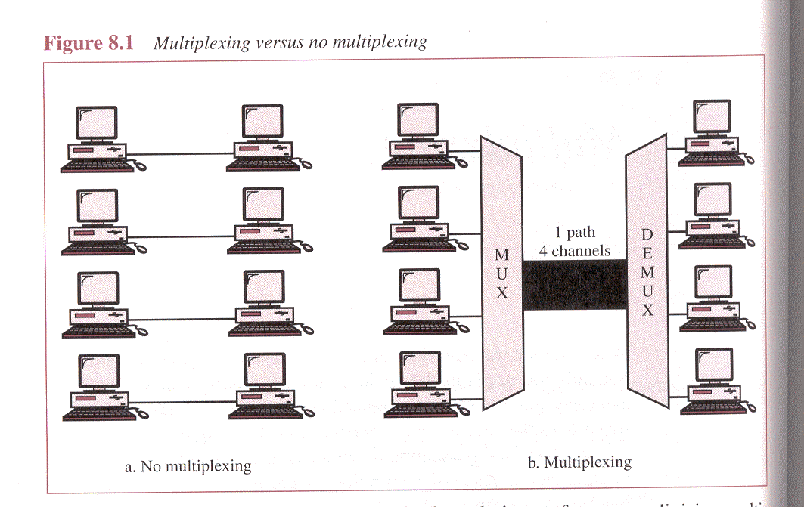

Slide 5
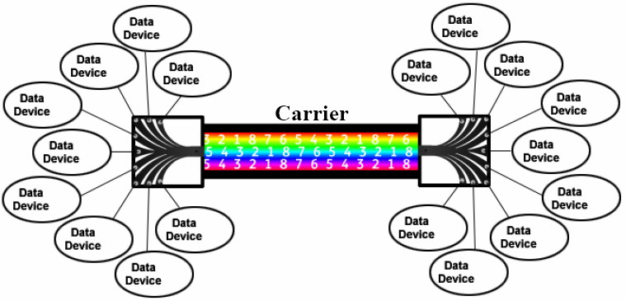

Slide 6
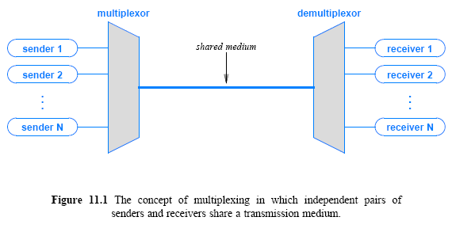
11.2 The Concept of Multiplexing
6
Notes:
6

Slide 7
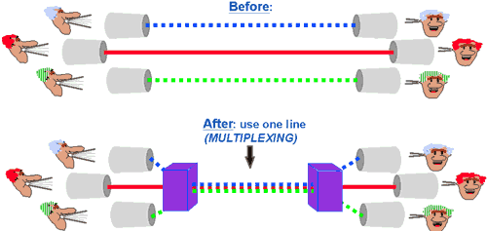
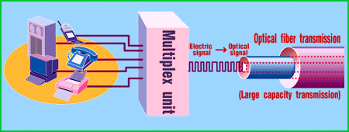
Multiplexing in networks
Sharing the medium
Main purpose is ?

Slide 8
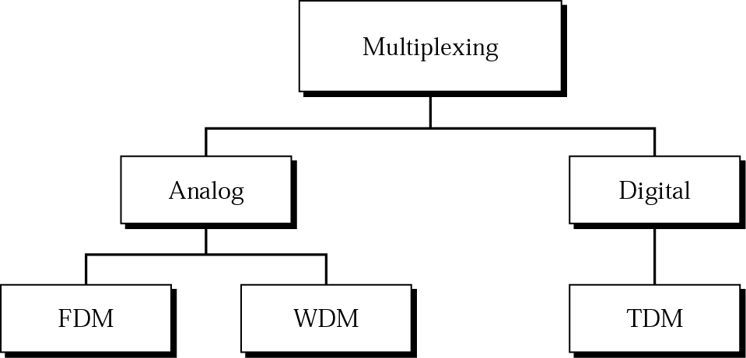
Categories of Multiplexing

Slide 9
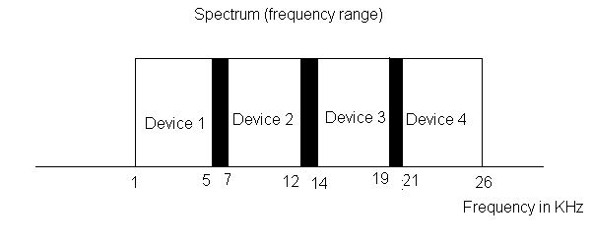
Frequency-division Multiplexing (FDM)
FDM is an analog technique that can be applied when the bandwidth of a link is greater than the combined bandwidths of the signals to be transmitted.

Slide 12
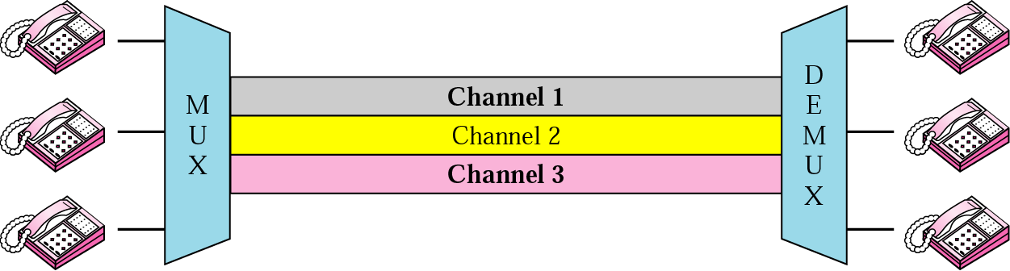
Frequency-division Multiplexing (FDM)
In FDM signals generated by each device modulate different carrier frequencies. These modulated signals are combined into a single composite signal that can be transported by the link.
FDM is an analog multiplexing technique that combines signals.

Slide 13
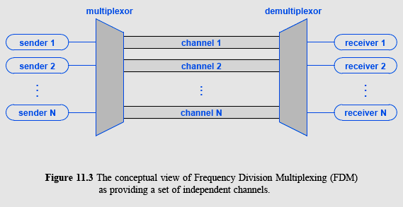
11.4 Frequency Division Multiplexing
13
Notes:
12

Slide 14
Frequency-division Multiplexing (FDM)
In FDM signals generated by each device modulate different carrier frequencies. These modulated signals are combined into a single composite signal that can be transported by the link.
Carrier frequencies are separated by enough bandwidth to accommodate the modulated signal.
These bandwidth ranges arte the channels through which various signals travel.
Channels must separated by strips of unused bandwidth (guard bands) to prevent signal overlapping.

Slide 15
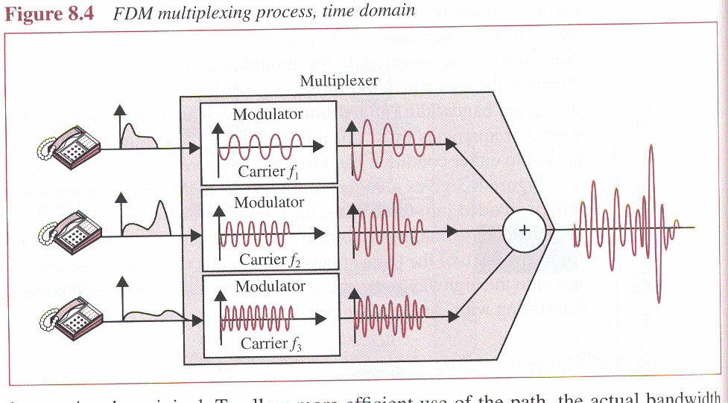

Slide 16
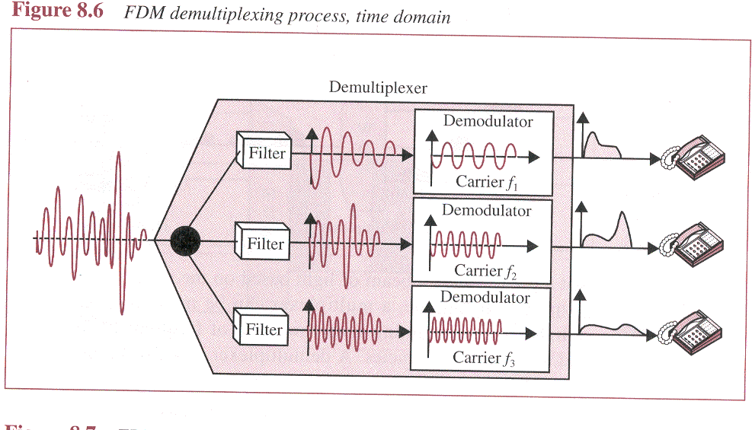

Slide 17
Frequency-division Multiplexing (FDM)
In FDM, signals are modulated onto separate carrier frequencies using either AM or FM modulation.

Slide 18
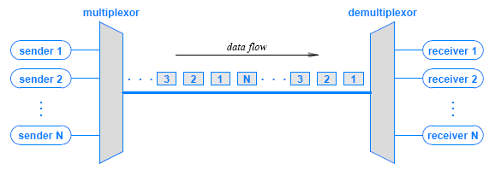
Time Division Multiplexing (TDM)
TDM assigns time slots to each channel repeatedly
multiplexing in time simply means transmitting an item from one source, then transmitting an item from another source, and so on
Figure 11.8 (below) illustrates the concept
18
Notes:
17

Slide 19
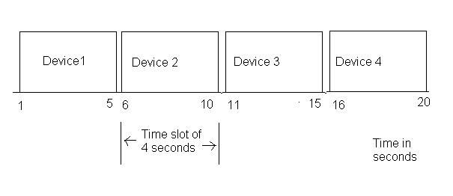
Time-division Multiplexing (TDM)
Time-division multiplexing (TDM) is a digital process that can be applied when the data rate capacity of the transmission medium is greater than the data rate required by the sending and receiving devices.

Slide 20
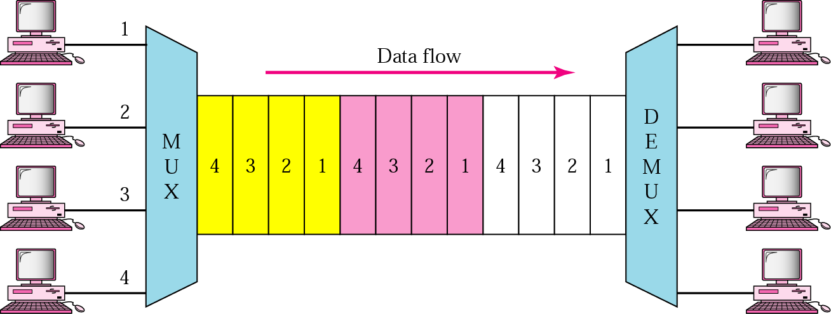
TDM
TDM is a digital multiplexing technique to combine data.

Slide 21
Time-division Multiplexing (TDM)
TDM can be implemented in two ways: synchronous TDM and asynchronous TDM.
In synchronous time-division multiplexing, the term synchronous means that the multiplexer allocates exactly the same time slot to each device at all times, whether or not a device has anything to transmit.
Frames
Time slots are grouped into frames. A frame consists of a one complete cycle of time slots, including one or more slots dedicated to each sending device.

Slide 22
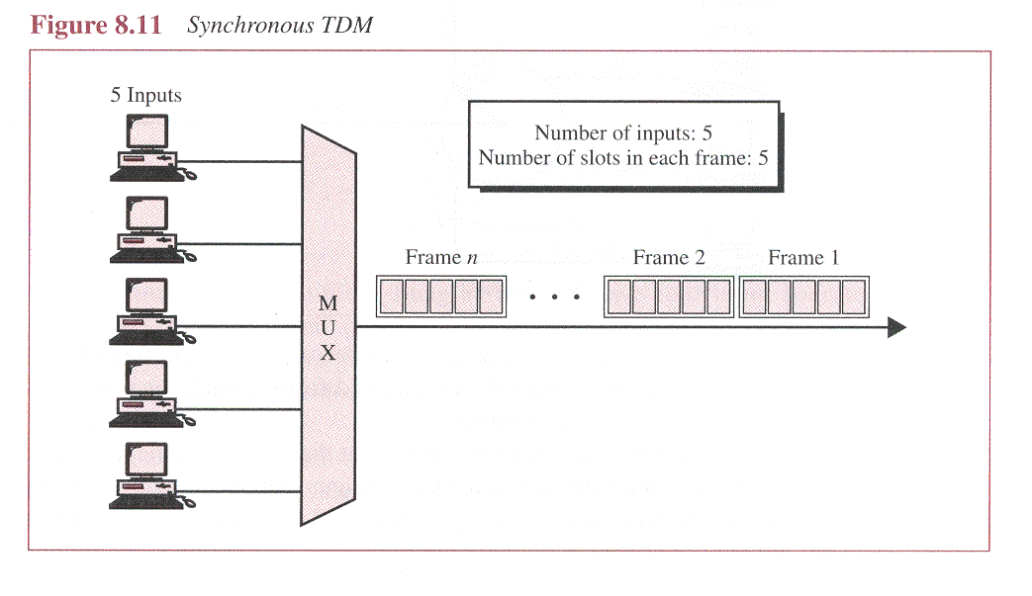

Slide 23
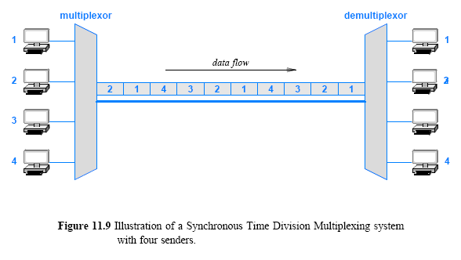
Synchronous TDM
23
Notes:
22

Slide 24
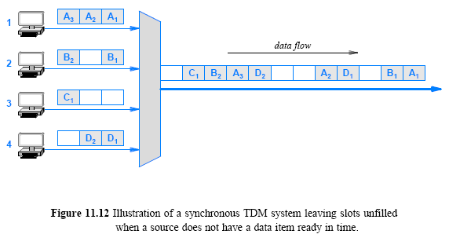
The Problem with Synchronous TDM: Unfilled Slots
24
Notes:
23

Slide 25
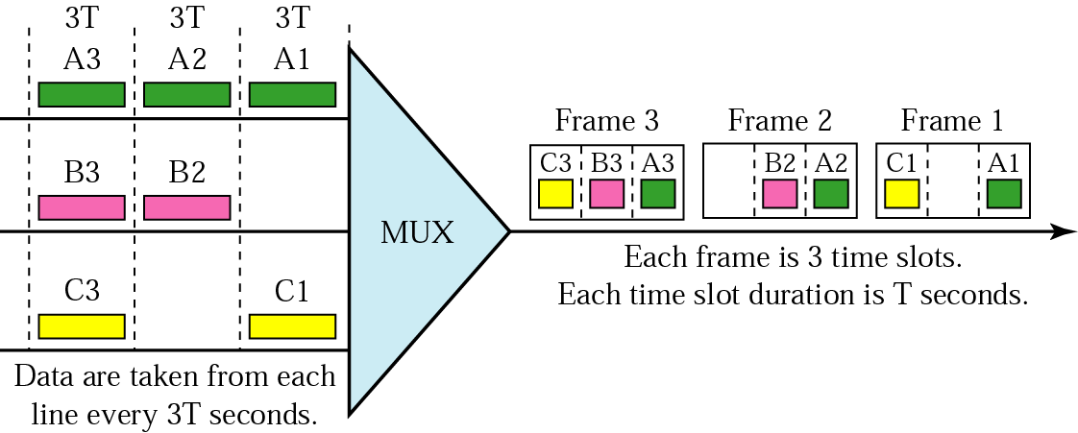
TDM frames

Slide 26
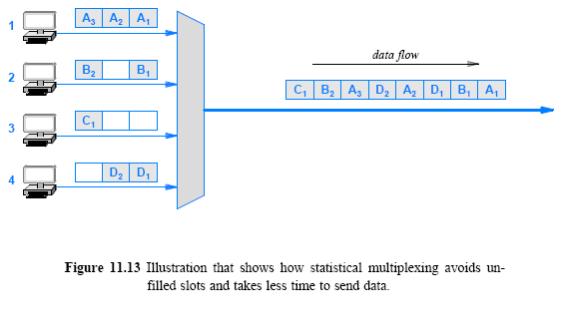
Statistical TDM
26
Notes:
25

