Slide 1

Analog Communication Systems
BECE304L
Module-7

Slide 2
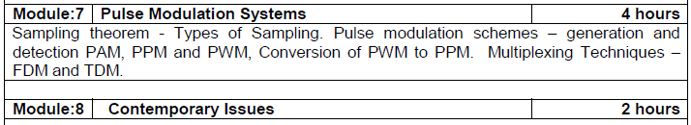
Course-modules

Slide 3
PULSE ANALOG MODULATION
3

Slide 4
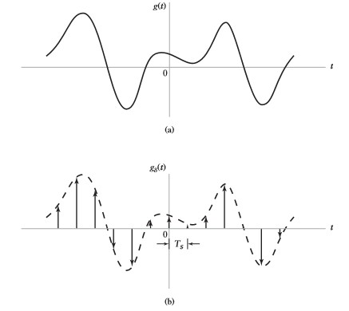
Sampling Process
Definition:
An analog signal is converted into a corresponding sequence of samples that are usually spaced uniformly in time.
Figure: Illustration of sampling process. (a) Analog waveform (b) Instantaneously sampled representation of the analog Signal
4

Slide 5



(1)
(2)
Where G(f) is the Fourier Transform of the original signal g(t), and is the sampling rate.
The above equation states that the process of uniformly sampling a continuous time signal of finite energy results in a periodic spectrum with a period equal to sampling rate.
(3)
5

Slide 6
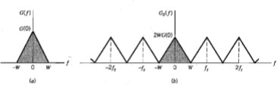
Sampling Process Contd.,
Suppose, that the signal g(t) is strictly band-limited, with no frequency components higher than W Hertz. That is, the Fourier transform of g(t) has the property that G(f) is zero for
, as illustrated in below figure. Also we choose, Ts = 1/2W, then the corresponding spectrum shown in figure b.
Figure: (a)Spectrum of a strictly band-limited signal g(t)
(b) Spectrum of the sampled version of g(t) for a sampling period Ts=1/2W
6

Slide 7


Sampling Process Contd.,
(4)
The Fourier Transform of
may also be expressed as
(5)
Hence, under the following two conditions, 1.
2.
We find from equation (5) that
(6)
substitute equation (4) into the above equation, we may also write
7

Slide 8


(7)
Therefore, if the sampled values of g(n/2W) of a signal g(t) are specified for all n, then the Fourier transform G(f) of the signal is uniquely determined using eq (7). Because the sequence g(n/2W) has all the information contained in g(t).
The expression for reconstructing the original signal g(t) from
the sequence of sample values {g(n/2W)} is
(8)
playing the role of an interpolation function. Each sample is multiplied by a delayed version of interpolation function, and all the resulting waveforms are added to obtain g(t)
•

Slide 9




Sampling Theorem
A band-limited signal of finite energy, which has no frequency components higher than W Hertz, is completely described by specifying the values of the signal at instants of time seperated by 1/2W seconds.
OR
A band-limited signal of finite energy, which has no frequency components higher than W Hertz, may be completely recovered from a knowledge of its samples taken at the rate of 2W samples per second.
The sampling rate of 2W samples per second, for a signal bandwidth of W Hertz, is called Nyquist rate; its reciprocal 1/2W is called Nyquist interval.

Slide 10
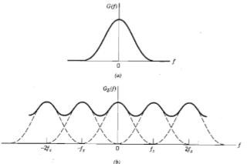
Aliasing Effect
If , an information bearing signal is not strictly band-limited, some aliasing is produced by the sampling process.
Aliasing refers to the phenomenon of a high frequency component in the spectrum of the signal seemingly taking on the identity of a lower frequency in the spectrum of its sampled version, as illustrated in below figure.
Figure: (a)Spectrum of a signal (b) Spectrum of an undersampled version of the signal
exhibiting the aliasing phenomenon

Slide 11
Corrective Measures for Aliasing
Prior to sampling, a low-pass anti-aliasing filter is used to attenuate those high frequency components of the signal that are not essential to the information being conveyed by the signal.
The filtered signal is sampled at a rate slightly higher than the Nyquist rate. Also, it has the beneficial effect of easing the design of the reconstruction filter used to recover the original signal from its sampled version.

Slide 12
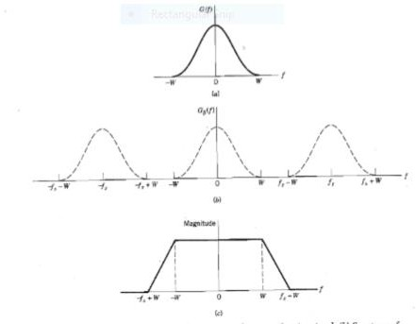
Figure: (a) Anti-alias filtered spectrum of an information bearing signal (b) Spectrum of instantaneously sampled version of the signal, assuming the use of a sampling rate greater than the Nyquist rate (c) Magnitude response of reconstruction filter

Slide 13
Pulse Analog Modulation
In analog modulation systems, some parameter of a sinusoidal carrier is varied according to the instantaneous value of the modulating signal.
In Pulse modulation methods, the carrier is no longer a continuous signal but consists of a pulse train. Some parameter of which is varied according to the instantaneous value of the modulating signal.

Slide 14
Types of Pulse Modulation
Pulse Modulation
Pulse Analog
Modulation
Pulse Digital
Modulation
PAM
PCM
PWM
DPCM
PPM
DM & ADM

Slide 15
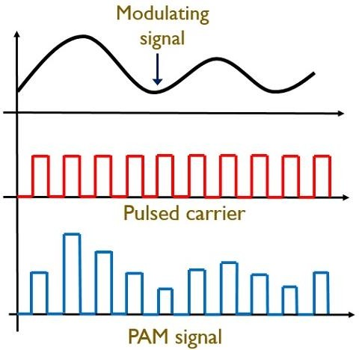
Pulse Amplitude Modulation
The amplitude of the pulses of the carrier pulse train is varied in accordance with the modulating signal, that is amplitude of the pulses depends on the value of m(t) during the time of pulse.

Slide 16
Pulse Amplitude Modulation
In fact the pulses in a PAM signal may of Flat-top type or natural type or ideal type.
The Flat-top PAM is most popular and is widely used. The reason for using Flat-top PAM is that during the transmission, the noise interferes with the top of the transmitted pulses and this noise can be easily removed if the PAM pulse as Flat-top.
In natural samples PAM signal, the pulse has varying top in accordance with the signal variation. Such type of pulse is received at the receiver, it is always contaminated by noise. Then it becomes quite difficult to determine the shape of the top of the pulse and thus amplitude detection of the pulse is not exact.

Slide 17
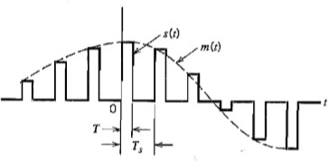
Generation of PAM
There are two operations involved in the generation of PAM signal
Instantaneous sampling of the message signal m(t) every Ts seconds, where the sampling rate fs = 1/Ts is chosen in accordance with the sampling theorem.
Lengthening the duration of each sample so obtained to some constant value T.
Figure: PAM signal

Slide 18
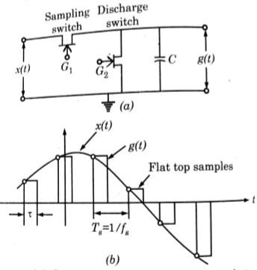
Sample and Hold Circuit for Generating Flat-top sampled PAM
Figure: (a) Sample and hold circuit generating flat top sampled PAM
(b) Waveform_{Pro}s_{f.C}o_{h.S}f_{ri}f_{n}l_{iv}a_{as}t_{a} t_{R}o_{ao}p_{- J}s_{NT}a_{U}m_{K - U}p_{C}l_{E}e_{V} d PAM
6/5/2020
19

Slide 19
Sample and Hold Circuit for Generating Flat-top sampled PAM
The sample and hold circuit consists of two Field Effect Transistor switches and a capacitor.
The sampling switch is closed for a short duration by a short pulse applied to the gate G1 of the transistor. During this period, the capacitor C is quickly charged up to a voltage equal to the instantaneous sample value of the incoming signal.
Now, the sampling switch is opened and the capacitor holds the charge. The discharge switch is then closed by a pulse applied to gate G2 of the other transistor. Due to this, the capacitor is discharged to zero volts. The discharges switch is then opened and thus capacitor has no voltage. Hence the output of the sample and hold circuit consists of a sequence of flat-top samples as shown in figure.

Slide 20



Mathematical Representation of PAM
We may express the PAM signal as
where
Ts = sampling period
m(nTs) = sample value of m(t) obtained at t = nTs
h(t) = standard rectangular pulse of unit amplitude and duration
T and it is defined as
The spectrum of flat-top PAM signal is

Slide 21


Naturally Sampled PAM signal
The natural sampling is basically pulse amplitude modulation. Therefore it is called naturally sampled PAM signal.
The time-domain representation of a naturally sampled PAM
signal will be given as
The frequency spectrum of naturally sampled PAM signal will be given as

Slide 22


Ideally Sampled PAM signal
The instantaneous sampling is basically PAM. It is called ideally or instantaneously sampled PAM signal.
The time-domain representation of a ideally sampled PAM signal will be given as
The frequency domain representation i.e., frequency spectrum of a ideally sampled PAM signal will be given as

Slide 23
Transmission Bandwidth of PAM
In PAM signal the pulse duration τ is assumed to be very small compared to time period Ts between the two samples i.e τ< Ts
If the maximum frequency in the modulating signal x(t) is fm
then sampling frequency fs is given by 2fm or Ts <= 1/2fm
Therefore, τ < < Ts <= 1/2fm
fs>=2fm Or 1/Ts >=
If ON and OFF time of PAM pulse is equal then maximum frequency of PAM pulse will be fmax = 1/ τ+ τ = 1/2 τ
Therefore, transmission bandwidth >=fmax But fmax=1/2 τ
B.W>=1/2 τ
B.W>=1/2 τ >>fm

Slide 24


Demodulation of PAM
PAM signal
s(t)
Reconstruction Filter
Equalizer
Message signal m(t)
Figure: System for recovering message signal m(t) from PAM signal s(t)
The distortion caused by the use of PAM to transmit an analog information bearing signal is referred to as the aperture effect. This distortion may be corrected by connecting an equalizer in cascade with the low-pass reconstruction filter as shown in fig.
The equalizer has the effect of decreasing the in-band loss of the reconstruction filter as the frequency increases in such a manner as to compensate for the aperture effect.

Slide 25

Demodulation of PAM
Ideally, the magnitude response of the equalizer is given by
The amount of equalization needed in practice is usually small.
Advantages of PAM :
It is the simple and simple process for modulation and demodulation
Transmitter and receiver circuits are simple and easy to construct.

Slide 26
Drawbacks of PAM signal
The bandwidth required for the transmission of a PAM signal is very large in comparison to the maximum frequency present in the modulating signal.
Since the amplitude of the PAM pulses varies in accordance with the modulating signal therefore the interference of noise is maximum in a PAM signal. This noise cannot be removed easily.
Since the amplitude of the PAM pulses varies, therefore, this also varies the peak power required by the transmitter with modulating signal.

Slide 27
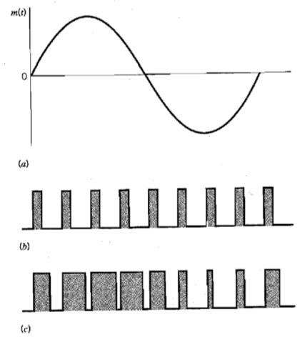
Pulse Width Modulation
PWM is also called Pulse Duration Modulation (PDM), Pulse Length Modulation (PLM) and
Definition:
In PWM, Width of the pulses of the carrier pulse train is varied in accordance with the modulating signal.
_{6/5/}F₂i₀g₂u₀ re: Illustration of PWM (_{P}a_{r})_{of.}M_{Ch.}o_{Sr}d_{in}u_{iv}l_{a}a_{sa}ti_{R}n_{ao}g₋s_{JN}ig_{T}n_{UK}a₋l _{U}(_{C}b_{EV}) Pulse Carrier (c) PWM signal₂₉

Slide 28








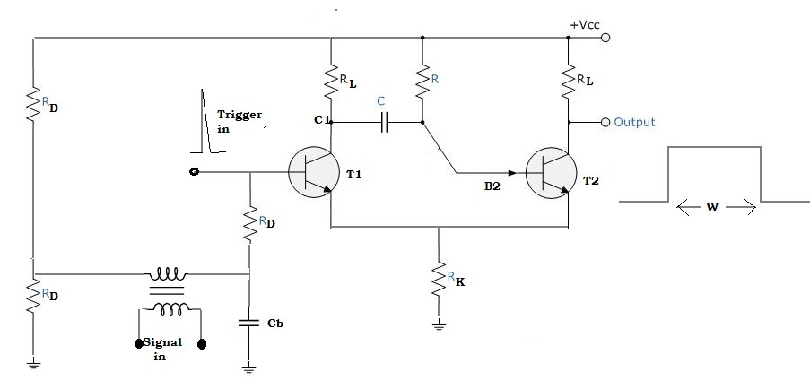
PWM Generation
Direct Method Multivibrator
of PWM generation using Monostable

Slide 29
We know that stable state for this type of multivibrator is T1 Off and T2 On.
The applied trigger pulse switches T1 ON, whereupon the voltage at C1 falls as T1 now begins to draw collector current.
The voltage at B2 follows C1 and T2 is switched off by regenerative action.
As soon as this happens, C begins to charge up to the collector supply potential through R.
After a time determined by the supply voltage and RC time constant of the charging network, B2 becomes sufficiently positive to switch T2 on.
T1 is simultaneously switched off by regenerative action and stays OFF until the arrival of the next trigger pulse.

Slide 30
The voltage at the base of T2 must reach to allow T2 to turn on, is slightly more positive than the voltage across the common emitter resistor Rk. This voltage depends on the current flowing through the circuit, which at the time is the collector current of T1(at that time T1 ON)
The collector current depends on the base bias, which is controlled by the instantaneous changes in the applied signal voltage.
The applied modulating voltage control the voltage to which B2 must rise to switch T2 ON. Since the voltage rise is linear, the modulating voltage is seen to control the period of time during which T2 is OFF.

Slide 31
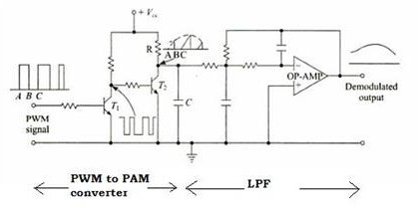
PWM Demodulation
PWM to
PAM
converter
Low-Pass Filter
PWM
signal
Message signal
Figure: PWM Demodulator Circuit

Slide 32
The transistor T1 works as an inverter. Hence during the time interval A –B, when the PWM signal is high, the input to the transistor T2 is low.Therefore, during this time interval, the transistor T2 is cut-off and the capacitor C gets charged through an R-C combination.
During the time interval B –C when the PWM signal is low, the input to the transistor T2 is high, and it gets saturated.The capacitor C then discharges very rapidly through T2. The collector voltage of T2 during the interval B-C is then low. Thus the waveform at the collector of T2 is more or less a saw- tooth waveform whose envelope is the modulating signal.
When this is passed through a second – order OP-AMP low pass filter, we get the desired demodulated output

Slide 33
PWM Demodulation
PWM signal
Schmitt
Trigger
Ramp Generator
Adder
Level Shifter
Rectifier
Synchronization Pulse Generator
LPF
Demodulated Output
35
6/5/2020
^{Fig}P^{u}ro^{r}f^{e}.C:h.^{P}Sri^{W}niva^{M}sa R^{D}ao^{e}- ^{t}JN^{e}T^{c}U^{t}Kº- ^{r}UCEV

Slide 34
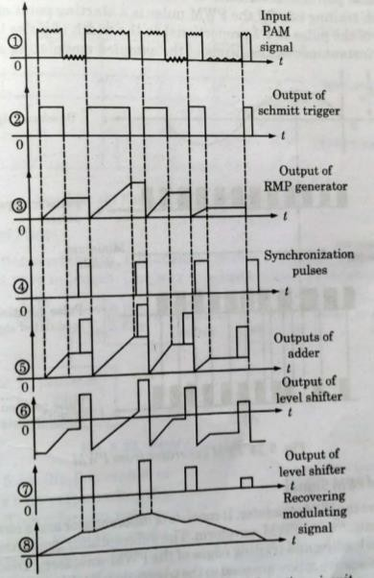
PWM Demodulation Contd.,
Figure: Waveforms for
PWM detection circuit

Slide 35
PWM Demodulation
The received PWM signal is applied to the schmitt trigger circuit. This schmitt trigger circuit removes the noise in the PWM waveform.
The regenerated PWM is then applied to the ramp generator and the synchronization pulse detector. The ramp generator produces ramps for the duration of pulses such that height of ramps are proportional to the width of PWM pulses.
The maximum ramp voltage is retained till the next pulse. On the other hand, synchronous pulse detector produces reference pulses with constant amplitude and pulse width. These pulses are delayed for specific amount of delay as shown in figure.
The delayed reference pulses and the output of ramp generator is added with the help of adder. The output of adder is given to the level shifter. Here, negative offset shifts the waveform as shown in figure.

Slide 36
PWM Demodulation
The negative part of the waveform is clipped by rectifier.
Finally, the output of rectifier is passed through lowpass filter to recover the modulating signal.
Advantages of PWM:
Noise is less, since in PWM, amplitude is held constant.
Signal and noise separation is very easy
PWM communication does not required synchronization between transmitter and receiver.
Disadvantages of PWM:
In PWM, pulses are varying in width and therefore their power contents are variable this requires that the transmitter must be able to handle the power content of the pulse having maximum pulse width.
Large bandwidth is required for the PWM as compared to
6/5/2_{P}02_{A}0
M
Prof.Ch.Srinivasa Rao - JNTUK - UCEV 38

Slide 37
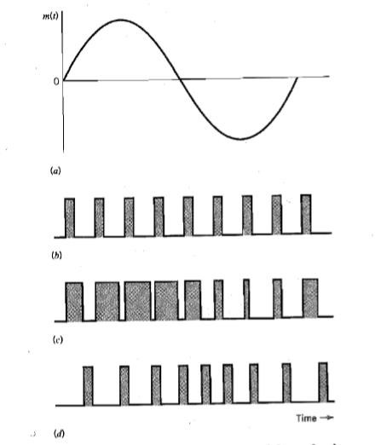
Pulse Position Modulation (PPM)
Definition:
In PPM, the position of the pulse relative to its un-modulated time occurrence is varied in accordance with the message signal.
Modulating wave
Pulse carrier
PWM wave
PPM wave

Slide 38
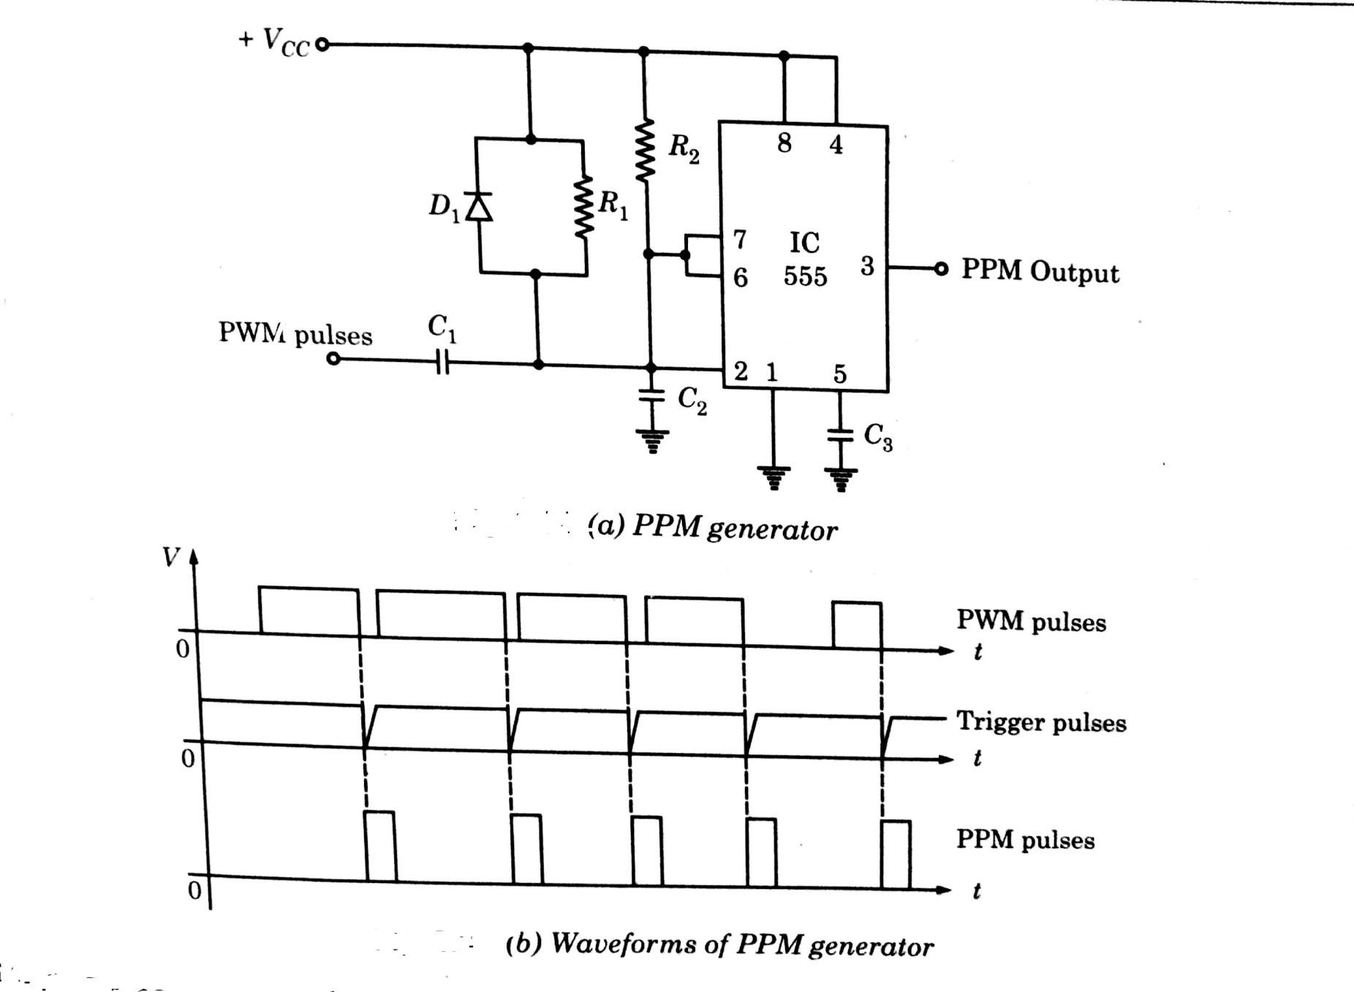
PPM Generation

Slide 39
PPM Generation
PPM generator consists of differentiator and monostable multivibrator.
The differentiator generates positive and negative spikes corresponding to leading and trailing edges of the PWM waveform.
Diode D1 is used to bypass the positive spikes
The negative spikes are used to trigger the multivibrator.
The monostable multivibrator then generates the pulses of same width and amplitude with reference to the trigger to give PPM waveform as shown in figure.

Slide 40
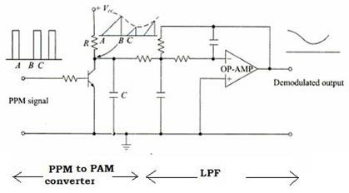
Demodulation of PPM
PPM to PAM
converter
Low-Pass Filter
PPM
signal
Message signal
Figure: PWM Demodulator Circuit

Slide 41
Demodulation of PPM
This utilizes the fact that the gaps between the pulses of a PPM signal contain the information regarding the modulating signal.
During the gap A- B between the pulses, the transmitter is cut- off, and the capacitor C gets charged through the R-C combination. During the pulse duration B-C, the capacitor discharges through the transistor, and the collector voltage becomes low.
Thus the waveform at the collector is approximately a saw tooth waveform whose envelope is the modulating signal.
When this is passed through a second order OP- AMP low pass filter, we get the desired demodulated output.

Slide 42
PPM
Advantages of PPM:
Like PWM, in PPM, amplitude is held constant thus less noise interference.
Signal and noise separation is very easy
Because of constant pulse widths and amplitudes, transmission power for each pulse is same
Disadvantages of PWM:
Synchronization between transmitter and receiver is required.
Large bandwidth is required for the PPM as compared to PAM

Slide 43
Comparison between PAM, PWM & PPM
S. No | PAM | PWM/PDM | PPM
1 | Amplitude of the pulse is proportional to the amplitude of modulating signal | Width of the pulse is proportional to amplitude of modulating signal. | The relative position of the pulse is proportional to the amplitude of modulating signal.
2 | The bandwidth of the transmission channel depends on width of the pulse | Bandwidth of transmission channel depends on rise time of the pulse. | Bandwidth of transmission channel depends on rise time of the pulse.
3 | The instantaneous power of the transmitter varies with amplitude of pulses. | The instantaneous power of the transmitter varies with width of pulses | The instantaneous power of the transmitter remains constant with width of pulses.

Slide 44
Comparison between PAM, PWM & PPM Contd.,
S. No | PAM | PWM/PDM | PPM
4 | Noise interference is high | Noise interference is minimum | Noise interference is minimum
5 | System is complex | Simple is implement | Simple is implement
6 | Similar to Amplitude modulation | Similar to frequency modulation | Simple to Phase modulation

